Slide 1






Slide 2
Introduction
Hypertension is a common disease that is simply defined
as persistently elevated arterial blood pressure (BP).
The percentage of men with high BP is higher than that of women before the age of 45 years, but After age 45 years, the percentage is slightly higher with women.
BP values increase with age, and hypertension (persistently elevated BP values) is very common in the elderly.

Slide 3
Hypertension doubles the risk of
Cardiovascular diseases, including
Coronary heart disease (CHD),
Congestive heart failure (CHF),
Ischemic and hemorrhagic stroke,
Renal failure, and
Peripheral arterial disease.

Slide 4
Types of hypertension
Essential or primary hypertension
No identifiable cause for their disorder. This form of
hypertension cannot be cured, but it can be controlled.
90% of individuals with high BP have essential hypertension
Secondary hypertension
Have a specific identified cause for elevated BP . If the cause can be identified, hypertension in these patients has the potential to be cured.
Fewer than 10% of patients have secondary hypertension

Slide 5
Pseudo hypertension
An artificially and falsely elevated blood pressure obtained
due to arteriosclerotic, calcified blood vessels which do not
physiologically compress with pressure, results in high
blood pressure reading than it truly ought to be.
 White-Coat Hypertension
White-coat hypertension describes patients who have consistently elevated BP values measured in a clinical environment in the presence of a health care professional (e.g., physician's office), yet when measured elsewhere or with 24-hour ambulatory monitoring, BP is not elevated.

Slide 6
Etiology
Essential/primary hypertension

No identifiable cause
Genetic factors
Genetic mutations

Slide 7
Secondary hypertension etiology
Disease Primary aldosteronism Renovascular disease Thyroid disease Parathyroid disease Pheochromocytoma Coarctation of the aorta Obstructive sleep apnea Cushing’s syndrome Chronic kidney disease | Drugs and food Prednisone , cyclosporine and tracolimus Nonsteroidal antiinflammatory drugs, cyclooxygenase-2 inhibitors β-blocker or centrally acting α-agonists (when abruptly discontinued) Cocaine Nicotine withdrawal Ephedra alkaloids Sodium Ethanol Licorice

Slide 8
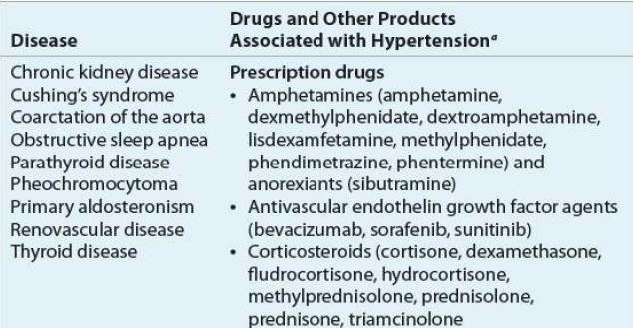


Slide 9
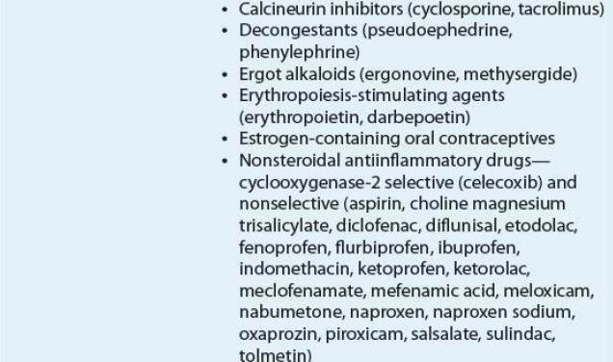


Slide 10
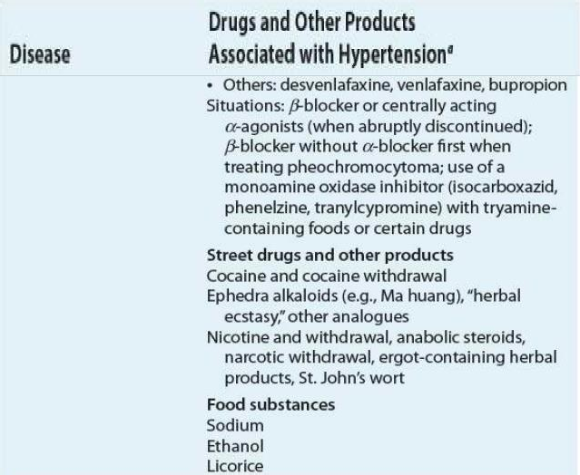


Slide 11
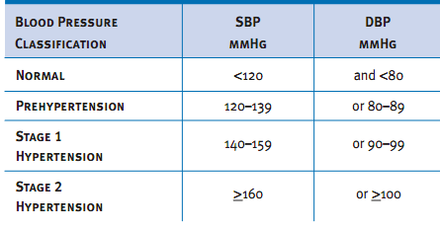
Classification of hypertension for adults


Slide 12
Hypertensive crisis
Hypertensive crises are clinical situations where BP values are very elevated, typically greater than 180/120
mm Hg.

 They are categorized as either
 Hypertensive emergency
 Hypertensive urgency.
Hypertensive emergencies are extreme elevations in BP that are accompanied by acute or progressing target- organ damage.
Hypertensive urgencies are high elevations in BP without acute or progressing target-organ injury.
Isolated systolic hypertension Patients with DBP values less than 90 mm Hg and SBP values ≥140 mm.

Slide 13
PATHOPHYSIOLOGY

Slide 14
1)HUMORAL MECHANISMS
RAAS(Renin–Angiotensin–Aldosterone System)
Natriuretic hormones,
Insulin resistance and hype rinsulinemia
NEURONAL REGULATION
Autonomic nervous system Baroreceptors
Central nervous system
PERIPHERAL AUTOREGULATORY COMPONENTS
VASCULAR ENDOTHELIAL MECHANISMS
ELECTROLYTES AND OTHER CHEMICALS

Slide 15
Renin–Angiotensin–Aldosterone System
RAAS is primarily governed by the kidney
RAAS regulates sodium, potassium, and fluid balance.
Renin is an enzyme that is stored in the juxtaglomerular cells, which are located in the afferent arterioles of the kidney.
Juxtaglomerular cells function as a baroreceptor-sensing device.

Slide 16
Sodium and chloride delivered to the distal tubule
Sympathetic tone

Serum potassium and/or intracellular calcium
BP
All these 4factorsactivate the juxtaglomerular cells resulting in renin secretion.

Slide 17
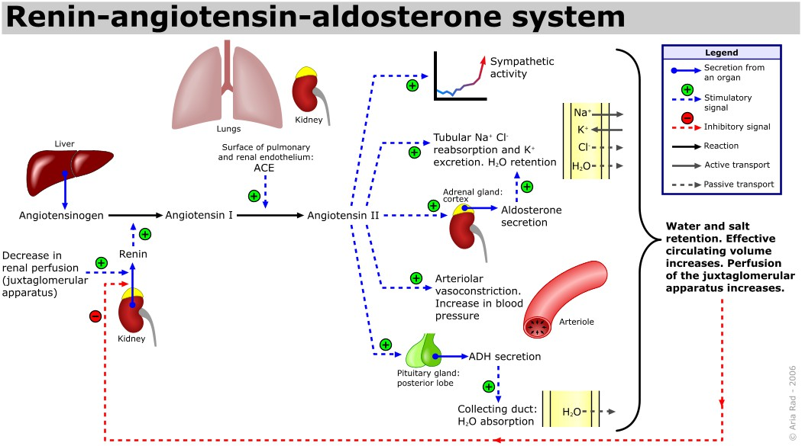


Slide 18
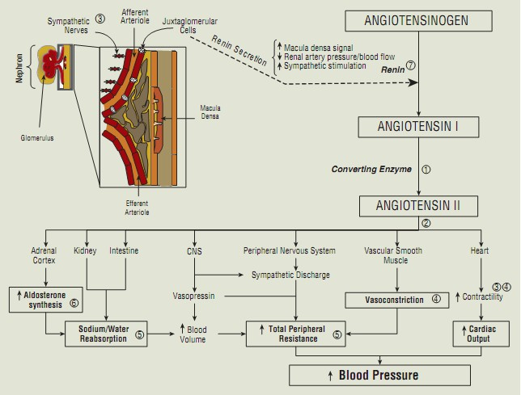


Slide 19
Circulating angiotensin II can elevate BP through pressor and volume effects
Pressor effects include direct
 Vasoconstriction,
 Stimulation of catecholamine release from the adrenal medulla,
 Centrally mediated increases in sympathetic nervous system activity.
Volume effect-
 Aldosterone synthesis from the adrenal cortex. This leads to sodium and water reabsorption that increases plasma volume, total peripheral resistance, and ultimately BP.

Slide 20
Atrial natriuretic peptide/ harmone
Atrial natriuretic peptide (ANP)is a powerful vasodilator, and a protein (polypeptide) hormone secreted by heart
muscle cells.

ANP is secreted in response to:
Increased intravascular volume
Atrial distention

Slide 21
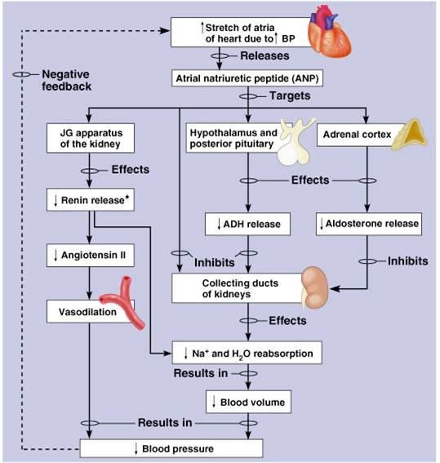


Slide 22
Natriuretic hormone inhibits sodium and potassium- ATPase and thus interferes with sodium transport across cell membranes
Inherited defects in the kidney’s ability to eliminate sodium can cause increased blood volume.
A compensatory increase in the concentration of circulating natriuretic hormone theoretically could increase urinary excretion of sodium and water.
However, this hormone might block the active transport of sodium out of arteriolar smooth muscle cells.
The increased intracellular sodium concentration ultimately would increase vascular tone and BP.

Slide 23
Insulin Resistance and Hyperinsulinemia
The development of hypertension and associated metabolic abnormalities is referred to as the metabolic
syndrome.

Increased insulin concentrations may increase renal sodium retention and enhanced sympathetic nervous system activity
Insulin has growth hormone–like actions that can induce hypertrophy of vascular smooth muscle cells
Also may elevate BP by increasing intracellular calcium, which leads to increased vascular resistance.

Slide 24
2)NEURONAL REGULATION
Autonomic nervous system
Autonomic nervous system is involved in the regulation

of arterial BP.
 The α and β presynaptic receptors play a role in negative and positive feedback to the norepinephrine- containing vesicles located near the neuronal ending.
Stimulation of presynaptic α-receptors (α2 ) exerts a negative inhibition on norepinephrine release.

Slide 25
Autonomic nervous system
Stimulation of presynaptic βreceptors facilitates
norepinephrine release.

Stimulation of postsynaptic α1 receptors in smooth muscles elicit vasoconstriction.
Stimulation of β1-receptors in the heart results in an increase in heart rate and contractility.
Stimulation of β2-receptors in the arterioles and venules causes vasodilation.

Slide 26
Baroreceptors
The baroreceptor reflex system is the major negative-
feedback mechanism that controls sympathetic activity.

Baroreceptors are nerve endings lying in the walls of large arteries, especially in the carotid arteries and aortic arch.
 Changes in arterial pressure rapidly activate baroreceptors that then transmit impulses to the brainstem through the ninth cranial nerve and vagus nerves.

Slide 27
Baroreceptors
In this reflex system, a decrease in arterial BP stimulates
baroreceptors, causing reflex vasoconstriction and
increased heart rate and force of cardiac contraction.
These baroreceptor reflex mechanisms may be blunted (less responsive to changes in BP) in the elderly and those with diabetes.

Slide 28
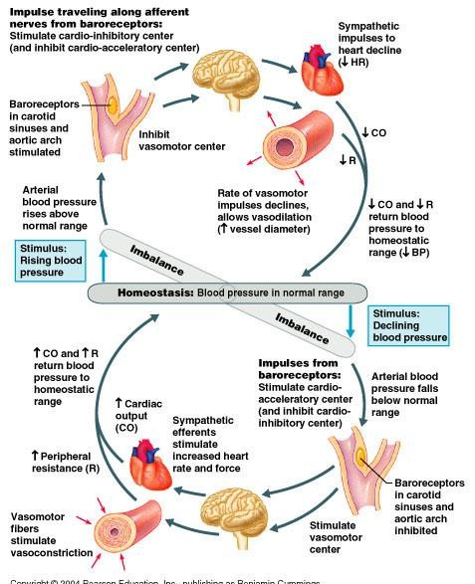


Slide 29
Central nervous system
Stimulation of certain areas within the central nervous system (nucleus tractus solitarius, vagal nuclei,
vasomotor center, and thearea postrema) can either
increase or decrease BP.
For example,
Adrenergic stimulation within the central nervous system decreases BP through an inhibitory effect on the vasomotor center.
Angiotensin II increases sympathetic outflow from the vasomotor center, which increases BP.

Slide 30
The purpose of these neuronal mechanisms is to regulate BP and maintain homeostasis.
Pathologic disturbances in any of the four major components could conceivably lead to chronically elevated BP.
Autonomic nerve fibers,
Adrenergic receptors,
Baroreceptors, or
Central nervous system.

Slide 31
3)PERIPHERAL AUTOREGULATORY COMPONENTS
Abnormalities in renal or tissue autoregulatory systems could cause hypertension.

When BP drops, the kidneys respond by increasing retention of sodium and water.
These changes lead to plasma volume expansion that increases BP and vice versa when BP increases.

Slide 32
3)PERIPHERAL AUTOREGULATORY COMPONENTS
Tissue autoregulatory processes maintain adequate tissue oxygenation.

When tissue oxygen demand is normal to low, the local arteriolar bed remains relatively vasoconstricted.
However, increases in metabolic demand trigger arteriolar vasodilation that lowers peripheral vascular resistance and increases blood flow and oxygen delivery through autoregulation.

Slide 33
Intrinsic defects in these renal adaptive mechanisms could lead to plasma volume expansion and increased blood flow to peripheral tissues, even when BP is
normal.

 Local tissue autoregulatory processes that vasoconstrict would then be activated to offset the increased blood flow.
This effect would result in increased peripheral vascular resistance, and if sustained, would also result in thickening of the arteriolar walls.

Slide 34
4)VASCULAR ENDOTHELIAL MECHANISMS
Vascular endothelium and smooth muscle play important roles in regulating blood vessel tone and BP
mediated by vasoactive substances that are synthesized
by endothelial cells.
Nitric oxide is produced in the endothelium, relaxes the vascular epithelium, and is a very potent vasodilator.
The nitric oxide system is an important regulator of arterial BP.

Slide 35
Patients with hypertension may have an intrinsic deficiency in nitric oxide, resulting in inadequate vasodilation

It has been postulated that a deficiency in the local synthesis of vasodilating substances (prostacyclin and bradykinin)
or
Excess vasoconstricting substances (angiotensin II and endothelin I) contribute to essential hypertension, atherosclerosis, and other CV diseases

Slide 36
5)ELECTROLYTES AND OTHER CHEMICALS
Sodium
Excess sodium intake will lead to hypertension
The exact mechanisms by which excess sodium leads to hypertension are unknown.
When NaCl intake exceeds the capacity of the kidney to excrete sodium, vascular volume initially expands and cardiac output increases.

Slide 37
Sodium
Atrial natriuretic hormone is thought to block the
active transport of sodium out of arteriolar smooth

muscle cells.
The increased intracellular sodium concentration ultimately would increase vascular tone and BP.

Slide 38
Calcium
A lack of dietary calcium hypothetically can disturb the
balance between intracellular and extracellular calcium,
resulting in an increased intracellular calcium concentration.
This imbalance can alter vascular smooth muscle function by increasing peripheral vascular resistance.

Slide 39
Potassium
The role of potassium fluctuations is also inadequately
understood.

Potassium depletion may increase peripheral vascular resistance, but the clinical significance of small serum potassium concentration changes is unclear.

Slide 40
Symptoms
Most patients with hypertension are asymptomatic
A "hypertensive headache" observed in patients with severe hypertension which occurs in the morning and is localized to the occipital region.
Signs: Previous BP values in either the prehypertension or the hypertension category
Other nonspecific symptoms
Dizziness ,
Palpitations ,
Easy fatigability,

Slide 41
Complications
Damage to the heart and coronary arteries,
Stroke
CKD
Vision loss
Ischeic heart disease
Heart failure
Myocardial infarction
Erectile dysfunction
Cognitive changes
Fluid in the lungs
Hepatomegaly
Cor-pulmanale
Angina
Peripheral artery disease


Slide 42
Thank you


