Slide 1

INFLAMMATORY BOWEL DISEASE

Slide 2
Inflammation and ulceration of the lining of the intestines with unknown etiology
2 types
  Ulcerative colitis (UC)
  Crohn’s disease (CD)

Slide 3
Crohn disease most commonly affects the distal small intestine and proximal colon, but can affect any area of the GI tract from the esophagus to the anus
ulcerative colitis is confined to the colon and rectum

Slide 4
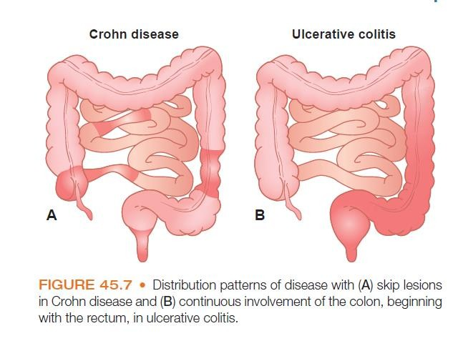

Slide 5
These two condition share many common features like
🞍 Diarrhea
🞍 Bloody stools
🞍 Weight loss
🞍 Abdominal pain
🞍 Fever and fatigue
but each has unique features

Slide 6
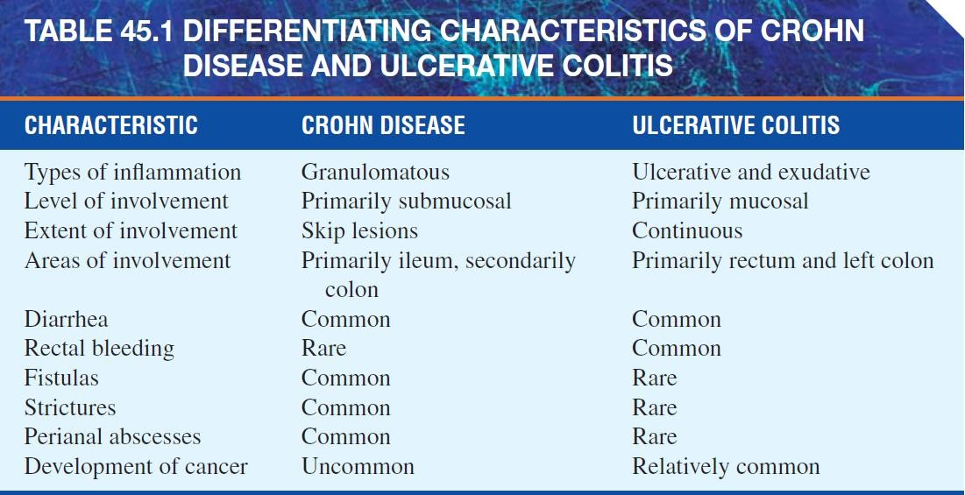

Slide 7
Both diseases produce inflammation of the bowel, both lack confirming evidence of a proven causative agent
As in many other autoimmune disorders, the pathogenesis of Crohn disease and ulcerative colitis involves a failure of immune regulation, genetic predisposition, and an environmental trigger, especially microbial flora

Slide 8
ETIOLOGY
Genetics
Profound disorders of mucosal immunity
IBD1 locus on chromosome 16 has recently been shown to contribute to Crohn disease
NOD2 / CARD15 mutations that are associated with Crohn disease
IBD3 on chromosome 6 linked to Crohn disease and ulcerative colitis.
IBD5 on chromosome 5
Human leukocyte antigen (HLA) associations HLA) DR2, HLA-DR3 for UC
(ABCB/MDR 1) on chromosome 7 is a potential susceptibility gene for ulcerative colitis.

Slide 9
Environmental Factors :
Microbes –
🢝 Escherichia coli
🢝 Mycobacterium paratuberculosis
Smoking (Crohn's disease)
Immune defects :
Altered host defence
Immune-mediated mucosal damage
alterations in mucosal T-cell and B-cell function
Deregulation of cytokine release.
Mucosal immune dysregulation
Psychological factors :
Stress
Emotional or physical trauma
Occupation

Slide 10
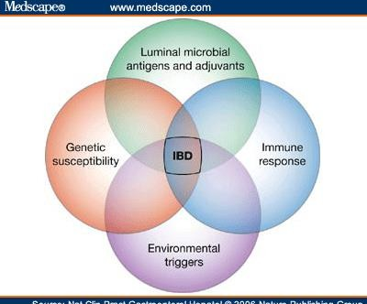

Slide 11
Pathophysiology
NOD2 protein is expressed in many types of leukocytes as well as epithelial cells and is thought to act as an intracellular receptor for lipopolysaccharides on microbes.
On binding microbial products, it may trigger the NFκβ pathway, which leads to the production of cytokines and other proteins involved in the innate immune defense against microorganisms.

Slide 12
NOD2 mutations that are associated with Crohn disease may reduce the activity of the protein, resulting in persistence of intracellular microbes and prolonged immune responses.
IBD5 rich in genes encoding several cytokines that may contribute to the disease.

Slide 13
Smoking- Due to coagulopathies occurring in the intestine or as a result of an immune response.
Microbes- Provide the antigen trigger for an unregulated immune response.
Bacteria produce toxins (necrotoxins, hemolysins, and enterotoxins) that cause mucosal damage.
Bacteria elaborate peptides (e.g., formyl-methionyl- leucylphenylalanine) that have chemotactic properties and that cause an influx of inflammatory cells with subsequent release of inflammatory mediators and tissue destruction.

Slide 14
immune response dysfunction,
genetic predisposition
proinflammatory
cytokines in the gut trigger an “attack” on the colonic mucosa by leukocytes and other factors
autoimmune
cascade occurs
Edema, ulceration,
and destruction of the tissue

Slide 15
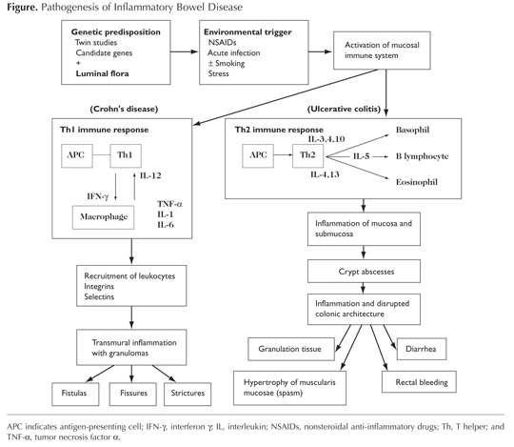

Slide 16
2. Signs of oxidative stress
TNF - α
Reactive
Oxygen species
Nuclear Factor
– Kappa B

Slide 17
Abnormal glycosaminoglycan (GAG) content of the mucosa:
GAGs are abundant in the basement membrane, lamina propria, and submucosa of the GI tract
Ulcerative colitis yielded a distinctly abnormal distribution of GAGs
Whether it is a result of, or cause of, inflammation remains to be determined

Slide 18
↑ sulfide production (sulfide-induced colonocyte toxicity)
In the colon, H₂S is produced both endogenously and by naturally occurring sulfate-reducing bacteria (SRB).

Slide 19
CLINICAL PRESENTATION
ULCERATIVE COLLITIS-The inflammation is limited to the mucosa
Crypt abscesses
necrosis of the epithelium
Edema
Hemorrhage
surrounding accumulations of chronic inflammatory cells
granular, and erythematous, with or without ulceration.

Slide 20
Chronic, loose, bloody stools
tenesmus (urge to defecate)
Abdominal pain
Severe disease is defined as more than six bloody stools a day, fever, tachycardia, anemia, or an ESR greater than 30
A major complication is toxic megacolon, which is a segmental or total colonic distension of >6 cm with acute colitis and signs of systemic toxicity.

Slide 21
CROHN’S DISEASE
CD is a chronic, transmural, patchy, granulomatous, inflammatory disease that can involve the entire GI tract, from mouth to anus, with discontinuous ulceration (so-called skip lesions), fistula formation, and perianal involvement.

Slide 22
Predominantly inflammatory
Stricturing, or fistulizing
Abdominal pain and chronic, often nocturnal, diarrhea
Weight loss, low-grade fever, and fatigue are also common
Abdominal masses or abscesses and fistulae
Enterocutaneous and enterorectal fistulae are common

Slide 23
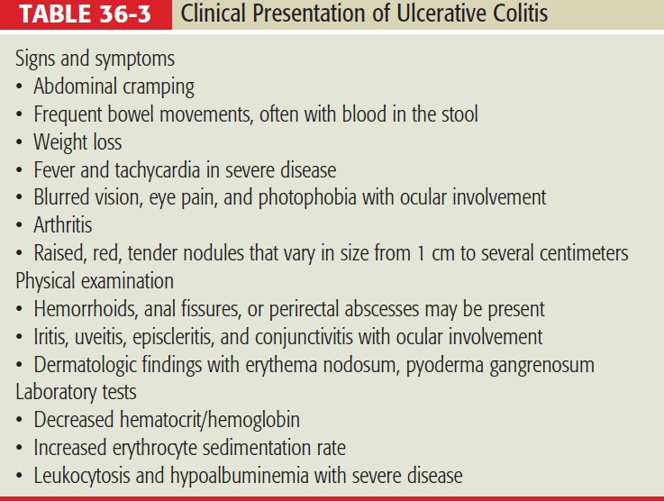

Slide 24
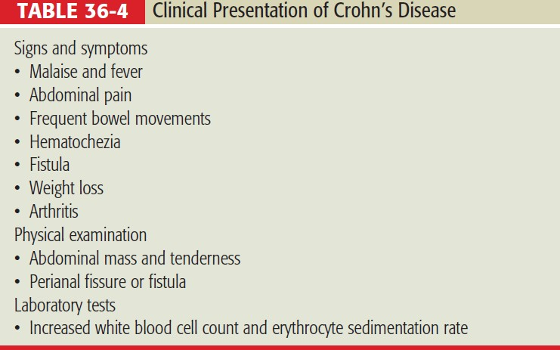

Slide 25
Extraintestinal manifestations of IBD
Reactive arthritis,
Uveitis,
Ankylosing spondylitis,
Pyoderma gangrenosum, and
Primary sclerosing cholangitis.

