Slide 1
PRAMACEUTICAL BIOTECHNOLOGY
3- TYPES OF IMMUNITY
17-09-2024
1

Slide 2
TYPES OF IMMUNITY
Immunity is the capability of multicellular organisms to resist harmful microorganisms.
Immunity involves both specific and nonspecific components.
The nonspecific components act as barriers or eliminators of a wide range of pathogens irrespective of their antigenic make-up.
Other components of the immune system adapt themselves to each new disease encountered and can generate pathogen-specific immunity.
17-09-2024
2

Slide 3
Innate and adaptive
The immune system has two components: innate and adaptive immunity.
The innate immunity is present in all metazoans, while the adaptive immunity only occurs in vertebrates.
The innate system relies on the recognition of certain foreign molecules to stimulate two types of innate immune responses: inflammatory responses and phagocytosis.
The adaptive system, on the other hand, is composed of more advanced lymphatic cells that are programmed to distinguish between specific "non-self" substances in the presence of "self".
The reaction to foreign substances is described as inflammation, meaning to set on fire.
The non-reaction to self substances is described as immunity - meaning to exempt.
These two components of the immune system create a dynamic biological environment where "health" can be seen as a physical state where the self is immunologically spared, and what is foreign is inflammatorily and immunologically eliminated. "Disease" can arise when what is foreign cannot be eliminated or what is self is not spared.

Slide 4
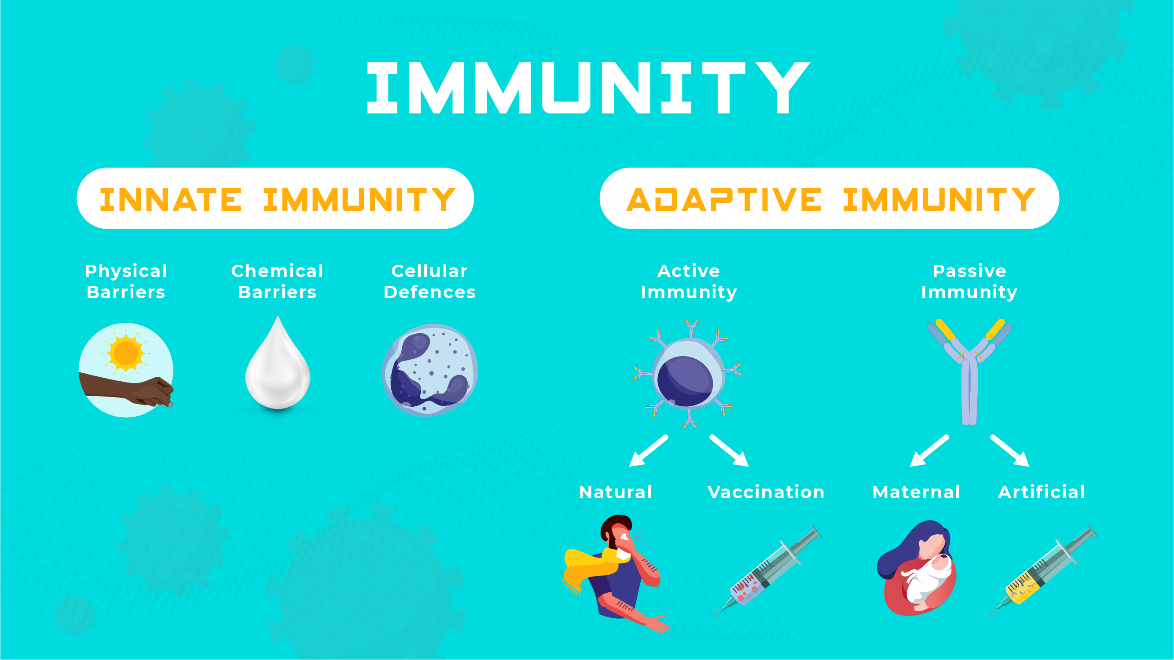

Slide 5
Innate immunity, also known as native immunity, is a semi-specific and widely distributed form of immunity.
It is defined as the first line of defence against pathogens, representing a critical systemic response to prevent infection and maintain homeostasis, contributing to the activation of an adaptive immune response.
Adaptive or acquired immunity is the active component of the host immune response, mediated by antigen-specific lymphocytes.
Unlike the innate immunity, the acquired immunity is highly specific to a particular pathogen, including the development of immunological memory.
Like the innate system, the acquired system includes both humoral immunity components and cell-mediated immunity components.

Slide 6
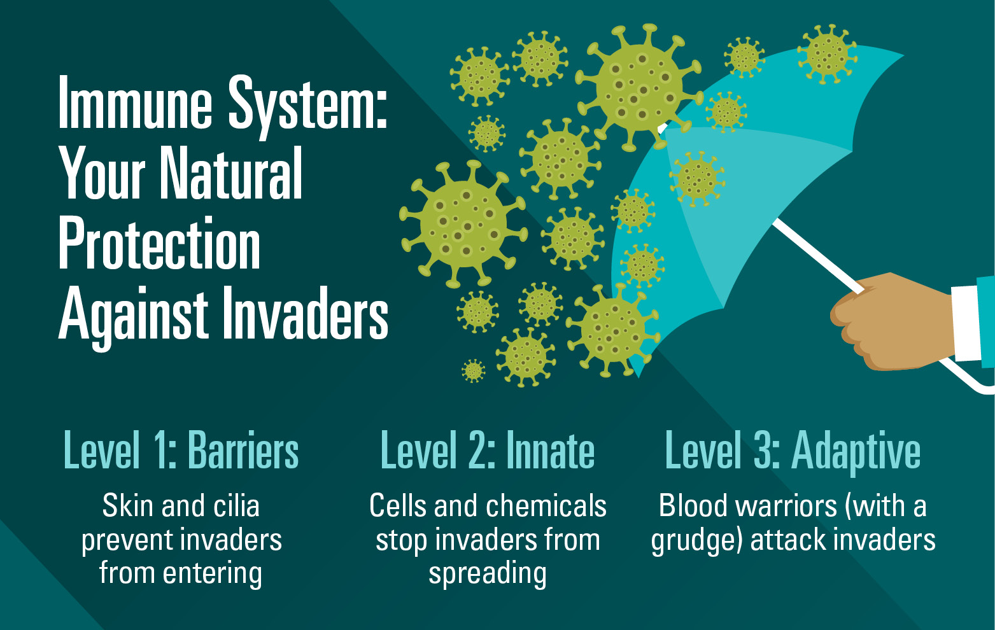

Slide 7
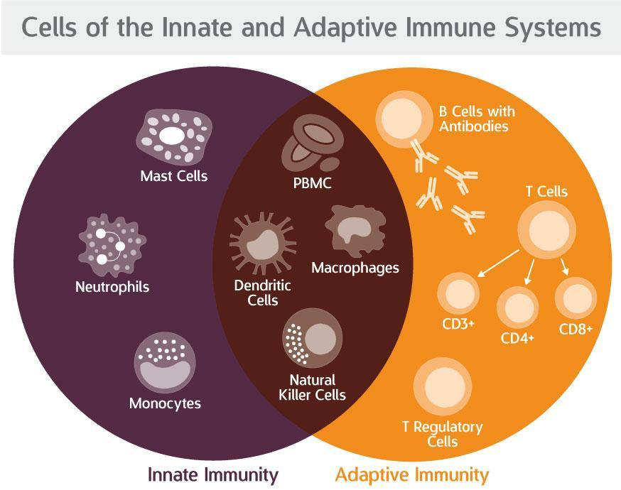

Slide 8
Adaptive immunity can be acquired either 'naturally' (by infection) or 'artificially' (through deliberate actions such as vaccination). Adaptive immunity can also be classified as 'active' or 'passive’.
Active immunity is acquired through the exposure to a pathogen, which triggers the production of antibodies by the immune system.
Passive immunity is acquired through the transfer of antibodies or activated T-cells derived from an immune host either artificially or through the placenta; it is short-lived, requiring booster doses for continued immunity.
The diagram below summarizes these divisions of immunity. Adaptive immunity recognizes more diverse patterns. Unlike innate immunity it is associated with memory of the pathogen.

Slide 9
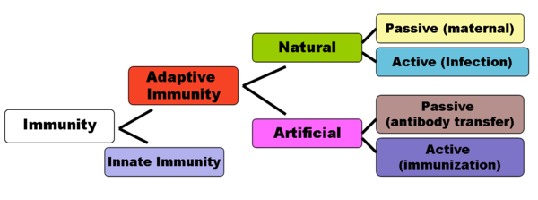

Slide 10
Passive
Passive immunity is the transfer of immunity, in the form of ready-made antibodies, from one individual to another.
Passive immunity can occur naturally, when maternal antibodies are transferred to the foetus through the placenta, and can also be induced artificially, when high levels of human (or horse) antibodies specific for a pathogen or toxin are transferred to non-immune individuals.
Passive immunization is used when there is a high risk of infection and insufficient time for the body to develop its own immune response, or to reduce the symptoms of ongoing or immunosuppressive diseases.
Passive immunity provides immediate protection, but the body does not develop memory, therefore the patient is at risk of being infected by the same pathogen later.

Slide 11
Naturally acquired
Maternal passive immunity is a type of naturally acquired passive immunity, and refers to antibody-mediated immunity conveyed to a fetus by its mother during pregnancy.
Maternal antibodies are passed through the placenta to the fetus by an receptor on placental cells.
This occurs around the third month of gestation.
IgG is the only antibody isotype that can pass through the placenta.
Passive immunity is also provided through the transfer of IgA antibodies found in breast milk that are transferred to the gut of the infant, protecting against bacterial infections, until the new born can synthesize its antibodies.
Colostrum present in mothers milk is an example of passive immunity.
.
17-09-2024
11

Slide 12
Artificially acquired
Artificially acquired passive immunity is a short-term immunization induced by the transfer of antibodies, which can be administered in several forms; as human or animal blood plasma, as pooled human immunoglobulin for intravenous (IVIG) or intramuscular (IG)
Passive transfer is used prophylactically in the case of immunodeficiency diseases, such as hypogammaglobulinemia.
It is also used in the treatment of several types of acute infection, and to treat poisoning
Immunity derived from passive immunization lasts for only a short period of time, and there is also a potential risk for hypersensitivity reactions, and serum sickness, especially from gamma globulin of non-human origin.
The artificial induction of passive immunity has been used for over a century to treat infectious disease, and before the advent of antibiotics, was often the only specific treatment for certain infections.

Slide 13
Transfer of activated T-cells
T cells are one of the important white blood cells of the immune system and play a central role in the adaptive immune response. T cells can be easily distinguished from other lymphocytes by the presence of a T-cell receptor (TCR) on their cell surface
Passive or "adoptive transfer" of cell-mediated immunity, is conferred by the transfer of "sensitized" or activated T-cells from one individual into another.
It is rarely used in humans because it requires histocompatible (matched) donors, which are often difficult to find.
In unmatched donors this type of transfer carries severe risks of graft versus host disease.
It has, however, been used to treat certain diseases including some types of cancer and immunodeficiency.

Slide 14
Active
When B cells and T cells are activated by a pathogen, memory B-cells and T- cells develop, and the primary immune response results.
Throughout the lifetime of an animal, these memory cells will "remember" each specific pathogen encountered, and can mount a strong secondary response if the pathogen is detected again.
This type of immunity is both active and adaptive because the body's immune system prepares itself for future challenges
Active immunity often involves both the cell-mediated and humoral aspects of immunity as well as input from the innate immune system.

Slide 15
Naturally acquired
Naturally acquired active immunity occurs when a person is exposed to a live pathogen and develops a primary immune response, which leads to immunological memory.
This type of immunity is "natural" because deliberate exposure does not induce it.
Many disorders of immune system function can affect the formation of active immunity such as immunodeficiency (both acquired and congenital forms) and immunosuppression.

Slide 16
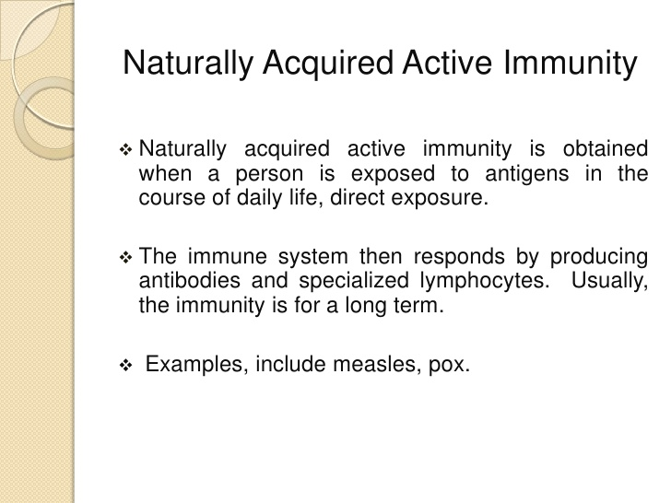

Slide 17
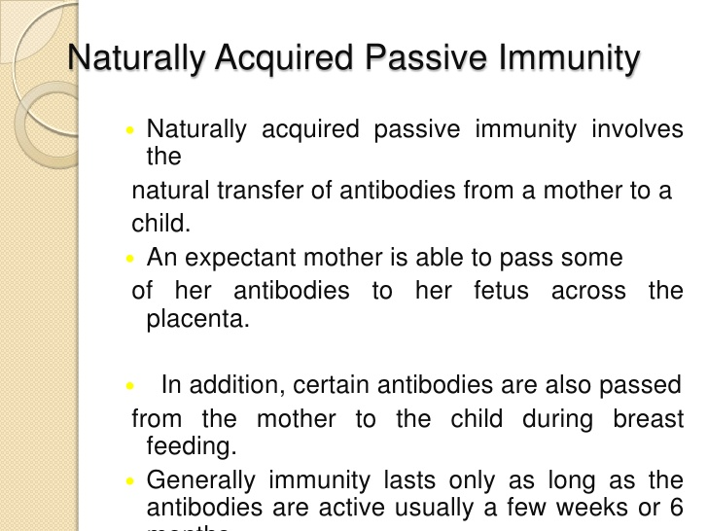

Slide 18
Artificially acquired
Artificially acquired active immunity can be induced by a vaccine, a substance that contains antigen.
A vaccine stimulates a primary response against the antigen without causing symptoms of the disease.
Richard Dunning coined the term vaccination, a colleague of Edward Jenner, and adapted by Louis Pasteur for his pioneering work in vaccination.
The method Pasteur used entailed treating the infectious agents for those diseases, so they lost the ability to cause serious disease.
Pasteur adopted the name vaccine as a generic term in honor of Jenner's discovery, which Pasteur's work built upon.

Slide 19
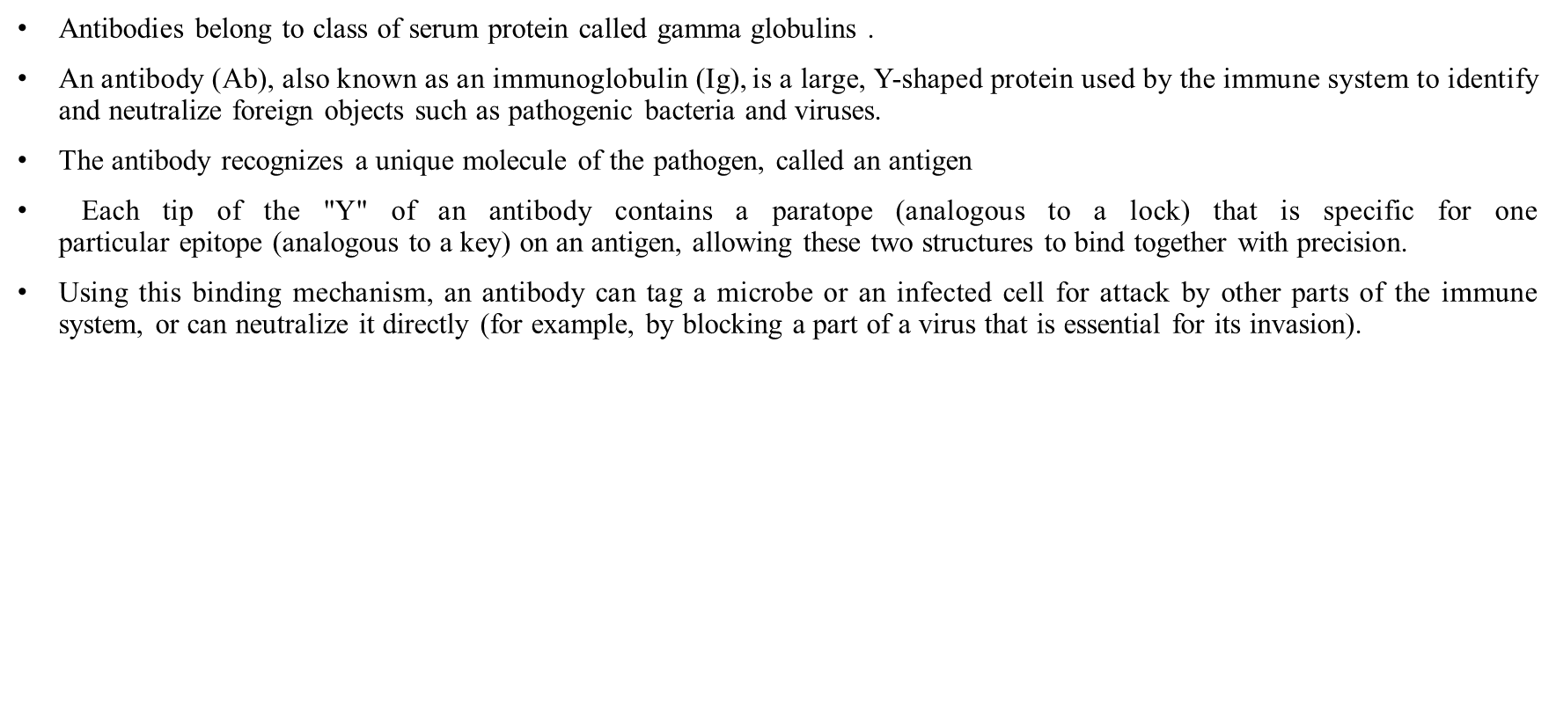

Slide 20
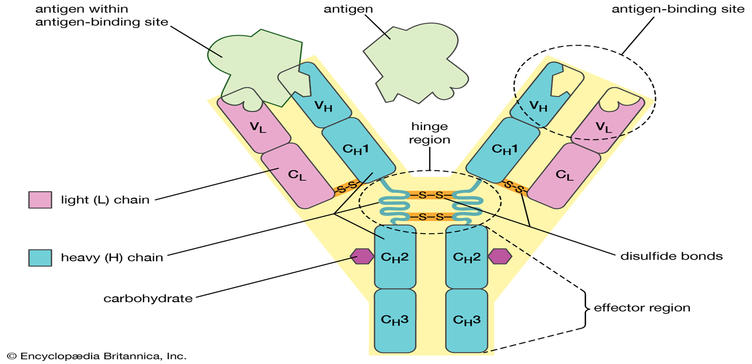

Slide 21
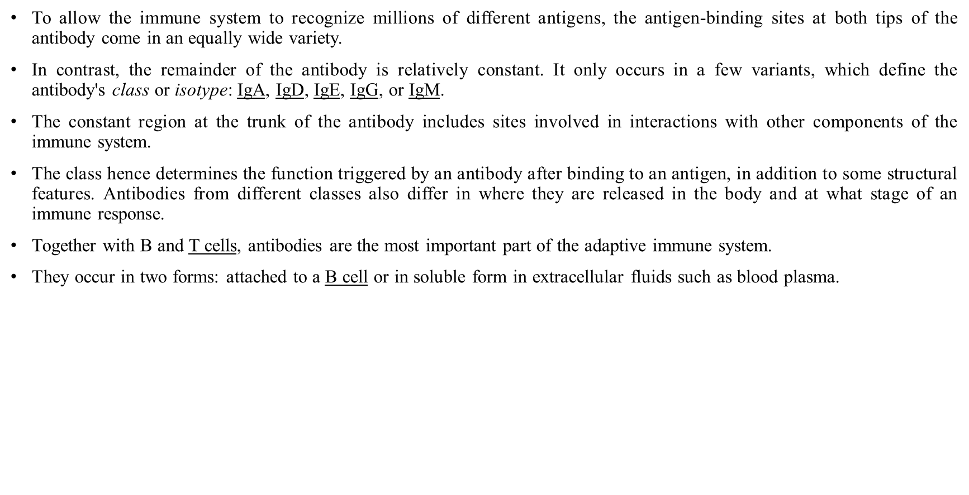

Slide 22
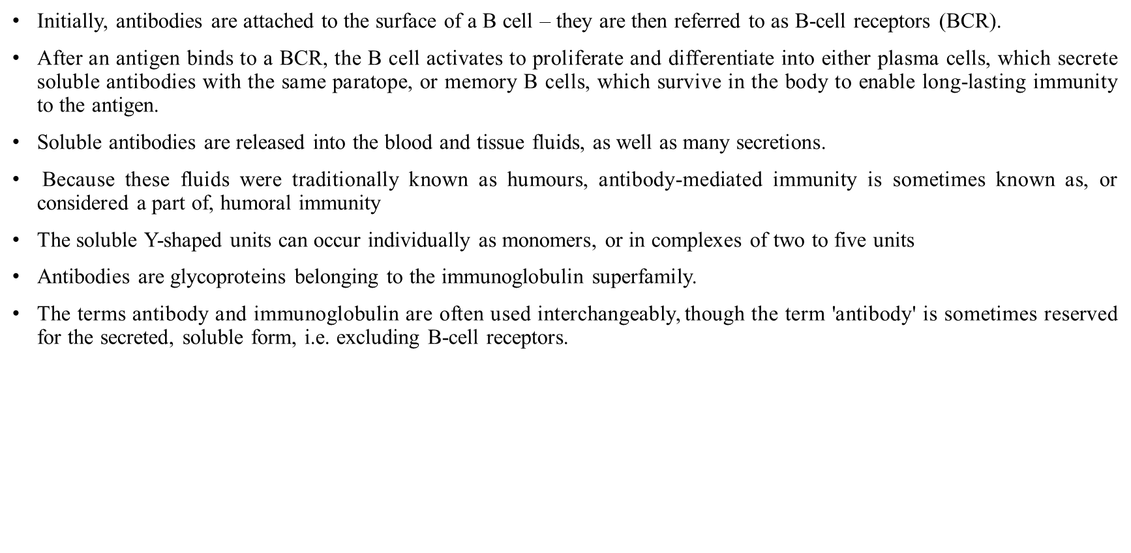

Slide 23
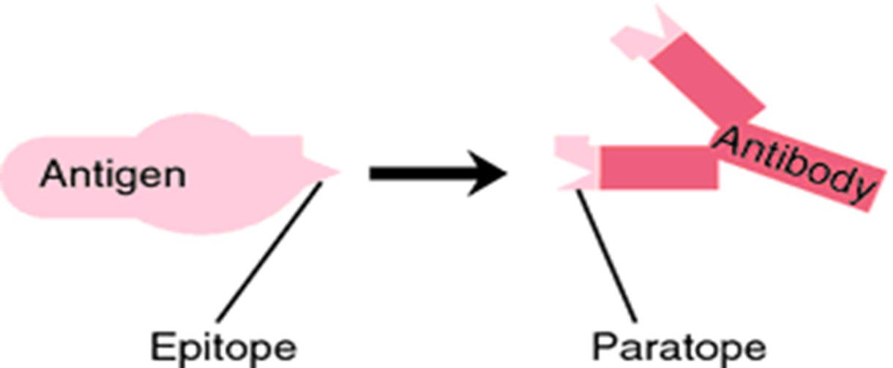

Slide 24
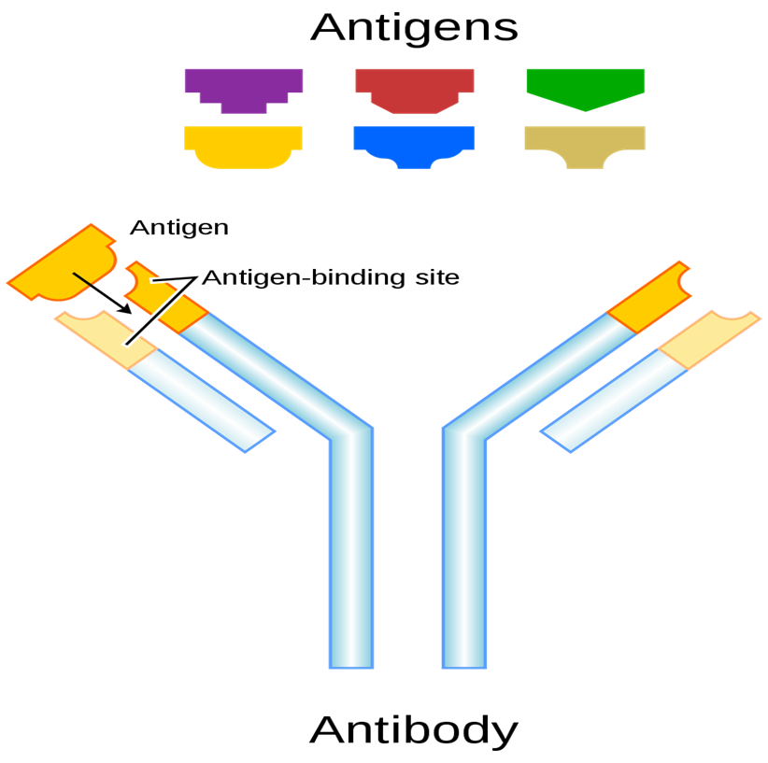

Slide 25
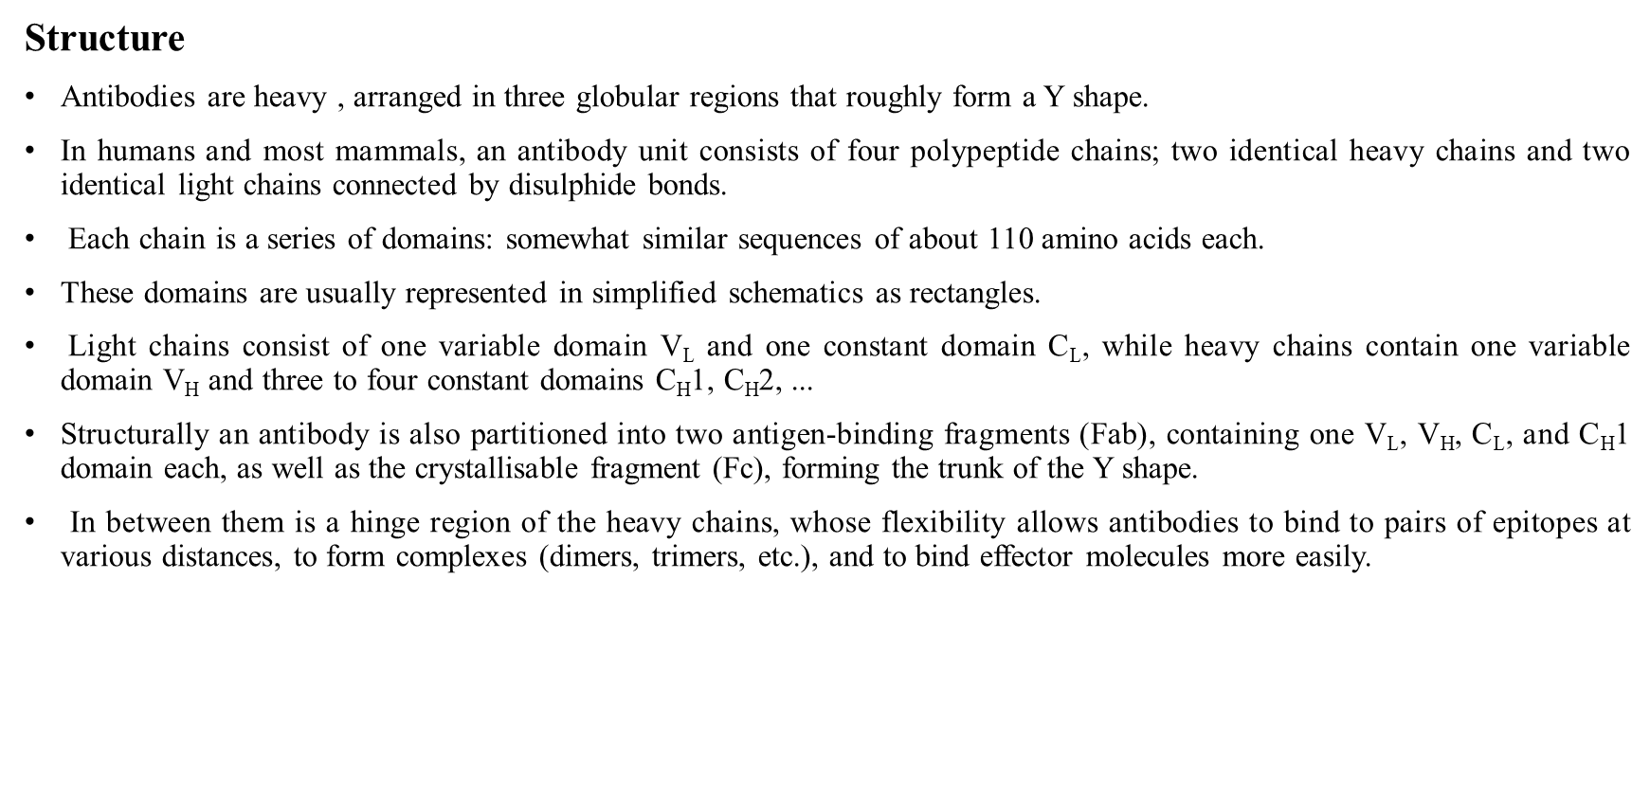

Slide 26
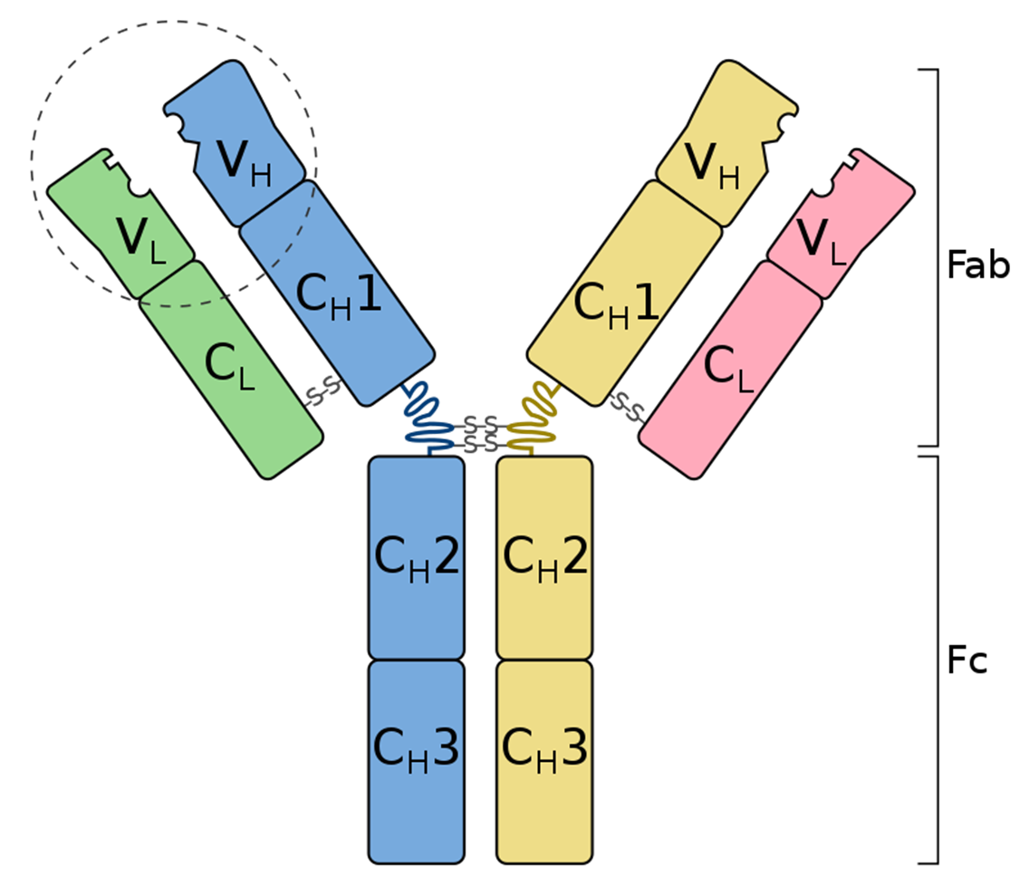

Slide 27
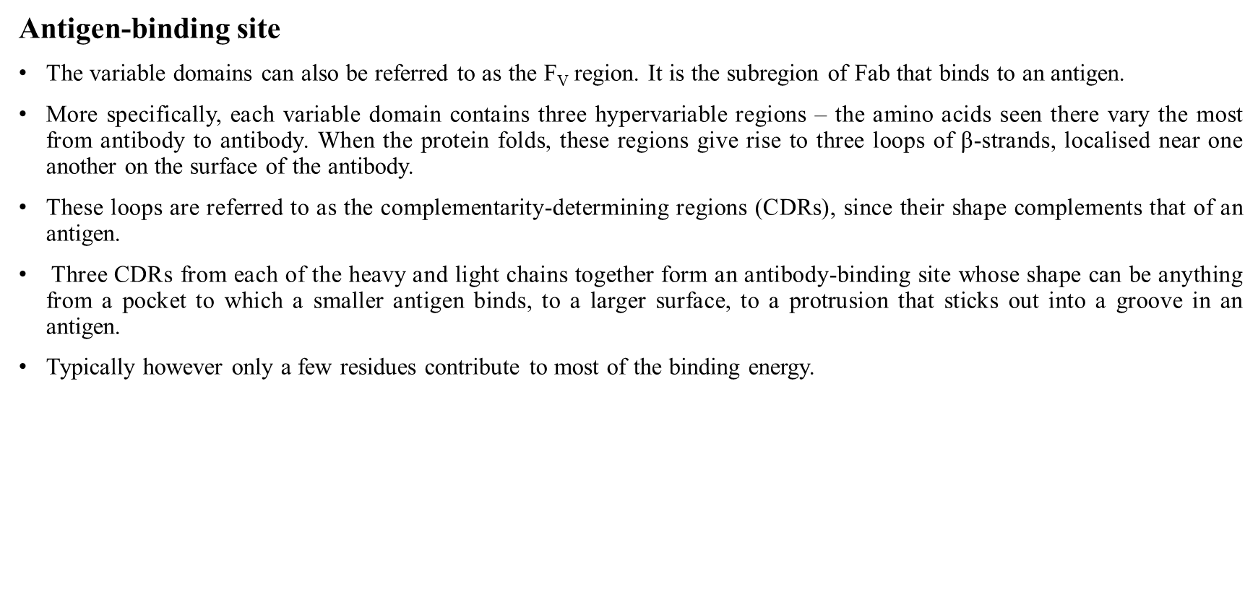

Slide 28
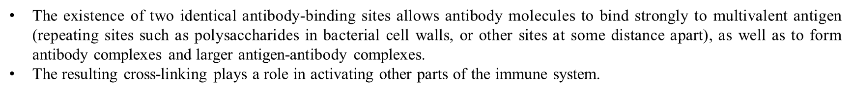
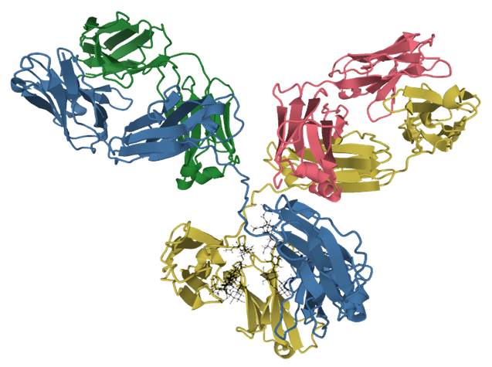

Slide 29
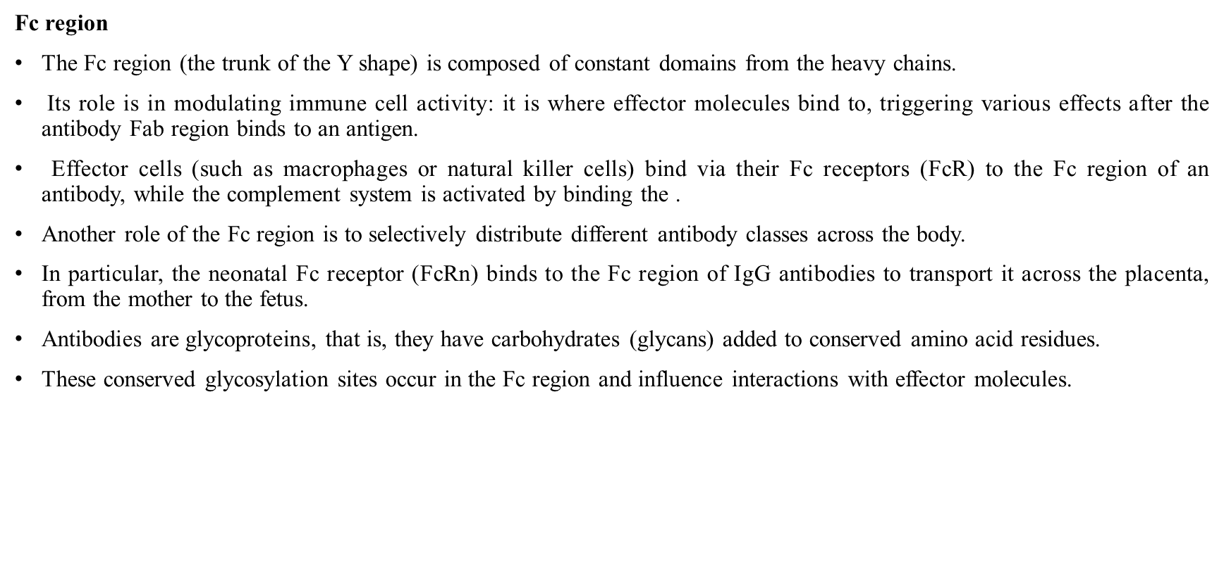

Slide 30
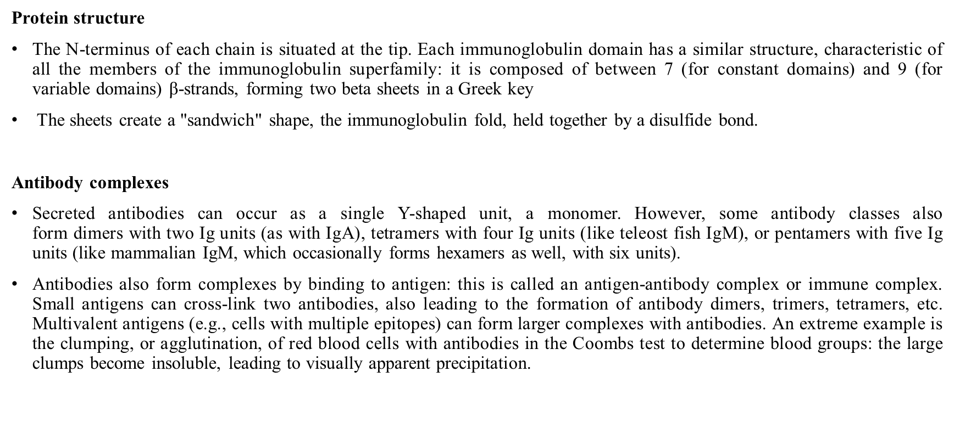

Slide 31
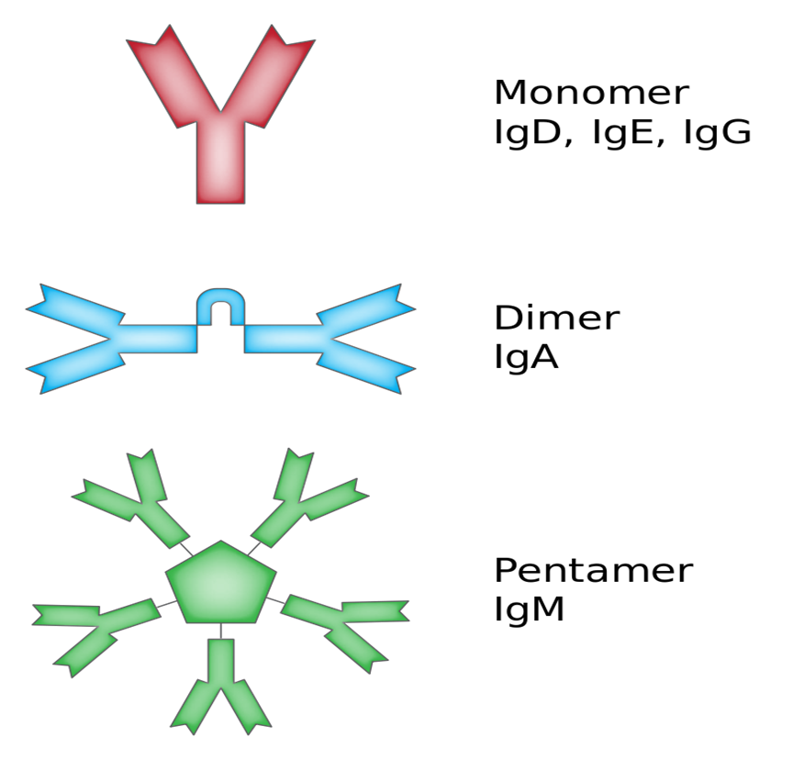

Slide 32
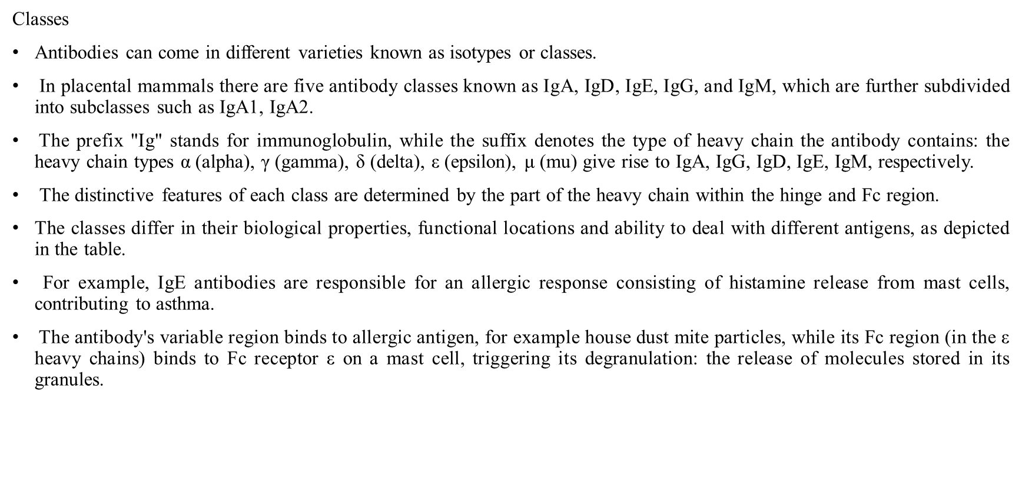

Slide 33
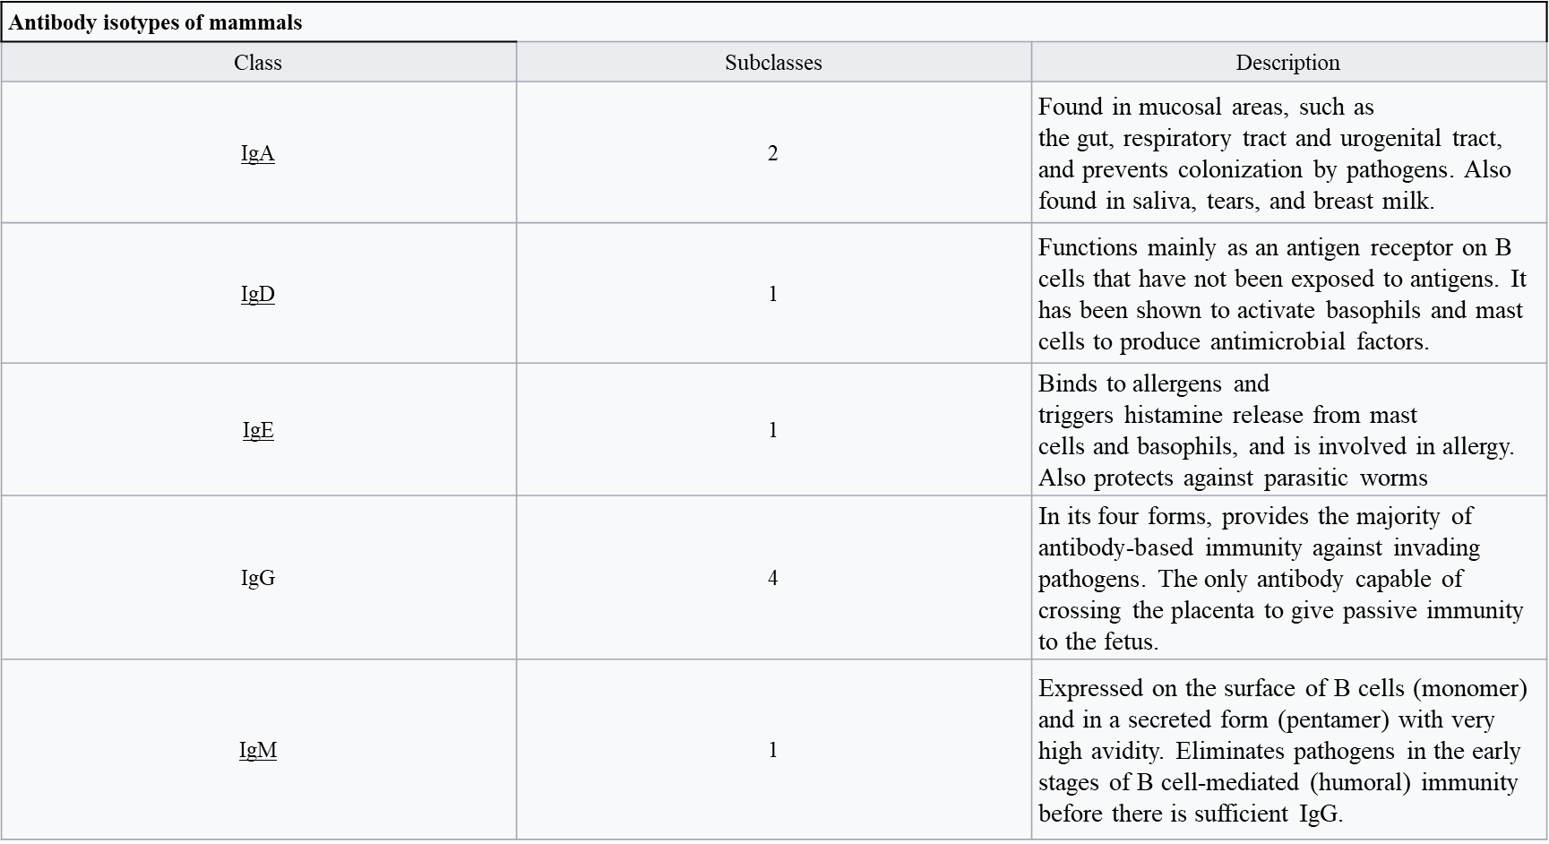

Slide 34
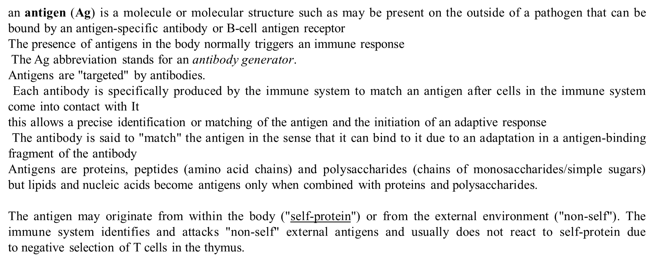
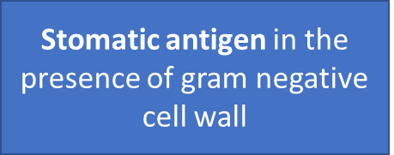

Slide 35
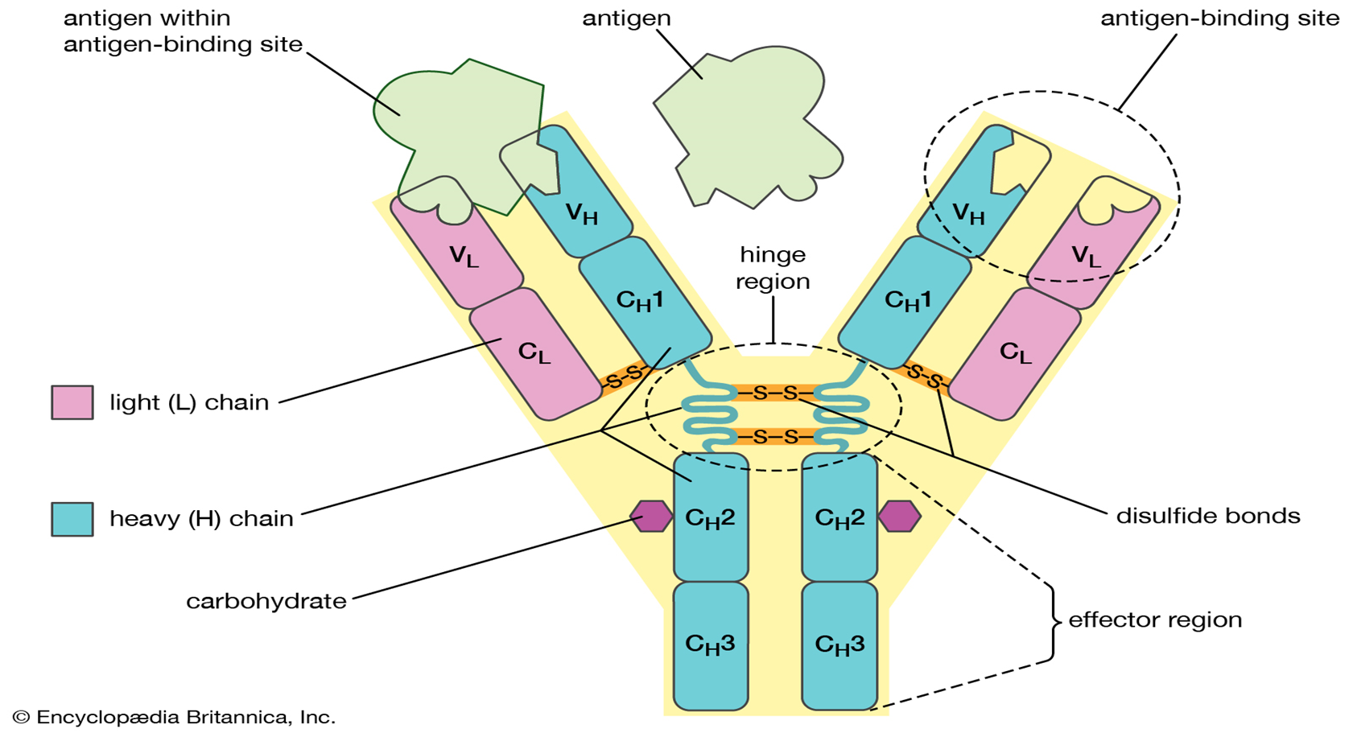

Slide 36
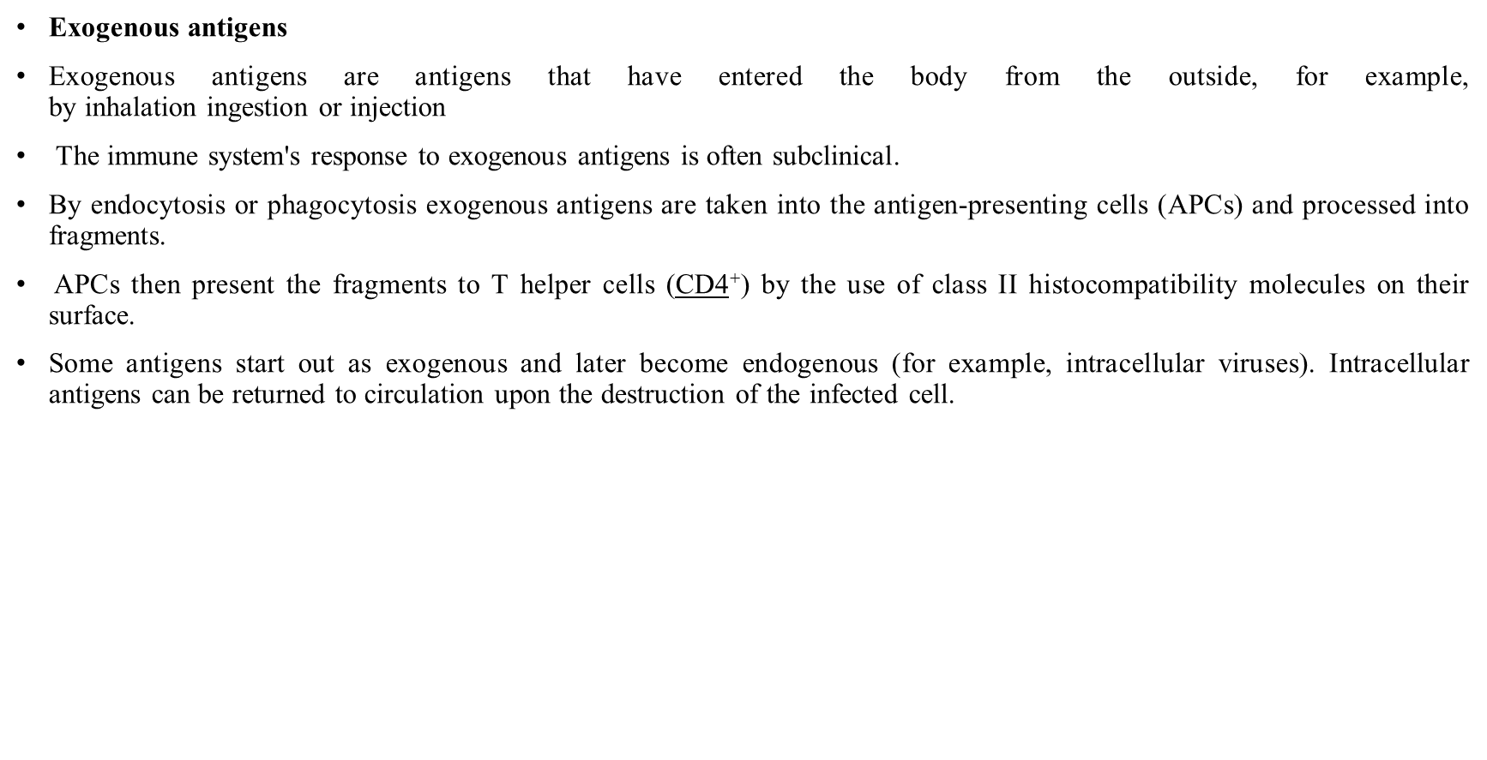


Slide 37
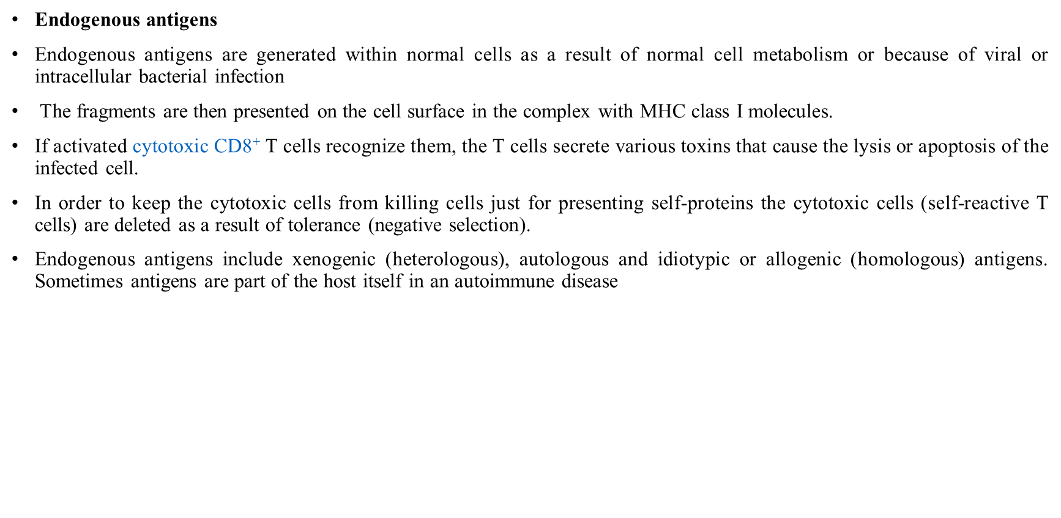

Slide 38


Slide 39


Slide 40
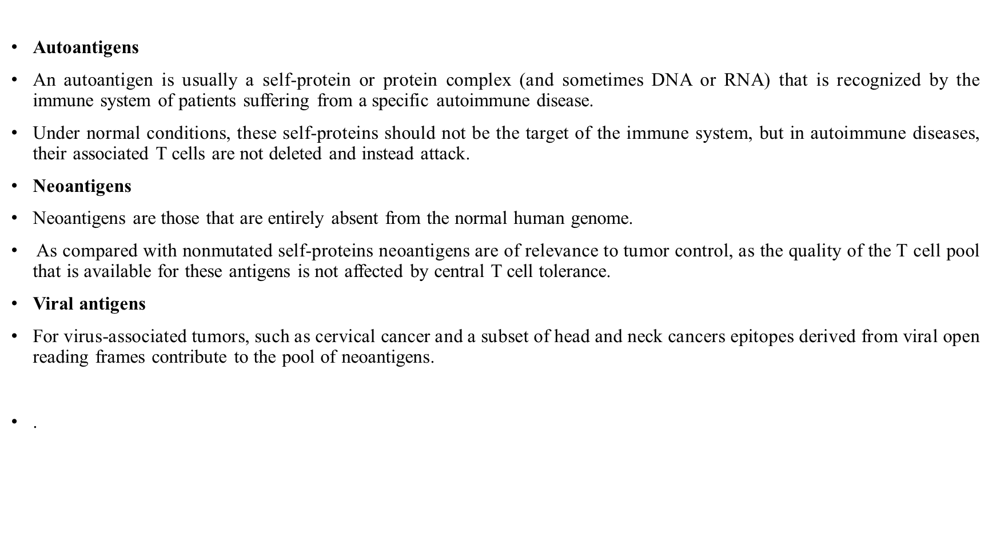

Slide 41
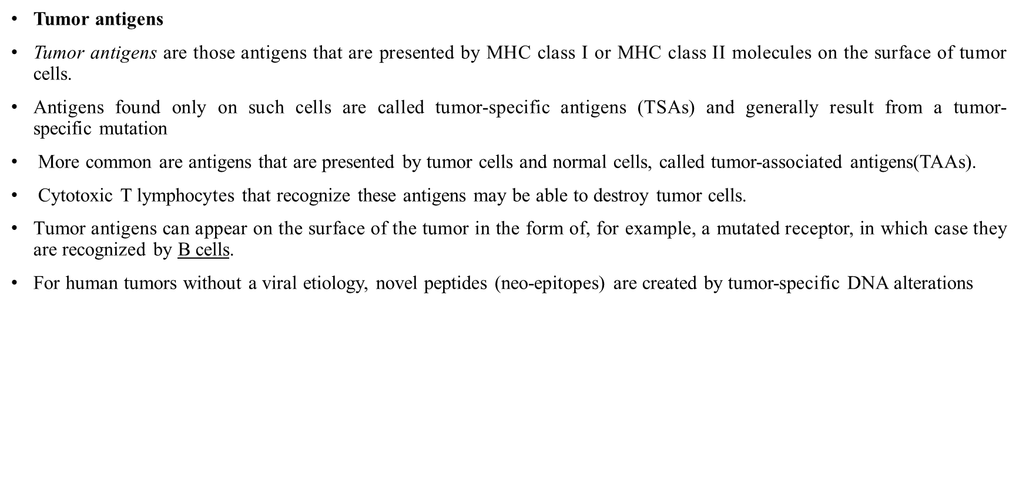

Slide 42
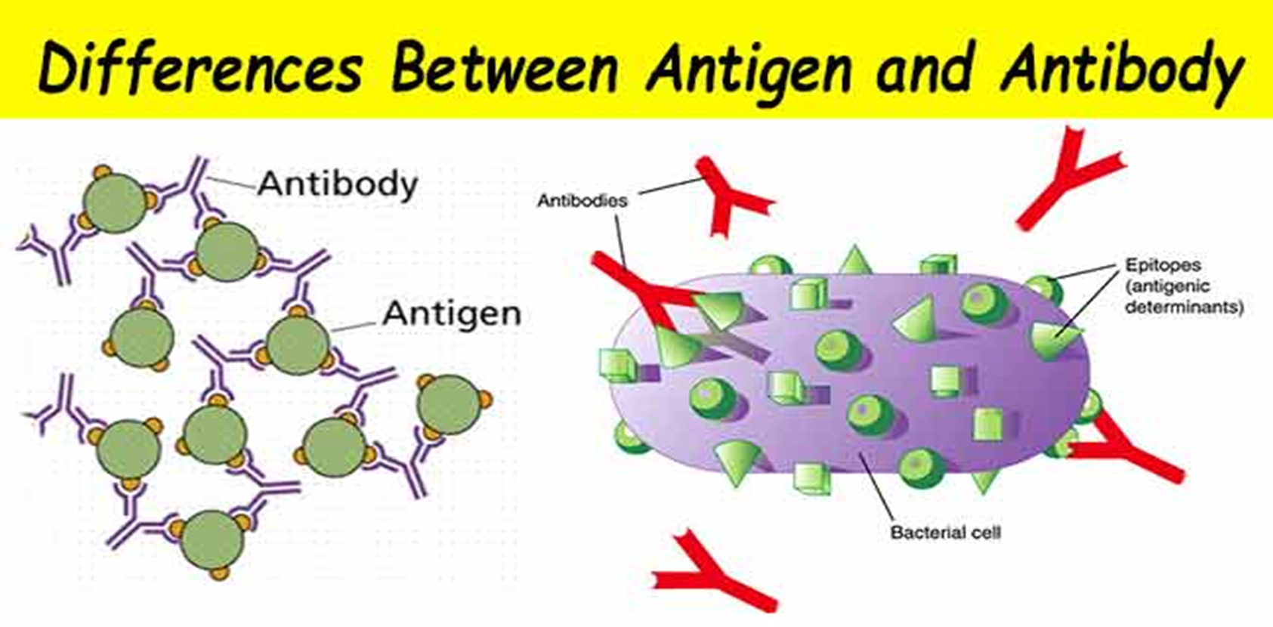

Slide 43
