Slide 1
BIOSTATISTICS AND RESEARCH METHODOLOGY
INTRODUCTION TO RESEARCH AND BIOSTATISTICS
14-09-2024
1

Slide 2
RESEARCH
Research in common parlance refers to a search for knowledge. Once can also define research as a scientific and systematic search for pertinent information on a specific topic. In fact, research is an art of scientific investigation.
Research is, thus, an original contribution to the existing stock of knowledge making for its advancement. It is the persuit of truth with the help of study, observation, comparison and experiment. In short, the search for knowledge through objective and systematic method of finding solution to a problem is research. The systematic approach concerning generalization and the
formulation of a theory is also research.
As such the term ‘research’ refers to the systematic method consisting of enunciating the problem, formulating a hypothesis, collecting the facts or data, analyzing the facts and reaching certain conclusions either in the form of solutions(s) towards the concerned problem or in certain generalizations for some theoretical formulation.
The purpose of research is to discover answers to questions through the application of scientific procedures. The main aim of research is to find out the truth which is hidden and which has not been discovered as yet.
To gain familiarity with a phenomenon or to achieve new insights into it (studies with this object in view are termed as exploratory or formulative research studies);
To portray accurately the characteristics of a particular individual, situation or a group (studies with this object in view are known as descriptive research studies);
To determine the frequency with which something occurs or with which it is associated with something else (studies with this object in view are known as diagnostic research studies);
To test a hypothesis of a causal relationship between variables (such studies are known as hypothesis-testing research studies).
14-09-2024
2

Slide 3
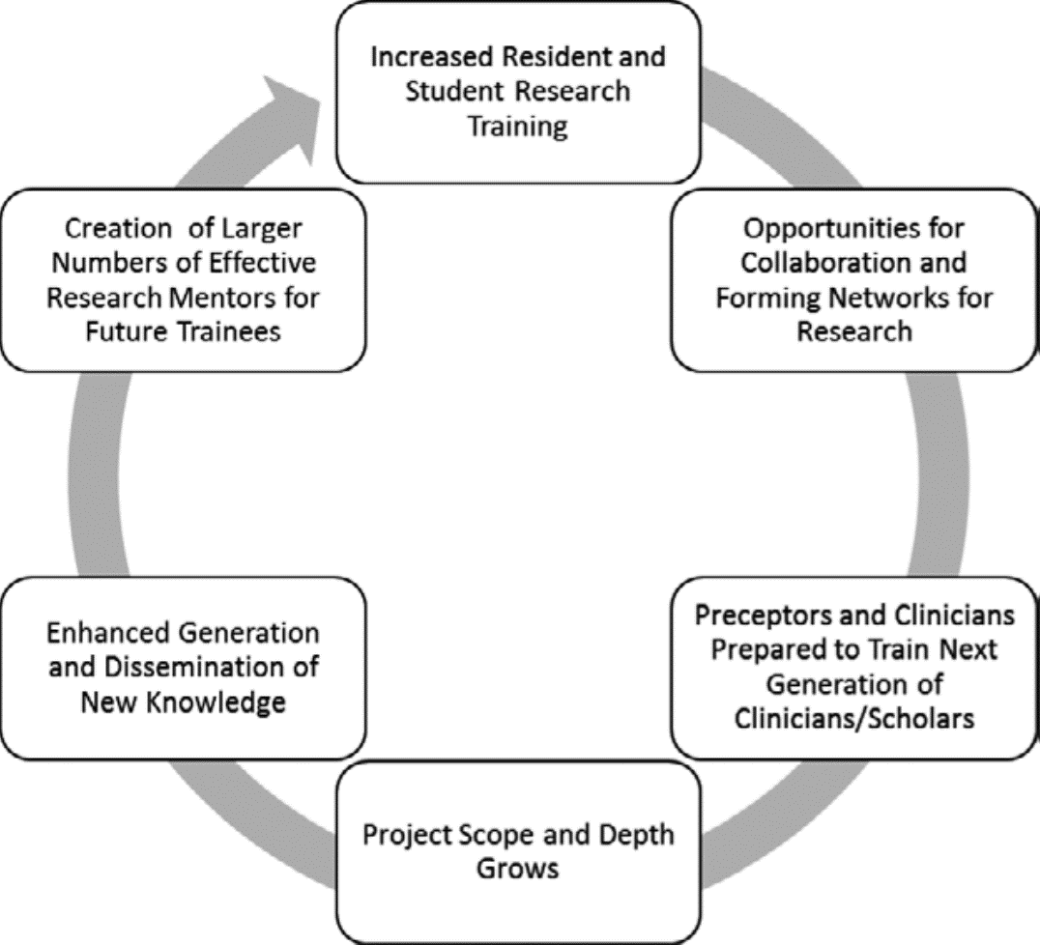
Identify relevant problems and gaps in Pharmacotherapeutics knowledge.
Generate a research hypothesis and Design a study to test the hypothesis.
Analyze data results using appropriate statistical tests.
Interpret and apply results of research study to practice.
Effectively communicate research and clinical findings to pharmacy, medical, and basic science audiences.
Interpret and effectively communicate research and clinical findings to patients and caregivers.
Apply regulatory and ethical principles when conducting research, or when using the research results.

Slide 4
The research opportunities include lab-based pharmaceutical sciences and basic science research in drug discovery and development; clinical and translational research that applies new discoveries in clinical and community settings; and research that advances the practice of pharmacy and improves education to make meaningful health care interventions to enhance patient care.
Most hospital pharmacists need to work on and design new projects, Doing research has helps develop and become more competent in project design, data collection, and projecting outcomes. These are skills that can really further my career as a pharmacist
“Once you’re involved in research and in generating new knowledge, you get a knack for asking the right questions, Student also get familiar with primary literature and methods. A Pharm D student might end up running clinical trials or collaborating with researchers to oversee applications of new drugs.
Working on pharmaceutical sciences research, while introducing students to a possible career path, also helps Pharm D students understand the connection between drug development and delivery and their role as pharmacists. As the field is becoming increasingly complex, it’s important for today’s pharmacists to have that scientific context. But pharmaceutical sciences is just one piece of the research pie.
One can know so many things, but knowing how to communicate them is different. It’s good for pharmacists to understand and have an appreciation for how difficult it is to find and isolate products that hold potential for drug development, but that research also involved learning how to communicate the results and methods

Slide 5
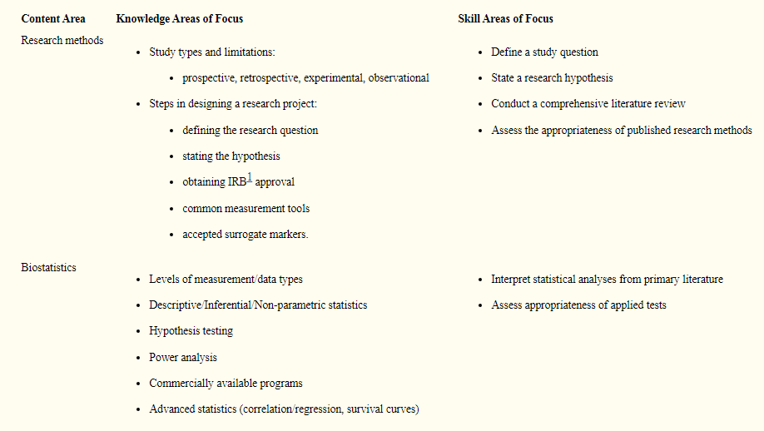

Slide 6
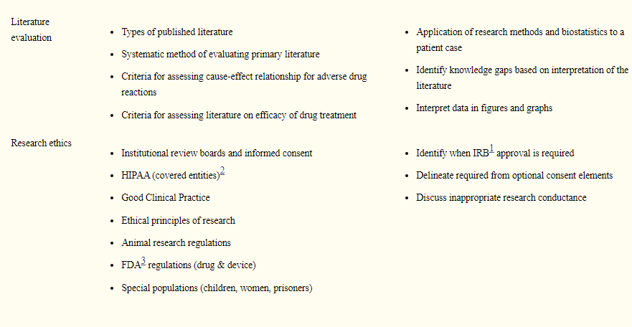

Slide 7
BIOSTATISTICS
Biostatistics is a branch of Statistics which deals with the data related to Medical Science, Public Health, Medical Research, Epidemiology and so on. In simpler words, when we apply Statistics in Biological Science – it is called Biostatistics.
Biostatistics is the application of scientific and quantitative procedures, which are used in descriptive and inferential statistics, for evaluating the quality of evidence in biological sciences. It deals with the statistical processes and methods applied to the analysis of biological phenomena.
Statistical processes and methods applied to the collection, analysis, and interpretation of biological data and especially data relating to human biology, health, and medicine.
Biostatistics is the application of statistical reasoning to the life sciences, and it is the key to unlocking the data gathered by researchers and the evidence presented in the scientific literature. In this course, we'll focus on the use of statistical measurement methods within the world of public health research.
Along the way, you'll be introduced to a variety of methods and measures, and you'll practice interpreting data and performing calculations on real data from published studies.

Slide 8
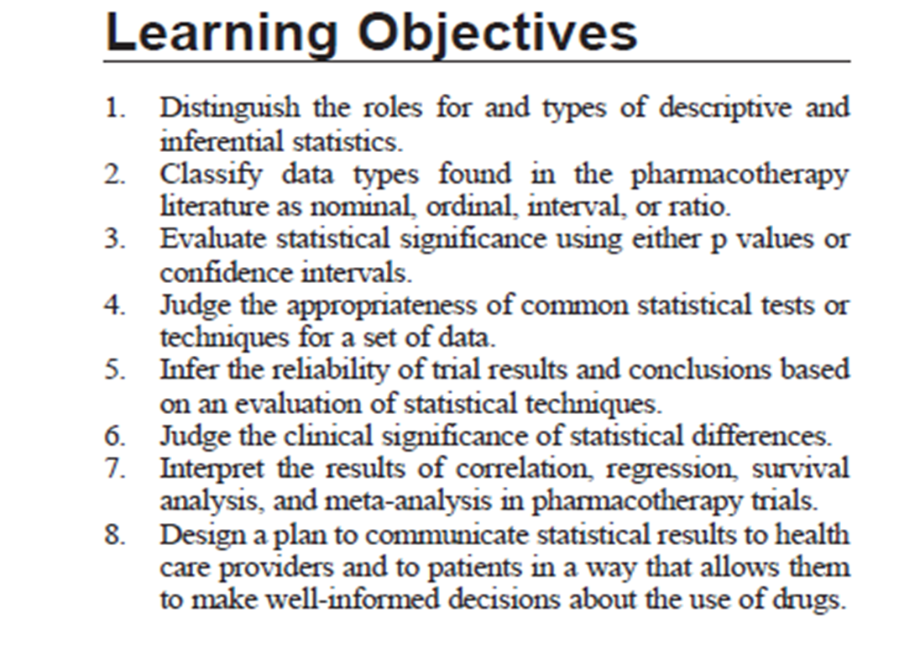

Slide 9
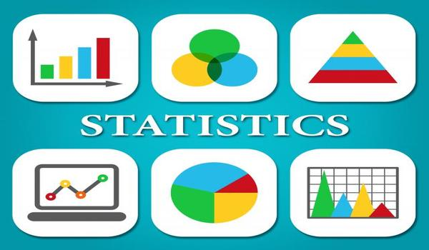
Describe basic terms in biostatistics related to types of data studied, measures of central tendency, and descriptors of population distribution variability
Compare and contrast different statistical tests to determine significance and apply them to a given clinical trial
Discuss study designs and the level of evidence each design can achieve
Appraise the results of a biomedical study and its applicability to practice including bias and confounding, internal and external validity, and numbers needed to treat/harm.
What to Focus in Biostatics
DATA
SAMPLING
HYPOTHESIS
MEASUREMENT OF SYSTEM ANALYSIS

Slide 10
Data are the first thing which pops out on the head when we talk about any kind of analysis. Since we are dealing with data for analysis, we should know the basic concepts of it. Data are the actual pieces of information that we collect through our process or experiment. It can be categorized into categorical and numerical data. Categorical data are defined in categories or groups.
Sampling is a method used in Statistical Analysis of a data where a specific number of samples are taken from a population for a study.
Hypothesis testing is a method to determine whether the results are statistically significant or not. In simpler words, the process of drawing inferences (making decisions) about the sample with regards to the population as a whole is known as Hypothesis Testing.
Measurement System Analysis helps us to detect the amount of variation exists within a measurement system.
HISTORY OF BIOSTATISTICIANS IN PHARMACEUTICAL INDUSTRY
• Started in the 70’s
– 70’s and 80’s: Statisticians to a large extent employed as consultants
– To calculate sample sizes for studies and write related sections in the protocol
– No impact on analysis and trial interpretation
• 90’s:
– Take on reporting safety and efficacy
– Start to become integrated in development teams
• Last decade:
– Becoming more strategic
– Move from a statistician working in drug development to a drug developer with biostatistics background

Slide 11

Biostatisticians are in high demand due to their various responsibilities in scientific data. They also collaborate with informatics, experts, scientists, and researchers for various functions.
They consider the variables in subjects like patients, communities, or population to understand them and also make sense of different sources of variation. It is to achieve their ultimate goal of solving problems in public health by disentangling the received data and make valid inferences. Their research is used often to influence changes at the policy-making levels.
The responsibilities of Biostatisticians:
To determine the ways to utilize the vast information and statistics obtained through various sources like genomics, clinical trials, experimental studies and observational and longitudinal studies for public health.
Being specialists of data evaluation, they take complex and mathematical findings of clinical trials and research related data. They then translate them into variable information to make public health decisions.

Slide 12
Being specialists of data evaluation, they take complex and mathematical findings of clinical trials and research related data, they then translate them into variable information to make public health decisions.
Biostatisticians are required to develop statistical methods for the following:
Clinical trials to study and evaluate treatments, screening and prevention methods in the population (e.g. Evaluating protocol in terms of study rationale, study objectives, study design, sample size calculation, statistical analysis of primary endpoints, statistical analysis of secondary endpoints, treatment of missing data, informed consent, insurance issues, economic issues)
Epidemiological studies of the origins of disease in humans
Spatial studies of the geographical distribution of disease and risk factors
Genomics which is the study of the biological activity of genes as they relate to disease and treatments
Human genetics a study of the genetic differences among diseases and disease states
Biostatistics is responsible for public health all over the world with data collection and its interpretation by various ways.
Many students studying medicine find it unnecessary in their initial years of study to learn statistics. But the reality is many profound doctors feel the need biostatistics since in the time of their study it was not in the medical study curriculum. The doctors need to study biostatistics not only for researchers but also to enhance their reading capability of medical literature. Only with the introduction of evidence-based medicines as a cornerstone for medical management, biostatistics came into vital prevalence.

Slide 13
Guidelines of evidence-based medicine are squarely depended on meta-analysis. It is, in turn, is based on many randomized controlled clinical types of research. Only this will provide rock-solid evidence to help doctors in making decisions on the best management options for patients. A firm understanding of statistical methods only will facilitate the understanding of the randomized clinical research methods and results.
Hence biostatistics plays an important role in evidence-based medicine, which is the base for doctors to recommend treatments for patients now.
Roles of biostatistics in clinical research:
It is crucial for any clinical research from design, conduct, analysis, and reporting in terms of controlling and minimizing biases, confounding factors, and measuring random errors.
They provide formal accounting for sources of variability n patients’ response to treatment.
It helps the clinical researcher to form reasonable and precise inferences from all collected information to make the correct decisions during the presence of uncertainty.
Since clinical research is critical for a new drug for its efficacy, it is helped by biostatistics in drug development. It helps in the following areas , Protocol & study design (e.g. randomized trials), Data management, Sample size calculation for dose response studies, microarray studies and Bayesian approaches, Misclassification, Effect modification, confounding, Study implementation, Study monitoring for safety and efficacy, Data analysis and Data reporting.

Slide 14

Pharmaceutical statisticians spend a lot of time working with people from different disciplines, including doctors, scientists, production managers and marketing teams. They also have to work with government agencies in many different geographical locations, all round the world.
Pharmaceutical statisticians carry out and have the responsibility for a wide range of activities. These often begin with the design of scientifically sound experiments or trials ensuring that these will efficiently generate the required data, there will then be the analysis of the collected data followed by the vital step of arriving at correct interpretations of the data analyses ensuring that the correct decisions are made.
The results then have to be presented to senior managers and regulatory authorities as necessary.
The pharmaceutical industry has come to realize how important statisticians are, and as a result the opportunities to apply statistical skills are increasing all the time.
For example, statisticians are playing leading roles in the development of areas such as pharmacology, biological and process modelling, health economics, personalized healthcare, real world evidence and cost-effectiveness modelling

Slide 15

Pharmaceutical statisticians carry out and have the responsibility for a wide range of activities. These often begin with the design of scientifically sound experiments or trials ensuring that these will efficiently generate the required data, there will then be the analysis of the collected data followed by the vital step of arriving at correct interpretations of the data analyses ensuring that the correct decisions are made.
The results then have to be presented to senior managers and regulatory authorities as necessary.
The pharmaceutical industry has come to realize how important statisticians are, and as a result the opportunities to apply statistical skills are increasing all the time.
For example, statisticians are playing leading roles in the development of areas such as pharmacology, biological and process modelling, health economics, personalized healthcare, real world evidence and cost-effectiveness modelling

Slide 16
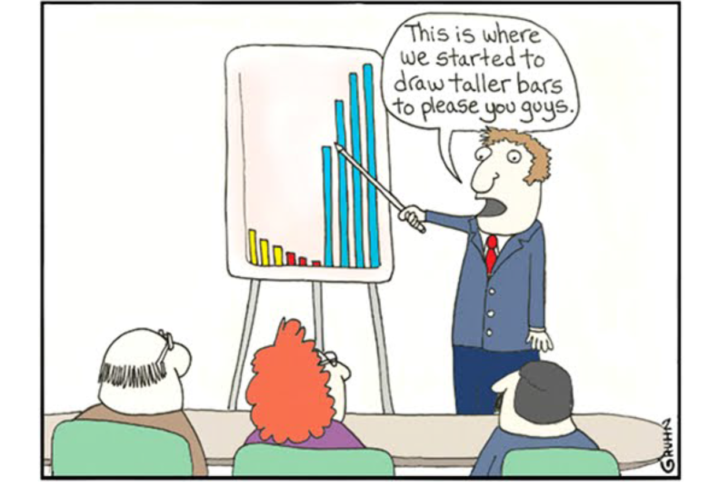
Drug development today organized globally
– Many sites
– Many therapeutic areas to work on
Biostatistics usually part of a larger organization frequently called biometrics
– Data management and statistical programming separate
Biostatistics works in a metric structure on development teams together with
– Pharmacology and medical Scientist
– Operations
– Regulatory
– Research
– Business and production
Planning
– Designing drug development plans
– Protocol writing
– Strategy discussions
Reporting
– HA interactions and registration
– Drug safety
– Biomarker
– Experimental studies

Slide 17
APPLICATIONS :-
1. Clinical trials
The medical industry is continuously innovating, and new treatments are being developed at top speed. Before a treatment is offered to the public, it first undergoes a series of tests and trials that validate its safety and efficiency. These studies involve data collection, analysis and interpretation. A biostatistician helps design the study, optimize the sample size, choose appropriate data collection methods, eliminate coincidences and remove misleading information from data. Biostatistics specialists draw accurate conclusions in comparison studies, which test if a new or alternative drug is better than the existing ones in the market.
2. Public health programs
Biostatistics experts use statistical techniques to assess the impact of public health programs and initiatives being undertaken by governments, nonprofits and hospitals. They develop robust studies and sampling techniques that help researchers understand how well an initiative is performing and whether that model can be replicated in other areas.
3. Epidemiological studies
There are various factors that influence the cause, outbreak and distribution of a disease. Epidemiological studies aim to identify these factors by collecting various data related to the disease, and deriving the link between the cause and effect. Based on the outcome, public health policies and preventive healthcare measures are developed. Understanding the correlation between the variables requires the skill of a biostatistics specialist, who can extract the most meaningful information from the data.
4. Estimating the severity of a disease and survival rates
Survival statistics help estimate how long a terminally ill patient will live and guides treatment accordingly.. Biostatistics experts are able to put forth numbers drawn from the careful examination of previous studies, providing both doctor and patient with reference data.

Slide 18
5. Meta-analysis and evidence-based medicine
Biostatistics also plays a huge role in systematic reviews and meta-analysis of medical data, which can in turn be useful in developing evidence-based healthcare. Meta-analysis is a structured study design which evaluates all the previous medical research published on a specific topic. Drawing conclusions from these studies require integration of individual results and outcomes into reliable findings that will guide further research.
For example, meta-analysis can be used to determine if an individual has a risk factor for a disease, what kind of environmental and genetic factors play a role in a disease, and what kind of treatment should be given to the patient.
Having a biostatistics expert study the literature and provide a rigorous, quantitative review of it helps healthcare providers improve their chances of delivering successful, data-driven treatment.
6. Genome sequencing data analysis
Genome sequencing generates large amounts of data that can help scientists understand complex traits. Sophisticated tools and software help sequence entire genomes quickly, providing insights into identifying variants that cause disease. Data from the variant genome is typically compared to the reference genome of the individual or a control group.
Biostatistics experts study variant frequencies in populations according to specific parameters such as blood type, ethnicity, etc. and draw conclusions as to how the genetic make-up of an individual or subpopulation can affect if they’re at-risk or prone to specific conditions.

