Slide 1
SUBJECT NAME- PHARMACEUTICAL MICROBIOLOGY
UNIT NO & NAME-3 ISOLATION OF AEROBIC BACTERIA
17-09-2024
1

Slide 2
TOPIC NAME – ISOLATION OF AEROBIC BACTERIA
CULTIVATION OF AEROBIC BACTERIA
Main Principle: Provide Oxygen
Atmospheric condition is generally satisfactory for culture of aerobes or facultative anaerobes but for the growth of many aerobes, it is necessary to provide extensive aeration.
Forced aeration of cultures is therefore frequently desirable and can be achieved either by vigorously shaking the flask or tube on a shaker or by bubbling sterilized air into the medium.
When aerobic organisms are to be grown in large quantities, it is advantageous to increase the exposure of the medium to the atmosphere.
This can be accomplished by dispensing the medium in shallow layers or by providing aeration by constantly shaking the inoculated liquid cultures.
17-09-2024
2

Slide 3
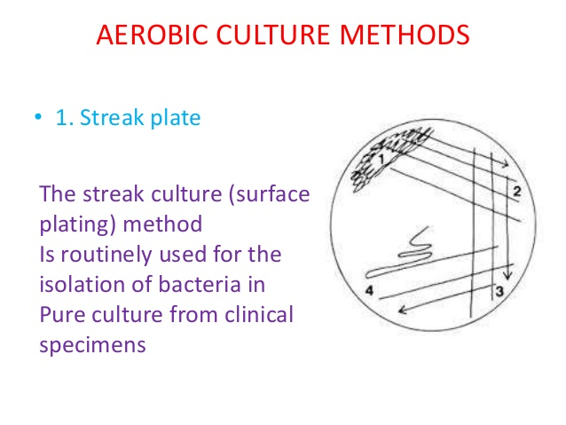

Slide 4
STREAK PLATE METHOD
In microbiology, streaking is a technique used to isolate a pure strain from a single species of microorganism, often bacteria. Samples can then be taken from the resulting colonies and a microbiological culture can be grown on a new plate so that the organism can be identified, studied, or tested.
The modern streak plate method has progressed from the efforts of Robert Koch and other microbiologists to obtain microbiological cultures of bacteria in order to study them.
The dilution or isolation by streaking method was first developed by Loeffler and Gaffky in Koch's laboratory, which involves the dilution of bacteria by systematically streaking them over the exterior of the agar in a Petri dish to obtain isolated colonies which will then grow into quantity of cells, or isolated colonies.
If the agar surface grows microorganisms which are all genetically same, the culture is then considered as a microbiological culture.

Slide 5
TECHNIQUE
Streaking is rapid and ideally a simple process of isolation dilution.
The technique is done by diluting a comparatively large concentration of bacteria to a smaller concentration.
The decrease of bacteria should show that colonies are sufficiently spread apart to affect the separation of the different types of microbes.
Streaking is done using a sterile tool, such as a cotton swab or commonly an inoculation loop. Aseptic techniques are used to maintain microbiological cultures and to prevent contamination of the growth medium.
There are many different types of methods used to streak a plate. Picking a technique is a matter of individual preference and can also depend on how large the number of microbes the sample contains
The three-phase streaking pattern, known as the T-Streak, is recommended for beginners. The streaking is done using a sterile tool, such as a cotton swab or commonly an inoculation loop.

Slide 6
The inoculation loop is first sterilized by passing it through a flame. When the loop is cool, it is dipped into an inoculum such as a broth or patient specimen containing many species of bacteria.
The inoculation loop is then dragged across the surface of the agar back and forth in a zigzag motion until approximately 30% of the plate has been covered.
The loop then is re-sterilized and the plate is turned 90 degrees. Starting in the previously streaked section, the loop is dragged through it two to three times continuing the zigzag pattern.
The procedure is then repeated once more being cautious to not touch the previously streaked sectors. Each time the loop gathers fewer and fewer bacteria until it gathers just single bacterial cells that can grow into a colony.
The plate should show the heaviest growth in the first section. The second section will have less growth and a few isolated colonies, while the final section will have the least amount of growth and many isolated colonies.

Slide 7
POUR PLATE METHOD
The pour-plate technique requires a serial dilution of the mixed culture by means of a loop or pipette.
Molten agar cooled to 45°C, is poured into a Petri dish containing a specified amount of the diluted sample.
Following the addition of the molten-then cooled agar, the cover is replaced, and the plates gently rotated in a circular motion to achieve uniform distribution of microorganisms.
This procedure is repeated for all dilutions to be plated.
Dilutions should be plated in duplicate for greater accuracy, incubated overnight, and counted on a Quebec colony counter either by hand or by an electronically modified version of this instrument.

Slide 8
If the material to be tested is an aqueous liquid, a known volume is simply placed in the base of the Petri dish and 10–25 ml of molten culture medium (typically tryptone soy agar or plate count agar at 45º C) is poured onto it and quickly mixed by gentle swirling, then the plate is placed on one side for the agar to set.
If the sample is a solid that is soluble in water that solid would normally be dissolved, but if it were insoluble then a suspension would be used. The problem in the last case would be to ensure that the suspension remained uniformly dispersed during pipetting and any dilution steps.
Because the sample is dispersed through the medium before the gel sets, the colonies that grow are similarly dispersed throughout the agar.
Consequently, the colonies are usually of different sizes because there is less oxygen available within the gel than at its surface and most organisms are either strict aerobes or facultative anaerobes which will grow best where the oxygen concentration is highest.

Slide 9
The procedure of Pour Plate Technique
Label around the edge of the bottom (not the lid) of a sterile but empty Petri dish with at least your name, the date, the type of growth medium, and the type of organism to be added to the melted agar medium.
Include the dilution factor if plating serial dilutions, or a series of repeated dilutions, which results in a systematic reduction in the concentration of cells in the sample. Preparing serial dilutions is necessary if the number of cells in the sample exceeds the capacity of the agar plate, in which the statistically significant range is 30 to 300 CFU. If there are more than 300 CFU on a plate, then the colonies will be crowded and overlapping.
Obtain a tube containing 18 ml of melted agar medium.
The agar medium should be dispensed into test tubes and pre-sterilized in an autoclave. On the same day, it is needed for an experiment, the agar should be melted in a steamer for 30 minutes then transferred to a 55 °C water bath. Only as much agar as is needed for the experiment should be melted as it cannot be re-used.
Ten minutes before pouring plates, the tubes of melted agar should be transferred from the 55 °C water bath to a heat block on the laboratory bench set at 48 °C. Once the agar reaches this temperature, it is ready to pour. If the agar is too hot, the bacteria in the sample may be killed. If the agar is too cool, the medium may be lumpy once solidified.

Slide 10
Obtain your sample, which should be either a broth culture or a suspension of cells produced by mixing cells from a colony into buffer or saline.
The samples may be derived from a dilution series of a single sample.
The sample volume to be plated should be between 0.1 and 1.0 ml.
Open the lid of the empty Petri dish, and dispense your sample into the middle of the plate. Close the lid.
Use aseptic technique throughout this procedure.
Use either a serological pipette or micropipette to transfer your sample to the plate. Control the flow of the sample so it does not splash out of the plate.
Remove the cap from the tube of the melted agar, and pass the rim of the open tube through the flame of the Bunsen burner.
Open the lid of the Petri dish containing your sample and pour the agar in carefully. Close the lid then mix the sample with the agar by gently swirling the plate.
Allow the agar to thoroughly solidify before inverting the plate for incubation.

Slide 11
Advantages of Pour Plate Technique
Easy to undertake.
Will detect lower concentrations than surface spread method because of the larger sample volume.
It requires no pre-drying of the agar surface.
The most common method for determining the total viable count is the pour-plate method.
The pour plate technique can be used to determine the number of microbes/ mL in a specimen.
It has the advantage of not requiring previously prepared plates and is often used to assay bacterial contamination of foodstuffs.

Slide 12
Disadvantages of Pour Plate Technique
The use of relatively hot agar carries the risk of killing some sensitive contaminants, so giving a low result.
Small colonies may be overlooked.
In the case of solid sample dissolving in water, some species may suffer a degree of viability loss if diluted quickly in cold water; consequently, isotonic buffer (phosphate-buffered saline for example) or peptone water are used as solvents or diluents.
Colonies of different species within the agar appear similar — so it is difficult to detect contaminants.
The reduced growth rate of obligate aerobes in the depth of the agar.
Preparation for the pour plate method is time consuming compared with streak plate/and or spread plate technique.

Slide 13
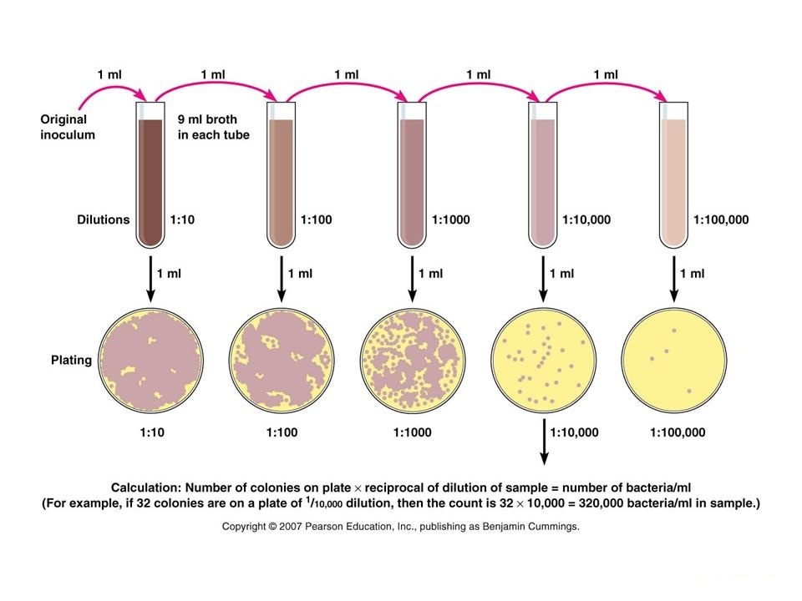

Slide 14
SPREAD PLATE METHOD
Spread plate technique is the method of isolation and enumeration of microorganisms in a mixed culture and distributing it evenly. The technique makes it easier to quantify bacteria in a solution.
Principle of Spread Plate Technique
The spread plate technique involves using a sterilized spreader with a smooth surface made of metal or glass to apply a small amount of bacteria suspended in a solution over a plate.
The plate needs to be dry and at room temperature so that the agar can absorb the bacteria more readily. A successful spread plate will have a countable number of isolated bacterial colonies evenly distributed on the plate.

Slide 15
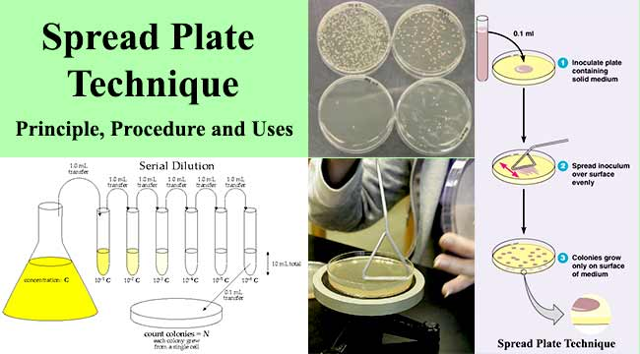

Slide 16
Procedure of Spread Plate Technique
Make a dilution series from a sample.
Pipette out 0.1 ml from the appropriate desired dilution series onto the center of the surface of an agar plate.
Dip the L-shaped glass spreader into alcohol.
Flame the glass spreader (hockey stick) over a Bunsen burner.
Spread the sample evenly over the surface of agar using the sterile glass spreader, carefully rotating the Petridish underneath at the same time.
Incubate the plate at 37°C for 24 hours.
Calculate the CFU value of the sample. Once you count the colonies, multiply by the appropriate dilution factor to determine the number of CFU/mL in the original sample.

Slide 17
Limitations of Spread Plate Technique
Strick aerobes are favoured while microaerophilic tends to glow slower.
Crowding of the colonies makes the enumeration difficult.
MICRO MANIPULATOR
A micromanipulator is a device which is used to physically interact with a sample under a microscope, where a level of precision of movement is necessary that cannot be achieved by the unaided human hand.
It may typically consist of an input joystick, a mechanism for reducing the range of movement and an output section with the means of holding a microtool to hold, inject, cut or otherwise manipulate the object as required. The mechanism for reducing the movement usually requires the movement to be free of backlash.
This is achieved by the use of kinematic constraints to allow each part of the mechanism to move only in one or more chosen degrees of freedom, which achieves a high precision and repeatability of movement, usually at the expense of some absolute accuracy.

Slide 18
