Slide 1
SUBJECT NAME- PHARMACEUTICAL MICROBIOLOGY
UNIT NO & NAME-1 ISOLATION OF ANAEROBIC BACTERIA
17-09-2024
1

Slide 2
TOPIC NAME – ISOLATION OF ANAEROBIC BACTERIA
Anaerobic bacteria grows in absence of air
Boiling:
In this technique, the culture media is taken in bottles fitted with a screw cap having a central aperture and a rubber washer
The bottles is then placed in a water bath after loosening the screw cap, and boiled for 10 minutes
Then the bottle is cooled after tightening the screw cap
The microorganism is inoculated using a hypodermic syringe, the needle being plunged through the rubber washer
17-09-2024
2

Slide 3
Use of alkaline pyrogallol:
After filling a desiccator with alkaline pyrogallol, culture media are placed in it for oxygen removal
The method can be modified by using a petri dish having double compartment lid; one compartment contains sodium hydrochloride solution and other contains pyrogallol solution
The microorganisms to be grown is streaked on an agar plate, which is the placed downwards over the lid, the two solutions are gently mixed and the assembly is incubated
A reducing agent cysteine is added to lower the oxygen content
Oxygen- free N2 is bubbled through the medium to keep it anaerobic
The medium is then dispensed inti tubes which are being flushed with oxygen – free N2 , stopped tightly and sterilized by autoclaving

Slide 4
Isolation of anaerobic bacteria using anaerobic chamber
Glove ports and rubber gloves that allows the operation to perform manipulations within the chamber
Air lock with inner and outer doors.
Media are placed within the chamber, which contains H2 +CO2+N2.
A circulator(e) the gas atmosphere through pellets of palladium catalyst (f) causing any residing O2 to react with H2 any media that is fully anaerobic they can be inoculated and placed in an incubator

Slide 5
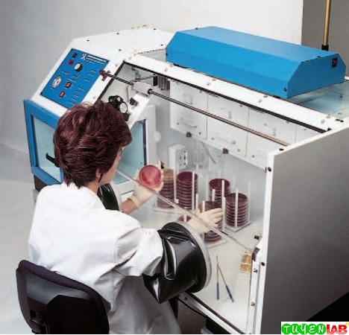

Slide 6
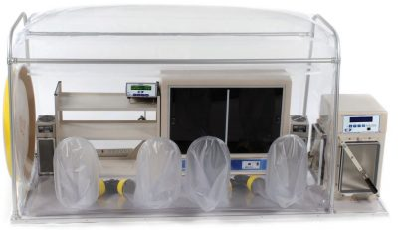

Slide 7
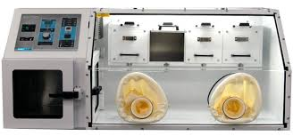

Slide 8
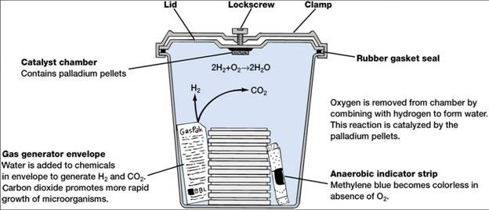

Slide 9
