Slide 1
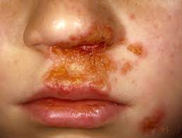
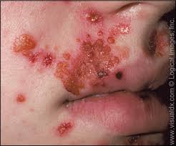
Impetigo
Dermatology
By Animesh Das

Slide 2
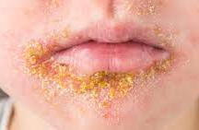
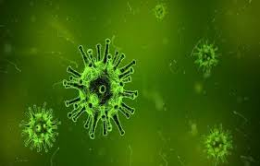
Definition
It is a highly contagious skin infections that cause by streptococcus and staphylococcus aureus , red sores on the face . And it is affected infants and children . To cause poor hygiene and warm temperature .
Causative organism – streptococcus and staphylococcus aureus

Slide 3
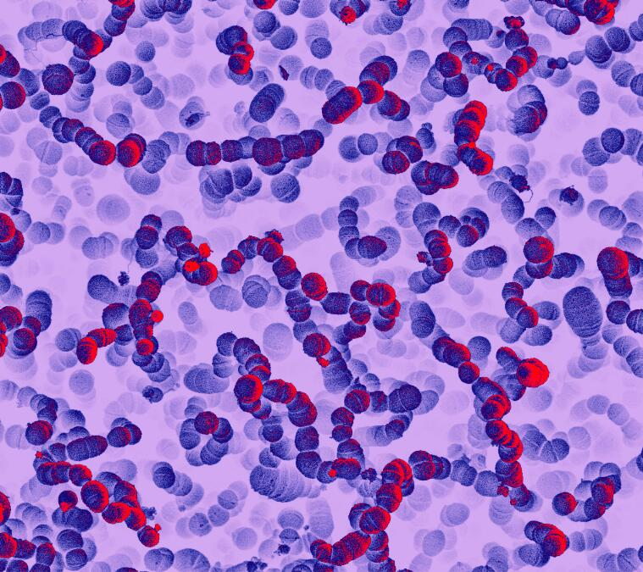
Type / Classifications
There are two types --
primary Impetigo
secondary Impetigo

Slide 4
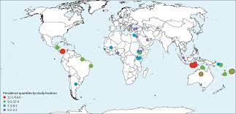
Epidemiology
impetigo affects more than 160 million children in low to middle income countries .
impetigo zone – India , China , UK ,USA etc.

Slide 5
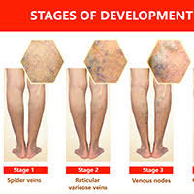
Stages
There are three types --
Non bullous impetigo
Bullous impetigo
Ecthyma

Slide 6
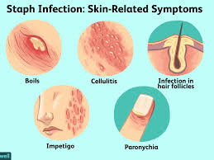
Sings and symptoms
Itchy rashes
Skin lesions
Swollen lymph nodes
open sores with a yellow crust
Painful blisters
accumulation of fluids in the lumps

Slide 7
Risk factor
malnutrition
Immunosuppression
over crowding
Diabetes
poor hygienic
infants and children

Slide 8
Triggering factor
varicella infections
herpes zoster infections
scratching
lice
burns
trauma
insect bites

Slide 9
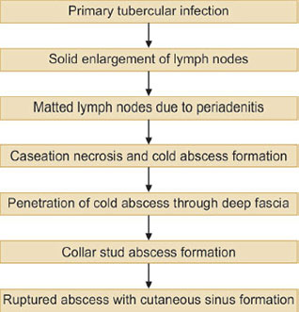
Pathophysiology

Slide 10
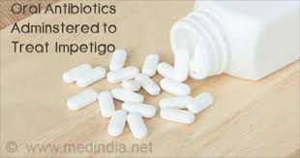
Management
Diagnosis
Treatment

Slide 11
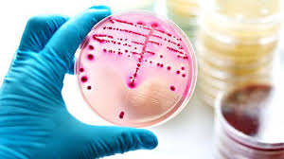
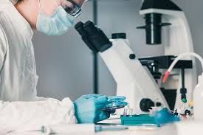
Diagnosis
medical history
clinical presentation
bacterial culture test
skin biopsy

Slide 12
Treatment
Category | Drug name
penicillin's | Dicloxacillin
antibiotics | Cephalexin
antibiotics | Cefadroxil
lincomycin antibiotics | Clindamycin
Antibacterials | Mupirocin ointment

Slide 13
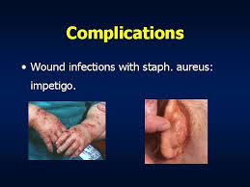
Complications
Cellulitis. Cellulitis occurs when the infection spreads to a deeper layer of skin.
Guttate psoriasis.
Scarlet fever.
Septicaemia.
Scarring.
Staphylococcal scalded skin syndrome.
Post-streptococcal glomerulonephritis

Slide 14
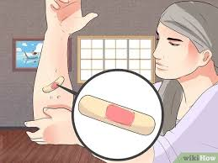
Preventions
maintain hygienic conditions
cover with bandages
counselling

Slide 15
Thank
you

