Slide 1
PHARMACOGNOSY AND PHYTOCHEMISTRY
Macro, powder and microscopic study of Isapgol
17-09-2024
1

Slide 2
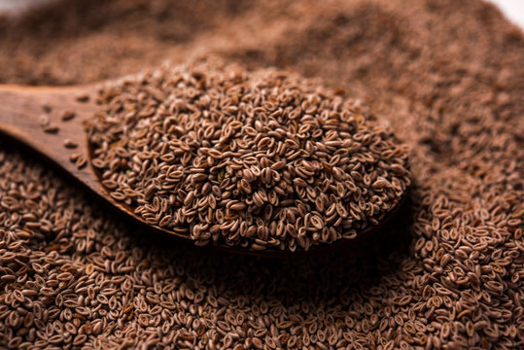
ISAPGOL
Synonyms and Regional name: Ispaghula, Isapgol, Spogel seeds; Ben. Eshopgol; Guj.- Isafghol; Hin.- Isabghol.
Biological source: It consists of dried seeds of Plantago ovata Forsk.
Geographical source: Plant is cultivated largely in Gujarat, Punjab, Southern Rajasthan, Maharastra and Karnataka. The variety P. psyllium Linn is cultivated in Spain, Cuba and France.
Family: Plantaginaceae
17-09-2024
2

Slide 3
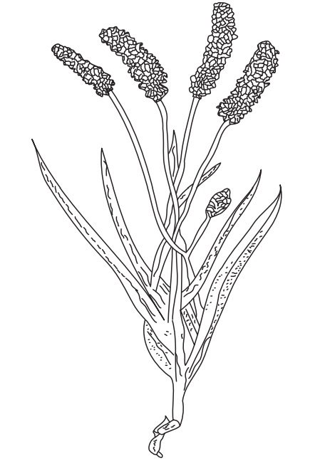
MACROSCOPICAL CHARACTERS:
(i) Size- 1 to 3.5 mm length and 1 to 1.75 mm wide
(ii) Shape – ovate and boat shaped with a dorsal or convex surface and a ventral or concave surface.
(iii) Dorsal Surface – dull, opaque, pinkish grey, there is a small elongated reddish brown spot in the center;
(iv) Ventral Surface – a deep furrow may be seen, Hilum which is covered by thin membrane appears as a red spot in the center
(v) Odour – none.
(vi) Taste – Mucilaginous.
(vii) Appearance :- Seeds are hard ,translucent and smooth, the dorsal surface (convex surface ) consists of small elongated glossy reddish spot at the centre while the ventral (concave surface ) has a cavity having nil uncovered with whitish membrane.
17-09-2024
Plantago ovata plant
3

Slide 4
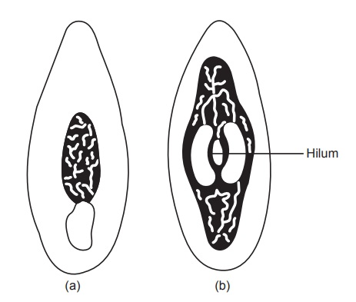
(a) Dorsal (b) Ventral
17-09-2024
4

Slide 5
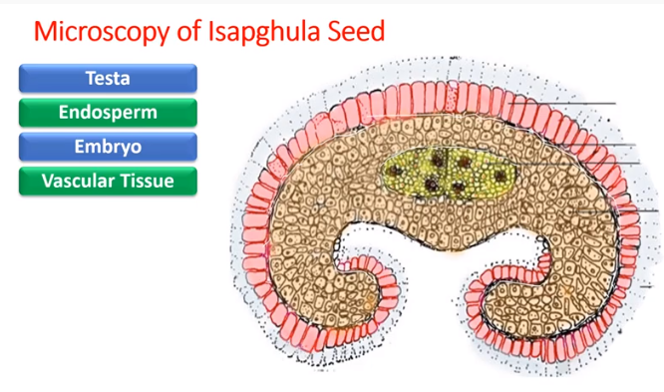
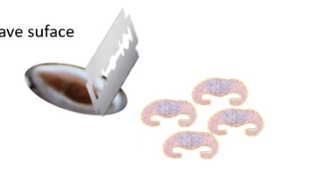
Epidermal or periperi outermost layer - mucilage
Volatile oil and aleurone – protein – which help giving the strength , support and nutrient in plants
Vascular bundles
17-09-2024
5

Slide 6
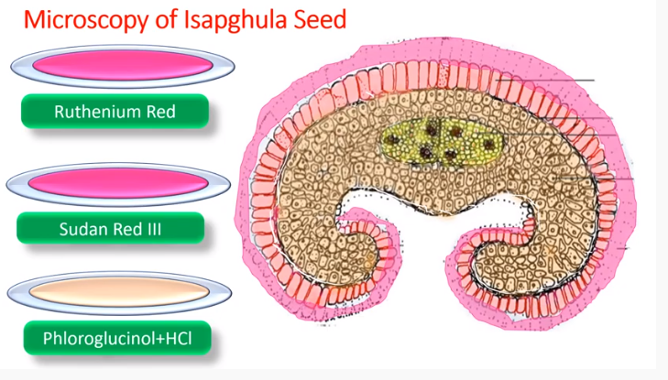
RR – pinkish / redish colour the testa layer [ mucilaginous layer ]
Red color of volatile oil cells
Color the vascular bundles
Addition to the picric acid to the aleurone layer - will enhance the red color
17-09-2024
6

Slide 7
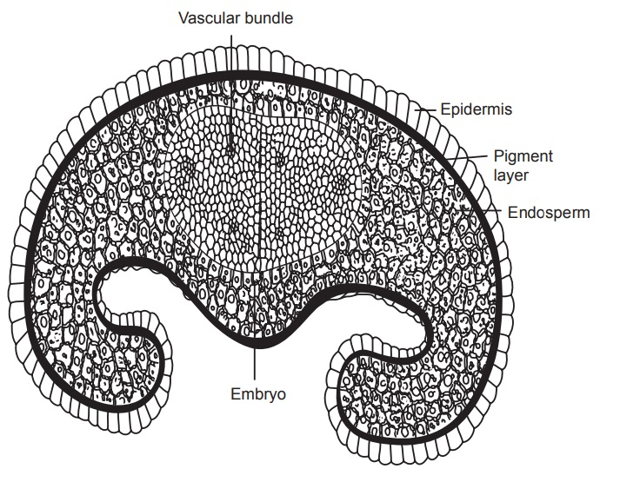
TRANSVERSE SECTION OF ISAPGOL SEED
17-09-2024
7

Slide 8
MICROSCOPY:
The transverse section of ispaghula seed shows a crablike appearance and possesses two surfaces: a convex and a concave.
The following tissues are seen in the transverse section microscopically:
Testa: Epidermis and pigment layer form the testa of the seed:
i. Epidermis: -It is single layered and composed of polygonal, tabular, thin-walled, colourless, shining cells containing mucilage abundantly. Epidermis and sometimes mucilage show presence of starch grains, simple or compound. Epidermis is not present on the ventral surface of the seed.
ii. Pigment layer: It is a single layer and yellowish brown in colour.
B. Endosperm:
It occupies the major portion of the seed. Cells are thick walled, polygonal and pitted containing aleurone grains and fixed oil. The cells of the outermost layer of the endosperm appear palisade like in shape.
C. Embryo:
It contains two polyhedral cotyledons in the centre of the endosperm but slightly towards the convex surface. Cells contain aleurone grains and oil globules. The cells of the cotyledons are polyhedral and thin walled in surface view. Three to five vascular bundles are observed in each cotyledon. Cells of radicle are thin walled and uniformly arranged in layers.
17-09-2024
8

Slide 9
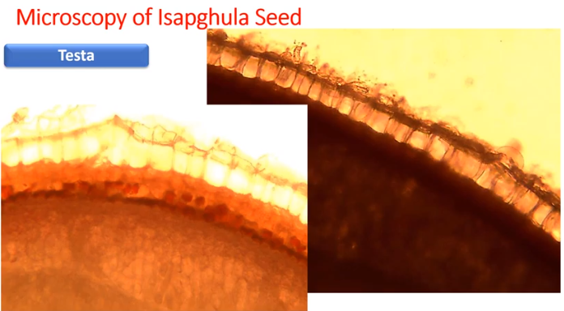
Yellow cell / pigment cells present below the epidermis
Mucilage contain polysaccharide and carbohydrate [ aqueous solution it is a gummy like structure
The cells are elongated and radial in nature .
17-09-2024
9

Slide 10
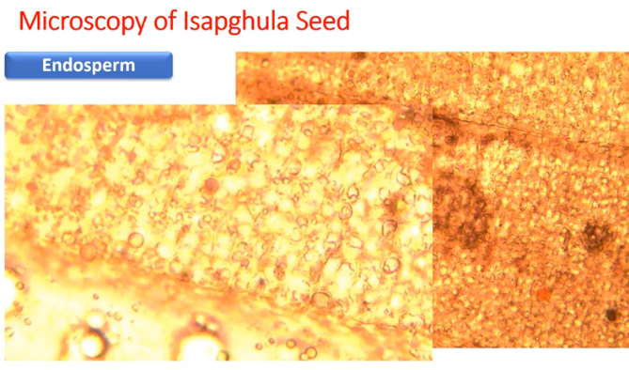
Occupying major par of the seed , cells are thick and contain the volatile oil and aleurone
17-09-2024
10

Slide 11
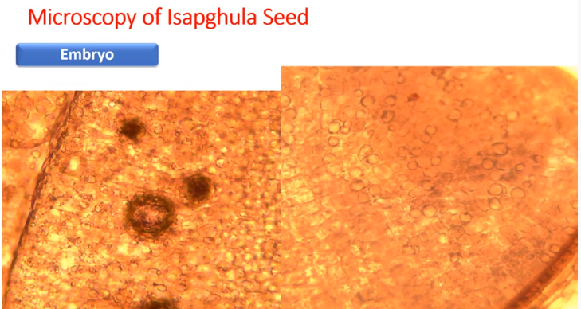
Vascular bundles , oil glands [ cotyledon present in the embryo which will give nutrition to the plant]
17-09-2024
11

Slide 12
POWDER CHARACTER:
The powder of ispaghula seeds is pale pinkish fawn in colour with a faint odour and very mucilaginous taste.
It shows the following diagnostic characters:
Epidermis of the testa:
Entire cells or fragments of cells are observed. It is composed of large cells with transparent thin walls containing mucilage abundantly. These cells swell rapidly in aqueous mount and observed as slightly rounded to polygonal in surface view.
When seen from above, cells appear elongated to rectangular. Swelling of cells with mucilage mainly takes place in a radial direction. Mucilage is stained with solution of ruthenium red. Occasionally small, simple or compound starch granules are seen in some of the epidermal cells and may be found as embedded in the mucilage.
b. Fragments of the endosperm:
The endospermic cells are thick walled with many large, very conspicuous pits, usually found attached to the pigment layer. The pigment layer is the inner layer of the testa composed of indistinct, thin-walled cells with yellowish-brown pigment.
Endosperm contains oil globules which show red colour with Sudan red III. Aleurone grains give yellow colour with alcoholic picric acid solution.
17-09-2024
12

Slide 13
c. Fragments of embryo:
These are composed of small, thin-walled cells. Cells of cotyledons are polygonal to slightly round. Fragments of radicle show thin-walled, regularly arranged, uniform cells.
d. Starch granules:
These are seen occasionally in epidermal cells and some as embedded in the mucilage of the cells. These granules are small and simple or compound with four or more components.
17-09-2024
13

Slide 14
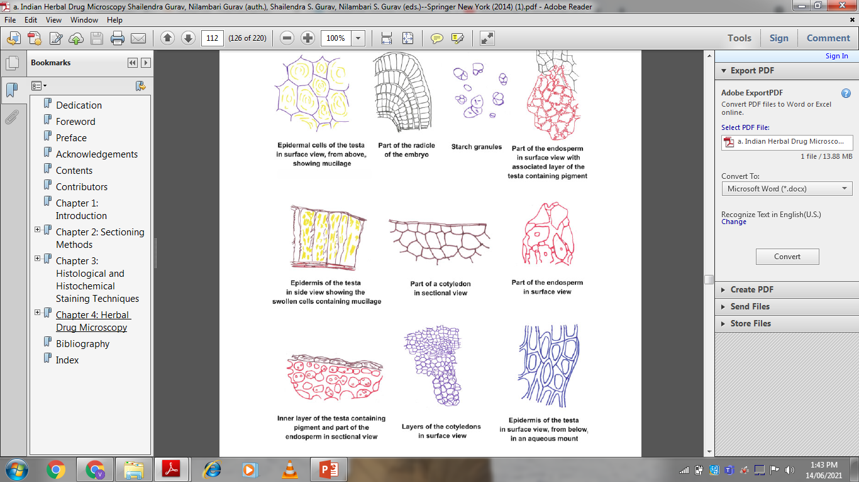
17-09-2024
14

Slide 15
CHEMICAL CONSTITUENTS:
(i) Ispaghula seeds and husk contains 10-30% of hydrocolloids as mucilage.
(ii) Chemically, it contains pentosan and aldobionic acid, Rhamnose, arabinose and galactouronic acids are hydrolyzed products of mucilage.
(iii) Fixed oils and proteinsare also present in the drug.
Ispaghula seeds contain about 10% mucilage which is present in the epidermis of testa.
Mucilage consists of two complex polysaccharides, of which one is soluble in cold water and the other soluble in hot water. Chemically it is pentosan and aldobionic acid.
Pentosan on hydrolysis yields xylose and arabinose and aldobionic acid yields galactouronic acid and rhamnose. Protein and fixed oil are present in endosperm and embryo.
17-09-2024
15

Slide 16
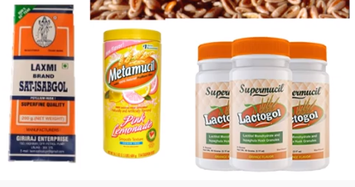
USES:
1. Demulcents (Soothing property).
2. It is use in treatment of chronic constipation.
3. It is used in chronic dysentery of amoebic and bacillary origin.
4. It is used in chronic diarrhea
5 .Disintegrating agent
6. Thickening agent.
17-09-2024
16

