Slide 1

JOURNAL CLUB
A STUDY TO EVALUATE THE PATTERN OF PRE ANAESTHETIC MEDICATION IN VARIOUS SURGICAL SPECIALTIES IN A TERTIARY CARE HOSPITAL
Pritam Biswas*1 , Niveditha 2 and M.C Shivamurthy 1
Department of Pharmacology, M.S. Ramaiah Medical College 1 , M.S.R.I.T Post, Bangalore-5600054, Karnataka, India
Department of Pharmacology, ESIC-MC & PGIMSR 2 , Bangalore-560010, Karnataka, India
International Journal of Pharmaceutical Sciences and Research Biswas et al., IJPSR, 2014; Vol. 5(6): 2441-2446.
04-09-2024
1

Slide 2
ABSTRACT
Objective: To analyze and compare pattern of pre anesthetic medication use in various surgical specialties.
Methodology: Data was collected retrospectively from inpatient records of major surgeries in the Department of Surgery, Orthopedics, Neurosurgery, Pediatric Surgery, Obstetrics and Gynecology, Plastic surgery, Urology and Vascular Surgery at M.S. Ramaiah Hospitals, during the period of January 2012 to June 2012. Descriptive analysis was used to analyze the data .SPSS version 19 was used for analysis of data.
Results: 752 pre anaesthetic records were analysed, the most frequently used pre anaesthetic medications, in the order of frequency among antianxiety drug is alprazolam (15.6%),followed by midazolam (7.6%),among opioid analgesics fentanyl (5.9%) followed by sufentanyl (0.1%),among antiemetic drugs ondansetron (57.3%),followed by ramosetron (22.8%) and metoclopramide (18.8%) , among gastro protective pantoprazole (74.6%),followed by ranitidine (11.9%), rabeprazole (8.3%),esomeprazole (2.9%) and glycopyrrolate was the only anticholinergic used .
Conclusion: Our study gives an insight into the current practice pattern of anesthetists for pre medication in various surgical specialties in a tertiary care hospital. . It also points out areas of potential drug interactions and the need for a practice protocol for the choice of pre anesthetic medications, its dosing and timing of administration.
04-09-2024
2

Slide 3
INTRODUCTION
The preoperative period is a stressful experience for majority of the patients undergoing surgery .
Historically the rationale for preoperative medication arose from the need to minimize the side effects of anesthetics.
However, in the current practice the major objective of pre anesthetic medication is to ensure comfort of the patient and make the experience of anesthesia and surgery less traumatic and minimize the associated side effects .
The pre anesthetic medication correlates with various outcomes like duration of post-operative recovery, post-operative analgesia requirement and hospital stay .
Yet literature on the current pattern of use of premedication is not well documented and limited to few British and American Surveys .
Studying the pattern of use gives an insight into the current practice of anesthetists and help in recognizing areas of improvement .
04-09-2024
3

Slide 4
OBJECTIVE OF STUDY
To analyze and compare pattern of pre anesthetic medication use in various surgical specialties.
04-09-2024
4

Slide 5
METHODOLOGY
Study design – Retrospective study
Study population - 752
Study period - January 2012 to June 2012
INCLUSION CRITERIA - Those who have undergone major surgeries in the Department of Surgery .
EXCLUSION CRITERIA - Those who not have undergone major surgeries in the Department of Surgery .
04-09-2024
5

Slide 6
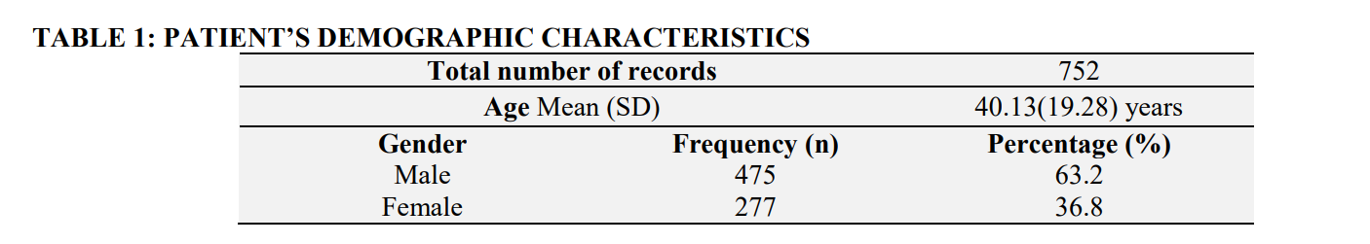
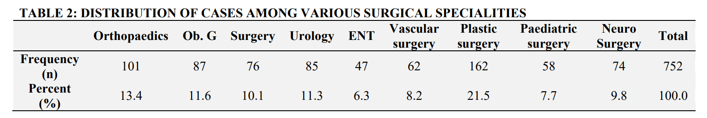
Result

Slide 7
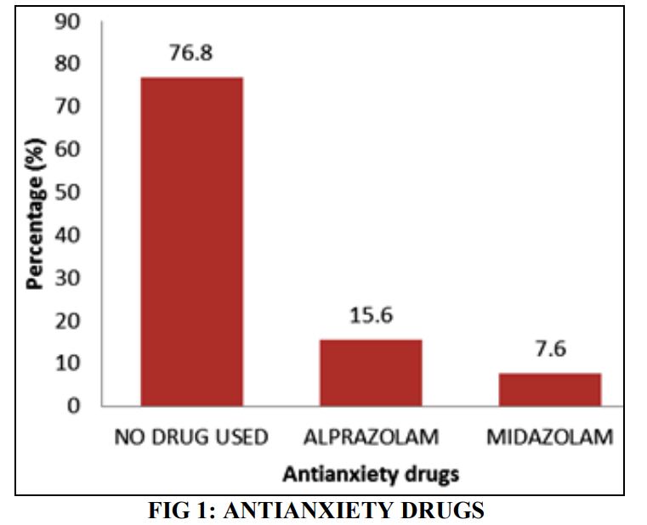
Anxiolytic Medication: Alprazolam (15.6%) was the most commonly used by anesthetists followed by midazolam (7.6%) and 76.8% did not receive any medication.

Slide 8
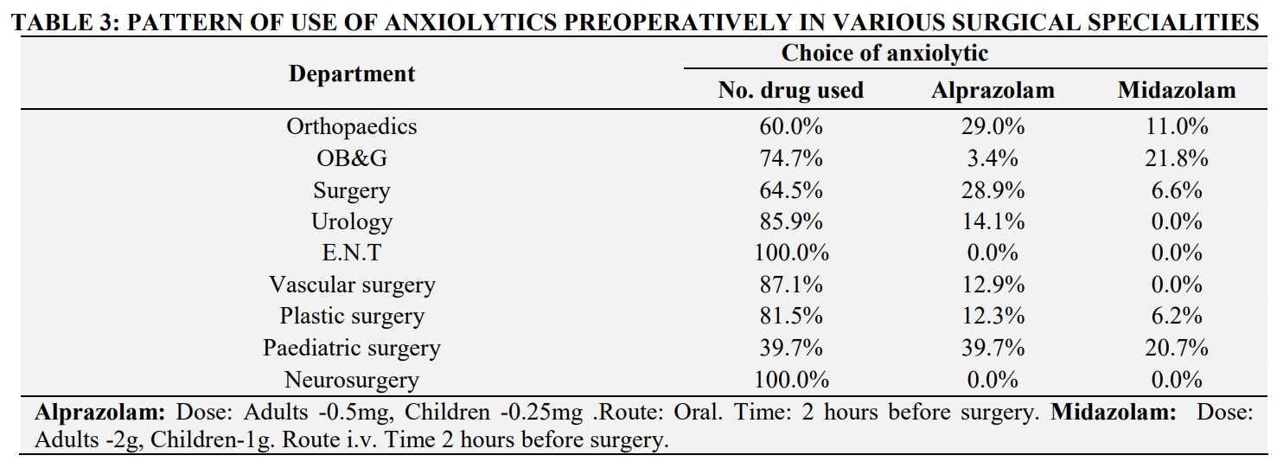

Slide 9
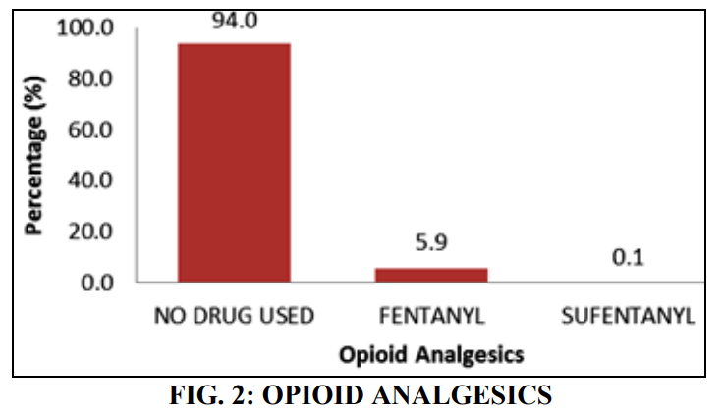
Opioid analgesics: Among the preoperative opioid analgesics prescribed, Fentanyl was the most commonly prescribed followed by sufentanyl [Fig. 2]. 5.9% of the 752 surveyed were prescribed fentanyl, 0.1 % was given sufentanyl.

Slide 10
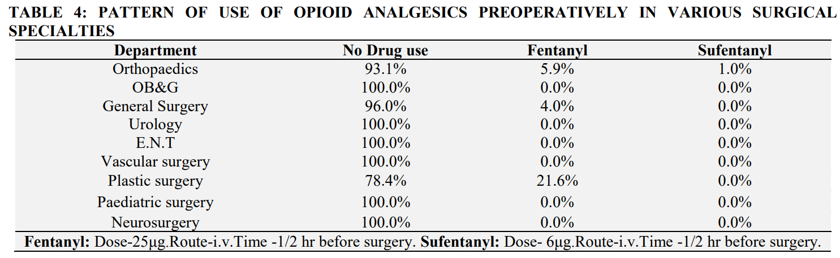

Slide 11
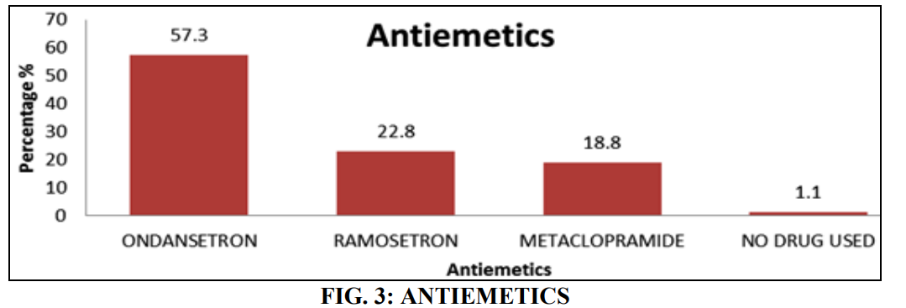
Antiemetics: The most commonly used antiemetic was ondansetron (57.3%) followed by ramosetron (22.8%) and metoclopramide (18.8%)

Slide 12
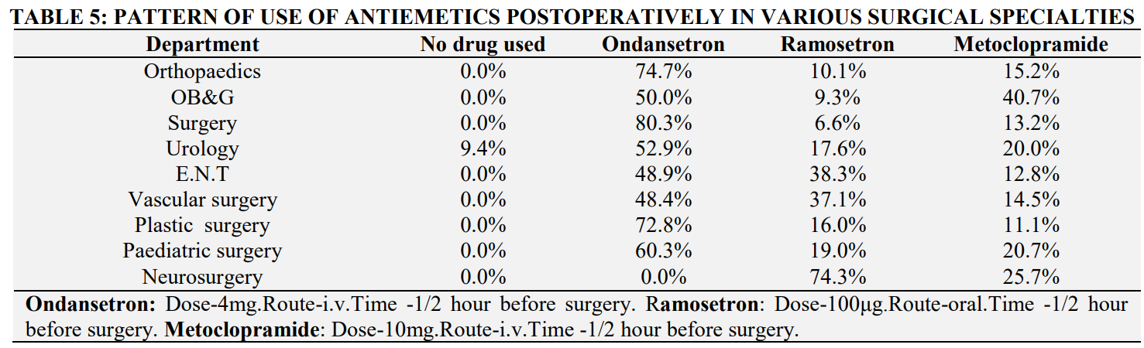

Slide 13
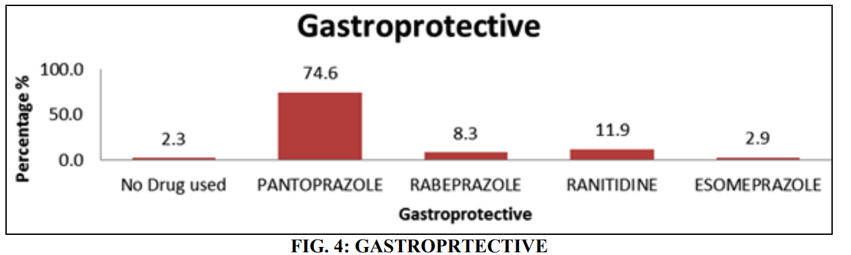
Gastro protective: It is routine practice to prescribe an antacid prior to induction to decrease the volume of gastric acid and the pH and also to prevent aspiration, the most commonly prescribed was Pantoprazole (74.6%) followed by ranitidine (11.9%), rabeprazole (8.3%) and esomeprazole (2.9%).

Slide 14
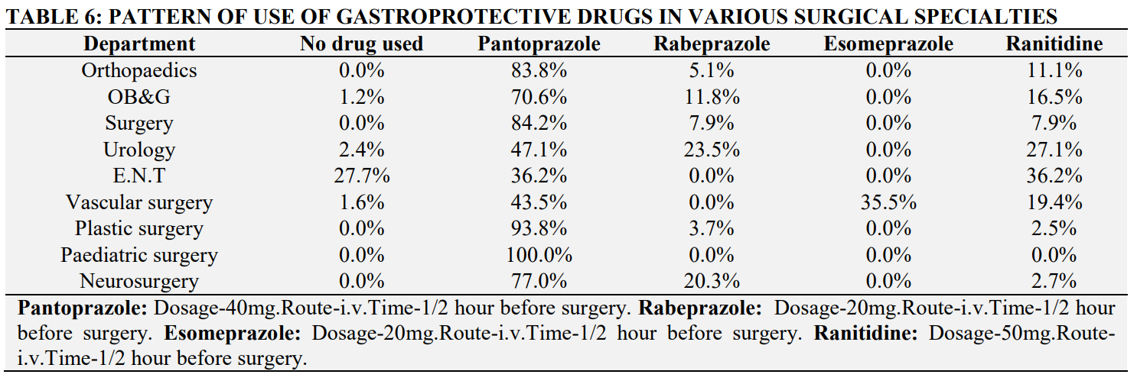

Slide 15
Table 3 - Among the eight surgical departments surveyed, the anxiolytics were most extensively used by Pediatric surgery, orthopedics, general surgery and OB & G .
Table 4 - In our survey, only 3 departments used opioids prior to induction, among them the highest use was noted in plastic surgery followed by orthopedics and general surgery
Table 5 - Antiemetics were given preoperatively to all surgical patients, except in 1.1 % who underwent DJ stenting under spinal anesthesia. The pattern of use of each drug in various surgical departments is represented in .
Table 6 - It is routine practice to prescribe an antacid prior to induction to decrease the volume of gastric acid and the pH and also to prevent aspiration, the most commonly prescribed was Pantoprazole (74.6%) followed by ranitidine (11.9%), rabeprazole (8.3%) and esomeprazole (2.9%). The pattern of uses of these individual drugs is depicted in .

Slide 16
DISCUSSION
Preanesthetic medication in various surgical specialties we found that there is a great variability in utilization of these drugs among the different departments . Premedication for anxiolysis is important in children and the elderly and has importance in emergence agitation in these groups of patients . The most commonly used followed by IV midazolam and was extensively used in Pediatric surgery, General surgery, Orthopedics and Obstetrics and gynecology . Alprazolam as well as Midazolam have a additive effect with intravenous anesthetics (propofol, fentanyl) and could prolong the sedative effects after surgery . IM Glycopyrrolate was the only anticholinergic used in all patients who underwent general anesthesia when compared to Zeev N and R K Mirakur et al where Atropine was the most commonly used . Among the antiemetic drugs, ondansetron was most commonly used followed by ramosetron and metoclopramide . Pantoprazole was the most commonly used followed by ranitidine, rabeprazole and esomeprazole. Studies of potential drug interactions of pre anesthetic medications with the intravenous agents used for anesthesia and the effect of such interactions on postoperative outcomes .
04-09-2024
16

Slide 17
CONCLUSION
Our study gives an insight into the current practice pattern of anesthetists for pre medication in various surgical specialties in a tertiary care hospital. It also points out areas of potential drug interactions and the need for a practice protocol for the choice of pre anesthetic medications, its dosing and timing of administration.
04-09-2024
17

Slide 18
REFERENCE
Abdalla C, Hannalla R: Premedication of the child undergoing surgery. M.E.J. ANESTH. 2011; 21(202):165– 76.
R K Mirakhur: Preanaesthetic medication : a survey. J. R. Soc. Med. 1991; 84(August):481–3.
Kain ZN, Mayes LC, Bell C, Hofstadter MB, Rimar S, Weisman S: Premedication in the United States: A Status Report. Anesth Analg 1997; 84:427-32). 1997; 84:427–32.
Kain ZN, Caldwell-Andrews AA., Krivutza DM, Weinberg ME, Wang S-M, Gaal D: Trends in the Practice of Parental Presence During Induction of Anesthesia and the Use of Preoperative Sedative Premedication in the United States, 1995-2002: Results of a Follow-Up National Survey. Anesth. Analg. 2004 May; 98:1252–9.
Short TG, Chui PT: Propofol and midazolam act synergistically in combination. Br. J. Anaesth. 1991 Nov; 67(5):539–45.
Twyman RE, Rogers CJ, and Macdonald RL: Differential regulation of gamma-aminobutyric acid receptor channels by diazepam and phenobarbital. Ann. Neurol. 1989 Mar; 25(3):213–20.
Kongsrud F, Sponheim S: A comparison of atropine and glycopyrrolate in anaesthetic practice. Acta Anaesthesiol. Scand. 1982 Dec; 26(6):620–5.
04-09-2024
18

Slide 19
Heller J, Taylor P: Muscarinic Receptor Agonists and Antagonists. Goodman Gilman’s "The Pharmacological
Basis of Therapeutics". 12th ed. New York: The McGrawHill Companies, Inc; 2012;
196–7.
Fujii Y: Prophylaxis of postoperative nausea and vomiting in patients scheduled for breast surgery. Clin. Drug Investig. 2006 Jan; 26(8):427–37.
Mihara T, Tojo K, Uchimoto K, Morita S, Goto T: Reevaluation of the effectiveness of ramosetron for preventing postoperative nausea and vomiting: a systematic review and meta-analysis. Anesth. Analg. 2013 Aug; 117(2):329–39.
Clark K, Lam LT, Gibson S, Currow D: The effect of ranitidine versus proton pump inhibitors on gastric secretions: a meta-analysis of randomized control trials. Anaesthesia. 2009 Jun; 64(6):652–7.

Slide 20
THANK YOU

