Slide 1

JOURNAL CLUB
Influence of comorbidities on treatment considerations for first- line biologic prescribing in patients with inflammatory bowel disease in the UK
Ayesha Akbar,1 Tim Orchard,2 Nick Powell,3 Christian Selinger,4 Clare tibbatts5
1St Mark’s Hospital and Academic Institute, Harrow, UK 2Department of Metabolism, Digestion and Reproduction, Imperial College Healthcare NHS Trust, London, UK 3Department of Metabolism, Digestion and Reproduction, Imperial College London, London, UK 4Department of Gastroenterology, St James’s University Hospital, Leeds, UK 5Gastroenterlogy, Cardiff and Vale University Health Board, Cardiff, UK
Akbar A, Orchard T, Powell N, et al. Frontline Gastroenterology 2022;13:490–496.
05-09-2024
1

Slide 2
ABSTRACT
Background: Anti- tumour necrosis factor (anti TNF) therapies are the most commonly used biologics for inflammatory bowel disease (IBD), but for patients with a comorbidity, newer agents may be a more appropriate treatment choice. Aims To investigate the impact of comorbidities in patients with IBD, on first- line biologic prescribing habits of IBD- specialist healthcare practitioners in the UK.
Methods: IBD- specialist physicians and nurses were asked to answer an online survey, considering different prescribing scenarios in ulcerative colitis (UC) and Crohn’s disease (CD). Respondents could indicate a preference for anti- TNFs or newer biologics, both in the absence and presence of 10 common comorbidities.
Results: A total of 120 IBD- specialist healthcare professionals (HCPs) completed the survey. In the absence of comorbidities, anti- TNFs were favoured; infliximab was the preferred first- line biologic in both UC and CD (43% and 37% of respondents, respectively). On introducing comorbidities, the largest shift in prescribing behaviour was for vedolizumab, with preference increasing by 27% and 21%, compared with infliximab, which fell by 14% and 9% in UC and CD, respectively. Chronic/recurring infection (46%), congestive heart failure (≤44%) and malignancies (≤43%) were the most commonly selected comorbidities for vedolizumab treatment.
Conclusions: Clinicians adapt their biologic prescribing habits in patients with IBD with comorbidities, considering known contraindications and precautions. A preference for vedolizumab is evident in many cases, anti- TNFs are prescribed despite known risks. It is important that continual re- evaluation of the IBD treatment landscape is undertaken by HCPs, in alignment with recommendations in published guidelines.
05-09-2024
2

Slide 3
INTRODUCTION
The treatment landscape for inflammatory bowel disease (IBD) in the UK is ever evolving as options become available with differing mechanisms of action.1 Used for over a decade, anti- tumour necrosis factor (anti- TNF) therapies are licensed for the treat ment of patients with IBD refractory to conventional therapy. Three newer biologic classes, anti- integrins (ie, vedolizumab), anti- IL- 12/23s (ie, ustekinumab) and Janus kinase (JAK) inhibitors (ie, tofacitnib), have entered the therapeutic landscape. These agents offer alternative efficacy and safety profiles to those of anti- TNFs.
Comorbidities tend to be under- represented in clinical trials and patients with severe comorbidities are usually excluded.18–20 Prescribing advice is typi cally based on expert opinion or real- world obser vational studies. The limited literature addressing comorbidities in IBD focuses on anti- TNFs. Given this lack of evidence and guidance, it is helpful to understand how clinicians take comorbidities into account. In this study, we employed a survey to understand the impact of common comorbidities on first- line biologic prescribing preferences in IBD in the UK.
While anti- TNFs are widely used, providing good efficacy in ulcerative colitis (UC) and Crohn’s disease (CD) with an established safety profile
05-09-2024
3

Slide 4
OBJECTIVE OF STUDY
To investigate the impact of comorbidities in patients with IBD, on first- line biologic prescribing habits of IBD- specialist healthcare practitioners in the UK.
05-09-2024
4

Slide 5
METHODOLOGY
Study design - online survey
Study population – 120 patient
Study period - 2015 and 2017
INCLUSION CRITERIA - Of 2000 members of a market research panel matching the inclusion criteria,
the first 100 physicians and 20 nurses to respond to the survey were included
in the study.
EXCLUSION CRITERIA – who do not have IBD .

Slide 6
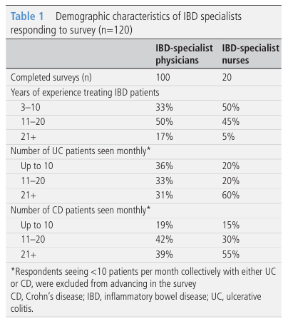
RESULTS
The survey was completed in November 2018 with 120 healthcare practitioners. The majority of nurses saw at least 21 patients per month (55%–60%); physi cians mainly fell into the ‘11–20’ and ‘21 or more’ patients per month categories
05-09-2024
6

Slide 7
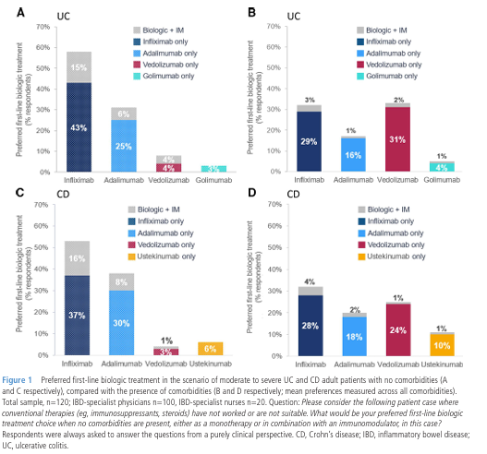

Slide 8
When the 10 comorbidities were introduced into the survey, there was a shift in pattern of practitioners’ prescribing habits for first- line biologics, affecting both UC and CD. A change in preference for vedol izumab was evident, increasing choice by 21%–27% for use across CD and UC in the presence of comor bidities, whereas the preference for infliximab reduced by 9%–14% across CD and UC

Slide 9
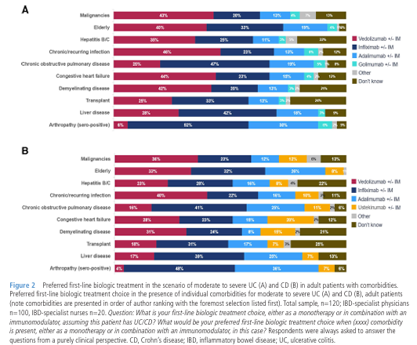

Slide 10
In UC, vedolizumab was the foremost preferred first- line biologic treatment choice for 6 of the 10 comorbidities investigated . Infliximab was favoured for the remaining four comorbidities in UC; most pronounced for arthropathy (up to 52%) . In CD, the prescribers' preference for infliximab compared with vedolizumab as a first- line biologic with each as first preference for five comor bidities . In UC and CD, vedolizumab was the first- line biologic treatment choice for the comorbidities including chronic/recurring infection, elderly, malig nancy and demyelinating disease.

Slide 11
DISCUSSION
In the absence of comorbidities, treatment with inflix imab was the preferred first- line biologic, in line with real- world data demonstrating the dominance of anti- TNFs in current prescribing, with an increase in vedol izumab use between 2015 and 2017. Adalimumab was the second- choice biologic, whereas the recent European Crohn's and Colitis Organisation (ECCO) guidelines recommend ‘vedolizumab rather than adali mumab for the induction and maintenance of remission in patients with moderately- to- severely active ulcer ative colitis’ and, therefore, prescribing may change in favour of vedolizumab in future. When surveyed about prescribing choices in patients presenting with a comorbidity, we observed that clinicians adapt their prescribing. It is notable that ustekinumab preference overall is relatively low likely reflecting its relative recent licensing at the time of the survey, limited availability of data and practitioner’s comfort with pre- existing prescribing habits for patients with CD. However, data from the Psoriasis Longitudinal Assessment and Registry has identified no increased risk of malignancy, major adverse cardiovascular events, serious infec tion or mortality with ustekinumab, suggesting that this option may also have a favourable safety profile in patients with IBD, although the dose of usteki numab used for psoriasis is typically lower than for IBD. Furthermore, since the survey was conducted, findings from the SEAVUE study have added to the overall body of knowledge for ustekinumab in IBD.
05-09-2024
11

Slide 12
CONCLUSION
Clinicians adapt their biologic prescribing habits in patients with IBD with comorbidities, considering known contraindications and precautions. A preference for vedolizumab is evident in many cases, anti- TNFs are prescribed despite known risks. It is important that continual re- evaluation of the IBD treatment landscape is undertaken by HCPs, in alignment with recommendations in published guidelines.
05-09-2024
12

Slide 13
REFERENCE
Lamb CA, Kennedy NA, Raine T, et al. British Society of gastroenterology consensus guidelines on the management of inflammatory bowel disease in adults. Gut 2019;68:s1–106.
SmPC Infliximab. Available: https://www.medicines.org.uk/ emc/product/3831/smpc [Accessed June 2019]
SmPC Infliximab. Available: https://www.medicines.org.uk/ emc/product/2150/smpc [Accessed June 2019].
SmPC Infliximab. Available: https://www.medicines.org.uk/ emc/product/5707/smpc [Accessed June 2019].
Cohn HM, Dave M, Loftus EV. Understanding the cautions and contraindications of immunomodulator and biologic therapies for use in inflammatory bowel disease. Inflamm Bowel Dis 2017;23:1301–15.
Lopetuso L, Gerardi V, Papa V, et al. Can we predict the efficacy of anti- TNF-α agents? Int J Mol Sci 2017;18:1973 2017.
Dignass A, Van Assche G, Lindsay JO, et al. The second European evidence- based consensus on the diagnosis and management of Crohn's disease: current management. J Crohns Colitis 2010;4:28–62.
Lemaitre M, Kirchgesner J, Rudnichi A, et al. Association between use of thiopurines or tumor necrosis factor antagonists alone or in combination and risk of lymphoma in patients with inflammatory bowel disease. JAMA 2017;318:1679–86.
05-09-2024
13

Slide 14
THANK YOU

