Slide 1

JOURNAL CLUB
Anemia and iron deficiency in pregnancy and adverse
perinatal outcomes in Southern India
Julia L. Finkelstein, Anura V. Kurpad, Beena Bose, Tinku Thomas, Krishnamachari Srinivasan, Christopher Duggan
Division of Nutritional Sciences, Cornell University, Ithaca, NY, USA St. John’s Research Institute, Bangalore, India
St. John’s Medical College, Bangalore, India
Department of Nutrition, Harvard T.H. Chan School of Public Health and Center for Nutrition, Boston Children’s Hospital, Boston, MA, USA
Published in final edited form as: Eur J Clin Nutr. 2020 January ; 74(1): 112–125. doi:10.1038/s41430-019-0464-3.
04-09-2024
1

Slide 2
ABSTRACT
Background/Objectives: We investigated the prevalence of anemia, iron deficiency, and inflammation during pregnancy in India, as well as the relationships between these conditions and unfavorable pregnancy and neonatal outcomes.
Subjects/Methods: A total of 366 women who were enrolled in a randomized study involving vitamin B12 supplementation had their pregnancy-related hemoglobin (Hb), serum ferritin (SF), hepcidin, C-reactive protein (CRP), and alpha-1-acid glycoprotein (AGP) measured. Every woman received daily prenatal iron–folic acid supplementation; vitamin B12 supplementation (50 μg per day) or placebo was given to all women. Maternal iron biomarkers were compared to pregnancy and baby outcomes using binomial and linear regression models.
Results: At their initial prenatal visit, 30% of women were anemic (Hb < 11.0 g/dl), 48% were iron deficient (SF < 15.0 μg/l), and 23% had iron deficiency anemia. Anaemia of inflammation (Hb < 11.0 g/dl, SF > 15.0 μg/l, plus CRP > 5.0 mg/l or AGP > 1.0 g/l: 2%) and prevalence of inflammation (CRP > 5.0 mg/l: 17%; AGP > 1.0 g/l: 11%) were both low. Low birth weight (<2500 g) was twice as likely to occur in infants born to anaemic women (risk ratio [RR]: 2.15, 95%underweight (RR: 2.67 (1.43–5.00); p = 0.002), preterm delivery (CI: 1.20–3.84, p = 0.01)
04-09-2024
2

Slide 3
INTRODUCTION
Over 1.6 billion people worldwide suffer from anemia, making it a serious public health issue.
Reduced cognitive performance, physical labor capacity , poor neurodevelopment in offspring, and an increased risk of maternal and newborn mortality have all been linked to anemia.
India has one of the highest rates of anemia worldwide, with severe consequences for mortality, disability, and lost production .
In India, anemia is thought to afflict 56% of women who are of reproductive age, 59% of pregnant women, 63% of nursing women, and 70% of small children.
The most common cause of anemia worldwide is iron deficiency, and the recommended course of therapy for both treating and preventing anemia is iron supplementation.
An iron deficiency is thought to be the cause of approximately 50% of anemia (50%, 95%CI: 47–53%).
Recent research, however, suggests that the percentage of anemia caused by iron deficiency may be significantly lower, especially in environments with high anemia frequency and high exposure to inflammation.
The aetiology of anemia is influenced by both non-nutritional factors like inflammation and nutritional factors like vitamin B12 and folate. These factors also have an impact on human health.
Clarifying the cause of anemia in the early stages of pregnancy and how it affects perinatal outcomes may aid in the development of screening programs and focused anemia prevention initiatives.
Thus, among expectant mothers and their babies taking part in a randomised trial of vitamin B12 supplementation in Bangalore, India, we performed a prospective observational analysis.
The aims of this study were to: (1) evaluate the prevalence of anaemia, iron deficiency, iron deficiency anaemia (IDA), and inflammation in pregnant women; and (2) explore the relationships between maternal biomarkers of iron status with the risks of bad pregnancy and infant outcomes.
04-09-2024
3

Slide 4
OBJECTIVE OF STUDY
We studied the prevalence of
Inflammation
Iron deficiency
Anemia
during pregnancy in India and how these conditions were related to poor pregnancy and neonatal outcomes.
04-09-2024
4

Slide 5
METHODOLOGY
  STUDY DESIGN
  It was a prospective design
  Study Population
  In Bangalore, India, pregnant women were recruited to take part in a randomised, double-blind, placebo-controlled trial of vitamin B12 supplementation. The purpose of this experiment was to investigate how daily vitamin B12 supplementation affected pregnancy-related indicators of the mother's vitamin B12 status. The trial's design and primary outcomes have already been reported (#NCT00641862). In summary, 366 pregnant women were selected from Hosahalli Referral Hospital in Bangalore, India, and randomly assigned to receive either a placebo or daily vitamin B12 supplementation from the time of pregnancy until six weeks after giving birth. Results showed that vitamin B12 supplementation during pregnancy raised the concentrations of the vitamin in the mother, breast milk, and baby. Starting during their initial prenatal appointment, every woman was given daily iron and folic acid (500 μg) supplements, adhering to the guidelines of care.

Slide 6
Study period
6 weeks postpartum
Inclusion criteria
Women who were at least eighteen years old, ≤14 weeks gestation at enrollment, in good health, and carrying a single fetus were eligible to take part in this study.
Exclusion criteria
Women with known medical conditions, such as syphilis, hepatitis B, or HIV infection, were not allowed to participate. Exclusion criteria also included women who had a history of cesarean delivery, were taking daily vitamin supplements in addition to iron and folic acid, or had a major prior medical condition that required frequent drug use.

Slide 7
Follow up procedure
Measurements were taken by study personnel who were trained, and the weight of the infant was recorded on an electronic weighing scale to the nearest 0.01 kg. Using standardized protocols and calibrated instruments, research assistants with training measured the length of the infant in supine position, the circumference of the mid-upper arm, the circumference of the head and chest, and the skinfolds of the triceps and biceps.

Slide 8
Blood sample collection
Mother blood samples were taken during enrollment (≤14 weeks) study visits, as well as in the second and third trimesters, scheduled to correspond with the early, mid, and late stages of gestation (median [IQR]: 10.6 (9.1, 12.6), mid, (24.1 (23.7, 25.0), and late, (33.1 (32.7, 33.6) weeks) stages. By venipuncture, infant blood samples were taken at six weeks of age. Previous descriptions of the trial's laboratory protocols and biochemical analyses can be found [10]. In short, around 10 milliliters of blood were extracted via venipuncture from pregnant women and their 6-week-old babies. The blood was collected in BD Biosciences EDTA and plain vacutainers, which were kept on ice until they were separated in a refrigerated centrifuge, which happened within 4 hours of the blood being extracted. On whole-blood samples, hemoglobin and the total blood count were examinedsamples in a Horiba Medicals automated Coulter counter (ABX Pentra C+). Red blood cells (RBCs) and plasma were kept apart and at −80 °C or lower until analysis.

Slide 9
Biomarkers
Electrochemiluminescence (Elecsys 2010, Roche Diagnostics Mannheim, USA) was used to assess serum ferritin. Using a Roche Hitachi 902 analyzer (Roche Diagnostics, Germany), the particle-enhanced immune-turbidometric assay was used to assess serum C-reactive protein and alpha-1-acid glycoprotein (AGP). The competitive enzyme immunoassay method (Peninsula Laboratories, LLC, Bachem Group) was used to test hepcidin.
Low hemoglobin concentrations were characterized as anemia according to trimester-specific cutoffs (i.e., hemoglobin < 11.0 g/dl in the first trimester, hemoglobin < 10.5 g/dl in the second trimester, and hemoglobin < 11.0 g/dl in the third trimester). The thresholds for iron deficiency and iron insufficiency were respectively SF < 15.0 μg/l and SF < 30.0 μg/l. Using established cutoffs (CRP > 5.0 mg/l and AGP > 1.0 g/l), inflammation was defined as increased levels of either CRP or AGP. The definition of anemia of inflammation was established as anemia with high inflammatory biomarkers (i.e., Hb < 11.0 g/dl, SF > 15.0 μg/l, plus CRP > 5.0 mg/l, or AGP > 1.0 g/l) and normal serum ferritin concentrations.
The World Health Organization's categories were used to classify maternal body mass index (BMI), which was defined as the ratio of weight in kilograms to height in meters squared (m2) [16]. Less than 37 full weeks of gestation was considered preterm birth. A baby born under 2.5 kg was considered low birth weight. Using the INTERGROWTH reference, small for gestational age (SGA) was defined as birth weight <10th percentile of the gestational age [17]. The infant ponderal index (g/cm3) was calculated by dividing the weight in grams by the length in centimeters cubed. World Health Organization (WHO) guidelines were used to compute the weight-for-length (WLZ), weight-for-age (WAZ), and length-for-age (LAZ) z-scores [18–20]. Using LAZ, WLZ, and WAZ, respectively, standardised, sex-specific z-scores < −2 were used to define stunting, wasting, and underweight.

Slide 10
Data analysis
When available, traditional cutoffs were used to define the variables; if not, the population's medians for the variables were used. Taking into account the Thurnham and Biomarkers Reflecting Inflammation and Nutritional Determinants of Anaemia (BRINDA) techniques, serum ferritin values were corrected for inflammation. Before undergoing additional analysis, non-normally distributed variables were natural logarithmically transformed to assure normality; untransformed values are shown in Table 1 for interpretive purposes.
Maternal iron status biomarkers at enrollment (i.e., ≤14 weeks) were analyzed using linear and binomial regression models for continuous and categorical pregnancy and infant outcomes, such as birth weight (continuous), low birth weight (categorical), gestational age at birth (continuous), preterm delivery (categorical), SGA (categorical), and infant WHO z-scores (continuous). In several models, relationships between maternal iron status biomarkers and perinatal outcomes were investigated separately. To account for the study design and sample collection time, adjustments were included in all models for the intervention regimen and gestational age at sample collection.

Slide 11
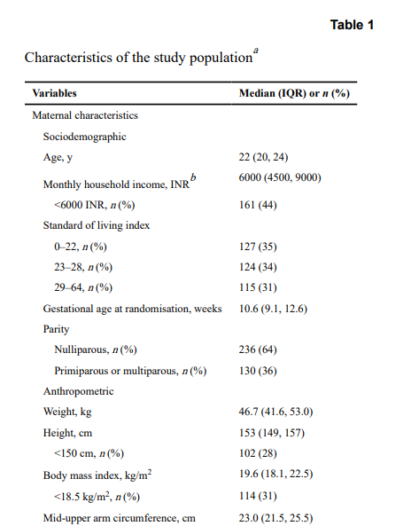
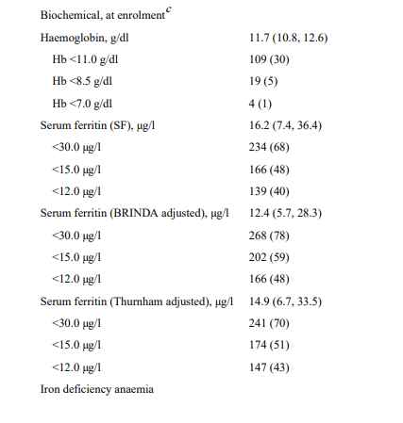
RESULTS

Slide 12
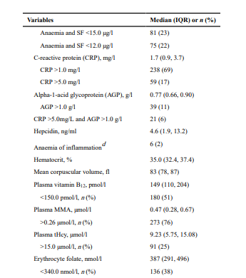
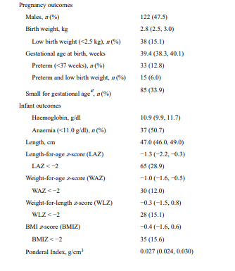

Slide 13
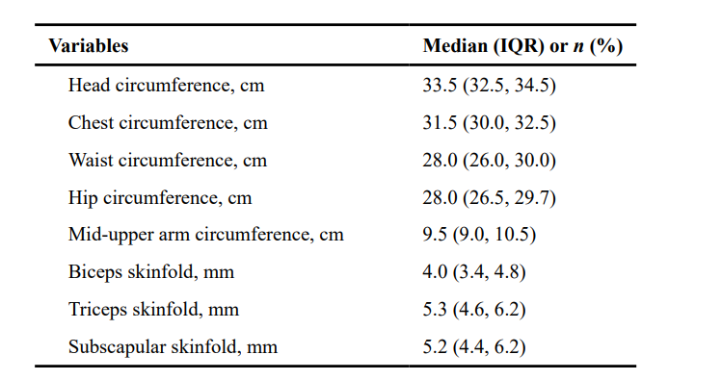

Slide 14
RESULTS
Table 1 displays the characteristics of the study participants, and Figure 1 shows a flow chart of the participants. 30% of mothers were anaemic (Hb < 11.0 g/dl), 48% were iron deficient (SF < 15.0 μg/l), 68% had insufficient iron status (SF < 30.0 μg/l), and 23% had IDA at enrollment (≤14 weeks gestation). Compared to AI (Hb < 11.0 g/dl, SF > 15.0 μg/l, plus CRP > 5.0 mg/l or AGP > 1.0 g/l: 2%) and inflammation (CRP > 5.0 mg/l: 17%; AGP > 1.0 g/l: 11%), the prevalence of AI was relatively low. The results were same when serum ferritin was adjusted for inflammation (Supplementary Table I, e.g., BRINDA, Thurnham); 59% of pregnant women had inadequate iron status (SF < 30.0 μg/l) and 59% of iron deficient individuals (SF < 15.0 μg/l).
The linear regression analyses revealed a significant association between higher maternal haemoglobin concentrations and maternal serum ferritin concentrations (β(SE): 0.78 (0.07) μg/l; p < 0.0001), hepcidin concentrations (β(SE): 0.37 (0.05) ng/ml; p < 0.0001), and iron deficiency (β(SE): −1.29 (0.15); p < 0.0001) at baseline. The results were comparable when serum ferritin concentrations were corrected for inflammation (ID: β(SE): −1.19 (0.16), p < 0.0001) and SF: (β(SE): 0.79 (0.08) μg/L, p < 0.0001. Higher baseline maternal serum ferritin (RR: 0.48, 95%CI: 0.40–0.57, p < 0.0001) and hepcidin (RR: 0.73, 95%CI: 0.67–0.79, p < 0.0001) concentrations were linked to a lower risk of maternal anemia, while maternal iron deficiency was linked to a 3.6-fold increased risk of anemia (RR: 3.62, 95%CI: 2.09–6.36, p < 0.0001).
Tables 2 and 3 show the relationships, respectively, between maternal anemia, hemoglobin concentrations, and the risk of unfavorable pregnancy and newborn outcomes. When compared to women who were not anaemic, those who were anaemic at enrollment had infants with lower birth weights (β(SE): −166.8 (61.1) g; p = 0.006) and 2.15 times higher risk of low birth weights (<2500 g; RR: 2.15, 95%CI: 1.20–3.84, p = 0.01) in multivariate analyses that adjusted for maternal BMI, socioeconomic status, inflammation, gestational age at sample collection, vitamin B12 intervention, and BMI.
04-09-2024
14

Slide 15
Babies born to anaemic mothers had 2.67 times higher risk of premature birth (<37 weeks; RR: 2.67, 95%CI: 1.43–5.00, p = 0.002) and significantly lower gestational age at birth (β(SE): −0.95 (0.28); p = 0.0007). Compared to mothers who were not anemic, infants born to anemic women had a significantly higher chance of being underweight (WAZ < −2; RR: 2.20, 95%CI: 1.16–4.15, p = 0.02), had lower mid-upper arm circumference (β(SE): −0.94 (0.45), p = 0.03), and had lower WAZ scores at birth (β(SE): −0.41 (0.14), p = 0.004). Maternal hemoglobin concentrations (Table 3) at the first prenatal visit were also linked to a lower risk of preterm delivery (<37 weeks; RR: 0.76, 95%CI: 0.66–86) and a significantly higher gestational age at delivery (β(SE): 0.28 (0.08) weeks; p = 0.001). In multivariate analysis, there was a correlation between greater maternal haemoglobin concentrations and bigger newborn mid-upper arm circumference (β(SE): 0.36 (0.13); p = 0.006).
The next tables show the relationships between iron deficiency (Table 5) and maternal serum ferritin concentrations (Table 4A–C) at enrollment and unfavorable pregnancy and newborn outcomes. Increased infant length at birth (β(SE): 0.44 (0.20) cm, p = 0.03) was linked to maternal serum ferritin concentrations in multivariate analyses, which also took into account maternal BMI, socioeconomic status, inflammation, and gestational age at sample collection. After correcting for inflammation using the BRINDA (β(SE): 0.47 (0.20) cm, p = 0.02) and Thurnham (β(SE): 0.45 (0.20) cm, p = 0.02) approaches, the results were similar (Tables 4B, C). Whether or not maternal iron insufficiency was adjusted for inflammation, it did not significantly increase the chance of an unfavorable pregnancy or baby outcome.

Slide 16
Table 6 lists the correlations between maternal IDA and pregnancy and baby outcomes. In multivariate analyses, infants of women with IDA at enrollment had significantly lower birth weights (β(SE): −159.7 (67.7) g, p = 0.02) and a higher risk of low birth weights (RR: 1.99 (1.08–3.68); p = 0.03). Additionally, their gestational age at delivery was considerably lower (β(SE): −1.16 (0.31) weeks, p = 0.0002), and their risk of preterm delivery was 3.46 times greater (RR: 3.46 (1.81–6.61), p = 0.0002). When compared to infants born to women without IDA, newborns born to iron-deficient anemic mothers likewise exhibited significantly reduced WAZ (β(SE): −0.39 (0.16), p = 0.01).
Pregnancy was associated with a modest prevalence of anemia of inflammation (2%) and elevated inflammatory biomarkers (CRP > 5.0 mg/l: 17%; AGP > 1 g/l: 11%) (Supplemental tables I–IV). CRP and AGP, two maternal inflammatory indicators during pregnancy, were not linked to the mother's hemoglobin status, risk of a difficult pregnancy, or the health of the unborn child. Increased baby length (β(SE): 0.31 (0.13), p = 0.02), lower arm circumference (β(SE): 0.40 (0.15), p = 0.007), WAZ (β(SE): 0.09 (0.05), p = 0.04), and LAZ (β(SE): 0.13 (0.06), p = 0.04) were all linked to maternal hepcidin concentrations during pregnancy.

Slide 17
DISCUSSION
In this prospective analysis among pregnant women and their infants, anemia and iron deficiency were common early in gestation and were associated with increased risk of adverse pregnancy and infant outcomes. Maternal hemoglobin concentrations were associated with higher birth weight and gestational age at delivery, lower risk of preterm birth, and higher infant weight-for-age z-scores. The prevalence of anaemia and iron deficiency at the first prenatal visit in this study was high: 30% of pregnant women were anaemic (Hb < 11.0 g/dl), 48% were iron deficient (SF < 15.0 μg/l), and 23% of women had IDA (Hb < 11.0 g/dl and SF < 15.0 μg/l); and 51% of infants were anaemic at 6 weeks of age. The burden of anaemia in rural areas is estimated to be higher than in urban settings, ranging from 77% in Maharashtra state to over 90% in Northeast India . Previous studies have also noted a high prevalence of iron deficiency and IDA in pregnancy. The prevalence of elevated inflammatory biomarkers (CRP > 5 mg/l: 17%; AGP > 1 g/l: 11%) and anaemia of inflammation (2%) were low in pregnancy and were not significantly associated with risk of adverse pregnancy or infant outcomes. he aetiology of anaemia is multifactorial and complex, and includes nutritional and nonnutritional factors [43]. Findings from this study are consistent with previous evidence of the importance of iron deficiency as the leading cause of anaemia [1], as maternal serum ferritin concentrations and iron deficiency were significantly associated with maternal haemoglobin levels (p < 0.0001). The risk of iron deficiency is increased in pregnancy due to greater physiological demand for iron to support development of the placenta and fetus, increased maternal RBC mass volume, and requirements for maternal and infant metabolism .
04-09-2024
17

Slide 18
SUMMARY
In this large cohort of pregnant women participating in a randomized trial of vitamin B12 supplementation in Southern India, maternal anemia and iron deficiency were common in pregnancy and predicted increased risk of adverse pregnancy and neonatal outcomes. Maternal anemia at enrolment predicted a two to four times greater risk of low birth weight and preterm delivery. Findings suggest that, although prenatal iron–folic acid supplementation improves hematological status during pregnancy, maternal anemia and IDA early in pregnancy have an important role in determining the risk of adverse outcomes early in life. Further research is needed to understand the complex a etiology of anemia in women of reproductive age, to inform screening and interventions to prevent anemia and improve the health of mothers and their children.
04-09-2024
18

Slide 19
CONCLUSION
There were several other limitations to this study. Although the sample was the same cohort as the parent randomized trial, these observational analyses do not inform causal interpretation of findings. Although maternal biomarkers were available for all women early in pregnancy (n = 366), data for pregnancy outcomes (n = 258), and infant blood measurements (n = 73) were available on a smaller subset of the total sample (n = 366). Although this population did not differ in terms of measured sociodemographic and nutritional variables, it is possible that they differ on other unmeasured variables. This analysis included a comprehensive assessment of iron status, including hemoglobin, serum ferritin, C-reactive protein, and AGP. However, the lack of assessment of soluble transferrin receptor and total body iron remains a study limitation.
04-09-2024
19

Slide 20
REFERENCE
1. WHO The global prevalence of anaemia in 2011. Geneva: WHO; 2015.
2. Janbek J, Sarki M, Specht IO, Heitmann BL A systematic literature review of the relation between iron status/anemia in pregnancy and offspring neurodevelopment. Eur J Clin Nutr. 2019.
3. McClung JP, Murray-Kolb LE. Iron nutrition and premenopausal women: effects of poor iron status on physical and neuropsychological performance. Annu Rev Nutr. 2013;33:271–88. [PubMed: 23642204]
4. Murray-Kolb LE, Beard JL. Iron treatment normalizes cognitive functioning in young women. Am J Clin Nutr. 2007;85:778–87. [PubMed: 17344500]
5. Haas JD, Brownlie Tt. Iron deficiency and reduced work capacity: a critical review of the research to determine a causal relationship. J Nutr. 2001;131:676S–88S. [PubMed: 11160598]
6. Kalaivani K. & Prevalence consequences of anaemia in pregnancy. Indian J Med Res. 2009;130:627–33. [PubMed: 20090119]
7. Petry N, Olofin I, Hurrell RF, Boy E, Wirth JP, Moursi M, et al. The proportion of anemia associated with iron deficiency in low, medium, and high human development index countries: a systematic analysis of national surveys. Nutrients 2016;8.
8. Finkelstein JL, Layden AJ, Stover PJ. Vitamin B-12 and perinatal health. Adv Nutr. 2015;6:552–63. [PubMed: 26374177]
9. Finkelstein JL, Kurpad AV, Thomas T, Srinivasan K, Duggan C. Vitamin B12 status in pregnant women and their infants in South India. Eur J Clin Nutr. 2017;71:1046–53. [PubMed: 28402324]
04-09-2024
20

Slide 21
10. Duggan C, Srinivasan K, Thomas T, Samuel T, Rajendran R, Muthayya S, et al. Vitamin B-12 supplementation during pregnancy and early lactation increases maternal, breast milk, and infant measures of vitamin B-12 status. J Nutr. 2014;144:758–64. [PubMed: 24598885]
11. World Health Organization Training course on child growth assessment. Geneva: World Health Organization; 2008.
12. Gibson RS. Principles of nutritional assessment. 2nd ed. New York, NY: Oxford University Press, Inc; 2005.
13. Assessing the iron status of populations: report of a joint World Health Organization/Centers for Disease Control and Prevention technical consultation on the assessment of iron status at the population level, 2nd ed. Geneva: World Health Organization; 2007.
14. Technical meeting: use and interpretation of haemoglobin concentrations for assessing anaemia status in individuals and populations. Geneva: World Health Organization; 2017.
15. Nemeth E, Ganz T. Anemia of inflammation. Hematol/Oncol Clin North Am. 2014;28:671–81. [PubMed: 25064707]
16. WHO. Physical status: the use and interpretation of anthropometry. Report of a WHO Expert Committee. Geneva: World Health Organization; 1995.

Slide 22
17. Villar J, Cheikh Ismail L, Victora CG, Ohuma EO, Bertino E, Altman DG, et al. International standards for newborn weight, length, and head circumference by gestational age and sex: the newborn cross-sectional study of the INTERGROWTH-21st project. Lancet 2014;384:857–68. [PubMed: 25209487]
18. de Onis M, Blossner M. The World Health Organization Global Database on Child Growth and Malnutrition: methodology and applications. Int J Epidemiol. 2003;32:518–26. [PubMed: 12913022]
19. WHO Multicentre Growth Reference Study Group WHO Child Growth Standards: growth velocity based on weight, length and head circumference: methods and development. Geneva: World Health Organization; 2009.
20. WHO Multicentre Growth Reference Study Group WHO Child Growth Standards: methods and development: length/height-for-age, weight-for-age, weight-for-length, weight-for-height and body mass index-for-age. Geneva: World Health Organization; 2006
21. Thurnham DI, McCabe LD, Haldar S, Wieringa FT, Northrop-Clewes CA, McCabe GP. Adjusting plasma ferritin concentrations to remove the effects of subclinical inflammation in the assessment of iron deficiency: a meta-analysis. Am J Clin Nutr. 2010;92:546–55. [PubMed: 20610634]

Slide 23
22. Thurnham DI, Northrop-Clewes CA, Knowles J. The use of adjustment factors to address the impact of inflammation on vitamin A and iron status in humans. J Nutr. 2015;145:1137S–43S.
23. Namaste SM, Rohner F, Huang J, Bhushan NL, Flores-Ayala R, Kupka R, et al. Adjusting ferritin concentrations for inflammation: biomarkers reflecting inflammation and nutritional determinants of anemia (BRINDA) project. Am J Clin Nutr. 2017;106:359S–71S. [PubMed: 28615259]
24. Suchdev PS, Williams AM, Mei Z, Flores-Ayala R, Pasricha SR, Rogers LM, et al. Assessment of iron status in settings of inflammation: challenges and potential approaches. Am J Clin Nutr. 2017;106:1626S–33S.
25. Modeling Greenland S. and variable selection in epidemiologic analysis. Am J public health. 1989;79:340–9. [PubMed: 2916724]
26. Miettinen O. Theoretical Epidemiology. New York: John Wiley & Sons; 1985. 107
27. NFHS. National Family Health Survey-4: 2015–16. Government of India, 2016.
28. Ahankari AS, Myles PR, Dixit JV, Tata LJ, Fogarty AW. Risk factors for maternal anaemia and low birth weight in pregnant women living in rural India: a prospective cohort study. Public health. 2017;151:63–73. [PubMed: 28743049]
29. Toteja GS, Singh P, Dhillon BS, Saxena BN, Ahmed FU, Singh RP, et al. Prevalence of anemia among pregnant women and adolescent girls in 16 districts of India. Food Nutr Bull. 2006;27:311–5. [PubMed: 17209473]
30. Bora R, Sable C, Wolfson J, Boro K, Rao R. Prevalence of anemia in pregnant women and its effect on neonatal outcomes in Northeast India. J Matern-fetal Neonatal Med. 2014;27:887–91. [PubMed: 24041147]

Slide 24
31. Mohanty D, Gorakshakar AC, Colah RB, Patel RZ, Master DC, Mahanta J, et al. Interaction of iron deficiency anemia and hemoglobinopathies among college students and pregnant women: a multi center evaluation in India. Hemoglobin. 2014;38:252–7. [PubMed: 25023086]
32. Hambidge KM, Westcott JE, Garces A, Figueroa L, Goudar SS, Dhaded SM, et al. A multicountry randomized controlled trial of comprehensive maternal nutrition supplementation initiated before conception: the women first trial. Am J Clin Nutr. 2019;109:457–69. [PubMed: 30721941]
33. Baingana RK, Enyaru JK, Tjalsma H, Swinkels DW, Davidsson L. The aetiology of anaemia during pregnancy: a study to evaluate the contribution of iron deficiency and common infections in pregnant Ugandan women. Public health Nutr. 2015;18:1423–35. [PubMed: 25222882]
34. van den Broek NR, Letsky EA. Etiology of anemia in pregnancy in south Malawi. Am J Clin Nutr. 2000;72:247S–56S. [PubMed: 10871590]
35. Suchdev PS, Namaste SM, Aaron GJ, Raiten DJ, Brown KH, Flores-Ayala R. Overview of the biomarkers reflecting inflammation and nutritional determinants of anemia (BRINDA) project. Adv Nutr. 2016;7:349–56. [PubMed: 26980818]
36. Bah A, Pasricha SR, Jallow MW, Sise EA, Wegmuller R, Armitage AE, et al. Serum hepcidin concentrations decline during pregnancy and may identify iron deficiency: analysis of a longitudinal pregnancy cohort in the Gambia. J Nutr. 2017;147:1131–7. [PubMed: 28424258]

Slide 25
37. Shaw JG, Friedman JF. Iron deficiency anemia: focus on infectious diseases in lesser developed countries. Anemia. 2011;2011:260380:1–10.
38. Nair M, Choudhury MK, Choudhury SS, Kakoty SD, Sarma UC, Webster P, et al. Association between maternal anaemia and pregnancy outcomes: a cohort study in Assam, India. BMJ Glob health. 2016;1:e000026.
39. Rahman MM, Abe SK, Rahman MS, Kanda M, Narita S, Bilano V, et al. Maternal anemia and risk of adverse birth and health outcomes in low- and middle-income countries: systematic review and meta-analysis. Am J Clin Nutr. 2016;103:495–504. [PubMed: 26739036]
40. Sukrat B, Wilasrusmee C, Siribumrungwong B, McEvoy M, Okascharoen C, Attia J, et al. Hemoglobin concentration and pregnancy outcomes: a systematic review and meta-analysis. Biomed Res int. 2013;2013:769057:1–9.
41. Alwan NA, Cade JE, McArdle HJ, Greenwood DC, Hayes HE, Simpson NA. Maternal iron status in early pregnancy and birth outcomes: insights from the baby’s vascular health and iron in pregnancy study. Br J Nutr. 2015;113:1985–92. [PubMed: 25946517]
42. Breymann C. Iron deficiency anemia in pregnancy. Semin Hematol. 2015;52:339–47. [PubMed: 26404445]
43. Camaschella C. New insights into iron deficiency and iron deficiency anemia. Blood Rev. 2017;31:225–33. [PubMed: 28216263]
44. Fisher AL, Nemeth E. Iron homeostasis during pregnancy. Am J Clin Nutr. 2017;106:1567S–74S.

Slide 26
THANK YOU

