Slide 1

JOURNAL CLUB
Drug related adverse pregnancy outcomes at a tertiary care hospital from the foothills of Himalayas: A Prospective observational study
Chahat Choudhary1, Arkapal Bandyopadhyay1, Anupama Bahadur2, Jaya Chaturvedi2, Shailendra Handu1, Puneet Dhamija1
1Departments of Pharmacology and 2Obstetrics and Gynaecology, All India Institute of Medical Sciences, Rishikesh, Uttarakhand, India
Journal of Family Medicine and Primary Care Volume 10 : Issue 11 : November 2021
07-09-2024
1

Slide 2
ABSTRACT
Context and Aim: Safety of drug usage during pregnancy is of utmost importance. Unrestricted usage of drugs may lead to undesirable and unpredictable pregnancy outcomes. This study was designed to detect drug‑related adverse pregnancy outcomes, perform prescription audit and develop a pregnancy drug registry.
Methods and Materials: A prospective observational study was conducted at a tertiary care hospital in northern India. Pregnant females attending antenatal clinic, irrespective of their duration of pregnancy were included in the study over a period of 1 year. The participants were followed up monthly during their pregnancy till the pregnancy outcome. Adverse pregnancy outcomes were evaluated and causality assessment was done using the WHO‑UMC scale. Statistical Analysis: Descriptive and inferential statistical tools were used for appropriate variables. Regression model was used to establish relationship between factors proposed to be responsible for adverse pregnancy outcomes. Presence of adverse pregnancy outcome was used as an independent variable. Microsoft Excel and Strata (version 12) were used for statistical analysis.
Results: A total 326 pregnant women were screened out of which 305 were included in the final analysis. Mean age of participants was 27.82 (±4.51) years. Pre‑existing comorbidities were present in 4.26% of participants. Average number of drugs per participant was 6.32 (±1.94). Most drugs prescribed to participants were from FDA category B (49.23%) and category A (33.60%). Mean ADR reported per patient was 1.16 (±1.18) with involvement of musculoskeletal (56.42%) and gastrointestinal (7.16%) being most frequent. Adverse pregnancy outcomes were reported in 25 participants among which IUGR (24%) followed by IUD (20%) and ectopic pregnancy (16%) were most frequently observed. Multivariate logistic regression showed number of comorbidities (P = 0.037) and number of drugs consumed during pregnancy (P = 0.02) to be statistically significantly associated with occurrence of adverse pregnancy outcome.
Conclusions: Pregnancy registries have been instrumental in detection of signals for further research in drug‑related adverse outcomes. Inappropriate usage of drugs has been shown to be associated with adverse pregnancy outcomes. Our study warrants need for further well‑designed studies on adverse pregnancy outcomes in larger patient populations
07-09-2024
2

Slide 3
INTRODUCTION
Pregnancy is a highly variable physiological state where medication use can have a significant impact on the outcome.
Safety of the drug usage is a key consideration in every pregnancy. Use of over‑the‑counter medications during pregnancy may be even higher as many women take dietary or herbal supplement other than multivitamins or folic acid.
Identification and safety profile of use of medications in pregnancy is still incomplete.
Pregnancy outcomes may vary from adverse maternal outcomes, a normal live birth, low birth weight, prematurity, stillbirth, intrauterine fetal death, early or late neonatal death and wide spectrum of congenital anomalies.
The objective of the study was to observe the possible association between medication intake during antenatal phase and adverse pregnancy outcomes (APOs) from the first trimester to delivery or till termination of pregnancy. There is limited data on drug-induced APOs from the region. This study is the first of its kind to provide comprehensive analysis of drug‑related APOs in a tertiary care hospital in Himalayan foothills.
07-09-2024
3

Slide 4
OBJECTIVE OF STUDY
To observe the possible association between medication intake during antenatal phase and adverse pregnancy outcomes (APOs) from the first trimester to delivery or till termination of pregnancy.
07-09-2024
4

Slide 5
METHODOLOGY
Study design - A Prospective observational study
Study population - 326 patients
Study period - October 2019 to October 2020
INCLUSION CRITERIA - All patients attending the ANC over a period of 1 year (October 2019 to October
2020) were screened for inclusion in the study. Women with at least one
documented follow‑up visit or women having one of the APOs during period of
study were included.
EXCLUSION CRITERIA - 21 patients were lost to follow up hence excluded from the final analysis.

Slide 6
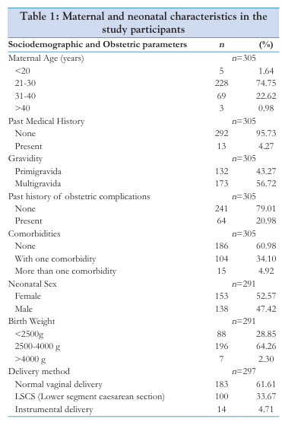
RESULTS
A total of 326 patients were screened over the study period. 21 patients were lost to follow up hence excluded from the final analysis. Among them 19 patients moved to other hospitals for their delivery and two refused to participate in the study. Final analysis included 305 participants. Mean age of participants recruited in the study 27.82 (±4.51) years with range of 20 to 47. Majority (95.74%) of the participants did not have any significant past medical history whereas 4.26% of total had pre‑existing diseases like diabetes mellitus (1.64%), seizure (1.31%), and tuberculosis (0.98). Among the participants, 241 (79.02%) had no history of any obstetric complications while 53 (17.38%) had undergone caesarean section due to previous pregnancy. 8 (2.62%) had recurrent abortion due to unknown cause and 2 (0.66%) had intrauterine death of fetus. None of participants were smokers or alcoholic. In total, 186 (60.98%) participants in the study did not have any comorbid condition during the course of pregnancy while 104 (34.01%) had at least one comorbid condition in antenatal period and 15 (4.92%) suffered from more than one comorbidity
07-09-2024
6

Slide 7
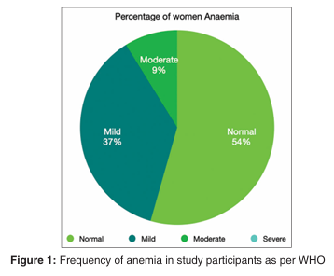
Mean hemoglobin level in first trimester was 10.36 (±1.6) g/dL, second trimester was 10.72 (±1.8) g/dL, and in third trimester was 11.12 (±2.64) g/dL. There was a statistically significant difference between mean hemoglobin levels among first and second trimester (P = 0.0004), second and third trimester (P = 0.0001). None of the participants showed severe hemoglobin deficiency status

Slide 8
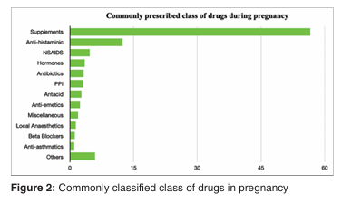

Slide 9
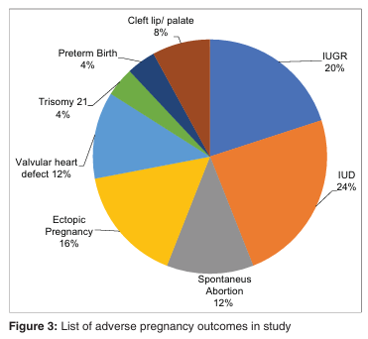
Among 305 participants, 25 major APOs were noted. IUD (6), IUGR (5) followed by ectopic pregnancy (4), spontaneous abortion (3), valvular heart defects (3), orofacial malformation (cleft lip/palate) in 2 cases were seen. 1 case each was reported with trisomy 21, and preterm delivery

Slide 10
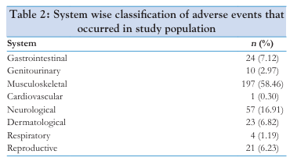

Slide 11
Total 337 adverse events were recorded among study population. Most common ADE reported in study population was back pain 44 (13.06%) followed by constipation 28 (8.31%), vomiting 27 (8.01%), nausea 22 (6.54%), allergic reaction 21 (6.23%), drowsiness 21 (6.23%). 18 (5.34%) ADR were headache and fatigue. Severity assessment was done for presenting ADRs. Serious and nonserious adverse events occurring during the study were 10.3% and 89.6%, respectively. Among 34 serious adverse events, 24 of them were nausea and vomiting

Slide 12
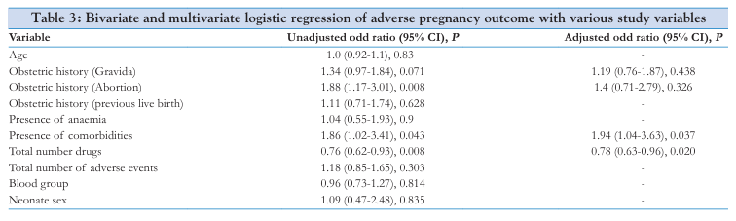
Bivariate logistic regression was used to analyze the association with various variables with occurrence of APOs. Values with P < 0.2 were included in multivariate logistic regression model. It was found that total number of comorbidities (P = 0.037) and total number of drugs consumed during pregnancy (P = 0.02) were statistically significantly associated with the occurrence of APO among the study participants

Slide 13
DISCUSSION
This study highlighted the pregnancy registry‑based analysis of drug usage at tertiary care center. Prevalence of APO at AIIMS, Rishikesh a tertiary care hospital in Northern India catering to the population of mainly two states of Uttar Pradesh and Uttarakhand was 8.1%. Incidence in our study was similar to the previously conducted studies. Our study showed IUGR in 1.64% participants, whereas national data showed incidence of 9.65%. Lesser incidence of IUGR cases in our study is probably due to limited sample size. The prevalence of APO in African countries is probably higher due to poor socioeconomic conditions, low antenatal check‑up’s and lack of basic medical facilities. Antenatal screening for anemia, pre‑eclampsia, GDM, previous pregnancy loss, and regular antenatal visits are contributing factors that may reduce occurrence of APO . IUD has been reported in 2% of pregnancies worldwide where most common causes include placental abnormalities followed by congenital anomalies.Incidence of IUD was 2.3% in our study which was slightly higher than previous reports. This was probably due to associated comorbidities like SLE, retroplacental hemorrhage, PIH and fibroid uterus. Prevalence of congenital anomalies in our study was 1.31% which is lower to that of 3.0% global prevalence as estimated by WHO.
07-09-2024
13

Slide 14
CONCLUSION
APO has been associated with significant morbidity and mortality. Pregnancy registries have been associated with detection of signals for further research in drug‑related adverse outcomes. Inappropriate usage of drugs has been shown to be associated with APOs. Our study warrants a need for further well‑designed studies on APOs on larger patient populations.
07-09-2024
14

Slide 15
REFERENCE
Athukorala C, Rumbold AR, Willson KJ, Crowther CA. The risk of adverse pregnancy outcomes in women who are overweight or obese. BMC Pregnancy Childbirth 2010;10. doi: 10.1186/1471‑2393‑10‑56.
Werler MM, Mitchell AA, Hernandez‑Diaz S, Honein MA. Use of over‑the‑counter medications during pregnancy. Am J Obstet Gynecol 2005;193:771‑7.
Sammaritano LR, Bermas BL. Management of pregnancy and lactation. Best Pract Res Clin Rheumatol 2018;32:750‑66. De Santis M, Straface G, Carducci B, Cavaliere AF, De Santis L, Lucchese A, et al.
Risk of drug‑induced congenital defects. Eur J Obstet Gynecol Reprod Biol 2004;117:10‑19. Vallance P. Drugs and the fetus. BMJ (Clinical Research ed.) 1996;312:1053‑4.
Tsegaye, B., Kassa, A. Prevalence of adverse birth outcome and associated factors among women who delivered in Hawassa town governmental health institutions, south Ethiopia, in 2017.
Reprod Health 2018;15:193. Chaibva BV, Olorunju S, Nyadundu S, Beke A.
Adverse pregnancy outcomes, ‘stillbirths and early neonatal deaths’ in Mutare district, Zimbabwe (2014): A descriptive study. BMC Pregnancy Childbirth 2019;19:86.
Andemel N, Gaoussou S, Barry A, Issiaka D, Mahamar A, Traore M, et al. Adverse pregnancy outcomes among women presenting at antenatal clinics in Ouélessébougou, Mali. Reprod Health 2020;17:39
07-09-2024
15

Slide 16
THANK YOU

