Slide 1

JOURNAL CLUB
A prospective study on drug utilization pattern of anti-diabetic drugs in a tertiary care teaching hospital of eastern Uttar Pradesh, India
Chaudhary K. Pankaj1*, Singh P. Satendra2, Pandey Dhananjay1, Ranjan Kumud3, Chaudhary Rajmangal4, Pratap Bhanu1
1Department of Pharmacology, 2Department of Microbiology, 3Department of Anatomy, 4Department of Biochemistry,
GMC, Azamgarh, Uttar Pradesh, India
International Journal of Research in Medical Sciences Pankaj CK et al. Int J Res Med Sci. 2019 Mar;7(3):669-675
04-09-2024
1

Slide 2
ABSTRACT
Background: Diabetes mellitus is a metabolic disorder with common denominator of hyperglycemia, arising from a variety of pathogenic mechanisms. The aim of the study was to evaluate the drug utilization pattern of anti-diabetic drugs in diabetic patients and observe adverse drug events (ADEs) associated with anti-diabetic therapy in a prospective way.
Methods: A prospective study was carried out in diabetic patients visiting the Departments of General Medicine in a tertiary care teaching hospital. Demographic data, drug utilization pattern and ADEs due to Anti-diabetic drugs were summarized.
Results: In the present study, 153 (54%) of the 282 diabetic patients were males and 129 (46%) were females. Majority of patients were in the age group of 51-60 years (31.20%) and most of the patients (31.56%) had a diabetic history of 11-15 years. Metformin was the most commonly prescribed drug (64.89%). Majority of the patients (36.87%) were on multidrug therapy. Co-morbid condition was found in 232 patients (82.26%) where hypertension (22.69%) being the most common co-morbid condition. 32 ADRs were observed with Nausea being the most common ADR reported.
Conclusions: The present study helps to find out current prescribing pattern of oral diabetic medications with different co-morbidities with respect to diagnosis, cost of treatment and it also highlight the need for comprehensive management of diabetic patients, including life style changes, dietary control, hypoglycemic agents, cardiovascular prevention, treatment of complications and co-morbidity. Therefore, through the existing prescribing patterns, attempts can be made to improve the quality and efficiency of drug therapy.
04-09-2024
2

Slide 3
INTRODUCTION
Drug utilization has been defined as the marketing, distribution, prescription, and use of drugs in a society, with emphasis on the resulting medical and social consequences. The principal aim of drug utilization studies (DUS) is to facilitate the rational use of drugs in population.
Diabetes Mellitus (DM) is a most common metabolic disorder characterized by hyperglycemic.2 Diabetes has emerged as a major healthcare problem in India. India has the largest population of diabetes in the world. The international diabetes federation (IDF) estimates the number of people with diabetes in India will reach 80million by the year 2025.
The American Association of Clinical Endocrinologists/American College of Endocrinology (AACE/ACE-2015) is considered the “gold standard” consensus guidelines for the management of DM.
The current pharmacotherapy of diabetes mellitus includes treatment with drugs such as insulin and oral hypoglycemic agents. The main classes include agents sulfonylureas, biguanides, α-glucosidase inhibitors, thiazolidinediones, dipeptidyl peptidase-4 inhibitors.
It is necessary to follow a treatment protocol in common co-morbidities associated with type 2 diabetes. So, authors have aimed to study the drug utilization pattern of Antidiabetic drugs in diabetes mellitus Patients in a tertiary care teaching hospital of Eastern Uttar Pradesh, India.
04-09-2024
3

Slide 4
OBJECTIVE OF STUDY
The aim of the study was to evaluate the drug utilization pattern of anti-diabetic drugs in diabetic patients and observe adverse drug events (ADEs) associated with anti-diabetic therapy in a prospective way.
04-09-2024
4

Slide 5
METHODOLOGY
Study design - A prospective study
Study population - 282 patients
Study period - 6 months (June-November 2018)
INCLUSION CRITERIA - All cases diagnosed with diabetes mellitus (both type 1and type 2)
admitted at the In and out patient Department of General Medicine.
EXCLUSION CRITERIA - • Patients with gestational diabetes.
• Pregnant female having diabetes.

Slide 6
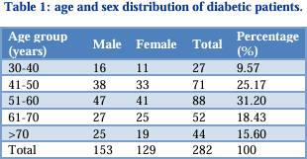
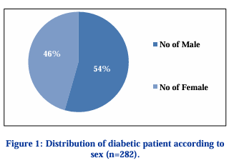
RESULT -

Slide 7
TABLE 1 - Out of 282 Patients of DM, 266 patients were diagnosed as type 2 diabetes mellitus while 16 were diagnosed as type 1 diabetes mellitus. These results are represented in Figure 2. Out of 282 Patients of DM, it was observed that Majority of patients were in the age group pf 51-60 (31.20%) years followed by age group of 41-50 (25.17%) years while Patients with age group of 30-40 (9.57%) was found to be least
FIGURE 1 - During the study period, a total of 282 patients with Diabetes Mellitus were included from Department of medicine. Out of the 282 patients, 154 (54.6%) were males and 129 (45.74%) were females

Slide 8
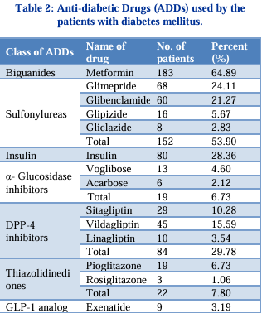
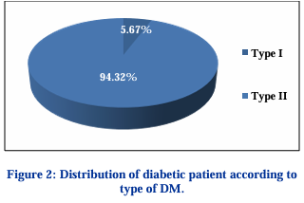

Slide 9
TABLE 2 - Out of 282 Patients it was observed that 183 (64.89%) Patients was prescribed with metformin which was highest of all group of drugs. 152 (53.90%) patients were prescribed with sulfonylureas group of drugs of which glimepride (24.11%) was the most commonly prescribed drugs. Insulin was prescribed in 80 (28.36%) patients. DPP-4 Inhibitors was prescribed in 84 (29.78%) Patients of which vildagliptin was the most commonly prescribed drugs. Thiazolidinediones was prescribed in 22 (7.80%) patients and α- Glucosidase Inhibitors in 19 (6.73%) patients while GLP-1 Analog was the least commonly prescribed drugs 9 (3.19%).

Slide 10
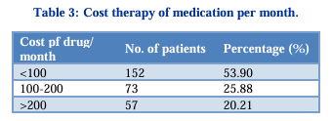
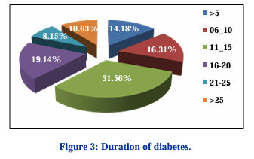
RESULTS
04-09-2024
10

Slide 11
TABLE 3 - It was observed that out of 282 patients, in 152 (53.90%) patients’ total cost of drug per month was less than 100 rupees. Similarly, in 73 (25.88%) patients, total cost of drug per month was between 100-200 rupees while in 57 (20.21%) patients, total cost of drug per month was more than 200 rupees.
FIGURE 3 - Among 282 patients of DM maximum no. of patients had a history of Diabetes between 11-15 (31.56%) years followed by 16-20 (19.14%) years followed by 6-10 (16.31%) years while only 23 (8.15%) patients had a history of diabetes 21-25 years

Slide 12
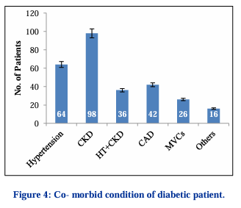
Out of 282 Patients, Co-morbid conditions were found in 232 patients. Among the 232 patients, 36 Patients had more than two comorbid conditions in our study while 50 Patients were without any comorbidity. The comorbid conditions found were cardiovascular (hypertension, coronary artery disease), Chronic Kidney Disease (CKD), Micro vascular Complications (MVCs) like neuropathy, retinopathy etc. while 16 (9.25%) Patients was found with other types of complication. Hypertension accounted for Maximum (22.69%) of the total comorbidities followed by CKD, CAD.

Slide 13
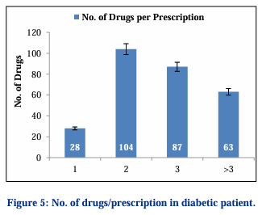
Out of 282 patients, maximum no. (104) of patients were prescribed with dual therapy (36.87%) while 87(30.85%) patients were prescribed with triple therapy and 28 (9.92%) patients was prescribed with monotherapy. 63 (22.34%) patients were prescribed with more than three drugs

Slide 14
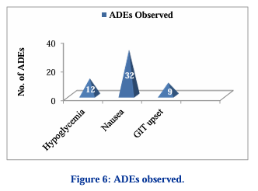
In present study, 53 (18.79%) patients were observed with ADEs out of which 32 (11.34%) was seen with nausea followed by hypoglycemia in 12 (4.25%) patients and GIT Upset was seen in 9 (3.19%) of patients

Slide 15
DISCUSSION
Diabetes mellitus is a chronic lifelong disease affecting a large spectrum of population in the developing countries including India. The WHO defines diabetes mellitus as “A chronic, metabolic disease characterized by elevated levels of blood glucose (or blood sugar), which leads over time to serious damage to the heart, blood vessels, eyes, kidneys, and nerves. total of 282 diabetic patients were evaluated during the study period and it was observed that male had preponderance in the prevalence of diabetes (Males 54.60%; Females 45.75%). DM was found to be most prevalent 88 (31.20%) in the age group of 51-60 years as aging causes increase prevalence of diabetes and carbohydrate intolerance. Prescriptions with two or more drugs were found to be common among patients above 51 years of age. With the advancing age, the co-morbidities also increase and consequently increase the number of prescribed medications. Cost of prescription is very important in chronic disease like diabetes as it may be a major cause for non adherence to treatment. In our study, cost for both insulin and oral antidiabetic agent was under 100 INR/patient/month for 152 (53.90%). In present study out of 282 Diabetic Patients, 16(5.67%) was suffering from Type I DM while 266 (94.32%) was suffering Type II DM which is almost similar to a study done by Agrawal R et al, who reported 96.52% 0f patients with Type II DM while 3.48% with Type I DM out of 230 Patients
04-09-2024
15

Slide 16
CONCLUSION
Diabetes should be managed properly to enhance the quality of life of the patient. In the study carried out most of the prescriptions were rational, but further improvement is needed. The present study has clearly delineated the drug utilization pattern of diagnosed diabetic patients at GMC, Azamgarh a tertiary care teaching hospital in Eastern Uttar Pradesh, India. More than 90% of patients were diagnosed as type 2 DM. High frequency of oral hypoglycemic agents were prescribed, reflecting higher glycemia at the time of diagnosis. Amongst this group of drugs biguanides accounted for the most commonly prescribed drug. Polypharmacy was found to be low, suggestive of more rational mode of prescribing. Present study showed, low cost of drugs per prescription as Generic drugs has been prescribed to the patients. So, it is necessary to taken care of quality of drugs. The choice of drug should be based economic status, associated conditions. Rational prescribing should focus on dose and duration as well as interaction with other medications. This can be done by prescribing a proper drug regimen consisting of hypoglycemic agents as well as diet control and exercise. Efforts from both patients and the physician should be made to meet the target glucose levels and have a better and healthy life.
04-09-2024
16

Slide 17
REFERENCE
WHO. The selection of essential drugs. WHO Tech Rep. 1997;615:36. Available at: https://www.jscimedcentral.com/Pharmacology/phar macology-5-1078.pdf.
Dan LL, Anthony SF, Dennis LK, Stephen LH, Larry JJ, Joseph L. Harrison’s Principles of Internal Medicine. Eighteenth edition, McGraw-Hill Medical, New York, United States of America; 2012:2968.
King H, Aubert RE, Herman WH. Global burden of diabetes, 1995–2025: prevalence, numerical estimates, and projections. Diabetes Care. 1998 Sep 1;21(9):1414-31.
Sierra GN. the global pandemic of diabetes; for American journal of diabetes medicine. 2009. Available at: http://www.ijrpc.com/files/10-01 17/09.pdf
IDF Diabetes Atlas, 6th ed. 2013;1-160. Available at: https://www.idf.org/e-library/epidemiology research/diabetes-atlas/19-atlas-6th-edition.html.
Bope ET, Kellerman RD. Conn’s Current Therapy 2014. Saunders-Elsevier, Philadelphia, United States of America; 2014;701-704. Available at: http://www.ijopp.org/sites/default/files/10.5530.ijop p_.9.4.3_0.pdf
Richard AH. Diabetes Mellitus/Pathophysiology: Etiologic factors associated with diabetes mellitus. In: Stephen M Setter, John R White. Textbook of Therapeutics: Drug and Disease Management. 8th ed, Lippincott Williams and Wilkins-Wolters Kluwer, Philadelphia, United States of America; 2007.
Baksaas I, Lunde PK. National drug policies: the need for drug utilization studies. Trends Pharmacol Sci. 1986 Jan 1;7:331-4.
Fowler MJ. Microvascular and macrovascular complications of diabetes. Clin Diab. 2008 Apr 1;26(2):77-82.
04-09-2024
17

Slide 18
Knowler WC, Barrett-Connor E, Fowler SE, Hamman RF, Lachin JM, Walker EA, et al. Reduction in the incidence of type 2 diabetes with lifestyle intervention or metformin. New Eng J Med. 2002 Feb;346(6):393-403.
Garber AJ, Abrahamson MJ, Barzilay JI, Blonde L, Bloomgarden ZT, Bush MA, et al. AACE/ACE comprehensive diabetes management algorithm 2015. Endocrine Practice. 2015 Apr;21(4):438-47.
American Diabetes Association. Standards of medical care in diabetes-2010. Diab Care. 2010 Jan 1;33(Supplement 1):S11-61.
NICE Clinical guideline-87. Type 2 diabetes. 2014. Available at: http://www.ijopp.org/sites/default/files/10.5530.ijop p_.9.4.3_0.pdf.
Unger J. Current strategies for evaluating, monitoring, and treating type 2 diabetes mellitus. Am J Med. 2008 Jun 1;121(6):S3-8.
Krentz AJ, Bailey CJ. Oral antidiabetic agents: current role in type 2 diabetes mellitus. Drugs. 2005;65(3):385-411.
El-Kaissi S, Sherbeeni S. Pharmacological management of type 2 diabetes mellitus: An update. Curr Diabetes Rev. 2011;7(6):392-405.
Diagnostic Criteria. 2005. ICMR Guidelines for Management of Type 2 Diabetes. Available at: https://www.peertechz.com/articles/assessment-of prescription-pattern-of-antidiabetic-drugs-in-the outpatient-department-of-a-tertiary-care hospital.pdf.
Joshi SR. Management of obese Indian patient. Indian J Obes. 2005;I(1):11-20.

Slide 19
Kumar P, Mallik D, Mukhopadhyay DK, Sinhababu A, Mahapatra BS, Chakrabarti P. Prevalence of diabetes mellitus, impaired fasting glucose, impaired glucose tolerance, and its correlates among police personnel in Bankura District of West Bengal. Indian J Public Health. 2013 Jan 1;57(1):24.
Vengurlekar S, Shukla P, Patidar P, Bafna R, Jain S. Prescribing pattern of antidiabetic drugs in Indore city hospital. Indian J Pharmaceut Sci. 2008;70(5):637-40.
Boccuzzi SJ, Wogen J, Fox J, Sung JC, Shah AB, Kim J. Utilization of oral hypoglycemic agents in a drug-insured U.S. Population. Diab Care. 2004;24(8):1411-5.
Johnson JA, Pohar SL, Secnik K, Yurgin N, Hirji Z. Utilization of diabetes medication and cost of testing supplies in Saskatchewan, 2001. BMC Health Services Res. 2006 Dec;6(1):159.
Yurgin N, Secnik K, Lage MJ. Antidiabetic prescriptions and glycemic control in German patients with type 2 diabetes mellitus: a retrospective database study. Clin Ther. 2007;29(2):316-25.
John L, Arifulla M, Sreedharan J, Muttappallymyalil J, Das R, John J, Basha A. Age and gender based utilisation pattern of antidiabetic drugs in Ajman, United Arab Emirates. Malaysian J Pharma Sci. 2012;10(1):79-85.
Sutharson L, Hariharan RS, Vamsadhara C. Drug utilization study in diabetology outpatient setting of a tertiary hospital. Indian J Pharmacol. 2003 Jul 1;35(4):237-40.
Meneilly GS, Elliott T, Tessier D, Hards L, Tildesley H. NIDDM in the elderly. Diab Care. 1996 Dec 1;19(12):1320-5.
Rizvi AA. Management of diabetes in older adults. Am J Med Sci. 2007 Jan 1;333(1):35-47.

Slide 20
Upadhyay DK, Palaian S, Ravi Shankar P, Mishra P, Sah AK. Prescribing pattern in diabetic outpatients in a tertiary care teaching hospital in Nepal. J Clin Diagn Res. 2007 Aug 1;1(4):248-55.
Kannan, Arshad, Kumar S. A study on drug utilization of oral hypoglycemic agents in type-2 diabetic patients. Asian J Pharm Clin Res. 2011;4:60-4.
Sutharson L, Hariharan RS, Vamsadhara C. Drug utilization study in diabetology outpatient setting of a tertiary hospital. Indian J Pharmacol. 2003 Jul 1;35(4):237-40.
Karthikeyan V, Maadhusudhan S, Selvamuthukumran S. Studies on Prescribing Pattern in the Management of Diabetes Mellitus in Rural Teaching Hospital. Saudi J Med Pharm Sci. 2016;2(5):100-7.
Priya D, Purohit S, Pandey BL, Mishra S. Evaluation of antidiabetic prescriptions from medical reimbursement applications at Banaras Hindu University health care facility. J Pharmaceut Care. 2014:49-54.
Sivasankari V, Manivannan E, Priyadarsini SP. Drug utilization pattern of anti-diabetic drugs in a rural area of Tamilnadu, South India–A prospective, observational study. Int J Pharm Biol Sci. 2013 Jan;4:514-9.
Alex SM, Sreelekshmi BS, Smitha S, JijiKn MA, Devi PU. Drug Utilization Pattern of Anti-Diabetic Drugs Among Diabetic Outpatients in a Tertiary Care Hospital. Asian J Pharmaceut Clin Res. 2015;8(2).
Truter I. An investigation into antidiabetic medication prescribing in South Africa. J Clin Pharma Therapeutics. 1998 Dec;23(6):417-22.
Boccuzzi SJ, Wogen J, Fox J, Sung JC, Shah AB, Kim J. Utilization of oral hypoglycemic agents in a drug-insured US population. Diab Care. 2001 Aug 1;24(8):1411-5.

Slide 21
Patel B, Oza B, Patel KP, Malhotra SD, Patel VJ. Pattern of antidiabetic drugs use in type 2 diabetic patients in a medicine outpatient clinic of a tertiary care teaching hospital. Int J Basic Clin Pharmacol 2013;2:485 91.
Alam MS, Aqil M, Qadry SA, Kapur P, Pillai KK. Utilization pattern of oral hypoglycemic agents for diabetes mellitus type 2 patients attending out patient department at a University hospital in New Delhi. Pharmacol Pharm. 2014;5:636-45.
Acharya KG, Shah KN, Solanki ND, Rana DA. Evaluation of antidiabetic prescription cost and adherence to treatment guidelines: a prospective, cross-sectional study at a tertiary care teaching hospital. J Basic Clin Pharm. 2013;4(4):82-8.
Agrawal R, Rath B, Saha K, Mohapatra S. Drug utilization pattern of antidiabetic agents in a tertiary care hospital of western Odisha, India Int J Basic Clin Pharmacol. 2016 Oct;5(5):2222-6.

Slide 22
THANK YOU

