Slide 1

JOURNAL CLUB
Regular vitamin C supplementation during pregnancy reduces
hospitalization: outcomes of a Ugandan rural cohort study
Unim Hans &, Byamukama Edward
1 Gastroenterology Unit, Department of Clinical Sciences, University “La Sapienza”, Rome, Italy, 2 St. Mary's
Health Center, P.O.BOX 9 Kyeibuza, Kiruhura District , Uganda
Pan African Medical Journal. 2010, Volume 5, Article 5, ISSN: 1937- 8688
1

Slide 2
ABSTRACT
Vitamin C or ascorbic acid is a hydro-soluble lactone (synthesized from glucose) essential to human body and available from diet. Despite its broad availability in fruits and vegetables, in many developing countries the incidence of clinical symptoms due to the vitamin deficiency is still very high. Also, pregnant women in the developing countries are frequently hospitalized for several preventable reasons such as anemia in pregnancy, mostly iron-deficient anemia (IDA) and the upper/lower respiratory tract infections.
The aim of the study was to investigate, in a Ugandan rural pregnant women cohort, the preventive effects of vitamin C supplementation on hospital admission.
384 pregnant women met the inclusion criteria and were randomly assigned to receive either 400 mg of vitamin C daily (187) or not (197) in addition to their standard antenatal vitamins until delivery.
Results: 42.2% women in the vitamin C group and 27.9% in the control group were not hospitalized during pregnancy; this difference was found statistically significant.
Conclusion: The results of this study suggest including vitamin C in the guidelines of multivitamin prevention for pregnant women, especially in developing countries where seasonal availability of fruits and vegetables could result in adverse clinical outcomes.
04-09-2024
2

Slide 3
INTRODUCTION
Vitamin C or ascorbic acid is a hydro-soluble lactone (synthesized from glucose) essential to human body for several functions. Chemically is considered an electron donor (reducing agent or antioxidant), and probably all of its biochemical and molecular roles can be accounted for by this function.
The most important disorder of vitamin C deficiency is scurvy, characterized by gingival changes, pain in the extremities, deformed bone growth in infants, hemorrhagic manifestations, ulcerations and ultimately death.
In the developing countries, pregnant women are frequently hospitalized for several preventable reasons such as anemia in pregnancy, mostly iron-deficient anemia (IDA) and respiratory tract infections (RTI).
All this considerations led us to investigate, in an open-label cohort randomized study, the preventive effects of regular vitamin C supplementation on overall hospitalization rate in the pregnant women population attending a Ugandan rural health center for antenatal assessment.
04-09-2024
3

Slide 4
OBJECTIVE OF STUDY
The aim of the study was to investigate, in a Ugandan rural pregnant women cohort, the preventive effects of vitamin C supplementation on hospital admission.
04-09-2024
4

Slide 5
METHODOLOGY
Study design – cohort study .
Study population – 384 people.
Study period - August 2007 and January 2009.
INCLUSION CRITERIA - diagnosis of pregnancy confirmed serologically by B-HCG reagent test along with
referred last menstrual period (LMP) not exceeding the past three months, aged
at least 18.
EXCLUSION CRITERIA - referred pregnancy of more than three months by LMP, concomitant HIV infection
status, active or recent (< two weeks) sexually transmitted disease (STD) infection,
medical record of any severe organ disease such as heart, liver or renal failure at the
time of assessment, diagnosis of pregnancy during inpatient admission for any other
reason.

Slide 6
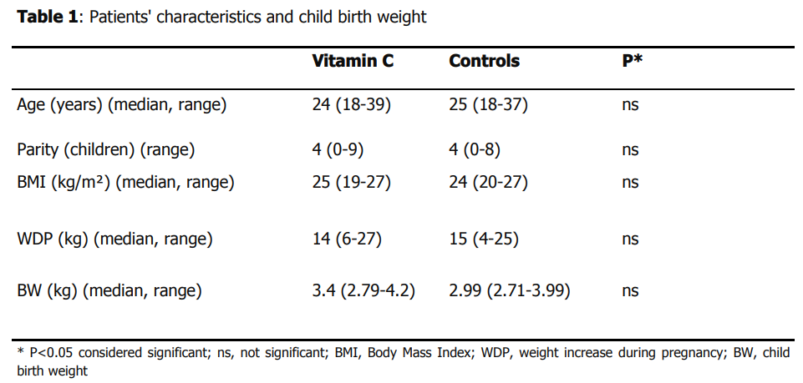

Slide 7
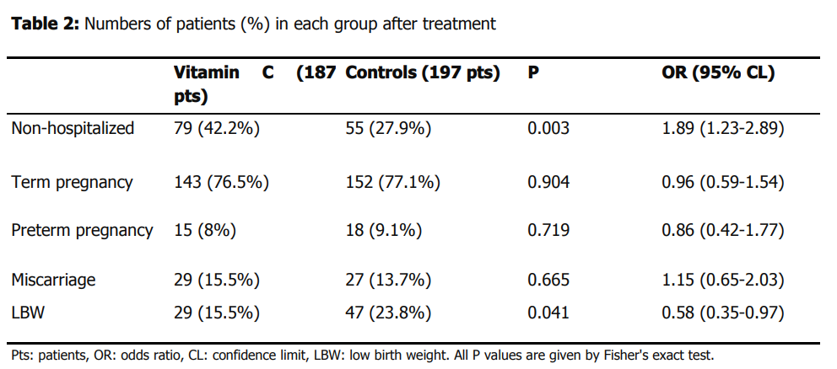

Slide 8
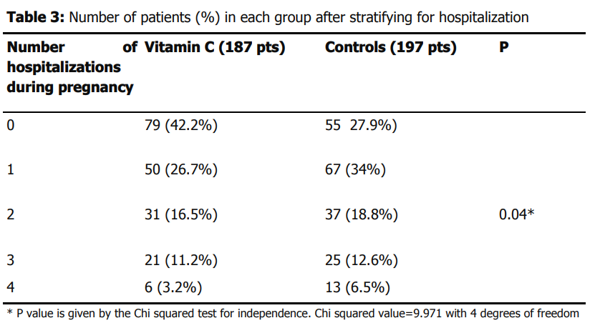

Slide 9
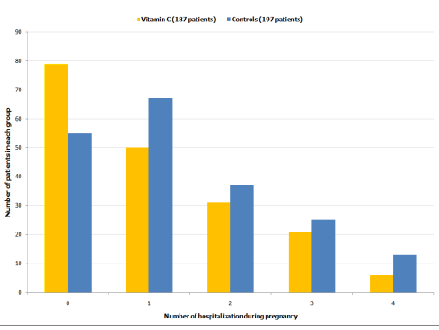

Slide 10
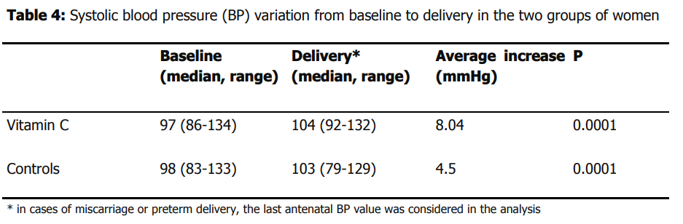

Slide 11

Of the four hundred patients assessed and entered into the trial, sixteen were excluded from further analysis after randomization, thirteen in the vitamin C group and three in the control group. Of these, six patients were found to have discontinued their treatment shortly after review and ten patients (7 vs. 3, respectively) failed to come back the following month for review despite repeated attempts to make contact with them.

Slide 12
RESULTS
Table 1 - Three hundred and eighty four evaluable patients of which (n=187) in the vitamin C group and (n=197) in the control group were included in the analysis. There were no significant differences between the two groups at baseline in relation to age, parity and BMI. Average weight gain during pregnancy was of 14kg in the vitamin C group of women and 15 kg in the control group, this difference was found statistically not significant. the average child birth weight at delivery was similar in both groups of women and the difference found statistically not significant.
Table 2 - Child low birth weight was found in 29 women in the vitamin C group and in 47 women among the control group, this difference was considered significant.
Table 3 - Comparing the groups in terms of overall number of hospitalizations during pregnancy, this different trend was found significant.
Table 4 - From baseline to delivery there was a significant increase in systolic blood pressure both in the vitamin C and control groups.
04-09-2024
12

Slide 13
DISCUSSION
In this randomized, open label, cohort study, the daily vitamin C supplementation provided important clinical signs in the group of women treated. First of all, the rate of women that did not require hospitalization during pregnancy was found significantly higher compared to the group of women undergoing only routine prevention of anemia with iron, folic acid and B-complex supplements. A high percentage of term pregnancies were achieved in both groups and this could be interpreted as more related to the continuous follow up and regular multivitamin supplementation provided to all women than a real picture of the cohort’s pregnancy outcome. In the case of children born with a body weight lower than 2500g, the significant difference found among groups in favor of the vitamin C women is intriguing as it can be interpreted as more and better energy supply to child during gestation. Although the average weight gain was normal in the two groups during pregnancy without any significant statistical difference, this was found lower in the vitamin C group compared to controls, and this could suggest the possibility of a better fatty acid catabolism provided by high dose vitamin C intake which is known to enhance carnitine synthesis, a fundamental long chain fatty acid transporter to the mitochondrial site for energy production in form of ATP.
04-09-2024
13

Slide 14
CONCLUSION
The regular supplementation of ascorbic acid to pregnant women proved to reduce hospitalization rate during pregnancy and provide overall mother-to-child health benefit, also to be safe as no patient complained or withdrew from the study due to side effects. Our results indicate the benefit of adding vitamin C in the guidelines of multivitamin supplementation to pregnant women. This is particularly important in developing countries were the hazards to a successful pregnancy outcome are greater due to numerous socio-political and environmental obstacles, nonetheless poor nutritional availability of regular fruit and vegetable portions, thus limiting strongly the normal bioavailability of several important vitamins such as ascorbic acid. However, further controlled studies with a larger women population are welcomed in order to confirm the findings of the present study.
04-09-2024
14

Slide 15
REFERENCE
Report of a joint FAO/WHO expert consultation. Vitamin and mineral requirements in human nutrition. Bangkok, Thailand, September 1998.
Nishikimi M, Fukuyama R, Minoshima S, Shimizu N, Yagi K. Cloning and chromosomal mapping of the human nonfunctional gene for Lgulono-gamma-lactone oxidase, the enzyme for L-ascorbic acid biosynthesis missing in man. J Biol Chem. 1994 May 6;269(18):13685-8. This article on PubMed
Hathcock JN. Vitamin and Mineral Safety. 2nd Edition. 2004
Kallner A, Hartmann D, Hornig D. Steady-state turnover and body pool of ascorbic acid in man. Am J Clin Nutr. 1979 Mar;32(3):530-9.. This article on PubMed
Krebs NA, Peters RA, Coward KH. Vitamin C requirement of human adults:experimental study of vitamin C deprivation in man. Lancet. 1948 Jun 5;1(6510):853-8. This article on PubMed
Baker EM, Hodges RE, Hood J, Sauberlich HE, March SC. Metabolism of ascorbic-1–14C acid in experimental human scurvy. Am J Clin Nutr. 1969 May;22(5):549-58. This article on PubMed
Haytowitz D. Information from USDA’s Nutrient Data Book. J Nutr. 1995 Jul;125(7):1952-5. This article on PubMed
Bates CJ, Prentice AM, Paul AA. Seasonal variations in vitamins A, C, riboflavin and folate intakes and status of pregnant and lactating women in a rural Gambian community:some possible implications. Eur J Clin Nutr. 1994 Sep;48(9):660-8. This article on PubMed
Gregory JF. Ascorbic acid bioavailability in foods and supplements. Nutr Rev. 1993; 51(10):301-303. This article on PubMed.
04-09-2024
15

Slide 16
Irwin MI, Hutchins BK. A conspectus of research on vitamin C requirements in man. J Nutr. 1976 Jun;106(6):821-79. This article on PubMed
Olson JA, Hodges RE. Recommended dietary intakes (RDI) of vitamin C in humans. Am J Clin Nutr. 1987 Apr;45(4):693-703. This article on PubMed
Carr AC, Frei B. Toward a new recommended dietary allowance for vitamin C based on antioxidant and health effects in humans. Am J Clin Nutr. 1999;69(6):1086-1107. This article on PubMed
Kubler W, Gehler J. On the kinetics of the intestinal absorption of ascorbic acid: a contribution to the calculation of an absorption process that is not proportional to the dose. Int Z Vitaminforsch. 1970;40(4):442-53. This article on PubMed
Graumlich JF, Ludden TM, Conry-Cantilena C, Cantilena LR Jr, Wang Y, Levine M. Pharmacokinetic model of ascorbic acid in humans during depletion and repletion. Pharm Res. 1997 Sep;14(9):1133-9.. This article on PubMed
Pauling LC. Vitamin C and the Common Cold. San Francisco: W. H
Douglas RM, Hemila H, D´Souza R, Chalker EB, Treacy B. Vitamin C for preventing and treating the common cold. Cochrane Database Syst Rev. 2004; 4:CD000980. This article on PubMed
Sasazuki S, Sasaki S, Tsubono Y, Okubo S, Hayashi M, Tsugane S. Effect of Vitamin C on common cold: randomized controlled trial. Eur J Clin Nutr. 2006; 60(1):9-17. This article on PubMed
Hemilä H. Vitamin C supplementation and common cold symptoms:factors affecting the magnitude of the benefit. Med Hypotheses. 1999 Feb;52(2):171-8. This article on PubMed.

Slide 17
World Health Organization. The prevalence of anaemia in women: a tabulation of available information. 2nd ed. Geneva:1992
Ajayi OA. Iron stores in pregnant Nigerians and their infants at term. Eur J Clin Nutr. 1988 Jan;42(1):23-8. This article on PubMed
Fleming AF, Ghatoura GBS, Harrison KA, Briggs ND, Dunn DT. The prevention of anemia in pregnancy in primigravidae in the guinea savanna of Nigeria. Ann Trop Med Parasitol. 1986 Apr;80(2):211-33. This article on PubMed
EN Shu, SO Ogbodo. Role of ascorbic acid in the prevention of iron-deficiency anaemia in pregnancy. Biomedical Research. 2005; 16 (1): 40-44
Curlo M. Influence of BMI on gastric acid secretion in acid related disease. Dig Liv Dis. 2009; 41(1):S83 24. Johnston CS, Meyer CG, Srilakshmi JC. Vitamin C elevates red blood cell glutathione in healthy adults. Am J Clin Nutr. 1993 Jul;58(1):103-5. This article on PubMed.

Slide 18
THANK YOU

