Slide 1

JOURNAL CLUB
Use of Antihypertensives in Patients Having Associated Renal Parenchymal Disorders: Cross Sectional Prescription Pattern Study in a Tertiary Care Hospital
Supratim Datta*
Department of Pharmacology, Sikkim Manipal Institute of Medical Sciences, 5th Mile; Tadong, Gangtok, Sikkim-737 102
International Journal of Pharmaceutical Sciences and Drug Research 2011; 3(3): 256-259
04-09-2024
1

Slide 2
ABSTRACT
Hypertension is both a cause and a consequence of renal parenchymal disease. Once detected, formulation of an appropriate therapeutic strategy is imperative to not only control hypertension, but also to retard the progression of the renal pathology. Judicious and optimal use of the available antihypertensive agents is of utmost importance .
This study aims at analyzing the influence of current guidelines on prescribing in this particular subset of patients. Case history of patients having hypertension comorbid with renal pathological disorders was noted down from the medical records department.
A total of 58 prescriptions thus noted were analyzed on the basis of antihypertensive agents that were prescribed. The CCB’s were the group of drugs prescribed the most in renal disease associated hypertension (79%) followed by the diuretics (48%).The ACE‐inhibitors and ARB’s were prescribed in around 34% of the patients. Amlodipine and Frusemide were the most frequently used individual agents.
04-09-2024
2

Slide 3
INTRODUCTION
Long standing, uncontrolled hypertension is linked to a plethora of systemic effects, prominent of which are its effects on the kidney.
hypertension can ensue as a consequence of renal disease. Primary renal parenchymal disease has been observed to be responsible for 3%-4% of hypertension in some populations, and renovascular disease in around 1%.
Most patients (80-90%) presenting to renal replacement programmed are hypertensive. Diabetic nephropathy, hypertensive nephropathy and primary glomerulonephritis are the three most common causes of end stage renal failure worldwide .
Important aetiological factors include reflux nephropathy, polycystic kidney disease, analgesic nephropathy and secondary glomerulonephritis.
There is also evidence that any familial tendency to hypertension will increase the prevalence of renal failure in patients with primary renal disorders or with diabetes .
Clinical studies have shown that blood pressure control slows the disease progression in renal failure.
This underlines the importance of taking appropriate therapeutic measures so as to control hypertension as well as reduce the pathophysiological process associated with renal disorders.
04-09-2024
3

Slide 4
INTRODUCTION
The Joint National Committee (JNC) on detection, evaluation and treatment of blood pressure has published reports outlining recommendations and guidelines in the treatment of hypertension.
The Sixth report of the JNC, as well as the seventh documents major progress in the scientific basis for treatment of hypertension and recognizes advances in the availability of major new classes of drugs that have clear benefits in treating hypertension under certain conditions.
The Indian guidelines, endorsed by the Cardiology Society of India, The Hypertension Society of India and the Indian College of Physicians closely follow the Joint National Committee Guidelines.

Slide 5
OBJECTIVE OF STUDY
To analyzing the influence of current guidelines on prescribing in this particular subset of patients. Case history of patients having hypertension comorbid with renal pathological disorders was noted down from the medical records department.
04-09-2024
5

Slide 6
METHODOLOGY
Study design –cross sectional study
Study population – 303
Study period – March 2004-July 2004
INCLUSION CRITERIA – Those patients having hypertension as the primary disease and renal parenchymal
disease as the secondary comorbid condition .
EXCLUSION CRITERIA – Those patients not having hypertension despite having some from of renal disorder .

Slide 7
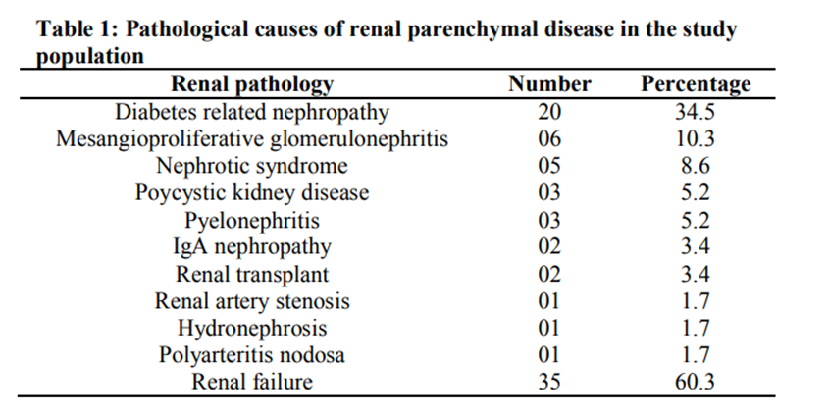
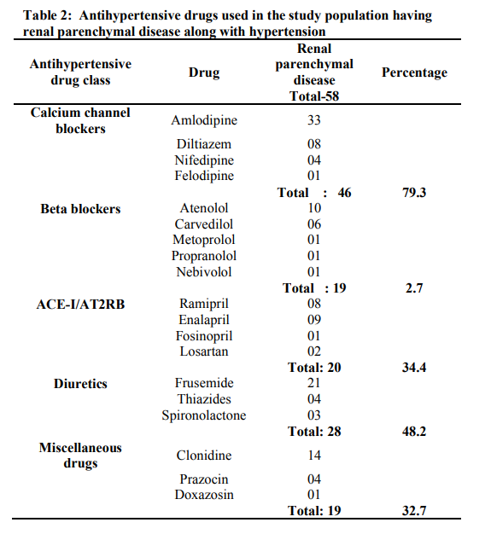
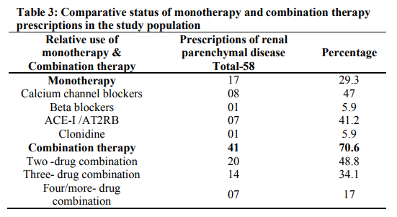

Slide 8
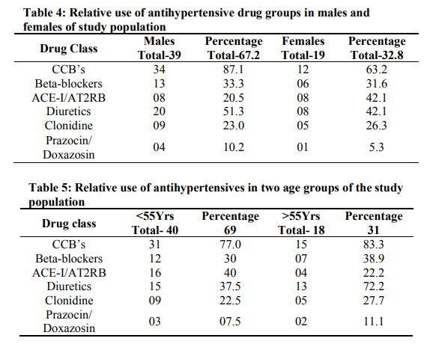

Slide 9
RESULTS
Table 1. -- The most commonly seen renal pathology is diabetes related nephropathy (35%). Mesangioproliferative glomerulonephritis (10%), nephrotic syndrome (8.6%) and polycystic kidney disease (5.2%) are the other important renal pathology seen in these patients. Around 60% of the patients were suffering from renal failure, many of whom had one or more underlying renal pathology.
Table 2 -- shows the overall use of antihypertensives in renal parenchymal disease. The calcium channel blockers have been used most extensively (79%). Amlodipine is the CCB used the most (72%) followed by Diltiazem (17%). The diuretics have been prescribed the most following the CCB’s. Amongst the diuretics, Frusemide (75%) and the Thiazides (14%) have been the most commonly used. Potassium sparing diuretics like Spironolactone have been used sparingly. Utilization of the ACE-Inhibitors/AT2RB’s is around 34%. Enalapril (45%) and Ramipril (40%) are the drugs from this group that have been mostly used.
Table 3 – shows the relative use of monotherapy and combination therapy. Combination therapy comprising two, three or more drugs have been used more frequently (71%) than monotherapy (29%). The calcium channel blockers (47%) and the ACE-Inhibitors/AT2RB’s (41%) are the group of drugs used most frequently as monotherapy. The diuretics have always been used only in combination with other agents. A two drug combination has been used most frequently (49%), followed by a three drug combination (34%) .
04-09-2024
9

Slide 10
Table 4 and 5 show the relative use of antihypertensives in both genders and two age groups .

Slide 11
DISCUSSION
Renal parenchymal hypertension represents an interaction of many independent mechanisms. Potential factors include sodium retention leading to volume expansion, increased pressor activity and decrease in endogenous vasodepressor compounds. Treatment of hypertension has been shown to retard the rate of progression of renal impairment in several disease states. In patients having diabetic or non-diabetic renal disease, vital factors for preserving residual renal function include adequate control of blood pressure and blockade of the renin-angiotensin pathway. The major mode of action of certain antihypertensive groups, like the ACE Inhibitors and the angiotensin receptor blockers (AT2RB’s), is by virtue of their effects on the renin-angiotensin pathway. These patients are characterized by hypertension refractory to sodium restriction and diuretics and often require the addition of potent non diuretic antihypertensive agents, such as the calcium channel blockers and the ACE inhibitors/AT2RB’s. Calcium channel blockers are effective antihypertensive agents for treating patients with chronic renal impairment. Findings of pharmacokinetic studies suggest that there may be no need to modify the dosing of Amlodipine, when prescribed for patients with renal failure. The high utilization of the calcium channel blockers seen in this study, probably reflects the safety profile that they have in renal parenchymal disorders, apart from their ability to reduce blood pressure.
04-09-2024
11

Slide 12
CONCLUSION
Renal parenchymal diseases aetiologically include a heterogenous group of pathological disorders. The underlying renal pathology may require specific therapeutic intervention. The Joint National Committee Guidelines considers hypertension due to renal pathology as a homogenous group. In this study, the use of antihypertensives in this particular group of patients does not deviate from the guidelines laid down by the Joint National Committee. Further large scale studies carried out at other tertiary care centres would help to compare, analyze and rationalize prescribing trends in renal parenchymal hypertension, giving a broader perspective to these findings .
04-09-2024
12

Slide 13
REFERENCE
Brown MA. Whitworth JA. Hypertension in human renal disease. J Hypertens. 1992; 10:701-712.
Klag MJ, Whelton PK, Neaton JD, Brancati FL, Ford CE, et al. Blood pressure and end stage renal disease in men. N Engl J Med. 1996; 334:13-18.
Iseki K, Ikemiya Y, Fukiyama K. Blood pressure and risk of endstage renal disease in a screened cohort. Kidney Int 1996; 49(Suppl 55): s 69-71.
Ritz E, Rambausck M, Masslacher C, Mann J. Pathogenesis of hypertension in renal disease. AM J Nephrol 1989; 9:85-90.
Krolewski AS, Canessa M, Warran JH, Laffel LMB, Chrislich AR, Knowler WC, et al. Predisposition to hypertension and susceptibility to renal disease in insulin dependent diabetes mellitus. N Engl J Med. 1988; 318:140-145.
Bergstrom J, Alvestrand A, Bucht H, Gutlerrez A. Progression of chronic renal failure in man is retarded with more frequent clinical follow- ups and better blood pressure control. Clin Nephrol. 1986; 25:1-6.
JNC-6. The Sixth report of the Joint National Committee on detection, education and treatment of high blood pressure. Arch Intern Med. 1997; 157:2417.
8. JNC-7. The Seventh Report of the Joint National Committee on prevention, detection, evaluation and treatment of high blood pressure. The JNC 7 Report. JAMA 2003; 289:2563.
04-09-2024
13

Slide 14
Preston RA, Singer I, Epstein M. Renal parenchymal hypertension: current concepts of pathogenesis
and management. Arch Intern Med. 1996; 156:602-611.
Smith MC, Dunn MJ. Hypertension in renal parenchymal disease. In: Laragh JH, Brenner BM, eds.
Hypertension: pathophysiology, diagnosis and management. New York, NY: Raven press;
1995:2081-2082.
Lowenthal DT, Dickerman D. The use of diuretics in varying degrees of renal impairment: an
overview. Clin Exp Hypertens. 1983; 5:297-307
Voelker JR, Cartwright-Brown D, Anderson S, Leinfelder J, Sica DA, Kokko JP. Comparison of loop
diuretics in patients with chronic renal insufficiency. Kidney Int. 1987; 32:572-578.
Kincaid-Smith P, Whitworth JA. Pathogenesis of hypertension in chronic renal disease. Semin
Nephrol. 1988; 8:155-162.
Walker WG. Hypertension related renal injury: a major contributor to end stage renal disease. Am J
Kidney Dis. 1993; 22:164-173.
Jafar TH, Schmid CH, Landa M, Giatrus I, Toto R, Remuzzi G, et al. Angiotensin converting
enzyme inhibitors and progression of non diabetic renal disease: a meta-analysis of patient level data.
Ann Intern Med. 2001; 135:73-87.

Slide 15
16. Meyer TW, Anderson S, Rennke HG, Brenner BM. Reversing glomerular hypertension stabilizes
established glomerular injury. Kidney Int. 1987; 31:752-759.
17. Laher MS, Kelly JG, Doyle GD, et al. Pharmacokinetics of amlodipine in renal impairment. J Cadiovasc
Pharmacol. 1988; 12 (suppl 7) 60-63.
18. Ter Wee P, De Michelli AG, Epstein M. Effects of calcium antagonists on renal hemodynamics and
progression of nondiabetic chronic renal disease. Arch Intern Med. 1994; 154:1185-1202.
19. Lewis EJ, Hunsicker LG, Bain RP, Rohde RD, for the Collaborative Study Group. The effect of
angiotensin converting enzyme inhibition on diabetic nephropathy. N Engl J Med. 1993; 329:1456-1462
20. Maschio G, Alberti D, Janin G, et al. For the Angiotensin Converting Enzyme inhibition in Progressive
Renal Insufficiency Study Group. Effect of the angiotensin converting enzyme benazepril on the
progression of chronic renal insufficiency. N Engl J Med. 1996; 334:939-945.
21. Giatrus I,Lau J, Levey AS. Effect of angiotensin converting inhibitors on the prodression of non-
diabetic renal disease: a metaanalysis of randomized trials. Ann Intern Med. 1997; 127:337- 345.

Slide 16
THANK YOU

