Slide 1

JOURNAL CLUB
CARDIAC MANIFESTATIONS IN PATIENTS WITH HYPERTHYROIDISM
Dr. Syed Fasih Ahmed Hashmi , Dr. Mashooq Ali Dasti1 , Dr. Zulfiqar Ali Qutrio Baloch and Dr. Hamid
Nawaz Ali Memon
Department of Cardiology, Liaquat University of Medical and Health Sciences (LUMHS), Jamshoro.
2Brandon Regional Hospital, Brandon, Florida. 3 Zulekha Hospital, Dubai United Arab Emirates
Syed Fasih Ahmed Hashmi et al, Cardiac Manifestations in Patients with Hyperthyroidism,
Indo Am. J. P. Sci, 2017; 4(03)
04-09-2024
1

Slide 2
ABSTRACT
OBJECTIVE: To evaluate the cardiac manifestation in patients with hyperthyroidism.
PATIENTS AND METHODS: This descriptive study was conducted from January 2015 to June 2015 on subjects with clinical manifestation of hyperthyroidism. The inclusion criteria of the study were patients, of ≥12 years of age, either gender with hyperthyroidism. The subjects were further evaluated for cardiac manifestations by advising X-ray chest, ECG and echocardiography. The frequency / percentages (%) and means ±SD computed for study variables.
04-09-2024
2

Slide 3
INTRODUCTION
Hyperthyroidism is the cause of fatal arrhythmia and thromboembolic phenomenon is also more prevalent in patients with atrial fibrillation due to hyperthyroidism.
The thyroid hormone can directly have effect on the cardiovascular system by increasing myocardial inotropic effect and heart rate and peripheral vascular dilatation to increase cardiac output.
The common causes are Graves’ disease, toxic adenomas and toxic multinodular goiter, the effect of thyroid hormone on heart and vascular function was also reported previously.
The hyperthyroidism causes tachycardia, wide pulse pressure and increases in cardiac output leads to heart failure or worsening of ischemic heart disease or angina pectoris.
Supraventricular arrhythmias account for cerebrovascular mortality because arterial fibrillation leads to embolic phenomena. Therefore, measuring of TSH is an important step as far as cardiac complications are concerned.
This study was conducted to evaluate the cardiac manifestations of patients with hyperthyroidism as early evaluation can prevent the patient to acquire life threatening arrhythmias due to thyrotoxicosis.
04-09-2024
3

Slide 4
OBJECTIVE OF STUDY
To evaluate the cardiac manifestation in patients with hyperthyroidism.
04-09-2024
4

Slide 5
METHODOLOGY
Study design - Descriptive Study.
Study population - 50
Study period - January 2015 to June 2015
INCLUSION CRITERIA - Patients, of ≥12 years of age, either gender with hyperthyroidism.
EXCLUSION CRITERIA - patients already on anti-thyroid medication, hypothyroidism, malignancy,
ischemic heart disease, cardiomyopathy and connective tissue disorders.

Slide 6
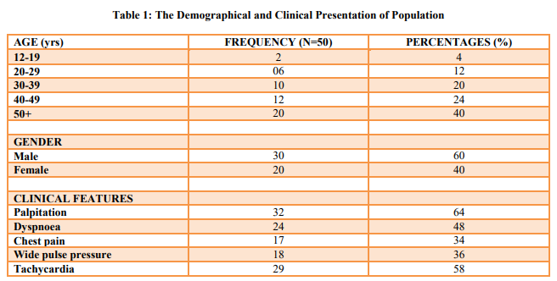

Slide 7
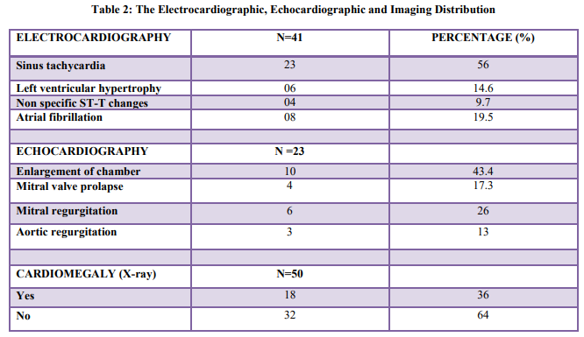

Slide 8
RESULTS
Total fifty patients of hyperthyroidism were identified to have cardiac manifestations and were evaluated and enrolled in the study. The mean ±SD for whole population was 48.87±5.86 while the mean free T3, T4 and TSH was 720.87±10.96 pg/d, 4.98±1.84 ng/dl and 0.23±1.20. The results are presented in Table1-2.
04-09-2024
8

Slide 9
DISCUSSION
In present study the male gender was predominant (60%), the gender is also consistent with former literature. In present study the clinical features observed were palpitation (64%), followed by dyspnea (48%) and tachycardia (58%). The clinical features are consistent to former study. In Klein I, et al [17] study 30% subjects had wide pulse while in present study it was reported as 36%. The difference among the percentage for wide pulse pressure might be because of the short duration illness of present study population. In current series, 08 patients had atrial fibrillation comparable to the Zargar et al (63.5%) left ventricular hypertrophy, non specific ST-T changes and cardiomegaly was observed in 06, 04 and 18 individuals while it is 5.4%, 9.8% and 14% in the study by Zargar et al. In present study the majority of population (72%) from rural areas and the observation was also reported by Hill AG, et al. In the study by Klein I, et al sinus tachycardia (74%) atrial fibrillation (12.5%), heart failure (3.6%) while in the study by Gupta S, et al tachycardia (74%), left ventricular hypertrophy (14.6%) and heart failure (3.6%) was observed in patients with hyperthyroidism.
04-09-2024
9

Slide 10
CONCLUSION
Hyperthyroidism associated with cardiac manifestation (palpitation, chest pain and dyspnea) while the ECG changes includes tachycardia, left ventricular hypertrophy and atrial fibrillation whereas echocardiogram detect chamber hypertrophy, mitral regurgitation and valve prolapsed and aortic regurgitation and chest X-ray shown cardiomegaly. Thus, the patients of hyperthyroidism should be carefully evaluated as early detection and appropriate treatment is a best strategy to reduce cardiovascular mortality and morbidity.
04-09-2024
10

Slide 11
REFERENCE
Cooper DS, Biondi B. Subclinical thyroid disease. Lancet. 2012 Mar 24;379(9821):1142-54
Cooper DS. Hyperthyroidism. Lancet. 2003 Aug 9;362(9382):459-68.
Reid JR, Wheeler SF. Hyperthyroidism: diagnosis and treatment. Am Fam Physician. 2005 Aug 15;72(4):623-30.
Kravets I. Hyperthyroidism: Diagnosis and Treatment. Am Fam Physician. 2016 Mar 1;93(5):363-70.
De Leo S, Lee SY, Braverman LE. Hyperthyroidism. Lancet. 2016 Aug 27;388(10047):906-18.
Ertek S, Cicero AF. Hyperthyroidism and cardiovascular complications: a narrative review on the basis of pathophysiology. Arch Med Sci. 2013 Oct 31; 9(5): 944–952.
Dahl P, Danzi S, Klein I. Thyrotoxic cardiac disease. Curr Heart Fail Rep. 2008 Sep;5(3):170-6.
Fadel BM, Ellahham S, Ringel MD, Lindsay J Jr, Wartofsky L, Burman KD, et al. Hyperthyroid heart disease. Clin Cardiol. 2000 Jun;23(6):402-8.
Danzi S, Klein I. Thyroid hormone and the cardiovascular system. Minerva Endocrinol. 2004 Sep;29(3):139-50.
Mohr-Kahaly S, Kahaly G, Meyer J. Cardiovascular effects of thyroid hormones. Z Kardiol. 1996;85 Suppl 6:219-31.
Vargas-Uricoechea H, Sierra-Torres CH. Thyroid hormones and the heart. Horm Mol Biol Clin Investig. 2014 Apr;18(1):15-26
04-09-2024
11

Slide 12
Schmidt-Ott UM, Ascheim DD. Thyroid hormone and heart failure. Curr Heart Fail Rep. 2006 Sep;3(3):114-9.
Grais IM, Sowers JR. Thyroid and the Heart. Am J Med. 2014 Aug; 127(8): 691–698.
Fazio S, Palmieri EA, Lombardi G, Biondi B. Effects of thyroid hormone on the cardiovascular system. Recent Prog Horm Res. 2004;59:31-50
Goichot B, Caron P, Landron F4, Bouee S. Clinical presentation of hyperthyroidism in a large representative sample of outpatients in France: relationships with age, aetiology and hormonal parameters. Clin Endocrinol (Oxf). 2016 Mar;84(3):445-51.
Zargar AH, Bashir MI, Wine AI, Laway BA, Masoodi SR, Ganie MA et al. Clinical and endocrine aspects of thyrotoxicosis and its cardiovascular complications. Annals of Saudi Medicine 2000;20:485-7.
Klein I, Ojamaa K. Thyroid hormone and the cardiovascular system. N Engl J Med 2001;344:501- 9.
Hill AG, Mwangi I, Wagana L. Thyroid disease in a rural Kenyan hospital. East Afr Med J. 2004 Dec;81(12):631-3.
Gupta S, Kolhe VS, Nath CS, Gupta MM. Cardiovascular manifestations in thyroid dysfunction status. Medical Journal Armed Forces India.1991;47(2):72-7.

Slide 13
Thank you

