Slide 1

JOURNAL CLUB
Prescription Pattern and Therapeutic Response of Various Anti Hypertensive Drugs for the Hypertensive Patients at Private Hospitals in Tamilnadu, India
G. Karthikeyan* , D. Ranganayakulu
Department of Pharmaceutics, Sri Padmavathi School of Pharmacy, Tiruchanoor, Tirupathi-517 503, Andhra Pradesh, India
International Journal of Pharmaceutical Sciences and Drug Research 2015; 7(3): 270-274
04-09-2024
1

Slide 2
ABSTRACT
The present study was conducted in order to establish the therapeutic responses and prescription pattern of various antihypertensive agents in patients with mild, moderate and severe hypertension. Prospective and comparative study was carried out on 500 patients attending the cardiology out patients department at private hospitals in Tamilnadu, India.
Patients of either sex aged between 18-60 years suffering from hypertension and to evaluate the characterization, drug therapy (mono or combination) of five major categories of antihypertensive drugs in patients with hypertension.
This study revealed that most of the patients were on mono therapy (43%, Male and 28% Female) and in combination therapy (17% male and 12% Female). In mono therapy, five classes of drugs were used. These were diuretics (33%), beta-blockers (20%), calcium channel blockers (19%), ACE inhibitors (17%) and angiotensin II receptor blocker (11%). mono therapy of drugs, diuretics were prescribed most whereas angiotensin II receptor blocker , combination therapy, angiotensin II receptor blocker and thiazide diuretic was given to the majority of the patients (42%), beta blocker and thiazide diuretic were (32%), calcium channel blocker and beta blocker were (15%) and ACE Inhibitor and calcium channel blocker were (10%).
04-09-2024
2

Slide 3
INTRODUCTION
Prevalence of hypertension in India in 2000 was 60.4 million males and 57.8 million females and projected to increase to 107.3 million and 106.2 million respectively in 2025. Hypertension is vary from 4-15% in urban and 2-8% in rural population.
Apart from unhealthy lifestyles, lack of awareness about hypertension, distorted public health systems, physicians treating hypertension also lag behind in treating hypertension according to standard guidelines. Non compliance to antihypertensive therapy is also a reason for uncontrolled hypertension.
drugs utilization studies, which evaluate, analyze the medical, social and economic outcomes of the drug therapy, are more meaningful and observe the prescribing pattern of doctors with the aim to provide drugs rationally.
04-09-2024
3

Slide 4
OBJECTIVE OF STUDY
To evaluate the prescribing pattern of antihypertensive drugs and assess blood pressure control at rural hospitals in south Indian population so as to better understand the pattern of antihypertensive care and potential opportunities for improvement in hypertension management and also this study identifies the lacunae in the present prescribing practice of doctors and pharmaceutical care and help in improving the patient health care.
04-09-2024
4

Slide 5
Study design – cross sectional study
Study population – Out of 500, 44 patients were excluded from the study since they are Pre-hypertensive so
remaining 456 patients treated with anti hypertensive drugs consented to participate in the
study .
Study period – May 2012 to October 2014
Eligibility CRITERIA – 1. They had a confirmed diagnosis of hypertension using anti hypertensive drugs.
2. Those who were ability to speak and write in Tamil.
3. They were at least 18 to 60 year old.

Slide 6
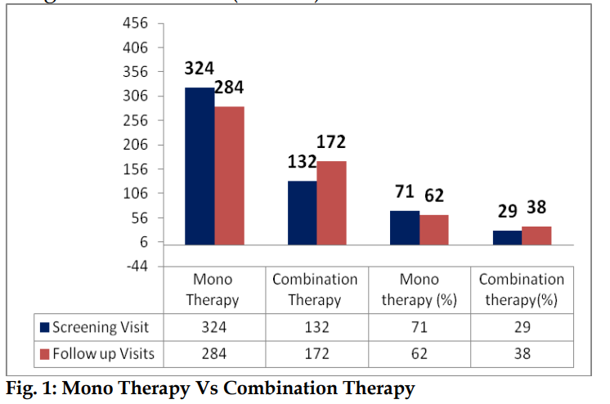
9% of patients who treated with mono therapy were changed to combination therapy because of their blood pressure value was not fall within normal range (i.e.) In overall 71% patients were treated with mono therapy and 29% patients treated with combination therapy during the screening visit was observed. In follow up visits 62% of patients were treated with mono therapy and 38% patients treated with combination therapy was observed .

Slide 7
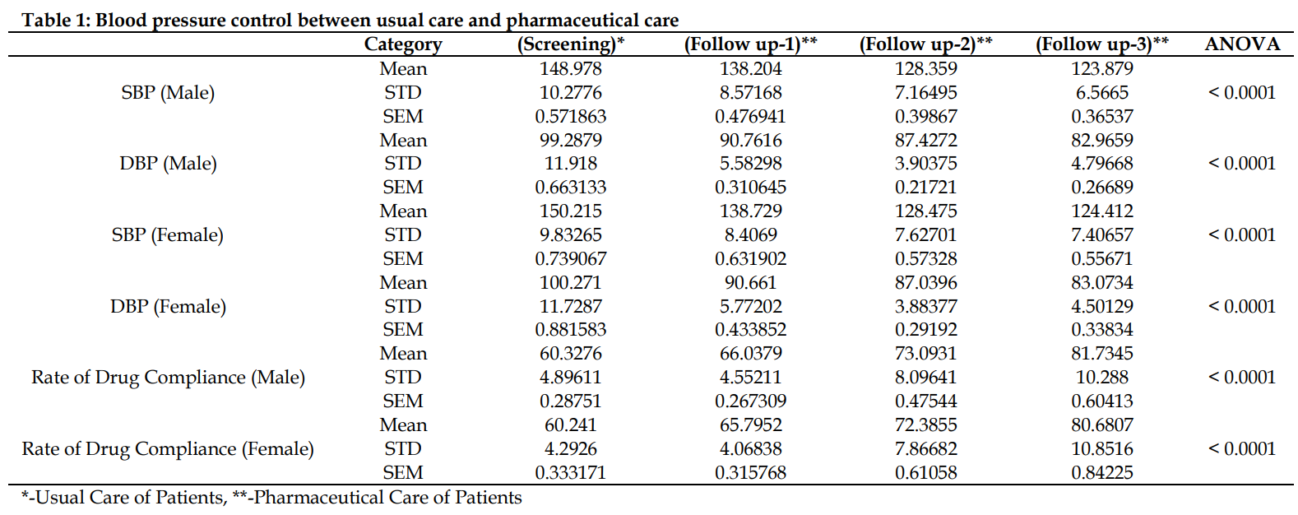

Slide 8
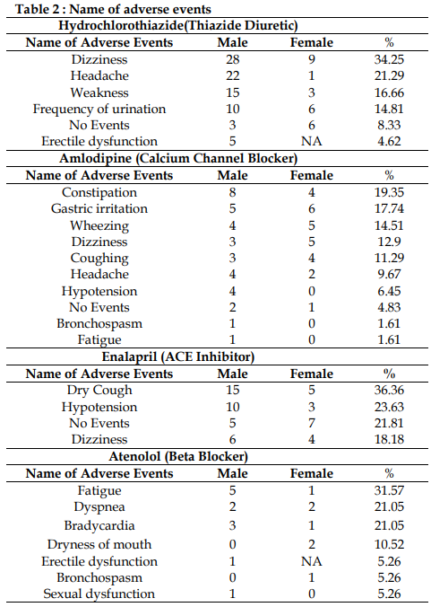
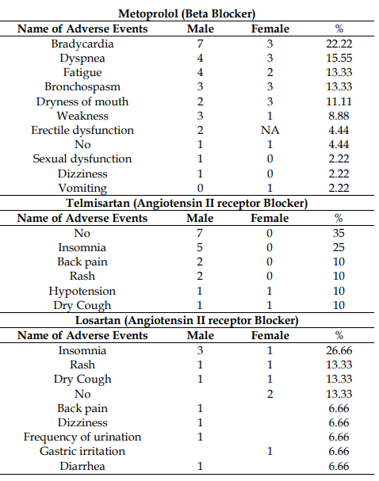

Slide 9
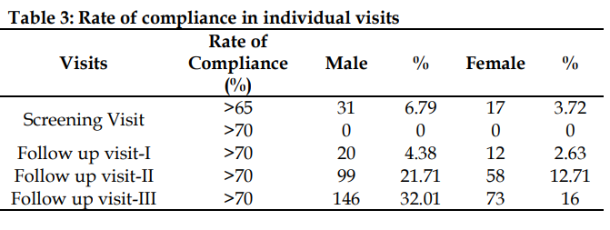

Slide 10
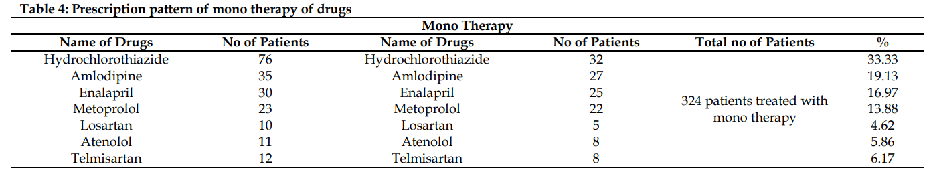

Slide 11
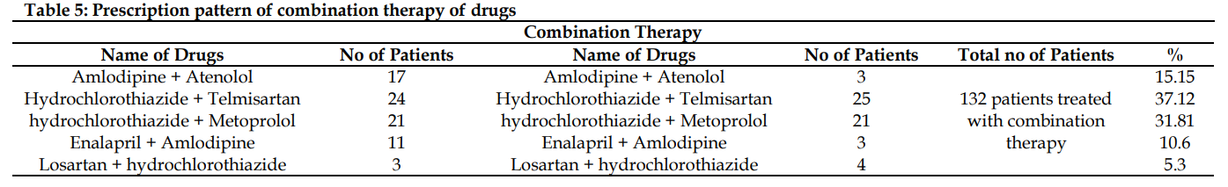

Slide 12
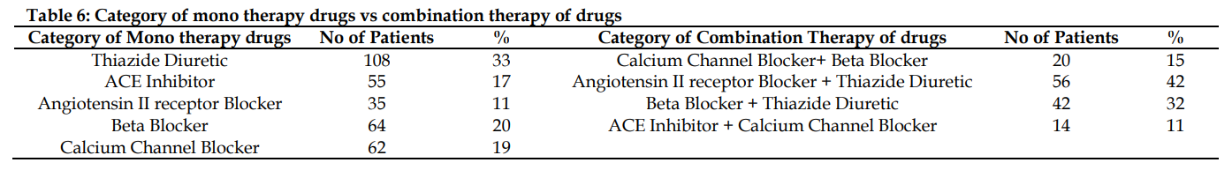

Slide 13
RESULTS
Table 1 - These results showed blood pressure could be adequately controlled with the help of mono therapy as only 9% of patients in our study changed from mono therapy to combination therapy and also pharmaceutical care helped the blood pressure control to normal level .
Table 2 - Dizziness, weakness, gastric irritation, constipation, dyspnea, bradycardia was mostly observed adverse events. Erectile dysfunction is the common adverse events of beta blockers but we observed in only few patients. The reported adverse events for each class of drugs are mentioned .
Table 3 - We measured rate of compliance to the patients in every visit. The patient should reach >=70% for compliance in all the visits, we was noticed that pharmacists who distribute the medicines did not give adequate written or oral instructions and also the patients were not aware about the knowledge of disease and medication so the patients were not compliance initially However, rate of compliance was improved from the follow up visit after the principal researcher educated the patients and the pharmacist about the medication knowledge and importance of compliance .
04-09-2024
13

Slide 14
DISCUSSION
India is not only facing the epidemic of Coronary Artery Disease but also of obesity, diabetes mellitus, and hypertension. Prevalence of hypertension has remained stable or has decreased in developed countries during the past decade; it has dramatically increased in developing countries like India . A prescription based study is considered to be one of the most effective methods to assess and evaluate the prescribing pattern of doctors and dispensing practice of pharmacists. It is also important to consider the recommendations of international bodies on hypertension that help to improve prescribing practice of the doctors and ultimately, the clinical standards . The present study consists 4 visits that include, screening visit, follow up visit-1 to follow up visit-3. Out of 500 patients only 456 patients were treated with either mono therapy or combination therapy of drugs were observed, remaining 44 patients were excluded from this study however they were treated with lifestyle modification but we did not show their results here. the rate of controlled BP among hypertensive patients was low at initial stage because lack of pharmacist interaction with patients and lack of instruction provided to the patients by pharmacist and doctors.
04-09-2024
14

Slide 15
CONCLUSION
To antihypertensive drugs was a significant factor for achieving blood pressure control but most of them were poor compliance and poor knowledge on disease and medication at initial stages however that was improved by pharmaceutical care in follow up visits. There is need for effective measures to improve adherence and educate them about the disease and medication knowledge among patients with Hypertension.
04-09-2024
15

Slide 16
REFERENCE
Lawes CM, Vander Hoorn S, Rodgers A. Global burden of blood pressure related disease, 2001. Lancet 2008; 3(371):1513-8.
Egan BM, Zhao Y, Axon RN. US trends in prevalence, awareness, treatment, and control of hypertension, 1988-2008. JAMA. 2010; 303: 2043-50.
Hansson L, Dahlof B, Gudbrandsson T, Hellsing T, Kullman S, Kuylenstierna J. Antihypertensive effect of felodipine or hydralazine when added to beta-blocker therapy. J Cardiovasc Pharmacol. 1988; 12:94-101.
Kjeldsen SE, Farsang C, Sleigh P, Mancia G. International Society of Hypertension. J Hypertens. 2001; 19:2285-8.
Ramsay LE. British Hypertension Society Guideline for hypertension management. Br Med J. 1999; 319:630-5.
Kapoor B, Raina RK, Kapoor S. Drug prescribing pattern in a teaching hospital. Ind J Pharmacol. 1985; 1:168.
Pradhan SC, Shewade DG, Shashindran CH, Bapna JS. Drug utilization studies. National Med J India. 1988; 1:185.
04-09-2024
16

Slide 17
8. Salvetti A, Ghiadoni L. Thiazide Diuretics in the Treatment of Hypertension: An
Update. Journal of the American Society of Nephrology. 2006; 17(4): S25-S29.
9. Psaty BM, Lumley T, Furberg CD, Schellenbaum G, Pahor M, Alderman MH.
Health outcomes associated with antihypertensive therapies used as first-line
agents: A systematic review and meta-analysis. Journal of the American Medical
Association. 1997; 277:739-45
10. Chaturvedi M, Jindal S, Kumar R. Lifestyle modification in hypertension in the
Indian context. J Indian Acad Commun Med. 2009; 10:46-51.
11. Yuen YH, Chang S, Chong CK, Lee SC, Critchlev JA, Chan JC. Drug utilization
in a hospital general medical outpatient clinic with particular reference to
antihypertensive and antidiabetic drugs. J Clin Pharm Ther. 1998; 23:287-94.

Slide 18
8. Salvetti A, Ghiadoni L. Thiazide Diuretics in the Treatment of Hypertension: An
Update. Journal of the American Society of Nephrology. 2006; 17(4): S25-S29.
9. Psaty BM, Lumley T, Furberg CD, Schellenbaum G, Pahor M, Alderman MH.
Health outcomes associated with antihypertensive therapies used as first-line
agents: A systematic review and meta-analysis. Journal of the American Medical
Association. 1997; 277:739-45
10. Chaturvedi M, Jindal S, Kumar R. Lifestyle modification in hypertension in the
Indian context. J Indian Acad Commun Med. 2009; 10:46-51.
11. Yuen YH, Chang S, Chong CK, Lee SC, Critchlev JA, Chan JC. Drug utilization
in a hospital general medical outpatient clinic with particular reference to
antihypertensive and antidiabetic drugs. J Clin Pharm Ther. 1998; 23:287-94.

Slide 19
THANK YOU

