Slide 1

JOURNAL CLUB
Prescription drugs use during pregnancy in Ethiopia: A systematic review and meta-analysis
Yohanes Ayele1 , Abraham Nigussie Mekuria2, Assefa Tola3 Kirubel Minsamo Mishore1 and Fisseha Bonja Geleto
Department of Clinical Pharmacy, College of Health and Medical Sciences, Haramaya University, Harar, Ethiopia 2 Department of Pharmacology, College of Health and Medical Sciences, Haramaya University, Harar, Ethiopia 3 Department of Epidemiology and Biostatistics, College of Health and Medical Sciences, Haramaya University, Harar, Ethiopia 4 Department of Medical laboratory, College of medicine and health science, Hawassa University, Hawassa, Ethiopia
SAGE Open Medicine Volume 8: 1 –10 © The Author(s) 2020
05-09-2024
1

Slide 2
ABSTRACT
Background: The selection of safe drugs for pregnant women in developing countries, such as Ethiopia, where there are limited options of drugs would be challenging. Hence, the aim of this review was to determine the extent of prescribed drugs use and their potential to cause fetal harm among pregnant women in Ethiopia based on the United States Food and Drug Administration risk category.
Methods: Relevant studies were identified through systematic searches conducted in PubMed, HINARI, Google Scholar and Researchgate. Data on study characteristics and outcomes were extracted using the format developed in Microsoft Excel. The primary measure was pooled prevalence of prescription drugs use during pregnancy. The I2 index was used to assess heterogeneity among studies. The presence of publication bias across studies was evaluated using funnel plot. A random effects model was used to estimate the pooled prevalence.
Results: A total of nine studies published between 2013 and 2019 were included. The pooled prevalence of prescription drugs during pregnancy, excluding minerals and vitamins, was 45.9 (95%CI: 29.3, 62.5)%. The pooled prevalence of prescription drug use, including minerals and vitamins, was 86.9 (95%CI: 81.2, 92.6)%. The pooled proportion of medications used based on the United States Food and Drug Administration risk category was 56.1 (95%CI: 43.0, 68.4)%, 29.0 (95%CI: 27.9, 30.1)%, 12.1 (95%CI: 7.9, 18.1)%, 4.1 (95%CI: 3.6, 4.6)%, and 2.5 (95%CI: 1.8, 3.6)% for the United States Food and Drug Administration fetal risk category “A,” “B,” “C,” “D,” and “X,” respectively.
Conclusion: The use of prescription drugs during pregnancy, excluding supplements, in Ethiopia was high. Drugs with evidence of fetal harm were widely used. Hence, health care providers should select relatively safe drugs. Stakeholders should ensure safe prescribing practice for pregnant women through developing guidelines and updating professionals on the fetal risk status of commonly prescribed drugs.
05-09-2024
2

Slide 3
INTRODUCTION
The use of drugs during pregnancy is a concern due to asso ciated risk for the fetus.1 Since it is difficult to determine the effects of drugs on pregnant women and their fetus through clinical trial due to maternal and fetal safety concern and ethical considerations, the use of nearly all drugs is not rec ommended during pregnancy
Medication used during pregnancy can be teratogenic. According to the United States Food and Drug Administration (US-FDA), the term teratogen refers a drug with the poten tial of producing abnormal development in an embryo or fetus used in clinical dose in human
The extent of fetal damage by drugs used during preg nancy is dependent on many factors, including fetus’s stage of development
In some pregnancy, the use of prescription drugs is highly beneficial for both mother and fetus. Mothers may enter into pregnancy with chronic disease, such as epilepsy, diabetes mellitus, asthma, hypertension, migraine, and severe depres sion, or develop disease during pregnancy which is not only dangerous for mother but also for the fetus.
It is important to consider the type of medications used during pregnancy. Generally, medications are categorized based on the harm they can pose on the fetus.
According to the FDA risk category, the drugs in category “A” are considered as safe, whereas for drugs categorized under “B” and “C” class, there is lack of evidence on the risk to human fetus or positive evidence is reported in animal studies. Category “D” and “X” is for drugs with clear risk of fetal abnormality, and “X” is absolutely contraindicated, whereas “D” can be used in certain situation where the dis ease carries higher risk for both mother and fetus, such as epilepsy.
05-09-2024
3

Slide 4
OBJECTIVE OF STUDY
The aim of this review was to determine the extent of prescribed drugs use and their potential to cause fetal harm among pregnant women in Ethiopia based on the United States Food and Drug Administration risk category.
05-09-2024
4

Slide 5
METHODOLOGY
Study design – systematic review
Study population – 4762 people
Study period - 2013 and 2019
INCLUSION CRITERIA - There were no restrictions on publication year, but only stud ies that were
written in English and conducted in Ethiopia were considered
EXCLUSION CRITERIA - Studies reporting utilization rate of drugs other than prescription drugs,
such as self-med ication, illicit drugs, and traditional medicines. studies with
unrelated or insufficient or missing outcome measures

Slide 6
DATA COLLECTION - The search was conducted in September 2019 and checked for a newly published
article up until the review process was finished on PubMed and HINARI using the following key words and
indexing terms: “prescription drug,” “pregnancy,” and “ Ethiopia.” Advanced Google Scholar and Research
gate search was also conducted to identify other relevant pub lished and unpublished works, including
dissertations, insti tutional repositories, and organizational manuals, among others. Boolean operators
(AND, OR) and truncation were used when appropriate to increase the number of relevant findings.
In addition, we searched reference lists from retrieved articles to identify further relevant studies.
STUDY PROCEDURE - The records retrieved from different databases were exported to EndNote version .
The original articles identified using the search strategy were subject to screening by two inde pendent reviewers,
Y.A. and A.T., after removing duplicate files. The title, abstract, and full text of each article were screened for
eligibility based on the established criteria. Any disagreement among the reviewers was resolved by A.N.M.
after thorough discussion.
DATA ANALYSIS - The extracted data were exported from Microsoft Excel to OpenMeta[Analyst] software
for analyses of outcome meas ures and sub-grouping. Pooled prevalence of outcomes was calculated assuming
DerSimonian–Laird random effects model at 95% confidence level (CI). The significance of het erogeneity of the
studies was assessed using I2 statistics based on I2 percent variation across studies. The presence of publication
bias was assessed by using funnel plots. A statis tical test with a p-value < 0.05 was considered significant.

Slide 7
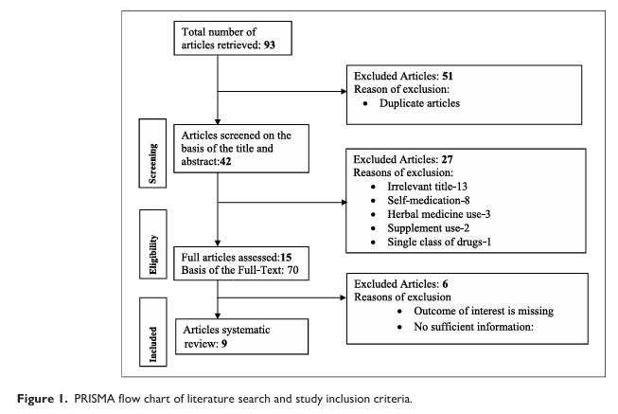
RESULTS
05-09-2024
7

Slide 8
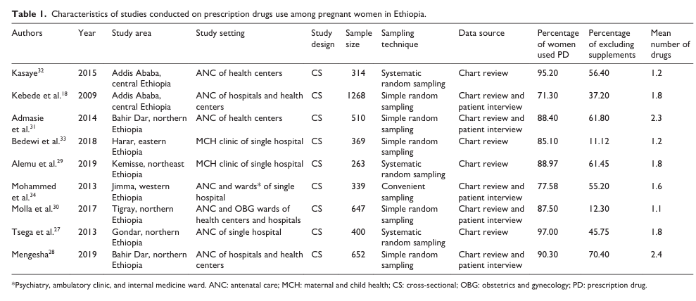

Slide 9
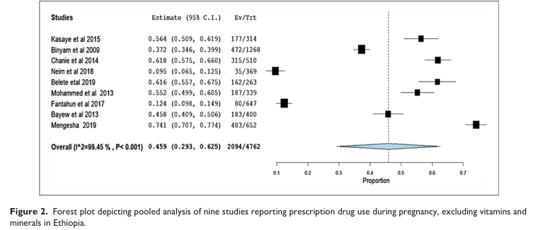

Slide 10
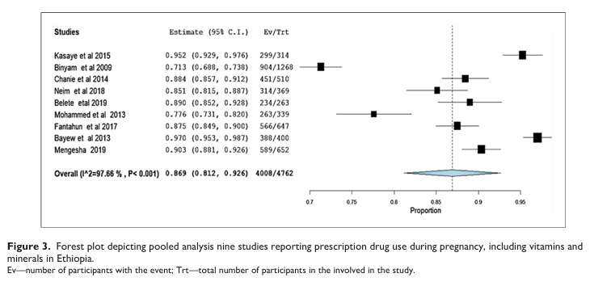

Slide 11
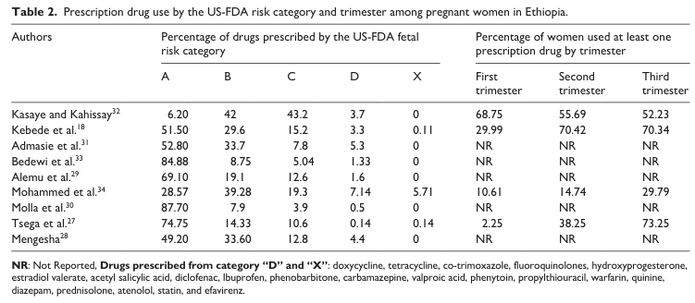

Slide 12
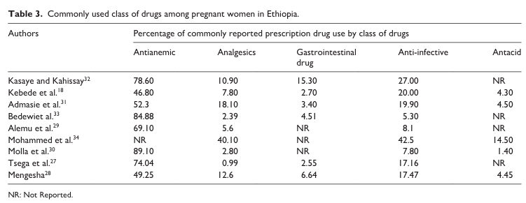
05-09-2024
12

Slide 13
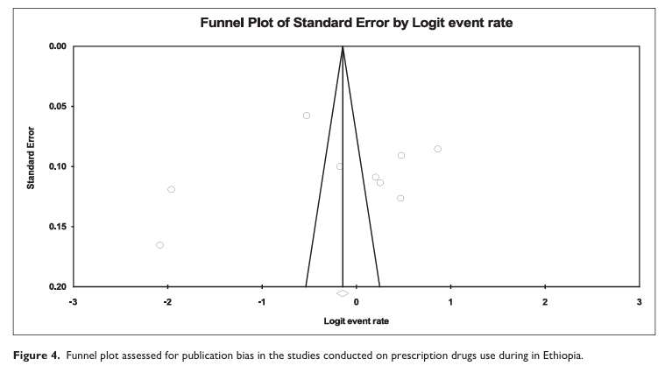
05-09-2024
13

Slide 14
DISCUSSION
The use of medications during pregnancy is common prac tice. While it is challenging to avoid the use of drugs during pregnancy, it is possible to indicate and encourage the use of medications with good safety profile. Pregnant mothers get exposed to drugs through different source; prescription drugs, over-the-counter medication, and herbal medicine. The aim of this review was to determine the extent of pre scribed drugs use and their potential for fetal risk among pregnant women in Ethiopia.
In this review, the pooled prevalence of prescription drugs use during pregnancy excluding minerals and vitamins was 45.9 (95%CI: 29.3, 62.5)%. The prevalence was less than half of the prevalence recorded when vitamins and minerals were included implying high rate supplement consumption among pregnant women, 86.9 (95%CI: 81.2, 92.6)%. The commonly prescribed supplements were iron products and vitamins, particularly folic acid separately or in combination with iron preparations. This practice is in line with World Health Organization recommendations.35 Hence, health care providers should encourage the use of other supplements additionally to iron and folic acid as there are evidences sup porting the added benefit of the use of multiple micronutri ents in developing countries. Although the figure for prevalence of prescription drugs use during pregnancy excluding supplement as is still high, it might be underestimated. This can be attributed for different reasons.

Slide 15
CONCLUSION
The use of prescription drugs during pregnancy, excluding supplements, in Ethiopia was high. The use of supple ments, particularly iron and folic acid, was highly preva lent and should be encouraged. Drugs with potential for fetal risk were widely used and there was high tendency to use prescription drugs in the later state of pregnancy. Hence, health care providers should select relatively safe drugs during pregnancy. Stakeholders should ensure safe prescribing practice for pregnant women through develop ing guidelines and updating professionals on the risk status of commonly used drugs. Finally, we recommend stand ardize approach in conducting researches on drugs use during pregnancy

Slide 16
REFERENCE
Bánhidy F, Lowry RB and Czeizel AE. Risk and benefit of drug use during pregnancy. Int J Med Sci 2005; 2(3): 100–106.
Riley LE, Cahill AG, Beigi R, et al. Improving safe and effective use of drugs in pregnancy and lactation: workshop summary. Am J Perinatol 2017; 34(8): 826–832.
Black RA and Hill DA. Over-the-counter medications in preg nancy. Am Fam Physician 2003; 67(12): 2517–2524.
Koren G, Pastuszak A and Ito S. Drugs in pregnancy. N Engl J Med 1998; 338: 1128–1137.
Sachdeva P, Patel BG and Patel BK. Drug use in pregnancy; a point to ponder! Indian journal of pharmaceutical sciences. Indian J Pharm Sci 2009; 71: 1–7.
Honein MA, Gilboa SM and Broussard CS. The need for safer medication use in pregnancy. Expert Rev Clin Pharmacol 2013; 6(5): 453–455.
US and Department of Health Human Services. Food and drug administration. Reviewer Guidance: Evaluating the Risks of Drug Exposure in Human Pregnancies, https://www.fda.gov › media › download 2005
Rurak DW, Wright MR and Axelson JE. Drug disposition and effects in the fetus. J Dev Physiol 1991; 15(1): 33–44.
Hill DS, Wlodarczyk BJ, Palacios AM, et al. Teratogenic effects of antiepileptic drugs. Expert Rev Neurother 2010; 10(6): 943–959.
Antonucci R, Zaffanello M, Puxeddu E, et al. Use of non-ste roidal anti-inflammatory drugs in pregnancy: impact on the fetus and newborn. Curr Drug Metab 2012; 13(4): 474–490.
Thorpe PG, Gilboa SM, Hernandez-Diaz S, et al. Medications in the first trimester of pregnancy: most common exposures and critical gaps in understanding fetal risk. Pharmacoepidemiol Drug Saf 2013; 22(9): 1013–1018.
05-09-2024
16

Slide 17
THANK YOU

