Slide 1
PHARMACOTHERAPEUTICS- III
JAUNDICE

Slide 2
CONTENTS :
Introduction
Definition
Epidemiology
Types and causes
Pathophysiology
Diagnosis
Treatment
Neonatal jaundice
References

Slide 3
INTRODUCTION :
Jaundice is not a disease but rather a sign that can occur in many different disease .
It is the yellow pigmentation of tissue and body fluids due to elevated serum bilirubin.
It is also known as icterus .
It is not a common chief complaint . Instead, the jaundiced patient often presents with a related symptom, (e.g., abdominal pain, pruritis, vomiting, or substance ingestion).

Slide 4
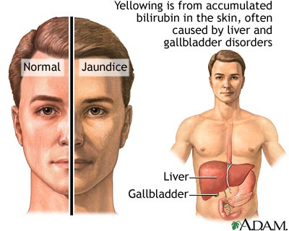

Slide 5
DEFINITION :
“Jaundice is a condition in which a person’s skin and the whites of the eyes are discolored yellow due to an increased level of bile pigment in the blood resulting from liver disease .”
Normal serum bilirubin level is 3-20µmol/L .

Slide 6
EPIDEMIOLOGY :
The prevalence of jaundice varies with age and sex; newborns and older adults are most often affected.
Approximately 20 percent of term newborns develop jaundice in the first week of life, primarily because of immaturity of the hepatic conjugation process.
Congenital abnormalities, haemolytic or bilirubin uptake disorders, and conjugation defects are also responsible for jaundice in infancy or childhood.
Viral hepatitis A is the most frequent cause of jaundice among school-age children.

Slide 7
EPIDEMIOLOGY (CONT…):
Common duct stones, alcoholic liver disease and neoplastic jaundice occur in middle-aged and older patients.
Jaundice in men is most likely to be due to cirrhosis, chronic hepatitis B, hepatoma, pancreatic cancer or sclerosing cholangitis.
Women tend to have higher rates of common duct stones, primary biliary cirrhosis and carcinoma of the gallbladder.

Slide 8
TYPES :
There are 3 types of jaundice depending on what is causing disruption to the normal removal of bilirubin from the body :
Pre-hepatic jaundice .
Intra-hepatic jaundice/ hepatocellular jaundice.
Post-hepatic jaundice/obstructive jaundice .

Slide 9
PRE-HEPATIC JAUNDICE :
It occurs when a condition or infection speeds up breakdown of red blood cells. This results in an increase in bilirubin levels in the blood and triggers the symptoms of jaundice.
Causes :
Malaria .
Sickle cell anemia .
Thalassaemia .
Crigler-najjar syndrome .
Hereditary spherocytosis .

Slide 10
INTRA-HEPATIC JAUNDICE :
It occurs when a problem in the liver. For ex-damage as the result of infection or exposure to a harmful substance, disrupts the liver’s ability to process bilirubin .
Causes :
The viral hepatitis group of infections-hepatitis A,B,&C.
Alcoholic liver disease .
Leptospirosis .
Glandular fever .
Drug misuse .
Primary biliary cirrhosis .

Slide 11
INTRA-HEPATIC JAUNDICE(CONT…):
Gilbert’s syndrome.
Liver cancer.
Exposure to substance known to be harmful to the liver, such as phenol or carbon tetrachloride.
Auto immune hepatitis.
Primary sclerosing cholangitis.
Dubin-johnson syndrome.

Slide 12
POST-HEPATIC JAUNDICE:
It is triggered when the bile duct system is damaged, inflamed or obstructed, which results in the gall bladder being unable to move bile into the digestive system .
Causes :
Gall stones obstructing the bile duct system .
Pancreatic cancer .
Gall bladder or bile duct cancer which are both relatively rare types of cancer .
Pancreatitis .

Slide 13
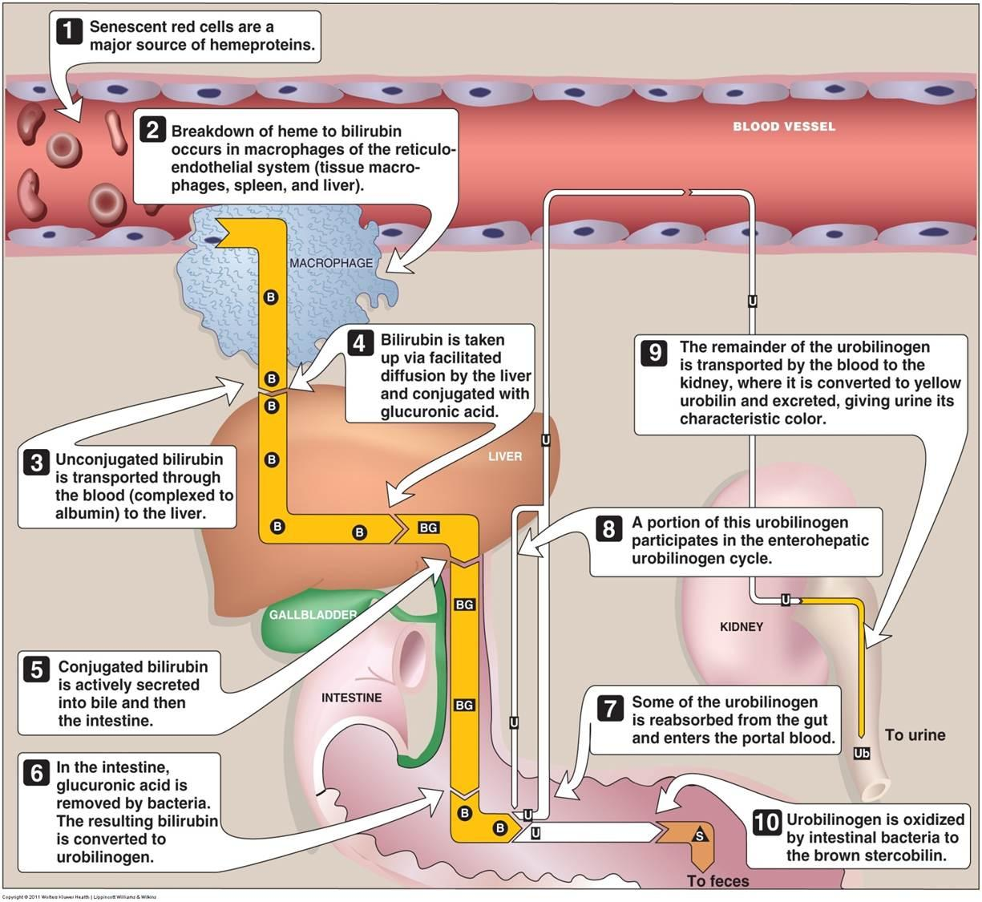
PATHOPHYSIOLOGY:

Slide 14
DIAGNOSIS :
Before certain tests physician will take the medical history for flu-like symptoms, abdominal pain, itchy skin or weight loss . And physical examinations like swelling of the legs, ankles and feet or a noticeable swelling of liver.
Urine test
Liver function and blood tests
Imaging tests
Liver biopsy

Slide 15
TREATMENT :
There’s no treatment for jaundice as such, since its not a disease but a sign of a medical problem.
Medications may or may not be necessary. After diagnosing the cause of the patient’s jaundice, the health care practitioner will direct the patient’s treatment and prescribe medications if they are necessary.
Treatment may include the following:
Supportive care

Slide 16
IV fluids in cases of dehydration.
Medications for nausea/vomiting and pain.
Antibiotics.
Antiviral medications.
Blood transfusion.
Steroids.
Chemotherapy/radiation therapy, and
Phototherapy for newborns.

Slide 17
Surgical treatment may be necessary in certain cases of cancer, congential malformations, conditions that obstruct the bile duct, gall stones and abnormalities of spleen. Some times, a liver transplant may be necessary.

Slide 18
PREVENTION:
Avoid heavy alcohol use.
Vaccines for hepatitis.
Medicines should be taken to prevent malaria before travelling to high risk regions.
Avoid potentially contaminated food/water and maintain good hygiene.
Avoid high risk behaviors such as IV drug use or unprotected intercourse.
Avoid medications that can cause hemolysis in susceptible individuals.
Avoid medications and toxins that directly damage the liver.

Slide 19
NEONATAL JAUNDICE :
Neonatal jaundice is the term used when a new born has an excessive amount of bilirubin in the blood .

Slide 20
CAUSES :
The hemoglobin of the RBC’s in the womb is different from the hemoglobin after birth.
Therefore, the rate at which newborn babies bodies breakdown pre-birth RBC and produces new ones is very quick.
This generates higher than normal levels of bilirubin that must be filtered out of blood stream by the liver and sent to the kidney for excretion.
However, an underdeveloped liver cannot filter out the bilirubin as fast as it is being produced, resulting in hyperbilirubinemia.

Slide 21
TYPES:
Physiological
Pathological

Slide 22
PHYSIOLOGICAL :
This occurs in the first few days after birth and will have cleared by day 10.
It occurs because of physiological changes taking place during the transition from intrauterine to neonatal life.
It is the consequence of : immature liver enzymes, high red cell mass.

Slide 23
PATHOLOGICAL :
This refers to jaundice that arises from factors that alter the usual process involved in bilirubin metabolism in the liver.
It is significant in the first 24hrs of life especially if there is Rhesus incompatibility.
It may persist more than 2 weeks in some conditions when the baby will be jaundice all over and may appear a muddy yellow colour.

Slide 24
RISK FACTORS :
Premature baby.
Breastfeeding.
Rhesus incompatibility.
Bruising during birth.

Slide 25
SIGNS AND SYMPTOMS:
Drowsiness.
Itchy skin.
Pale stool.
Poor-sucking/feeding.
Dark urine.

Slide 26
DIAGNOSIS:
Transcutaneous bilirubinometer.
Further, blood test are conducted like complete blood test, coomb’s test, reticulocyte count.

Slide 27
TREATMENT:
Phototherapy:
First line therapy for neonatal jaundice.
Reduces TSB level.
Its efficacy depends on wavelength and luminance of light source and the skin surface area illuminated by the light.
Intravenous immunoglobulin.
Exchange transfusion threshold.
Intravenous albumin.

Slide 28
NEWER DRUGS:
Tin-mesoporphyrin-The administration of a single intramuscular dose of tin-mesoporphyrin in glucose-6-phosphate dehydrogenase-deficient (G-6-PD-deficient) newborns at approximately 24 hours after birth completely suppressed the development of hyperbilirubinemia, eliminating the need for phototherapy.

Slide 29
REFERENCES:
www.emedicinehealth.com.
www.nhs.uk.com.
http://drugtopics.modernmedicine.com/drug-topics/news/new-help-available-neonatal-jaundice#sthash.9eylklkE.dpuf.

Slide 30


