Slide 1
PHARMACOGNOSY & PHYTOPHARMACEUTICALS
Macro, powder and microscopic study of Liquorice.
17-09-2024
1

Slide 2
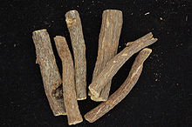
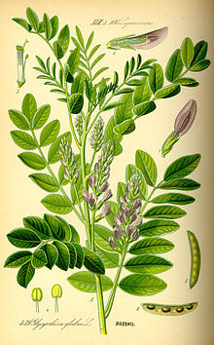
LIQUORICE
Synonyms :-Mulethi, Radix glycyrrhizae, Licorice, Jethi Madh, Yashtimadhu .
Biological Source :- It consists of subterranean peeled and unpeeled stolons, roots, and subterranean stems of Glycyrrhiza globra Linn.
Geographical Source :-It is produced in a number of countries like Iran, Russia, Spain, Greece, U.S.S.R., and India.
Family: Leguminosae
17-09-2024
2

Slide 3
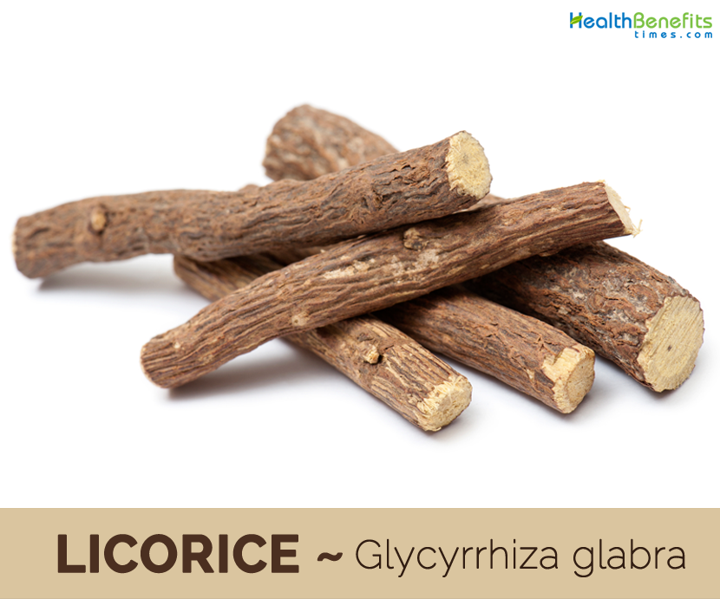
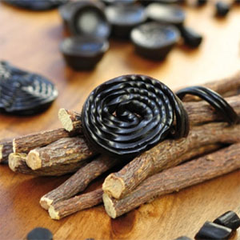
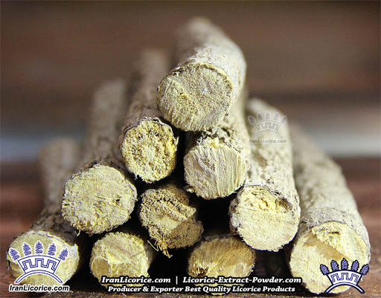
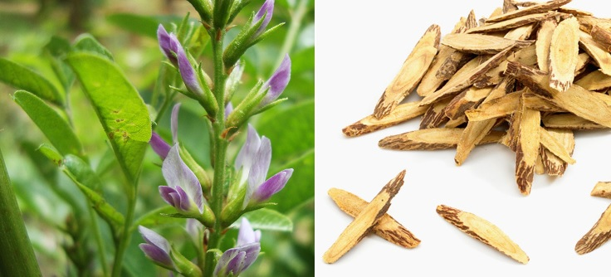
The following are the three commonly grown varieties of Glycyrrhiza glabra namely :-
G. glabra var. Violaceae (Persian Liquorice) :- This specific species bears violet flower.
G. glabra var. gladulifera (Russian Liquorice) :- It has a distinct big stock together with a number of elongated roots but it has not got any stolon
G. glabra var. typica (Spanish liquorice) :- This specific plant bear only purplish blue coloured papilionaceous flower.
17-09-2024
3

Slide 4
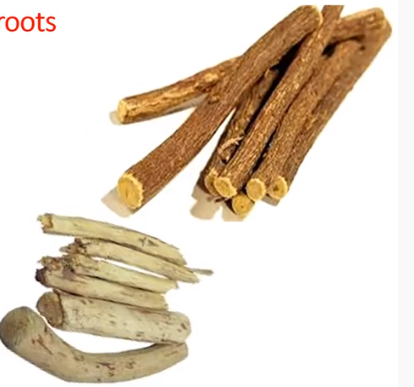
MACROSCOPIC CHARACTERISTICS:-
Colour :- Unpeeled liquorice externally yellowish brown or dark brown & internally yellowish colour.
Odour :- Faint & Characteristics
Taste :- Sweet
Size :- length :- 10 to 50 cm
Diameter :- 2 cm
Shape :- Unpeeled drug straight and nearly cylindrical
17-09-2024
4

Slide 5
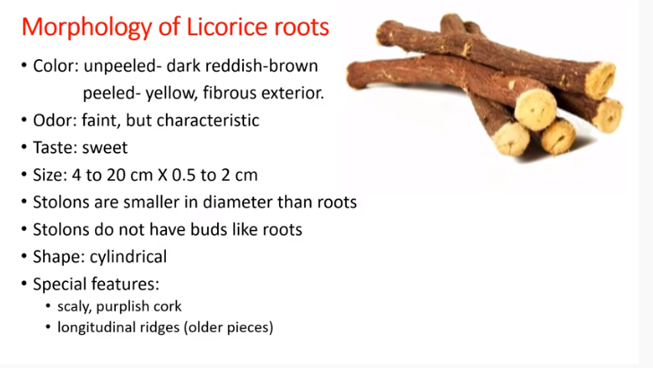
17-09-2024
5

Slide 6
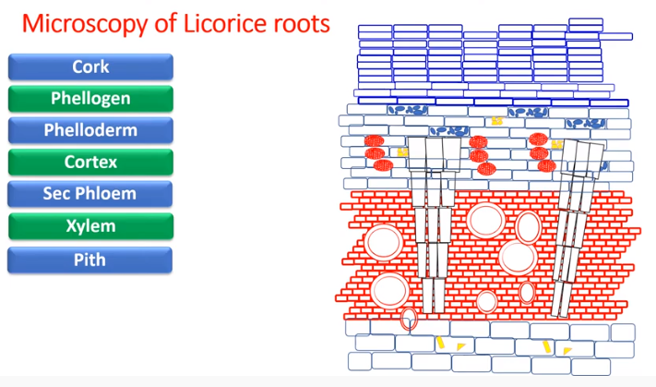
17-09-2024
6

Slide 7
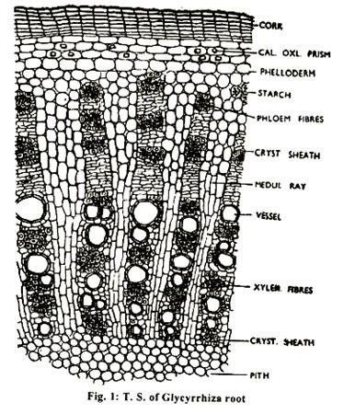
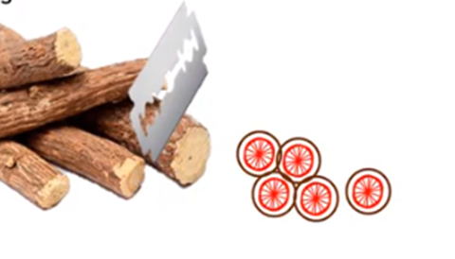
17-09-2024
7

Slide 8
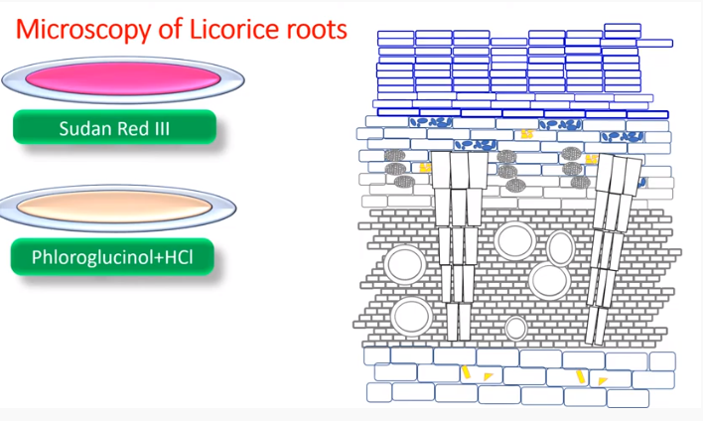
17-09-2024
8

Slide 9
MICROSCOPICAL CHARACTERS:
1. Periderm: Phellem (cork):
Several layers with tabular cells, outer layers are filled with reddish brown contents and inner few are colourless.
Phellogen: Indistinct Phelloderm: 3-5 layered, immediately below cork, parenchymatous cells whose corners thickened with cellulose (collenchymatous); some cells contain prism of calcium oxalate and minute starch grain.
2. Secondary phloem:
Wide zone with numerous concentrically arranged bundles of phloem fibres each bundle is surrounded by a parenchymatous sheath whose cells contain prisms of calcium oxalate. Radially the fibre bundles alternated with soft phloem elements and tangentially with medullary rays.
3. Medullary rays:
Distinct, bi-to multiseriate, parenchymatous, in continuation with those of xylem however, the rays are narrower in the xylem region and become wider in the phloem region.
17-09-2024
9

Slide 10
4. Secondary xylem:
Well represented, divided (like phloem) by large medullary rays at regular interval. Xylem consists of vessel, fibres and lignified wood parenchyma.
The vessels, fibres and lignified wood parenchyma the vessels, fibres and lignified wood parenchyma the vessels which are relatively wide show scalariform and bordered pitted thickenings.
Wood fibres are also unsheathed by a layer of parenchyma containing crystals. Starch is present in the wood parenchyma.
5. Pith:
Consist of large parenchyma with intercellular spaces and contain few starch grains. Pith absent in root.
17-09-2024
10

Slide 11
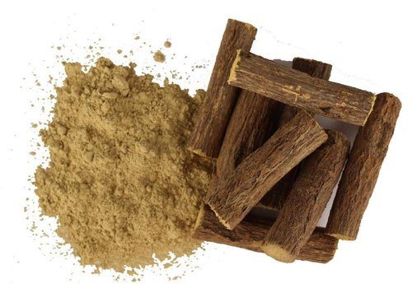
POWDER ANALYSIS OF LIQUORICES:
1. Organoleptic characters:
(i) Colour: Pale, yellowish- brown.
(ii) Odour: Faint, characteristic.
(iii) Taste: Sweet.
(iv) Odour: Faint, characteristic.
(v) Taste: Sweet
17-09-2024
11

Slide 12
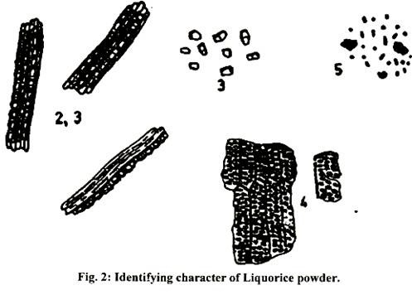
2. Fibres:
They are yellow coloured fibres in bundles of about 10- 15; the tips of the bundles appear fringed like that of an electric cable.
3. Calcium oxalate:
Parenchymatous sheath of small parenchymatous cell (crystal sheath), each containing a single prism of calcium oxalate, encircle the above fibres; scattered prism are also seen (mostly twin prisms).
4. Wood elements:
vessels large, with numerous bordered pits.
5. Starch granules:
Both simple (oval to elongated) and compound (not many), minute.
17-09-2024
12

Slide 13
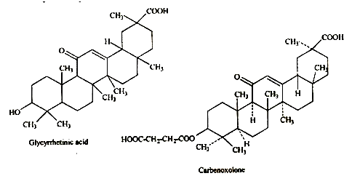
Chemical constituents:
1. Saponin glycosides: Glycyrrhizin and glycyrrhetic acid.
2. Flavonoids: Liquiritin, liquiritigenin, isoliquiritin and isoliquiritigenin.
3. Coumarin derivatives: Herniarin, umbelliferone.
4. Bitter principle: glyceramarin
5. Asparase, β-sitosterol, starch, resin and malic acid
.
17-09-2024
13

Slide 14
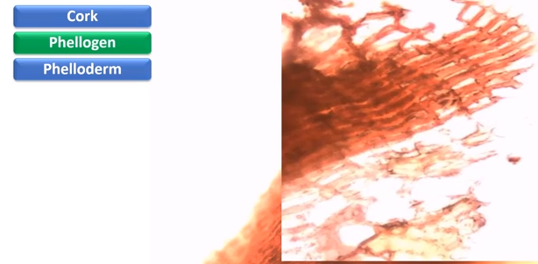
17-09-2024
14

Slide 15
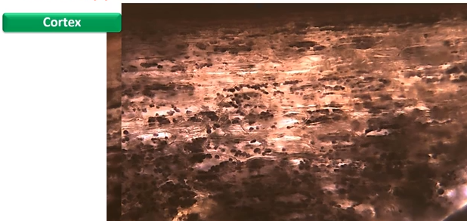
17-09-2024
15

Slide 16
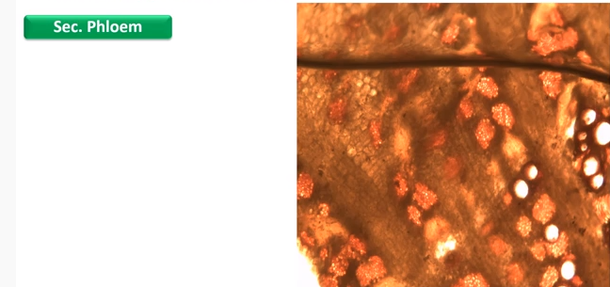
17-09-2024
16

Slide 17
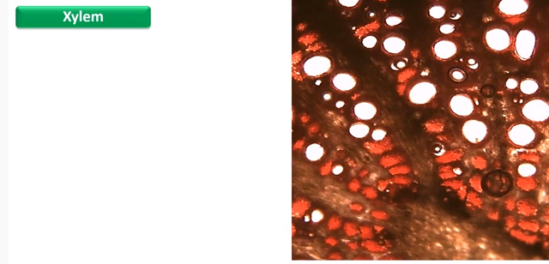
17-09-2024
17

Slide 18
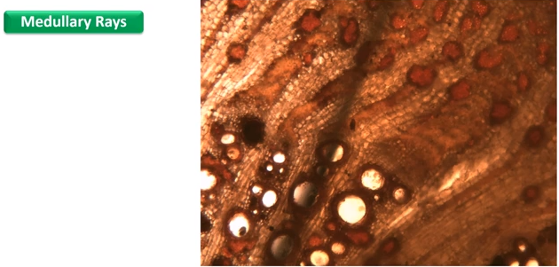
17-09-2024
18

Slide 19
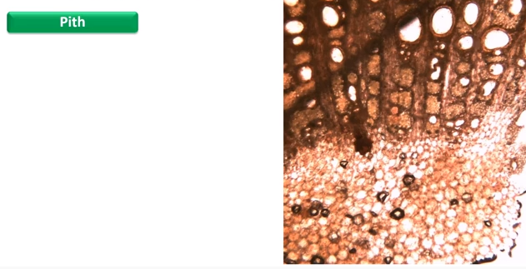
17-09-2024
19

