Slide 1
PHARMACOGNOSY & PHYTOPHARMACEUTICALS
Macro, powder and microscopic study of Liquorice.
17-09-2024
1

Slide 2
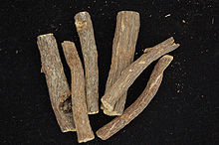
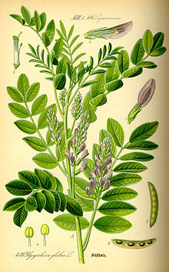
LIQUORICE
Synonyms :-Mulethi, Radix glycyrrhizae, Licorice, Jethi Madh, Yashtimadhu .
Biological Source :- It consists of subterranean peeled and unpeeled stolons, roots, and subterranean stems of Glycyrrhiza globra Linn.
Geographical Source :-It is produced in a number of countries like Iran, Russia, Spain, Greece, U.S.S.R., and India.
Family: Leguminosae
17-09-2024
2

Slide 3
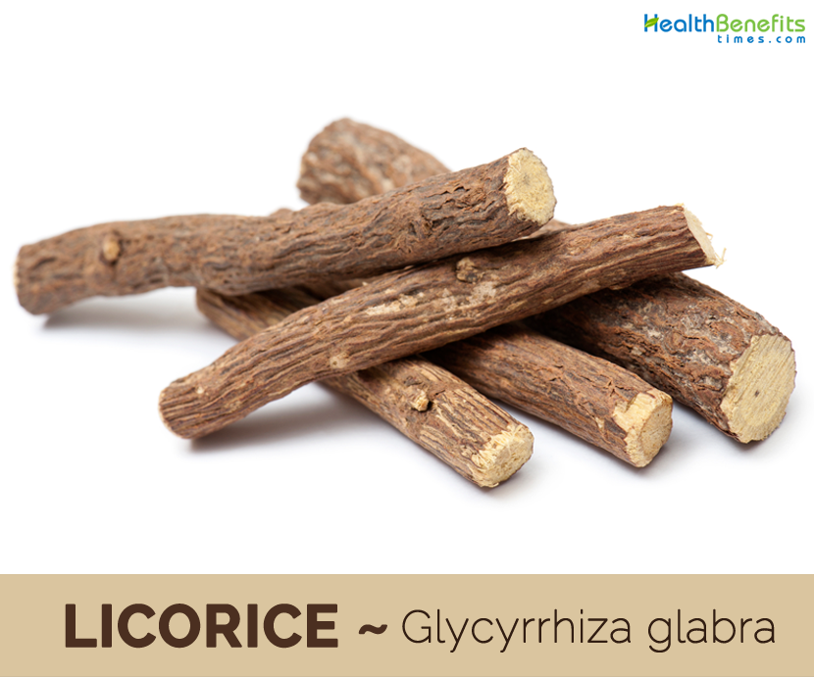
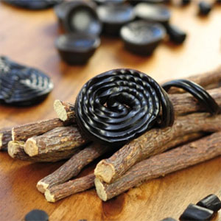
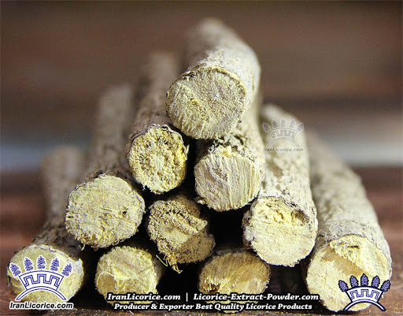
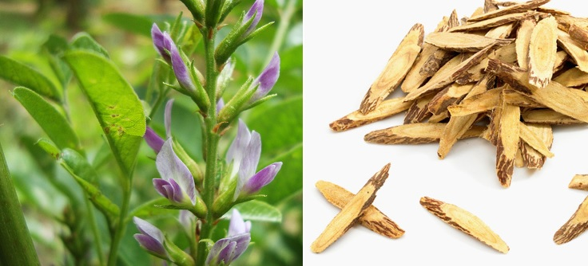
The following are the three commonly grown varieties of Glycyrrhiza glabra namely :-
G. glabra var. Violaceae (Persian Liquorice) :- This specific species bears violet flower.
G. glabra var. gladulifera (Russian Liquorice) :- It has a distinct big stock together with a number of elongated roots but it has not got any stolon
G. glabra var. typica (Spanish liquorice) :- This specific plant bear only purplish blue coloured papilionaceous flower.
17-09-2024
3

Slide 4
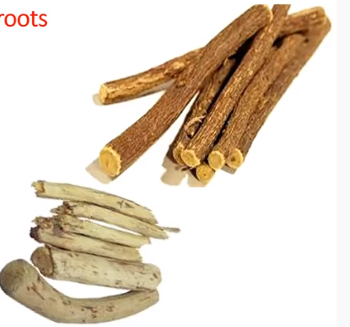
MACROSCOPIC CHARACTERISTICS:-
Colour :- Unpeeled liquorice externally yellowish brown or dark brown & internally yellowish colour.
Odour :- Faint & Characteristics
Taste :- Sweet
Size :- length :- 10 to 50 cm
Diameter :- 2 cm
Shape :- Unpeeled drug straight and nearly cylindrical
17-09-2024
4

Slide 5
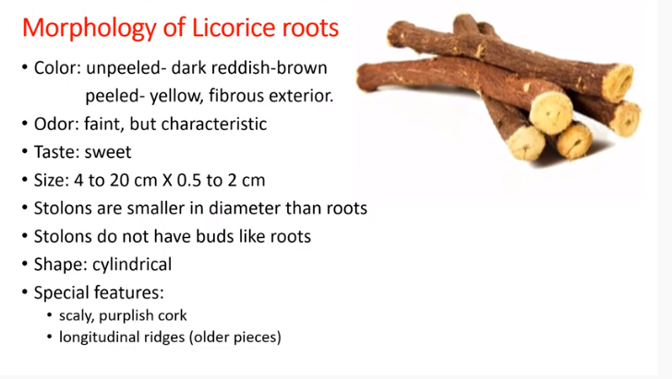
17-09-2024
5

Slide 6
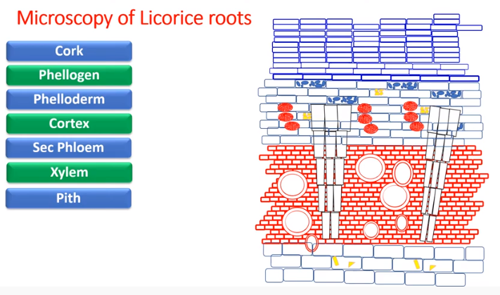
17-09-2024
6

Slide 7
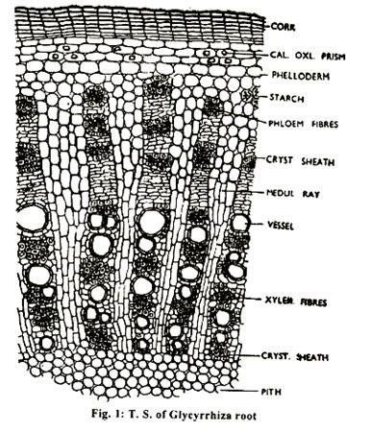
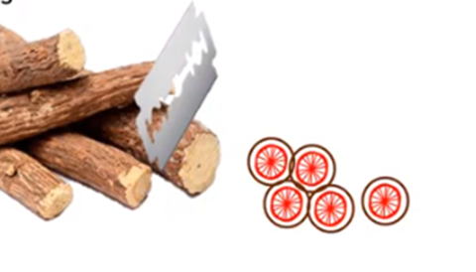
17-09-2024
7

Slide 8
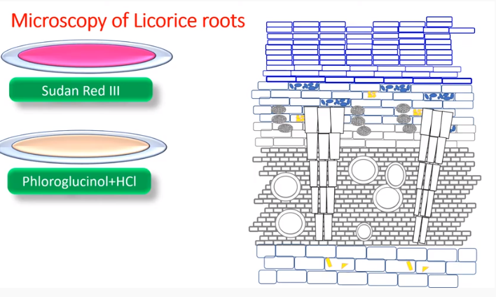
17-09-2024
8

Slide 9
MICROSCOPICAL CHARACTERS:
1. Periderm: Phellem (cork):
Several layers with tabular cells, outer layers are filled with reddish brown contents and inner few are colourless.
Phellogen: Indistinct Phelloderm: 3-5 layered, immediately below cork, parenchymatous cells whose corners thickened with cellulose (collenchymatous); some cells contain prism of calcium oxalate and minute starch grain.
2. Secondary phloem:
Wide zone with numerous concentrically arranged bundles of phloem fibres each bundle is surrounded by a parenchymatous sheath whose cells contain prisms of calcium oxalate. Radially the fibre bundles alternated with soft phloem elements and tangentially with medullary rays.
3. Medullary rays:
Distinct, bi-to multiseriate, parenchymatous, in continuation with those of xylem however, the rays are narrower in the xylem region and become wider in the phloem region.
17-09-2024
9

Slide 10
4. Secondary xylem:
Well represented, divided (like phloem) by large medullary rays at regular interval. Xylem consists of vessel, fibres and lignified wood parenchyma.
The vessels, fibres and lignified wood parenchyma the vessels, fibres and lignified wood parenchyma the vessels which are relatively wide show scalariform and bordered pitted thickenings.
Wood fibres are also unsheathed by a layer of parenchyma containing crystals. Starch is present in the wood parenchyma.
5. Pith:
Consist of large parenchyma with intercellular spaces and contain few starch grains. Pith absent in root.
17-09-2024
10

