Slide 1
PHARMACOTHERAPEUTICS
UNIT NO- 01(b) & NAME- LIVER DISORDERS
16-09-2024
1

Slide 2
LIVER DISORDERS
Liver is the largest organ in the body.
Weighs about 1500 to 1600 gms.
Reddish brown triangular pyramid shaped, in Hypochondrium and most of epigastrium.
It performs a wide range of metabolic activities necessary for homeostasis, nutrition and immune defence.
It is composed largely of epithelial cells (hepatocytes), which are bathed in blood derived from the hepatic portal veins and hepatic arteries.
Hepatocytes are also associated with an extensive system of minute canals, which form the biliary system into which products are secreted.
16-09-2024
2

Slide 3
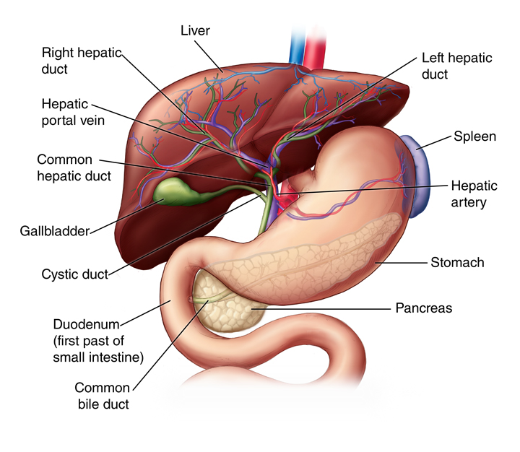
ANATOMY
The liver is located in the upper right-hand portion of the abdominal cavity, beneath the diaphragm, and on top of the stomach, right kidney, and intestines.
Shaped like a cone, the liver is a dark reddish-brown organ that weighs about 3 pounds.
There are 2 distinct sources that supply blood to the liver, including the following:
  Oxygenated blood flows in from the hepatic artery
  Nutrient-rich blood flows in from the hepatic portal vein
Notes:
The liver holds about one pint (13%) of the body's blood supply at any given moment. The liver consists of 2 main lobes. Both are made up of 8 segments that consist of 1,000 lobules (small lobes). These lobules are connected to small ducts (tubes) that connect with larger ducts to form the common hepatic duct. The common hepatic duct transports the bile made by the liver cells to the gallbladder and duodenum (the first part of the small intestine) via the common bile duct.

Slide 4
FUNCTIONS OF THE LIVER
Production of bile, which helps carry away waste and break down fats in the small intestine during digestion
Production of certain proteins for blood plasma
Production of cholesterol and special proteins to help carry fats through the body
Conversion of excess glucose into glycogen for storage (glycogen can later be converted back to glucose for energy) and to balance and make glucose as needed
Regulation of blood levels of amino acids, which form the building blocks of proteins
Processing of hemoglobin for use of its iron content (the liver stores iron)
Conversion of poisonous ammonia to urea (urea is an end product of protein metabolism and is excreted in the urine)
Clearing the blood of drugs and other poisonous substances
Regulating blood clotting
Resisting infections by making immune factors and removing bacteria from the bloodstream
Clearance of bilirubin, also from red blood cells. If there is an accumulation of bilirubin, the skin and eyes turn yellow.

Slide 5
ALCOHOLIC LIVER DISEASE
Alcoholic liver disease (ALD), also called alcohol-related liver disease (ARLD), is a term that encompasses the liver manifestations of alcohol overconsumption, including fatty liver, alcoholic hepatitis, and chronic hepatitis with liver fibrosis or cirrhosis.
Alcohol causes liver damage, if:
Consumption of 60-80g / day (75-100ml/day) for 20yrs or more in men.
Consumption of 20g /day (25ml/day) for women significantly increase the risk of liver damage.
Women have double the risk of getting ALD when compared to men.

Slide 6
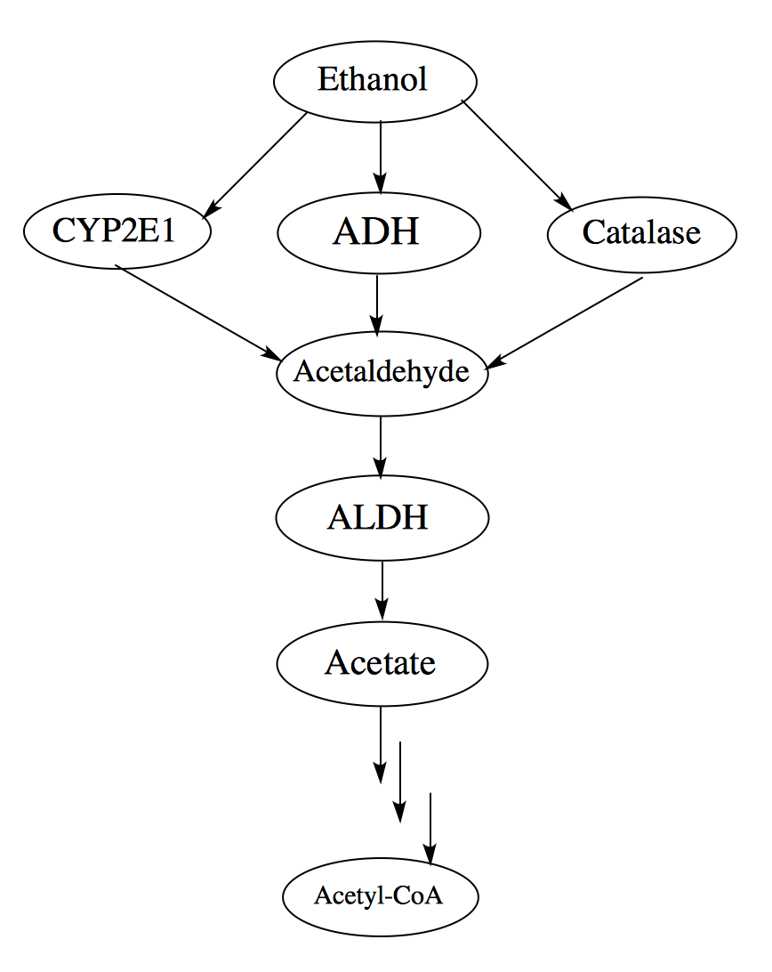
METABOLISM OF ALCOHOL

Slide 7
INCIDENCE
Prevalence of alcohol related disorders was 1.7 % worldwide and alcohol was the 3rd leading cause of death in US.
Worldwide mortality is estimated to be 150,000 per year .
Among heavy drinkers 90-100% will develop hepatic steatosis in 10 years.
Only 10-35% develop steatohepatitis and 8-20% will develop cirrhosis in the same period.
Liver cirrhosis develops in 6-14 % of those who consume > 60-80g alcohol daily for men and > 20g daily in women .
Who drink >120g daily only 13.5 % will suffer serious alcohol related injury .
Despite cessation of alcohol use only 10% will have normalization of histology and LFTs .

Slide 8
The following categories are designated by NIAA criteria :
Moderate drinking: low risk for alcohol problems
  Men: <3 drinks per day
  Women: <2 drinks per day
  People age ≥65: < 2 drinks per day
Heavy drinking: at risk for alcohol problems
  Women: >7 drinks per week or 3 drinks per occasion
  Men: >14 drinks per week or 4 drinks per occasion
Binge drinking:
  Women: 4 or more drinks in a row
  Men: 5 or more drinks in a row

Slide 9
RISK FACTORS:
Quality of alcohol taken
Pattern of drinking
Gender
Hepatitis C infection
Genetic factors
Iron overload
diet

Slide 10
SYMPTOMS
Digestive symptoms:
Pain & swelling in the abdomen
Decrease appetite & weight loss
Nausea and vomiting
Fatigue
Dry mouth & increased thirst
Bleeding from enlarged veins in the lower part of the esophagus

Slide 11
SYMPTOMS (cont…)
Skin problems:
Yellow color in the skin, mucus membranes or eyes.
Small, red spider like veins on the skin
Very dark or pale skin
Redness on the feet/ hands
Itching

Slide 12
Brain and nervous system symptoms includes:
Problems with thinking, memory and mood
Fainting and light headedness
Numbness in legs and feet.

Slide 13
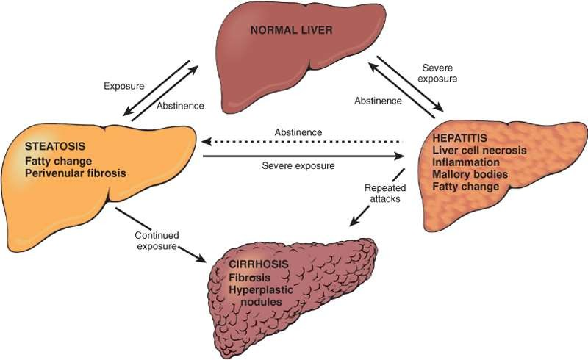
PATHOLOGICAL CHANGES

Slide 14
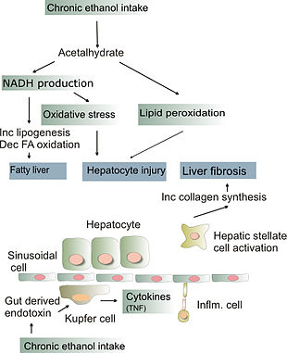
PATHOPHYSIOLOGY

Slide 15
STAGES OF LIVER DAMAGE
Fatty liver- deposits of fat lead to liver enlargement
Liver fibrosis- scar tissue forms
Cirrhosis- growth of connective tissue destroys liver cells

Slide 16
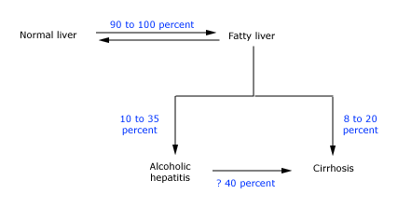
PROGRESSION IN ALCOHOLIC LIVER DISEASE

Slide 17
FATTY LIVER/ STEATOSIS:
Fatty changes/ steatosis is the accumulation of fatty acids in liver cells.
Alcoholism causes development of large fatty globules throughout the liver and can begin to occur after a few days of heavy drinking.
Alcohol metabolizes by ADH into acetaldehyde.
Aldehyde dehydrogenase into acetic acid which is finally oxidised into CO2 and H2O.
A higher NADH concentration induces fatty acid synthesis while a decrease NAD level results in decrease fatty acid oxidation.
Triglycerides accumulate resulting in fatty acid.
SYMPTOMS:
Weakness
Nausea
Abdominal pain
Loss of appetite
Malaise

Slide 18
ALCOHOLIC HEPATITIS
SYMPTOMS:
Pain/ tenderness in the abdomen
Jaundice, spider like veins appear on the skin
Malaise
Fever
Nausea
Loss of appetite
End stage there will be hair loss, dark urine, black or pale stools, dizziness, fatigue, loss of libido, bleeding gums or nose, edema, vomiting, muscle cramps, weight loss.
Alcoholic hepatitis is characterized by the inflammation of hepatocytes. Between 10 to 35% of heavy drinkers develop alcoholic hepatitis.
Development of hepatitis is not directly related to the dose of alcohol. Some people seem more prone to this reaction than others. This is called alcoholic steatonecrosis and the inflammation appears to predispose to liver fibrosis.
Inflammatory cytokines are thought to be essential in the initiation and perpetuation liver injury by inducing apoptosis and necrosis.

Slide 19
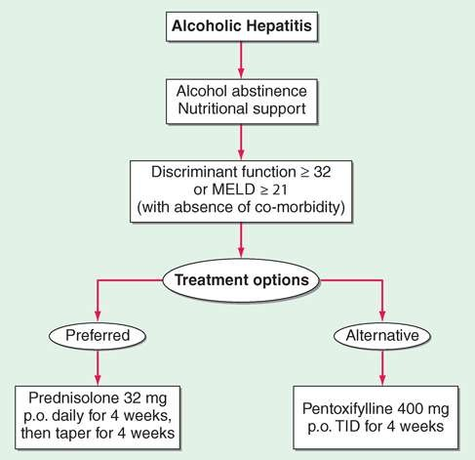

Slide 20
CIRRHOSIS
Cirrhosis is a late stage of serious liver disease marked by inflammation, fibrosis and damaged membranes preventing detoxification of chemicals in the body, ending in scarring and necrosis.
Between 10-20% of heavy drinkers will develop cirrhosis.
Acetaldehyde may be responsible for alcohol- induced fibrosis by stimulating collagen deposition by hepatic stellate cells.
Symptoms:
  Jaundice
  Hepatomegaly
  Pain and tenderness from the structural changes in damaged liver architecture.

Slide 21
DIAGNOSIS
LIVER FUNCTION TESTS:
These are simple, inexpensive and easy to perform but cannot be used in alone to make diagnosis which include-
Serum albumin levels and prothrombin time indicates hepatic protein synthesis.
Bilirubin is a marker of whole liver function, transaminase levels indicate hepatocellular injury and death.
Alkaline phosphatase levels estimate the impedance of bile flow.

Slide 22
IMAGING TEST:
An ultrasound scan, CT scan or a MRI scan also be carried. These scans produce detailed images of liver.
Imaging studies do not confirm the presence of alcoholic liver disease.
Can be used to assess for hepatic parenchymal changes.
Ultrasound, CT scan and MRI can be used to diagnosis fatty change, cirrhosis or neoplastic diseases of the liver.

Slide 23
LIVER ENDOSCOPY:
A fine needle is inserted into body and a small sample of liver cell is taken under local anaesthesia and is examined under microscope.
Biopsy may be indicated in:
Any patient with serum aminotransferases elevations that persist for more than 6 months, even if the patient is asymptomatic.
Patient who have evidence of liver failure in addition to elevated aminotransferases.
If a coagulopathy is present, transjugular biopsy is usually safer than percutaneous biopsy.
Patients in whom the diagnosis of alcoholic hepatitis is uncertain based upon clinical and laboratory findings.
Patient who may have more than one type of liver disease in whom a liver biopsy may help determine the relative contribution of these factors.
Patients in whom a more detailed understanding of prognosis is desired.

Slide 24
ENDOSCOPY:
an endoscope is a thin long flexible tube with a light and video camera at one end this tube is passed into esophagus and stomach and examine for varices.

Slide 25
SCREENING FOR ALCOHOL ABUSE
Several screening tools exist to establish the diagnosis of alcoholism, including the
CAGE,
AUDIT (Alcohol Use Disorders Identification Test).
MAST (Michigan Alcoholism Screening Test),

Slide 26
CAGE QUESTIONNAIRE
Have you ever felt the need to Cut down on drinking?
Have you ever felt Annoyed by criticism of your drinking?
Have you ever had Guilty feelings about your drinking?
Do you ever take a morning Eye opener (a drink first thing in the morning to steady your nerves or get rid of a hangover)?
One positive response to any CAGE question suggests the need for closer assessment .
A positive response to at least two questions is seen in the majority of patients with alcoholism and to all four questions in approximately 50 percent .
In comparison, over 80 percent of nonalcoholic subjects have a negative response to all four questions .

Slide 27
ALCOHOL USE DISORDER IDENTIFICATION TEST (AUDIT)
AUDIT was designed to identify patients with recent heavy drinking in addition to alcohol dependence;
AUDIT focuses on identifying heavy drinkers and has a higher sensitivity and specificity than shorter screening instruments (sensitivity 51 to 97 percent; specificity 78 to 96 percent in primary care setting)
it performs better than the CAGE questionnaire for these purposes .
A major limitation to the AUDIT is its length !!

Slide 28
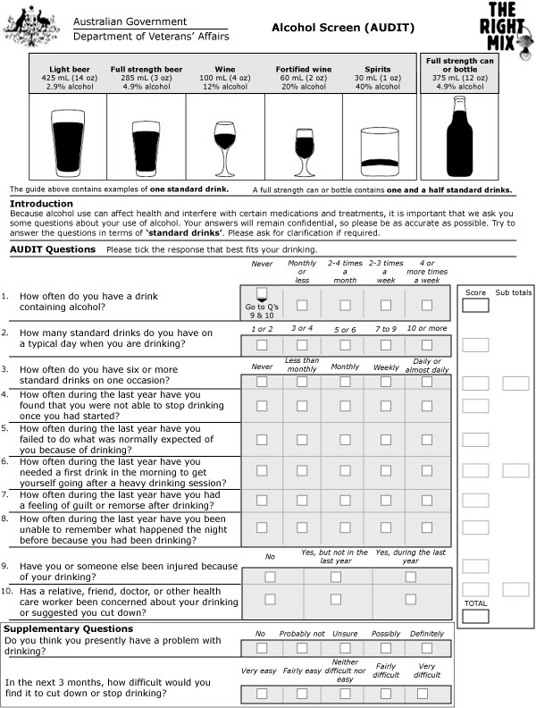

Slide 29
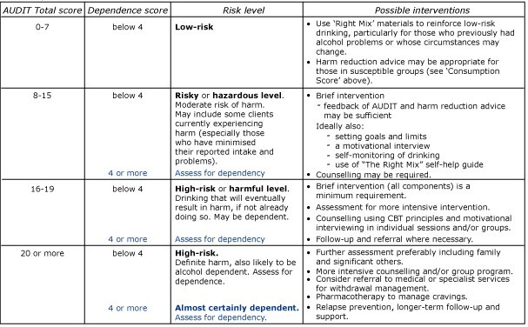

Slide 30
COMPLICATIONS
PORTAL HYPERTENSION
        Ascites
        Hepatic encephalopathy
        Pancytopenia
        Splenomegaly
        Blood vomiting
        Melena
VARICES
  Black, tarry stools
  Bloody stools
  Light headedness
  paleness
  vomiting

Slide 31
TREATMENT
Betablockers
Propranolol- 40mg initially increasing every 3-7 days, maintenance 80- 240mg/8-12hrly, not exceed 60mg/day.
Nadolol- 10-30mg/ 12 hrly PO
Timolol- 10-30mg/ 12hrly PO, maintenance 20-40mg/day
Isosorbide mononitrate
30-60mg once a day in the morning

Slide 32
ASCITES
Accumulation of fluid in the peritoneal cavity
A low salt diet may be enough to facilitate the elimination of ascites and delay reaccumulation of fluid (60-90 mEq/day).
Mild ascites is hard to notice, but severe ascites generally lead to abdominal distension.
Amounts of upto 35liters are possible.
Symptoms:
  Abdominal distension with fullness in the flanks
  Abdominal and back pain
  Gastroesophageal reflux

Slide 33
TREATMENT :
Bed rest and sodium restriction(60-90mEq/day)
Spironolactone- 100 to 400mg/day
Furosemide- 40 to 60 mg/day
Hydrochlorothiazide- 50 mg/day

Slide 34
HEPATIC ENCEPHALOPATHY
A high levels of toxins in the blood due to liver damage.
SYMPTOMS-
  Agitation
  Confusion
  Disorientation
  Muscle stiffness
  Muscle tremors
  Difficulty speaking
  Coma
  TREATMENT:
  Lactulose- 15 to 30ml orally 2 to 4 times/ day.
  Antibiotics
    Metronidazole- 250mg TID
    Neomycin- 0.5 to 1 gm every 6 to 12 hrs for 7 days.
    Rifaximin- 400mg orally 3 times day
  LOLA (L-ornithine- L- aspartate) – 9gm orally TID

Slide 35
TREATMENT
Abstinence .
Nutrition .
Medical therapy .
Liver transplantation .

Slide 36
ABSTINENCE
Leads to reversal of liver disease and improvement in survival .
Less than 20 % of patients will demonstrate progression of liver disease after abstinence .
5 year survival improves from 34 % to 60 % for those with decompensate liver disease .
Patients with chronic HCV infection should abstain from any alcohol intake due to the risk for rapid acceleration of liver disease.

Slide 37
NUTRITIONAL SUPPORT
Alcoholism is associated with nutritional deficiencies .
Enteral as well as tube feeding found to be associated with decreased mortality .
Continuous enteral nutrition support after hospitalization also improves long term morbidity .
Cirrhotic patients usually have protein malnutrition with decrease BCCAs.
Dietary protein should not be restricted for fear of hepatic encephalopathy.
During hepatic encephalopathy BCAAs may be considered .
In patients with alcoholic hepatitis BCCAs has not been found to influence short term or long term survival .

Slide 38
CORTICOSTEROIDS
Only five studies have shown benefit in survival mostly in rural populations the remaining studies have been equivocal .
Corticosteroid therapy is beneficial in improving 30 and 60 days mortality only in patients with severe acute alcoholic hepatitis and an MDF >32 in the absence of acute GI bleeding, renal failure, acute infection or pancreatitis.
2 month survival is about 80 % but up to 40 % of patients still die in 6 months.
Significant improvement in LFTs is evident at 7 day after initiation of therapy and may be present up to 1 year .
Patients with a score >0.45 using lille model had a mortality rate of 76 % at 6 months.
Prednisolone given at a dose of 40mg daily for 4 wks followed by rapid 4 wks taper .

Slide 39
PENTOXIFYLLINE
An inhibitor of TNF synthesis .
Shown to decrease the risk of HRS in pateints whose MDF >32.
Survival benefit was related to a reduction in mortality associated with the HRS .
Recommended dose in 400mg thrice a day.

Slide 40
PROPYLTHIOURACIL
PTU is given in an attempt to reverse this hypermetabolic response, thereby reducing pericentral hypoxia and cell injury.
A Cochrane review of six trials including 710 patients with alcoholic liver disease treated with PTU versus placebo did not reveal a benefit to PTU treated patients on liver histology or overall mortality and liver-related mortality .

Slide 41
COLCHICINE
Effects on hepatic fibrogenesis, including the inhibition of collagen production, enhancement of collagenase activity .
Meta-analysis of 15 randomized trials with 1714 patients with varying degrees of alcoholic liver disease, showed no benefit of colchicine on liver tests, histology, or overall mortality and liver-related mortal

Slide 42
SILMYRIN
Has been used for 2000 years in Europe for treatment of liver disease .
Believed to enhance liver regeneration and protect hapetocytes from toxicity .
Clinical trails have yet to demonstrate a clear benefit .

Slide 43
LIVER TRANSPLANTATION
Liver transplantation is the only definitive therapy .
Alcoholic hepatitis has been considered an absolute contraindication to liver transplantation .
Survival after transplantation is similar for patients with ALD and non ALD .
Requirements for transplant listing are the same as those for other types of liver disease except :
For a 6 months of abstinence and psychiatric evaluation before a patient become eligible for transplantation .
Veldt et al. suggested that patients with liver failure resulting from alcoholic liver disease who do not recover within the first 3 months of abstinence are unlikely to survive.

Slide 44
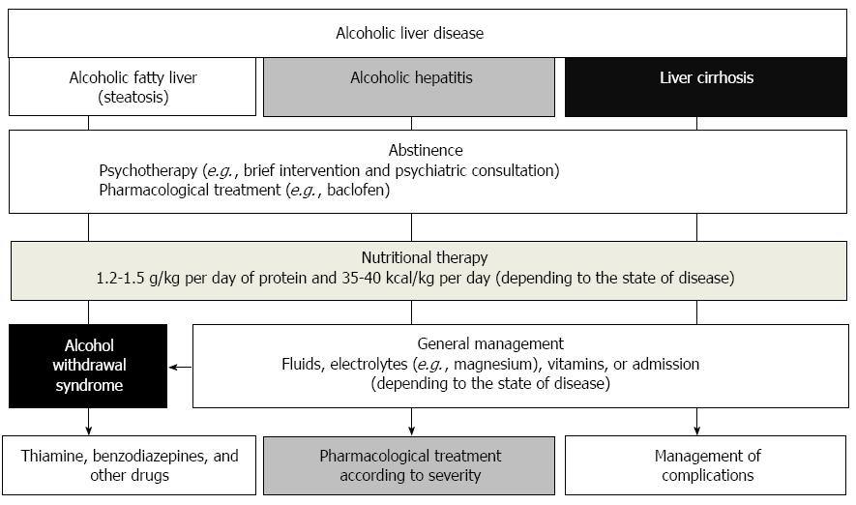
ALGORITHM

Slide 45
Thank you

