Slide 1
PHARMACEUTICAL MICROBIOLOGY
MICROBIAL CULTURE SENSITIVITY TESTING
17-09-2024
1

Slide 2
MICROBIAL CULTURE SENSITIVITY TESTING
A microbiological assay may be defined as qualitative or quantitative determination of any chemical compound from a simple or even complex material with the use of microorganisms
It is necessary to assay antimicrobial agents for determination of potency, for determining the pharmacokinetics of a drug in animals or man and for monitoring and controlling antimicrobial chemotherapy
Quantitative chemical or physical methods can assay most of the currently employed therapeutic agents
Many therapeutic agents, which either inhibit the growth of microorganisms or are essential for their growth can be standardised by microbiological assays.
17-09-2024
2

Slide 3
The microbiological assay of an antibiotic is based upon a comparison of the inhibition of growth of micro-organisms by measured concentrations of the antibiotics under examination with that produced by known concentration of a standard preparation of the antibiotic having a know
It is based upon a comparison of the inhibition of growth of microorganisms by measured concentrations of the antibiotic to be examined with that produced by known concentrations of a standard preparation of the antibiotic having a known activity
MEDIA USED FOR ANTIBIOTIC ASSAY
The media required for the preparation of test microorganisms inoculum are made from the ingredients listed .
Dissolve the ingredients insufficient water to produce 1000 ml and add sufficient 1M sodium hydroxide or 1M hydrochloric acid, as required, so that after sterilization the pH is adjusted .

Slide 4
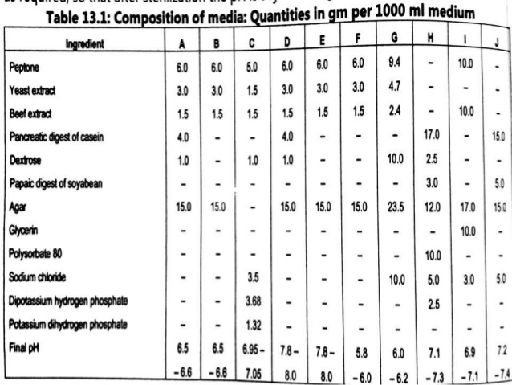

Slide 5
CUP-PLATE METHOD OR DISC DIFFUSION METHOD OR CYLINDRICAL PLATE METHOD
The disk diffusion test (also known as the agar diffusion test, Kirby–Bauer test, disc-diffusion antibiotic susceptibility test, disc-diffusion antibiotic sensitivity test and KB test) is a culture-based microbiology assay used in diagnostic and drug discovery laboratories.
In diagnostic labs, the assay is used to determine the susceptibility of bacteria isolated from a patient’s infection to clinically approved antibiotics. This allows physicians to prescribe the most appropriate antibiotic treatment.
In drug discovery labs, especially bioprospecting labs, the assay is used to screen biological material (eg. plant extracts, bacterial fermentation broths) and drug candidates for antibacterial activity.
When bioprospecting, the assay can be performed with paired strains of bacteria to achieve dereplication and provisionally identify antibacterial mechanism of action.

Slide 6
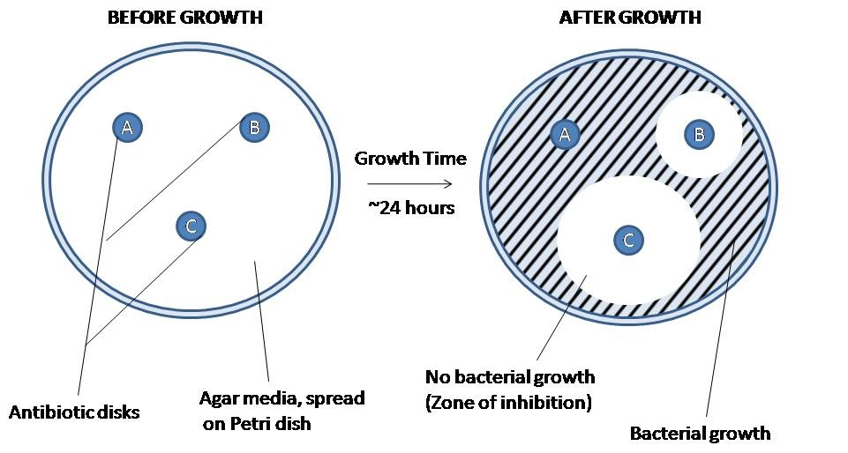

Slide 7
In diagnostic laboratories, the test is performed by inoculating the surface of an agar plate with bacteria isolated from a patient’s infection. Antibiotic-containing paper disks are then applied to the agar and the plate is incubated.
If an antibiotic stops the bacteria from growing or kills the bacteria, there will be an area around the disk where the bacteria have not grown enough to be visible.
This is called a zone of inhibition. The susceptibility of the bacterial isolate to each antibiotic can then be semi-quantified by comparing the size of these zones of inhibition to databases of information on known antibiotic-susceptible, moderately susceptible and resistant bacteria.
In this way, it is possible to identify the most appropriate antibiotic for treating a patient’s infection.
Although the disk diffusion test cannot be used to differentiate bacteriostatic and bactericidal activity, it is less cumbersome than other susceptibility test methods such as broth dilution

Slide 8
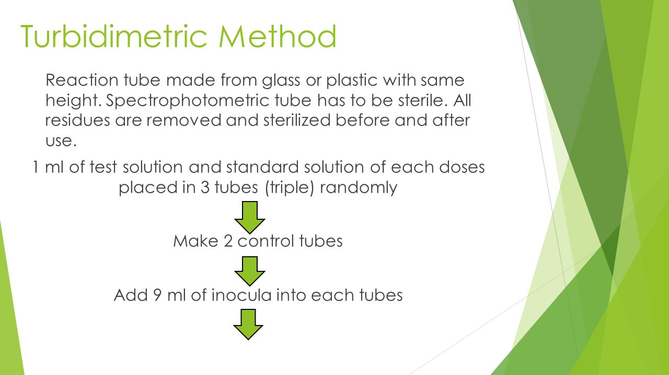
TURBIDIMETRIC OR TUBE ASSAY METHOD
The turbidimetric method is characterized by a series of tubes containing different concentrations of antibiotics in a liquid culture medium inoculated with the test microorganism.
Reading data obtained after incubation provides a curve displaying the antibiotic concentration with turbidity.

Slide 9
