Slide 1
PHARMACEUTICAL MICROBIOLOGY
MICROBIAL CULTURE SENSITIVITY TESTING
17-09-2024
1

Slide 2
MICROBIAL CULTURE SENSITIVITY TESTING
Two general methods are usually employed, the cylinder-plate (or cup-plate) method and the turbidimetric (or tube assay) method.
The cylinder-plate method (Method A) depends upon diffusion of the antibiotic from a vertical cylinder through a solidified agar layer in a Petri dish or plate to an extent such that growth of the added micro-organism is prevented entirely in a zone around the cylinder containing a solution of the antibiotic.
The turbidimetric method (Method B) depends upon the inhibition of growth of a microbial culture in a uniform solution of the antibiotic in a fluid medium that is favourable to its rapid growth in the absence of the antibiotic.
The assay is designed in such a way that the mathematical model on which the potency equation is based can be proved to be valid.
.
17-09-2024
2

Slide 3
MEDIA:
Prepare the media required for the preparation of test organism inoculate from the ingredients listed in Table 1.
Minor modifications of the individual ingredients may be made, or reconstituted dehydrated media may be used provided the resulting media have equal or better growth-promoting properties and give a similar standard curve response.
Dissolve the ingredients in sufficient water to produce 1000 ml and add sufficient 1 M sodium hydroxide or 1 M hydrochloric acid, as required so that after sterilization the pH is as given in Table 1.

Slide 4
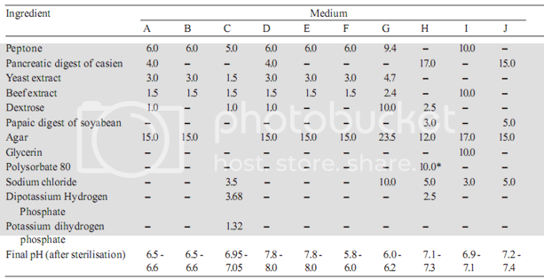
Quantity in ml, to be added after boiling the media to dissolve the agar.

Slide 5
A Standard Preparation is an authentic sample of the appropriate antibiotic for which the potency has been precisely determined by reference to the appropriate international standard.
The Potency of the standard preparation may be expressed in International Units or in μg per mg of the pure antibiotic.
The Standard Preparations for India are certified by the laboratory of the Indian Pharmacopoeia
Commission or by any other notified laboratory(ies) and are maintained and distributed by the agency(ies) notified for the purpose.
A Standard Preparation may be replaced by a working standard prepared by any laboratory which should be compared at definite intervals under varying conditions with the standard.

Slide 6
Buffer solution
Prepare by dissolving the following quantities given in Table 2 of dipotassium hydrogen phosphate and potassium dihydrogen phosphate in sufficient water to produce 1000 ml after sterilisation, adjusting the pH with 8 M phosphoric acid or 10 M potassium hydroxide.
* After addition of 2 ml of 10M potassium hydroxide
Buffer No. | Dipotassium Hydrogen Phosphate, K₂HPO₄(g) | Potassium Dihydrogen phosphate, KH₂PO₄(g) | pH adjusted after sterilization to
1 2 3 4 5 6 | 2.0 16.73 - 20.0 35.0 13.6 | 8.0 0.523 13.61 80.00 - 4.0 | 6.0±0.1 8.0±0.1 4.5±0.1 6.0±0.1 10.5±0.1* 7.0±0.2

Slide 7
Preparation of the standard solution
To prepare a stock solution, dissolve a quantity of the Standard Preparation of a given antibiotic, accurately weighed and previously dried where so indicated in Table 3, in the solvent specified in the table, and then dilute to the required concentration as indicated
Store in a refrigerator and use within the period indicated. On the day of assay, prepare from the stock solution five or more test dilutions, the successive solutions increasing stepwise in concentration, usually in the ratio 1:1.25 for Method A or smaller for Method B.
Use the final diluent specified and a sequence such that the middle or median has the concentration specified in Table 3
Preparation of the sample solution
From the information available for the substance under examination (the “unknown”), assign to it an assumed potency per unit weight or volume, and on this assumption prepare on the day of the assay a stock solution and test dilution as specified for each antibiotic in Table 3 but with the same final diluent as used for the Standard Preparation. The assay with 5 levels of the Standard requires only one level of the unknown at a concentration assumed equal to the median level of the standard.

Slide 8
Test organisms
The test organism for each antibiotic is listed in Table 4, together with its identification number in the American Type Culture Collection (ATCC). Maintain a culture on slants of the medium and under the incubation conditions specified in Table 5, and transfer weekly to fresh slants.
Table 4 - Test Organisms for Microbiological Assay of Antibiotics
Antibiotic | Test Organism | ATCC1 No.
Amikacin Amphotericin B Bacitracin Bleomycin Carbenicillin Chlortetracycline Erythromycin Framycetin Gentamicin Kanamycin sulphate Neomycin Novobiocin Nystatin Oxytetracycline Polymyxin B Spiramycin Streptomycin Tetracycline Tobramycin Tylosin | Staphylococcus aureus Saccharomyces cerevisiae Micrococcus luteus Mycobacterium smegmatis Pseudomonas aeruginosa Bacillus pumilus Micrococcus luteus Bacillus pumilus Bacillus subtilis Staphylococcus epidermidis Bacillus pumilus Staphylococcus aureus Staphylococcus epidermidis Staphylococcus epidermidis Saccharomyces cerevisiae Bacillus cereus var, mycoides Staphylococcus aureus Bordetella bronchiseptica Bacillus pumilus Bacillus subtilis Klebsiella pnumoniae Bacillus cereus Staphylococcus aureus Staphylococcus aureus Staphylococcus aureus | 29737 9763 10240 607 25619 14884 9341 14884 6633 12228 14884 29737 12228 12228 2601 11778 29737 4617 6633 6633 10031 11778 29737 29737 9144

Slide 9
Results
Micro organism has been confirmed sensitive and resistant bacterial strains for all antibiotic groups tested in our study.
Based on results Bacillus cereus ATCC 11778 (E plate) as the sensitive and Micrococcus luteus ATCC 9341 (AC plate) as the resistant strain for tetracycline and chlortetracycline from the tetracyclines group.
For tyrosine and erythromycin from the macrolides group Micrococcus luteus ATCC 9341 (AC plate) was chosen as the sensitive and Escherichia coli ATCC10536 (Kin plate) as the resistant strain.
For gentamycin, streptomycin and neomycin from the aminoglycosides group Bacillus subtilis BGA (I-BGA plate) was chosen as the susceptible and Staphylococcus epidermidis ATCC 12228 (ER plate) the resistant strain.
For cephalexin, cochaperone and cephazolin from the sensitive group Micrococcus luteus ATCC 9341 (AC plate) was chosen as the susceptible and Staphylococcus epidermidis ATCC 12228 (ER plate) as the resistant strain.
To discriminate between aminoglycosides and macrolides we had to utilise used magnesium sulphate which inactivates the aminoglycosides. To discriminate between cephalosporines and macrolides we used the cephalosporinase enzyme.

Slide 10
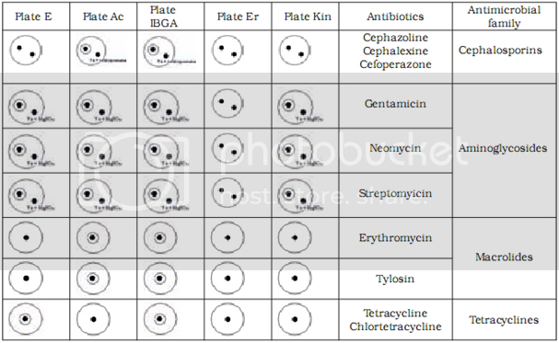
Table 4 shows the limit of detection for milk samples containing standardised antibiotic solutions on selected test plates. The level of detection was at or below the MRL in all tested antibiotics.

Slide 11
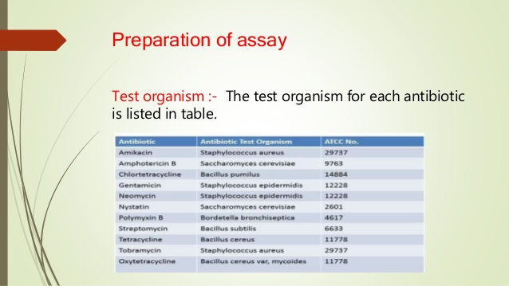
MICROBIAL ASSAY OF STREPTOMYCIN

Slide 12
Bacto-streptomycin assay agar, dehydrated, to provide a supply of a standard, uniform medium for the assay of streptomycin.1
The medium is prepared for use by dissolving 25.5 g per 1,000 ml in doubly distilled water.
After sterilization the medium may be stored at 2 to 4 C until used. 1 in making this medium available.
The medium as prepared for use has the following composition:
Peptone...................................................... 6.0 g
Beef extract ...................................................... 1.5 g
Yeast extract ...................................................... 3.0 g
Agar...................................................... 15.0 g
Distilled water, q.s................................................. 1,000.0 ml
pH after sterilization ............................................... 7.9 :1 0.1

Slide 13
Organism. A strain of Bacillus subtilis sensitive to streptomycin is employed as the test organism.
A stock spore suspension is prepared by cultivation of the organisms on agar or in submerged culture.
When microscopic examination reveals good sporulation, the cells are separated from the medium, suspended in sterile 0.05 M potassium phosphate buffer, pH 7.0, and the suspension pasteurized to kill the vegetative cells.
A viable spore count is made by plating. The stock spore suspension is stored at 2 to 4 C and used as needed.
Preparation of plates. To petri dishes (pyrex dishes, 100 mm in diameter, selected for uniform flat bottoms2) are added 20.0 ml of sterile assay agar, preferably with an automatic dispensing pipette.
The agar is allowed to harden with the petri dish tops tilted or removed.
While the plates are still warm, 4.0 ml of seeded agar is added and distributed evenly over the surface.
The volume of spore suspension used to seed the medium depends on the concentration of viable spores.
The amount to be used is best determined by actual test in the assay procedure, that quantity being selected which gives large, sharp zones.

Slide 14
Usually a concentration of approximately 250,000 spores per ml in the seeded agar gives the desired results.
The spores are added to the liquefied agar at 60 C, and. the seeded medium is maintained at that temperature until all the plates are poured.
The 'plates are stored at 2 to 4 C as soon as they have hardened and may be kept for several days with no effect on the assay.
It is essential that the plates be prepared on an absolutely level table top.
A section of heavy plate glass or marble supported on adjustable legs and equipped with a level indicator serves adequately for this purpose. Preparation of the sample.
All samples are diluted on the basis of their estimated potency to fall on the standard curve.
The initial dilution of liquid samples is made with an equal volume of 0.2 M potassium phosphate buffer, pH 7.9, and all subsequent dilutions with 0.1 M buffer. Solid samples are dissolved directly in 0.1 M buffer. Samples of submerged-culture beers are not clarified before dilution

Slide 15
Setting up the assay. Filter paper discs' are placed, flat side down, on the agar plates.
As each disc is placed, an 0.080-ml sample is immediately (within 5 seconds) pipetted onto it.
Since the disc rapidly absorbs moisture from the agar it is exceedingly important that the sample be applied in the shortest possible time.
As the sample is being delivered the disc is gently pressed to the agar with the tip of the pipette.
Four to six discs may be placed on one plate

Slide 16
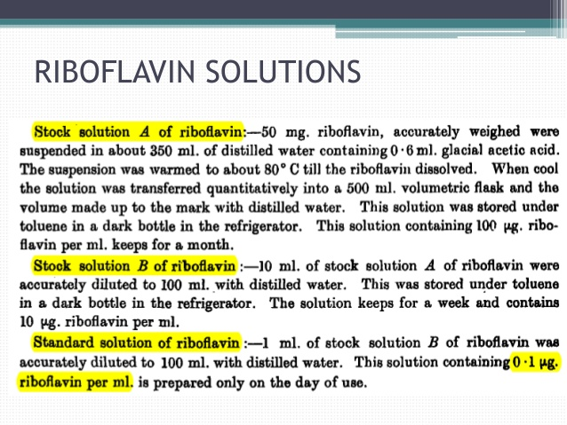
ASSAY OF VITAMIN B2

Slide 17
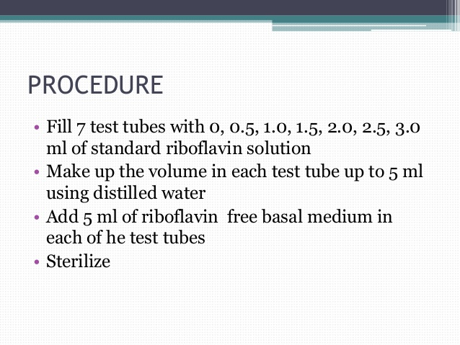

Slide 18
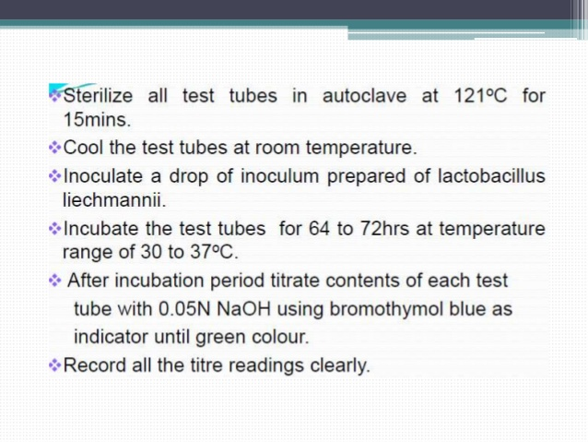

Slide 19
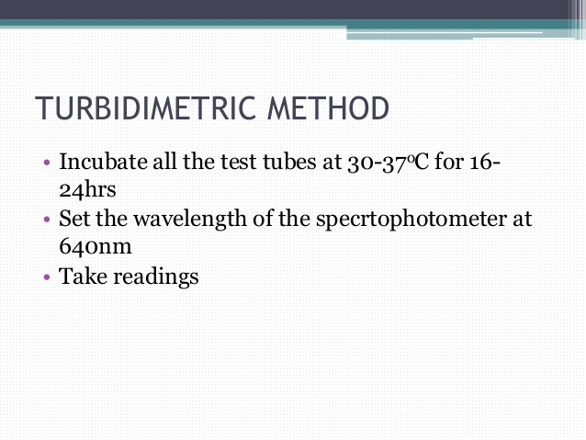

Slide 20

MICROBIAL ASSAY OF B12

Slide 21
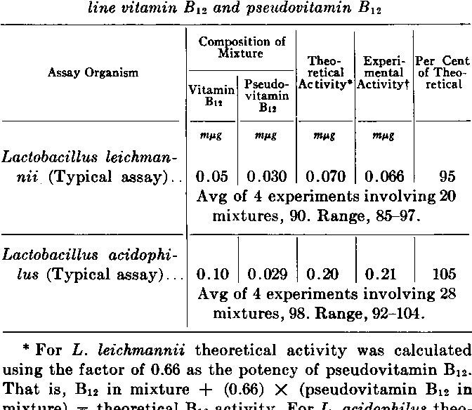

Slide 22
