Slide 1
BIOSTATISTICS AND RESEARCH METHODOLOGY
UNIT – 2 BIOSTATISTICS
2 .1 (d) Measurement of the spread of data -range, variation of mean, standard deviation, variance, coefficient of variation, standard error of mean
14-09-2024
1

Slide 2
(D) MEASUREMENT OF THE SPREAD OF DATA -RANGE, VARIATION OF MEAN, STANDARD DEVIATION, VARIANCE, COEFFICIENT OF VARIATION, STANDARD ERROR OF MEAN.
MEASUREMENT OF THE SPREAD OF DATA –
Measures of spread describe how similar or varied the set of observed values are for a particular variable, Measures of spread include the range, quartiles and the interquartile range, variance and standard deviation.
When can we measure spread? The spread of the values can be measured for quantitative data, as the variables are numeric and can be arranged into a logical order with a low end value and a high end value.
Why do we measure spread? Summarizing the dataset can help us understand the data, especially when the dataset is large. As discussed in the Measures of Central Tendency page, the mode, median, and mean summarise the data into a single value that is typical or representative of all the values in the dataset, but this is only part of the 'picture' that summarizes a dataset. Measures of spread summarise the data in a way that shows how scattered the values are and how much they differ from the mean value.

Slide 3
Spread can be measured, with some advantages, by measures based on squared pairwise differences instead of measures based on squared differences from the mean,The measures are equal to multiples of the various versions of the standard deviation. ,Their advantages are that the measure of spread does not depend on a previously defined measure of location, that the spread of a sample and of a population are both square roots of simple averages and are both intuitively reasonable, and that the formula for the normal density is simplified. Computation is not significantly increased.
RANGE
The range is the simplest measure of variability to calculate, and one you have probably encountered many times in your life. The range is simply the highest score minus the lowest score.
For example:
Dataset A Dataset B
4, 5, 5, 5, 6, 6, 6, 6, 7, 7, 7, 8 1, 2, 3, 4, 5, 6, 6, 7, 8, 9, 10, 11
The mode (most frequent value), median (middle value*) and mean (arithmetic average) of both datasets is 6.
(*note, the median of an even numbered data set is calculated by taking the mean of the middle two observations).
If we just looked at the measures of central tendency, we may assume that the datasets are the same.
However, if we look at the spread of the values in the following graph, we can see that Dataset B is more dispersed than Dataset A. Used together, the measures of central tendency and measures of spread help us to better understand the data.

Slide 4
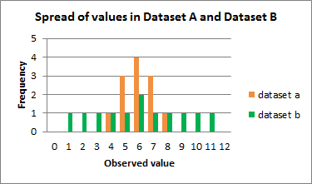

Slide 5
What does each measure of spread tell us?
The range is the difference between the smallest value and the largest value in a dataset.
Calculating the Range
Dataset A
4, 5, 5, 5, 6, 6, 6, 6, 7, 7, 7, 8
The range is 4, the difference between the highest value (8 ) and the lowest value (4).
Dataset B
1, 2, 3, 4, 5, 6, 6, 7, 8, 9, 10, 11
The range is 10, the difference between the highest value (11 ) and the lowest value (1).
Dataset A
4 5 5 5 6 6 6 6 7 7 7 8
Dataset B
1 2 3 4 5 6 7 8 9 10 11
On a number line, you can see that the range of values for Dataset B is larger than Dataset A.

Slide 6
Quartiles divide an ordered dataset into four equal parts, and refer to the values of the point between the quarters. A dataset may also be divided into quintiles (five equal parts) or deciles (ten equal parts).
Quartiles
25% of values | Q1 | 25% of values | Q2 | 25% of values | Q3 | 25% of values
The lower quartile (Q1) is the point between the lowest 25% of values and the highest 75% of values. It is also called the 25th percentile.
The second quartile (Q2) is the middle of the data set. It is also called the 50th percentile, or the median.
The upper quartile (Q3) is the point between the lowest 75% and highest 25% of values. It is also called the 75th percentile.

Slide 7
Calculating Quartiles
Dataset A
4 5 5 Q 1 5 6 6 Q2 6 6 7 Q 3 7 7 8
As the quartile point falls between two values, the mean (average) of those values is the quartile value:
Q1 = (5+5) / 2 = 5
Q2 = (6+6) / 2 = 6
Q3 = (7+7) / 2 = 7
Dataset B
1 2 3 Q1 4 5 6 Q2 6 7 8 Q3 9 10 11
As the quartile point falls between two values, the mean (average) of those values is the quartile value:
Q1 = (3+4) / 2 = 3.5
Q2 = (6+6) / 2 = 6
Q3 = (8+9) / 2 = 8.5
The interquartile range (IQR) is the difference between the upper (Q3) and lower (Q1) quartiles, and describes the middle 50% of values when ordered from lowest to highest. The IQR is often seen as a better measure of spread than the range as it is not affected by outliers.

Slide 8
Interquartile Range
25% of values Q1 25% of values Q2 25% of values Q3 25% of values
Calculating the Interquartile Range
The IQR for Dataset A is = 2
IQR = Q3 - Q1
= 7 - 5
= 2
The IQR for Dataset B is = 5
IQR = Q3 - Q1
= 8.5 - 3.5
= 5
The variance and the standard deviation are measures of the spread of the data around the mean. They summarise how close each observed data value is to the mean value.
In datasets with a small spread all values are very close to the mean, resulting in a small variance and standard deviation. Where a dataset is more dispersed, values are spread further away from the mean, leading to a larger variance and standard deviation.
The smaller the variance and standard deviation, the more the mean value is indicative of the whole dataset. Therefore, if all values of a dataset are the same, the standard deviation and variance are zero.

Slide 9
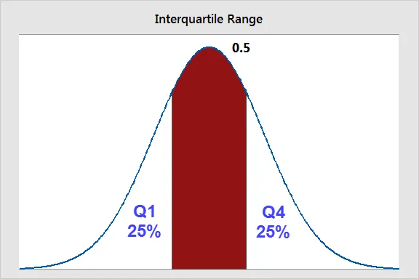
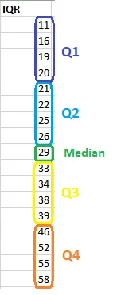
The Interquartile Range (IQR) . . . and other Percentiles
The interquartile range is the middle half of the data. To visualize it, think about the median value that splits the dataset in half. Similarly, you can divide the data into quarters. Statisticians refer to these quarters as quartiles and denote them from low to high as Q1, Q2, and Q3. The lowest quartile (Q1) contains the quarter of the dataset with the smallest values. The upper quartile (Q4) contains the quarter of the dataset with the highest values. The interquartile range is the middle half of the data that is in between the upper and lower quartiles. In other words, the interquartile range includes the 50% of data points that fall between Q1 and Q3. The IQR is the red area in the graph below
The interquartile range is a robust measure of variability in a similar manner that the median is a robust measure of central tendency. Neither measure is influenced dramatically by outliers because they don’t depend on every value. Additionally, the interquartile range is excellent for skewed distributions, just like the median. As you’ll learn, when you have a normal distribution, the standard deviation tells you the percentage of observations that fall specific distances from the mean. However, this doesn’t work for skewed distributions, and the IQR is a great alternative.
I’ve divided the dataset below into quartiles. The interquartile range (IQR) extends from the low end of Q2 to the upper limit of Q3.

Slide 10
Using other percentiles
When you have a skewed distribution, I find that reporting the median with the interquartile range is a particularly good combination. The interquartile range is equivalent to the region between the 75th and 25th percentile (75 – 25 = 50% of the data). You can also use other percentiles to determine the spread of different proportions. For example, the range between the 97.5th percentile and the 2.5th percentile covers 95% of the data. The broader these ranges, the higher the variability in your dataset.
SUMMARY - A measure of variability is a summary statistic that represents the amount of dispersion in a dataset. How spread out are the values? While a measure of central tendency describes the typical value, measures of variability define how far away the data points tend to fall from the center. We talk about variability in the context of a distribution of values. A low dispersion indicates that the data points tend to be clustered tightly around the center. High dispersion signifies that they tend to fall further away.
In statistics, variability, dispersion, and spread are synonyms that denote the width of the distribution. Just as there are multiple measures of central tendency, there are several measures of variability. In this blog post, you’ll learn why understanding the variability of your data is critical.

Slide 11
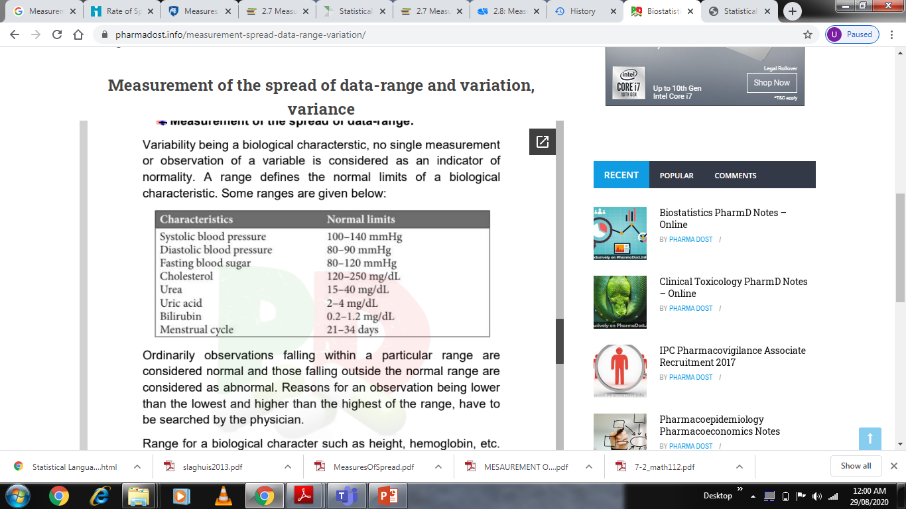
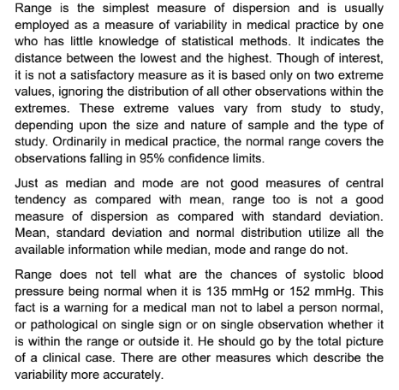
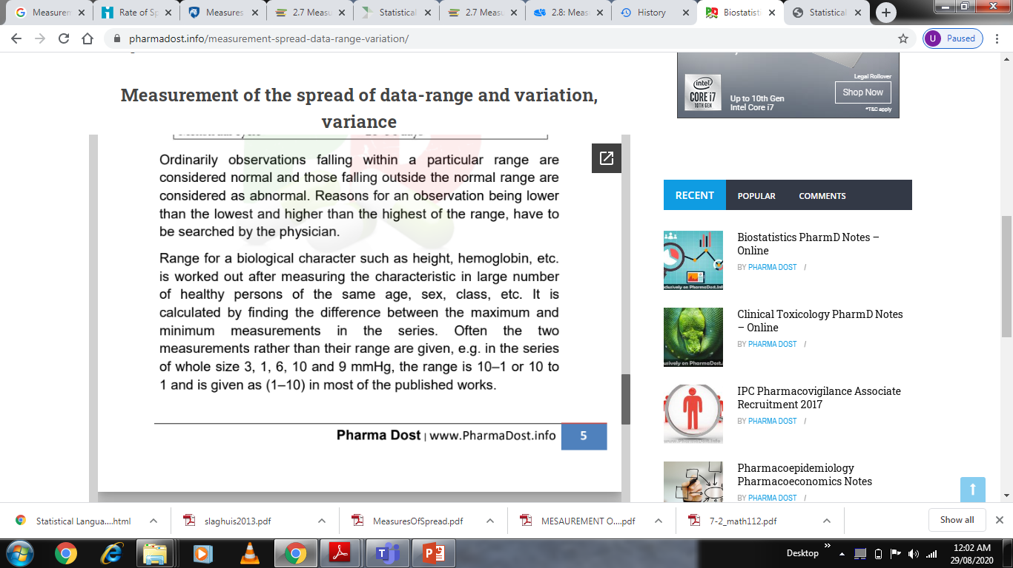

Slide 12
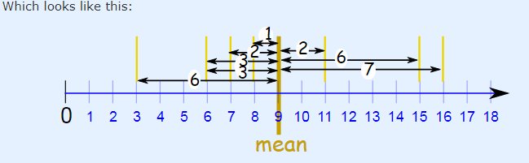
VARIATION OF THE MEAN (MEAN DEVIATION) - Mean deviation is a statistical measure of the average deviation of values from the mean in a sample. It is calculated first by finding the average of the observations. The difference of each observation from the mean then is determined. What Does It "Mean" ? Mean Deviation tells us how far, on average, all values are from the middle
Example: the Mean Deviation of 3, 6, 6, 7, 8, 11, 15, 16
Step 1: Find the mean:
Mean = 3 + 6 + 6 + 7 + 8 + 11 + 15 + 16 = 72/ 8 = 9
Step 2: Find the distance of each value from that mean:
Value Distance from 9
3 6
6 3
6 3
7 2
8 1
11 2
15 6
16 7
Step 3. Find the mean of those distances:
Mean Deviation = 6 + 3 + 3 + 2 + 1 + 2 + 6 + 78 = 30/8 = 3.75
So, the mean = 9, and the mean deviation = 3.75

Slide 13
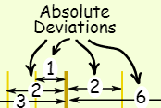
It tells us how far, on average, all values are from the middle, In that example the values are, on average, 3.75 away from the middle.
For deviation just think distance Formula
The formula is:
Mean Deviation = Σ|x − μ|
N
Σ is Sigma, which means to sum up
|| (the vertical bars) mean Absolute Value, basically to ignore minus signs
x is each value (such as 3 or 16)
μ is the mean (in our example μ = 9)
N is the number of values (in our example N = 8)
Absolute Deviation
Each distance we calculate is called an Absolute Deviation, because it is the Absolute Value of the deviation (how far from the mean). absolute deviation
To show "Absolute Value" we put "|" marks either side like this:
|-3| = 3
For any value x:
Absolute Deviation = |x - μ|
From our example, the value 16 has Absolute Deviation = |x - μ| = |16 - 9| = |7| = 7
And now let's add them all up ...

Slide 14
Sigma
The symbol for "Sum Up" is Σ (called Sigma Notation), so we have:
Sum of Absolute Deviations = Σ|x - μ|
N
Divide by how many values N and we have:
Mean Deviation = Σ|x − μ|
N
Let's do our example again, using the proper symbols:
Example: the Mean Deviation of 3, 6, 6, 7, 8, 11, 15, 16
Step 1: Find the mean:
μ = 3 + 6 + 6 + 7 + 8 + 11 + 15 + 168 = 72/8 = 9
Step 2: Find the Absolute Deviations:
x |x - μ|
3 6
6 3
6 3
7 2
8 1
11 2
15 6
16 7
Σ|x - μ| = 30
Step 3. Find the Mean Deviation:
Mean Deviation = Σ|x - μ|
N = 30/8 = 3.75

Slide 15
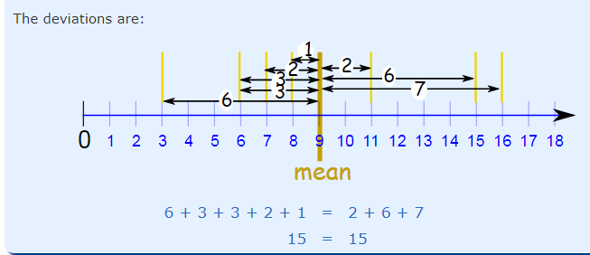
The deviations on one side of the mean should equal the deviations on the other side.
Example: 3, 6, 6, 7, 8, 11, 15, 16.
Interpret the result. The value of the mean deviation about the mean is a measure of how closely grouped your data values are. It answers the question, “How close to the mean, on average, are the data values?.
For example, with this data set, you can say that the mean is 9 and the average distance from that mean is 3.75. Note that some numbers are closer than 3.75 and some are farther. But that is the average distance.

Slide 16
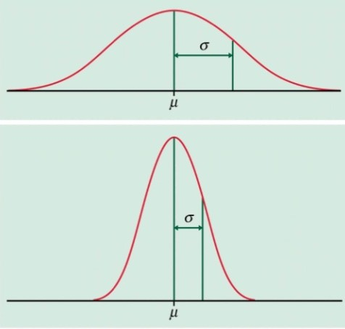
STANDARD DEVIATION
A standard deviation (or σ) is a measure of how dispersed the data is in relation to the mean. Standard Deviation of a set of a scores is defined as the square root of the average of the squares of the eviation of each from the mean.
Low standard deviation means data are clustered around the mean, and high standard deviation indicates data are more spread out. A standard deviation close to zero indicates that data points are close to the mean, whereas a high or low standard deviation indicates data points are respectively above or below the mean. In Image, the curve on top is more spread out and therefore has a higher standard deviation, while the curve below is more clustered around the mean and therefore has a lower standard deviation..

Slide 17
Standard deviation is a measurement used in statistics of the amount a number varies from the average number in a series of numbers. The standard deviation tells those interpreting the data, how reliable the data is or how much difference there is between the pieces of data by showing how close to the average all of the data is.
A low standard deviation means that the data is very closely related to the average, thus very reliable.
A high standard deviation means that there is a large variance between the data and the statistical average, thus not as reliable.
CONCEPT OF SD AND SEM
To study the entire population is time and resource intensive and not always feasible; therefore studies are often done on the sample; and data is summarized using descriptive statistics. These findings are further generalized to the larger, unobserved population using inferential statistics.
For example, in order to understand cholesterol levels of the population, cholesterol levels of study sample, drawn from same population are measured. The findings of this sample are best described by two parameters; mean and SD. Sample mean is average of these observations and denoted by X̄. It is the center of distribution of observations (central tendency). Other parameter, SD tells us dispersion of individual observations about the mean. In other words, it characterizes typical distance of an observation from distribution center or middle value. If observations are more disperse, then there will be more variability. Thus, a low SD signifies less variability while high SD indicates more spread out of data.

Slide 18
The importance of SD in clinical settings is discussed below. In a atherosclerotic disease study, an investigator reports mean peak systolic velocity (PSV) in the carotid artery, a measure of stenosis, as 220cm/sec with SD of 10cm/ sec In this case it would be unusual to observe PSV less than 200 cm/sec or greater than 240cm/sec as 95% of population fall within 2SD of the mean, assuming that the population follows a normal distribution. Thus, there is a quick summary of the population and the range against which to compare the specific findings. Unfortunately, investigators are quite likely to report the PSV as 220cm/ sec ± 1.6 (SEM). If one confused the SEM with the SD, one would believe that the range of the population is narrow (216.8 to 223.2cm/sec), which is not the case.
Additionally, when two groups are compared (e.g. treatment and control groups), SD helps in visualizing the effect size, which is an index of how much difference is there between two groups. Effect size gives an idea of magnitude of difference to help differentiate between statistical significance and practical importance. Effect size is determined by calculating the difference between the means divided by the pooled or average standard deviation from two groups. Generally, effect size of 0.8 or more is considered as a large effect and indicates that the means of two groups are separated by 0.8SD; effect size of 0.5 and 0.2, are considered as moderate or small respectively and indicate that the means of the two groups are separated by 0.5 and 0.2SD However, same can’t be interpreted with SEM. More importantly, SEMs do not provide direct visual impression of the effect size, if number of subjects differs between groups.
Exceptionally the SD as an index of variability may be a deceptive one in many experimental situations where biological variable differs grossly from a normal distribution (e.g. distribution of plasma creatinine, growth rate of tumor and plasma concentration of immune or inflammatory mediators). In these cases, because of the skewed distribution, SD will be an inflated measure of variability. In such cases, data can be presented using other measures of variability (e.g. mean absolute deviation and the interquartile range), or can be transformed (common transformations include the logarithmic, inverse, square root, and arc sine transformations).

Slide 19

A class of students took a test in therapeutics. The teacher determines that the mean grade on the exam is a 65%. She is concerned that this is very low, so she determines the standard deviation to see if it seems that most students scored close to the mean, or not. The teacher finds that the standard deviation is high. After closely examining all of the tests, the teacher is able to determine that several students with very low scores were the outliers that pulled down the mean of the entire class's scores.
A market researcher is analyzing the results of a recent customer survey. He wants to have some measure of the reliability of the answers received in the survey in order to predict how a larger group of people might answer the same questions. A low standard deviation shows that the answers are very projectable to a larger group of people.
Doctor wants to determine if the patients are close in weight or not close in weight. He takes the average of the weight of all ten patients . He then calculates the variance, and then the standard deviation. His standard deviation is extremely high. This suggests that the patients are of many various weights, or that he has a few patients whose weights are outliers that are skewing the data.
The symbol for Standard Deviation is σ (the Greek letter sigma).
This is the formula for Standard Deviation:
In the formula above μ (the greek letter "mu") is the mean of all our values.
Then for each number: subtract the Mean and square the result
This is the part of the formula that says So what is xi ? They are the individual x values.
Then work out the mean of those squared differences. -To work out the mean, add up all the values then divide by how many. First add up all the values from the previous step. But how do we say "add them all up" in mathematics? We use "Sigma": Σ, divide by how many, which is done by multiplying by 1/N (the same as dividing by N):

Slide 20
To calculate the standard deviation of those numbers:
1. Work out the Mean (the simple average of the numbers)
2. Then for each number: subtract the Mean and square the result
3. Then work out the mean of those squared differences.
4. Take the square root of that and we are done.
PROBLEMS:- A ward has 20 patients.
The age of particular patient in wards are
9, 2, 5, 4, 12, 7, 8, 11, 9, 3, 7, 4, 12, 5, 4, 10, 9, 6, 9, 4
Work out the Standard Deviation
Step 1. Work out the mean
In the formula above μ (the greek letter "mu") is the mean of all our values ...
Example: 9, 2, 5, 4, 12, 7, 8, 11, 9, 3, 7, 4, 12, 5, 4, 10, 9, 6, 9, 4
The mean is:
9+2+5+4+12+7+8+11+9+3+7+4+12+5+4+10+9+6+9+4/20
= 140/20 = 7
μ = 7
Step 2. Then for each number: subtract the Mean and square the result
This is the part of the formula that says:
So what is xi ? They are the individual x values 9, 2, 5, 4, 12, 7, etc...
In other words x1 = 9, x2 = 2, x3 = 5, etc.
So it says "for each value, subtract the mean and square the result", like this
Example (continued):
(9 - 7)² = (2)² = 4
(2 - 7)² = (-5)² = 25
(5 - 7)² = (-2)² = 4
(4 - 7)² = (-3)² = 9
(12 - 7)² = (5)² = 25
(7 - 7)² = (0)² = 0
(8 - 7)² = (1)² = 1.. etc ...
And we get these results:
4, 25, 4, 9, 25, 0, 1, 16, 4, 16, 0, 9, 25, 4, 9, 9, 4, 1, 4, 9

Slide 21

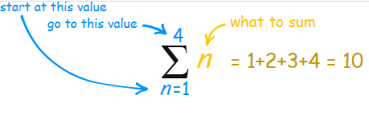

Step 3. Then work out the mean of those squared differences.
To work out the mean, add up all the values then divide by how many.
First add up all the values from the previous step.
But how do we say "add them all up" in mathematics? We use "Sigma": Σ
The handy Sigma Notation says to sum up as many terms as we want:
But that isn't the mean yet, we need to divide by how many, which is done by multiplying by 1/N (the same as dividing by N):
Mean of squared differences = (1/20) × 178 = 8.9
(Note: this value is called the "Variance")
Take the square root of that:
σ = √(8.9) = 2.983..
We want to add up all the values from 1 to N, where N=20 in our case because there are 20 values:
Which means: Sum all values from Which means: Sum all values from (x₁-7)² to (x_{N}-7)²
We already calculated (x1-7)2=4 etc. in the previous step, so just sum them up:
= 4+25+4+9+25+0+1+16+4+16+0+9+25+4+9+9+4+1+4+9 = 178.

Slide 22

Step 1. Work out the mean
Example 2: Using sampled values 9, 2, 5, 4, 12, 7
The mean is (9+2+5+4+12+7) / 6 = 39/6 = 6.5
So: x = 6.5.
Step 2. Then for each number: subtract the Mean and square the result
Example 2 (continued):
(9 - 6.5)² = (2.5)² = 6.25
(2 - 6.5)² = (-4.5)² = 20.25
(5 - 6.5)² = (-1.5)² = 2.25
(4 - 6.5)² = (-2.5)² = 6.25
(12 - 6.5)² = (5.5)² = 30.25
(7 - 6.5)² = (0.5)² = 0.25.
Then work out the mean of those squared differences. To work out the mean, add up all the values then divide by how many.
But, we are calculating the Sample Standard Deviation, so instead of dividing by how many (N), we will divide by N-1
Sum = 6.25 + 20.25 + 2.25 + 6.25 + 30.25 + 0.25 = 65.5
Divide by N-1: (1/5) × 65.5 = 13.1
(This value is called the "Sample Variance")
Sample Standard Deviation
sometimes our data is only a sample of the whole population.
A ward has 20 patients , but only counted the patients on 6 of them!
The "population" is all 20 patients , and the "sample "is the 6 patients were counted of
Let us say counts are: 9, 2, 5, 4, 12, 7.
We can still estimate the Standard Deviation.
But when we use the sample as an estimate of the whole population, the Standard Deviation formula changes to this:
The formula for Sample Standard Deviation:
The important change is "N-1" instead of "N" (which is called "Bessel's correction").
The symbols also change to reflect that we are working on a sample instead of the whole population:
The mean is now x (for sample mean) instead of μ (the population mean),
And the answer is s (for Sample Standard Deviation) instead of σ.
But that does not affect the calculations. Only N-1 instead of N changes the calculations.

Slide 23
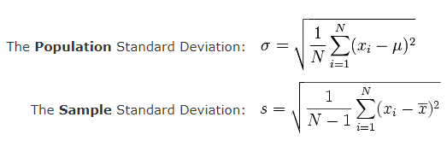
Step 4: Take the square root of that:
s = √(13.1) = 3.619
Comparing
When we used the whole population we got: Mean = 7, Standard Deviation = 2.983...
When we used the sample we got: Sample Mean = 6.5, Sample Standard Deviation = 3.619...
Our Sample Mean was wrong by 7%, and our Sample Standard Deviation was wrong by 21%.

Slide 24
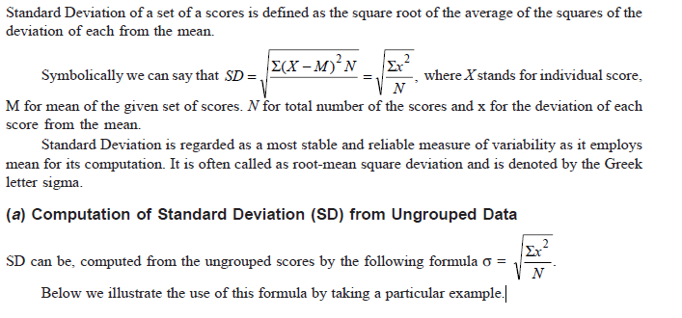
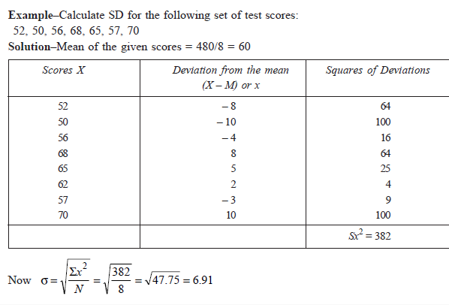

Slide 25
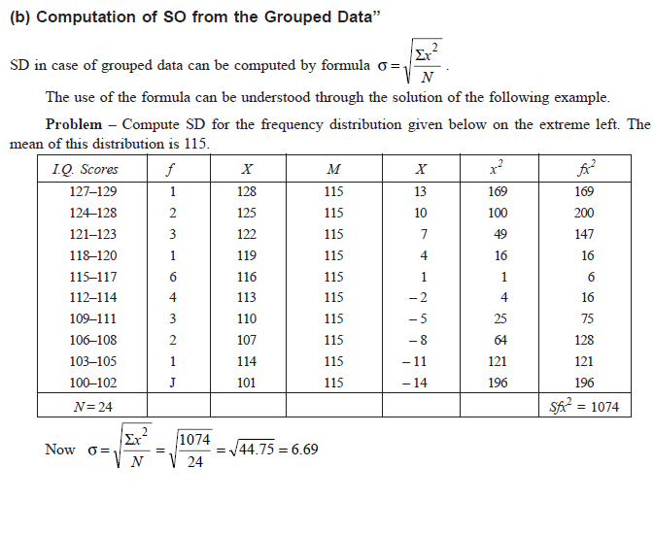

Slide 26
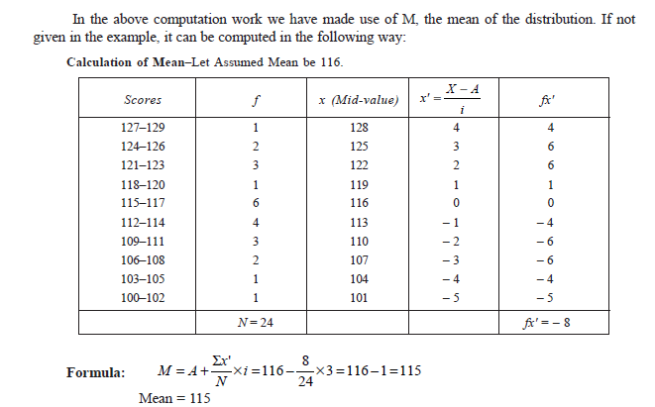

Slide 27
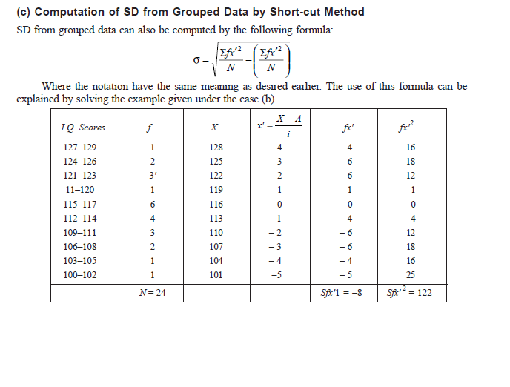
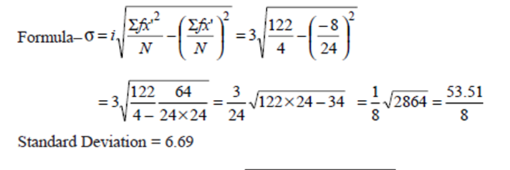

Slide 28

Merits of Standard Deviation
Squaring the deviations overcomes the drawback of ignoring signs in mean deviations
Suitable for further mathematical treatment
Least affected by the fluctuation of the observations
The standard deviation is zero if all the observations are constant
Independent of change of origin
Demerits of Standard Deviation
Not easy to calculate
Dependent on the change of scale
VARIANCE :- The Variance is defined as: The average of the squared differences from the Mean.
The point of statistics is to represent some situation (quantified, ostensibly, in a data set) in an efficient, concise, and clear manner. What the “typical” member of the set looks like, and how similar the items are. Statistics in a sense were created to represent the data in two or three numbers.
The variance is a measure of how dispersed or spread out the set is, something that the “average” (mean or median) is not designed to do. If data set has a variance of zero, for example, you know that every member of it is the same. If the variance is high, especially as a ratio to the mean, that tells you that the data have some very large dis-similarities amongst its members.

Slide 29
When assessing a set of numbers, in statistical inference, Its about “moments.” those calculations that derive from the data themselves.
The first moment is the “mean.” It is, in layman’s terms, a description of the location of the data: the centre of where the points are.
The second moment is the “variance.” It is a description of how spread the data are - if one considers the mean to be a sort of centre of the data, the variance tells you how scattered around the centre of mass the points are.
The third moment is the “skewness.” It is itself a description of how balanced the data are. Do they cluster in mass to the left with a few points way off to the right, or are they symmetrical. A data set that is equally distributed to the left and right has zero skewness.
The variance is the least-squares measurement of variation. It has the properties that it is non-negative , and can be scaled when the random variable is multiplied by a number, it is multiplied by the square of that number. So it is a one-dimensional property. Some probability distributions have infinite variance, for which the variance would not be useful. Assuming this is not the case, by the Central Limit Theorem, the mean of independent identically distributed random variables converge to a Normal distribution, which in turn is unique up to mean and variance, giving prominence to this variance.

Slide 30
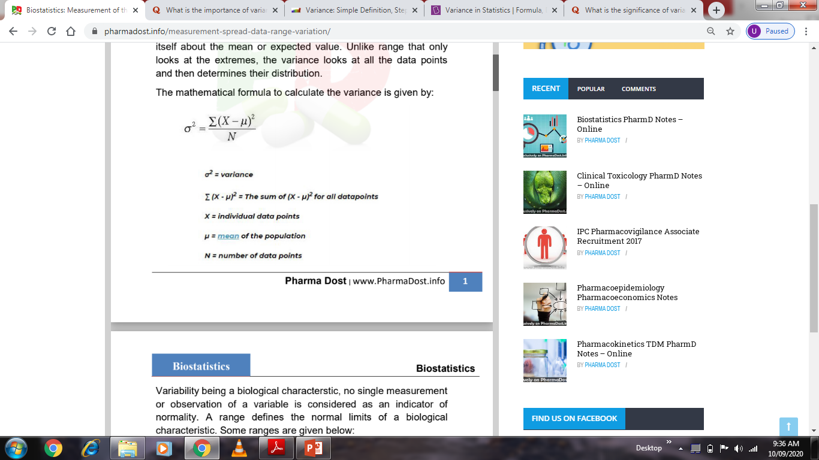
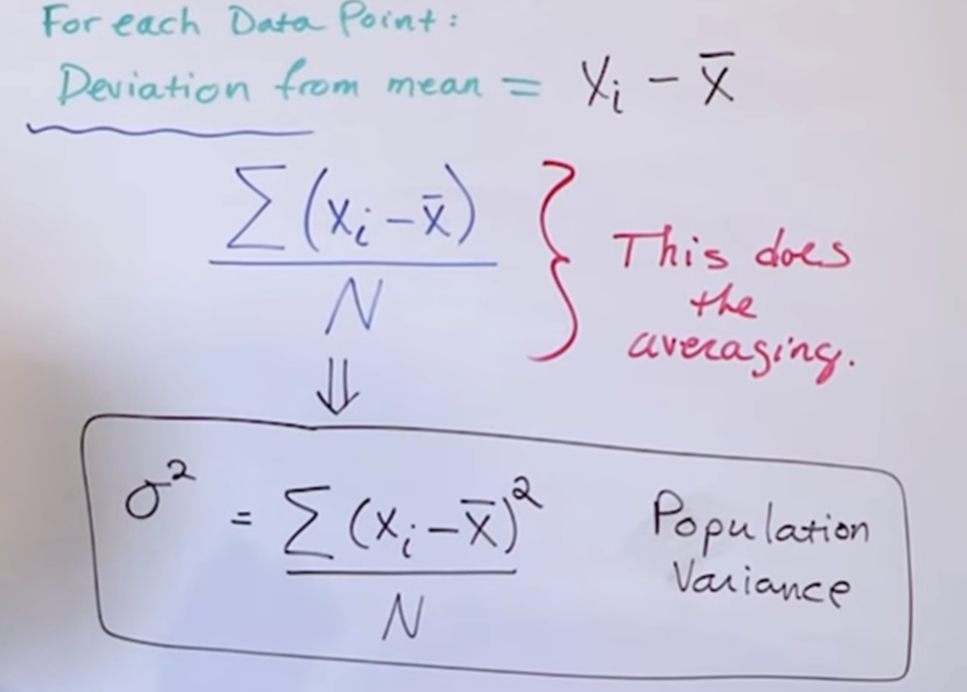
DATA
DATA
MEAN = X͞

Slide 31
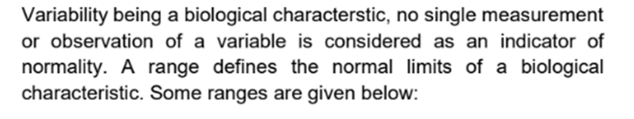
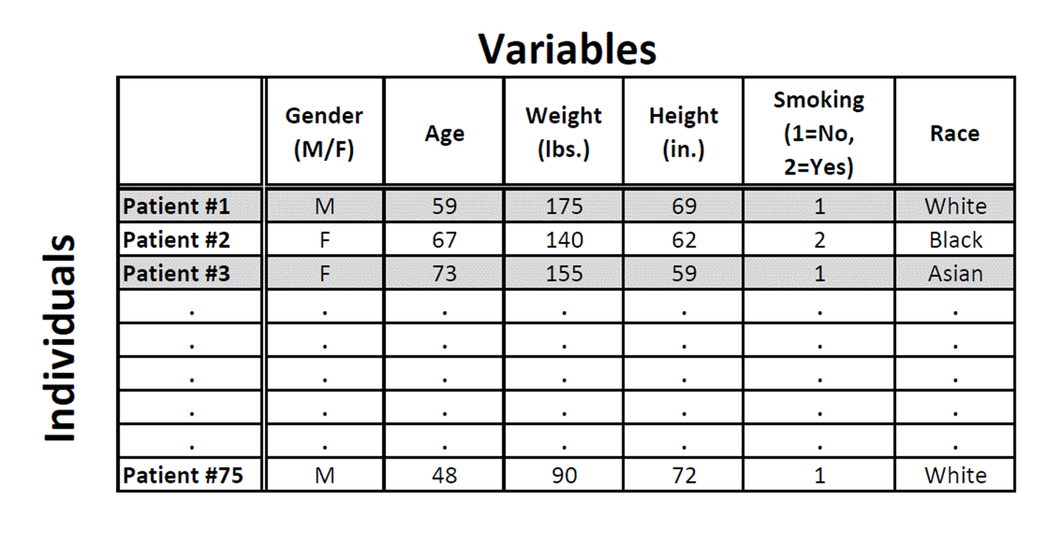
Biological Variation. Biological variation depends on the characteristic of the population being studied. For example, measuring the height of a random group of people will have a larger variability than a study limited to people of one age or sex. Also, for human gene expression, the coefficient of variation ranges from 20 to 100%.

Slide 32
The natural variability in a lab parameter due to physiologic differences among subjects and within the same subject over time.
Types of Biological Variability
• Inter-individual—Differences between subjects due to differences in diet, genetics or immune status.
•Intra-individual—Differences in the same subject over time due to diurnal cycles and other rhythms, biological repair mechanisms, dietary variables, ageing, etc.
Biological variation is important for survival of individuals and species, and is the underpinning force behind evolution. The intricacies of human biology with its many layers of interconnecting networks and inbuilt redundancy evolved over many millions of years to maximize an individual's chance of survival. It is, therefore, not surprising that multistage carcinogenesis starting from a background of genetic variation results in considerable heterogeneity between tumors arising in different patients. Individual (normal tissue) and tumor variability represents one of the biggest challenges in oncology. Radiotherapy schedules aim to maximize tumor cell kill while minimizing normal tissue damage, but they predominantly treat populations rather than individuals.
The medical, nursing and other professional staff on the ward round all understood the concept that variation in test results in individuals was due, not only to improvement or deterioration, but also to preanalytical variation, analytical imprecision and within-subject biological variation.
The Clinical Biochemist suggested that numerical data on biological variation had many uses and that these were very well documented
As far as everyday practice in ITU was concerned, there were two main applications, firstly, in deciding on the significance of change in serial results and, secondly, in setting desirable analytical performance targets.

Slide 33
Process Variation. Process variation refers to variability in the data that is exhibited when the same sample is run independently multiple times. Process variation results from the following:
Random (or Common-Cause) Variation
These include unpredictable and natural variations that may affect some, but not all, samples (e.g., a pipetting error). Efforts should be made to identify and reduce them, but they can never be completely eliminated. Taking the most accurate measurements possible and carefully following the experimental protocol or standard operating procedure (SOP) are also part of controlling random variations.
Systemic (or Special) Variation
Systemic variation affects the experimental process, so samples may be biased. Examples of systemic variation are equipment that is out of calibration and causes a bias, an unexpected temperature change during the experiment, or a delay from the normal timing that results in a change to the experimental procedure and affects the samples, process, and outcome.
System Variation. System variation comes from the instrument used to take measurements. The variability of the measurement system contributes to the process variability and can be a common cause or a special cause. A standard ruler is an example of a measurement system. Accuracy is usually taken to be half of the smallest division mark (e.g., ±0.5 mm, if the ruler has 1 mm marks). This is based on the assumption that estimating halfway between any two marks is relatively easy, while smaller fractions are not as accurately estimated by eye. Additional implicit assumptions are that the person taking the measurement has good eyesight and that the ruler markings are accurate. If the ruler manufacturer mismarked the ruler, the ruler would have a bias.
Experimental Variation. Experimental variation is the total variation seen in an experiment and comes from both the process and biological population variability.

Slide 34
Variance Formulas for Ungrouped Data
1.Formula For Population Variance
The variance of a population for ungrouped data is defined by the following formula:
σ² = ∑ (x − x̅)² / n
2. Formula for Sample Variance
The variance of a sample for ungrouped data is defined by a slightly different formula:
s² = ∑ (x − x̅)² / n − 1
Where,
σ² = Variance
x = Item given in the data
x̅ = Mean of the data
n = Total number of items
s² = Sample variance
Variance Formulas for Grouped Data
1.Formula for Population Variation
The variance of a population for grouped data is:
σ² = ∑ f (x − x̅)² / n
2. Formula for Sample Variance
The variance of a sample for grouped data is:
s² = ∑ f (x− x̅)² / n − 1
Where,
f = frequency of the class
x = midpoint of the class

Slide 35
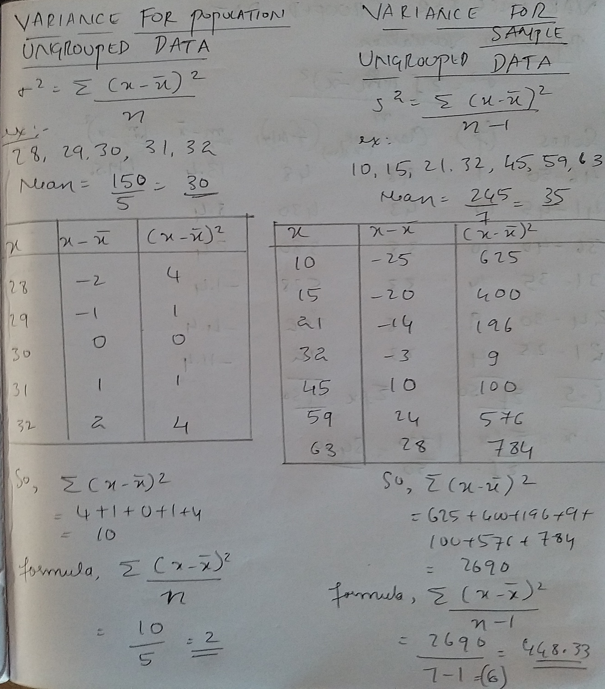
VARIANCE FOR UNGROUPED DATA = POPULATION AND SAMPLE

Slide 36
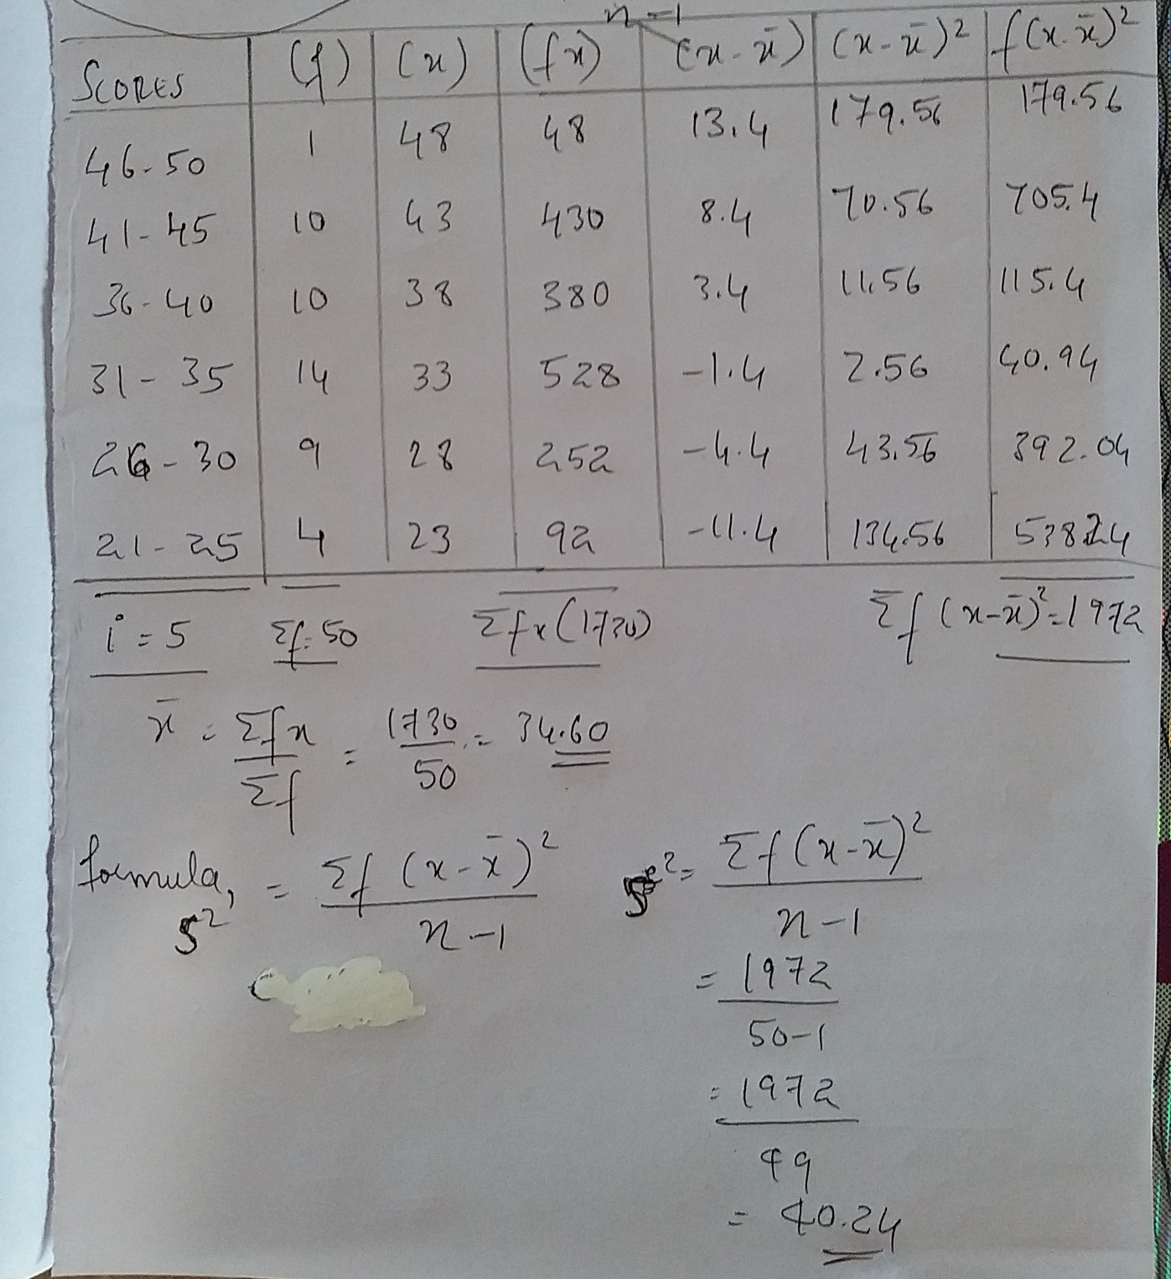
VARIANCE FOR GROUPED DATA – SAMPLE VARIANCE

Slide 37
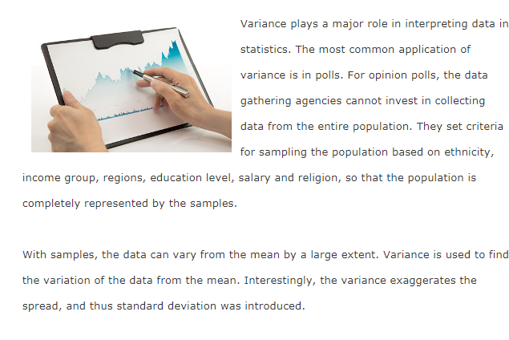

Slide 38
COEFFICIENT OF VARIATION
The coefficient of variation (CV) is a measure of relative variability. It is the ratio of the standard deviation to the mean (average). For example, the expression “The standard deviation is 15% of the mean” is a CV.
The CV is particularly useful when you want to compare results from two different surveys or tests that have different measures or values. For example, if you are comparing the results from two tests that have different scoring mechanisms. If sample A has a CV of 12% and sample B has a CV of 25%, you would say that sample B has more variation, relative to its mean.
The formula for the coefficient of variation is:
Coefficient of Variation = (Standard Deviation / Mean) * 100.
In symbols: CV = (SD/x¯) * 100.

Slide 39
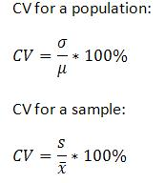
Use the following formula to calculate the CV by hand for a population or a sample.
how to find a coefficient of variation
σ is the standard deviation for a population, which is the same as “s” for the sample.
μ is the mean for the population, which is the same as X¯ in the sample.
In other words, to find the coefficient of variation, divide the standard deviation by the mean and multiply by 100.
Note: The Coefficient of Variation should only be used to compare positive data on a ratio scale. The CV has little or no meaning for measurements on an interval scale. Examples of interval scales include temperatures in Celsius or Fahrenheit, while the Kelvin scale is a ratio scale that starts at zero and cannot, by definition, take on a negative value (0 degrees Kelvin is the absence of heat).

Slide 40
Within (day-to-day variation) and Between Person Biological Variation: Coefficient of Variation (%)
Variable CV (Within) CV (Between)
Na 0.7% 0.8%
K 4.3% 4.3%
Cl 2.1% 1.2%
Ca 1.7% 2.8%
BUN 12.3% 16.4%
Creatinine 4.3% 9.5%
Cholesterol 5.3% 13.6%
SGOT (ALT) 24.2% 24.8%
TP 2.9% 5.7%

Slide 41
Analytical Variation - Coefficient of Variation (%) of Duplicate Samples
Variable CV (Analytical)
Na 1.1%
K 2.6%
Cl 2.1%
Ca 2.1%
BUN 2.2%
Creatinine 3.4%
Cholesterol 3.1%
SGOT (ALT) 7.3%
TP 1.7%

Slide 42
Two versions of a test are given to students. One test has pre-set answers and a second test has randomized answers. Find the coefficient of variation.
Calculation using the formula CV=(SD/Mean)*100 helps to make sense of the data:
Regular Test Randomized Answers
Mean 50.1 45.8
SD 11.2 12.9
Step 1: Divide the standard deviation by the mean for the first sample:
11.2 / 50.1 = 0.22355
Step 2: Multiply Step 1 by 100:
0.22355 * 100 = 22.355%
Step 3: Divide the standard deviation by the mean for the second sample:
12.9 / 45.8 = 0.28166
Step 4: Multiply Step 3 by 100:
0.28166 * 100 = 28.266%

Slide 43
KEY POINTS
In statistical analysis, the coefficient of variation (CV) measures relative event dispersion.
The CV is equal to the ratio between the standard deviation and the mean. Although CV is most commonly used in comparing relative risk, it may be applied to many types of probability distribution.
The CV isn't practical if there's a strong presence of both positive and negative values in the sample population.
The CV metric is best used when nearly all of the data points share the same plus-minus sign.
ADVANTAGES
The CV's chief advantage is its applicability to any given quantifiable data, thus paving the way for a comparative analysis between two unrelated entities. This quality separates CV from a standard deviation analysis, which cannot facilitate a meaningful comparison between two independent variables.
In the variable CV setting: The standard deviations of two variables, while both measure dispersion in their respective variables, cannot be compared to each other in a meaningful way to determine which variable has greater dispersion because they may vary greatly in their units and the means about which they occur. The standard deviation and mean of a variable are expressed in the same units, so taking the ratio of these two allows the units to cancel. This ratio can then be compared to other such ratios in a meaningful way: between two variables (that meet the assumptions outlined below), the variable with the smaller CV is less dispersed than the variable with the larger CV.

Slide 44
In the model CV setting: Similarly, the RMSE of two models both measure the magnitude of the residuals, but they cannot be compared to each other in a meaningful way to determine which model provides better predictions of an outcome.
The model RMSE and mean of the predicted variable are expressed in the same units, so taking the ratio of these two allows the units to cancel.
This ratio can then be compared to other such ratios in a meaningful way: between two models (where the outcome variable meets the assumptions outlined below), the model with the smaller CV has predicted values that are closer to the actual values. It is interesting to note the differences between a model’s CV and R-squared values.
Both are unit less measures that are indicative of model fit, but they define model fit in two different ways: CV evaluates the relative closeness of the predictions to the actual values while R-squared evaluates how much of the variability in the actual values is explained by the model.
Requirements and Disadvantages
There are some requirements that must be met in order for the CV to be interpreted in the ways we have described. The most obvious problem arises when the mean of a variable is zero. In this case, the CV cannot be calculated. Even if the mean of a variable is not zero, but the variable contains both positive and negative values and the mean is close to zero, then the CV can be misleading. The CV of a variable or the CV of a prediction model for a variable can be considered as a reasonable measure if the variable contains only positive values. This is a definite disadvantage of CVs

Slide 45
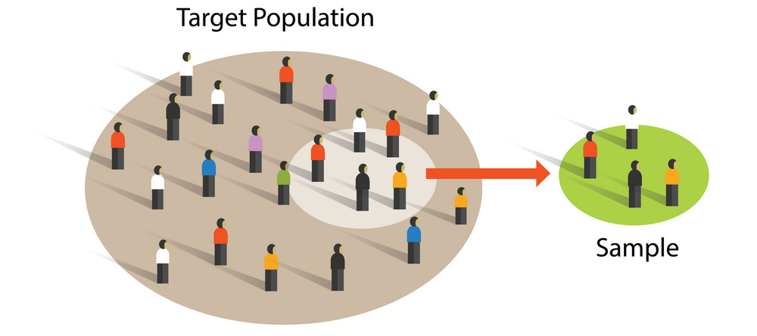
STANDARD ERROR OF MEAN
Basic Terminologies to understand Standard error of mean
Error is a measure of the estimated difference between the observed or calculated value of a quantity and its true value.
Population . Population is a comprehensive group of individuals, institutions, objects and so forth with have a common characteristics that are the interest of a researcher
Sample group of people, objects, or items that are taken from a larger population for measurement. The sample should be representative of the population to ensure that we can generalize the findings from the research sample to the population as a whole.

Slide 46
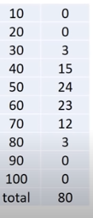
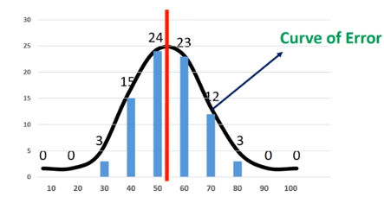
Data
Interpreting data into graph
BLUE BARS- POPULATION
RED LINE - MEAN
Standard deviation of the distribution of sample mean is known as standard error of the mean.

Slide 47
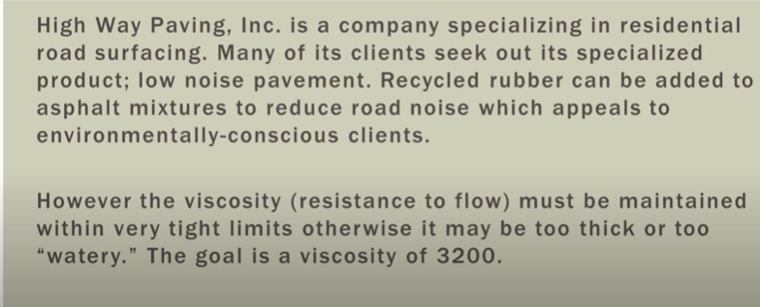
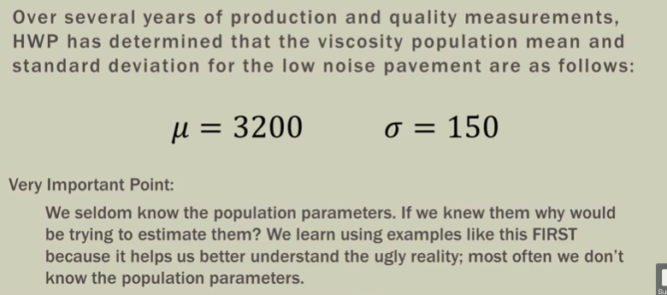

Slide 48
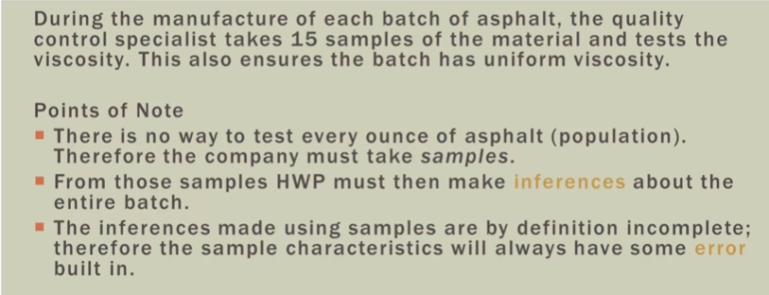
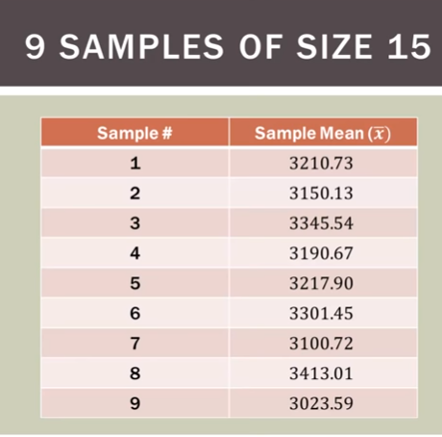

Slide 49
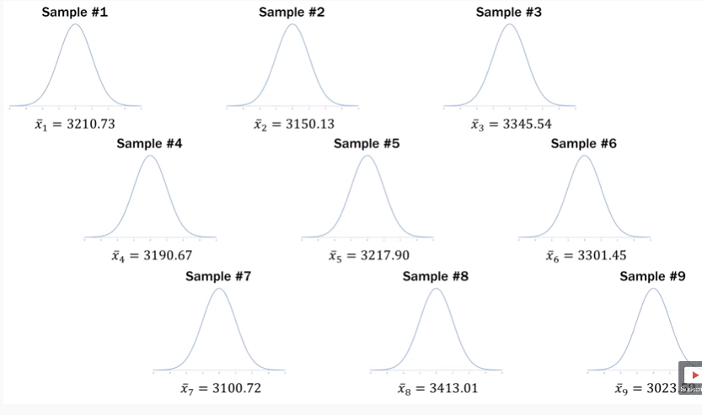

Slide 50
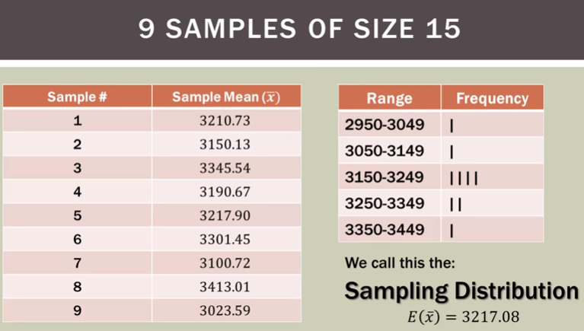

Slide 51
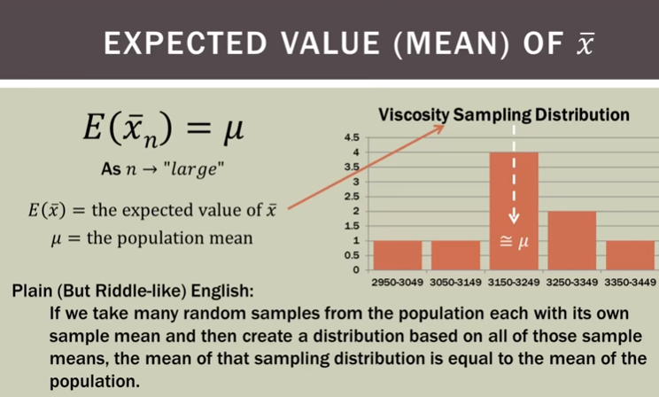

Slide 52
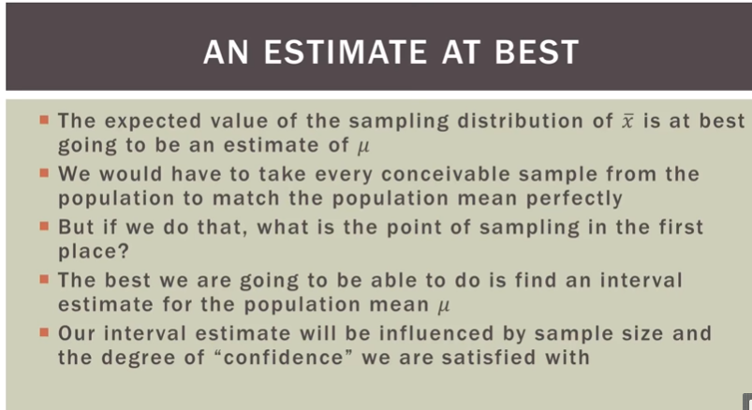

Slide 53
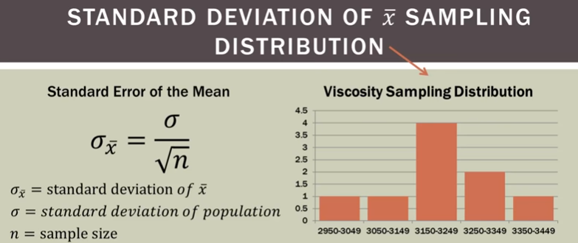
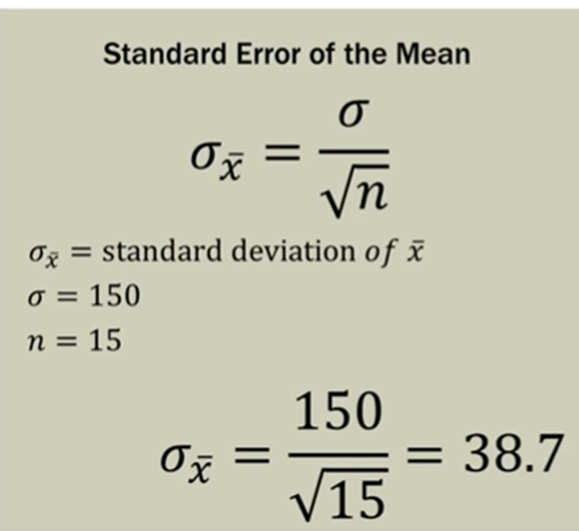

Slide 54
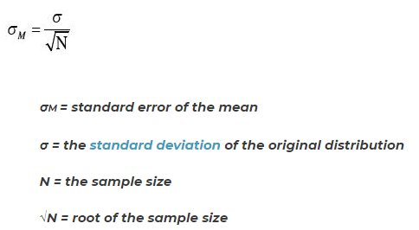
It can be seen from the formula that the standard error of the mean decreases as N increases. This is expected because if the mean at each step is calculated using many data points, then a small deviation in one value will cause less effect on the final mean.
The standard error of the mean tells us how the mean varies with different experiments measuring the same quantity. Thus if the effect of random changes are significant, then the standard error of the mean will be higher. If there is no change in the data points as experiments are repeated, then the standard error of mean is zero.

Slide 55
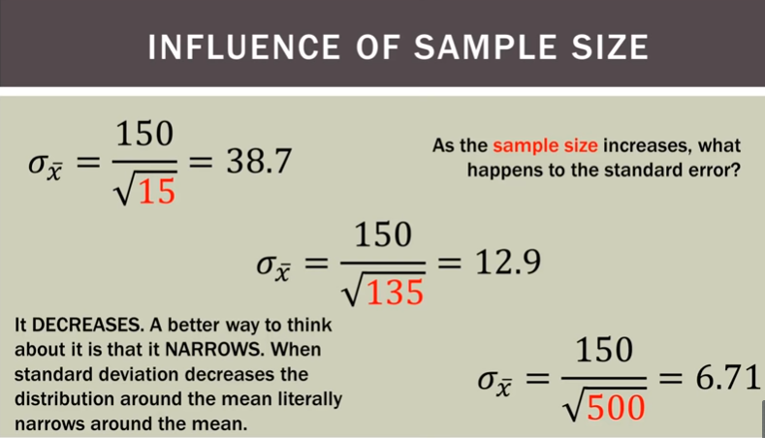

Slide 56
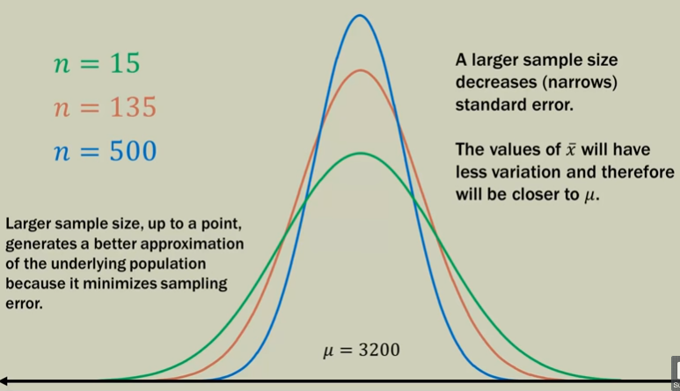

Slide 57
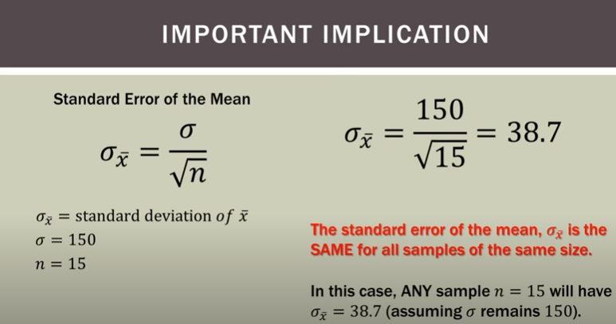

Slide 58
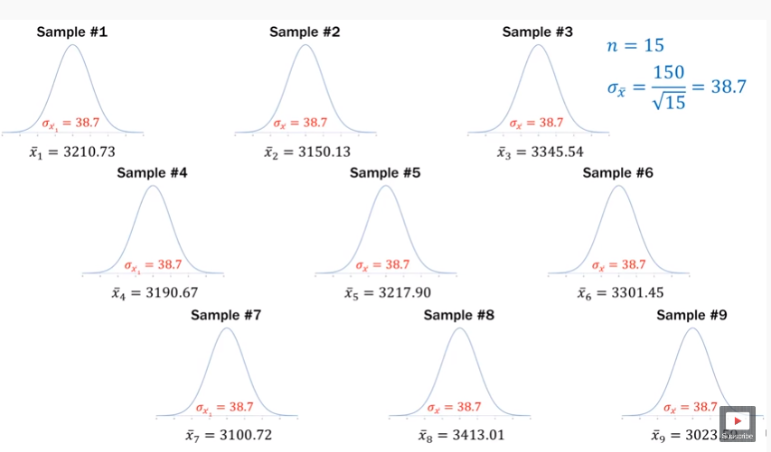

Slide 59
KEY POINTS
The standard error of the sample mean depends on both the standard deviation and the sample size, by the simple relation SE = SD/√(sample size). The standard error falls as the sample size increases, as the extent of chance variation is reduced—this idea underlies the sample size calculation for a controlled trial, for example. By contrast the standard deviation will not tend to change as we increase the size of our sample.
So, if we want to say how widely scattered some measurements are, we use the standard deviation. If we want to indicate the uncertainty around the estimate of the mean measurement, we quote the standard error of the mean. The standard error is most useful as a means of calculating a confidence interval. For a large sample, a 95% confidence interval is obtained as the values 1.96×SE either side of the mean.. The standard error is also used to calculate P values in many circumstances.
The principle of a sampling distribution applies to other quantities that we may estimate from a sample, such as a proportion or regression coefficient, and to contrasts between two samples, such as a risk ratio or the difference between two means or proportions. All such quantities have uncertainty due to sampling variation, and for all such estimates a standard error can be calculated to indicate the degree of uncertainty.

Slide 60
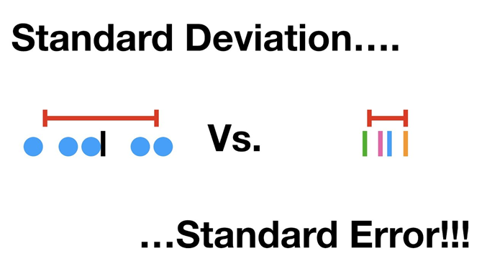
When to use standard deviation? When to use standard error?
It depends. If the message you want to carry is about the spread and variability of the data, then standard deviation is the metric to use. If you are interested in the precision of the means or in comparing and testing differences between means then standard error is your metric. Of course deriving confidence intervals around your data (using standard deviation) or the mean (using standard error) requires your data to be normally distributed.

