Slide 1
BIOSTATISTICS AND RESEARCH METHODOLOGY
UNIT – 2 BIOSTATISTICS
2 .1 (c) Measures describing the central tendency distributions- average, median, mode.
14-09-2024
1

Slide 2
(C)MEASURES DESCRIBING THE CENTRAL TENDENCY DISTRIBUTIONS
Measures of central tendency (or statistical averages) tell us the point about which items have a tendency to cluster. Such a measure is considered as the most representative figure for the entire mass of data. Measure of central tendency is also known as statistical average.
Central tendency is defined as “the statistical measure that identifies a single value as representative of an entire distribution.” It aims to provide an accurate description of the entire data. It is the single value that is most typical/representative of the collected data. The term “number crunching” is used to illustrate this aspect of data description. The mean, median and mode are the three commonly used measures of central tendency.
A measure of central tendency is a summary statistic that represents the center point or typical value of a dataset.
These measures indicate where most values in a distribution fall and are also referred to as the central location of a distribution.
Choosing the best measure of central tendency depends on the type of data you have.

Slide 3
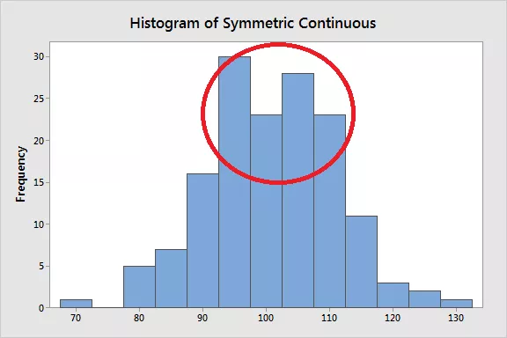
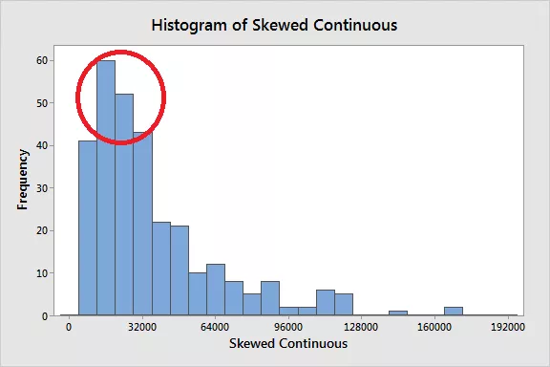
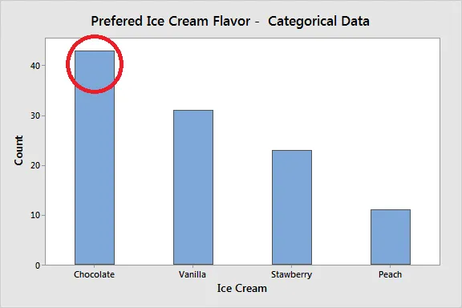

Slide 4
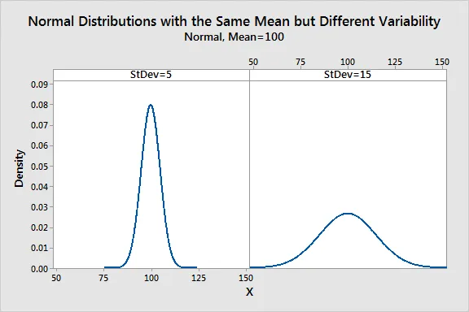
The central tendency of a distribution represents one characteristic of a distribution. Another aspect is the variability around that central value.
While measures of variability is the topic of a different article (link below), this property describes how far away the data points tend to fall from the center.
The graph below shows how distributions with the same central tendency (mean = 100) can actually be quite different.
The panel on the left displays a distribution that is tightly clustered around the mean, while the distribution on the right is more spread out.
It is crucial to understand that the central tendency summarizes only one aspect of a distribution and that it provides an incomplete picture by itself.

Slide 5
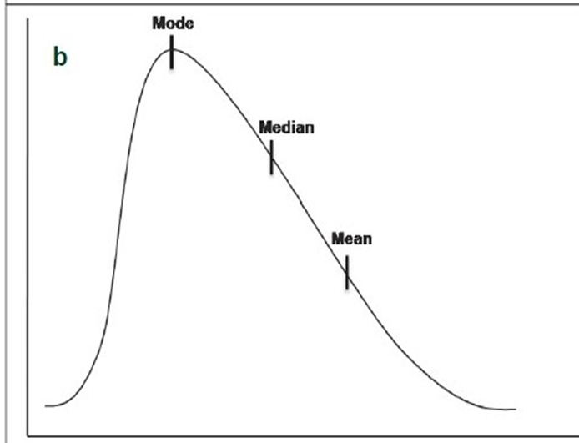
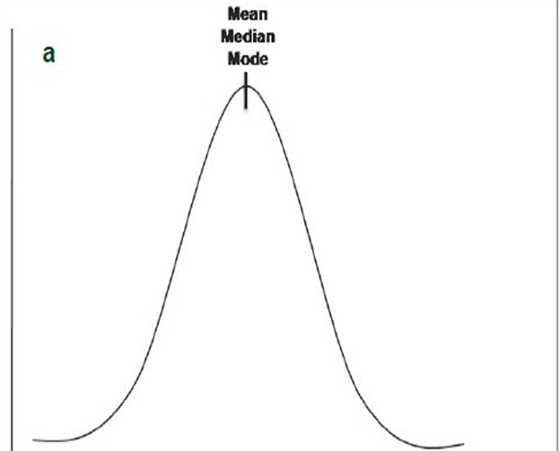
POSITION OF MEASURES OF CENTRAL TENDENCY
The relative position of the three measures of central tendency (mean, median, and mode) depends on the shape of the distribution. All three measures are identical in a normal distribution . As mean is always pulled toward the extreme observations, the mean is shifted to the tail in a skewed distribution Mode is the most frequently occurring score and hence it lies in the hump of the skewed distribution. Median lies in between the mean and the mode in a skewed distribution.

Slide 6
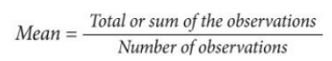
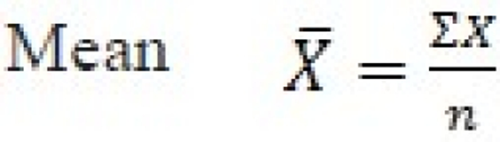
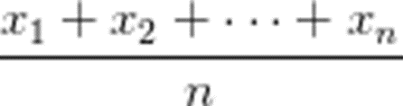
MEAN
Mean
The mean is the arithmetic average, and it is probably the measure of central tendency that you are most familiar. Calculating the mean is very simple. You just add up all of the values and divide by the number of observations in your dataset.
=
Mean is the most commonly used measure of central tendency. There are different types of mean, viz. arithmetic mean, weighted mean, geometric mean (GM) and harmonic mean (HM). If mentioned without an adjective (as mean), it generally refers to the arithmetic mean.
Arithmetic mean
Arithmetic mean (or, simply, “mean”) is nothing but the average. It is computed by adding all the values in the data set divided by the number of observations in it. If we have the raw data, mean is given by the formula
For ungrouped data

Slide 7
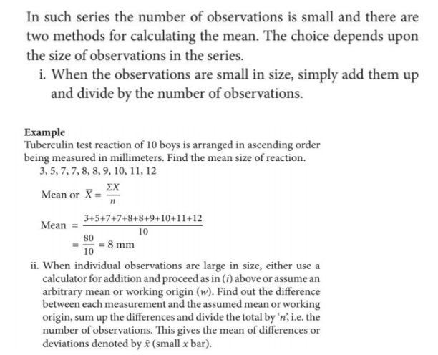
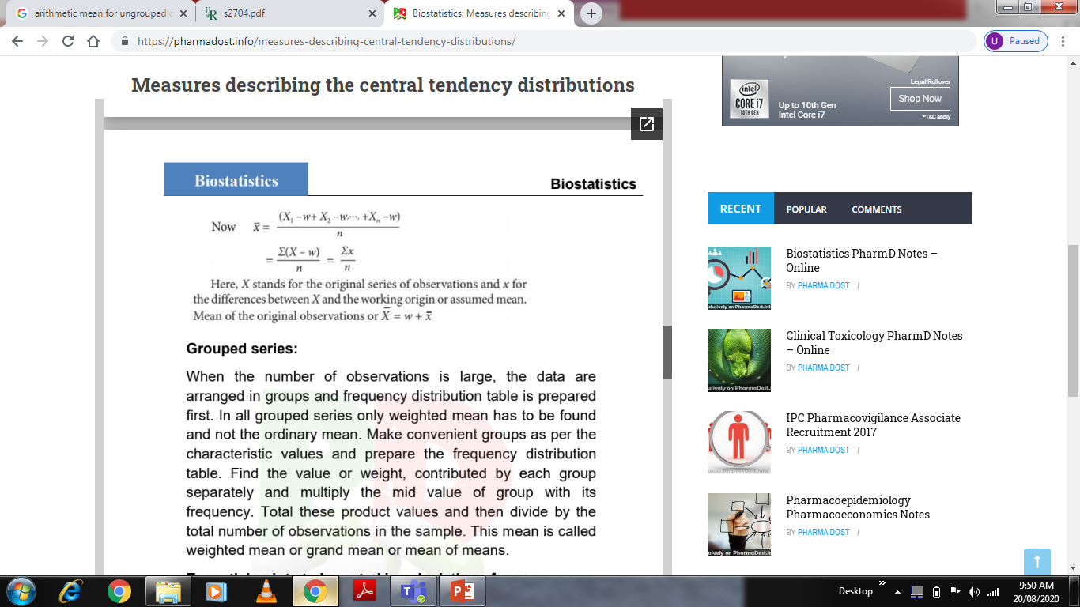
For ungrouped data, the mean is simply the sum of all values divided by the number of cases.

Slide 8
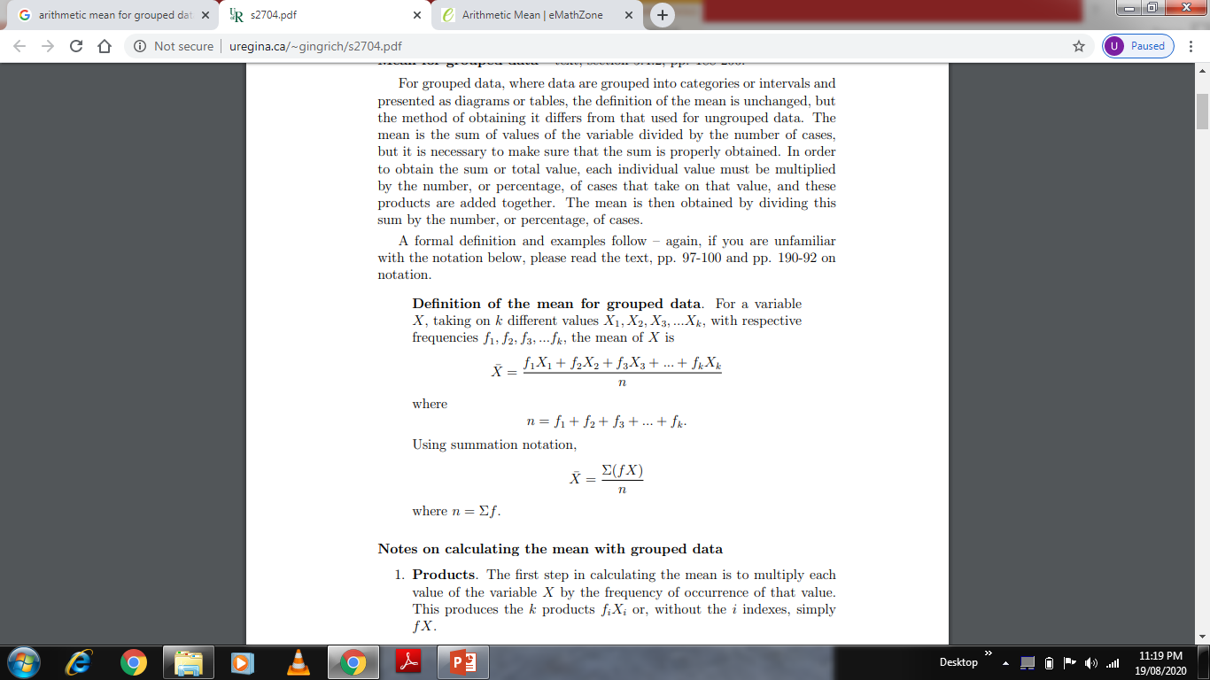
Mean for grouped data
For grouped data, where data are grouped into categories or intervals and presented as diagrams or tables, the definition of the mean is unchanged, but the method of obtaining it differs from that used for ungrouped data.
The mean is the sum of values of the variable divided by the number of cases, but it is necessary to make sure that the sum is properly obtained.
In order to obtain the sum or total value, each individual value must be multiplied by the number, or percentage, of cases that take on that value, and these products are added together.
The mean is then obtained by dividing this sum by the number, or percentage, of cases. Definition of the mean for grouped data. For a variable X, taking on k different values X1, X2, X3, ...Xk, with respective frequencies f1, f2, f3, ...fk, the mean of X is,

Slide 9
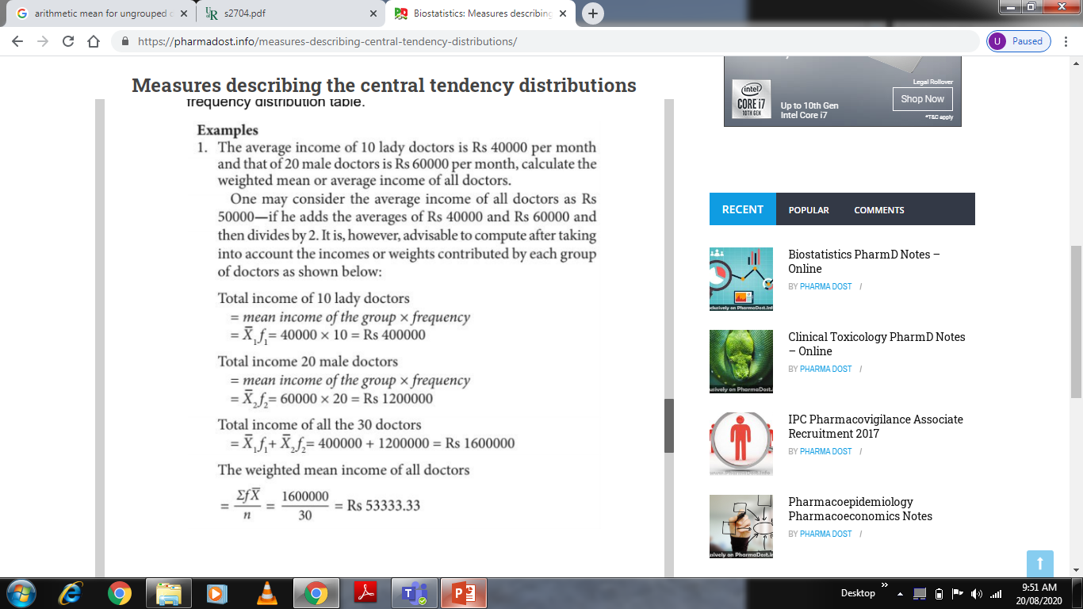

Slide 10
ADVANTAGES
The mean uses every value in the data and hence is a good representative of the data. The irony in this is that most of the times this value never appears in the raw data.
Repeated samples drawn from the same population tend to have similar means. The mean is therefore the measure of central tendency that best resists the fluctuation between different samples.
It is closely related to standard deviation, the most common measure of dispersion.
DISADVANTAGES
The important disadvantage of mean is that it is sensitive to extreme values/outliers, especially when the sample size is small. Therefore, it is not an appropriate measure of central tendency for skewed distribution.
Mean cannot be calculated for nominal or nonnominal ordinal data. Even though mean can be calculated for numerical ordinal data, many times it does not give a meaningful value, e.g. stage of cancer.
DEGREE OF VARIATION BETWEEN THE MEANS
If all the values in a data set are the same, then all the three means (arithmetic mean, GM and HM) will be identical. As the variability in the data increases, the difference among these means also increases. Arithmetic mean is always greater than the GM, which in turn is always greater than the HM.
The other measures of central tendency (median and mode) and the guidelines for selecting the appropriate measure of central tendency will be dealt with in the subsequent issue.

Slide 11
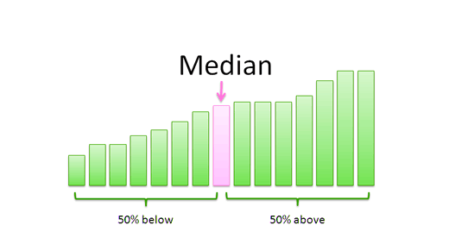
2. MEDIAN
Median is the value which occupies the middle position when all the observations are arranged in an ascending/descending order. It divides the frequency distribution exactly into two halves. Fifty percent of observations in a distribution have scores at or below the median. Hence median is the 50th percentile. Median is also known as ‘positional average’.
It is easy to calculate the median. If the number of observations are odd, then (n + 1)/2th observation (in the ordered set) is the median. When the total number of observations are even, it is given by the mean of n/2th and (n/2 + 1)th observation.
Median is preferred to mean, when
There are few extreme scores in the distribution.
Some scores have undetermined values.
There is an open ended distribution.
Data are measured in an ordinal scale

Slide 12
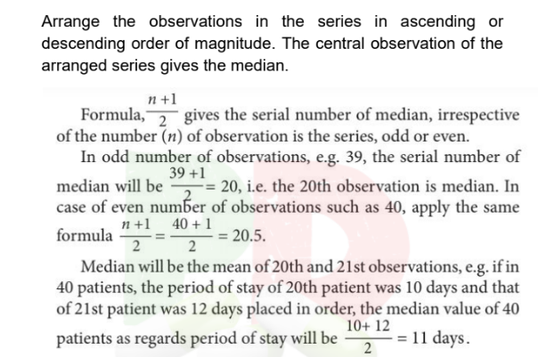
Median for ungrouped data
Find Median for Ungrouped Data
X – 20,7,2,19,18,17,3
Where , X – 2,3,7,17,18,19,20
N= 7
Median – 7+1/2 = 4
So 4 th term is 17,
MEDIAN = 17

Slide 13
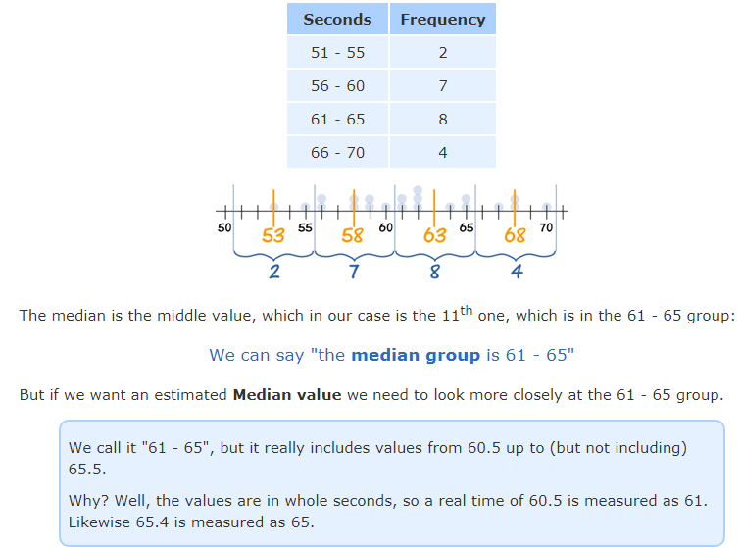
Median for grouped Data

Slide 14
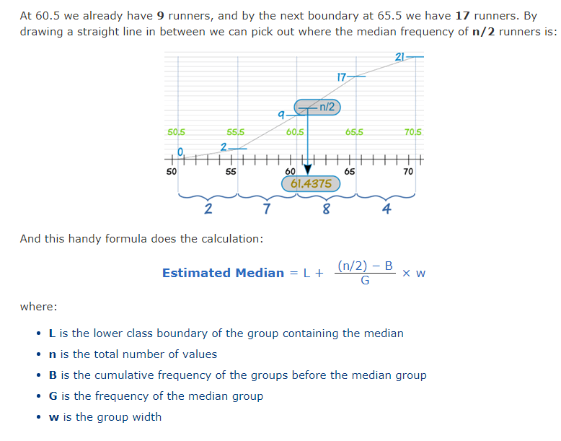
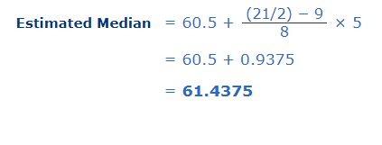
For our example:
L = 60.5
n = 21
B = 2 + 7 = 9
G = 8
w = 5

Slide 15
Advantages
It is easy to compute and comprehend.
It is not distorted by outliers/skewed data.
It can be determined for ratio, interval, and ordinal scale.
Disadvantages
It does not take into account the precise value of each observation and hence does not use all information available in the data.
Unlike mean, median is not amenable to further mathematical calculation and hence is not used in many statistical tests.
If we pool the observations of two groups, median of the pooled group cannot be expressed in terms of the individual medians of the pooled groups

Slide 16
When to use mean or median
Sometimes, we need to decide if calculating the mean or median is most appropriate for what you would like determine. Hospital length of stay can be an example of data that may be skewed if the wrong term is chosen (that is, when most of the data values fall to the left or right of the mean).
Most people stay in a hospital for a few days. However, some patients have hospital stays for months on end. In this example, you would likely report the median length of hospital stay, which separates the higher half from the lower half. In general, however, most people report the mean unless you have a good reason for not doing so, such as to avoid skewing the data like in the hospital example above.
3. MODE
Mode is defined as the value that occurs most frequently in the data. Some data sets do not have a mode because each value occurs only once.
On the other hand, some data sets can have more than one mode. This happens when the data set has two or more values of equal frequency which is greater than that of any other value.
Mode is rarely used as a summary statistic except to describe a bimodal distribution. In a bimodal distribution, the taller peak is called the major mode and the shorter one is the minor mode
You can remember mode the following way: MOde is the value that is in the set MOst often.

Slide 17
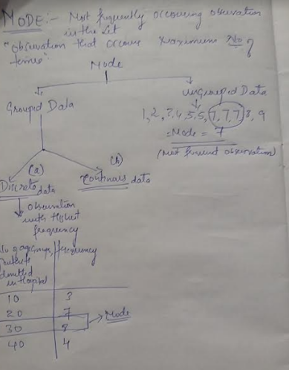
(b)Estimating the Mode from Grouped Data Again, looking at our data:
Seconds Frequency
51 - 55 2
56 - 60 7
61 - 65 8
66 - 70 4
We can easily find the modal group (the group with the highest frequency), which is 61 – 65 , We can say "the modal group is 61 - 65“
But the actual Mode may not even be in that group! Or there may be more than one mode. Without the raw data we don't really know.
But, we can estimate the Mode using the following formula
Estimated Mode = L + f_{m} − fm-1 X W
(f_{m} − f_{m-1}) + (f_{m} − f_{m+1})
where:
L is the lower class boundary of the modal group
fm-1 is the frequency of the group before the modal group
fm is the frequency of the modal group
fm+1 is the frequency of the group after the modal group
w is the group width
Class boundaries
50.5-55.5
55.5-60.5
60.5-65.5
65.5-70.5
example:
L = 60.5
fm-1 = 7
fm = 8
fm+1 = 4
w = 5
Estimated Mode = 60.5 + 8 − 7
(8 − 7) + (8 − 4)
= 60.5 + (1/5) × 5
= 61.5
X 5

Slide 18
Advantages
It is the only measure of central tendency that can be used for data measured in a nominal scale.
It can be calculated easily.
Disadvantages
It is not used in statistical analysis as it is not algebraically defined and the fluctuation in the frequency of observation is more when the sample size is small.

