Slide 1
Clinical Pharmacy
Medication Errors
4- 5- 2021
1

Slide 2
Introduction
Almost everyone in the modern world takes medication at one time or another
Most of the time medications are beneficial
But some occasion they do harmful effects (side effects) → adverse drug events, which is inevitable
But sometimes the harmis caused by anerror in prescribing or dispensing or taking medication

Slide 3
These damages arenot inevitable andcan be prevented
Medication error
Many studies shown, these medication errors are common, causing deathsandincrease the cost

Slide 4
Definition of medication error
An error in theprocessing ordering, delivery or administration of amedication
A medicationerroris by definition(NCCMERP) a preventable adverse event
Dose of medicationthatdeviates from the physicians orderas writtenin thepatients chartor from standardhospitalpolicy and procedures.

Slide 5
Categories of Medication Errors
Omission errors
Unauthorized error
wrong dose error
Wrong routeerror
Wrong rate error
Wrong Dosage form error
Wrong preparation of dose
Incorrect Administration technique errors
Wrong time error Other types
Prescribing error
Deteriorated drug errors
Monitoring errors
Compliance error
Dispensing error

Slide 6

Medication error may be related to
Physician
Pharmacist
Nurses
Patients

Slide 7
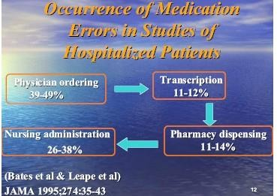

Slide 8
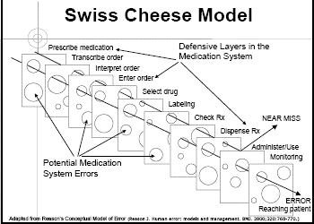

Slide 9
Causes of errors
Multiple factors lead to errors
  Human –related
  System related
  Medication –related
Preventing errors is everyone's responsibility

Slide 10

Human –related factors
Over worked
Shortage of professionals
Under trained
Incapacity
Illness / stressed
Insufficient or inadequate knowledge
Distraction or interruption
Illegible handwriting
Unclear dictation

Slide 11
Error-reducing strategies based on Human factors
Appoint professionals
Reduce reliance on memory
Reduce reliance on vigilance
Reduce the need for calculation
Manage fatigue
Provide adequatetraining
Provide adequateinformation resources

Slide 12

System –related factors
Using nonprofessionals where professional judgment is required
Inadequate policies regarding reporting of medication error
Disorganized workspace/ inadequate tools to complete work
Poor work flow/lack of supervision
Environmental factors Poor lighting Noise Interruptions
Too much work load Heat
Confined space

Slide 13

Organizational approach's to patient safety
Lay personnel should not allowed to do work were professional judgment is required
Blame- free environment
Encourage error reporting
Focus on systems problems
Educate the employees and sensitize the public
Multidisciplinary team work
Infrastructure investment

Slide 14
Medication-related error contributing factors
Look-alike/ sound- alike medications
High-alert medications
Multiple dosage forms

Slide 15
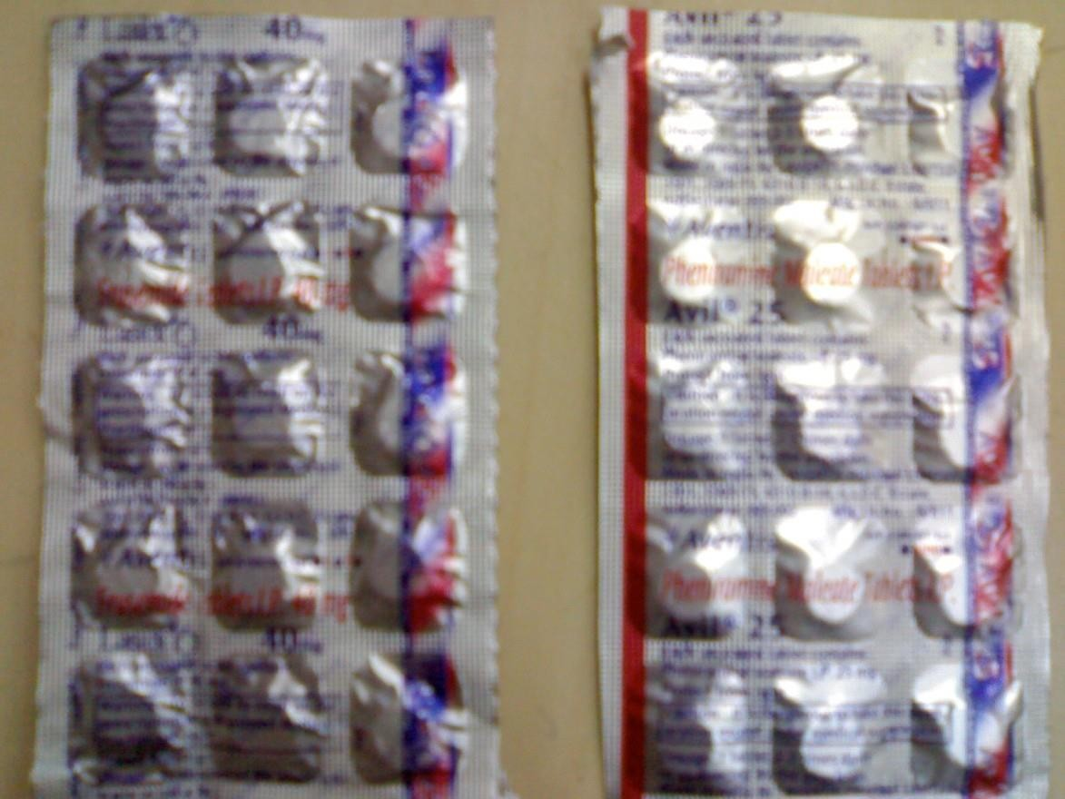
Look a like drugs

Slide 16
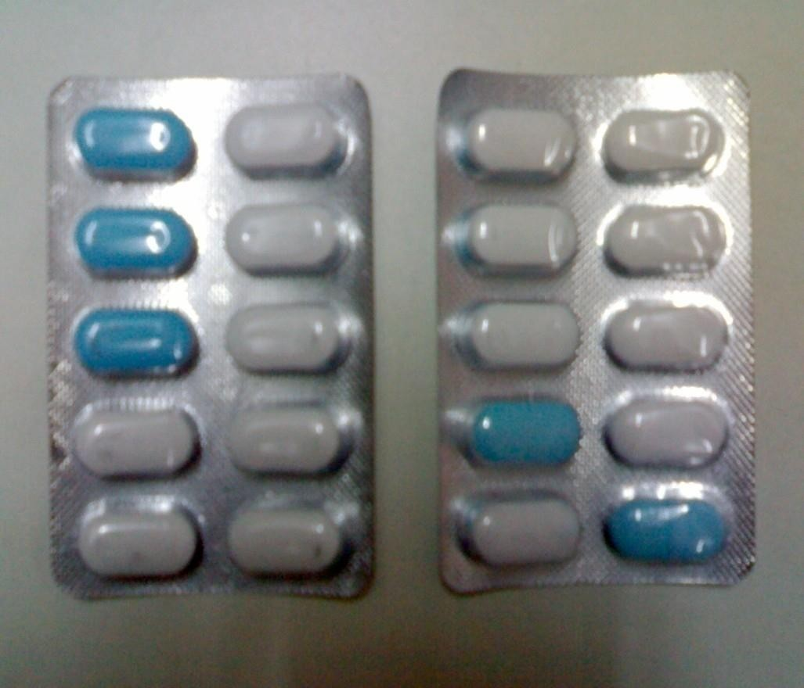
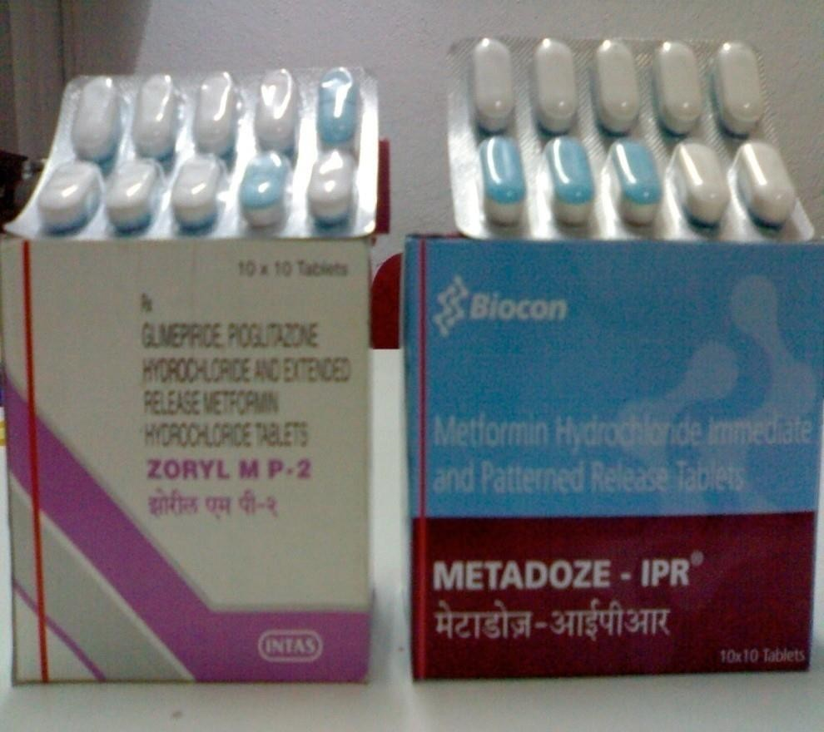
Look a like drugs
.

Slide 17

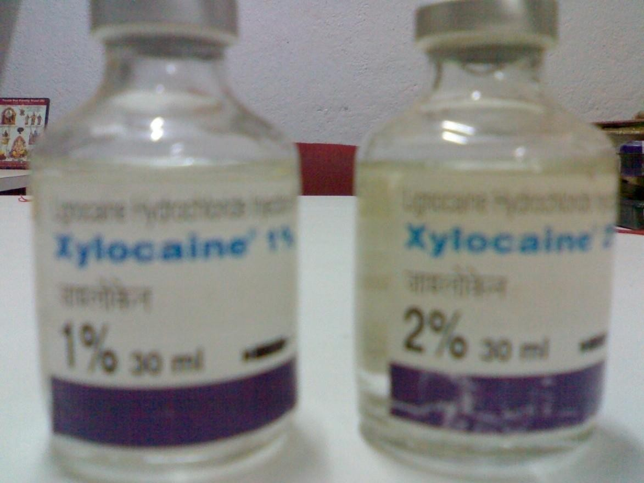
Look a like drugs

Slide 18
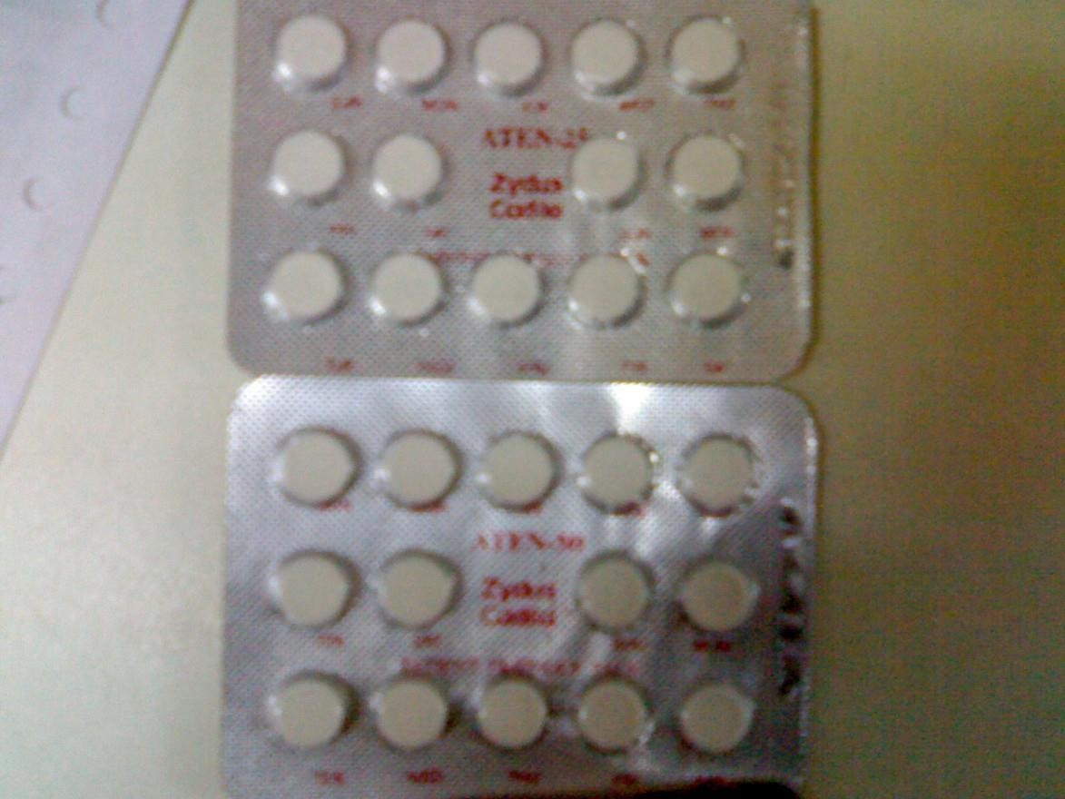
Look a like drugs

Slide 19

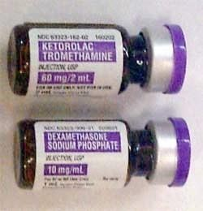
Look a like drugs
.

Slide 20
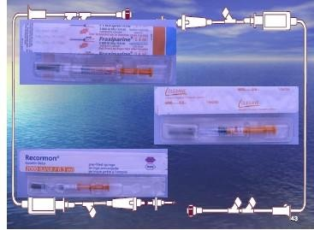
Look a like drugs
:
4- 5- 2021

Slide 21
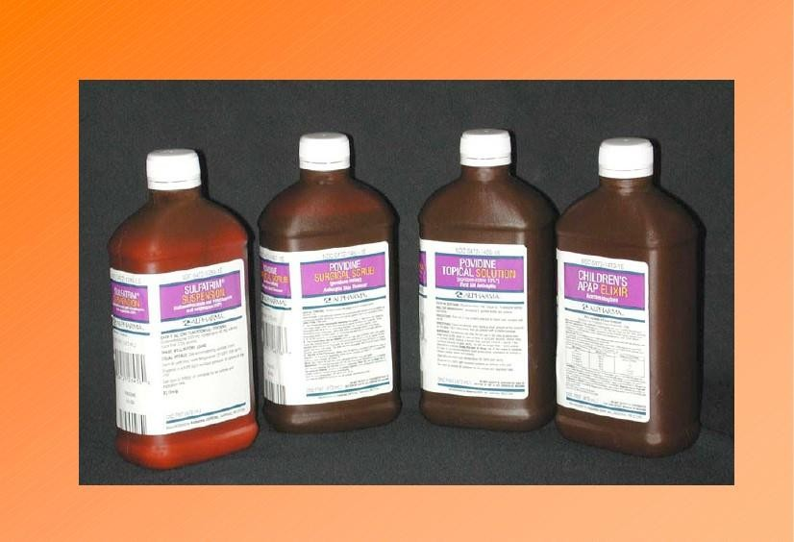
Look a like a drugs
.

Slide 22
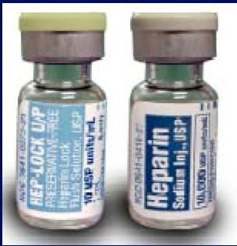
Look a like drugs

Slide 23
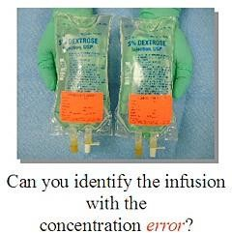

Slide 24
High –alert medications
Have an increased risk to causeharm
List available from imsp.org Examples
chemotherapy agents antithrombolytics anti-arrythmics insulin
anti-seizure medi

Slide 25
Sound a like or look a like
www.usp.org
Penegra
  Neroxim
  Losakind-H
  Unienzyme
  Eltroxine
  Oximet
  Listril
Allegra
Nitaxim
Lipikind Uniwarfin
Eltocin
Obimet Listerine

Slide 26
.
Strategies to overcome-medication
Monitoring while dispensing high alert drugs
While receiving telephonic order- receive by senior people
Proper storage
Automated alert system
Limited assess to high alert drugs
Standard procedure hasto follow for SALA drugs

Slide 27
Dispensing error
Pharmacists are ultimately responsible for accurate dispensing of medications.
The failure in this part of the chain of medication use process, results in dispensing error.

Slide 28
Dispensing Errors areof two types :
Errors of Commission :
Dispensing the wrong medication/dose/dosage form
Errors of Omission : No counseling to patients Failure to note DDI
Patient specific errors like alergy, age related dose.

Slide 29
Potentialcauses of Dispensing Errors:
Handwriting: Poorly written, ilegible prescriptions
Drug with similar names: SALADrugs.
Zeros and Decimal Points.
Metric andApothecarysystems.
Abbreviations.
Poorly written or incomplete prescriptions.
4- 5- 2021

Slide 30
UnapprovedAbbreviations Leading to Medication Errors:
Abbreviation
Intended
Misinterpretation
> and<
Greater than Less than
Often used the Opposite
μg
Microgram
Mistaken as mg
cc
cubic centimeter
Misread as ‘u’
IU
International Unit
Mistaken as IV
qd, QD or QOD
Every day or every other day
Often confused for each other
4- 5- 2021

Slide 31
Zeroafter decimal(1.0)
1mg
Misread as 10 mg
Zero not written before decimal
Half mg (0.5)
Misread as 5 mg
4- 5- 2021

Slide 32
Workload, Fatigue and stress.
Interruptions anddistractions
Miscommunications
Poor design of work place and workflow pattern
Dependence onassistants
4- 5- 2021

Slide 33
How to prevent Dispensing Errors
.
Medication should be given only on thewritten order of aphysician
Medication order - component
Any Questionarisingfromamedication order- refer tophysician
Labeling
4- 5- 2021

Slide 34
Lock or separate those drugs which frequently cause errors
Develop good SOP for drug storage
Reduce distractions
Design safe dispensing place
Use reminders for SALA drugs
4- 5- 2021

Slide 35
Have afinal check with acoleague
Check label of the container or carrybags
Provide patient counseling on vital aspects of medication like how to take, how long to take, any avoidance of food/drink with the drugs.
4- 5- 2021
35

Slide 36
Conclusion
Safe use of medication is very important in the hospital or in a community.
As apart of health care team, our duty to minimize the medication error andensure the safe use of drugs
30 -04-2021
36

