Slide 1
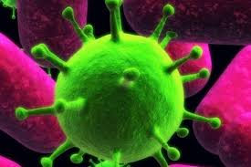
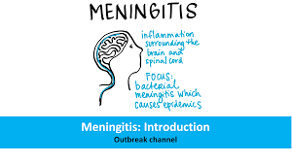
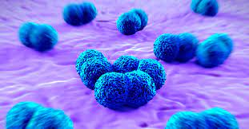
Meningitis
Infection Disease
By Animesh Das

Slide 2
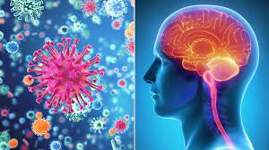
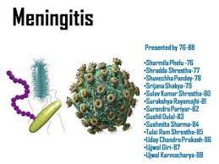
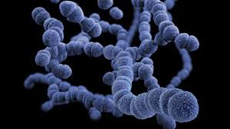
Definition
It is usually caused by a viral infection or bacterial or fungal infection , inflammation of brain and spinal cord membranes and can spread through coughing , sneezing , kissing or sharing utensils , a toothbrush or a cigarette.
Causative agent -- Streptococcus pneumoniae

Slide 3

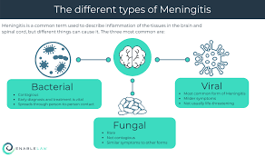
Type / Classification
There are the five type of meningitis --
Bacterial meningitis
Viral meningitis
Parasitic meningitis
Fungal meningitis
Non infection meningitis

Slide 4
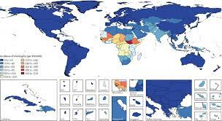
Epidemiology
An estimated 2.5 million cause of meningitis occur globally each per year .
Rates of disease are highest in children younger than 1 year old .
Meningitis zone – Saharan Africa , Nigeria , Ghana , India , UK .

Slide 5
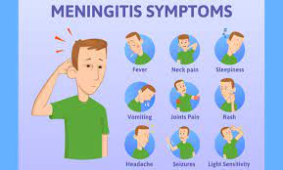
Sings and symptoms
Sever headache
Nausea
Vomiting
High grade fever
Restlessness
Irritability
Coma
Tachycardia
Sleeplessness
Altered mental status
Malaise

Slide 6
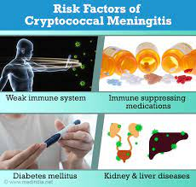
Risk factor
Age – children younger than 5 years
Use of immunosuppressive drugs
Chronic malnutrition
AIDS
CSF shunt
Chronic alcoholism
Diabetes
Pneumonia

Slide 7
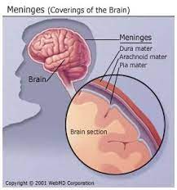
Mode of transmission
Incubation period – 3 to 5 Days
Direct contact
Droplets
Mosquito Bite
Throat Secretions

Slide 8
Pathogenesis
Causative organism enters the blood stream
Cross the blood barriers
Inflammation reaction in meningitis
Inflammation of subarachnoid space and pia meter occur

Slide 9

Inflammation may cause ICP
CSF flows in subarachnoid space
CSF cloudness or infected
CSF cell count increase

Slide 10
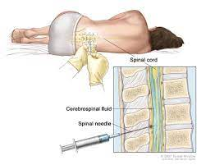
Management
Diagnosis
Treatment
Diagnosis
Blood test
Blood culture
CT scan
History collection
Physical examination
MRI
CBC
By positive sings

Slide 11
Treatment
Category | Drug Name
Antibiotic | Ampicillin , penicillin
Antiviral | Tenofovir
Antifungal | Fluconazole
Corticosteroid | Dexamethasone
Antipyretics | Acetaminophen

Slide 12
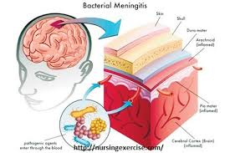
Complication
Brain damage
Cerebral edema
Hearing loss
Tissue damage
Kidney failure
Shock
Death
Memory difficulty

Slide 13
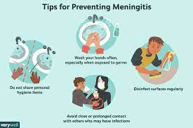
Prevention
To Reduce Fever
To maintain fluid balance
To Reduce pain
Cover with mouth
Stay heathy
Wash your hand carefully
Take care food in pregnant .

Slide 14
Thank
you

