Slide 1
MENINGITIS

Slide 2
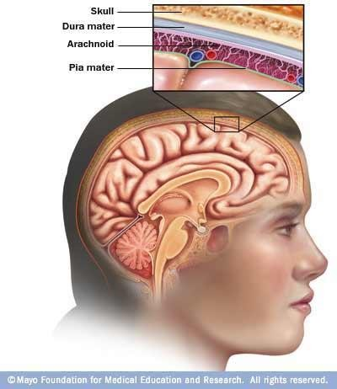

Slide 3
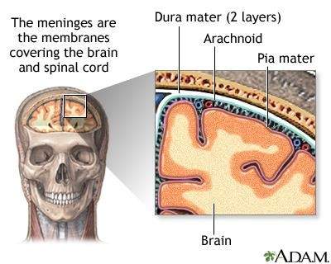

Slide 4
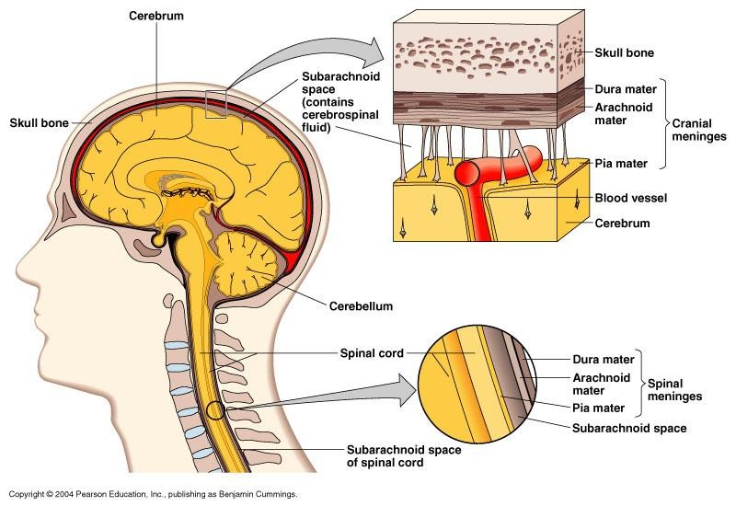

Slide 5
INTRODUCTION
Inflammation of pia matter, arachnoid, and the CSF filled sub arachnoid space.
Inflammation spreads rapidly because of CSF circulation around the brain and spinal cord

Slide 6
TYPES
ACUTE PURULENT MENINGITIS (USUALLY BACTERIAL)
ACUTE LYMPHOCYTIC (USUALLY VIRAL)

Slide 7
FACTORS FOR SEVERITY
Virulence factors
Host factors
Brain edema
Presence of permanent neurologic sequelae

Slide 8
BACTERIAL MENINGITIS

Slide 9
BACTERIA
Streptococcus pneumoniae
Neisseria meningitidis
Group B streptococci (except in neonates)
Hemophilus influenzae (incidence
Gram negative bacilli
Listeria monocytogenes
now)

Slide 10
RISK FACTORS
Head trauma with basilar skull fractures
Otitis media
Sinusitis
Mastoiditis
Neurosurgery
Dermal sinus tracts
Systemic sepsis
Immunocompromise

Slide 11

PATHOGENESIS
Bacteria replicate and undergo lysis in the CSF
Release endotoxins or cell wall fragments
Release of inflammatory mediators interleukin-1, tumor necrosis factor, and other inflammatory mediators

Slide 12
Proteolytic products and toxic oxygen radicals cause an alteration of the blood–brain barrier, whereas platelet-activating factor activates coagulation, and arachidonic acid metabolites stimulate vasodilation
These events lead to cerebral edema, elevated intracranial pressure, cerebrospinal fluid (CSF) pleocytosis, decreased cerebral blood flow, cerebral ischemia, and death.

Slide 13

Cranial nerve palsies
Impair outflow of CSF
Hydrocephalus

Slide 14
SYMPTOMS
Headache
Fever
Nuchal rigidity
Nausea
Vomiting
Photophobia
Altered mental status
Seizures
Cranial nerve palsies
Focal cerebral signs
Petechial rash , palpable purpura, acute hypotension and adrenal hemorrhage-waterhouse friderichsen syndrome (meningococcul)

Slide 15
Waterhouse–Friderichsen syndrome (WFS), hemorrhagic adrenalitis or fulminant meningococcemia is defined as adrenal gland failure due to bleeding into the adrenal glands, commonly caused by severe bacterial infection: Typically the pathogen is the meningococcus Neisseria meningitidis.

Slide 16
VIRAL MENINGITIS

Slide 17
VIRUS
HSV (HERPES SIMPLEX VIRUS)type 2
Enterovirus
Coxsackievirus
Poliovirus
Echovirus
Epstein-Barr virus
Mumps virus
West nile virus

Slide 18
Manifestation is same like bacterial meningitis, but course
is less severe
CSF findings are also markedly different
  lymphocytes present raher than
polymorphonuclear cells)
  Proteins moderately elevated
  Sugar is normal
Viral meningitides is self limiting and usually require
symptomatic treatment
HSV type 2-respond to IV acyclovir

Slide 19
CLINICAL SYMPTOMS: (General)
Infectious manifestations:
- Chills - Headache - Fever - Myalgia
Increased intracranial pressure, manifested as
- Malaise
Headache - lethargy - Vomiting --Papilledema
Unilateral or bilateral 6th nerve palsy,
3- Meningeal irritation
(noted by elicitation of Brudzinski's and/or Kernig's sign) .
- Nuchal rigidity.

Slide 20
4. Hemorrhage:
Petechia
Ecchymosis.
- Purpura
Eye affects:
  Photophobia
  Unequal pupils, Pupil dilation
  Sluggish reaction to light.
Mental state:
  Drowsiness
  Delirium
Coma
Stupor

Slide 21
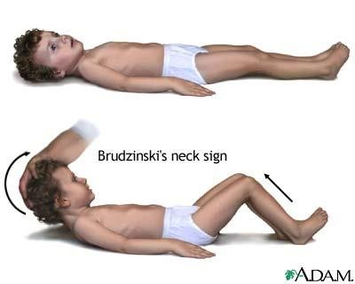

Slide 22
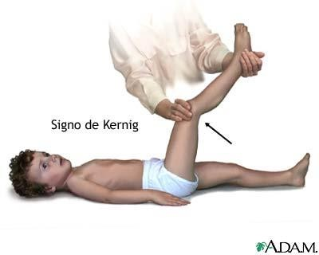

Slide 23
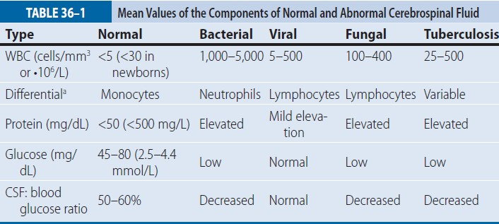

Slide 24
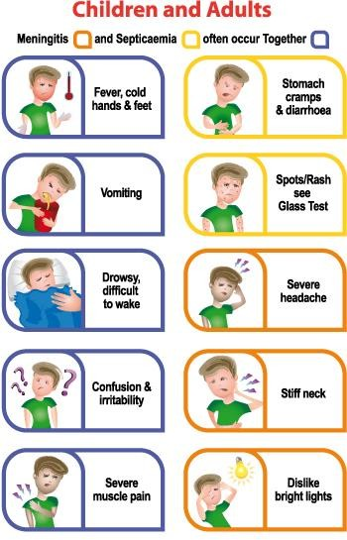

Slide 25
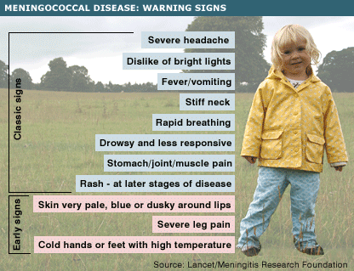

Slide 26
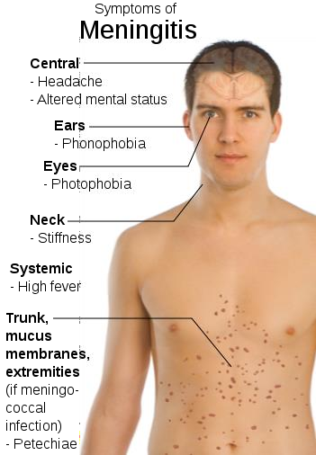

Slide 27
CHRONIC MENINGITIS
Tubercular meningitis
Fungal meningitis
Syphilitic meningitis
Amoebic meningitis

