Slide 1
CPKTDM
UNIT 2- DEGSIN OF DOSAGE REGIMENS
17-09-2024
1

Slide 2
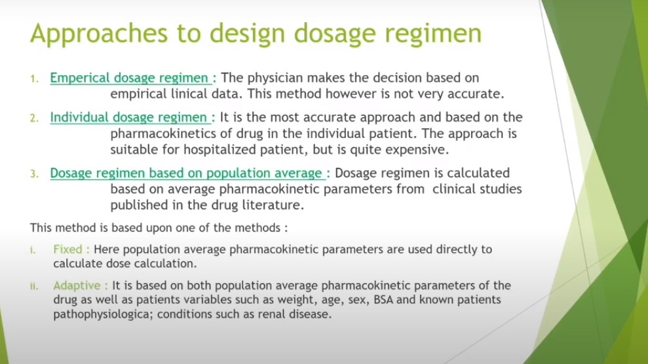
NOMOGRAMS AND TABULATIONS IN DESIGNING DOSAGE REGIMEN
17-09-2024
2

Slide 3
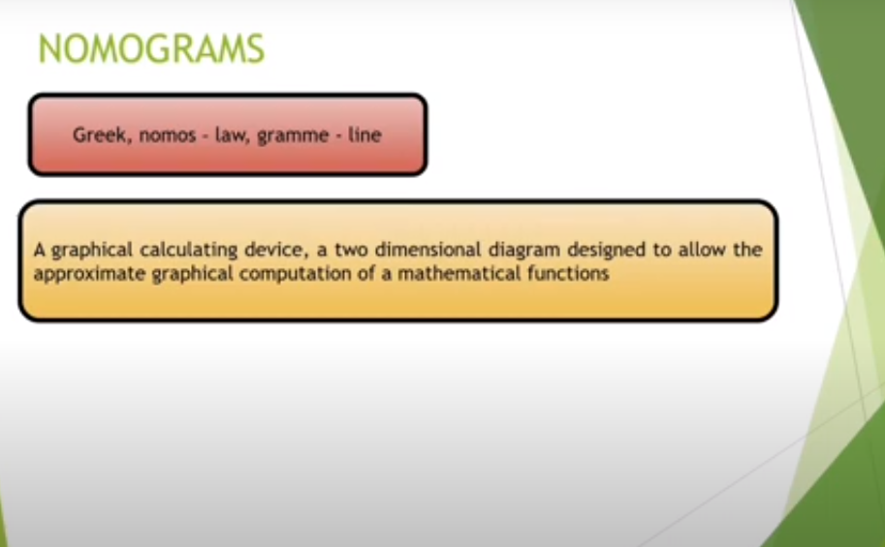
17-09-2024
3

Slide 4
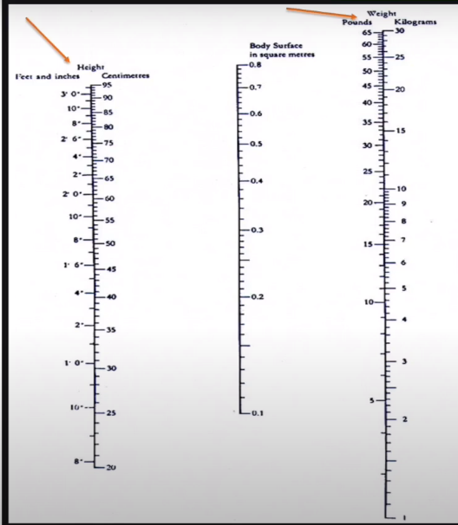
17-09-2024
4

Slide 5
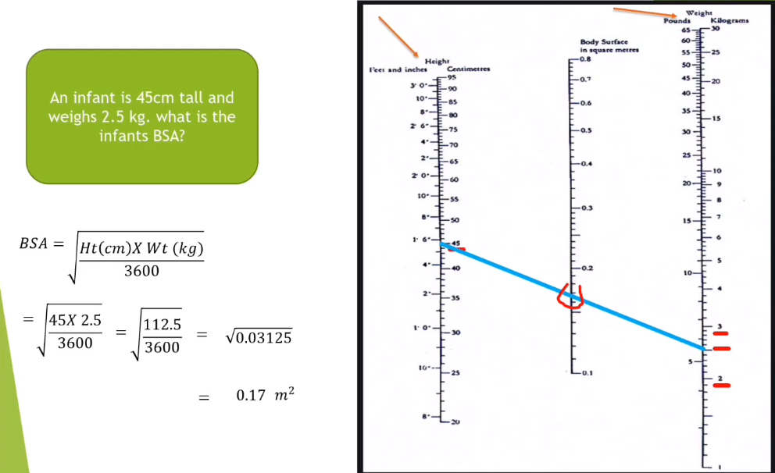
17-09-2024
5

Slide 6
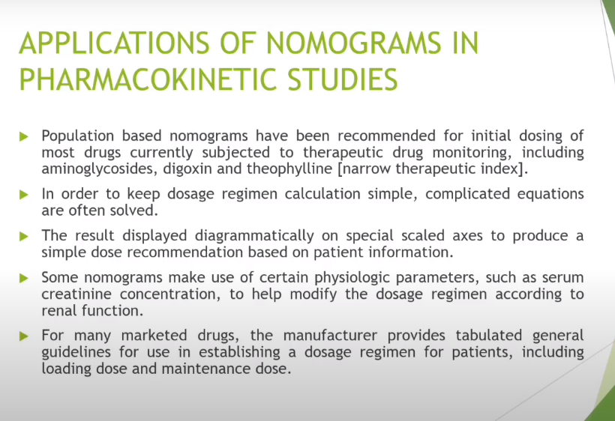
17-09-2024
6

Slide 7
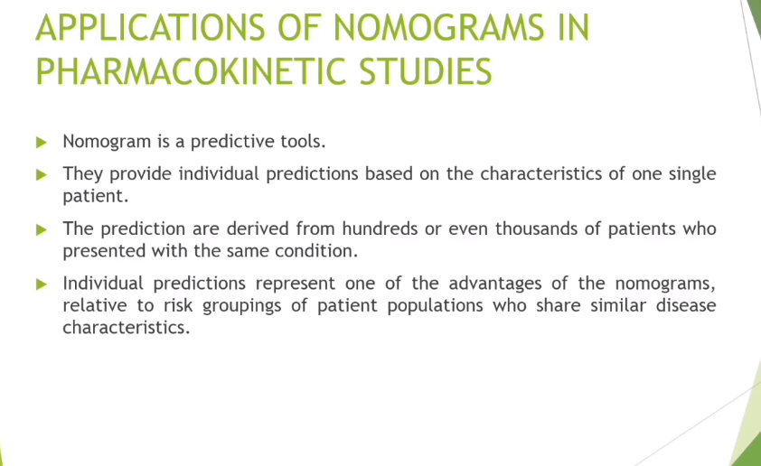
17-09-2024
7

Slide 8
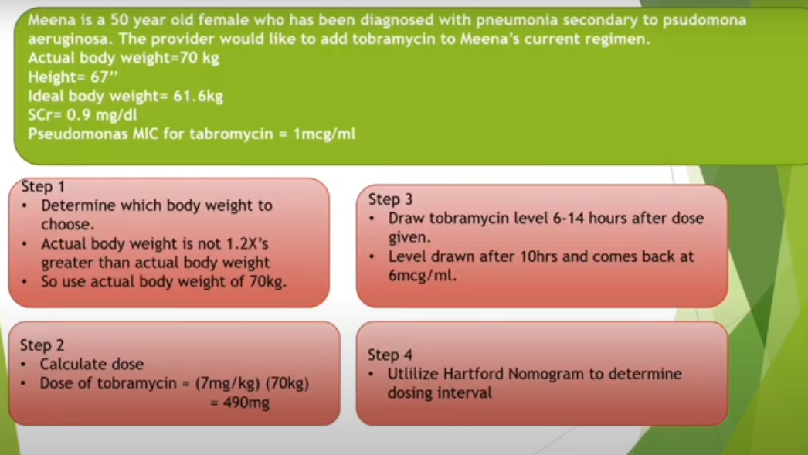
17-09-2024
8

Slide 9
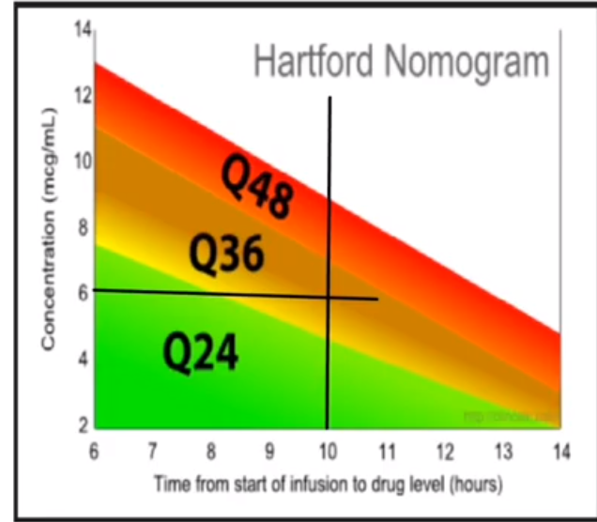
17-09-2024
9

Slide 10
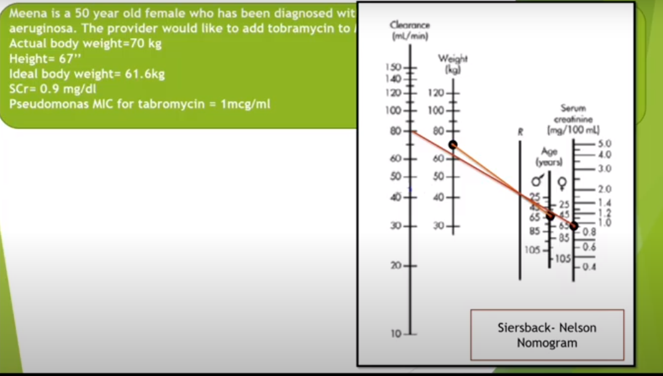
17-09-2024
10

Slide 11
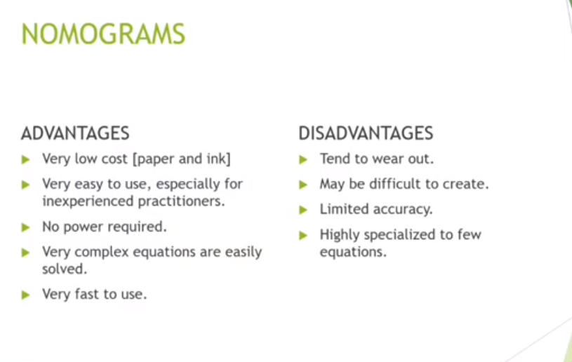
17-09-2024
11

Slide 12
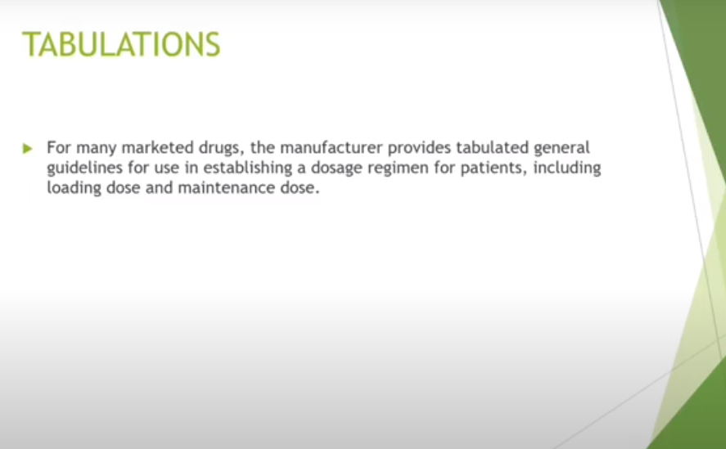
17-09-2024
12

Slide 13
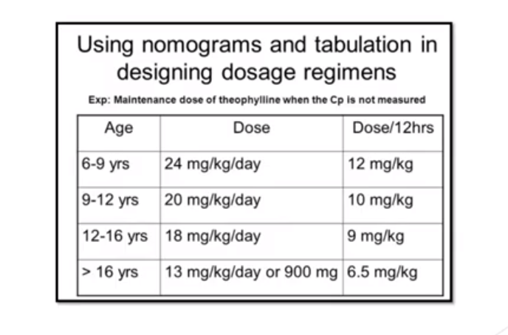
17-09-2024
13

Slide 14
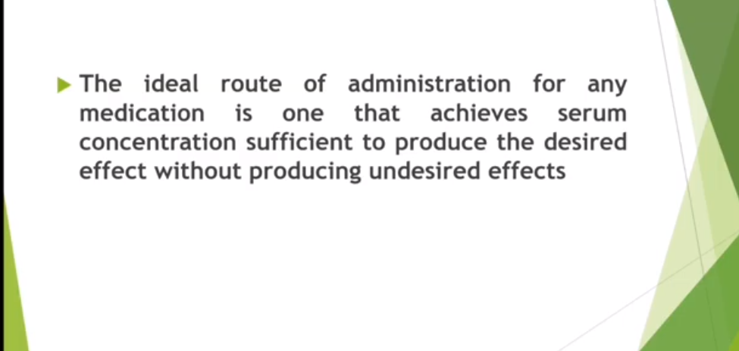
CONVERSION FROM INTRAVENOUS TO ORAL DOSING,
17-09-2024
14

Slide 15
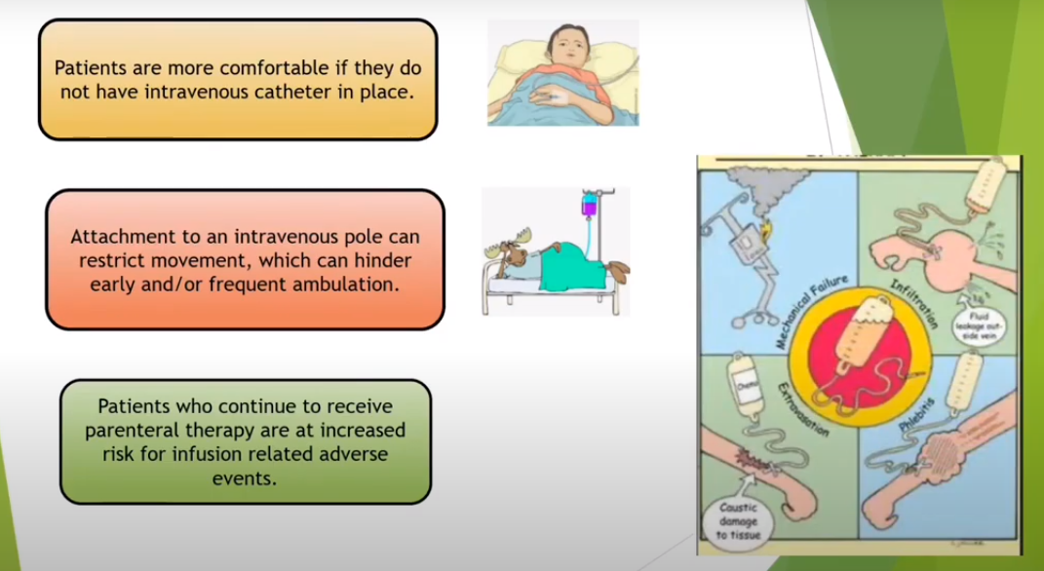
17-09-2024
15

Slide 16
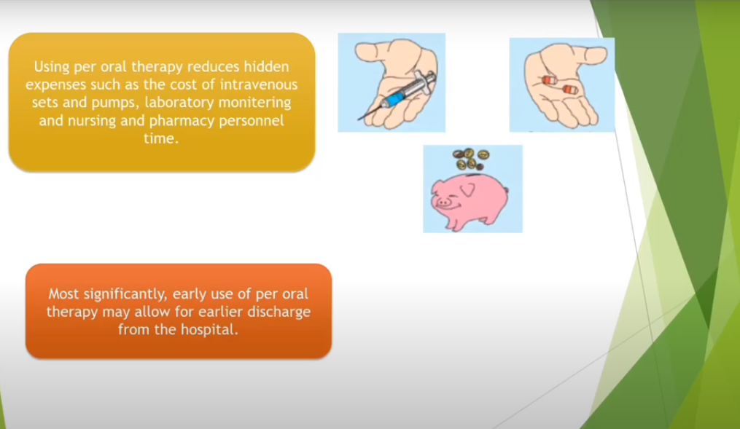
17-09-2024
16

Slide 17
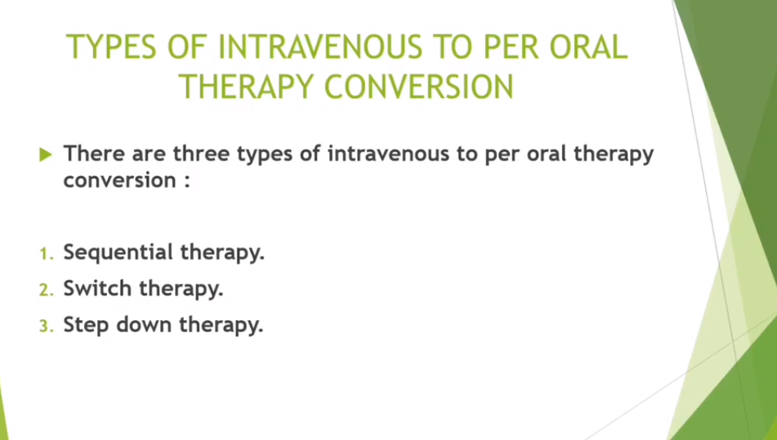
17-09-2024
17

Slide 18
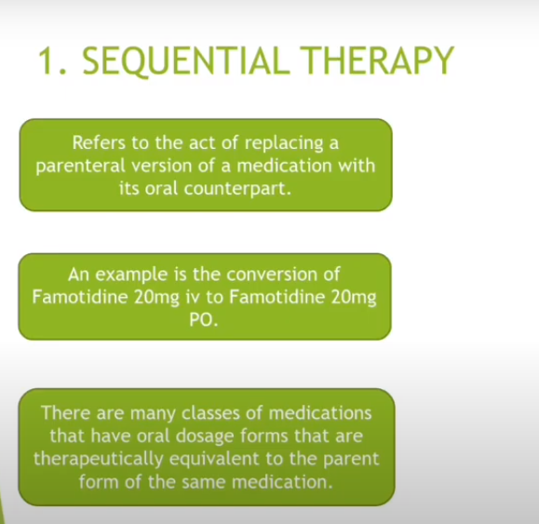
17-09-2024
18

Slide 19
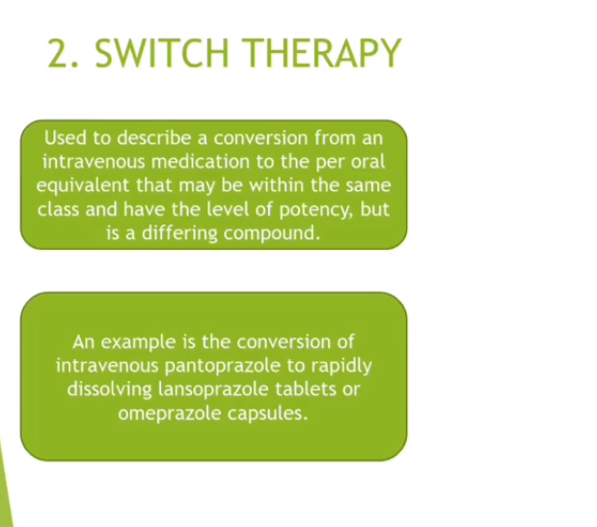
17-09-2024
19

Slide 20
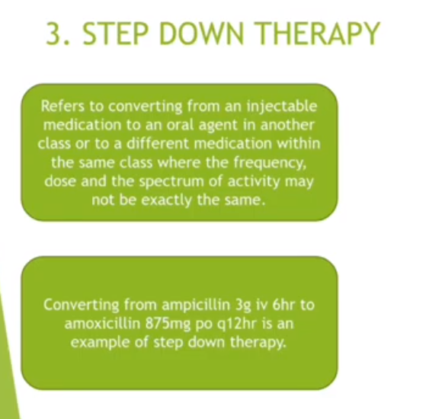
17-09-2024
20

Slide 21
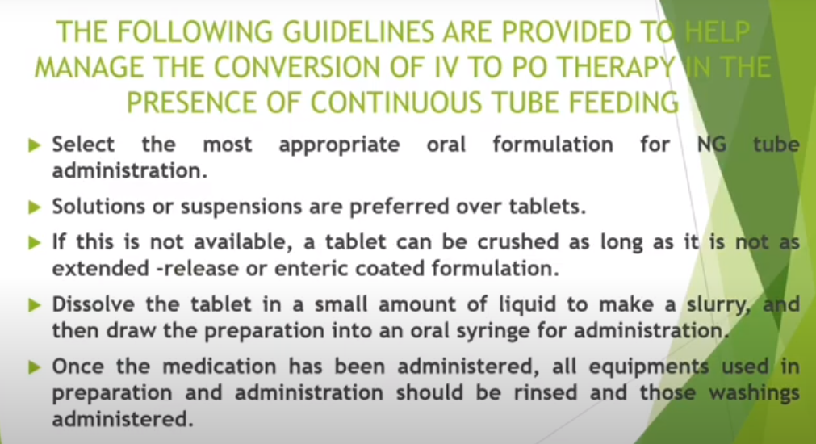
17-09-2024
21

Slide 22
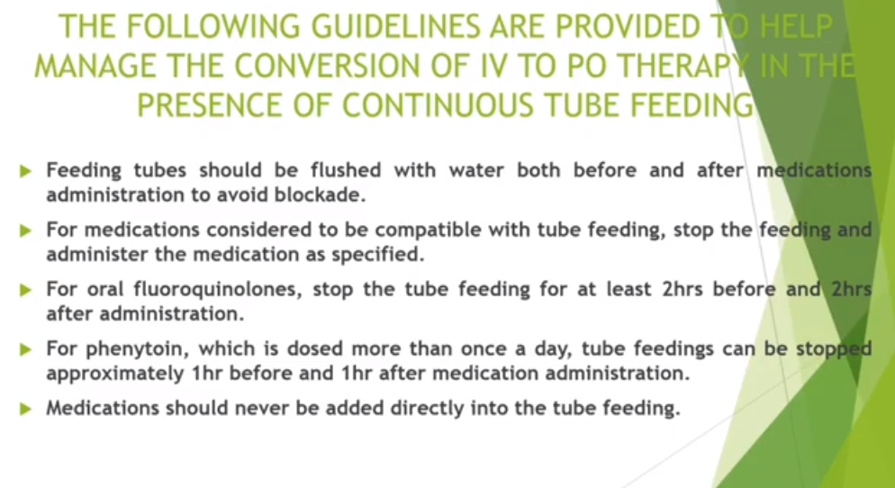
17-09-2024
22

Slide 23
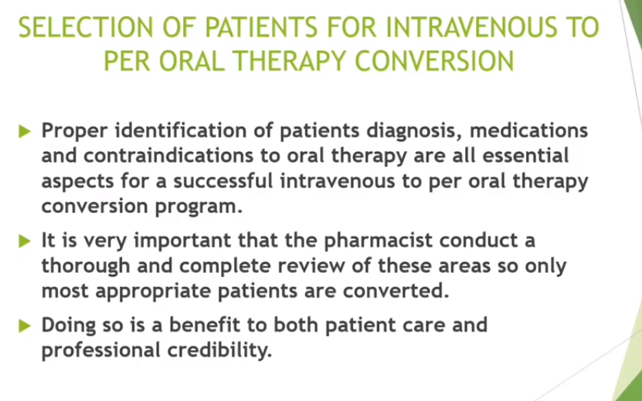
17-09-2024
23

Slide 24
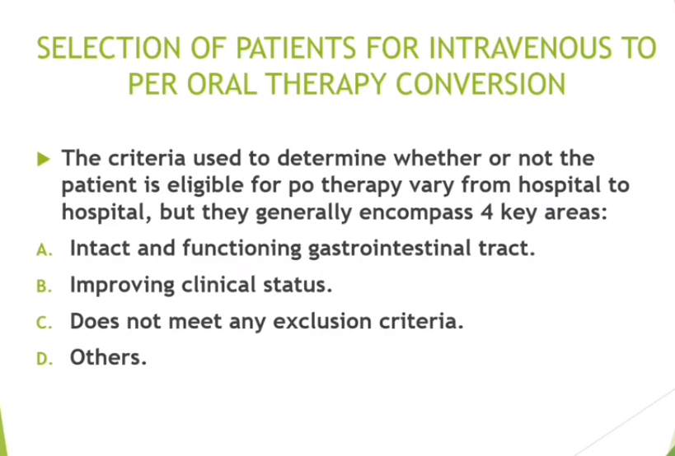
17-09-2024
24

Slide 25
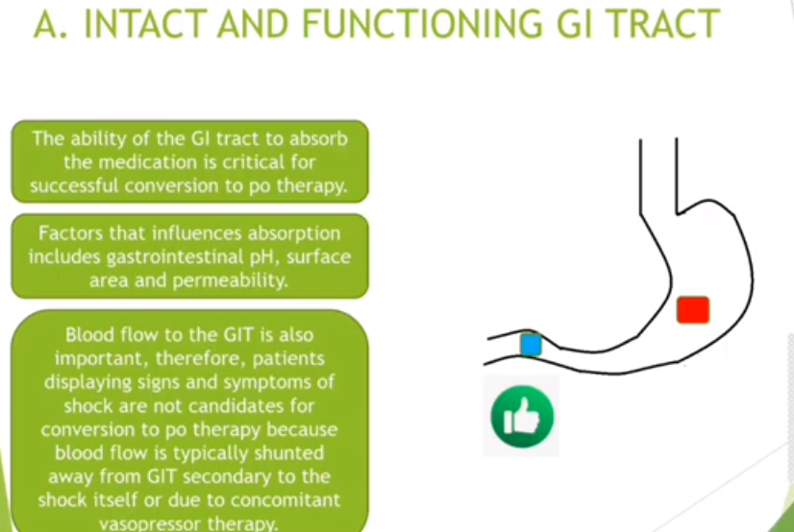
17-09-2024
25

Slide 26
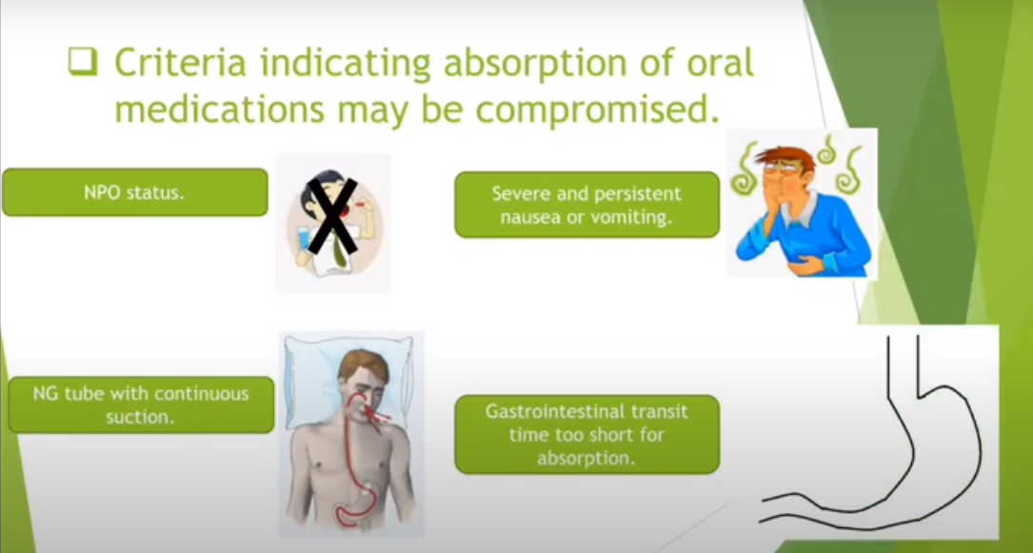
17-09-2024
26

Slide 27
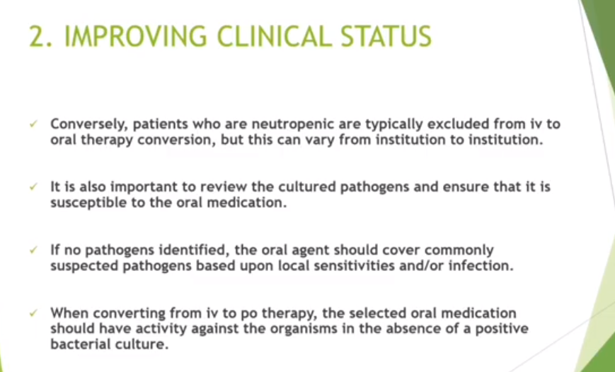
17-09-2024
27

Slide 28
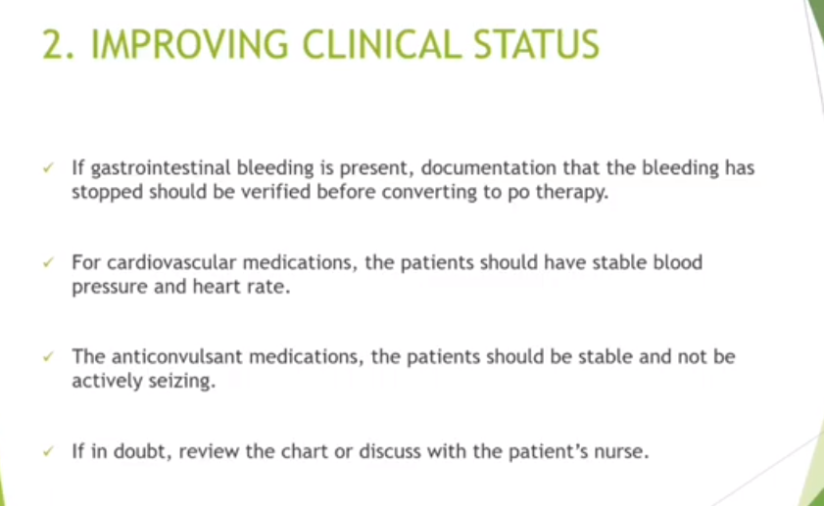
17-09-2024
28

Slide 29
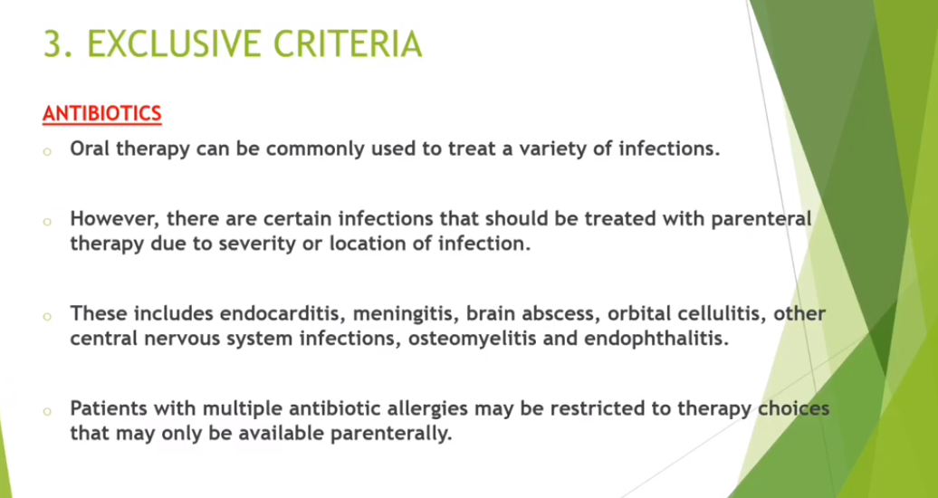
17-09-2024
29

Slide 30
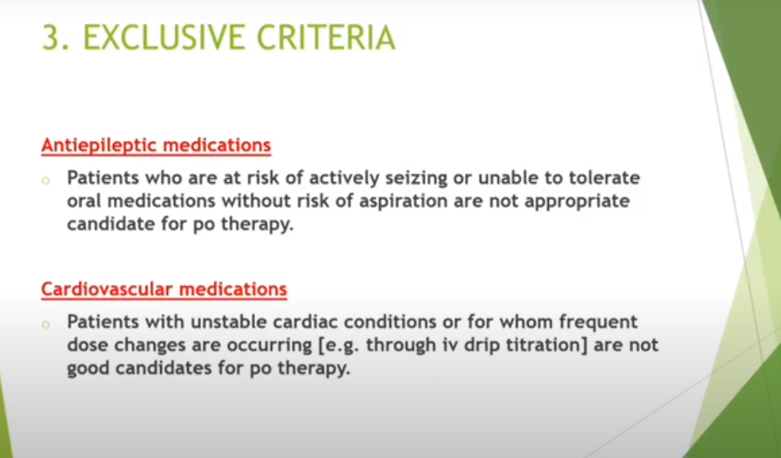
17-09-2024
30

Slide 31
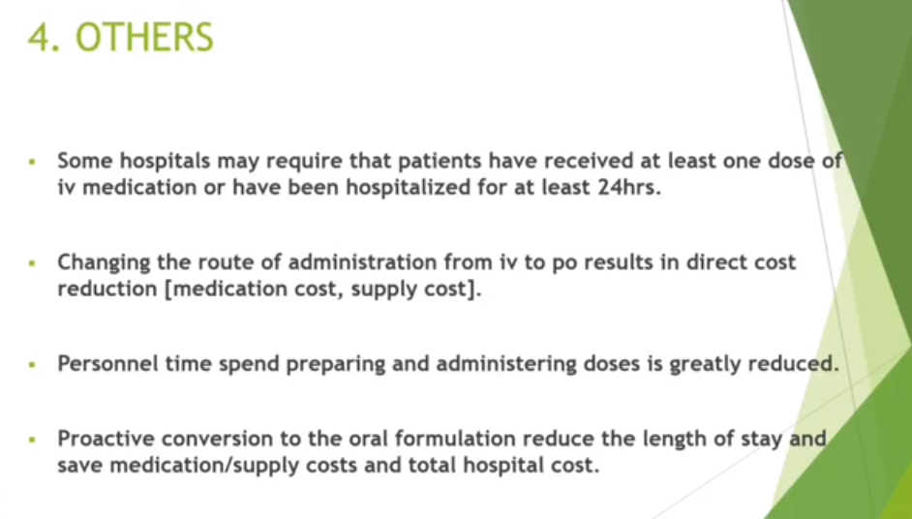
17-09-2024
31

Slide 32
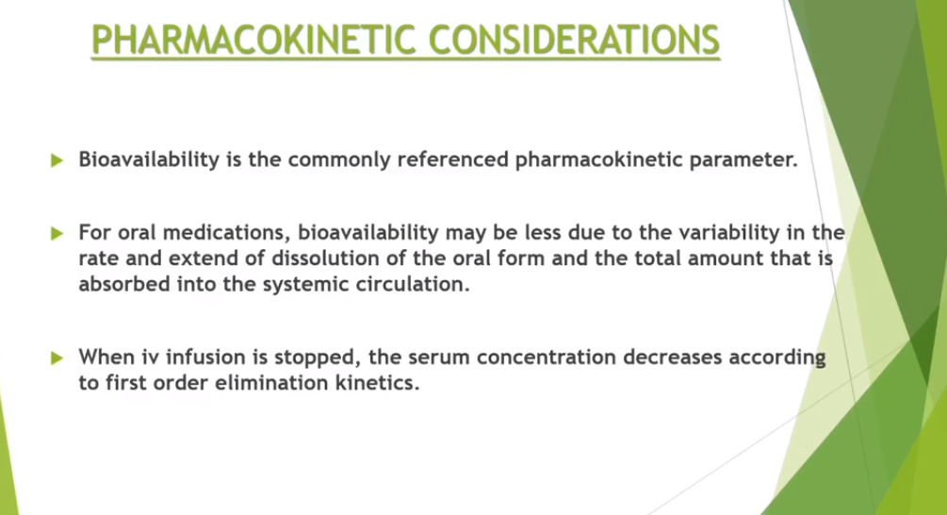
17-09-2024
32

Slide 33
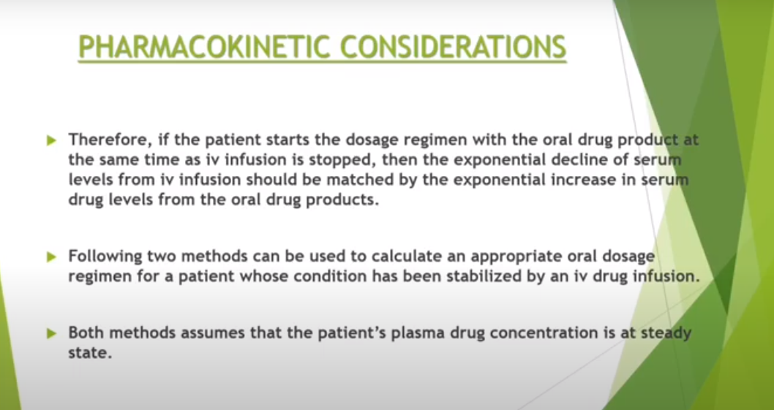
17-09-2024
33

Slide 34
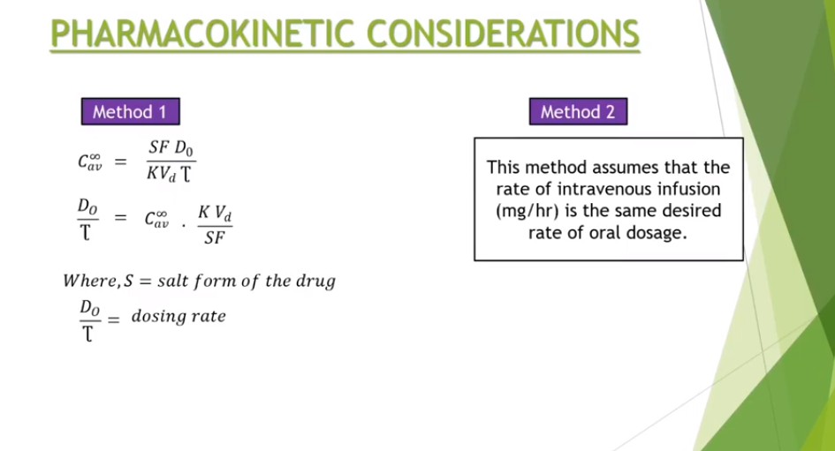
17-09-2024
34

Slide 35
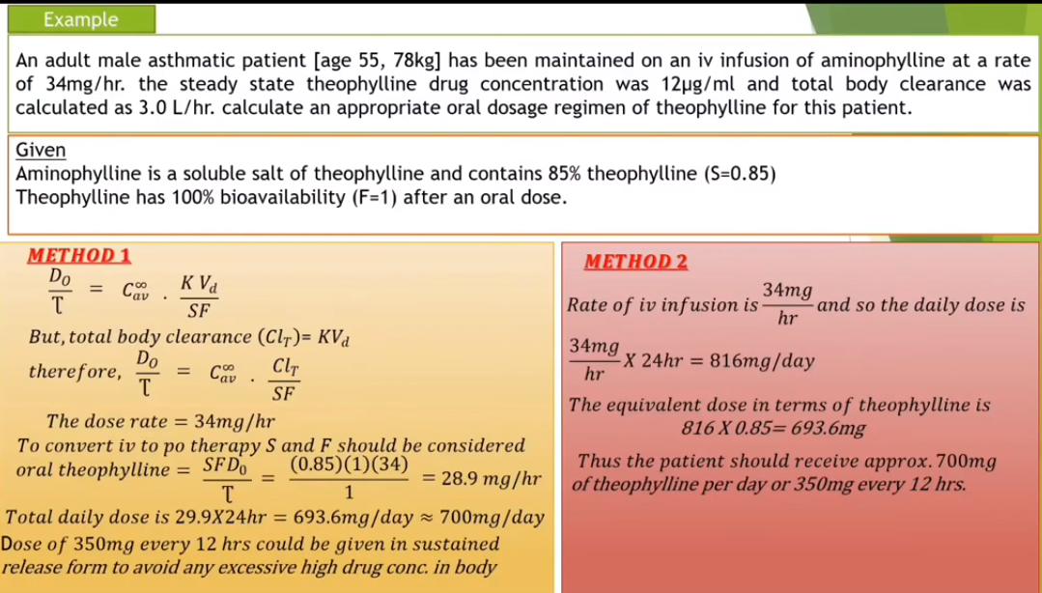
17-09-2024
35

Slide 36
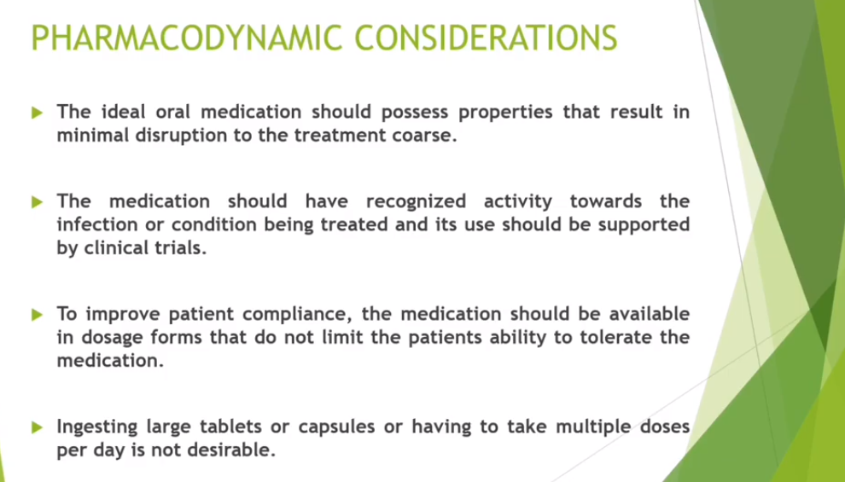
17-09-2024
36

Slide 37
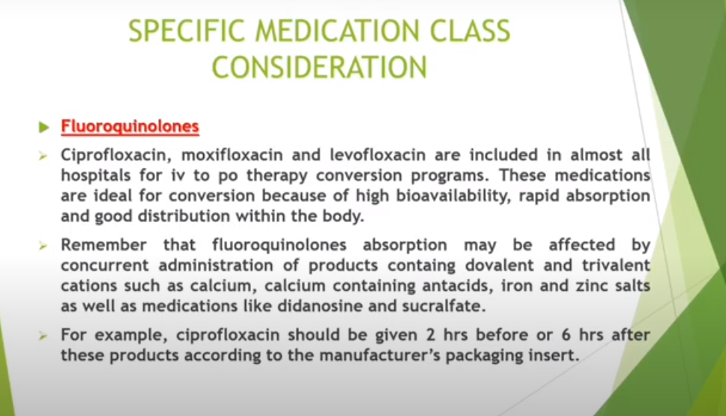
17-09-2024
37

Slide 38
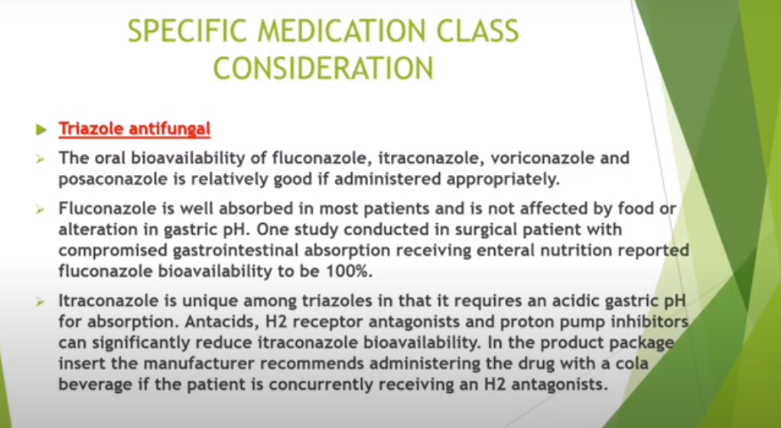
17-09-2024
38

Slide 39
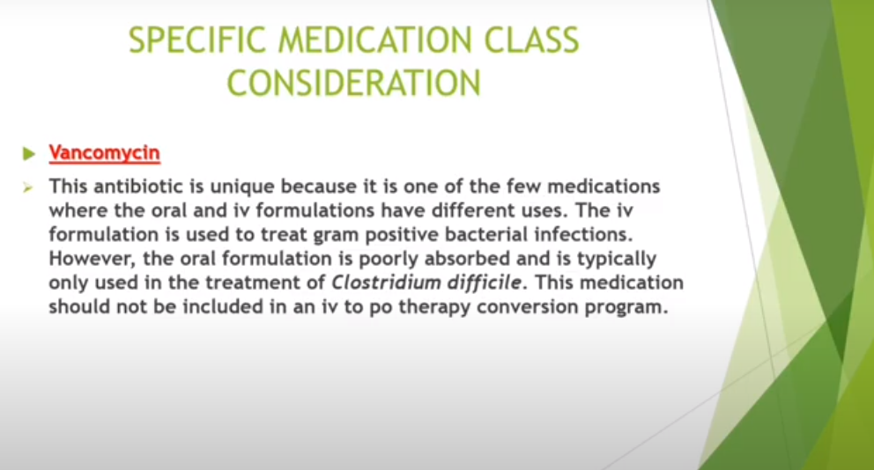
17-09-2024
39

Slide 40
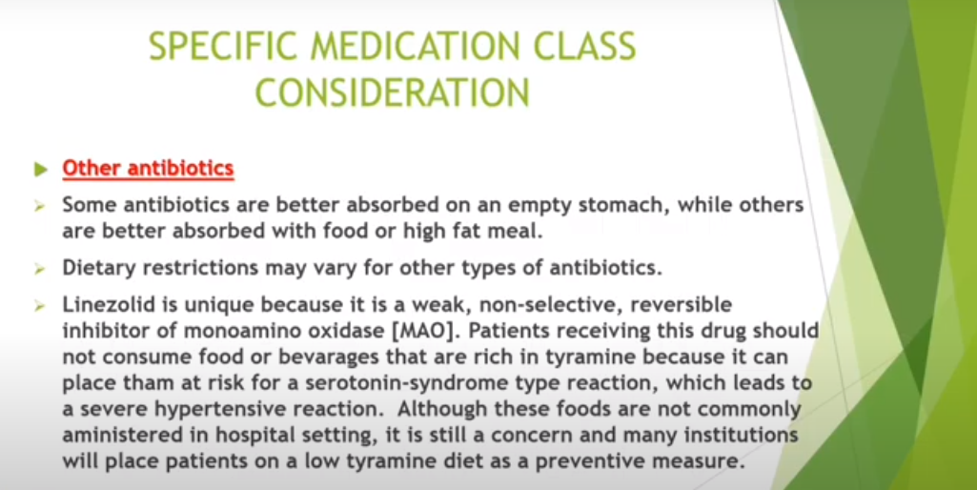
17-09-2024
40

Slide 41
17-09-2024
41

Slide 42
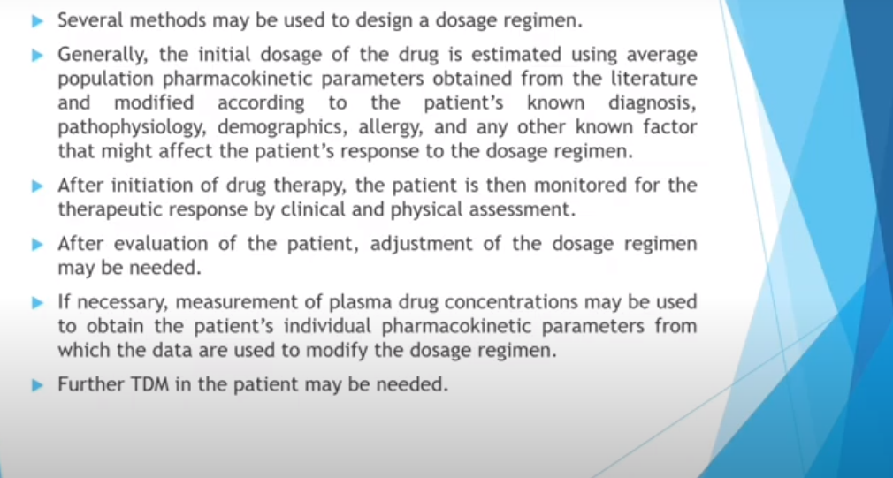
DETERMINATION OF DOSE AND DOSING INTERVALS
17-09-2024
42

Slide 43
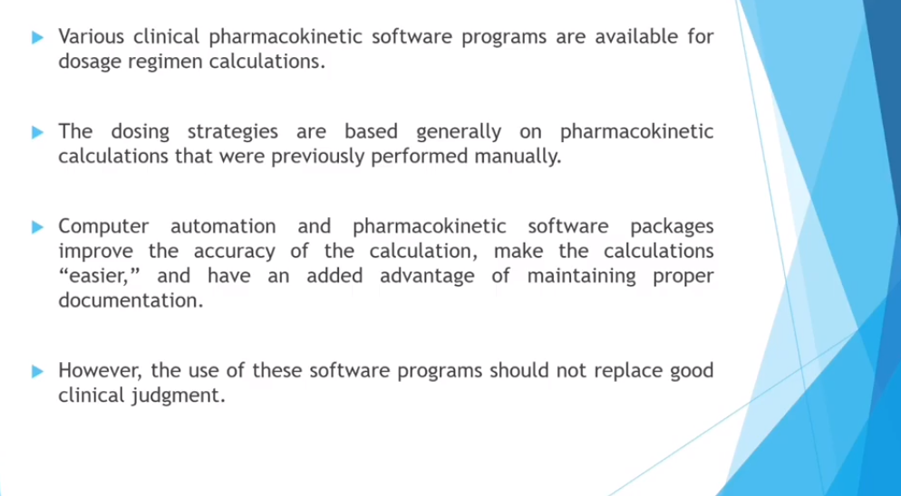
17-09-2024
43

Slide 44
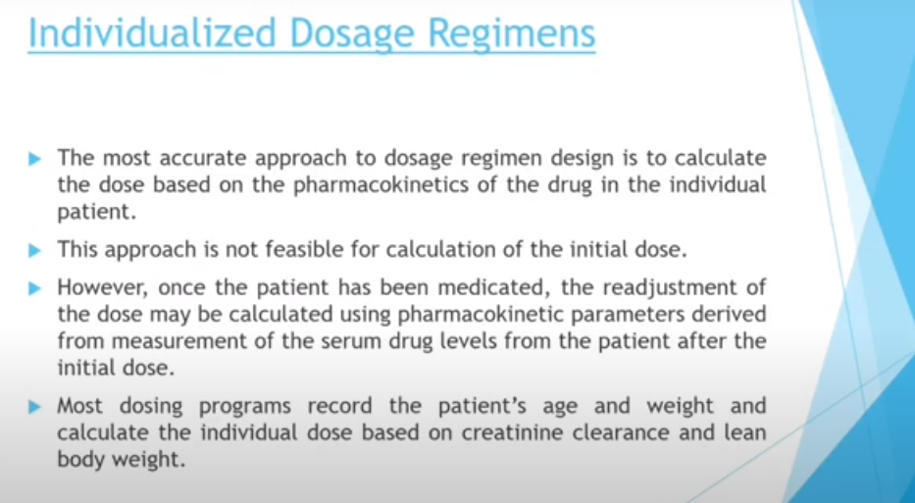
17-09-2024
44

Slide 45
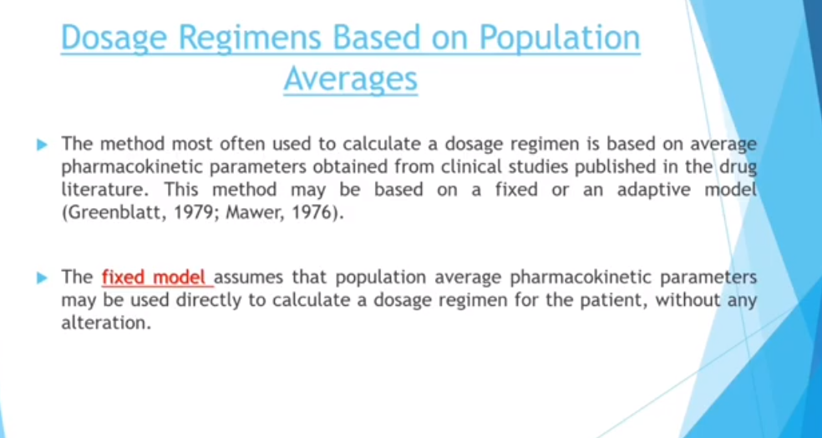
17-09-2024
45

Slide 46
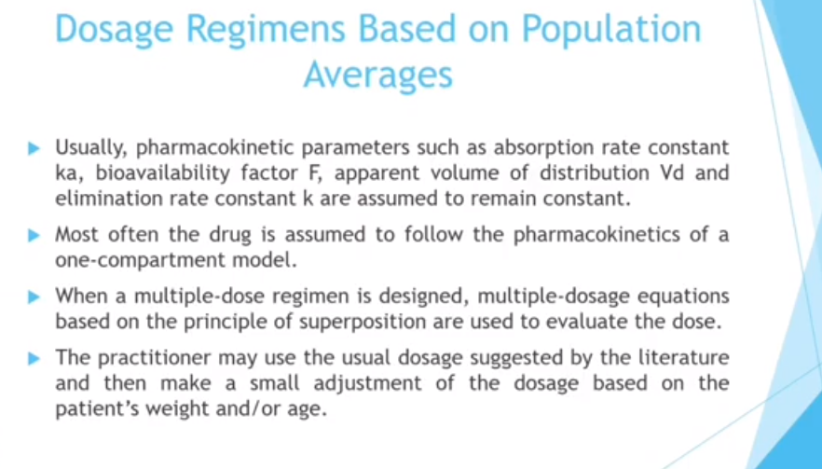
17-09-2024
46

Slide 47
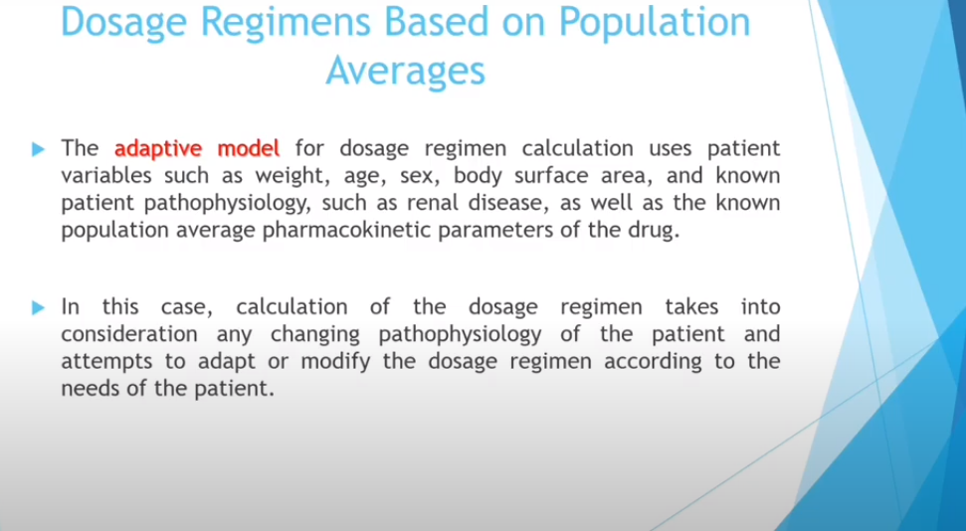
17-09-2024
47

Slide 48

17-09-2024
48

Slide 49
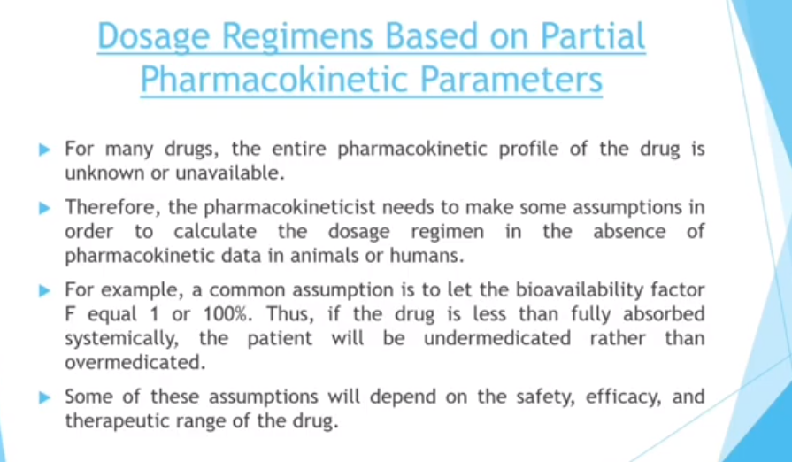
17-09-2024
49

Slide 50
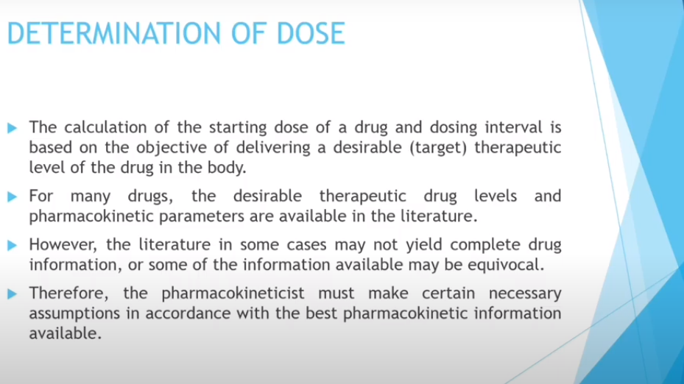
17-09-2024
50

Slide 51
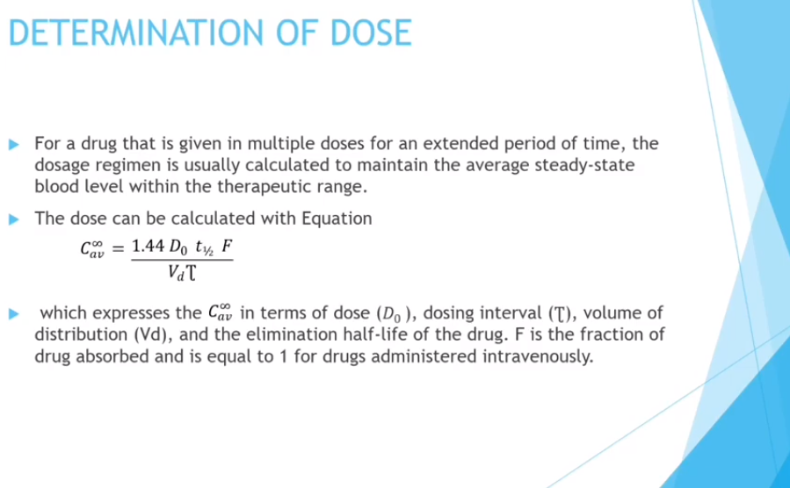
17-09-2024
51

Slide 52
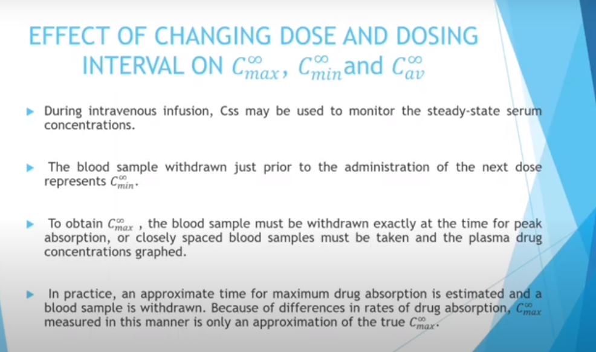
17-09-2024
52

Slide 53
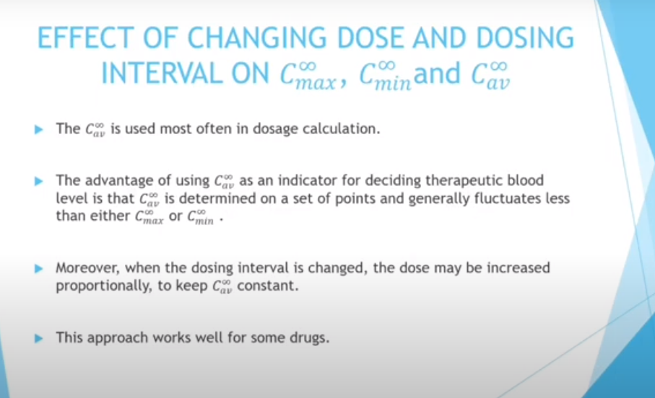
17-09-2024
53

Slide 54

17-09-2024
54

Slide 55

17-09-2024
55

Slide 56

17-09-2024
56

Slide 57

17-09-2024
57

Slide 58

17-09-2024
58

Slide 59

17-09-2024
59

Slide 60

17-09-2024
60

Slide 61

17-09-2024
61

Slide 62

17-09-2024
62

Slide 63

17-09-2024
63

Slide 64

17-09-2024
64

Slide 65

17-09-2024
65

Slide 66

17-09-2024
66

Slide 67

17-09-2024
67

Slide 68

17-09-2024
68

