Slide 1

NMR : Nuclear Magnetic resonance
NMR
NMR

Slide 2
Magnetic resonance
The phenomenon of absorption of certain frequencies of
radio and microwave radiation
by atoms placed in a magnetic field.
The pattern of absorption reveals molecular structure.

Slide 3
introduction
NMR
NMR
NMR is the most powerful tool available for organic structure determination.
It is used to study a wide variety of nuclei:
  ¹H
  ¹³C
  ¹⁵N
  ¹⁹F
  ³¹P

Slide 4
NMR
NMR
NMR
Nuclear magnetic resonance spectroscopy is a powerful analytical technique used to characterize organic molecules by identifying
carbon-hydrogen
frameworks within molecules.

Slide 5
NMR
NMR
NMR
Two common types of NMR spectroscopy are used to characterize organic structure:
¹H NMR is used to determine the type and number of Hydrogen atoms in a molecule;
¹³C NMR is used to determine the type of carbon atoms in the molecule.

Slide 6
NMR
NMR
NMR
The source of energy in NMR is radio waves
which have long wavelengths,
and thus low energy and frequency.
When low-energy radio waves interact with a molecule,
they can change the nuclear spins of some elements, including ¹H and ¹³C.

Slide 7
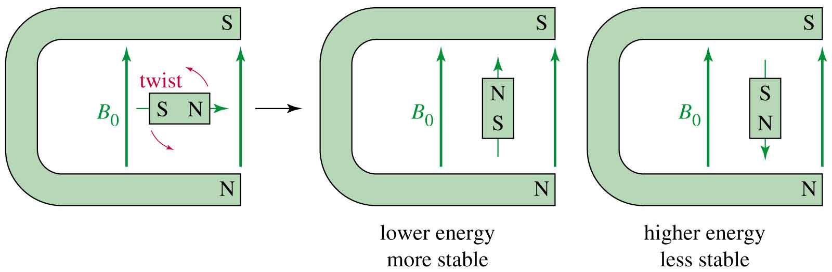
External Magnetic Field
NMR
NMR
When placed in an external field, spinning protons act like bar magnets.

Slide 8
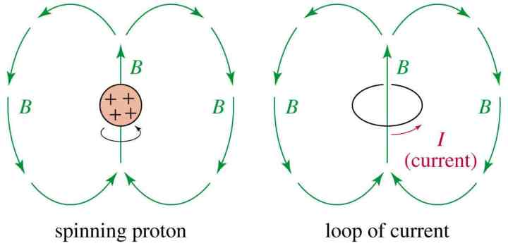
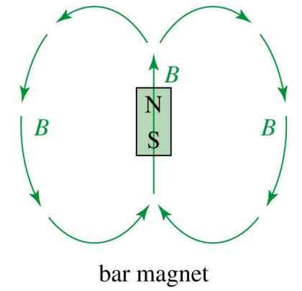
Nuclear Spin
NMR
NMR
A nucleus with an odd atomic number or an odd mass number has a nuclear spin.
The spinning charged nucleus generates a magnetic field.

Slide 9
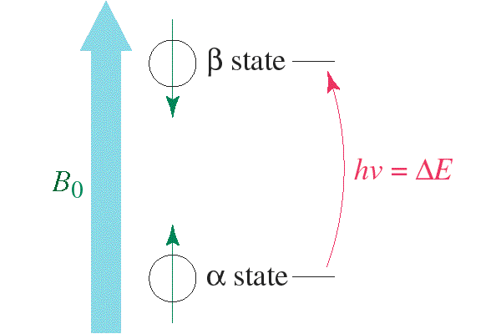
Two Energy States
NMR
NMR
The magnetic fields of the spinning nuclei will align either with the external field, or against the field.
A photon with the right amount of energy can be absorbed and cause the spinning proton to flip.

Slide 10
Introduction to NMR Spectroscopy
NMR
NMR
When a charged particle such as a proton spins on its axis, it creates a magnetic field.
Thus, the nucleus can be considered to be a tiny bar magnet.
Normally, these tiny bar magnets are randomly oriented in space.
However, in the presence of a magnetic field B₀, they are oriented with or against this applied field.
More nuclei are oriented with the applied field because this arrangement is lower in energy.
The energy difference between these two states is very small (<0.1 cal).

Slide 11
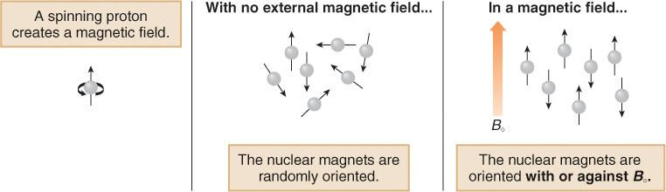

Slide 12
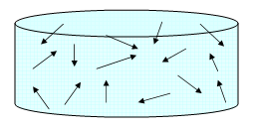
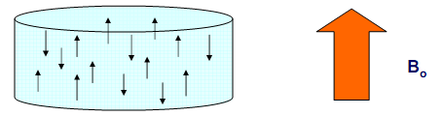
Effect of a Magnetic Field on I=1/2
NMR
NMR

Slide 13
NMR
NMR
When an external magnetic field is applied, the energy levels split.
So they can align themselves either “with the field” or
“against the field” corresponding to the spin values +1/2 or -1/2.

Slide 14
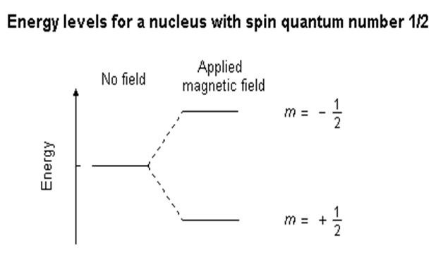
NMR
The energetically favourable +1/2 or ground state is that in which the nuclei are aligned with field
and unfavourable condition -1/2 can be considered as excited state.
NMR

Slide 15
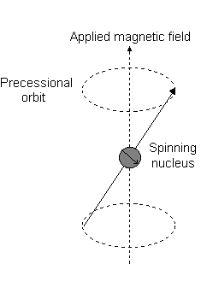
NMR
NMR

Slide 16
NMR
If energy is absorbed (light) by the nucleus,
then the angle of precession, θ, will change.
For a nucleus of spin +1/2, absorption of radiation "flips" the magnetic moment
so that it opposes the applied field (B)
ie: (the higher energy state).
NMR

Slide 17
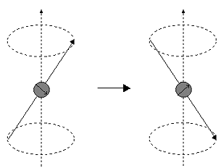
NMR
NMR

Slide 18
NMR
NMR
This frequency is also called as precessional frequency.
When precessional frequency matches with the applied radio frequency,
the absorption takes place and
NMR signal will be produced by the corresponding nucleus.

Slide 19
There is the possibility that by exciting these nuclei,
the populations of the higher (+1/2)
and lower (-1/2) energy levels will become equal.
If this occurs, then there will be no further absorption of radiation
and there will not be any signal in the NMR spectra.
The spin system is saturated.
avoid saturation relaxation process should happen.

Slide 20
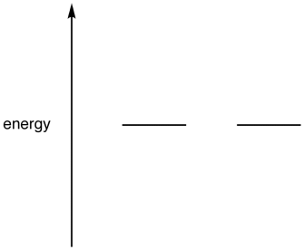
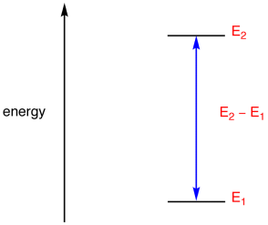
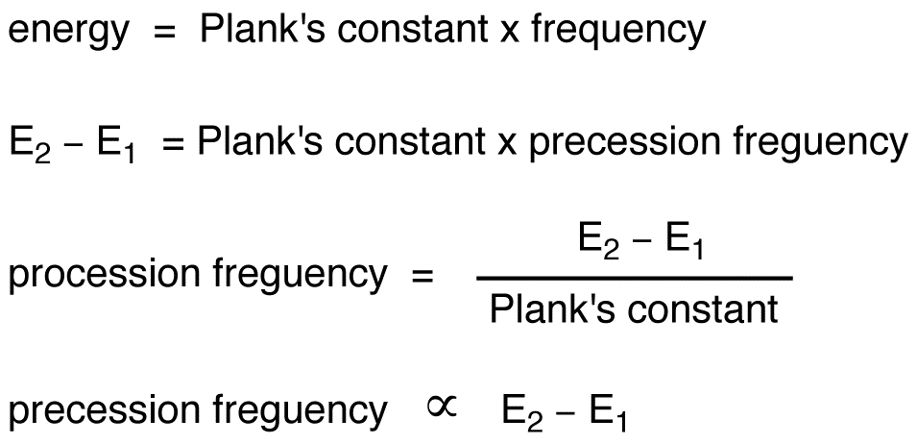
Precession Frequency
Some nuclei (eg: ¹H, ¹³C) could exist in more than one spin state, which,
in the absence of an external magnetic field, have identical energies.
For example, ¹H nucleus could exist in two spin states, which, in the absence of an external magnetic field
, have identical energies.
In an external magnetic field, they have different energies.
The frequency corresponding to the difference between the energies of the two spin states, E₂-E₁, is called the precession frequency.

Slide 21
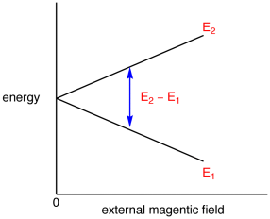
Thus, the greater the energy difference between the spin states,
the higher the precession frequency. e
Since the energy difference between the spin states is directly proportional to the external magnetic field (see the graph below),
the stronger the external magnetic field, the higher the precession frequency.

Slide 22
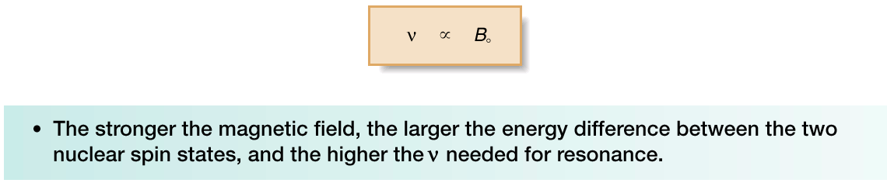
The frequency needed for resonance and the applied magnetic field strength are proportionally related:
NMR spectrometers are referred to as 200, 300, 400, 500 MHz instruments, and so forth, depending on the frequency of the RF radiation used for resonance.
These spectrometers use very powerful magnets to create a small but measurable energy difference between two possible spin states.

Slide 23
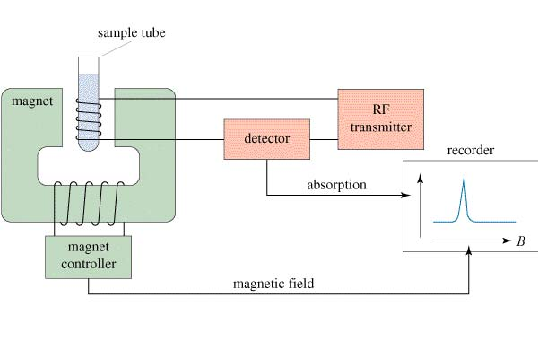
The NMR Spectrometer
NMR instruments are described in terms of the frequency at which they cause protons to resonate

Slide 24
NMR magnets contain Cryogens (liquid Helium and Nitrogen)
  Cryogens can cause severe burns if handled improperly (use eye protection and gloves).
  Cryogens evaporate and may cause asphyxiation if a lab is not properly ventilated.
  During a magnet quench up to 100 liters of liquid Helium are vaporized in a matter of minutes (2600 cu ft, 70,000 liters gas) and may cause asphyxiation, even if the lab is well ventilated.

Slide 25
NMR Sample Preparation
Tubes and Caps:
NMR tubes are a standard length (7 and 9 inch). When chipped (and reduced in length) they should not be reused as an unbalanced tube will not spin.
Always clean the tubes thoroughly after use.
Always store unused, clean tubes uncapped and laying on a flat surface.
Degassing Samples:
NMR spectra recorded using degassed solvents usually benefit from reduced half-height line-width and thus better S/N. (O₂ gas is paramagnetic!)
There are several ways of degassing your sample:
  the best is the freeze-pump-thaw technique,
  placing the sample in a ultrasonic bath works moderately well,
  bubbling nitrogen through or over the sample less well.

Slide 26
Quantity:
For proton NMR spectra of small organic compounds (up to MW=500) anything between 1 and 20 mg of sample will be fine.
Concentrated solutions can be viscous and may result in broad signals.
Very dilute samples could be masked by impurities and solvent peaks.
Preparing two samples - one dilute sample for proton NMR and one concentrated sample for carbon NMR is a useful, but unnecessary practice.
Solvent height (volume) should be uniform, 5 cm or 2 inches equal 0.5 ml.

Slide 27
A radio freequency oscillator
Supplies –signal require to induce transition in the nuclei of the sample
From ground to excited state
The source is often a highly stable crystal controlled oscillator
The output of which is multiplied to desired frequency
The signal arises from a coil situated in the gap of the magnet and the sample

Slide 28
The receiver
In single coil instruments ; radio frequency bridge like wheat stone bridge
The received signal is balanced against the received signal and absorption or resonance signal is recorded
In double coil instruments: transmitter and receiver coils used

Slide 29
Recorder and integrator
Spectra from high resolution instruments are recorded comparing with respect to reference compound
Resonance line intensity in NMR is propositional to the number of nuclei responsible for signal
The area under signal is direct measure of intensity
And calculated by integrator

Slide 30
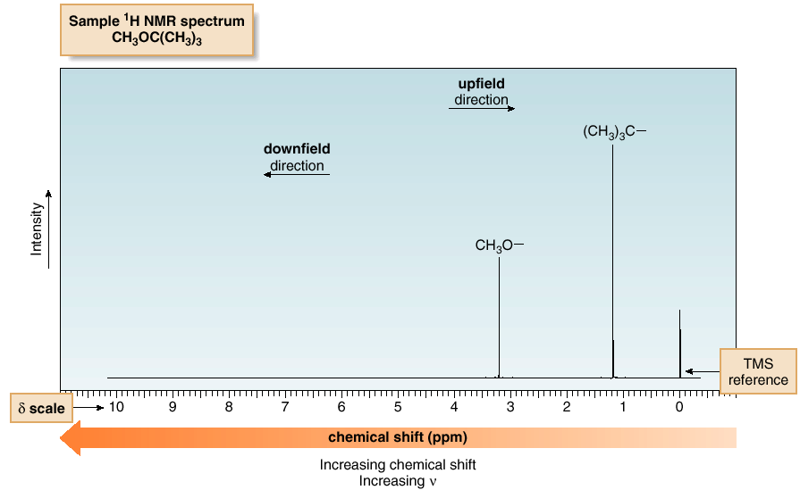
¹H NMR—The Spectrum
An NMR spectrum is a plot of the intensity of a peak against its chemical shift, measured in parts per million (ppm).

Slide 31
¹H NMR—The Spectrum
NMR absorptions generally appear as sharp peaks.
Increasing chemical shift is plotted from left to right.
Most protons absorb between 0-10 ppm.
The terms “upfield” and “downfield” describe the relative location of peaks.
Upfield means to the right.
Downfield means to the left.
NMR absorptions are measured relative to the position of a reference peak at 0 ppm on the d scale due to tetra methyl silane (TMS).
TMS is a volatile inert compound that gives a single peak up field from typical NMR absorptions.

Slide 32
Tetramethylsilane
TMS is added to the sample.
Since silicon is less electronegative than carbon, TMS protons are highly shielded.
Signal defined as zero.
Organic protons absorb downfield (to the left) of the TMS signal.

Slide 33
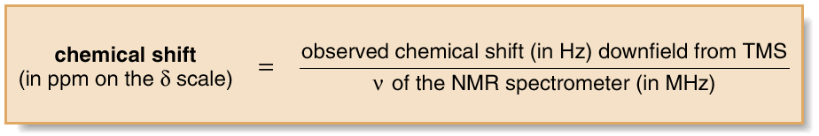
The chemical shift of the x axis gives the position of an NMR signal, measured in ppm, according to the following equation:
By reporting the NMR absorption as a fraction of the NMR operating frequency, we get units, ppm, that are independent of the spectrometer.
Four different features of a ¹H NMR spectrum provide information about a compound’s structure:
  Number of signals
  Position of signals
  Intensity of signals.
  Spin-spin splitting of signals.

Slide 34
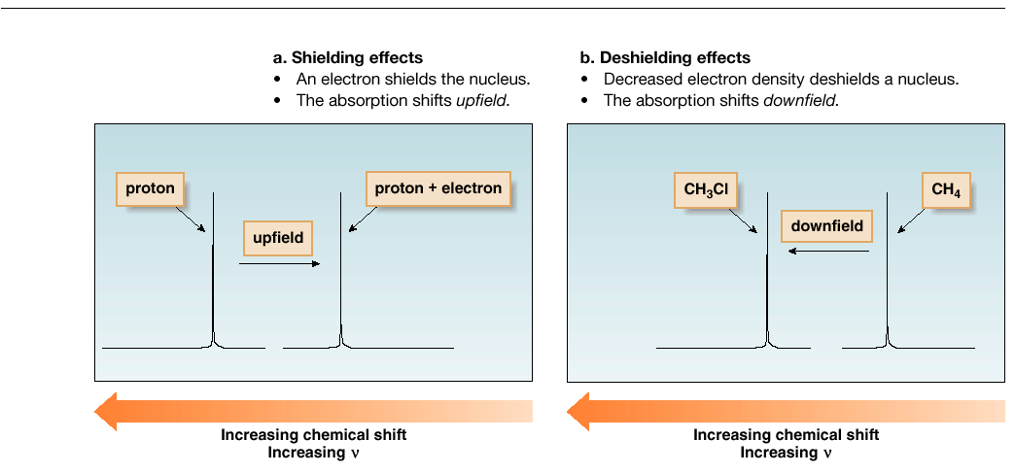
¹H NMR—Position of Signals

Slide 35
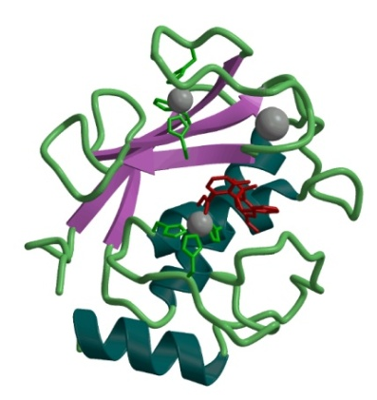
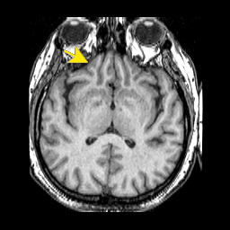
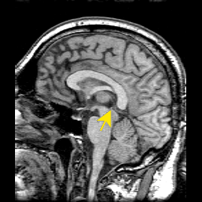
Typical Applications of NMR:
1.) Structural (chemical) elucidation
‚ Natural product chemistry
‚ Synthetic organic chemistry
- analytical tool of choice of synthetic chemists
- used in conjunction with MS and IR
  2.) Study of dynamic processes
‚ reaction kinetics
‚ study of equilibrium (chemical or structural)
  3.) Structural (three-dimensional) studies
‚ Proteins, Protein-ligand complexes
‚ DNA, RNA, Protein/DNA complexes
‚ Polysaccharides
  4.) Drug Design
  ‚ Structure Activity Relationships by NMR
  5) Medicine -MRI
Taxol (natural product)
NMR Structure of MMP-13 complexed to a ligand
MRI images of the Human Brain

Slide 36
Contents….
identification of structural isomers
Detction of hydrogen bonding
Detection of aromaticity
Determination of Ortho, Meta and Parpositions
Bond angle Determination
To distinguish Cis and Trans Isomers
Detection of electronegative atom or group
Detection of some double bond character due to resonance
Importance in quantitative analysis
APPLICATIONS OF NMR IN MEDICINE

Slide 37
Thank you

