Slide 1
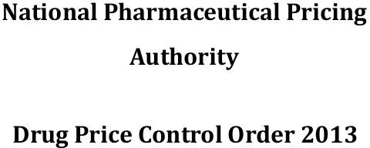
PHARMACEUTICAL JURISPRUDENCE

Slide 2
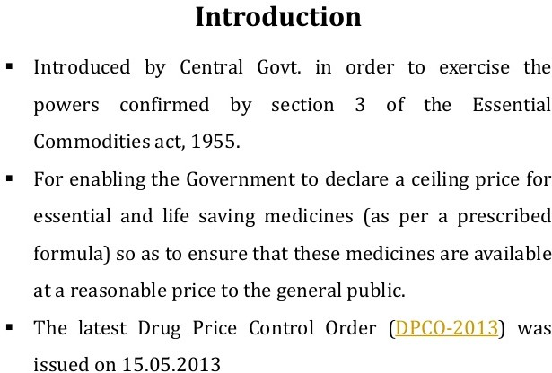

Slide 3
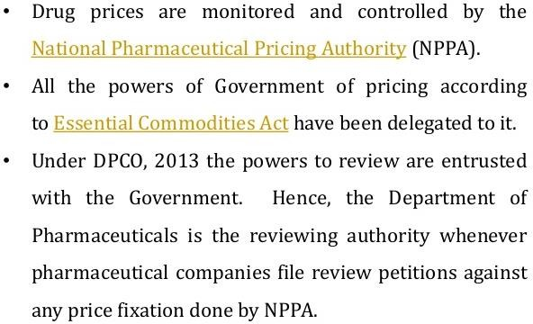

Slide 4
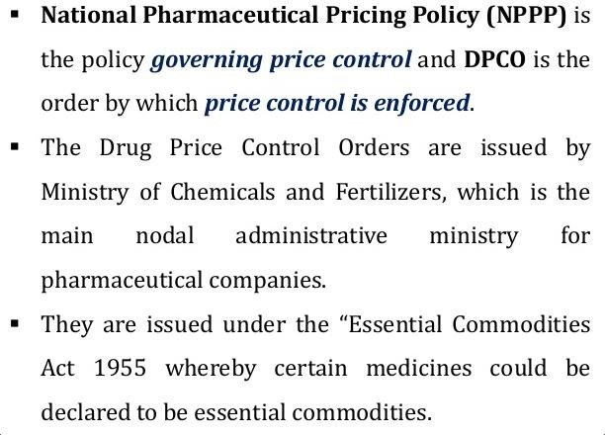

Slide 5
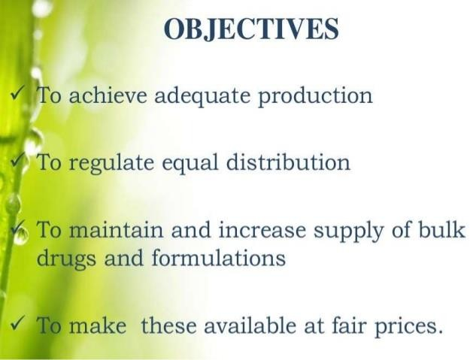

Slide 6
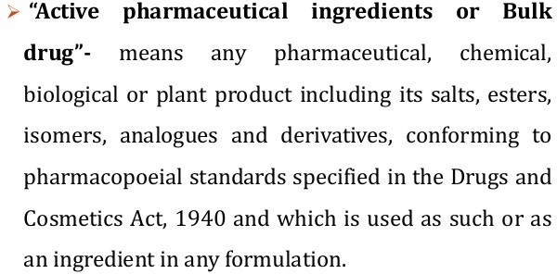
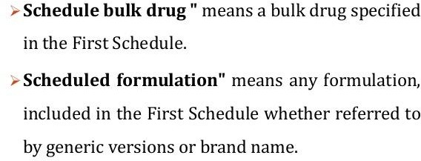
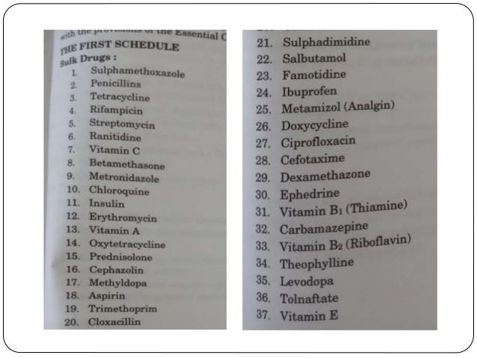
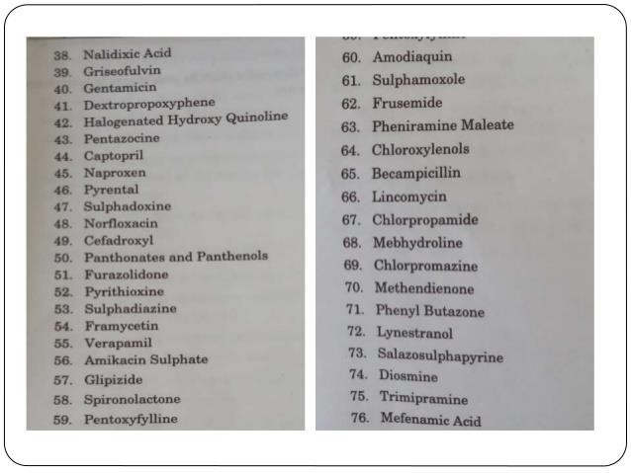

Slide 7
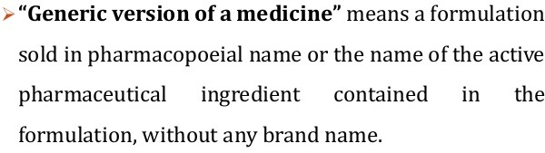
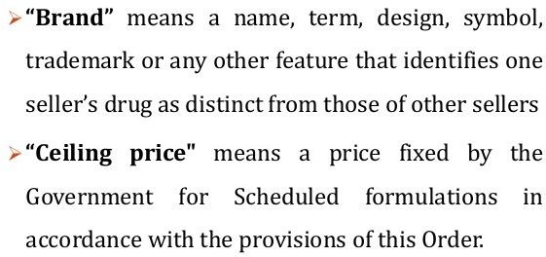
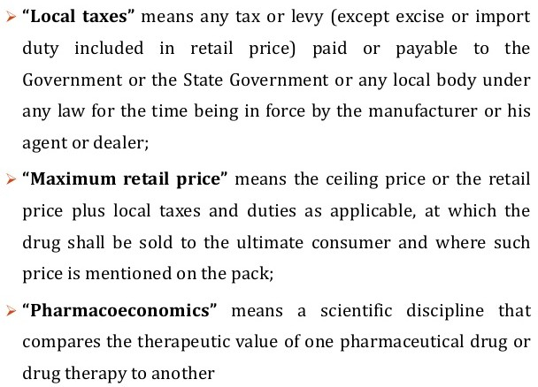
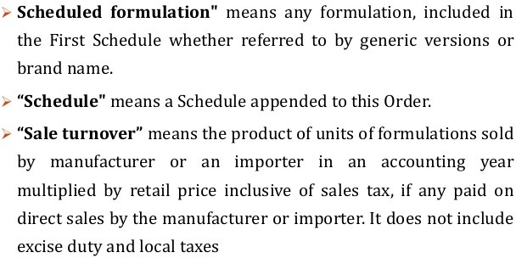

Slide 8
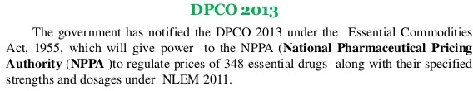
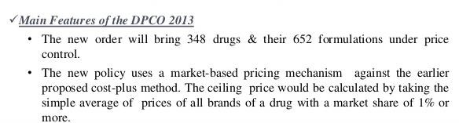
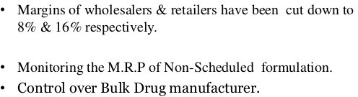

Slide 9
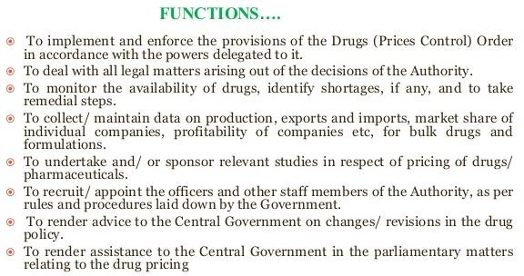

Slide 10
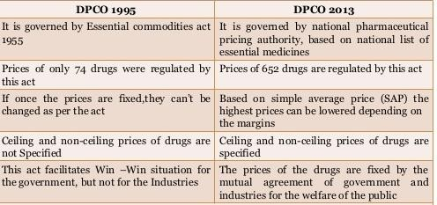

Slide 11
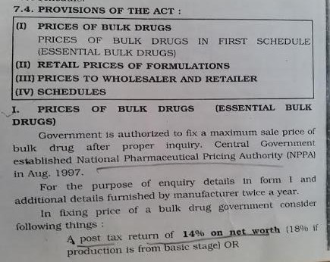

Slide 12
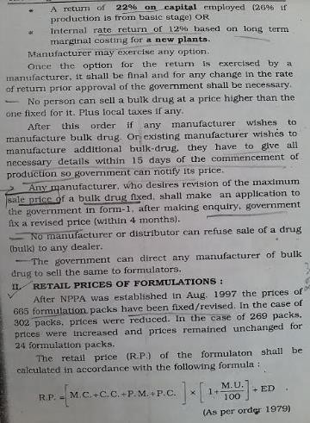

Slide 13
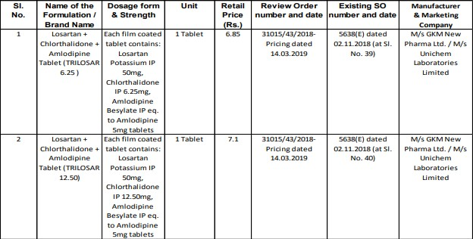

Slide 14
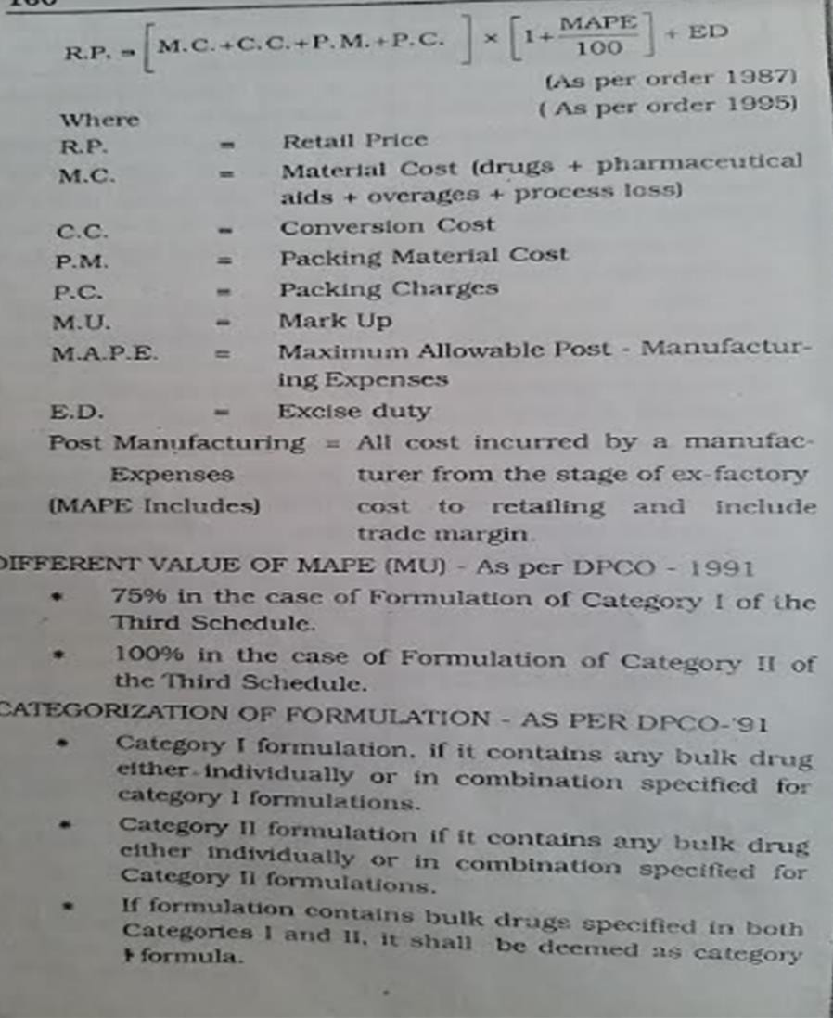

Slide 15
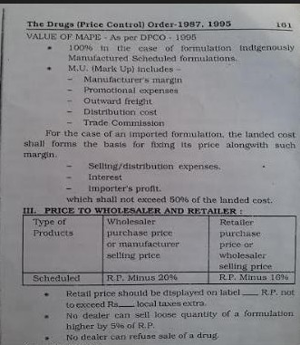

Slide 16
National List of Essential Medicines
  Any dosage form of a medicine, other than the dosage form included in this Schedule, but in same strength, and route of administration, which does not have significant difference in terms of pharmacokinetics or pharmacodynamics or efficacy-safety profile over the dosage form mentioned in the list shall be considered as included. To elaborate, if a tablet is included, other dosage forms like conventional tablets and capsules are considered as included.
However, such different dosage forms should be considered differently for purposes such as procurement policy, pricing, etc. This principle also applies to all other dosage forms e.g. oral liquid dosage forms, injectable, topical dosage forms, etc.
  Innovation in medicine must be encouraged. The formulations developed through incremental innovation or novel drug delivery systems like lipid/liposomal formulations, sustained release/controlled release etc. should be considered as included only if specified in the list against any medicine. Such different formulations should be considered differently for purposes such as procurement policy, pricing, etc.

Slide 17
In cases, where vaccines or immunoglobulin or sera are listed in this Schedule, irrespective of variation in
source, composition and strength, all the products of the same vaccines or immunoglobulin or sera as approved by the licensing authority are considered included.
In general, medicines have been mentioned with respect to their active moieties, without mentioning the salts and, in cases where there is significant difference between the salts, the medicine finds mention as its specific salt.
In cases where an active moiety is available as different isomers or analogues or derivatives, they are considered as separate entities, and inclusion of one does not imply inclusion of all isomers or analogues or derivatives.
For injectable preparations, the pack size (single and multi-dose packs) has not been mentioned. It is suggested that the single and multi-dose pack sizes be considered as separate entities for purposes such as procurement/ pricing etc.

Slide 18
The Core-Committee through a series of meetings and consultations across the country, deliberated and revised the National List of Essential Medicines (NLEM) 2011.
There were 348 medicines listed in NLEM 2011. A total of 106 medicines have been added, and 70 medicines have been deleted to prepare NLEM 2015 which now contains a total of 376 medicines.
Medicines in NLEM are listed with reference to the levels of healthcare, namely, Primary (P), Secondary
(S) and Tertiary (T). There are 209 medicine formulations listed for all levels of health care (P, S, T), 115 medicine formulations for secondary and tertiary levels (S, T) and 79 medicine formulations for the tertiary level (T). It is to be noted that formulations of certain medicines are listed at different levels but as item, they are counted as one. The total number of medicines remains 376.
The essentiality of a medicine has been considered in terms of its dosage form and strength also. The NLEM 2015 has been prepared adhering to the basic principles of Efficacy, Safety, Cost-
Effectiveness; consideration of diseases as public health problems in India. The list could be called as a Best-Fit List

Slide 19
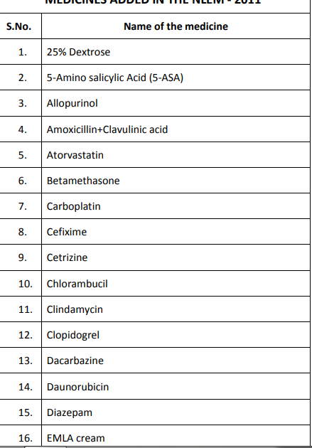
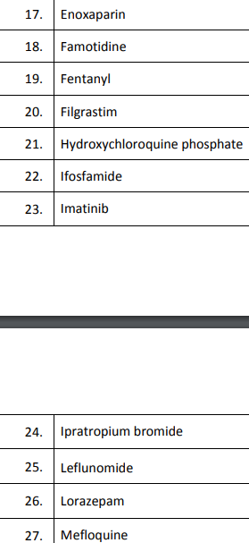
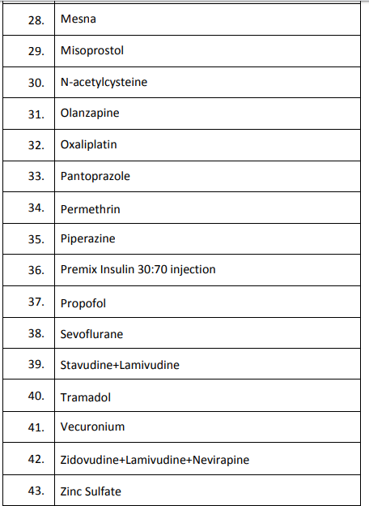

Slide 20
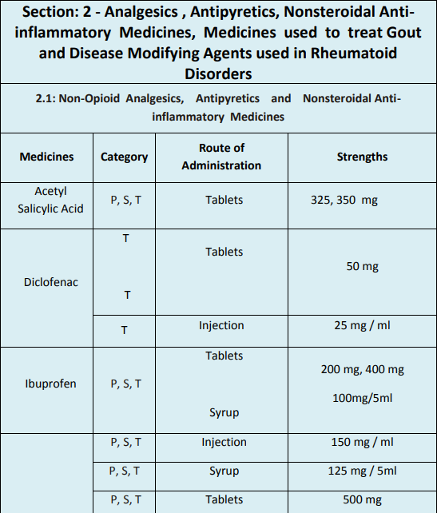

Slide 21
Fixation of ceiling price of scheduled formulations.–
The Government shall fix and notify the ceiling prices of the scheduled formulations in accordance with the provisions of the paragraphs 4 and 6, as the case may be, and no manufacturer shall sell the scheduled formulations at a price higher than the ceiling price (plus local taxes as applicable) so fixed and notified by the Government.
Where any manufacturer sells a scheduled formulation at a price higher than the ceiling price( plus local taxes as applicable) fixed and notified by the Government, such manufacturers shall be liable to deposit the overcharged amount along with interest thereon from the date of such overcharging.
The Government shall revise the ceiling prices of scheduled formulations as per the annual wholesale price index (WPI) for preceding calendar year on or before 1st April of every year and notify the same on the 1st day of April every year.
The manufacturers may increase the maximum retail price (MRP) of scheduled formulations once in a year, in the month of April, on the basis of the wholesale price index with respect to previous calendar year and no prior approval of the Government in this regard shall be required.

Slide 22
Information about the revision, if carried out, shall be forwarded to the Government in either
electronic or physical form in Form-II within a period of fifteen days of such revision and non-submission of information under this sub-paragraph shall be construed as non revision of maximum retail price (MRP) and the concerned manufacturer shall be liable to deposit the amount charged over and above the pre-revised maximum retail price (MRP), along with interest thereon from the date of overcharging.
In case of decline in wholesale price index, there shall be a corresponding reduction in the maximum retail price and in case of scheduled formulations produced or available in the market before the date of notification of revised ceiling price, the manufacturers shall ensure within a period of forty-five days of the date of such notification that the maximum retail price (MRP) of such scheduled formulation does not exceed the revised ceiling price (plus local taxes as applicable) and information about the revision shall be sent to the Government in either electronic or physical form in Form-II within a period of fifteen days of such revision.
Non-submission of information under the sub-paragraph (4) shall be construed as non reduction in maximum retail price (MRP) and the concerned manufacturer shall be liable to deposit the amount charged over and above the maximum retail price revised based on decline in wholesale price index, along with interest thereon as overcharged amount from the date of overcharging.
22

Slide 23
Fixation of retail price of a new drug for existing manufacturers of scheduled formulations.–
The Government shall form a Standing Committee of such Experts, as it may deem fit, within sixty days of notification of this order with a view to recommend the retail prices of new drugs on the principles of
“Pharmacoeconomics”.
Where an existing manufacturer of a drug with dosages and strengths as specified in National List of Essential Medicines launches a new drug, such existing manufacturers shall apply for prior price approval of such new drug from the Government in Form-I specified under Schedule-II of this Order.
On receipt of the application under sub-paragraph (2), in the event of the new drug available in domestic market, the Government shall fix the retail price of the new drug in accordance with the provision of sub- paragraph(1) of paragraph 5 and in the event of the new drug not available in domestic market, the Government shall forward the same to the Standing Committee of Experts who shall examine the application on the principles of “Pharmacoeconomics” and make recommendations of retail price of the new drug to the Government within thirty days of the receipt of application.
23

Slide 24
The Government shall, on receipt of recommendation under subparagraph (3), within thirty days, fix the retail price of such new drug and such price shall be applicable to such applicant of such new drug.
Where existing manufacturer of scheduled formulation fails to apply for prior approval of the price of the new drug in Form-I, such manufacturer shall be liable to deposit the overcharged amount over and above such price fixed and notified by the Government, if any, along with interest thereon from the date of launch of the new drug, in addition to the penalty.
No existing manufacturer of a scheduled formulation shall sell such a new drug at a price higher than the retail price (plus local taxes as applicable) fixed by the Government for such new drug and in case such a manufacturer is found to sell such a new drug at a price higher than the retail price (plus local taxes as applicable) fixed by the Government, such manufacturer of the new drug shall be liable to deposit the overcharged amount along with interest from the date of overcharge, in addition to the penalty.
24

