Slide 1
PHARMACOTHERAPEUTICS-III
OBSESSIVE COMPLUSIVE DISORDER
9/17/2024

Slide 2

◻ Introduction
◻ Definition
◻ Aetiology
◻ Patho physiology
◻ Clinical presentation
◻ Signs and symptoms
◻ Differential diagnosis
◻ Diagnosis
◻ Treatment
◻ Non-pharmacological
◻ Pharmacological
◻ Psychological
◻ Co-morbid conditions
◻ Relapse
◻ Therapeutic outcomes
◻ Conclusion

Slide 3
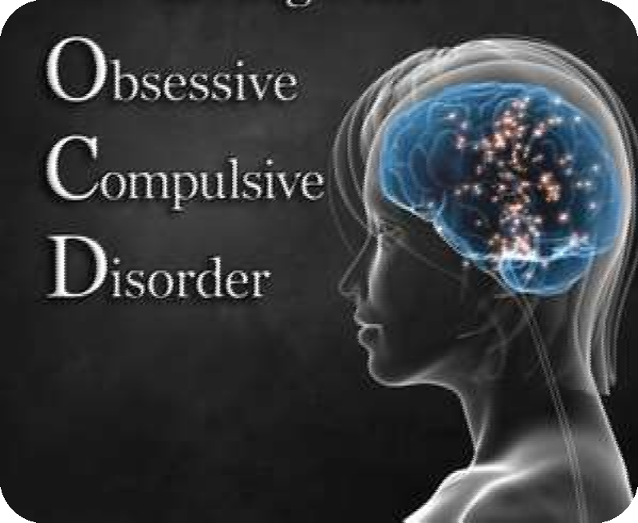
INTRODUCTION
◻ Obsessive compulsive disorder(OCD)
◻ Characterized by obsessional thoughts and compulsive rituals.
◻ Secondary to both depressive illness and Gilles de la Tourette syndrome.

Slide 4
DEFINITION
◻ OCD is an anxiety disorder characterized by intrusive thoughts that produce uneasiness, apprehension, fear or worry; by repetitive behaviours aimed at reducing the associated anxiety; or by a combination of such obsessions and compulsions

Slide 5
◻ OCD is characterized by anxiety-provoking ideas, images or impulses(obsessions) and by urges-compulsions to do something hat will lessen their anxiety.
◻ Obsession: Repetitive, intrusive thoughts, ideas or impulses that are recognized as a foreign or repugnant to the individual. They are involuntary, seemingly uncontrollable thoughts, images or impulses that occur over and over again in the mind.

Slide 6
◻ Compulsion:
◻ Repetitive, stereotyped behaviors that are senseless and are not connected un a realistic way with what they are meant to produce or prevent.
◻ The individuals usually recognizes the senselessness of the behaviors, although they do relieve tension.

Slide 7
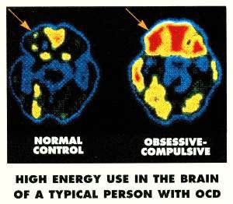

Slide 8
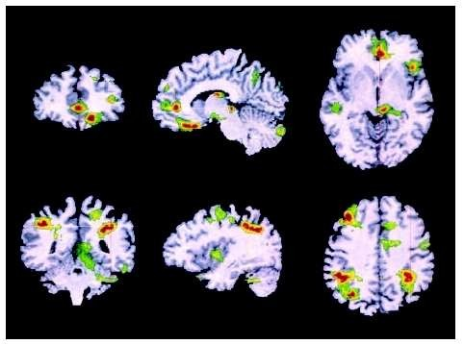

Slide 9

◻ 80% cases: before the age of 18.
◻ Higher in males than females
◻ But age of onset is younger in females than males
◻ It is common in Latin America, Africa, Europe at 2-3 times than those in Asia and Oceania.

Slide 10

◻ Psychological:
may have high amount of predisposing genes.
◻ Biological
◻ neuro=-transmitter’s role
◻ Genetic-hSERT mutation
◻ Basal ganglia dysfunction
◻ Stress
◻ Life style modification- new job, puberty, etc.

Slide 11

◻ 5-7% of the first degree relatives.
◻ Twin studies showed 80-90%concordance in monozygotic twins and about 50%in dizygotic twins.
◻ Basal ganglia dysfunction:
◻ Associated with a number of neurological disorders involving dysfunction of the striatum, including parkinsonism disease, Sydenham’s and Huntington's disease.

Slide 12

Fear of being contaminated by germs or dirt or
contaminated others.
Fear of causing harm
Intrusive sexually explicit or violent thoughts and images.
Excessive focus on religious or moral ideas.
Fear of losing or not having things that you might need.
Superstitions, excessive attention to something considered lucky or unlucky.
Order and symmetry: just right

Slide 13

◻ Double checking of things such as locks, appliances and switches.
◻ Repeatedly checking in on loved ones to make sure they are safe.
◻ Spending a lot of time in cleaning or washing.
◻ Counting, tapping, repeating certain words or doing other senseless things to reduce anxiety.
◻ Ordering or arranging things, “just so”.

Slide 14

◻ Cognitive deficits regarding:
Spatial memory loss
Verbal memory
Fluency
Auditory attention was not significantly affected Over-valued ideas:
The patient will be uncertain whether the fears that cause them to perform their compulsions are irrational or not.

Slide 15
Washers: afraid of contamination.
Checkers: repeatedly check things associated with harm or danger.
Doubters or sinners: everything isn’t perfect or done just right something terrible will happen or they will be punished.
Counters and arrangers: obsessed with order and symmetry.
Hoarders; something bad will happen if they throw anything away.

Slide 16

◻ Seretonergic probes
◻ Dopamine model
◻ Brain imaging studies

Slide 17
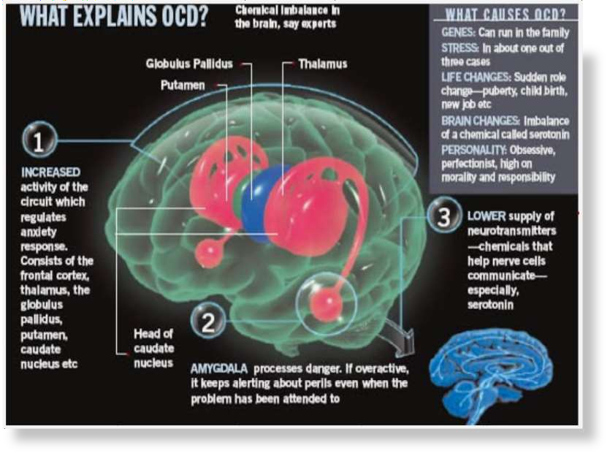

Slide 18

◻ Probe: m- chloro phenyl piperazine(m-CPP)
◻ Non-specific postsynaptic 5-HT agonist and metabolite of antidepressant Trazadone, m- CPP Produced very limited behavioural effects in normal volunteers.
◻ Other drugs which have been studied as 5-HT probes:
Metergoline
Ipsapirone
L-Tryptophan
Fenfluramine.

Slide 19

◻ To assess the biochemical and physiologic function of the brain using single- photon emission computed tomography and positron emission tomography have produced consistent findings that identify 3 areas of increased or abnormal metabolic activity:
The orbito-frontal areas-cortex
Cingulate cortex
Head of the caudate nucleus.

Slide 20

◻ Tourette’s syndrome: a disorder of dopamine(DA) dysfunction, DA dysregulation may contribute to come forms of OCD.
◻ Multiple tics(motor and speech) with behavioural problems including Affection Deficit Hyperactivity Disorder(ADHD) and OCD.
◻ More common in childhood or adolescence, males and is lifelong.
◻ Sometimes explosive barking and grunting of obscenities and gestures.
◻ Cause: Disorder of synaptic transmission.

Slide 21
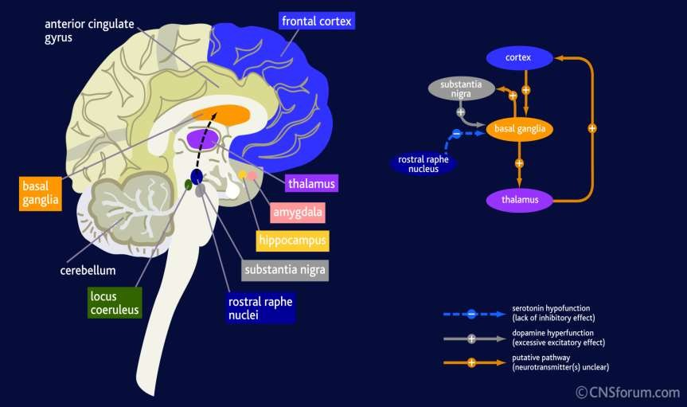

Slide 22

◻ ◻ | OCPD Major depressive disorder | ◻ ◻ | Asperger syndrome Attention deficit hyperactivity disorder
◻ | Bipolar disorder | ◻ | Dermatillomania
◻ | Generalized anxiety disorder | ◻ | Body dysmorphic disorder
◻ | Anorexia nervosa | ◻ | Trichotillomania
◻ | Social anxiety disorder | ◻ | Delayed sleep phase
syndrome
◻ autism spectrum disorder
◻ Bulimia nervosa
◻ Tourette syndrome

Slide 23
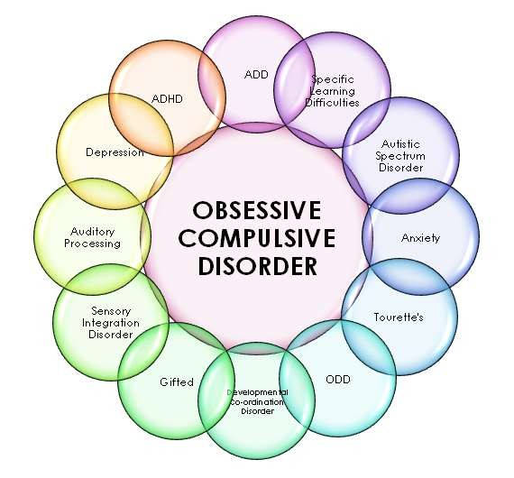

Slide 24
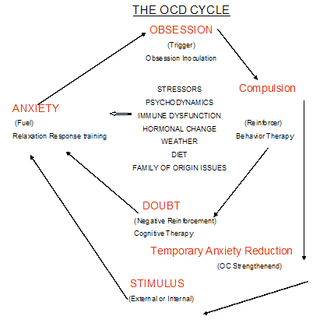

Slide 25

◻ Patients with OCD are aware of the irrationality of their symptoms, are often ashamed to admit their symptoms and are skilled at hiding them.
◻ OCPD patients do not view behaviour as irrational and do not wish to change, as they consider these personality features to be beneficial.
◻ OCD patients often initially seek treatment from primary care physicians/dermatologists because of severe dermatitis from excessive washing

Slide 26

◻ Only trained therapists can perform OCD diagnosis. They look for three things.
The patient has obsessions.
The patient does compulsive behaviours and
The obsessions and compulsions take a lot of time and get in the way of important activities the person values, such as working, going to school, or spending time with friends.

Slide 27

◻ To achieve a great level of symptom reduction as possible while recognizing that a complete cure or elimination of all symptoms is unlikely.
◻ To minimize adverse consequences on quality of life.
◻ To restore the patient to an optimal level of psycho-social and occupational functioning.

Slide 28
◻ In adolescents with OCD, CBT-generally selected for milder cases.
◻ For more severe OCD, CBT+SSRI-fluoxetine, fluoxamine, sertraline or paroxetine(or SSRI alone).
◻ Clomipramine-selected after 2 or 3 failed SSRI trials.

Slide 29
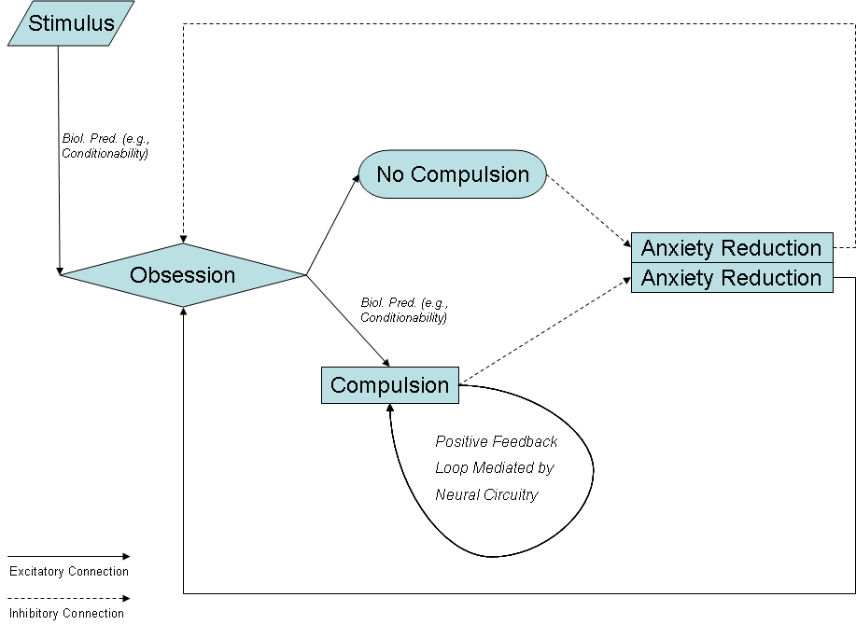

Slide 30
◻ Exposure with response prevention is particularly helpful for contamination or other fears, symmetry rituals, counting or repeating, hoarding and aggressive urges.
◻ Cognitive therapy is especially helpful for scrupulosity, more guilt and pathologic doubts. 13 to 20 sessions are typically required to treat uncomplicated OCD and an adequate trial is considered to be atleast 20 hours.

Slide 31

◻ Anti-depressants approved by the Food and Drug Administration:
Clomipramine(anafranil)
Fluvoxamine(Luvox)
Flouxetine(Prozac)
Paroxetine(Paxil, Pexeva)
Sertraline(Zolofit)

Slide 32
S.N o. | Generic name | Initial dose | Maintanence dose | Actual daily target dose
1 | CITALOPRAM | 20 | 20-60 | 40
2 | CLOMIPRAMINE | 10 | 100-250 | 150-200
3 | FLUOXETINE | 20 | 20-80 | 40-60
4 | FLUOXAMINE | 50 | 100-300 | 200
5 | PAROXETINE | 20 | 20-60 | 40
6 | SERTRALINE | 50 | 75-200 | 150

Slide 33

◻ Diarrhoea
◻ Nausea
◻ Imsomnia
◻ Akathisia
◻ Sedation
◻ Diminished libido and/or orgasm.
◻ Anxiety
◻ Insomnia
◻ Restlessness
◻ Anti-cholinergic side effects than to akathisia
◻ Tolerance to adverse effects develop over 6- 8 weeks of treatment.

Slide 34

◻ Hepatic and renal disorders
◻ Elderly
◻ Pregnancy and lactating women
◻ Children and adolescence

Slide 35
◻ Benzodiazepines
◻ Buspirone, 5HT1A partial agonist
◻ St. John’s wort(450 mg of Hypericin 0.3%)

Slide 36

Co-morbid condition | Treatment
Pregnancy | CBT alone
Cardiac or renal disease | CBT alone or with an SSRI
Tourette’s syndrome | CBT+conventional anti-psychotic +SRI
Attention deficit hyperactivity disorder | CBT+SSRI+Psycho-stimulant
Panic disorder or social phobia | CBT+SSRI
Major depression | CBT+SRI
Bipolar disorder | CBT+Mood stabiliser
schizophrenia | SRI+anti-psychotic

Slide 37

◻ Psychiatric hospitalization
◻ Residential treatment
◻ Electroconvulsant therapy(ECT)
◻ Transcranial magnetic stimulation
◻ Deep brain stimulation.

Slide 38

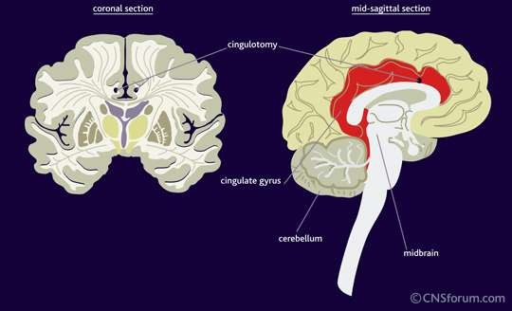

Slide 39
◻ Modelling
◻ Thought stopping
◻ Cognitive behaviour therapy

Slide 40

◻ OCD patients should be monitored for symptom response, adverse effects and drug interactions.
◻ Y-BOCS- monitors symptom severity-periodic assessment.
◻ Ellingrod’s review-rating scale
◻ Changes in social and occupational functioning should be assessed.

Slide 41
◻ Patients older than 40years-receive a pretreatment ECG before starting clomipramine.
◻ Periodic liver function tests in liver disease patients if clomipramine is used.
◻ White blood counts to evaluate for agranulocytosis.

Slide 42

◻ 89% chronically treated with clomiprmine- recurrence of symptoms after a 7 week placebo period.
◻ 2years after discontinuation of therapy with clomipramine, fluoxamine or fluoxetine, relapse rate were 77-80%
◻ Behaviour therapy increases the persistance of improvement after drug therapy is discontinued.

Slide 43
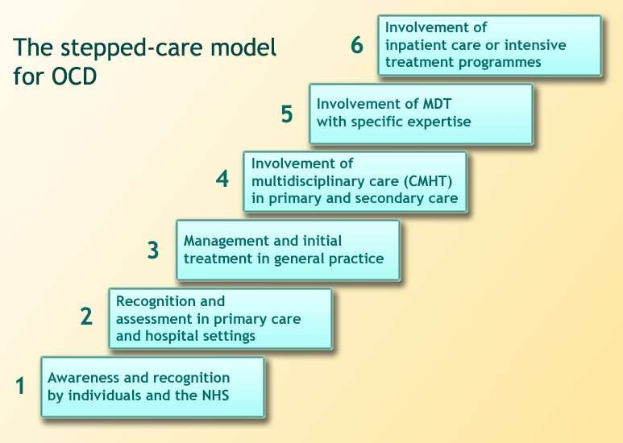

Slide 44

http://www.ocfondation.org.aspx, accessed on November 17,2013.
http://www.helpguide.org/mental/obsessive_co mpulsive_disorder_ocd.htm, accessed on November 17,2013.
http://www.mayoclinic.com/health/mental- illness-in- children/MY01915/NSECTIONGROUP=2, accessed on December 6,2013.
http://www.medicinenet.com/obsessive compulsive_disorder_ocd/article.htm, accessed on December 6,2013.

