Slide 1
PHARMACEUTICAL FORMULATIONS
OPHTHALMIC PREPARATIONS (SEMI – SOLIDS)
1

Slide 2
Ocular drug delivery has stayed as a standout amongst the most difficult charge for pharmaceutical researchers.
In developing a drug delivery approach, issues of absorption, distribution, metabolism, elimination (ADME) must be considered. Ocular disposition and elimination of a therapeutic agent is dependent upon its physicochemical properties as well as the relevant ocular anatomy and physiology.
The improvement of more up to date, more delicate demonstrative procedures and helpful operators renders direness to the advancement of greatest fruitful and advanced ocular drug delivery systems.
Eye, as an entryway for medication conveyance is by and large utilized for the neighborhood treatment as against systemic treatment with a specific end goal to maintain a strategic distance from the danger of eye harm from high blood groupings of medication which are not planned for eye.
VISHAL CS,RRCP
2

Slide 3
The conventional ocular dosage forms are eye drops, eye ointments, eye gels, eye solutions, eye injections, eye irritation solutions, eye suspensions, sol to gel systems. The most widely used are eye drops, eye ointments and gels, which constitute 80% of the total ophthalmic preparations.
Successful treatment of visual ailments is a ghastly test for researchers in the field, particularly as a result of the way of infections and nearness of the visual boundaries particularly in back visual portions. In order to remove the constraints placed by these conventional ocular therapies. A newer approach for ocular drug delivery systems are being explored to develop extended duration and controlled units release strategy.
Ocular drug delivery is one of the most challenging tasks faced by Pharmaceutical researchers. The ophthalmic preparations are available as sterile, buffered, isotonic solution. Several types of dosage forms are applied as the delivery system for the ocular delivery of drugs. The most prescribed dosage form is the eye drop solution as drops are easier to administer. Characteristics of ophthalmic preparations should be non-irritating to the ocular tissue, homogenous, relatively non-greasy, should not cause blurred vision. Prolonged drug release can be achieved using ophthalmic ^{VIS}i^{H}n^{AL}s^{C}e^{S,}r^{RR}t^{C}s^{P}, solid devices placed in the eye, but the inserts must then be removed when³ they are no longer needed.

Slide 4
The development of newer, more sensitive diagnostic techniques and therapeutic agents renders urgency to the development of maximum successful and advanced ocular drug delivery systems.
The following characteristics are required to optimize ocular drug delivery systems:
A good corneal penetration.
A prolonged contact time of drug with corneal tissue.
Simplicity of installation and removal for the patient.
A non-irritatie and at ease form (the viscous solution should not irritate lachrymation and reflex flashing).
Appropriate rheological properties and concentration of viscolyzer.

Slide 5
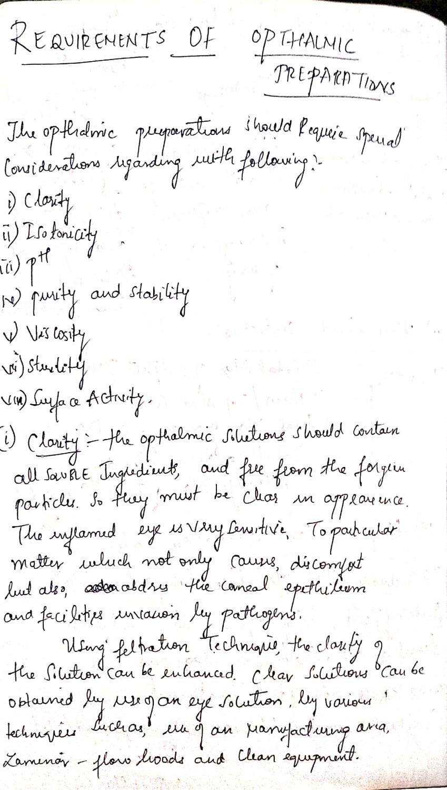

Slide 6
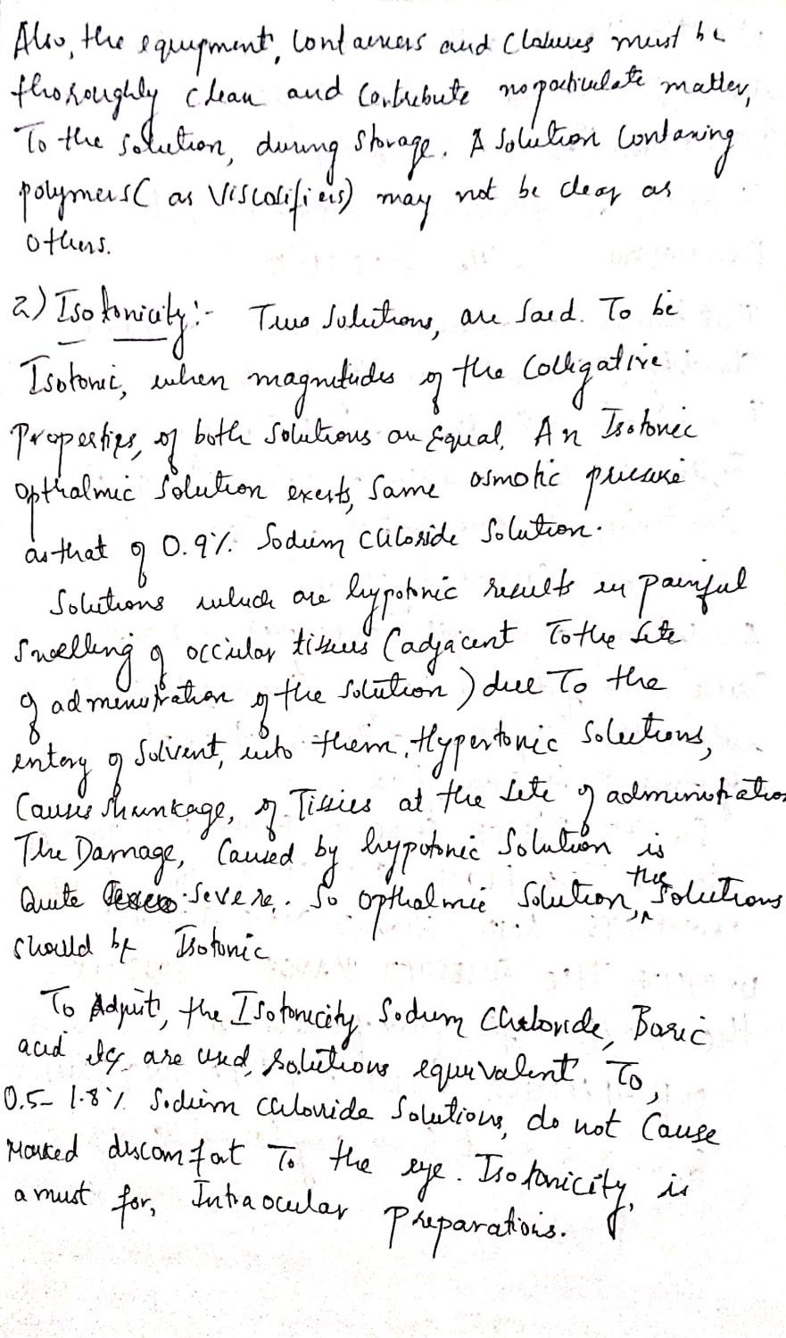

Slide 7
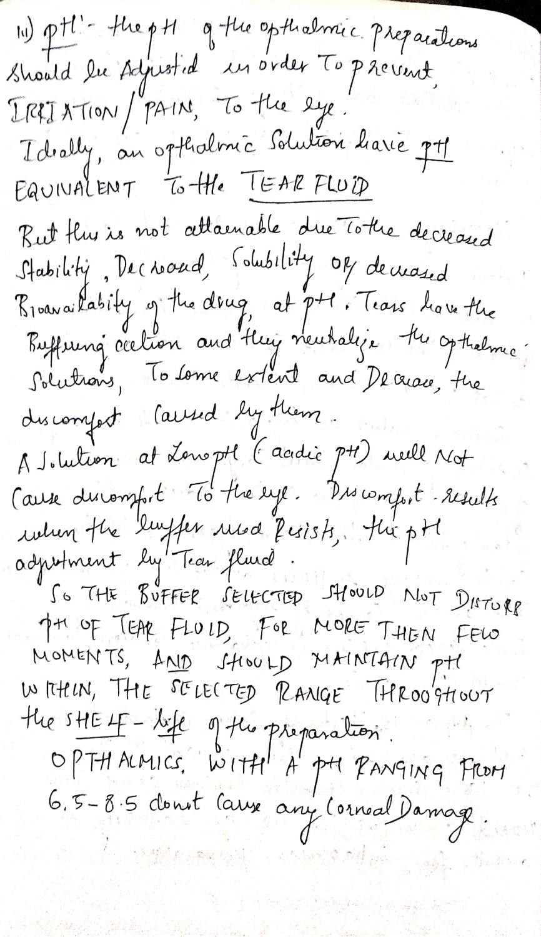

Slide 8
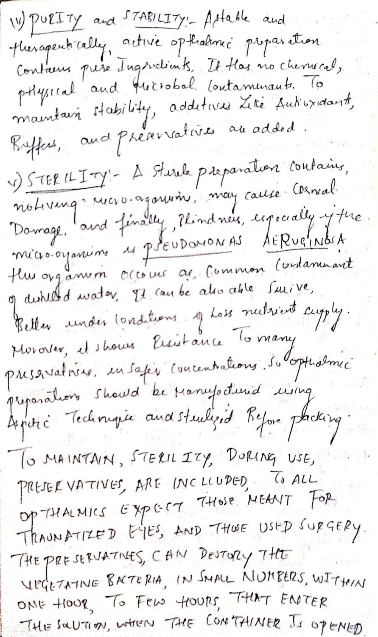

Slide 9
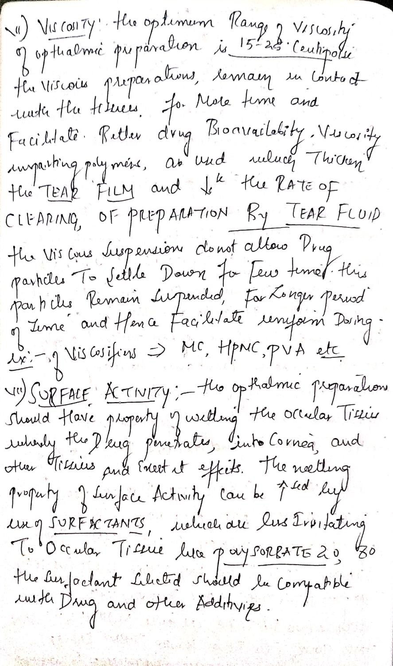

Slide 10
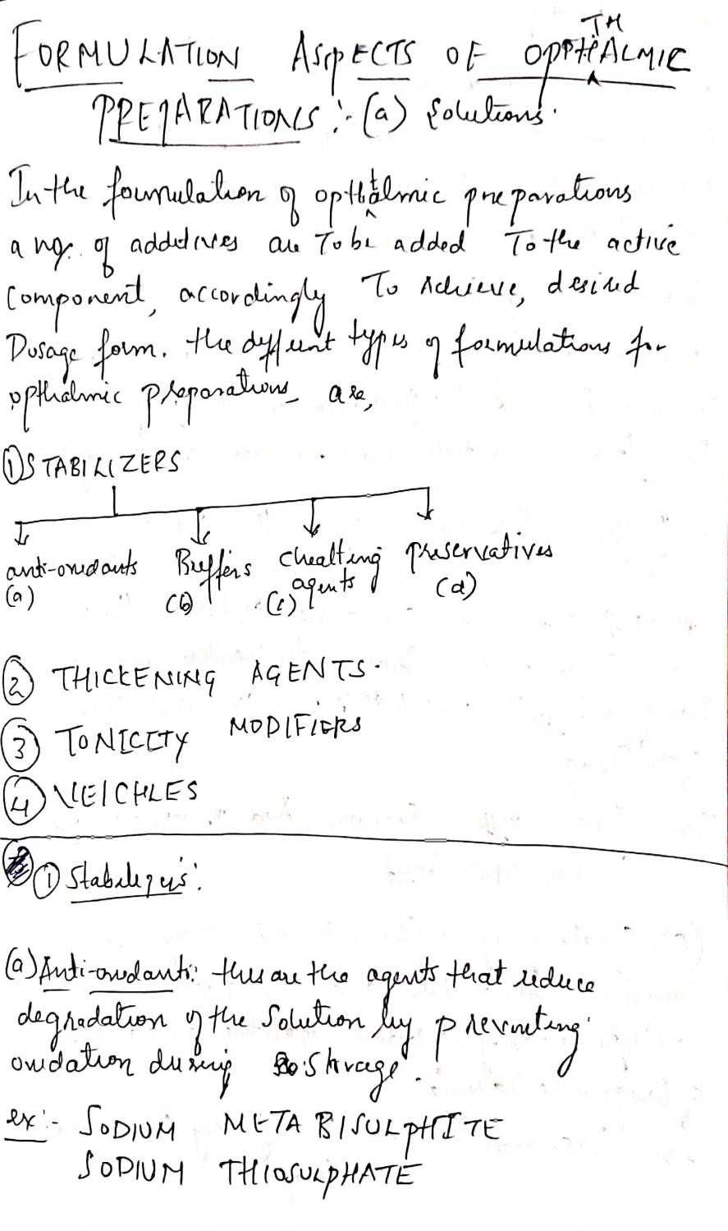

Slide 11
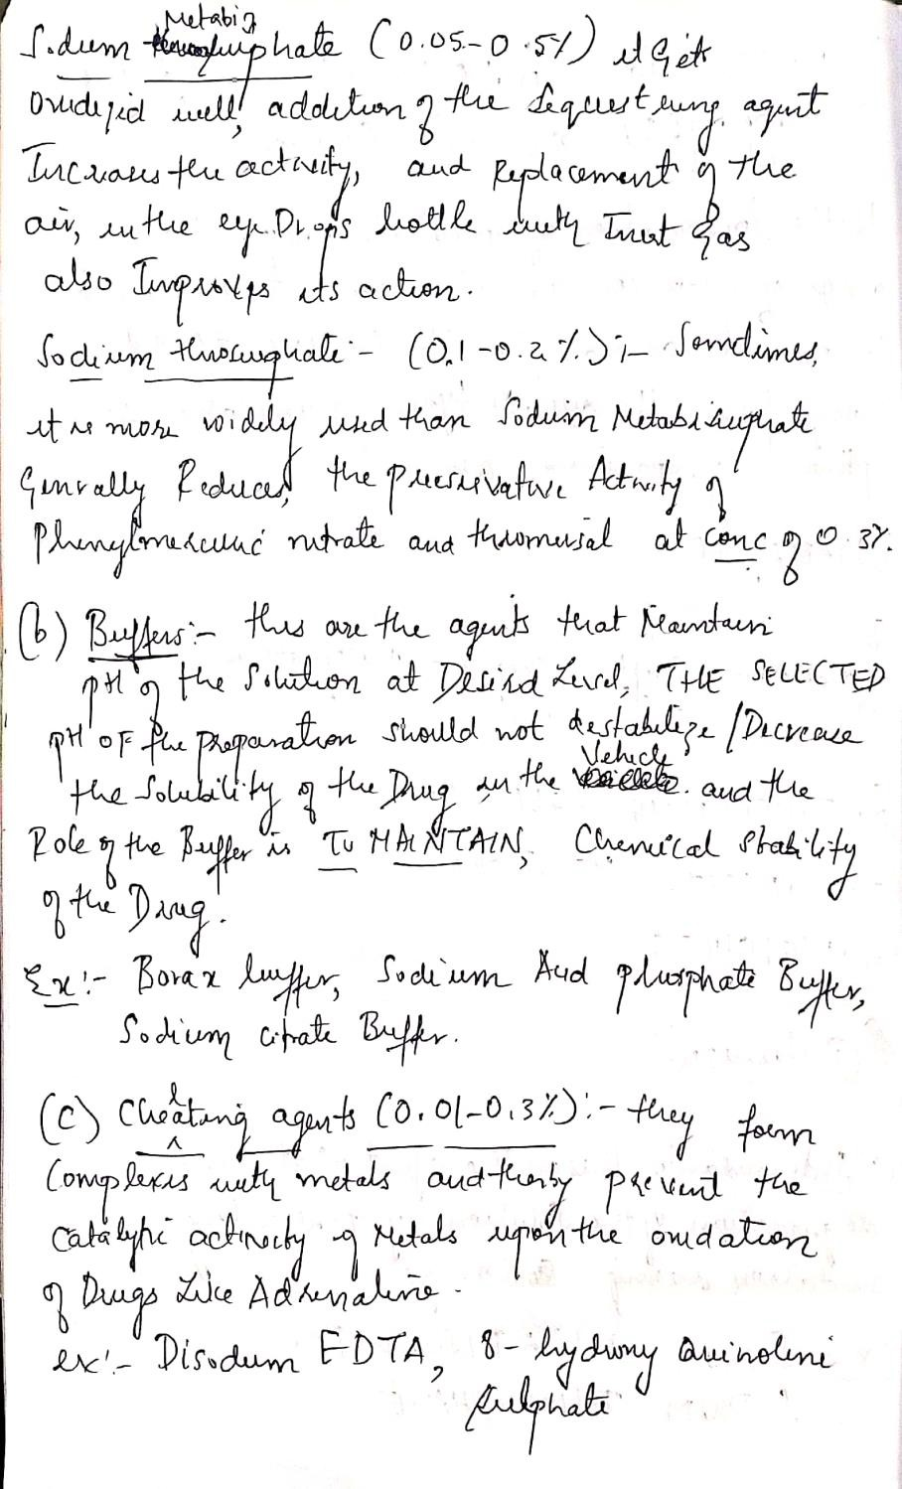

Slide 12
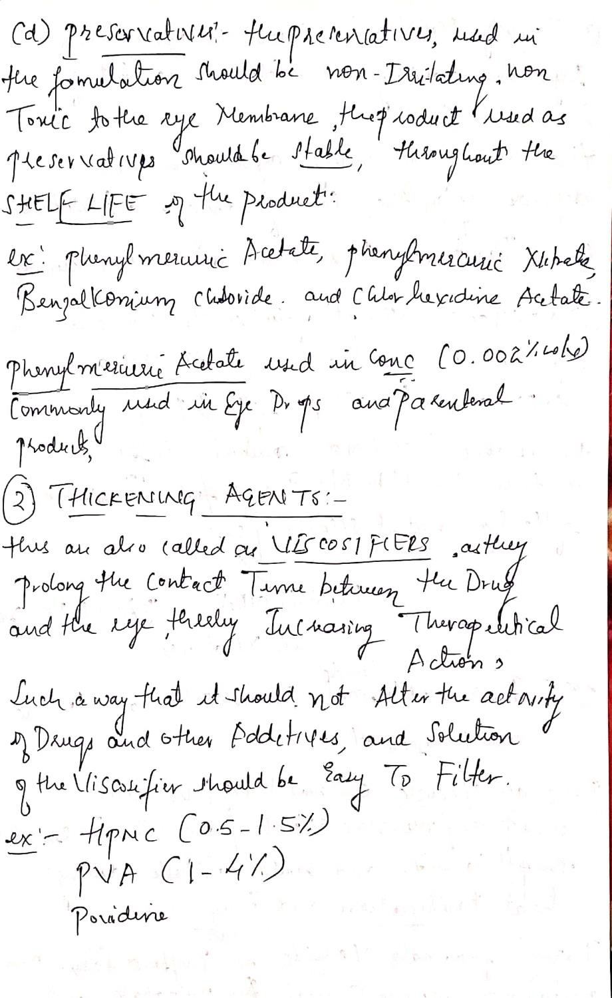

Slide 13
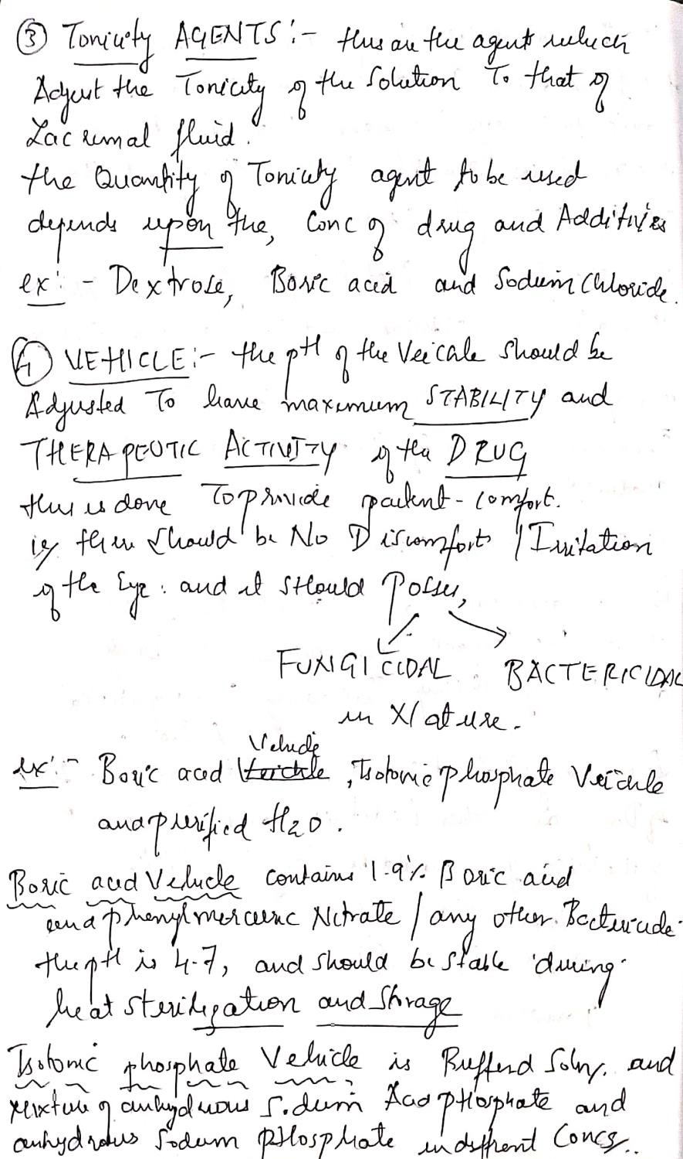

Slide 14
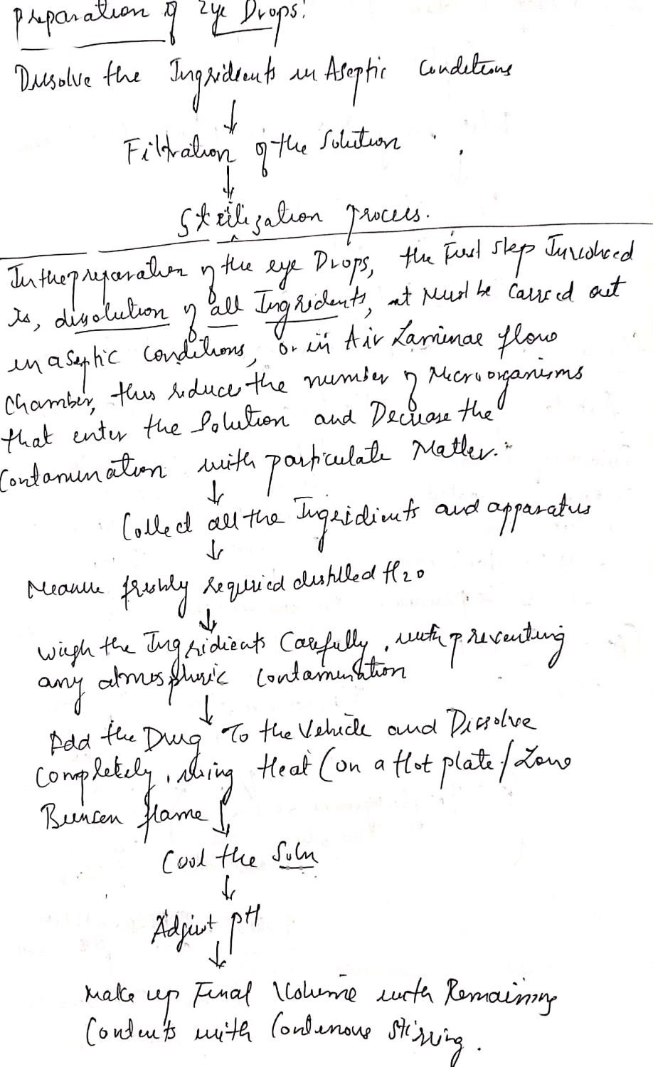

Slide 15
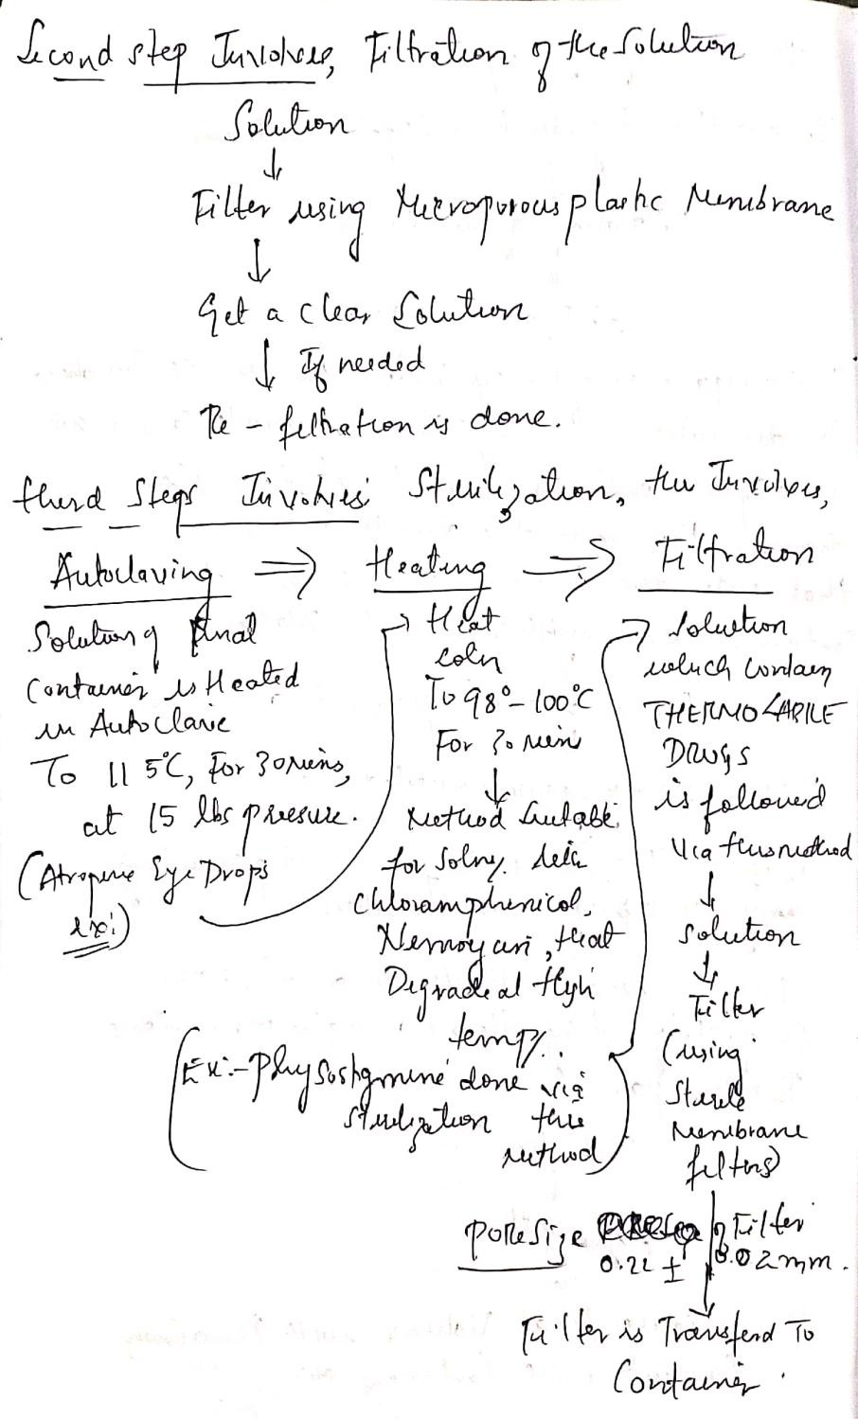

Slide 16
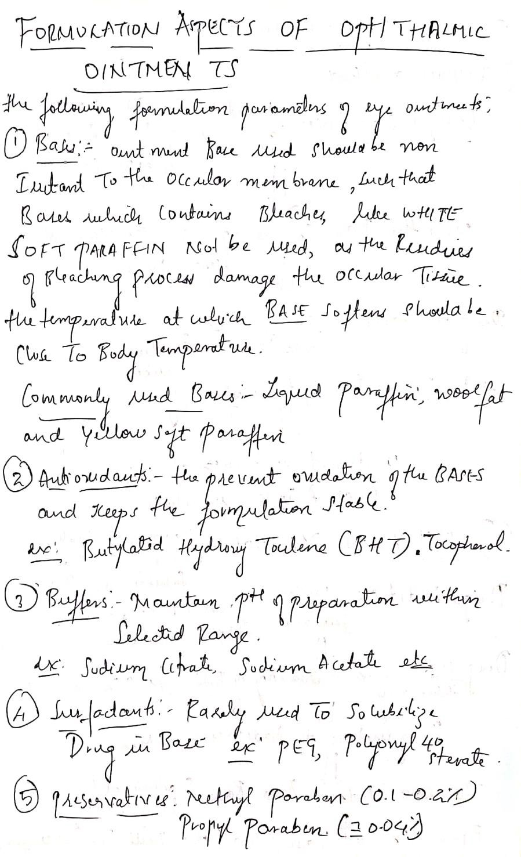

Slide 17
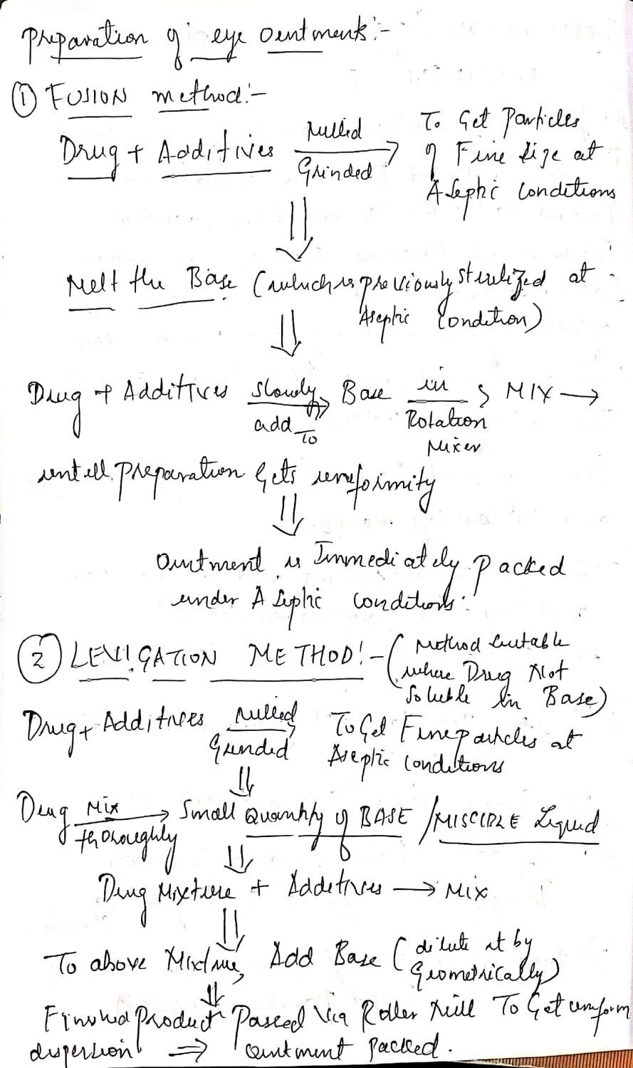

Slide 18
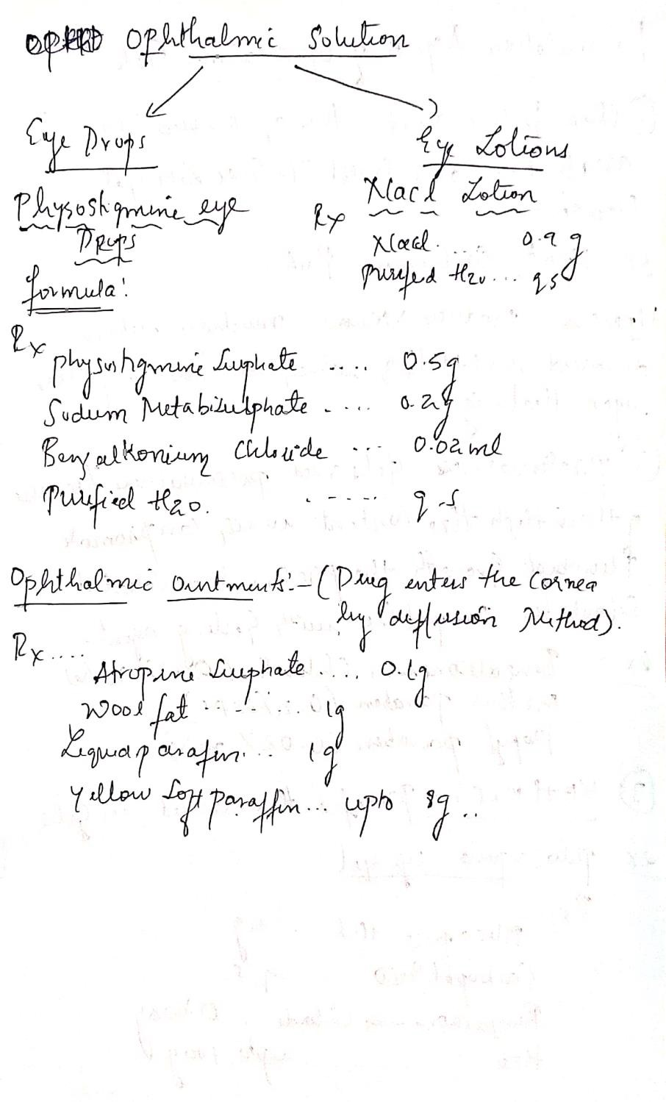

Slide 19
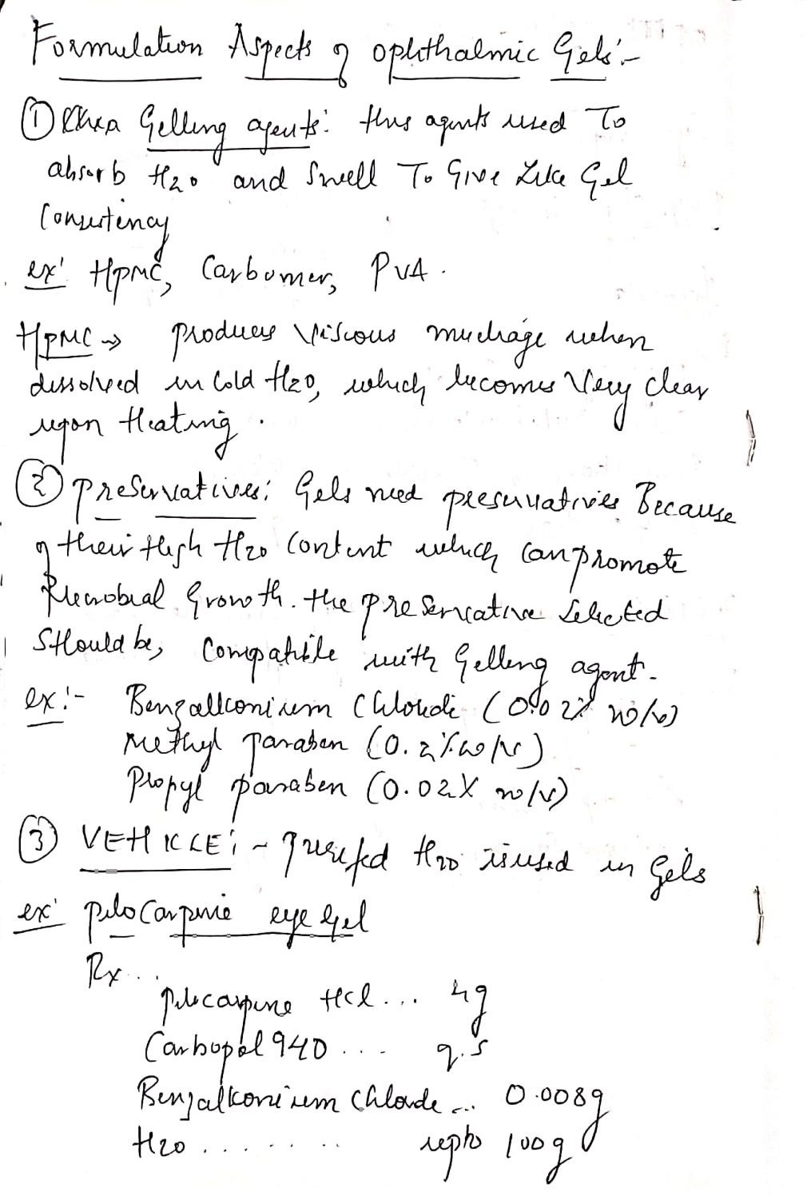

Slide 20
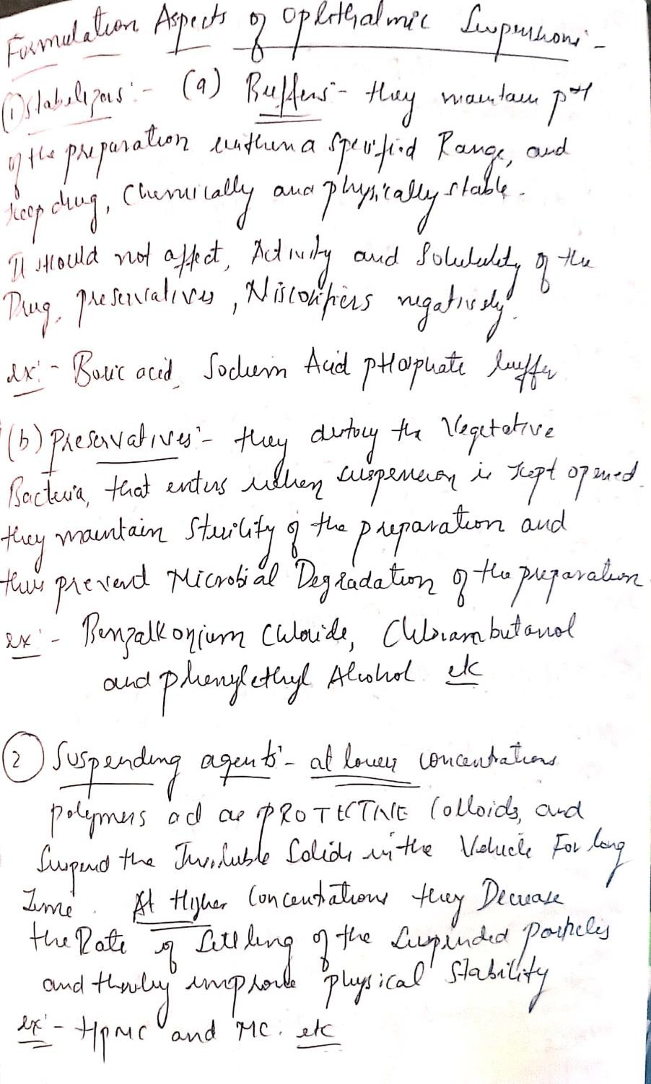

Slide 21
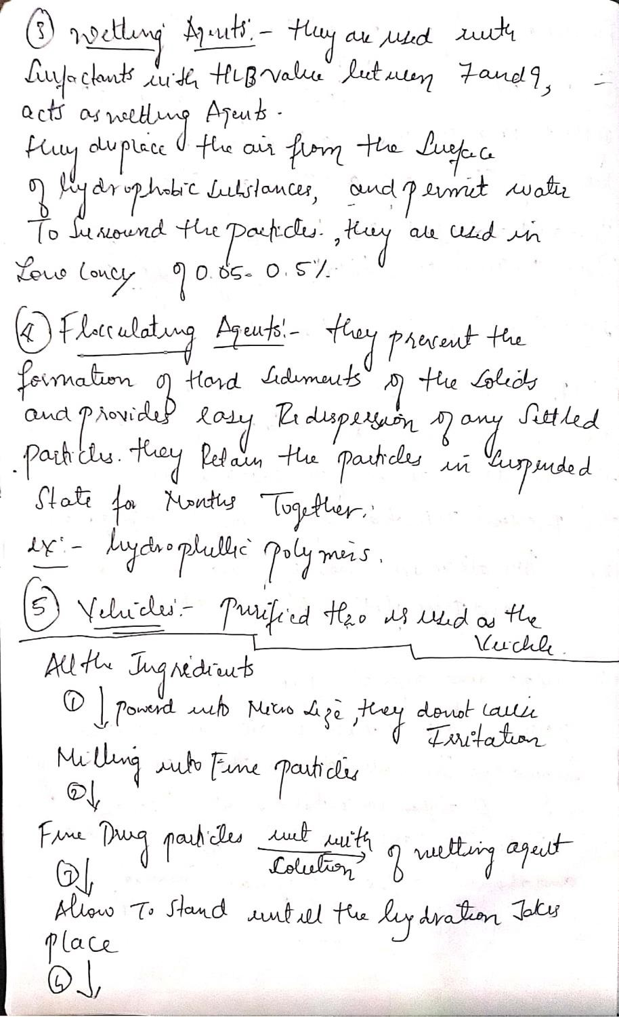

Slide 22
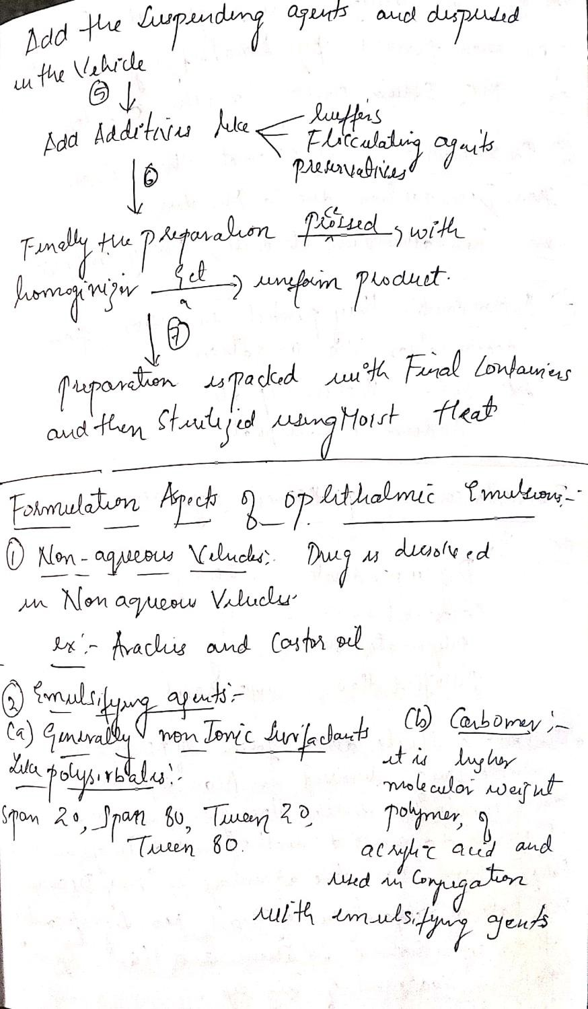

Slide 23
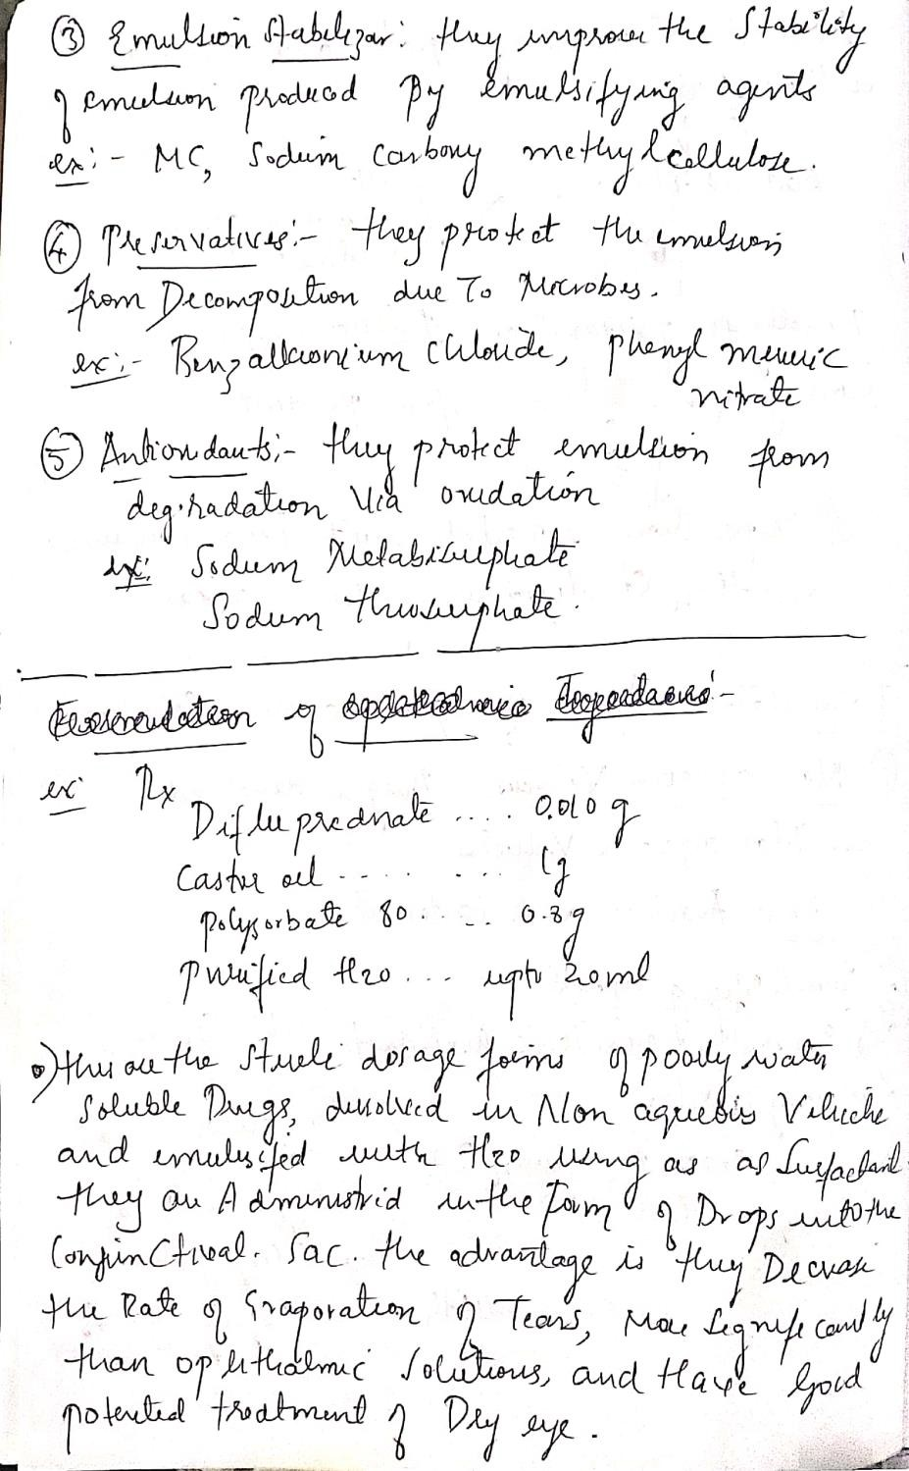

Slide 24


Slide 25
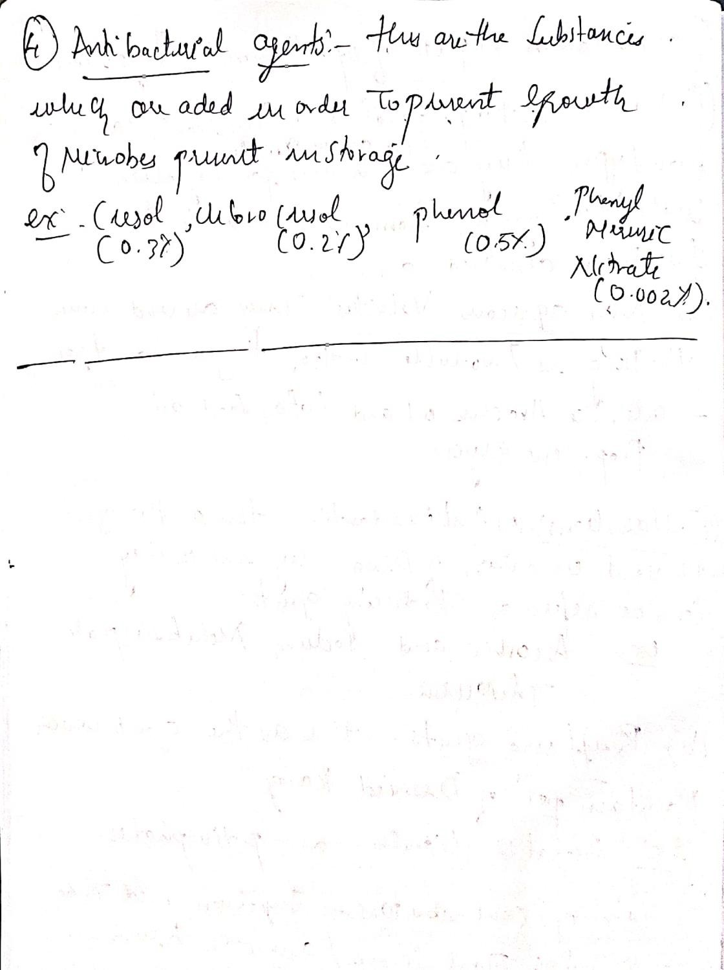

Slide 26
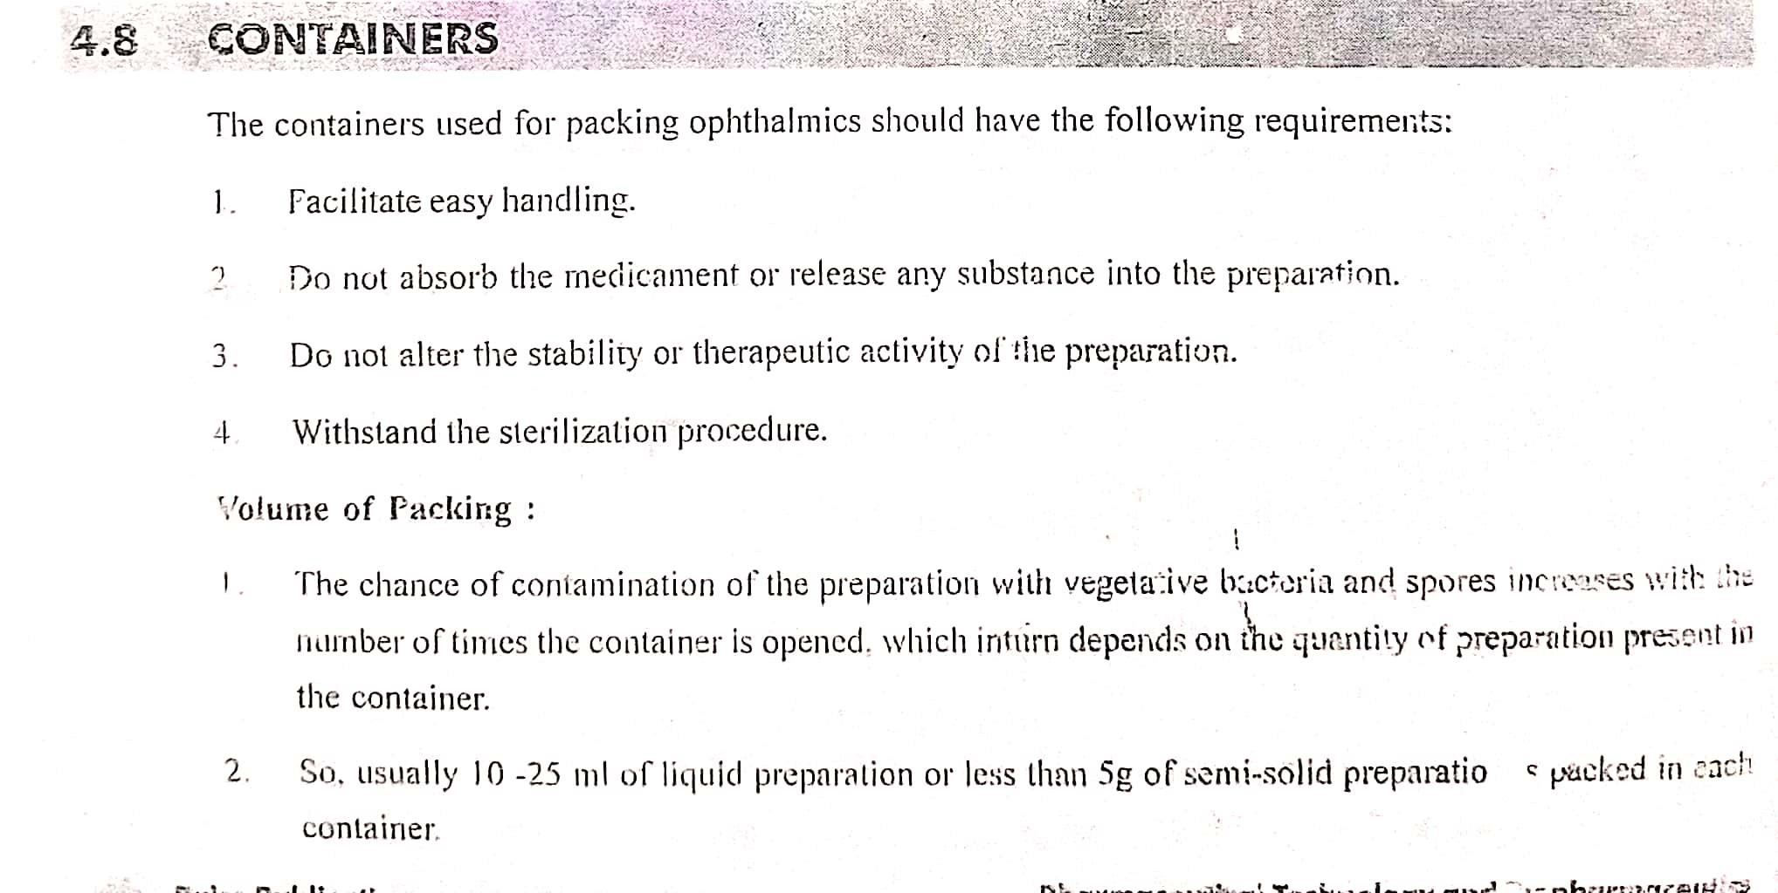

Slide 27
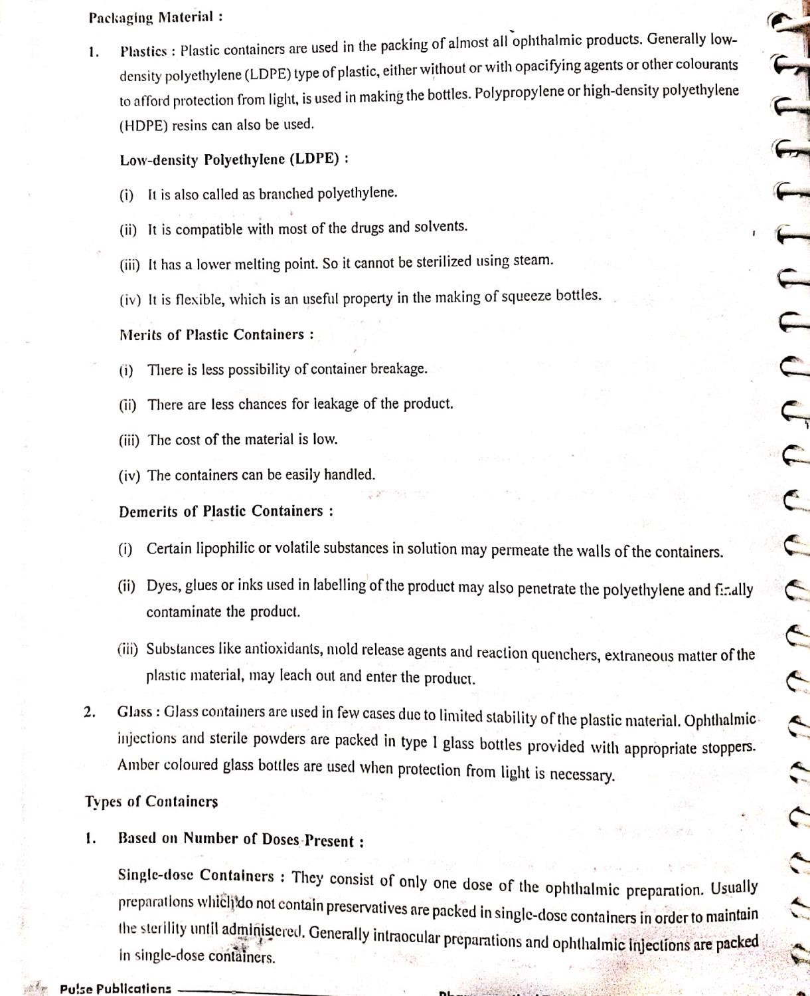

Slide 28
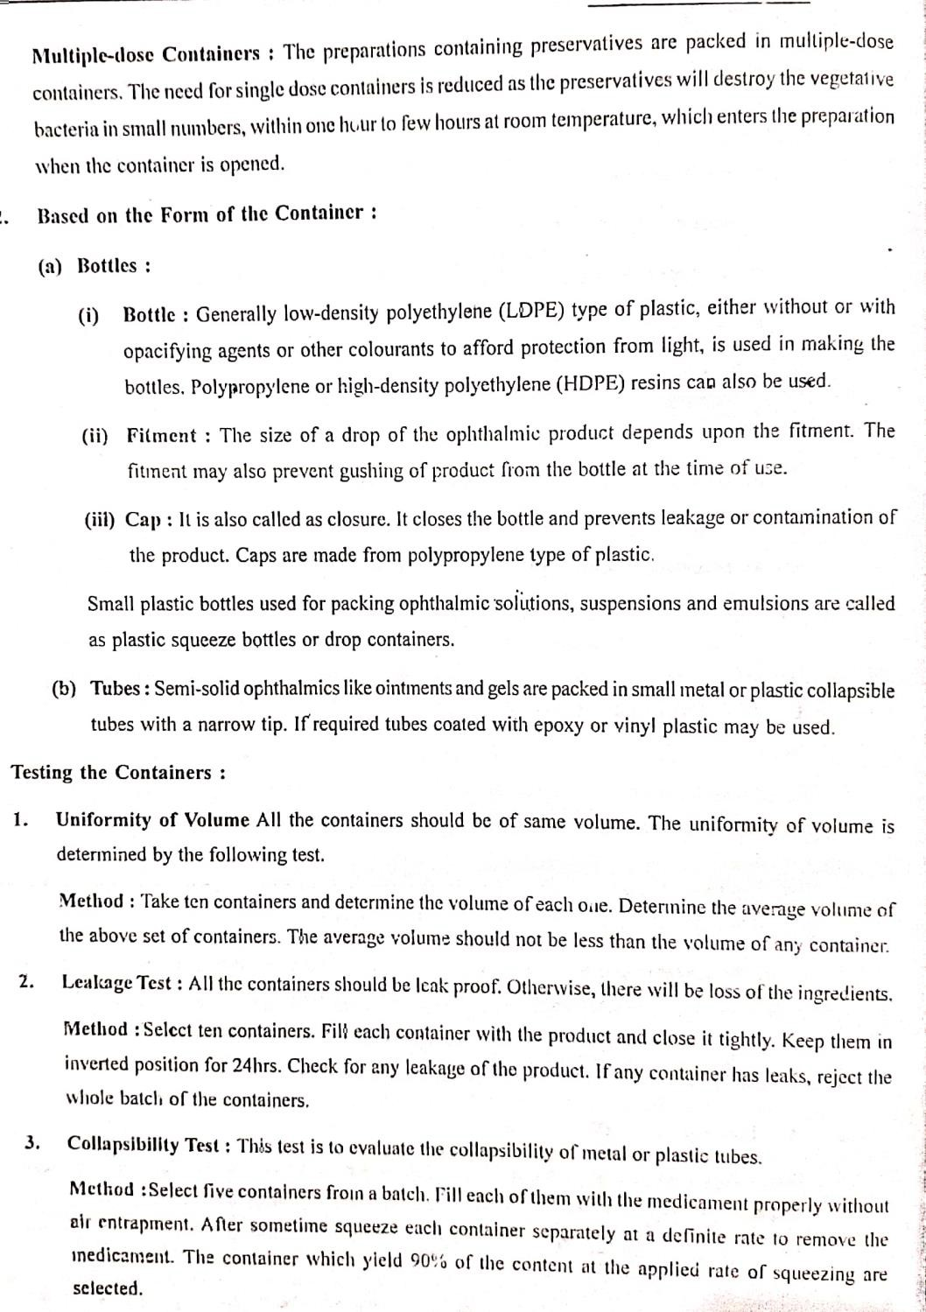

Slide 29
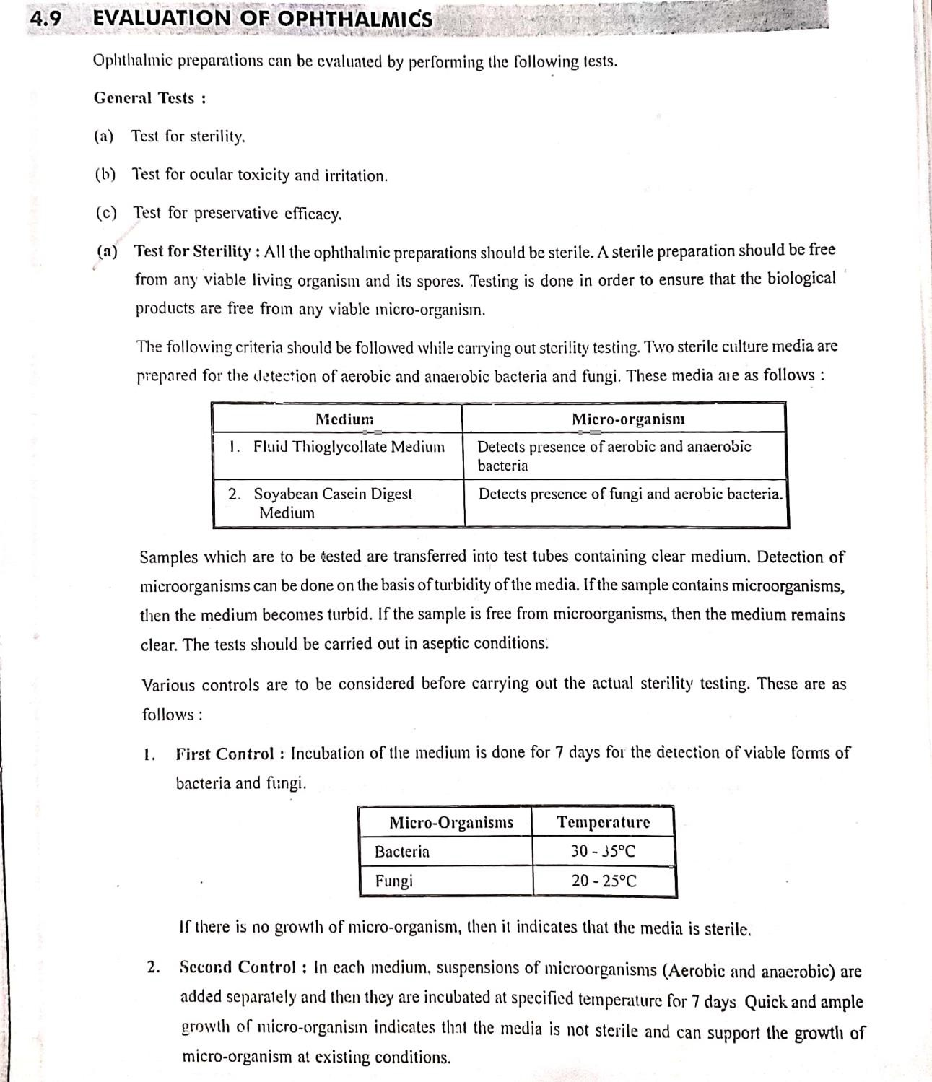

Slide 30
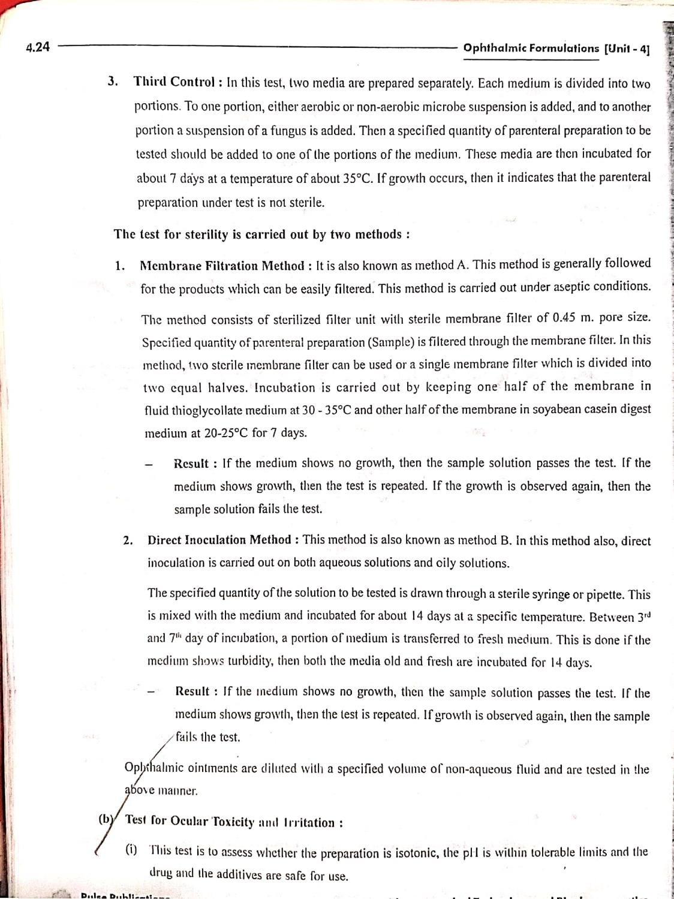

Slide 31
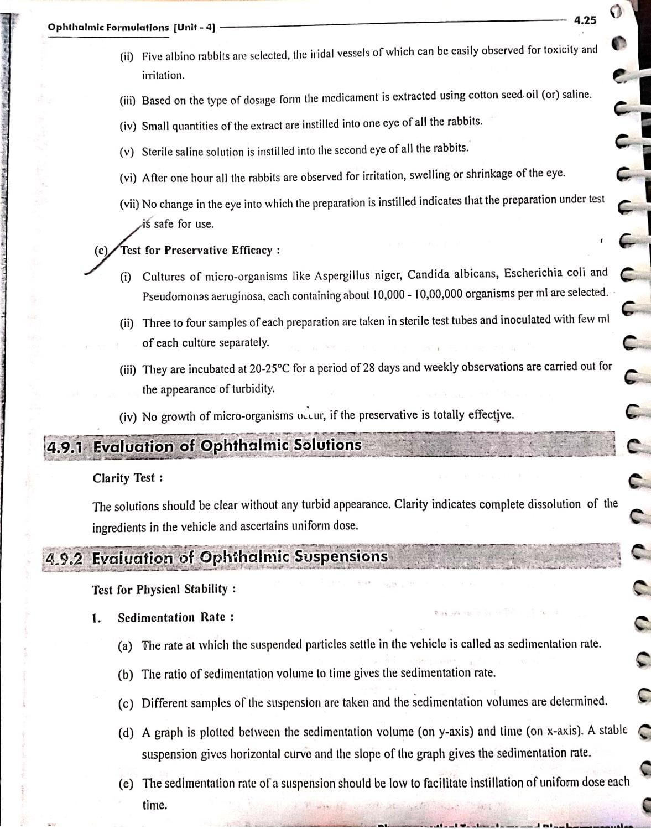

Slide 32
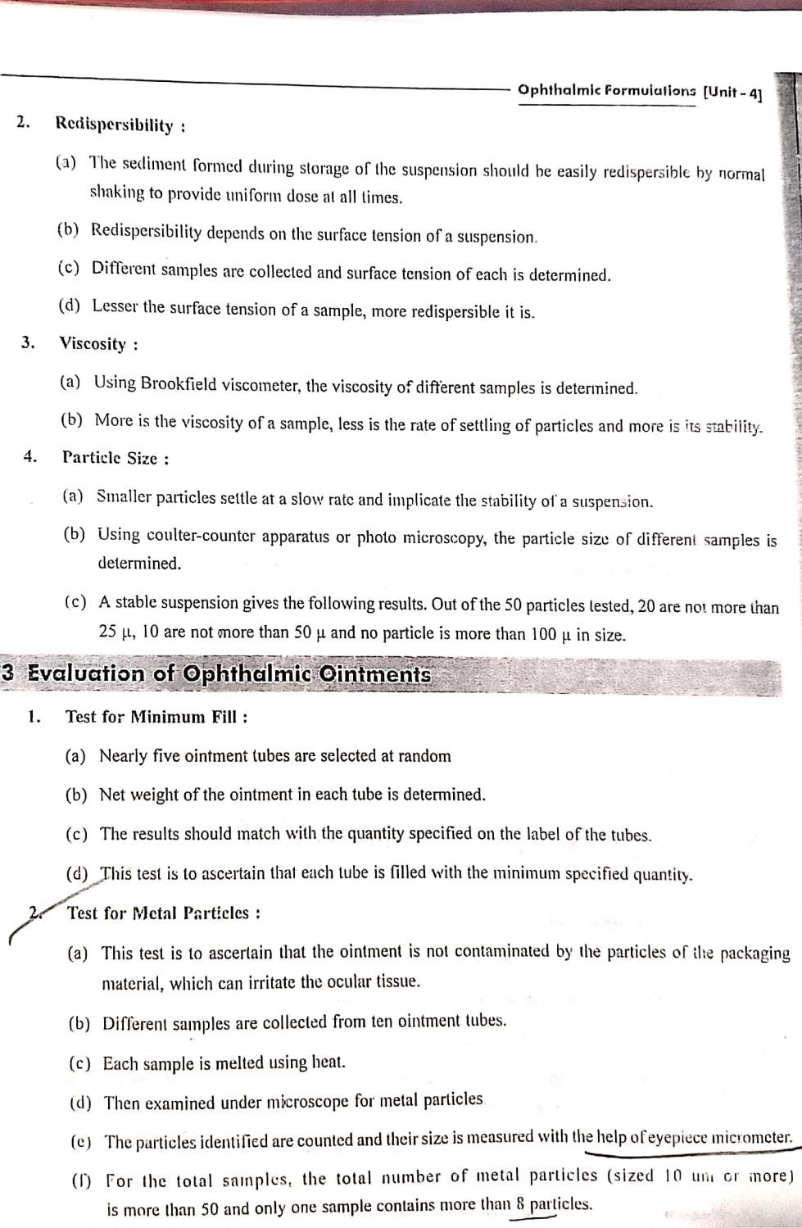

Slide 33
SKIN
The skin often has been referred to as the largest of the body organs: an average adult’s skin has a surface area of about 2 meter square .The ease with which some drugs can pass through the skin barrier into the circulating blood means that the transdermal route of medication is a possible substitute to the oral route
Skin is one of the most readily accessible organs of the human body .There are two kinds of human skin; one that is hair-less such as soles of foot and palms of hand, and the other kind which bears hair and sebaceous glands such as arms and face.

Slide 34
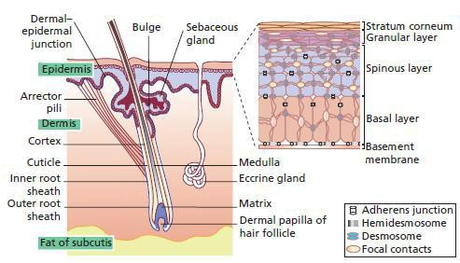

Slide 35
1) EPIDERMIS
Non-viable epidermis and viable epidermis together makes up the epidermis. Stratum corneum is known as the nonviable epidermis whereas the layer below the stratum corneum is called viable epidermis. The viable epidermis is made of various sublayers of epidermis which collectively is 50-100 μm thick and cells in this layer are held together by tonofibrils. Blood capillaries and nerve fibers reach the epidermis by passing through the dermis and subcutaneous fat layer. The main cell of the epidermis is the keratinocytes which make up 95% of the total cells present in the epidermis. These cells ascend from the epidermal basement membrane towards the skin surface, fashioning several definite layers during its transit. The separate layers of the epidermis are formed by the differing stages of keratin maturation. The epidermis has the following sublayers:
(a) Stratum basale (basal cell layer)
It is the deepest sublayer of the epidermis and is composed of a single layer of basal cells. Keratinocytes are produced in this sublayer. Stratum basale forms the boundary to the dermis. It holds approximately 8% of the water in the epidermis. With aging, stratum basale becomes thinner and loses the ability to retain water. Melanocytes also lie in this layer.

Slide 36
Stratum spinosum (prickle cell layer)
It refers to the 10 to 20 layers that lie on top of the basal cell layer. Basal cells, through the process of turn-over, make their shape somewhat flatter and form these layers. These cells are hence called prickle cells and have little spines on the outside of their membrane. The thickness of this sublayer is from 50 to 150 μm
Stratum granulosum(granular cell layer)
It is composed of 2 to 4 granular cell layers. The thickness of this layer is 3 μm. In this sublayer, cornification or keratinization of keratinocytes begins. In this process, organelles such as nuclei and mitochondria start to resolve. Cells become increasingly filled with keratin fibers and contain less moisture as compared to basal and prickle cell layers. The shape of these cells becomes much flatter during this process.
Stratum lucidum (clear layer)
It can only be found in soles and palms. Its cells become flatter and more densely
packed during turn-over.

Slide 37
Stratum corneum (horny layer)
The outermost layer of the skin, the stratum corneum, is responsible for the barrier function of the skin. It is also known as non-viable epidermis. The stratum corneum is 10-15 μm in thickness and is made up of dead flattened corneocytes which is surrounded by an extracellular matrix of lipid. Corneocytes are the final product of mortal differentiation of epidermal keratinocytes, and are constantly renewed. It also helps to regulate the exchange of moisture and oxygen with the external environment. The chief route of permeation is around the corneocytes. Therefore, the larger the size of corneocytes the longer will be the route for the permeation.
Corneocyte size relies upon the site on the body e.g. the size of corneocyte is smaller in the skin of the face as compared to the arm. The cells are joined together by desmosomes which maintains the cohesiveness of the layer.
The stratum corneum is composed of approximately 40% protein, mostly keratin, and 40% water, with the balance of lipid components. On the surface of the skin is a film of emulsified material which is composed of a complex blend of sweat, sebum, and desquamating cells of epidermis. However, this layer offers little obstruction for the drug to permeate . The major lipid classes in human stratum corneum involve
ceramides, cholesterol and saturated long chain fatty acids. Another essential
37
com^{V}p^{ISH}o^{AL}n^{C}e^{S,R}n^{RC}t^{P}of stratum corneum is water which acts as a plasticizer and prevents cracking and provides flexibility

Slide 38
2) Dermis
Once drug molecule is through the stratum corneum, it may pass through the deeper epidermal tissues and enter into the dermis. It is mainly made of fibrous tissues and is 1-2 mm thick. The dermis has a rich supply of blood vessels from where the drug gets absorbed into the general circulation . Sebaceous glands, sweat glands, and hair follicles rises to the surface of the skin from dermis and subcutaneous layer where they originates.
The skin surface of human is recognized to contain an average of 10-70 hair follicles and 200-250 sweat glands on every centimeter square of the skin area10. The dermis has
the following sublayers.
Papillary layer
It is the upper sublayer of the dermis that clearly segregates from the epidermis. Papillary
layer is a loosely connected tissue and includes a large amount of nerve fibers,
capillaries, water and cells (e.g. fibroblasts). In this sublayer, collagen fibers form a finer network than those of the reticular layer.

Slide 39
Reticularlayer
It constitutes the lower part of the dermis and represents a continuous transition to the subcutis or hypodermis. Reticular layer has a denser and thicker network as compared to the papillary layer and includes fewer nerve fibers and capillaries. In this sublayer, collagen fibers are aggregated into thick bundles which are mostly aligned parallel to the surface of skin.
Hypodermis
Subcutis, or hypodermis in histology, is the third layer beneath the dermis. Subcutis is an elastic layer and includes a large amount of fat cells that work as a shock absorber for blood vessels and nerve endings. The thickness of this layer is 4 to 9 mm on average. However, the actual thickness differs from person to person and it also depends on the body region.

Slide 40
FACTORS AFFECTINGSURFACE DRUG ABSORPTION THROUGH SKIN
Many factors affect how the application of a particular drug will be absorbed by the skin surface.
Skin Permeability:- Because the skin has an oily secretion, medication applied to the skin surface is absorbed best if such medication is suspended or dissolved in oily media. Drugs combined with inorganic substances such as petroleum are not absorbed as well as drugs combined with synthetic ointment bases that are like sebaceous secretions.
Drug Particle Size :- The size of the particles in the medication is an important factor in skin absorption. Very little absorption takes place if the particles in the skin medication are large and insoluble; for example, as in zinc oxide ointment. On the other hand, a great deal of absorption takes place when a solution such as oil of wintergreen in olive oil or in a lanolin base is rubbed on the skin.

Slide 41
C) Degree of Skin Hydration.
Medication is absorbed by the skin better if the cornified layer (the top layer of the epidermis) is moist. Ointments soften the skin by wetting it, thus allowing the medication in the ointment to be absorbed into the skin easily.
Another way to get moisture into the skin is to use an occlusive dressing over the skin lesion. An occlusive dressing is a dressing that prevents the loss of moisture from the skin's surface. This type of dressing can be made by placing an airtight plastic film over the medicated skin. Moisture is kept in the skin allowing the medicine to be absorbed into the skin. If a corticosteroid medication has been used, this medication will reduce skin inflammation faster. The occlusive dressing has kept moisture on the skin as well as prevented the medication from evaporating.

Slide 42
D) Contact Time
Absorption of medication on the skin is increased if the medication is in contact with the skin for longer periods of time. Since all disease organisms are not killed at the same time, there is a gradual decrease in the number of organisms. The longer the medication is on the skin lesions, the more organisms will be killed.
E) pH
The pH of skin is normally acidic, ranging from pH 4 to pH 6.36 whereas the internal environment has a near neutral pH which ranges from 7-9. Historically, it was thought that acidic pH provides defensive mechanism against microbes. The pH of skin is responsible for regulating permeability barrier and ensures integrity and cohesion of stratum corneum.
The pH of the skin can affect the percutaneous penetration of the amount of unionized drug available for absorption. According to the pH-partition hypothesis, only the unionized form of the drug can permeate through the lipid barrier in significant

Slide 43
F)Molecular weight
The percutaneous absorption is inversely proportional to the molecular weight of the drug. It may affect the diffusion coefficient of the respective drug. The preferred molecular weight for transdermal drug delivery system of drug by passive diffusion is less than 500 Dalton however the rate of permeation may be increased by use of various penetration enhancers.
Partition coefficient
Log P or partition coefficient is essential to determine the distribution of drug within an organism to exert its biological activity. Hydrophilic drugs are poorly absorbed when applied topically, due to low partitioning through the lipid matrix of the stratum corneum. Cutaneous blood flow rapidly clears the absorbed drug, which may result in low tissue levels.
Body site
According to the studies conducted the smallest number of cells in the stratum corneum was found to be in genital areas and the largest number of cells was in the heel.

Slide 44
Blood flow
The absorption of drug may be limited by the blood flow through the dermis. For example, if a drug having vasoconstriction activity is given through any other route, it will significantly affect the blood flow through the skin and hence the drug clearance for transdermal drug delivery system.
Hydration
The penetration rate of most of the drugs is increased by hydration of the stratum corneum. It does so by opening up the compacted structure of horny layer of stratum corneum thus enhancing the bioavailability of the drug. Impermeable films prevent surface loss of water from the skin which increases the hydration of stratum corneum thereby decreasing the diffusional path length.

Slide 45
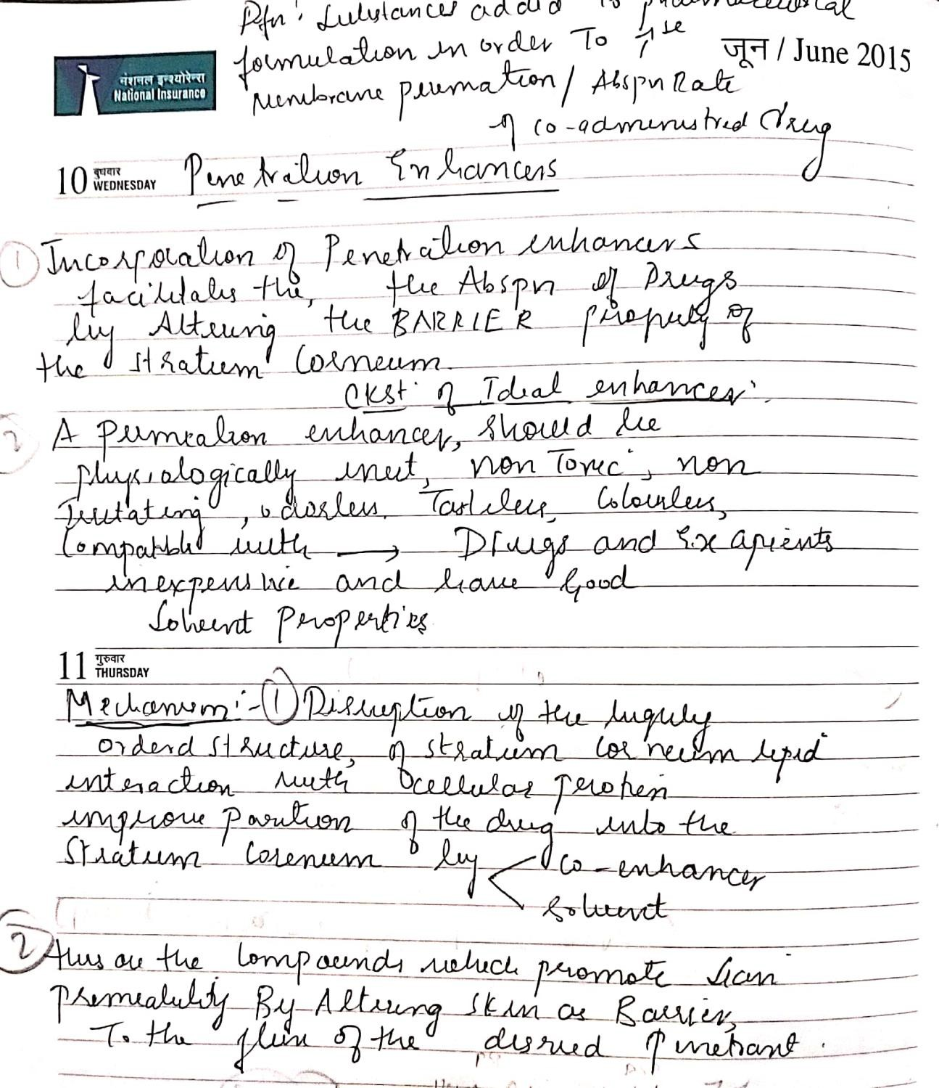

Slide 46
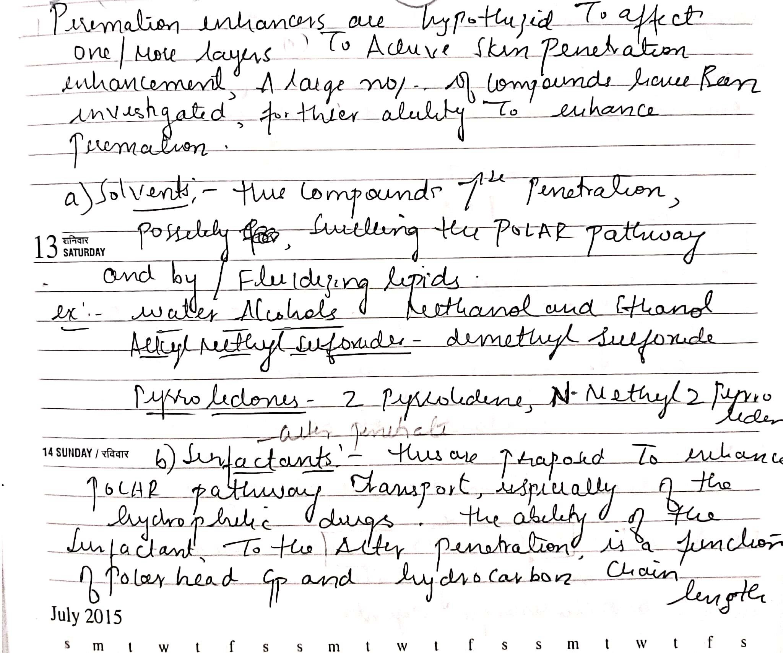

Slide 47
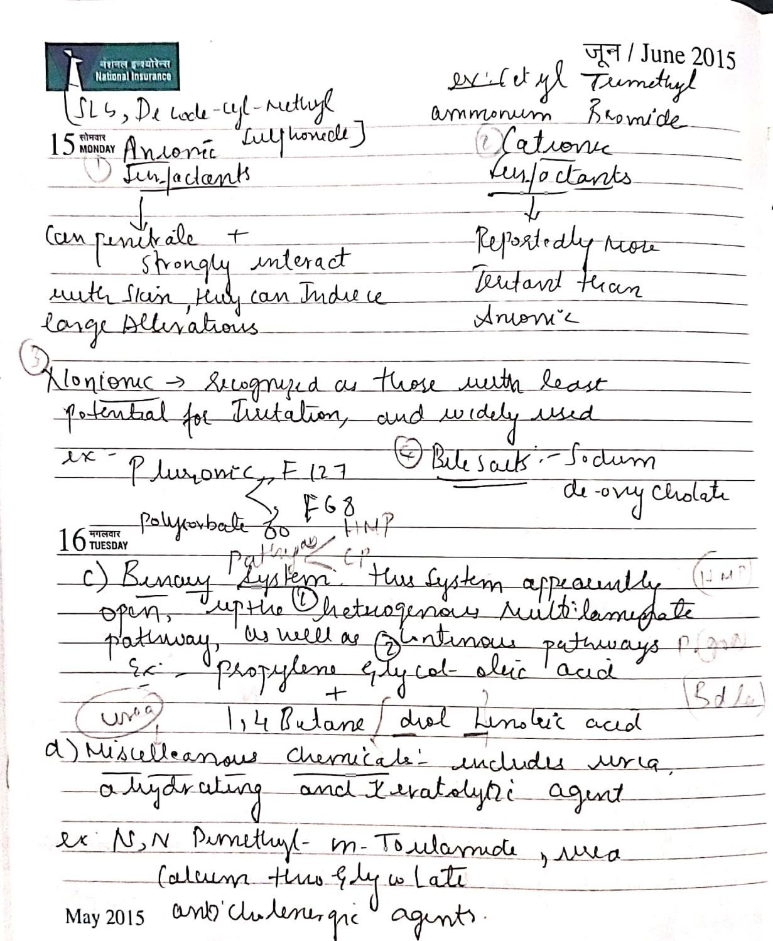

Slide 48
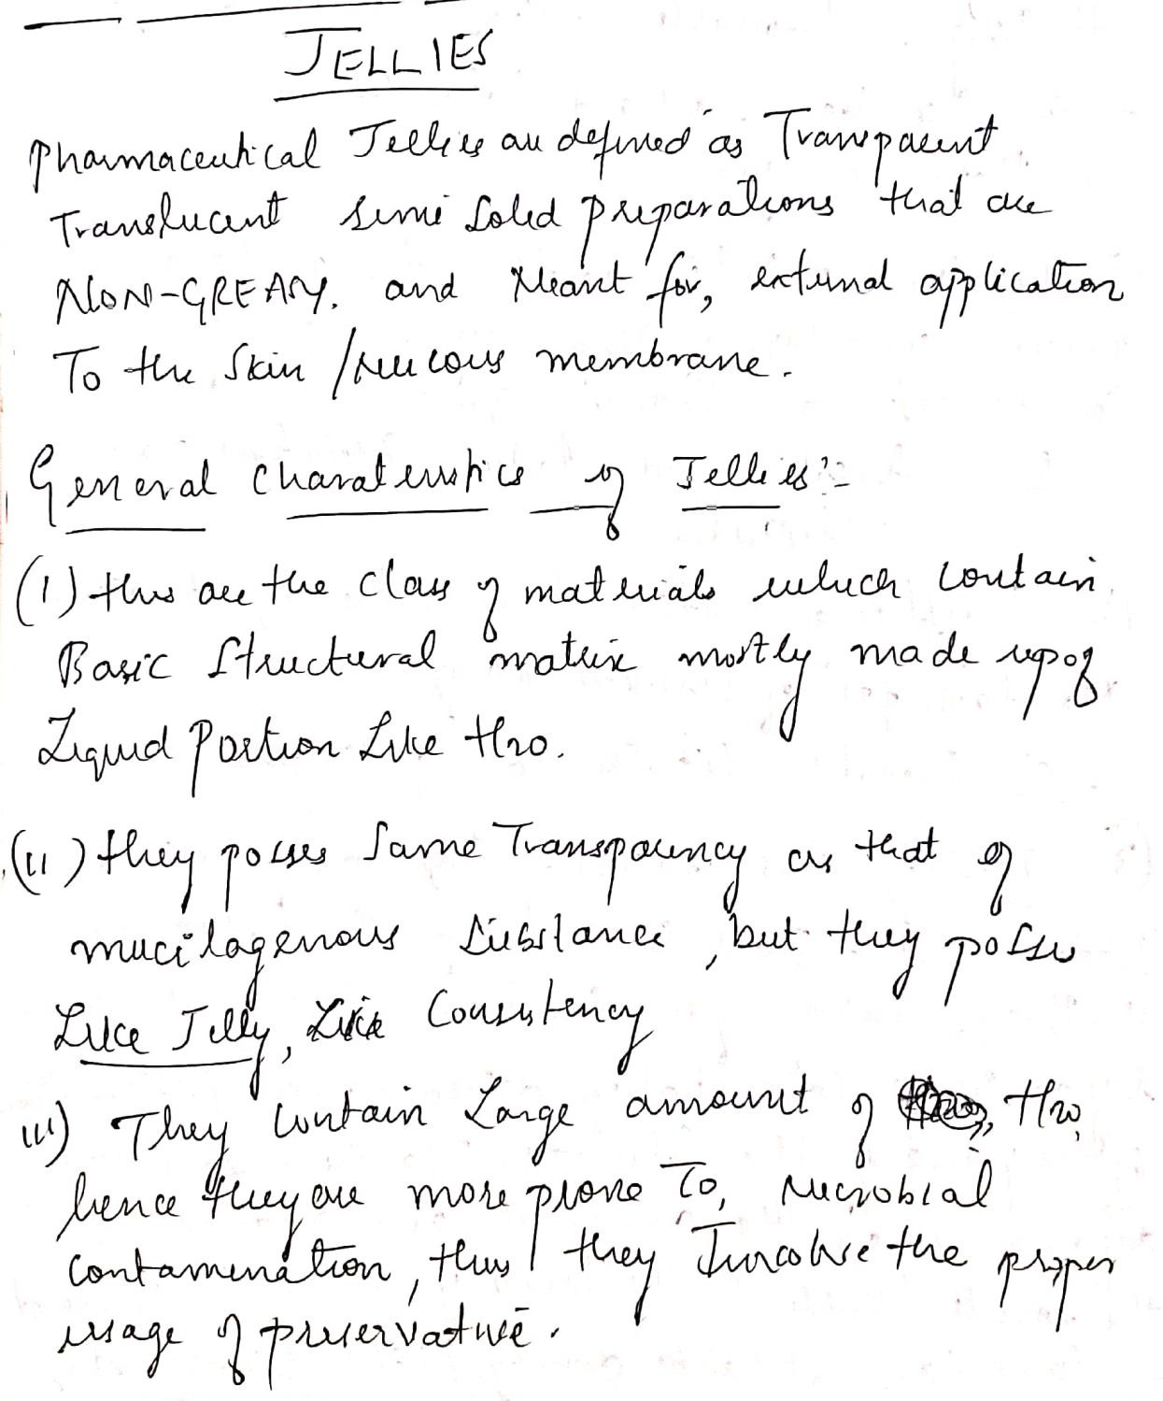
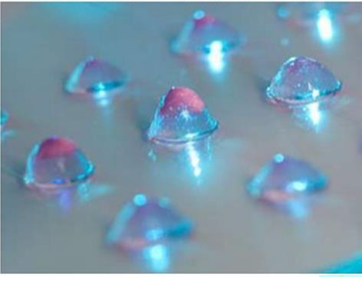

Slide 49
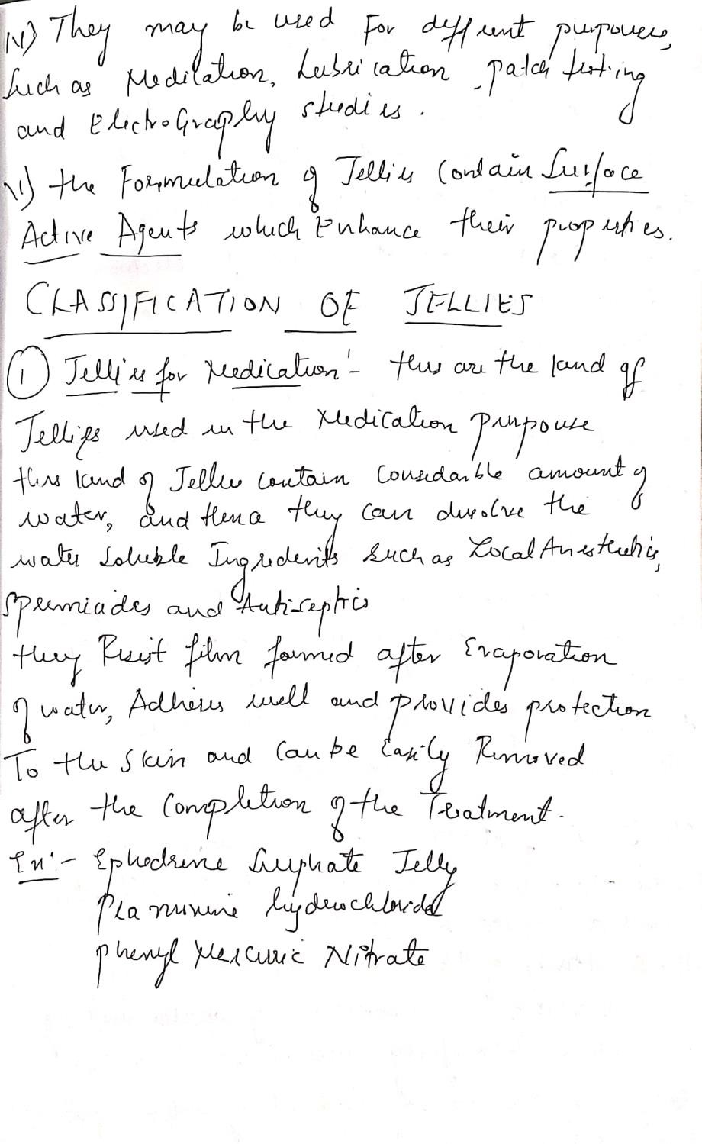

Slide 50
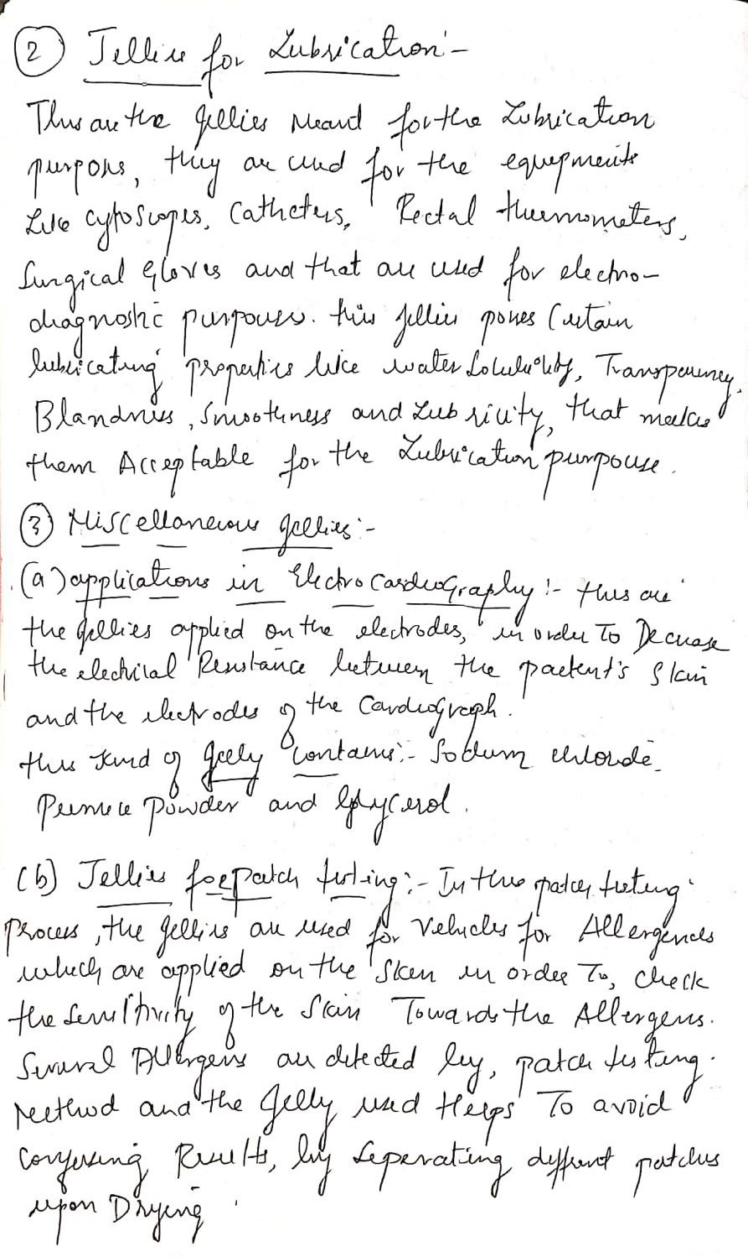

Slide 51
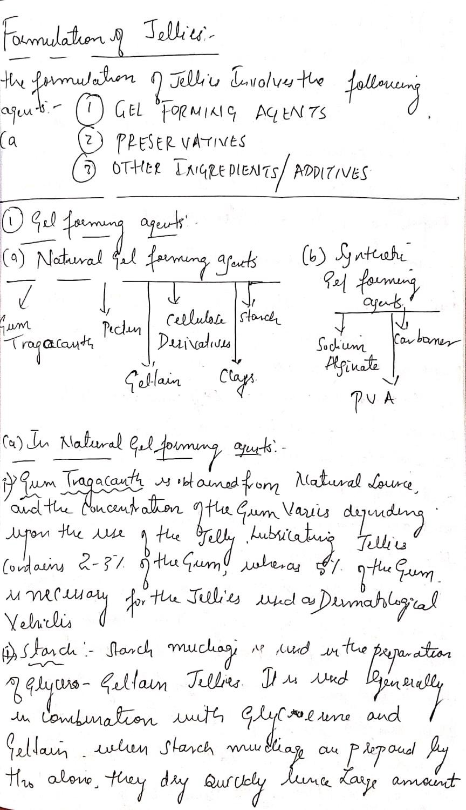

Slide 52
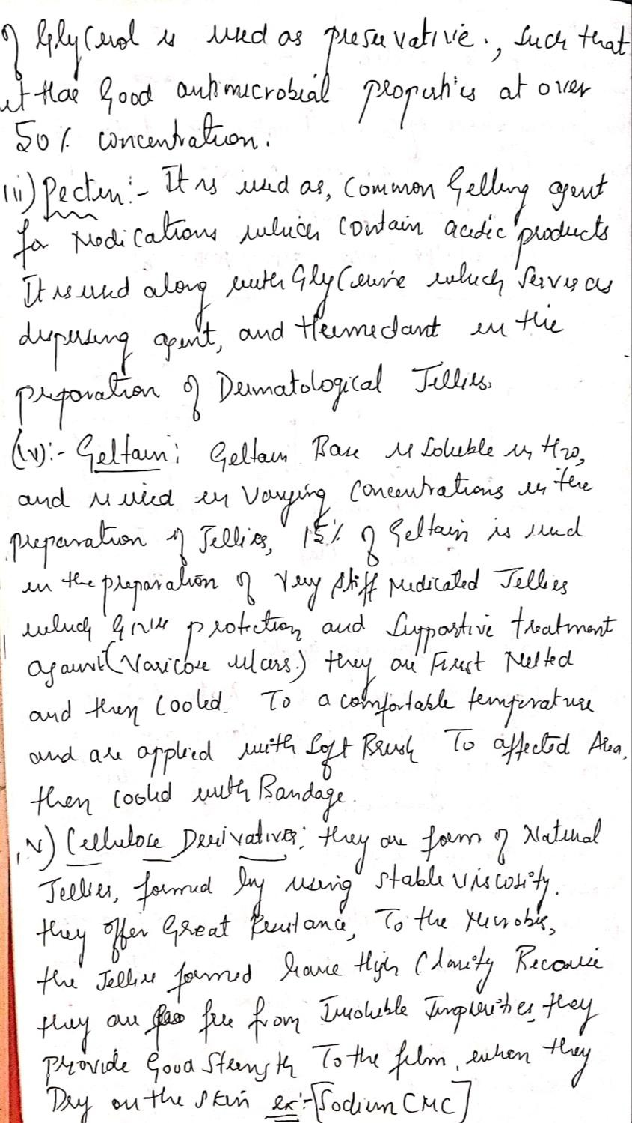

Slide 53
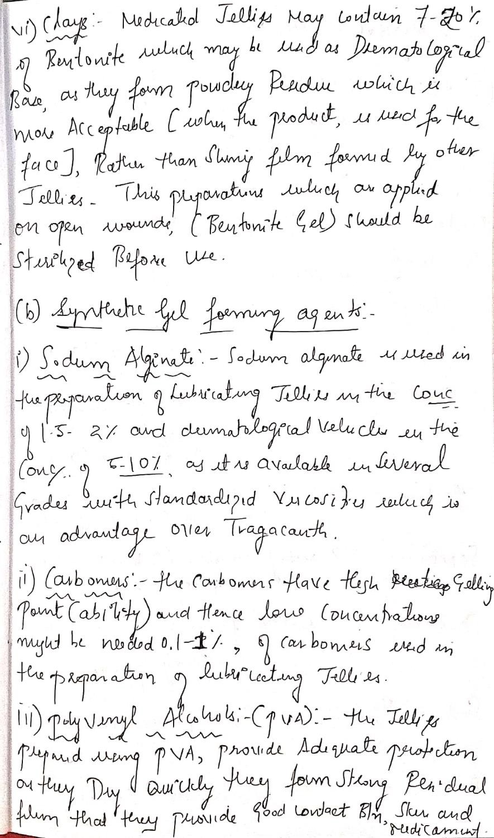

Slide 54
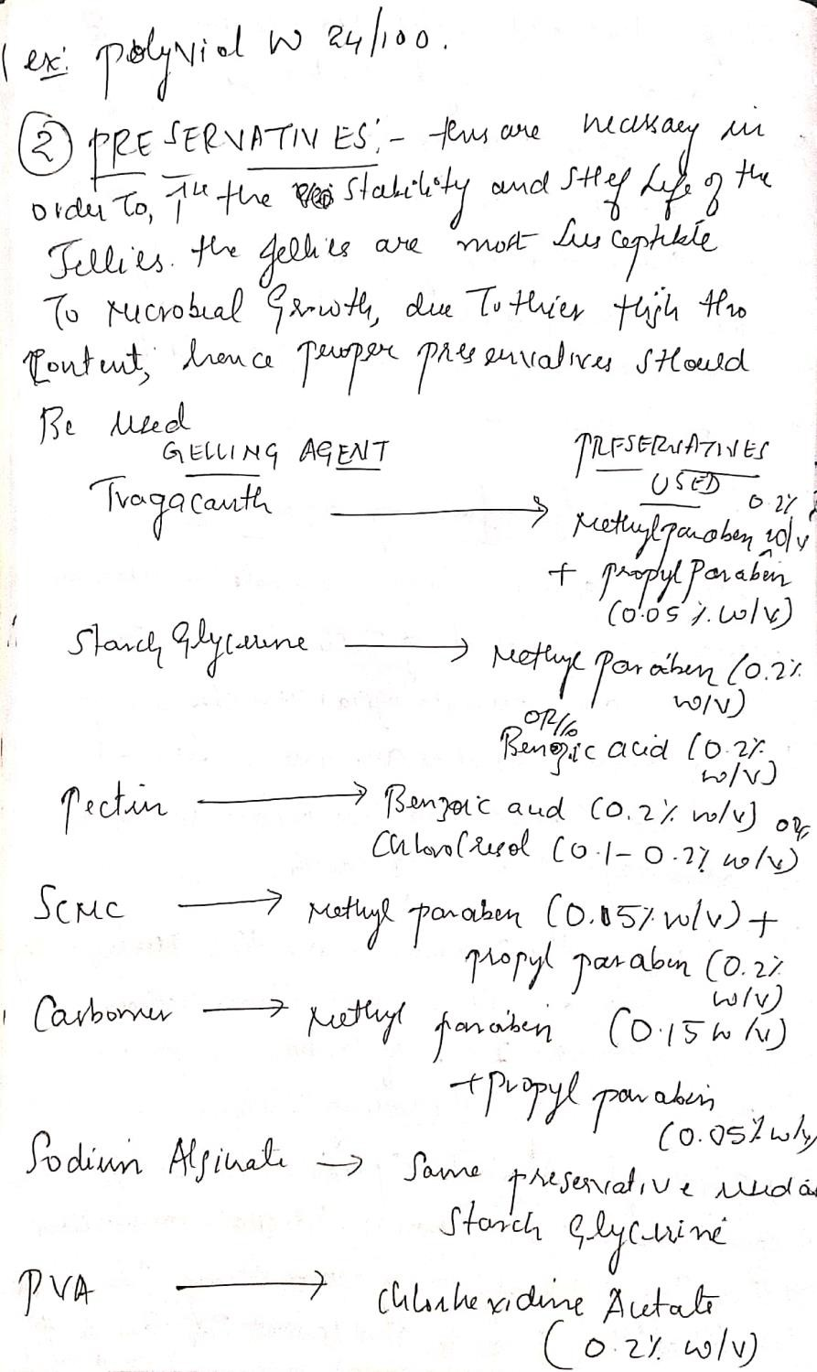

Slide 55
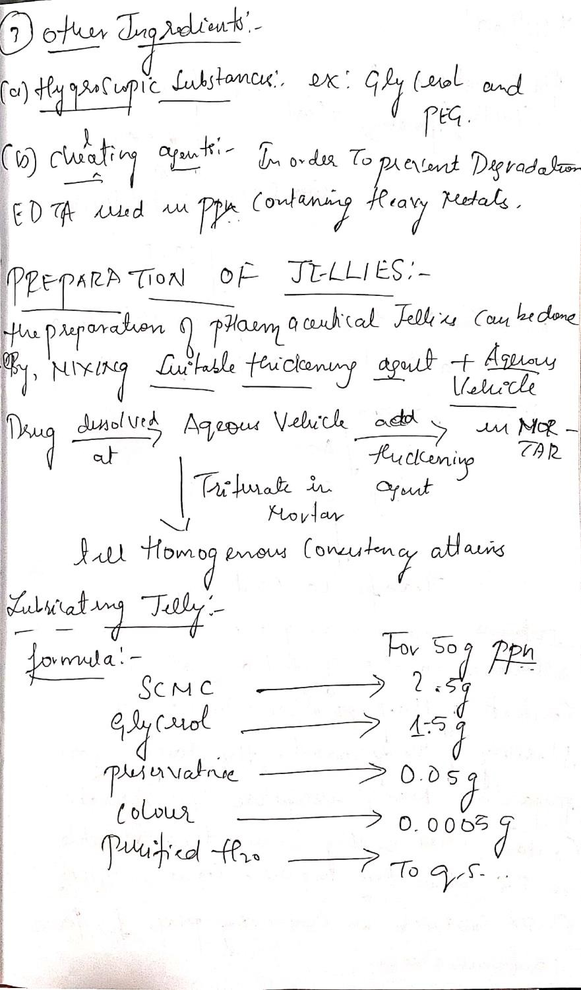

Slide 56
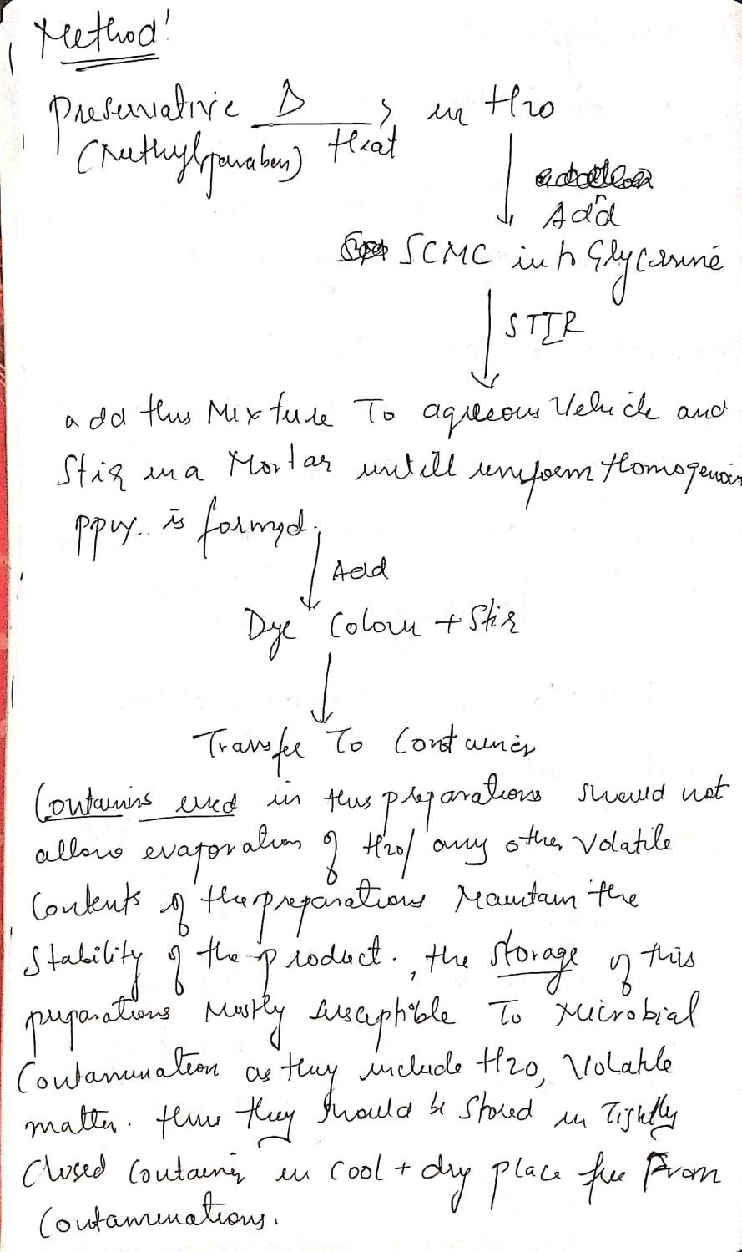

Slide 57
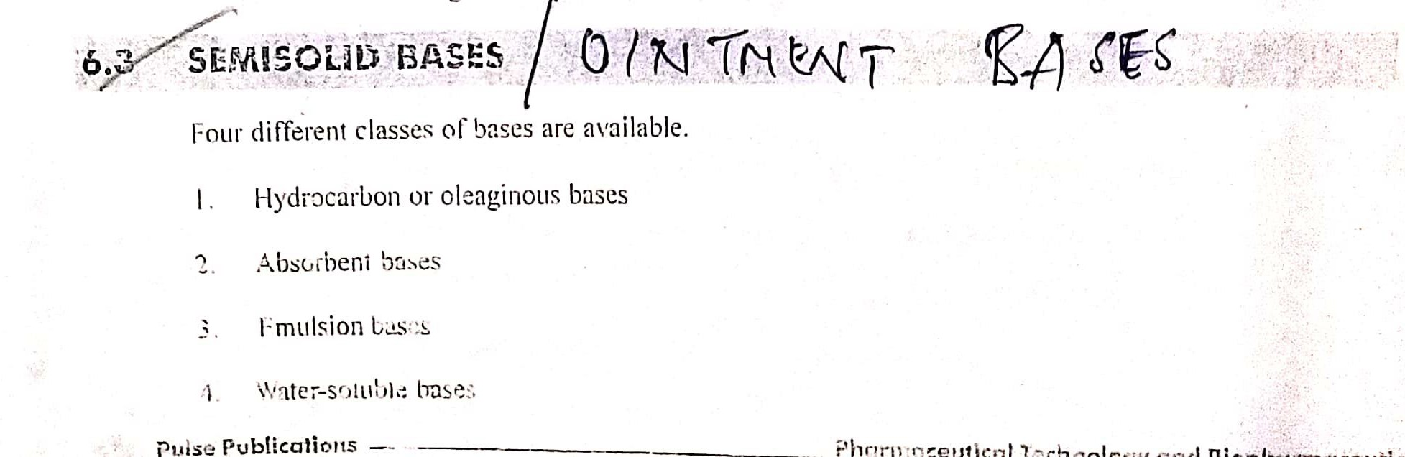

Slide 58
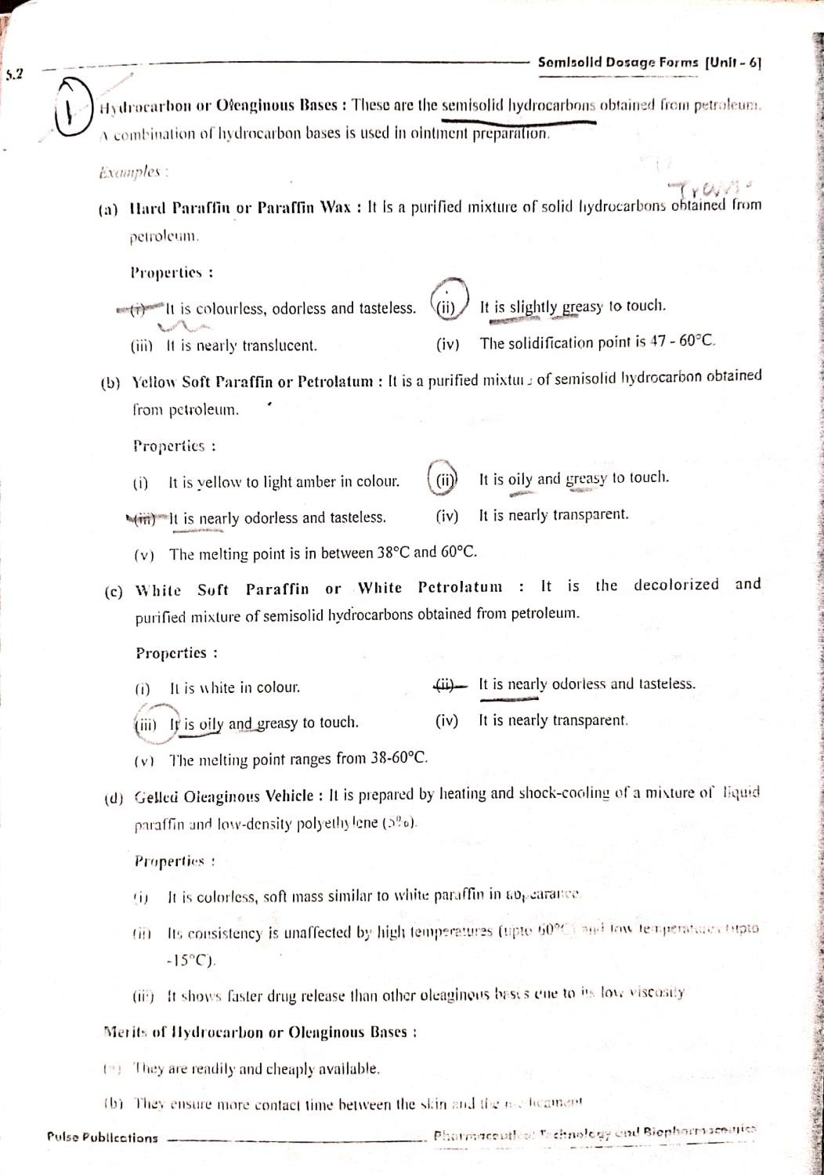

Slide 59
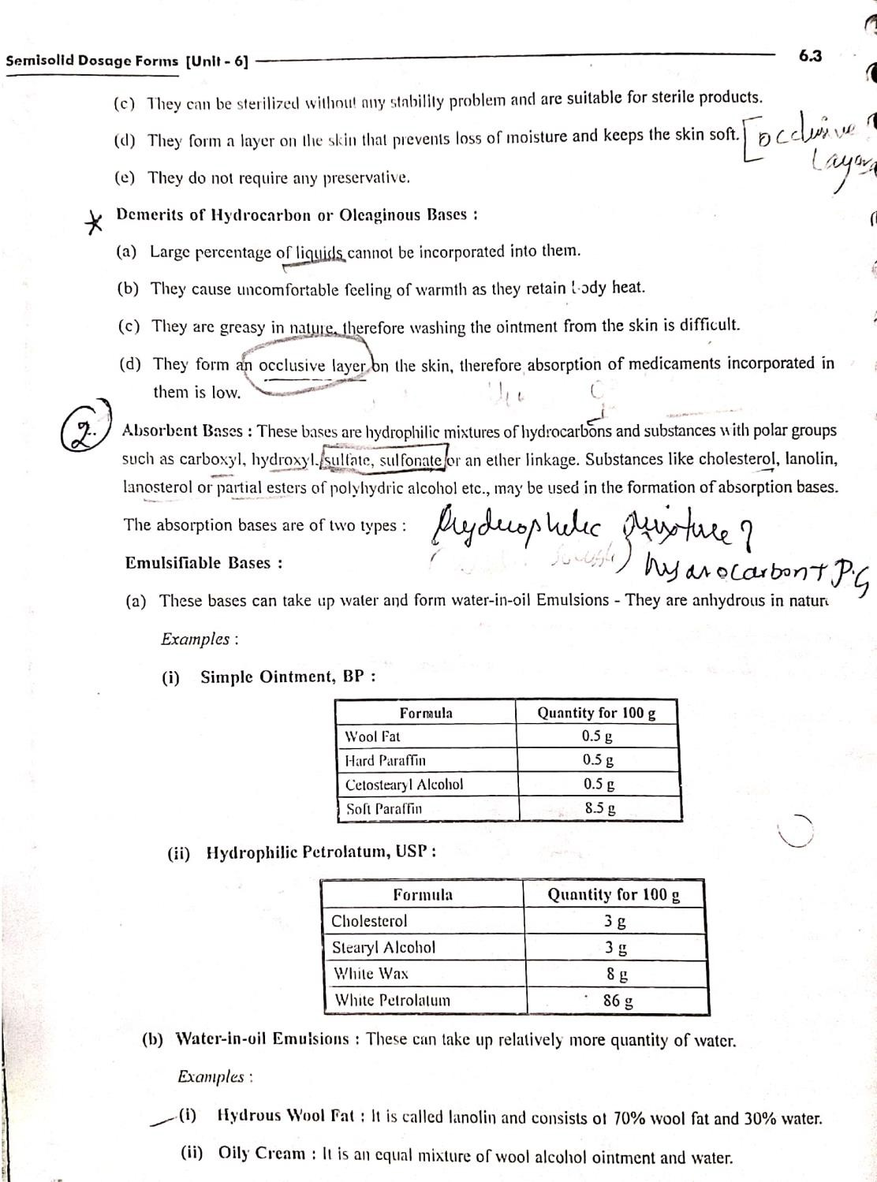

Slide 60
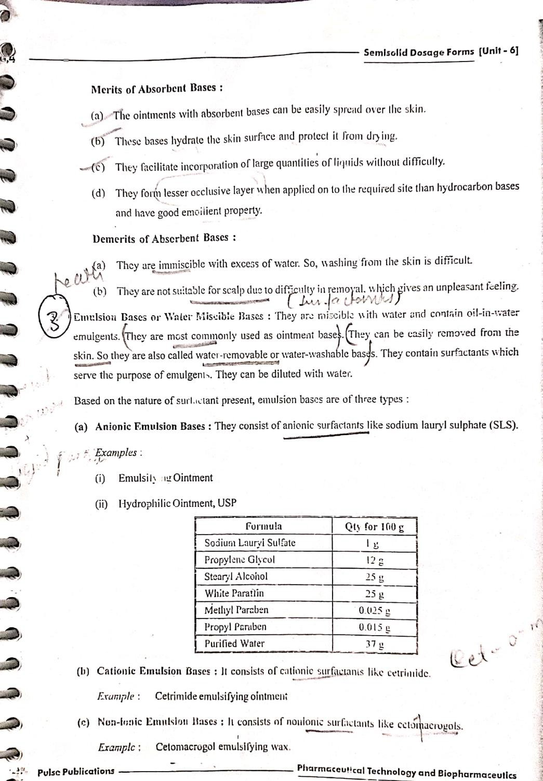

Slide 61
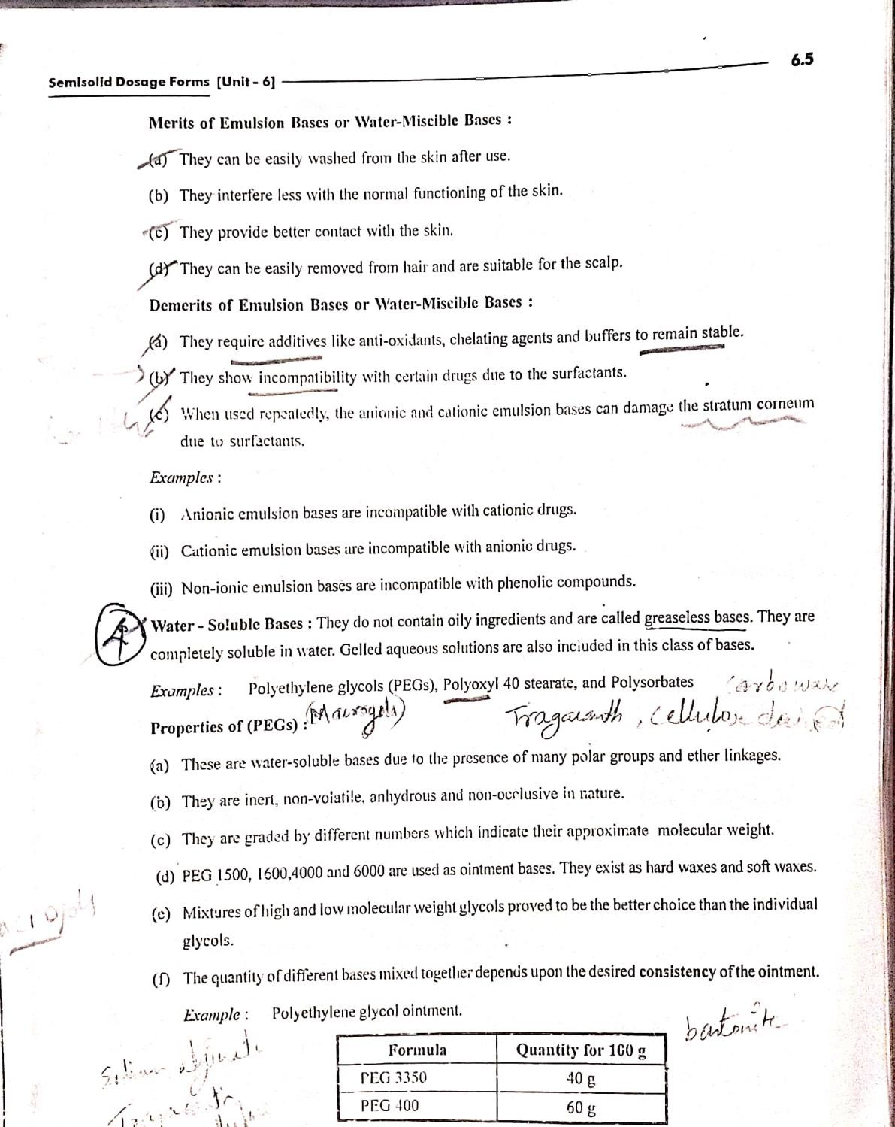

Slide 62
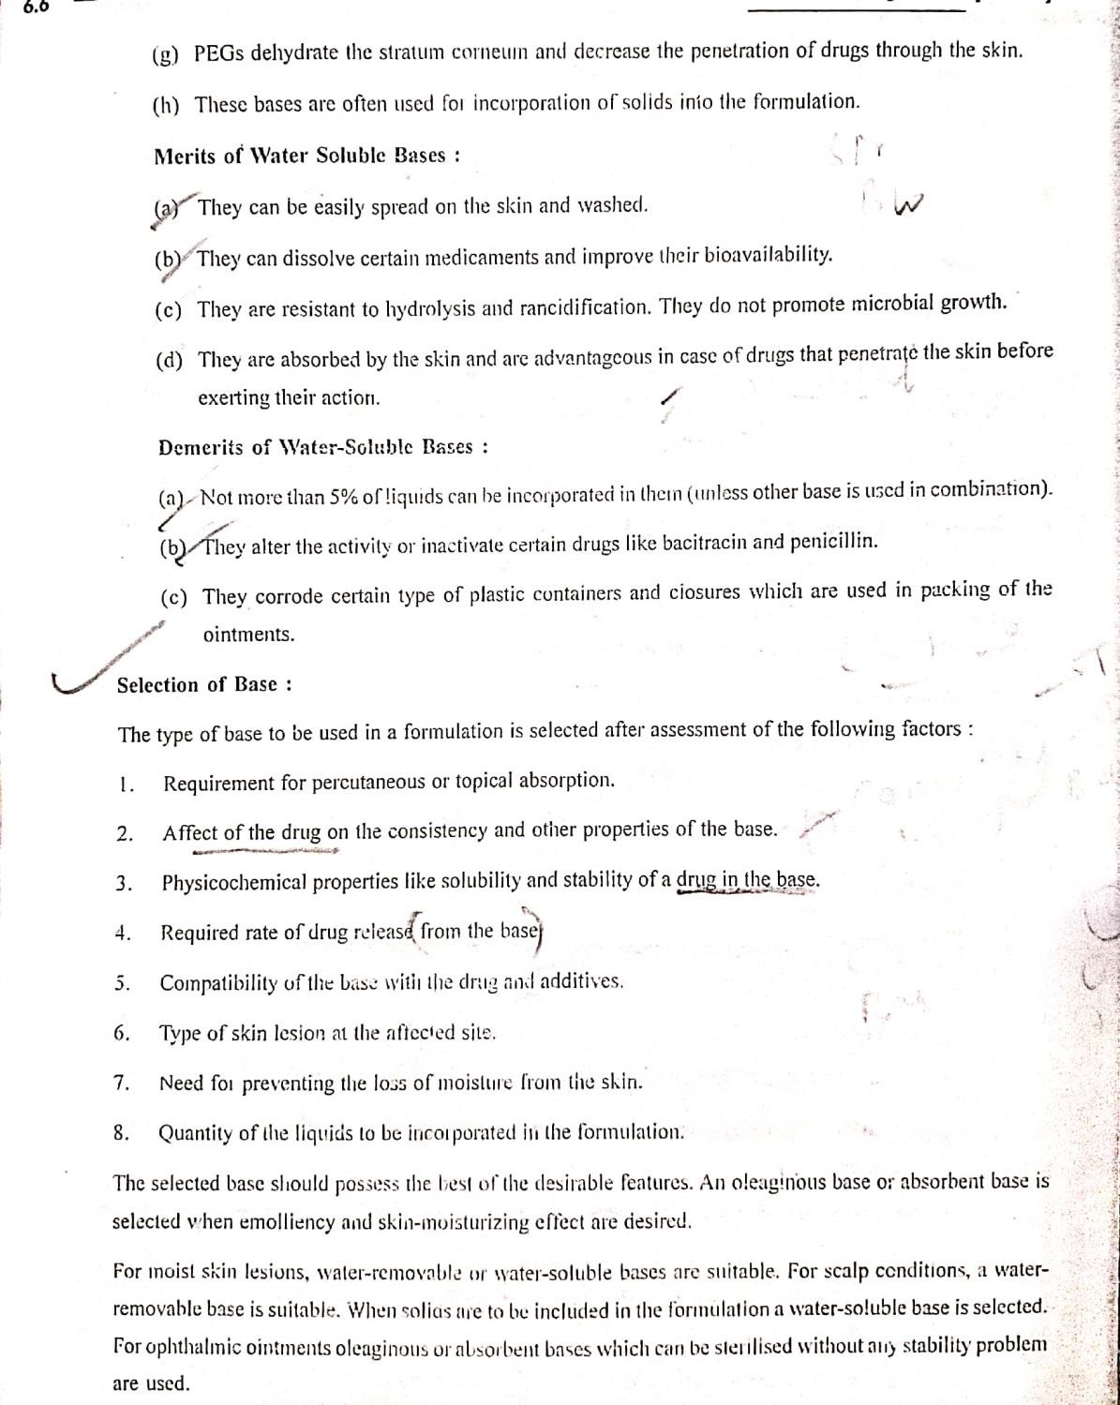

Slide 63
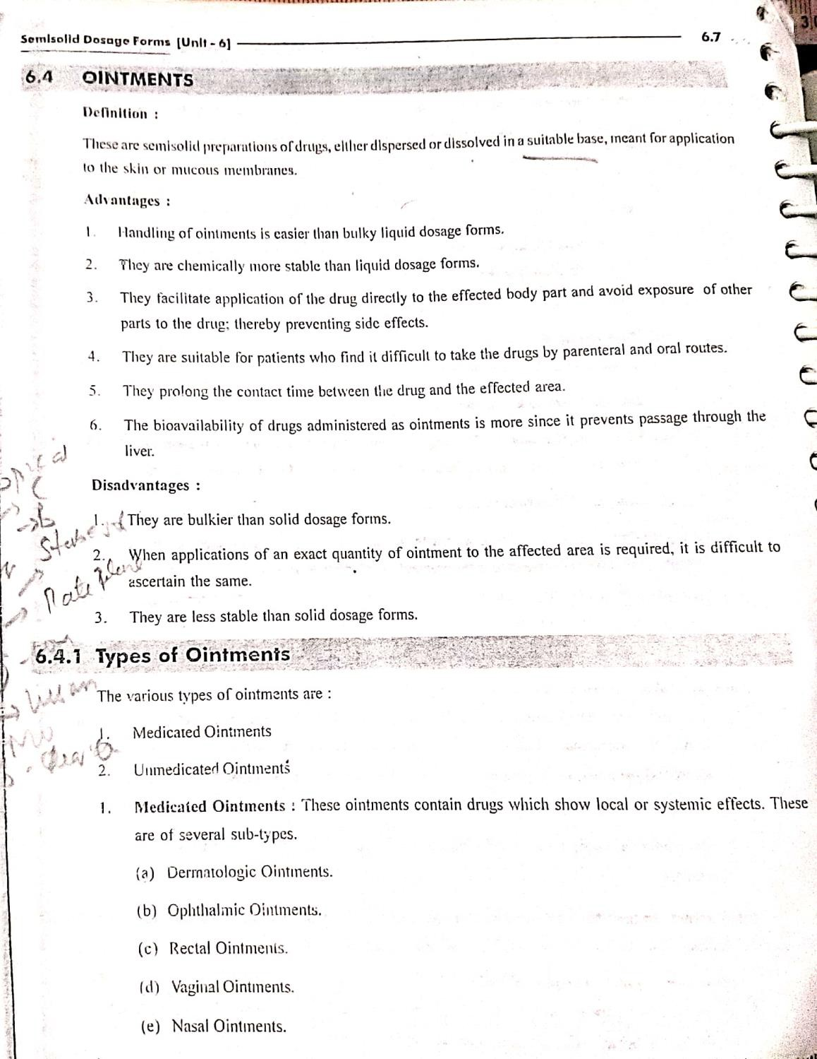

Slide 64
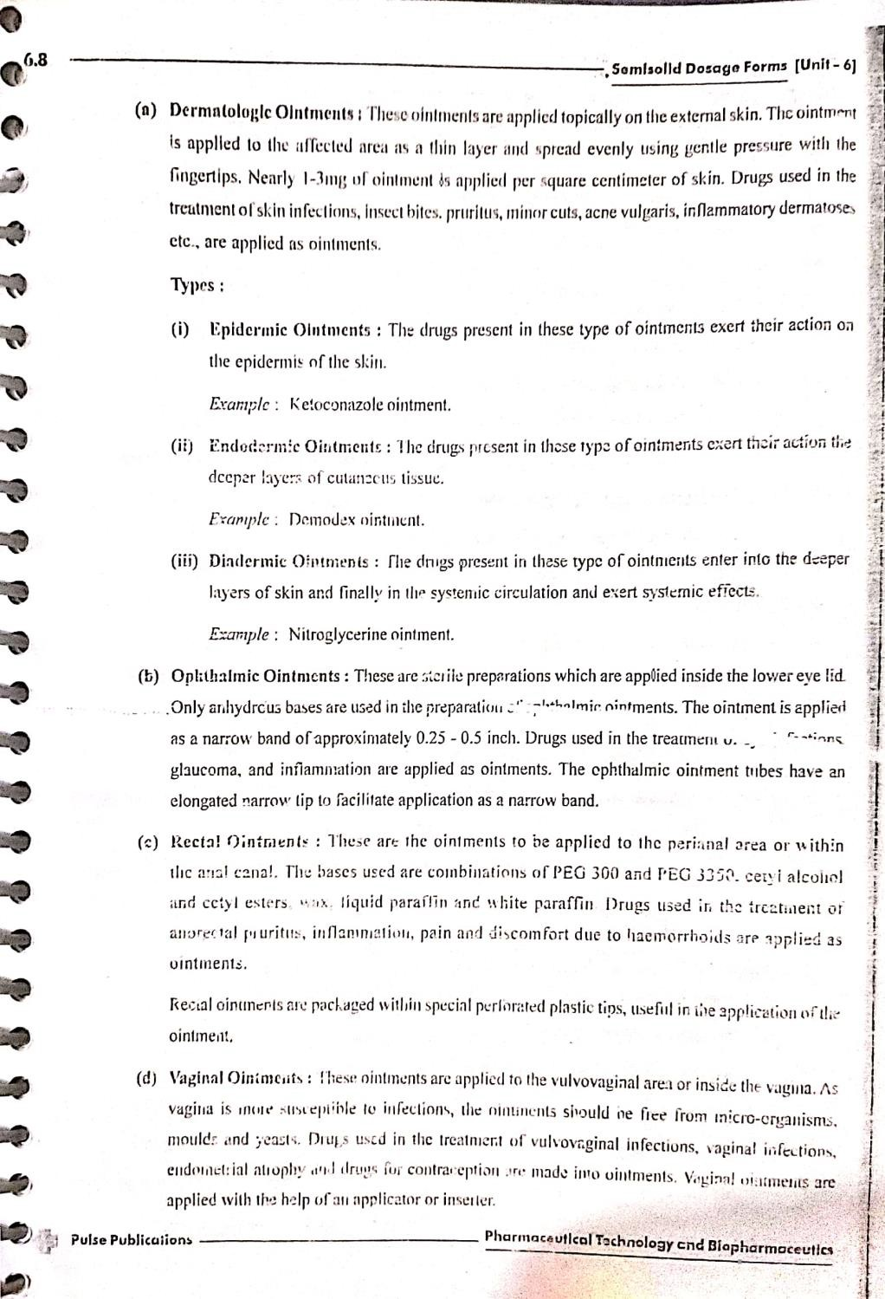

Slide 65
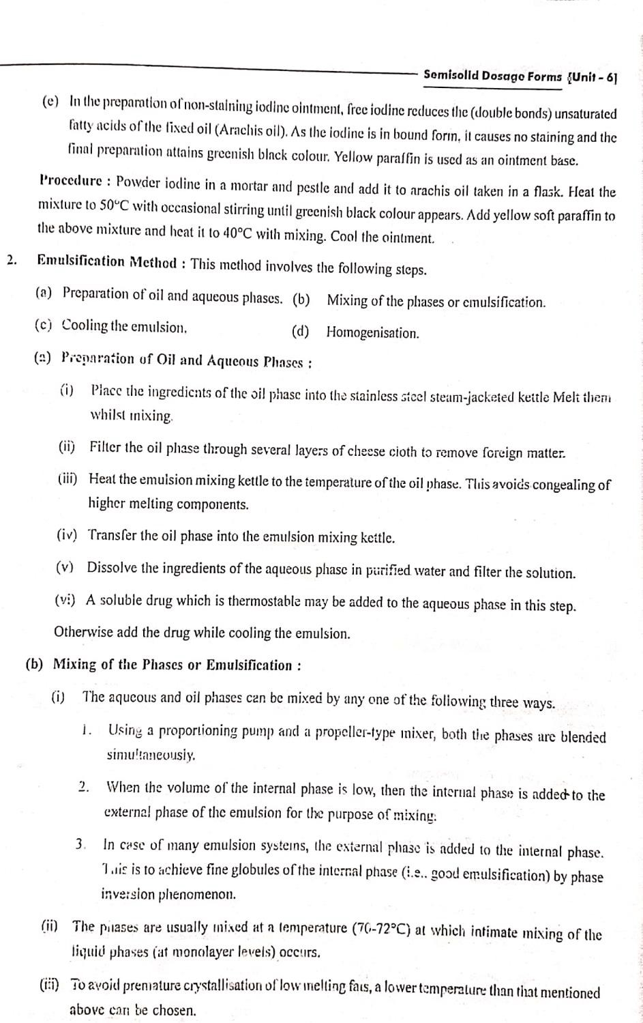

Slide 66


Slide 67


Slide 68


Slide 70


Slide 71


Slide 72


Slide 73

SUPPOSITORIES
The term suppositories have its origin in Latin and means, “to place under”. Suppositories
are a medicated solid dosage form intended for insertion into the body orifices.
Suppositories and creams are the two main modes of administration of drugs through the rectum. They are used to deliver both systemically acting and locally-acting medications. The general principle is that the suppositories is inserted as a solid, and dissolve or melt inside the body to deliver the medicine pseudo received
by the many blood vessels that follow the larger intestine. The suppository was first used in nursing facilities to be administered elderly patients who were not capable of
taking medications. Suppositories come in various sizes and shapes which facilitate their insertion and retention in the cavity

Slide 74


Slide 75


Slide 76


Slide 77


Slide 78


Slide 79


Slide 80


Slide 81


Slide 82
Suppositories can be extemporaneously prepared by :-
Hand Rolling
It is the oldest and simplest method of suppository preparation and may be used when only a few suppositories are to be prepared in a cocoa butter base. It has the advantage of avoiding the necessity of heating the cocoa butter. A plastic-like mass is prepared by triturating grated cocoa butter and active ingredients in mortar. The mass is formed into a ball in the palm of the hands, and then rolled into a uniform cylinder with a large spatula or small flat board on a pill tile. The cylinder is then cut into the appropriate number of pieces which are rolled on one end to produce a conical shape. Effective hand rolling requires considerable practice and skill. The suppository "pipe" or cylinder tends to crack or hollow in the center, especially when the mass is insufficiently kneaded and softened.
Compression Molding
It is a method of preparing suppositories from a mixed mass of grated suppository base and medicaments which is forced into a special compression mold. The method requires that the capacity of the molds first be determined by compressing a small amount of the base into the dies and weighing the finished suppositories. When active ingredients are added, it is
necesVIsSHaArL yCS,tRRoCPomit a portion of the suppository base based on the density factors of the active ingredients.
82

Slide 83
III) Fusion Molding
It involves first melting the suppository base and then dispersing or dissolving the drug in the melted base. The mixture is removed from the heat and poured into a suppository mold. When the mixture has congealed the suppositories are removed from the mold. The fusion method can be used with all types of suppositories and must be used with most of them. When they are mixed, melted and poured into suppository mold cavities they occupy a volume – the volume of the mold cavity. Since the components are measured by weight but compounded by volume density calculations and mold calibrations are required to provide accurate doses.
Double Casting Technique
The total quantity of drug is mixed with an amount of base which is inadequate to fill the number of cavities. The mixture is poured into the mold partially filling each cavity and the remaining portion of the cavities is filled with the melted blank base. The cooled suppositories are then removed, re melted, mixed and recast to evenly distribute the active ingredient. By recording the necessary information the pharmacist can determine the weight of base displaced by the drug and then calculate the density factor.

Slide 84


Slide 85


Slide 86


