Slide 1
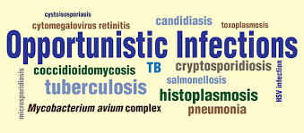
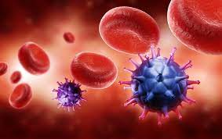
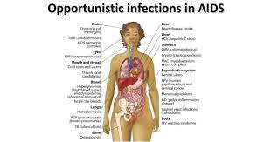
Opportunistic Infection
Infection Disease
By Animesh Das

Slide 2
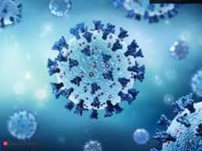

Definition
These are infection that occur more often , sever in people with weakness of their immune system than a healthy person immune system . And it is caused by verity germs like Virus , Bacteria , Fungi , Parasites .
Causative Agent --viruses, bacteria, fungi, and parasites

Slide 3
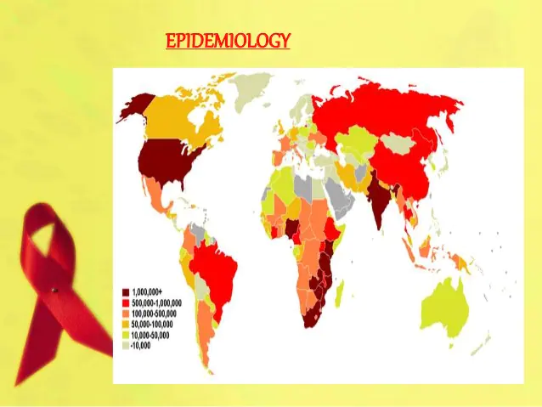
Epidemiology
many species , including Enter cytozoon bieneusi .risk greatest with CD4 count < 100 cells .
Incidence dramatically lower in countries with widespread use of effective .
Opportunistic Zone – India , Africa , Russia , south America .

Slide 4
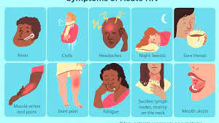
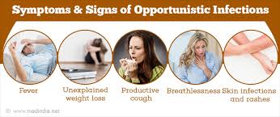
Sings and symptoms
Coma.
Coughing and shortness of breath.
Difficult or painful swallowing.
Extreme fatigue.
Fever.
Mental symptoms such as confusion and forgetfulness.
Nausea, abdominal cramps and vomiting.
Seizures and lack of coordination

Slide 5
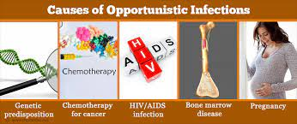
Risk factor
Age
comorbidity
immunomodulator therapy
geographic clustering

Slide 6
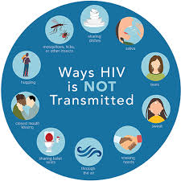
Mode of Transmission
Incubation period --Till development of AIDS
in body fluids

Slide 7
Management
Diagnosis
Treatment

Slide 8
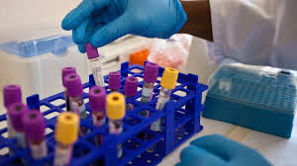

Diagnosis
Skin Scraping
mucosal Scraping
Virginal secretions
culturing blood
Microscopic observations

Slide 9
Treatment
Category | Drug Name
Antiviral | fomivirsen
Antibiotic | trimethoprim
Antifungal | clotrimazole

Slide 10
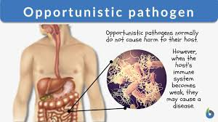
Complication
persistent diarrhoea
bacteremia
meningitis
HIV encephalopathy
disseminated CMV
systemic thrush

Slide 11

Prevention
take HIV medication daily
Stay in regular HIV care
Get HIV lab test done
talk to your doctor

Slide 12
Thank
you

