Slide 1
OSTEOARTHRITIS

Slide 2
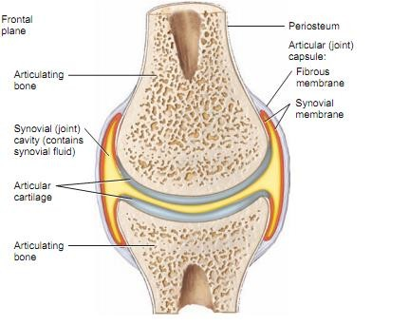

Slide 3
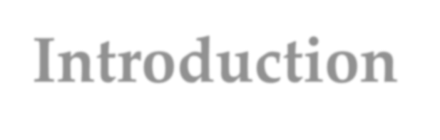
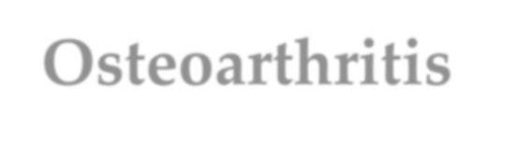
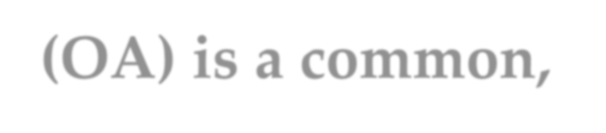
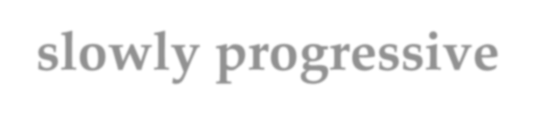

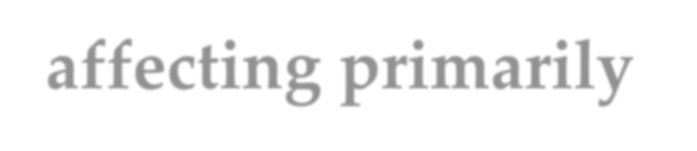
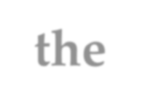



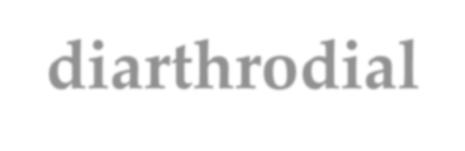

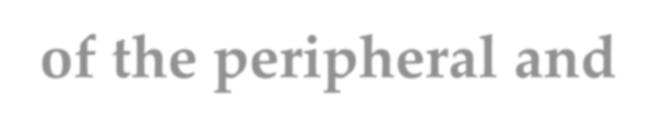
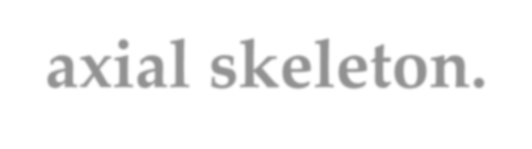
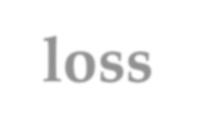
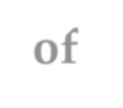



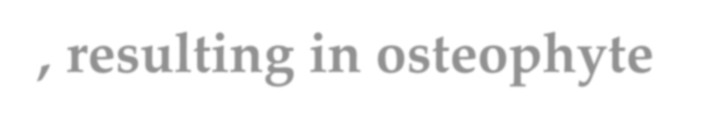
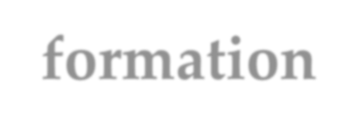

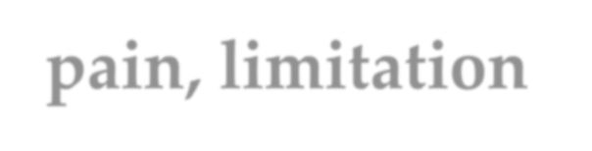
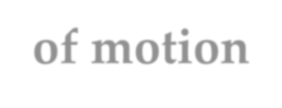
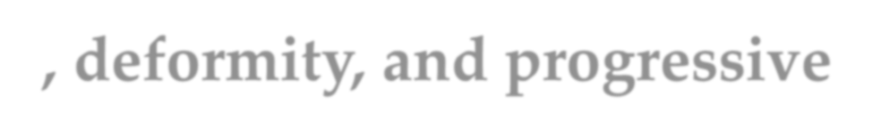
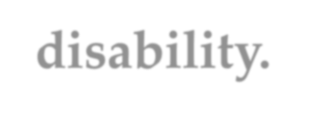
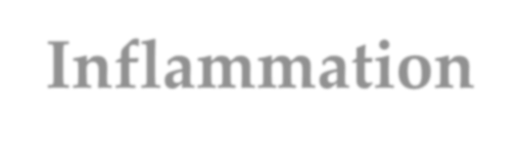
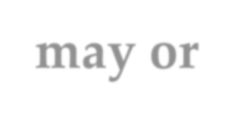



Introduction
Osteoarthritis (OA) is a common, slowly progressive disorder affecting primarily the weight-bearing diarthrodial joints of the peripheral and axial skeleton.
 It is characterized by progressive deterioration and loss of articular cartilage, resulting in osteophyte formation, pain, limitation of motion, deformity, and progressive disability.
 Inflammation may or may not be present in the affected joints.

Slide 4
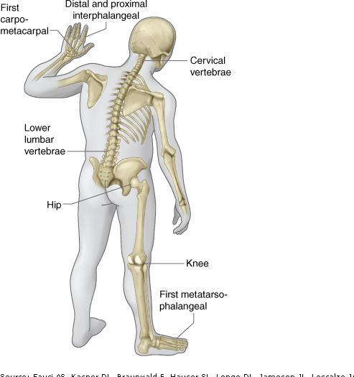

Slide 5
Previous Occupation
ETIOLOGY
Obesity
OSTEOARTHRITIS
Genetic Predisposition
Joint Trauma

Slide 6
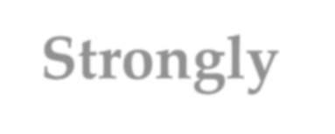
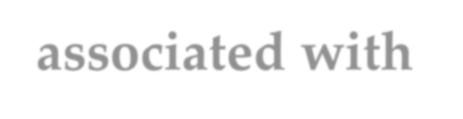

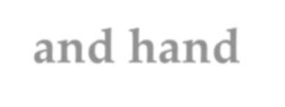

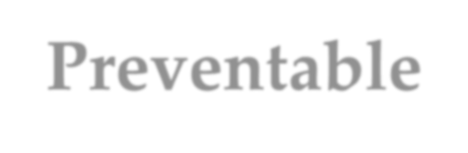
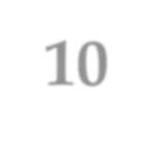
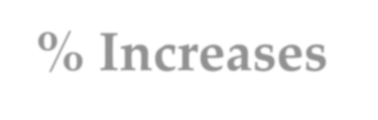
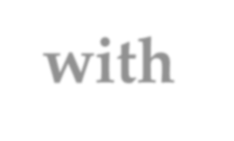

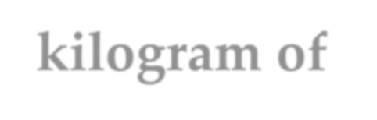
Obesity
 Strongly associated with hip, knee, and hand OA
 Preventable
 10% Increases with each additional kilogram of weight

Slide 7
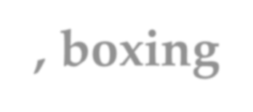

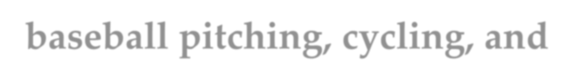
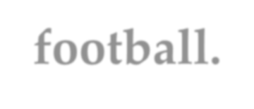
Occupation, Sports, and Trauma
 Activities involving repetitive motion or injury are at increased risk for developing OA
 OA is associated with participation in wrestling, boxing, baseball pitching, cycling, and football.

Slide 8




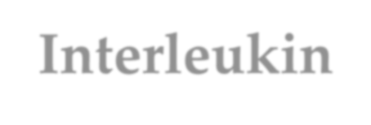
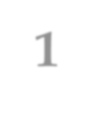
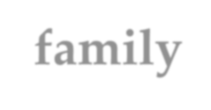



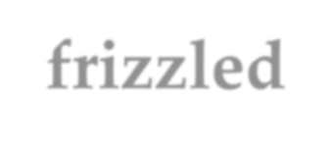




Genetic Factors
Variants in the
 Interleukin-1 family,
 Interleukin-4 receptor,
 Secreted frizzled-related protein (FRZB is a gene for a Frizzle protein) plays a critical role in matrix synthesis and joint development.
 All showed very significant associations with OA

Slide 9
 Genetic mutations in proteins that regulate the transcription of major cartilage molecules are at high risk of OA.

Slide 10








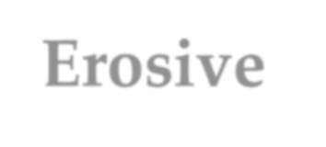
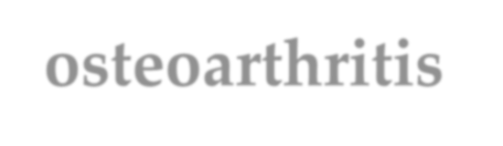
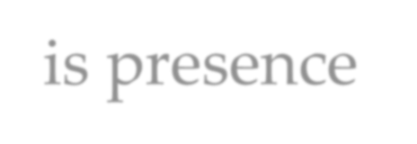
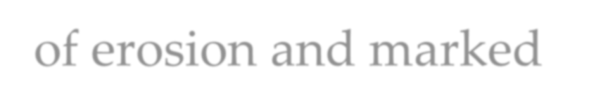
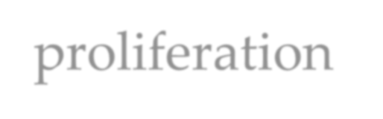
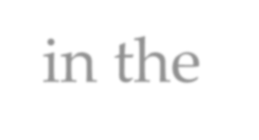
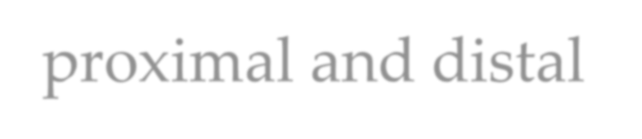


TYPES
OA
Primary OA
Secondary OA
Localized OA
Generalized OA
Erosive osteoarthritis is presence of erosion and marked proliferation in the proximal and distal interphalangeal joints of the hands

Slide 11
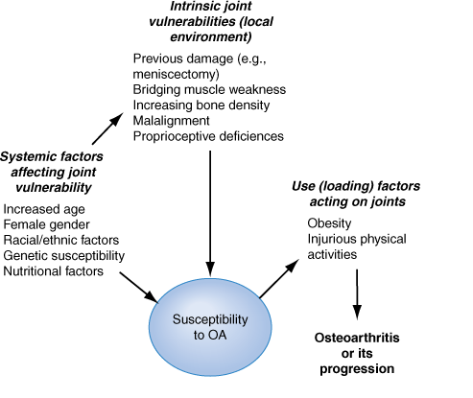
Risk Factors for OA

Slide 12
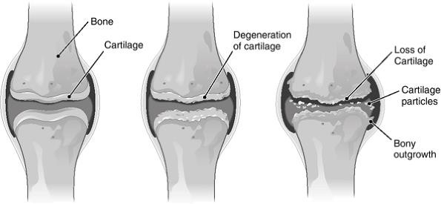

Slide 13
Cartilage function
Cartilage has 2 major molecules
 Type 2 collagen, (Provides cartilage its tensile strength)
 Aggrecan, (A proteoglycan macromolecule gives cartilage
its compressive stiffness)
 Chondrocytes, in avascular tissue, synthesize all elements of the matrix & in addition produce enzymes that break down the matrix and cytokines and growth factors.
 Cartilage matrix synthesis and catabolism are in a dynamic equilibrium influenced by the cytokine and growth factor environment and by mechanical stress

Slide 14
Cytokines
 Interleukin (IL) 1 (stimulating production of proteinases and
suppressing cartilage matrix synthesis)
 Tumor necrosis factor (TNF) ( same function as IL1)
 Cytokines also induce chondrocytes to synthesize
 Prostaglandin E₂,
 Nitric oxide (Inhibits aggrecan synthesis and enhances proteinase activity)
 Bone morphogenic protein 2 (BMP-2) (potent stimulator of anabolic activity)

Slide 15
 At early stages in the matrix response to injury cytokine stimulation may be matrix turnover ultimately, excess IL-1 triggers a process of matrix degradation
 Growth factors insulin-like growth factor type 1 stimulate anabolism by chondrocytes.

Slide 16
 Cartilage in early OA is highly metabolically active.
 In the latter situation, stimulated chondrocytes synthesize degrading enzymes & release of degraded aggrecan and type 2 collagen into cartilage and into the synovial fluid.
 Type 2 cartilage is degraded primarily by MMP-13 (collagenase 3)
 Aggrecan degradation is complex but appears to be a consequence, in part, of activation of aggrecanase 1 (ADAMTS- 4) and perhaps of MMPs.

Slide 17
 OA cartilage is characterized by
 Depletion of aggrecan,
 An unfurling of the tightly woven collagen matrix,
 Loss of type 2 collagen.
 With these changes comes increasing vulnerability of cartilage, which no longer has compressive stiffness.

Slide 18
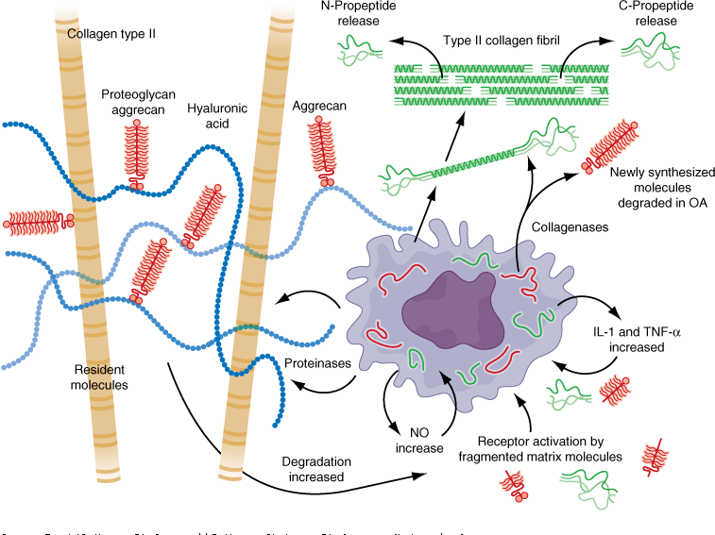

Slide 19

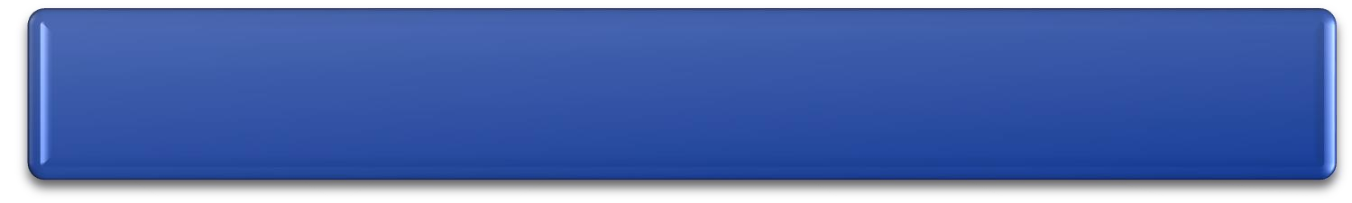

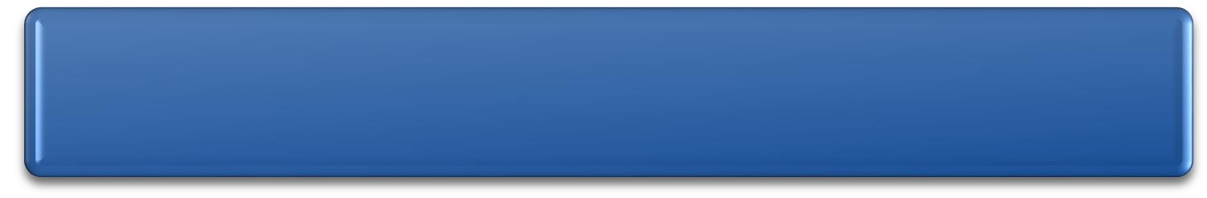

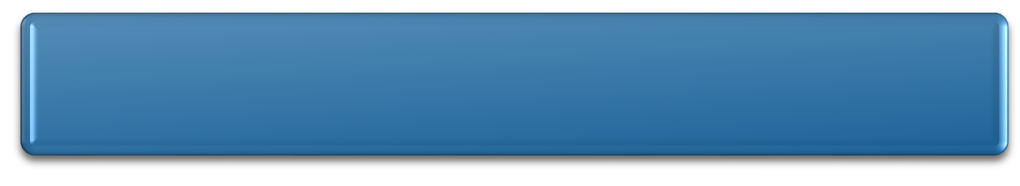

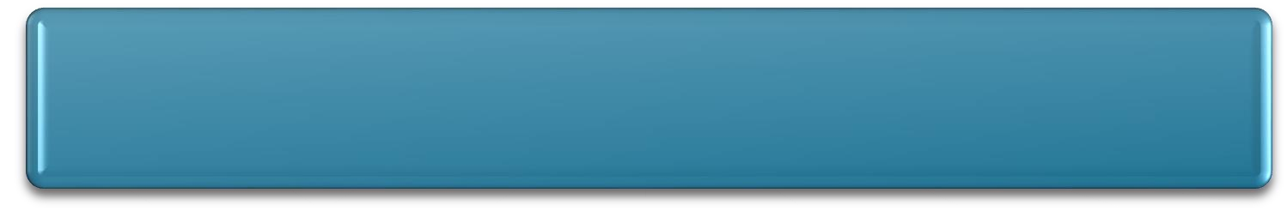


PATHOGENESIS
Injury to cartilage
Catabolic activity promote proteoglycan
depletion in the matrix
Negative charges of proteoglycans get exposed, and cartilage swells from ionic attraction to water molecules
Cartilage does not bounce back after loading vulnerable to further injury
Chondrocytes at the basal level of cartilage undergo apoptosis

Slide 20

Cont………………..
Growth factors and cytokines Stimulate osteoclasts and osteoblasts in the subchondral bony plate
Thickening and stiffness of the subchondral plate occurs & At the margin of the joint, near areas of cartilage loss, osteophytes form.
Synovium become edematous and inflamed, migration of macrophages from the periphery into the tissue, and cells lining the synovium proliferate.
Enzymes secreted by the synovium digest cartilage matrix . cartilage erosions produced by bony pressure from the opposite side of the joint.
Basic calcium phosphate and calcium pyrophosphate dihydrate crystals are present microscopically in most joints with end-stage OA.

Slide 21


Slide 22
























Clinical presentation
Symptoms
 Pain in the affected joints, with the hands, knees, and hips being the most common locations. Associated with motion, but pain in late disease occur with rest.
 Joint stiffness resolves with motion; recurs with rest.(Morning joint stiffness in OA resolves within 30 minutes)
Signs
 Joint stiffness
 Crepitus
 Limited range of motion
 Joint deformity (late disease)

Slide 23

 In OA, Heberden's nodes are bony enlargements of the DIP joints with loss of joint space and osteophyte formation. A similar bony enlargement of the PIP joint is called a Bouchard's node

Slide 24

Thank you

