Slide 1
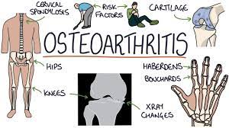
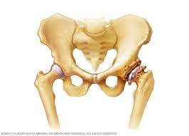
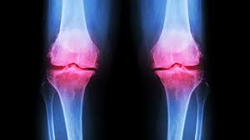
Osteoarthritis
Muscular Skeletal Disease
By Animesh Das

Slide 2
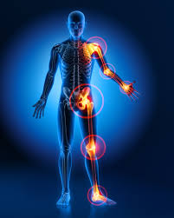
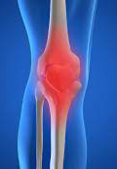
Definition
It is a type of arthritis that occur when flexible tissue at the ends of bones wear down also called as degenerative joint disease , by the breakdown of cartilage a rubbery material that frictions of joints .
Affected organ – joint place [ Hips , knees , feet , spine , hands ] in body .

Slide 3
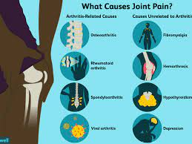
Etiology
Post-traumatic
Congenital/malformation
Malposition (varus/valgus)
Postoperative
Metabolic

Slide 4
Type / Classification
There are two type --
primary osteoarthritis
Secondary osteoarthritis
And there are other type to osteoarthritis present like –
Nodal generalised osteoarthritis
Crystal associated osteoarthritis
OA of premature onset

Slide 5
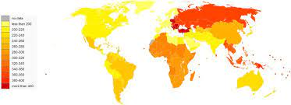
Epidemiology
wight bearing joints , more common in women , familial tendency .
Age > 65 years 25 – 30 % have its symptoms .
osteoarthritis zone – China , India , UK etc

Slide 6
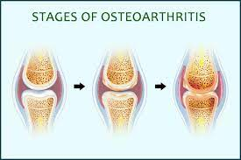
Stages
There are 4 stages --
stage 1 – minor
Stage 2 – Mild
Stage 3 – Moderate
Stage 4 – Sever

Slide 7
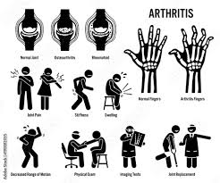
Sings and symptoms
Pain.
Stiffness.
Tenderness.
Loss of flexibility.
Grating sensation.
Bone spurs.
Swelling

Slide 8
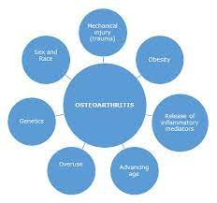
Risk factor
heredity
gender
obesity
high bone mineral density
trauma
joint shape
alignment

Slide 9
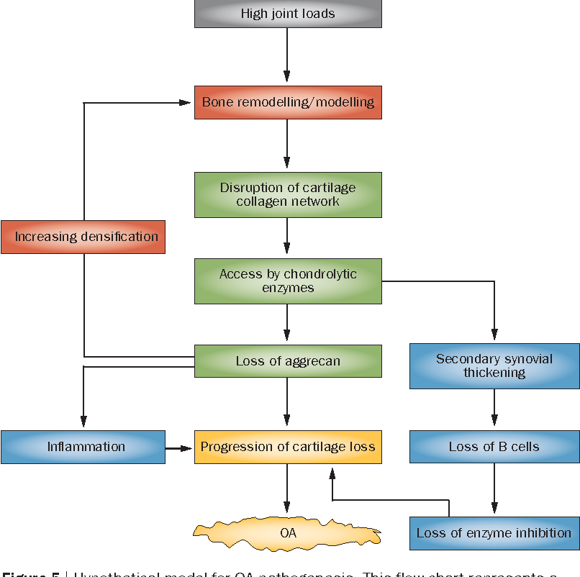
Pathophysiology

Slide 10
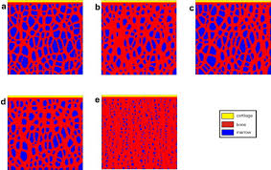
Macrostructural changes
loss of articular cartilage
Subchondral cyst
Osteophytes
sclerosis
Muscle wasting
Bone

Slide 11
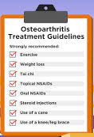
Management
Diagnosis
Treatment

Slide 12
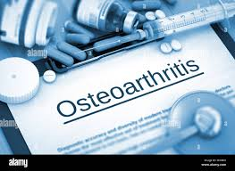
Diagnosis
medical history
physical exam
X ray
other test

Slide 13
Treatment
Category | Drug name
NSAID | Aspirin , ibuprofen , celecoxib , naproxen .
Opiate analgesic | Tramadol
CO X 2 inhibitors | Celecoxib
Proton pump inhibitor | Pantoprazole
Antidepressant | duloxetine
Muscle relaxant | Carisoprodol
Corticosteroid | Zilretta

Slide 14
Investigations
blood test
Synovial fluid Analysis
joint space Narrowing
Subchondral sclerosis

Slide 15
Complication
Rapid, complete breakdown of cartilage resulting in loose tissue material in the joint (chondrolysis).
Bone death (osteonecrosis).
Stress fractures (hairline crack in the bone that develops
gradually in response to repeated injury or
stress) .
Bleeding inside the joint

Slide 16
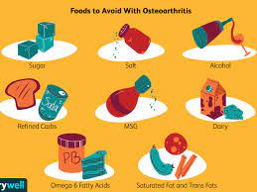
Prevention
Keep a healthy body weight. Extra weight puts stress on your joints.
Control your blood sugar. High blood sugar levels raise your risk of getting OA.
Be active every day. Exercise is a good way to prevent joint problems.
Prevent injury to your joints.
Pay attention to pain

Slide 17
Thank
you

