Slide 1
SUBJECT NAME –PHARMACEUTICAL MICROBIOLOGY
UNIT NO & NAME – 8 DIAGNOSTIC TEST
17-09-2024
1

Slide 2
TOPIC NAME – DIAGNOSTIC TESTS
PCR WIDAL In 1896 and named after its inventor, Georges-Fernand Widal, is an indirect agglutination test for enteric fever or undulant fever whereby bacteria causing typhoid fever is mixed with a serum containing specific antibodies obtained from an infected individual. In cases of Salmonella infection, it is a demonstration of the presence of O-soma false-positive result. Test results need to be interpreted carefully to account for any history of enteric fever, typhoid vaccination, and the general level of antibodies in the populations in endemic areas of the world. As with all serological tests, the rise in antibody levels needed to perform the diagnosis takes 7–14 days,
2-mercaptoethanol is often added to the Widal test. This agent more easily denatures the IgM class of antibodies, so if a decrease in the titer is seen after using this agent, it means that the contribution of IgM has been removed leaving the IgG component. This differentiation of antibody classes is important as it allows for the distinction of a recent (IgM) from an old infection (IgG).
The Widal test is positive if TO antigen titer is more than 1:160 in an active infection, or if TH antigen titer is more than 1:160 in past infection or in immunized persons. A single Widal test is of little clinical relevance especially in endemic areas such as Indian subcontinent, Africa and South-east Asia. This is due to recurrent exposure to the typhoid causing bacteria, immunization and high chances of cross-reaction from infections, such as malaria and non typhoidal salmonella
17-09-2024
2

Slide 3
Quantitative buffy coat (QBC) analysis, which is based on principle of centrifugal stratification of blood components, is a well-known and a very sensitive technique which can be used for the detection of malarial parasites in peripheral blood.
After centrifugation, one can distinguish a layer of clear fluid (the plasma), a layer of red fluid containing most of the red blood cells, and a thin layer in between. Composing less than 1% of the total volume of the blood sample, the buffy coat (so-called because it is usually buff in hue), contains most of the white blood cells and platelets. The buffy coat is usually whitish in colour, but is sometimes green if the blood sample contains large amounts of neutrophils, which are high in green-colored myeloperoxidase.
The layer beneath the buffy coat contains granulocytes and red blood cells.
The buffy coat is commonly used for DNA extraction, with white blood cells providing approximately 10 times more concentrated sources of nucleated cells. They are extracted from the blood of mammals because mammalian red blood cells are anucleate and do not contain DNA. A common protocol is to store buffy coat specimens for future DNA isolation and these may remain in frozen storage for many years.

Slide 4
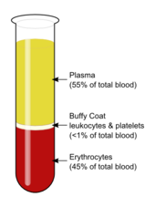
Quantitative buffy coat (QBC), based on the centrifugal stratification of blood components, is a laboratory test for the detection of malarial parasites
The blood is taken in a QBC capillary tube which is coated with acridine orange (a fluorescent dye) and centrifuged; the fluorescing parasitized erythrocytes get concentrated in a layer which can then be observed by fluorescence microscopy, under ultraviolet light at the interface between red blood cells and buffy coat. This test is more sensitive than the conventional thick smear and in > 90% of cases the species of parasite can also be identified.

Slide 5
Mantoux test is based on a delayed type hypersensitivity reaction (Type IV) to test for individuals cell mediated immunity against Mycobacterium tuberculosis. Mycobacterial antigen is available in the form of Purified Protein Derivative (PPD). 5 units of PPD (0.1 ml) is injected intradermally with 26,27 or 30 gauze needle. The results are read in 48-72 hours for induration (elevated hardened area). Erythema (redness) is not significant.
After injection, cytokines are released by memory Th1 cells to attract macrophages and granulocytes which cause induration and erythema. Delayed hypersensitivity reaction begin after 5-6 hours and reach peak at 48-74 hours.
PROCEDURE
Bring PPD reagent to room temperature.
The preferred site for injection is dorsal surface of the forearm, about 4cm below the elbow joint. Select an area free of barriers (e.g. scars, sores).
Disinfect the site of injection and allow to dry.
Draw up just over 0.1 ml of PPD by using 1 ml syringe. Remove excess PPD to make exactly 0.1 ml and remove air from the syringe if present.
Using 27 g needle to inject the PPD intradermally to make the deposition wheel, in the diameter of 6 to 8 mm which will rise up to the point of needle.
Mark the area of injection with indicator.
Read the result after 48-72 hours for induration.

Slide 6
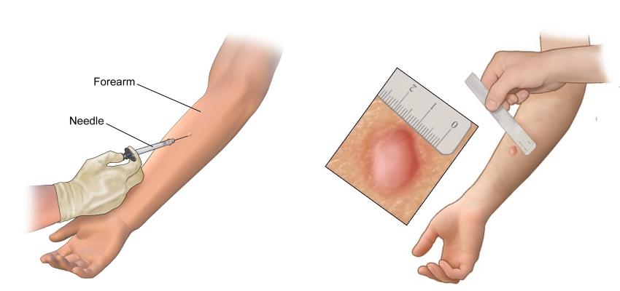

Slide 7
After 48-72 hours of administration of PPD, reaction should be measured in millimetres of induration (elevated hardened area). Erythema (redness) is not significant, it is thus not measured.
According to Center for Disease Control (CDC), interpretation of Mantoux test depends on two factors:
Measurement in millimeters (mm) of the induration
Person’s risk of being infected with TB and progression to disease if infected
Induration of ≥5 mm is considered positive in
Human immunodeficiency virus (HIV)-infected persons
Recent contacts of TB case patients
Persons with fibrotic changes on chest radiograph consistent with prior TB
Patients with organ transplants and other immunosuppressed patients
Induration of ≥10 mm is considered positive in
Recent immigrants (i.e., within the last 5 years) from countries with a high prevalence of TB
Injection drug users
Residents and employees of the high-risk congregate settings like; prisons and jails, nursing, hospitals and other health care facilities, residential facilities for patients with AIDS and homeless shelters

Slide 8
Life cycle of malaria parasite
The malaria parasite has a complex, multistage life cycle occurring within two living beings, the vector mosquitoes and the vertebrate hosts.
The survival and development of the parasite within the invertebrate and vertebrate hosts, in intracellular and extracellular environments, is made possible by a toolkit of more than 5,000 genes and their specialized proteins that help the parasite to invade and grow within multiple cell types and to evade host immune responses.
The parasite passes through several stages of development such as the sporozoites (Gr. Sporos = seeds; the infectious form injected by the mosquito), merozoites (Gr. Meros = piece; the stage invading the erythrocytes), trophozoites (Gr. Trophes = nourishment; the form multiplying in erythrocytes), and gametocytes (sexual stages) and all these stages have their own unique shapes and structures and protein complements.
The surface proteins and metabolic pathways keep changing during these different stages, that help the parasite to evade the immune clearance, while also creating problems for the development of drugs and vaccines

Slide 9
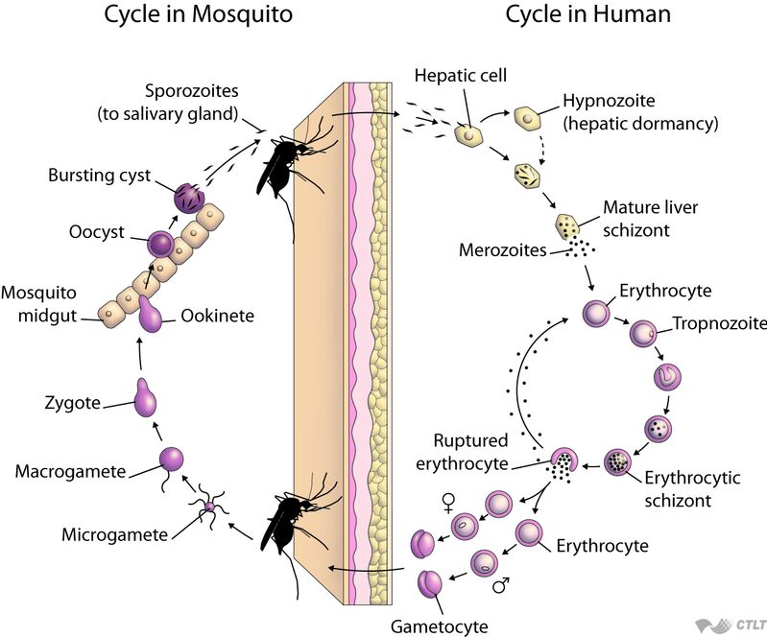

Slide 10
Mosquitoes are the definitive hosts for the malaria parasites, wherein the sexual phase of the parasite’s life cycle occurs. The sexual phase is called sporogony and results in the development of innumerable infecting forms of the parasite within the mosquito that induce disease in the human host following their injection with the mosquito bite.
When the female Anopheles draws a blood meal from an individual infected with malaria, the male and female gametocytes of the parasite find their way into the gut of the mosquito. The molecular and cellular changes in the gametocytes help the parasite to quickly adjust to the insect host from the warm-blooded human host and then to initiate the sporogonic cycle. The male and female gametes fuse in the mosquito gut to form zygotes, which subsequently develop into actively moving ookinetes that burrow into the mosquito midgut wall to develop into oocysts. Growth and division of each oocyst produces thousands of active haploid forms called sporozoites. After the sporogonic phase of 8–15 days, the oocyst bursts and releases sporozoites into the body cavity of the mosquito, from where they travel to and invade the mosquito salivary glands. When the mosquito thus loaded with sporozoites takes another blood meal, the sporozoites get injected from its salivary glands into the human bloodstream, causing malaria infection in the human host. It has been found that the infected mosquito and the parasite mutually benefit each other and thereby promote transmission of the infection. The Plasmodium-infected mosquitoes have a better survival and show an increased rate of blood-feeding, particularly from an infected host.

Slide 11
Symptoms of malaria can develop as quickly as 7 days after you're bitten by an infected mosquito.
Typically, the time between being infected and when symptoms start (incubation period) is 7 to 18 days, depending on the specific parasite you're infected with. However, in some cases it can take up to a year for symptoms to develop.
The initial symptoms of malaria are flu-like and include:
a high temperature of 38C or above
feeling hot and shivery
headaches
vomiting
muscle pains
diarrhoea
generally feeling unwell
These symptoms are often mild and can sometimes be difficult to identify as malaria.

Slide 12
Medications
The most common antimalarial drugs include:
Chloroquine phosphate. Chloroquine is the preferred treatment for any parasite that is sensitive to the drug. But in many parts of the world, parasites are resistant to chloroquine, and the drug is no longer an effective treatment.
Atovaquone-proguanil (Malarone)
Quinine sulfate (Qualaquin) with doxycycline (Oracea, Vibramycin, others)
Primaquine phosphate

