Slide 1
Case Presentation on Diabetes Type 2 Mellitus

Slide 2
SOAP analysis
Subjective evidence
Patient demographic details
NAME: XYZ
AGE: 53 years
SEX : Male
D.O.A: 03 / 07 / 2023
Ip no : 2302280141

Slide 3
Complain on admission
Burning sensation in all fore limbs since 2months.
He also had numbness in feet but he can feel hot and cold sensation.
He had a increased frequency of urination in night since 15days
Gastric irritations and refluxes

Slide 4
Patient history
He had type 2 diabetes mellitus since 5 years
He also had long term hypertension and was on treatment
Social history
He was an alcoholic

Slide 5
General examination
PICCLE-ABSENT
Weight – 65 kg
BP: 140/90mmHg(120/80mmHg)
Pulse: 70bpm
RS: B/L NVBS +ve
CVS: S1 S2 +ve, no murmur
CNS: Conscious, Oriented

Slide 6
Objective evidence
INVESTIGATION | OBSERVED VALUE |  |  | NORMAL VALUE
 | DAY 1 | DAY 2 | DAY 3
HB | 18gm% | 17.5gm% | 15gm% | 11-16gm%
FBS | 160mg/dl | 140mg/dl | 120mg/dl | 70-110mg/dl
RBS | 320mg/dl | 250mg/dl | 210mg/dl | 110-180mg/dl
PPBS | 311mg/dl | 280mg/dl | 220mg/dl | 110-160mg/dl
SR-CR | 0.5mg/dl | 0.6mg/dl | 0.9mg/dl | 0.8-1.4mg/dl
SR- UR | 22mg/dl | 28mg/dl | 34mg/dl | 20-40mg/dl
DAILY GRBS | 324 mg/dl

Slide 7
Confirmatory test
HBA1c – 8 % [normal value less then or equal 5.6 ]
Assessment
From the subjective and objective evidence we are confirm that patient was suffering from type 2 diabetes mellitus with hypertension .
Final diagnosis
Type 2 diabetes mellitus with hypertension

Slide 8
Planning
Patient specific:-
-> To Relieve from Type 2 Diabetes Mellitus and Hypertension
Disease specific:-
-> To prevent long term complications like foot problems, cardiovascular Diseases etc

Slide 9
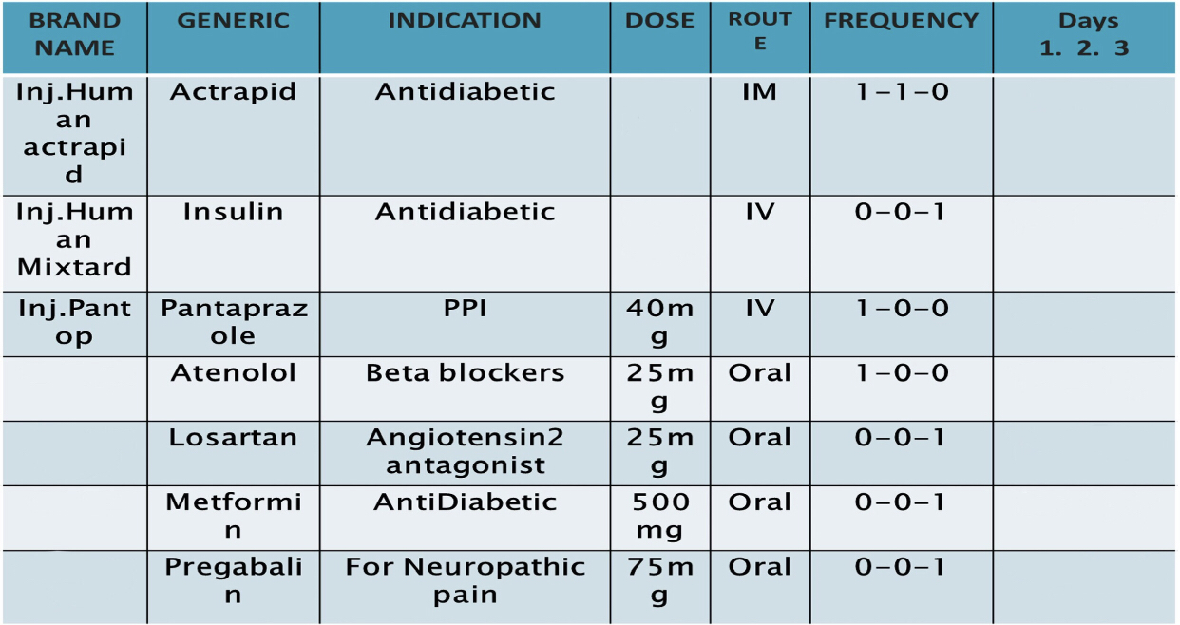
Drug plan
Human insulin
45 IU/ml
sc
40
✔️ ✔️ ➖
45 IU/ml
sc
Insulin isophane
✔️ ✔️ ✔️
✔️ ✔️ ✔️
Tab. Aten
✔️ ✔️ ✔️
Tab. Losartan
✔️ ✔️ ✔️
Tab. MF
➖ ➖ ✔️
Tab. Pregastar
✔️ ✔️ ✔️

Slide 10
GENERIC NAME | MOA | ADR
Pantoprazole | Inhibit the proton pump in the stomach. | Dizziness, diarrhoea, gastro intestinal tract infection, hyperglycaemia.
Atenolol | It block beta receptors and result in slowing of heart rate and thereby lowering BP. | Wheezing, slowing of heart rate, heart failure, dizziness, confusion.
Metformin | Suppressing glucose production by the liver(hepatic Gluconeogenesis) | Diarrhea, cramps, vomiting , nausea, increased flatulence, lactic acidosis

Slide 11
Losartan | Selective,competetive angiotensin II receptor antagonist reducing the end organ responses to angiotensin II. | Respiratory infection or stuffy nose, dizziness, back pain, diarrhea, fatigue, low BP.

Slide 12
Drug interaction
Moderate drug - drug interaction
Atenolol – insulin
it may increase the risk , severity or duration of hypoglycaemia , other symptoms of hypoglycaemia such as headache , dizziness , drowsiness , nervousness , confusion , nausea , hunger , weakness etc .
Insulin – metformin
insulin can increase the risk of hypoglycaemia or low blood sugar , symptoms of hypoglycaemias include headache , dizziness , drowsiness , nervousness , confusion , tremor , nausea , hunger , weakness etc .
Insulin – losartan
it may increase the risk of hypoglycaemia or low blood sugar , symptoms are headache , dizziness , drowsiness , nervousness , confusion , tremor , nausea , hunger , weakness etc .
Losartan – pregabalin
losartan may cause angioedema a condition associated with swelling of the face , eyes , lips , tough , throat and occasionally also the hands and feet .

Slide 13
Discharge medication
Tab pan 40 mg 1- 0- 0 for 15 days
Tab aten 25 mg 1 – 0 – 0 for 15 days
Tab losartan 25 mg 0 – 0 – 1 for 15 days
Tab metformin 500 mg 0 – 0 – 1 for 15 days
Tab pregastar 75 mg 0 – 0 – 1 for 5 days

Slide 14
Patient counselling
Take medications properly.
Proper diet should be followed.
Maintain low carbohydrate rich diet.
Reduce intake of sodium rich food.
Pantoprazole should be taken in empty stomach.
Avoid eating honey, jams and jellies.
Foot care – should check your feet regularly and keep them clear.
Exercise a lot.

Slide 15
Thank
you

