Slide 1
Case Presentation on
Viral fever with Thrombocytopenia

Slide 2
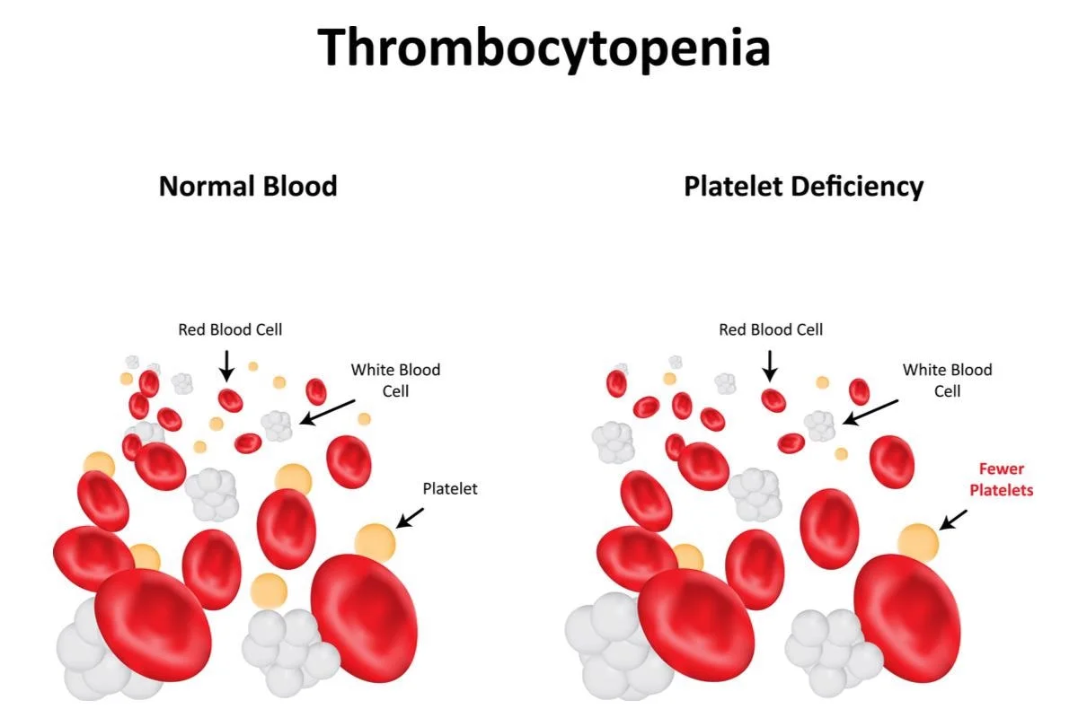
Introduction
Thrombocytopenia is a condition in which you have a low blood platelet count. Platelets (thrombocytes) are colorless blood cells that help blood clot. Platelets stop bleeding by clumping and forming plugs in blood vessel injuries

Slide 3
SOAP Analysis
S - Subjective Findings
O - Objective Findings
A – Assessment
P - Plan

Slide 4
Patient Demographic Details
Patient Demographic Details
Name: XYZ DOA: 18/01/2024
Age: 53 years DOD: 21 / 12 / 2023
Sex: female IP No: 2312180323
Weight : 45 Kg Unit : General medicine
Complaints on Admission :
c/o of fever since 4 to 5 days , loose stools since 2 days , vomiting since 2 days .

Slide 5
Subjective Evidences
1. c/o of fever since 4 to 5 days
2. c/o loose stools since 2 days
3. c/o vomiting since 2 days
Symptoms were present since last 4 to 5 days

Slide 6
Past History
Past Medical History : Nil
Past Medication History : Nil
Social History : Mixed diet
Family History : Nil

Slide 7
Physical Examination
General :
CVS : S1S2 +ve murmurs heard
RS : B/L NVBS +
CNS : Conscious and Oriented
PA : Soft
Others :
BP : 136/80 mmHg
Pulse : 64 bpm
Temp : 98.6⁰F
RR : 17 bpm

Slide 8
Provisional Diagnosis
Viral fever with thrombocytopenia

Slide 9
Objective Evidences
Investigation | Result | Normal Value
Haemoglobin | 12.7 g / dl | 13.8 – 17. 2 g/ dl
Leucocytes | 59 % | 20 – 40 %
Neutrophils | 36 % | 40 – 60 %
Eosinophils | 01 % | 1 – 4 %
Total count | 3930 | 4500 – 11000
RBC | 4.77 | 4.7 – 6.1
Monocytes | 04 % | 1 – 10
Platelet | 0.32 | 1.5 – 4.5
PCV | 36.4 | 38.3 – 48.6
ESR | 25 | 0 – 15 mm / hr

Slide 10
Objective Evidences
CHEMICAL EXAMINATION | REPORT
MICROSCOPICAL EXAMINATION | REPORT

Slide 11
Assessment
Based on subjective and objective evidence the patient was suffering from viral fever with Thrombocytopenia .

Slide 12
Plan
Goal
Patient Specific :
To improve the patient quality of life
To reduce further the complication of thrombocytopenia .
Disease specific :
To treat the weakness .
Correcting the underlying Etiology .
Prevent reoccurrence of thrombocytopenia .

Slide 13
Non Pharmacological Treatments
Avoid anti-inflammatory medication such as aspirin or ibuprofen.
Avoid activities that may result in injury.
Avoid alcohol as it can affect platelet production.

Slide 14
Pharmacological Treatment
Sl no | Brand name | Generic name | ROA | Dose | Frequency | Days
1 | Iv fluid ns | Normal saline | IV | 75 ml / hr |  | 1 DAY
2 | Inj pan | Pantoprazole | IV | 40 mg | 1 – 0 – 1 | 3 DAYS
3 | Inj emeset | Ondansetron | IV | 4 mg | S O S | 2 DAYS
4 | Tab dolo | Paracetamol | PO | 650 mg | S O S | 3 DAYS
5 | Tab sprolac DS | Lactic acid | PO |  | 1 –1– 1 | 1 DAY

Slide 15
Progress Chart
Date | Time | BP | Pulse Rate
18 / 12 /2023 | 10 : 30 am | 136 / 80 mmhg | 64 bpm
19 / 12 / 2023 | 10 : 30 am | 130 / 80 mmhg | 64 bpm
20 / 12 / 2023 | 11 : 00 am | 130 / 80 mmhg | 70 bpm
21 / 12 / 2023 | 11 : 30 am | 130 / 80 mmhg | 70 bpm

Slide 16
Discharge Medications
Sl.No | Brand Name | Generic Name | Dose | Freq | Route | No: of days
1 | Tab dolo | Paracetamol | 650 mg | S O S | Po
2 | Cap sprolac DS | Lactic acid |  | 1 – 1 – 1 | Po | 3 days

Slide 17
Patient Counselling
Patient is advice to take iron rich diet such as green leafy vegetables , fruits , egg liver kidney etc .
Eating health rich diet
Regular exercise
Drink plenty of water .

Slide 18
THANK YOU

