Slide 1
Case Presentation on
Hashimotos thyroiditis

Slide 2
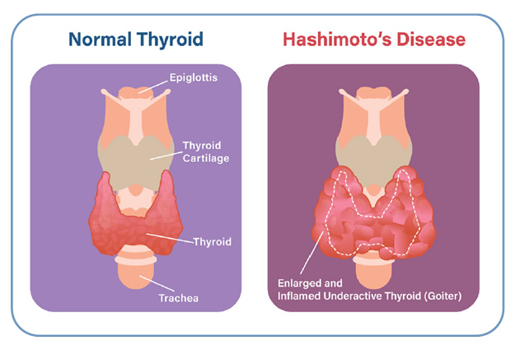
Introduction
Hashimoto thyroiditis is an autoimmune disease that destroys thyroid cells by cell and antibody-mediated immune processes. It is the most common cause of hypothyroidism in developed countries. In worldwide, the most common cause of hypothyroidism is an inadequate dietary intake of iodine .

Slide 3
SOAP Analysis
S - Subjective Findings
O - Objective Findings
A – Assessment
P - Plan

Slide 4
Patient Demographic Details
Patient Demographic Details
Name: XYZ DOA: 24 / 01 / 2024
Age: 38 years DOD: 26 / 01 / 2024
Sex: female IP No:
Weight : unit : General Surgery
Complaints on Admission :
c/o of swelling in front of neck since 2 years , pain over swelling since 1 month .

Slide 5
Subjective Evidences
1. c/o of swelling in front of neck since 2 years
2. c/o pain over swelling since 1 month
Symptoms were present since last 2 years .

Slide 6
Past History
Past Medical History : k/c/o of hypothyroidism since 2 years
Past Medication History : tab thyronorm 75 mcg
Social History : mixed
Family History : nil

Slide 7
Physical Examination
General :
CVS : S1 S2 +
RS : B/L NVBS +
CNS : conscious and oriented
Others :
BP : 130 / 90 mmhg
Pulse : 92 bpm
Temp : Afebrile
RR : 15 cpm

Slide 8
Provisional Diagnosis
Hashimoptos thyroiditis

Slide 9
Objective Evidences
Investigation | Result | Normal Value
Haemoglobin | 11.7 gm / dl | 13.8 – 17 . 2 gm / dl
Leucocytes | 34 % | 20 – 40 %
Neutrophils | 59 % | 40 – 60 %
Eosinophils | 03 % | 1 – 4 %
Basophils | 00 % | 0 – 1 %
Platelet | 3. 40 L /cmm | 1.5 – 4.5
Monocytes | 04 % | 1 – 10
PCV | 37.1 % | 38.3 – 48.6
RBC | 5.08 m / cmm | 4.7 – 6.1

Slide 10
Objective Evidences
Investigation | Result | Normal Value
Direct bilirubin | 0.1 mg / dl | 0.3 mg / dl
Indirect bilirubin | 0.1 mg / dl | 0.2 – 0.8 mg / dl
Total bilirubin | 0.2 mg / dl | 1.2 mg / dl
T3 | 1.06 ng / ml | 0.9 – 2.8 nmol / L
T4 | 9.68 ųg / dl | 5.0 – 12.0 ųg / dl
TSH | 2.259 mIU/L | 0.4 -4.0 mIU/L
Serum creatinine | 0.6 mg / dl | 0.7 – 1.35 mg / dl
Urea | 23 mg / dl | 5 – 20 mg / dl
Albumin | 4.6 gm / dl | 3.4 – 5.4 gm / dl

Slide 11
Assessment
Based on the subjective and objective evidence we are confirm that the patient was suffering from hashimotos thyroiditis .

Slide 12
Plan
Goal
Patient Specific :
to improve the patient quality of life .
To reduce the further complication of thyroid .
Disease specific :
To prevent the causes of the thyroid .
To decrease the sings and symptoms .

Slide 13
Non Pharmacological Treatments
Stick toa diet that low sugar and processed foods .
Limit intake of cruciferous vegetables .
Find ways to reduce stress .
Exercise three to five times .
Maintain a healthy body weight .

Slide 14
Pharmacological Treatment
Sl.No: | Brand Name | Generic Name | Dose | Freq. | Route | No: of days
1 | Tab thyronorm | Thyroxine sodium | 75 mcg | 1 – 0 – 0 | PO | 3 days
2 | Tab orofer Xt | Ferrous ascorbate | - | 0 – 1 – 0 | PO | 3 days
3 | Tab limcee | Ascorbic acid | 500 mg | 0 – 1 – 0 | PO | 3 days

Slide 15
Progress Chart
Date | Time | BP | Pulse Rate
24 / 01 / 2024 | 10 : 00 am | 130 / 90 mmhg | 92 bpm
25 / 01 / 2024 | 10 : 30 am | 130 / 90 mmhg | 92 bpm
26 / 01 / 2024 | 10 : 30 am | 130 / 90 mmhg | 92 bpm

Slide 16
Discharge Medications
Sl.No | Brand Name | Generic Name | Dose | Freq | Route | No: of days
1 | Tab thyronorm | Thyroxine sodium | 75 mcg | 1 – 0 – 0 | Po | Cont
2 | Tab etoshine | Etoricoxib & thiocolchicoside | - | 1 – 0 – 1 | Po | 5 days
3 | Tab tayo | Cholecalciferol | 60 k | Once in week | Po | 8 weeks

Slide 17
Patient Counselling
Getting adequate rest and relaxation .
Reducing or avoiding stress .
Maintain adequate nutrition .
Increase dietary iodine intake .
Take iron rich foods , fruits and green Leafly vegetables .
Over treatment may lead to decreased bone mineral density and adverse cardiac consequences .
Do not modify dose or stop treatment without consultation , over treatment may leads to decreased bone mineral density and adverse cardiac consequences .

Slide 18
THANK YOU

