Slide 1

CASE PRESENTATION ON HYPOTHYRODISM
03-09-2024
1

Slide 2
INTRODUCTION
Hypothyroidism is the leading cause of thyroid dysfunction and can be seen in up to 40% of these patients and appropriate treatment is critical importance. Hypothyroidism is seen most frequently in patients receiving total body irradiation containing conditioning regimens. Hypothyroidism may be seen in cases receiving chemotherapy-only conditioning regimens but less frequently.
Symptoms are Fatigue , weight gain , trouble tolerating cold , joint and muscle pain , dry
skin or dry, thinning hair , heavy or irregular menstrual periods or fertility problems ,
slowed heart rate , depression etc.
The most common cause of hypothyroidism is an autoimmune disease called Hashimoto's disease. Autoimmune diseases happen when the immune system makes antibodies that attack healthy tissues .

Slide 3
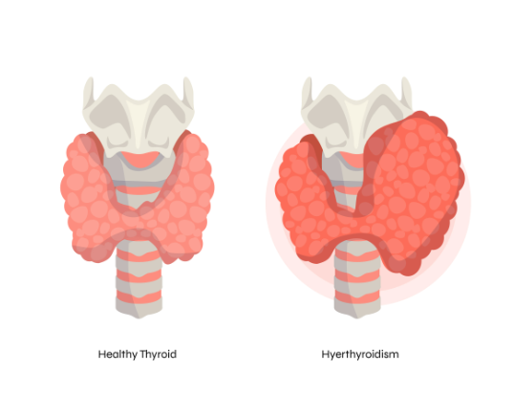

Slide 4
PATIENT DEMOGRAPHIC DETAILS
Name - XYZ
Age - 27 years
Gender - female
Ward - II
Date of admission - 02 / 01 / 2024
Department- Medi Gastro
Complaints on admission:
c/o pain abdomen and vomiting since 1 day .

Slide 5
SOAP ANALYSIS
S-Subjective findings
O-Objective findings
A-Assessment
P-Plan

Slide 6
SUBJECTIVE FINDINGS
PHYSICAL EXAMINATION
CVS : S1S2 +ve murmurs heard
RS : B/L NVBS +
CNS : Conscious and Oriented
PA : soft and mild tenderness
OTHERS
BP : 120 / 30 mmhg
Pulse : 70 bpm
Temp : normal
RR : 18 cpm

Slide 7
Past History
Past Medical History: k/c/o hypothyroidism , Crohn's disease .
Past Medication History : tab thyronorm
Social History : mixed .
Family History : nil

Slide 8
SUBJECTIVE EVIDENCES BASED ON THE COMPLAINTS DURING ADMISSION
1. c/o pain abdomen and vomiting since 1 day .
Symptoms were present since last 1 day .

Slide 9
PROVISIONAL DIAGNOSIS
AE CD / pain abdomen

Slide 10
OBJECTIVE FINDINGS
Investigation | Result | Normal Value
Haemoglobin | 12.1 g/ dl | 13.8 – 17. 2 g/ dl
Leucocytes | 12 % | 20 – 40 %
Neutrophils | 82 % | 40 – 60 %
Total bilirubin | 0.5 mg / dl | 1.2 mg / dl
Chloride | 103 meq / L | 96 – 106 meq/ L
Sodium | 134 meq / L | 135 – 145 meq / L
Potassium | 4.1 meq / L | 3.5 – 5.1 meq / L
Urea | 27 mg / dl | 5 – 20 mg / dl
serum creatinine | 0.4 mg / dl | 0.7 – 1.3 mg / dl

Slide 11
ABNORMAL FINDINGS
TEST | FINDINGS | NORMAL RANGE
Haemoglobin | 12.1 g/ dl | 13.8 – 17. 2 g/ dl
Leucocytes | 12 % | 20 – 40 %
Neutrophils | 82 % | 40 – 60 %
Total bilirubin | 0.5 mg / dl | 1.2 mg / dl
Sodium | 134 meq / L | 135 – 145 meq / L
Urea | 27 mg / dl | 5 – 20 mg / dl
serum creatinine | 0.4 mg / dl | 0.7 – 1.3 mg / dl

Slide 12
ASSESSMENT
Based on subjective and objective evidence the patient was suffering from hypothyroidism and Crohn's disease .

Slide 13
PLAN OF CURRENT THERAPY
Patient Specific :
to improve the patient quality of life .
To reduce the further complication of hypothyroidism .
Disease specific :
To prevent the sings and symptoms .
To decrease the abdomen pain .

Slide 14
NON-PHARMACOLOGICAL TREATMENT
.
Selenium-rich
Sugar-free
Gluten-free diet
As well as taking vitamin B supplements and probiotics

Slide 15
Pharmacological Treatment
Sl.No: | Brand Name | Generic Name | Dose | Freq. | Route | No: of days
1 | Inj tramadol | Tramadol | 50 mg | SOS | IV | 1 day
2 | Inj NS | Normal saline | 100 ml | SOS | IV | 1 day
3 | Inj pan | pantoprazole | 40 mg | 1 – 0 – 0 | IV | 1 day
4 | Inj emeset | Ondansetron | 4 mg | 1 – 1 – 1 | IV | 1 day
5 | Inj RL | Ringer lactate | 75 ml / hr
6 | Inj buscopan | Hyoscine | - | 1 – 1 – 1 | IV | 1 day
7 | Tab azofan | Azathioprine | 75 mg | 1 – 0 – 0 | PO | 1 day
8 | Tab rozo | Rabeprazole | 20 mg | 1 – 0 – 0 | PO | 1 day
9 | Tab budez CR | Budesonide | 3 mg | 2 – 0 – 0 | PO | 1 day

Slide 16
Progress Chart
Date | Time | BP | Pulse Rate
02 / 01 / 2024 | 11 : 00 am | 110 / 70 mmhg | 82 bpm

Slide 17
Discharge Medications
Sl.No | Bra5nd Name | Generic Name | Dose | Freq | Route | No: of days
1 | Tab budez CR | Budesonide | 3 mg | 3 – 0 – 0 | PO | 6 week
2 | Tab azopan | Azathioprine | 75 mg | 1 – 0 – 0 | PO | Cont
3 | Pentasa granules | Mesalazine granules | 1 gm | 1 – 0 – 1 | PO | Cont
4 | Tab Rozo | Rabeprazole | 20 mg | 1 – 0 – 0 | PO | Cont
5 | Tab thyronorm | Thyroxine sulphate | 112.5 mcg | 1 – 0 – 0 | PO | Cont
6 | Tab ultracet | Uroxylic acid . | 1 | SOS | PO

Slide 18
Pharmacist Intervention
Drug-Drug Interactions :-
Ondansetron and tramadol – can increase the risk of serotonin syndrome and an irregular heart rhythm both rare but potentially life threating effects . Fever , excessive sweating , muscle spasm or stiffness , tremor , nausea , vomiting , Diarrhea .

Slide 19
Patient Counselling
Getting adequate rest and relaxation .
Reducing or avoiding stress .
Maintain adequate nutrition .
Increase dietary iodine intake .
Take iron rich foods , fruits and green Leafly vegetables .
Over treatment may lead to decreased bone mineral density and adverse cardiac consequences .
Do not modify dose or stop treatment without consultation , over treatment may leads to decreased bone mineral density and adverse cardiac consequences .

Slide 20
THANK YOU

