Slide 1
SUBJECT NAME- PHARMACEUTICAL MICROBIOLOGY
UNIT NO & NAME-3 PRESERVATION OF PURE CULTURE
17-09-2024
1

Slide 2
PRESERVATION OF PURE CULTURE
Method 1. Refrigeration:
Pure cultures can be successfully stored at 0-4°C either in refrigerators or in cold-rooms.
This method is applied for short duration (2-3 weeks for bacteria and 3-4 months for fungi) because the metabolic activities of the microorganisms are greatly slowed down but not stopped.
Thus their growth continues slowly, nutrients are utilized and waste products released in medium.
This results in, finally, the death of the microbes after sometime.
Method 2. Paraffin Method:
This is a simple and most economical method of maintaining pure cultures of bacteria and fungi.
In this method, sterile liquid paraffin in poured over the slant (slope) of culture and stored upright at room temperature.
The layer of paraffin ensures anaerobic conditions and prevents dehydration of the medium.
This condition helps microorganisms or pure culture to remain in a dormant state and, therefore, the culture is preserved for several years.
17-09-2024
2

Slide 3
Method 3. Cryopreservation:
Cryopreservation (i.e., freezing in liquid nitrogen at-196°C) helps survival of pure cultures for long storage times. In this method, the microorganisms of culture are rapidly frozen in liquid nitrogen at -196°C in the presence of stabilizing agents such as glycerol, that prevent the formation of ice crystals and promote cell survival.
Method 4. Lyophilisation (Freeze-Drying):
In this method, the culture is rapidly frozen at a very low temperature (-70°C) and then dehydrated by vacuum.
Under these conditions, the microbial cells are dehydrated and their metabolic activities are stopped; as a result, the microbes go into dormant state and retain viability for years.
Lyophilized or freeze-dried pure cultures and then sealed and stored in the dark at 4°C in refrigerators. Freeze- drying method is the most frequently used technique by culture collection centres.

Slide 4
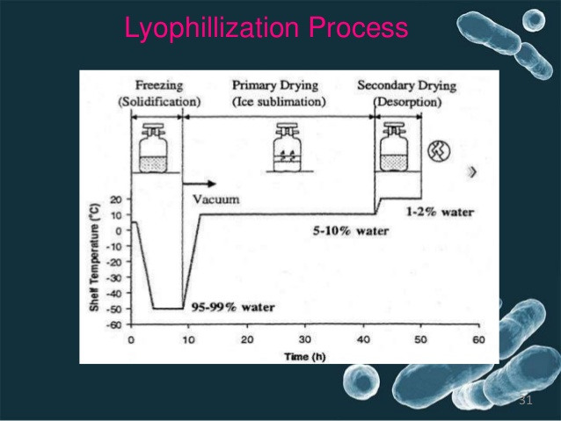

Slide 5
