Slide 1

Parkinsonism

Slide 2
Parkinson’s disease (PD) has highly characteristic neuropathologic findings and a clinical presentation, including motor deficits and, in some cases, mental deterioration.

Slide 3








Parkinson Disease
First described in 1817 by an English
physician, James Parkinson, in “An Essay on the Shaking Palsy.”
The famous French neurologist, Charcot, further described the syndrome in the late 1800s

Slide 4
What causes PD
May be combination of factors involving
genetics, environmental agents,& abnormalities in cellular process.

Slide 5
Age - the most impor^{R}ta^{i}n^{s}t r^{k}isk^{F}fªac^{c}tor^{tors}
Develops around age 50
  incidence rises with age
  affects 1-2% of population > age 65
Positive family history
Male gender
Higher incidence in men (62%) compared to women (38%)
Environmental exposure: Herbicide and pesticide exposure, metals (manganese, iron), well water, farming, rural residence, wood pulp mills; and steel alloy industries
Life experiences (trauma, emotional stress, personality traits such as shyness and depressiveness)

Slide 6
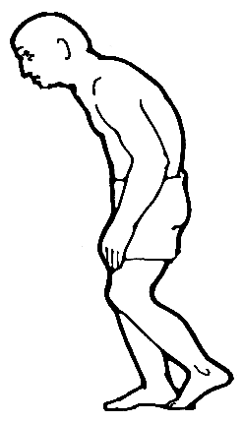
Three cardinal symptoms:
→ resting tremor
→ bradykinesia
(generalized slowness of
movements)
→muscle rigidity
→Postural instability
Symptoms worsen as disease progresses

Slide 7
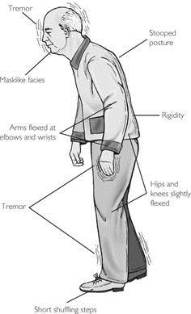

Slide 8
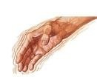
Resting tremor: Most common first symptom, Tremor is present most commonly in the hands, often begins unilaterally, and sometimes has a characteristic “pill-rolling” quality..

Slide 9
Bradykinesia: slowness of motion. The individual's movements become increasingly slow and over time muscles may randomly "freeze“
Difficulty with daily activities such as writing, shaving, using a knife and fork, and opening buttons; decreased blinking, masked facies, slowed chewing and swallowing.

Slide 10
Muscular Rigidity: Muscle tone
increased in both flexor and extensor muscles providing a constant resistance to passive movements of the joints; stooped posture, anteroflexed head, and flexed knees and elbows.

Slide 11
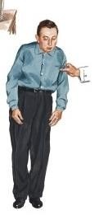
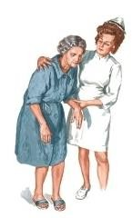
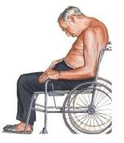
Postural manifestations –
postural instability
  rigidity
    stooped

Slide 12
Other symptoms
Decreased dexterity,
Difficulty arising from a chair,
Decreased eye blinking
Festinating gait,
Dysarthria,
Difficulty swallowing,
Reduced facial expression,
Freezing at initiation of movement,
Hypophonia,
Micrographia,
Bladder disturbances,
Constipation,
Blood pressure changes,
Dementia, anxiety, depression,
Sleepiness, insomnia, obstructive sleep apnea.

Slide 13
Additional Symptoms
Depression: Mild to moderate depression in 50 % of patients.
Cognitive impairment: Mild cognitive decline including impaired visual-spatial perception and attention, slowness in execution of motor tasks, and impaired concentration in most patients; at least 1/3 become demented during the course of the disease.

Slide 14
Parkinson’s Disease – Stages of Symptoms
Stage | Symptoms
One | Unilateral
Two | Bilateral No balance impairment
Three | Balance impairment Mild to moderate disease Physically independent
Four | Severe disability Still able to walk & stand unassisted
Five | Wheelchair-bound or bedriddened unless assisted

Slide 15
Etiology
Genetic and environmental factors
Oxidation hypothesis suggests that free radical damage
A recent hypothesis suggests that Parkinson disease is caused by abnormalities of the ubiquitin proteasome system
Genetic: mutation of alpha synuclein (neurodegeneration)gene which is an autosomaldominant familial form results in PD

Slide 16
Etiology
Metabolic disturbances Infectious
Drug Induced
Antipsychotics
Antiemetics
Dopamine depletors

Slide 17
Pathophysiology
Two hallmark features in the substantia nigra pars compacta are loss of neurons and presence of Lewy bodies.
Reduced activation of dopamine1 and dopamine2 receptors results in greater inhibition of the thalamus and reduced activation of the motor cortex.

Slide 18

Pathophysiology
In PD, nigral dopamine neurons and other cells die from a combination of factors
Genetic vulnerability folding of -synuclein
Oxidative stress
Proteasomal dysfunction
Environmental factors
abnormal processing or

Slide 19
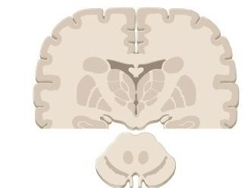
Parkinson’s Disease - Pathophysiology
Question: What causes the movement problems of PD?
Answer: Deficiency of the brain chemical dopamine
occurs in the basal ganglia.
The Basal Ganglia is an area deep inside the cortex of the brain that coordinates normal muscle activity.

Slide 20
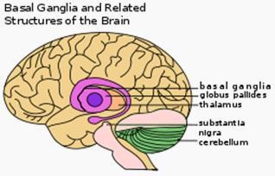
Basal ganglia is associated with a variety of functions, including voluntary motor control, procedural learning relating to routine behaviors or "habits," eye movements, and cognitive emotional functions

Slide 21
Question: deficiency?
Answer: Degenerative changes in the substantia nigra and striatum portions of the basal ganglia reduce dopamine production.
What causes the dopamine
Cross section of striatum
Substantia nigra

Slide 22
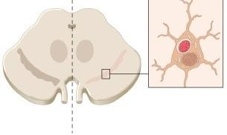

Parkinson’s Disease - Pathophysiology
Healthy Sn
PD Sn
Cells degenerate in substantia nigra (Sn)
Substantia nigra destroyed Dopamine decreases
Muscle cell activation decreases Movement control decreases

Slide 23
Lewy bodies are abnormal aggregates of protein that develop inside nerve cells in Parkinson's disease (PD).
They are identified under the microscope when histology is performed on the brain.

