Slide 1

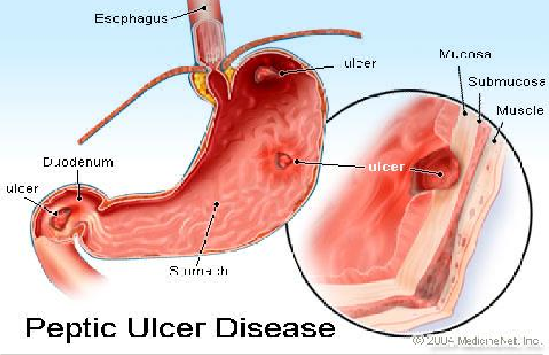
PEPTIC ULCER

Slide 2
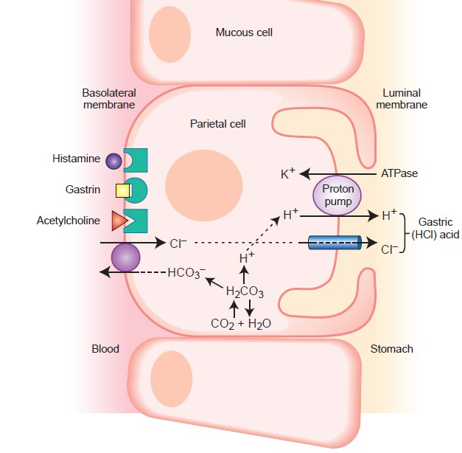

Slide 3
🞇 Ulcers develop when digestive juices produced in the stomach, intestines, and digestive glands damage the lining of the stomach or duodenum

Slide 4
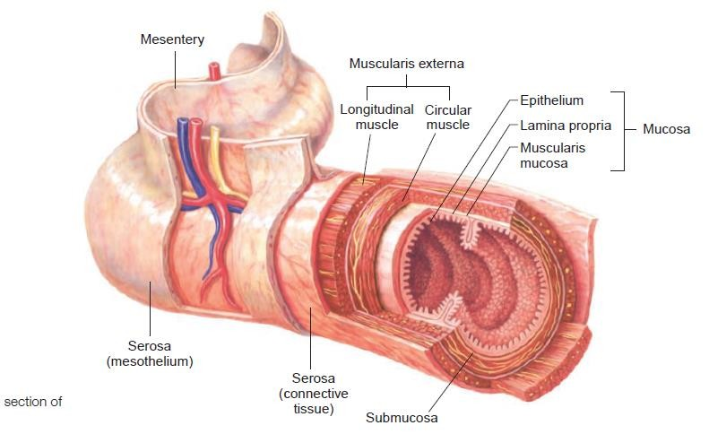

Slide 5
🞇 Parietal (or oxyntic) cells, chief cells, and G cells.
🞇 Parietal cells secrete hydrochloric acid (HCl) and intrinsic factor.
🞇 HCL-chemically breakdown and disinfect ingested food.
🞇 Intrinsic factor-necessary for the absorption of vitamin B12
🞇 The chief cells secrete pepsinogen, which is converted
rapidly to pepsin that initiates proteolysis
🞇 G cells secrete gastrin.

Slide 6
Protection
The mucus layer, which coats the stomach and duodenum, forms the first line of defense.
Bicarbonate, which the mucus layer secretes, neutralizes the digestive acids.
Prostaglandins are also believed to stimulate bicarbonate and mucus production.

Slide 7
Introduction
Peptic ulcer disease is a term used to describe a group of ulcerative disorders that occur in areas of the upper GI tract that are exposed to acid–pepsin secretions
It is related to variety of causes, such as medication use and
H. pylori infection
The most common forms of peptic ulcer are duodenal and gastric ulcers.
98 % Peptic Ulcer occurs in duodenum or in stomach in the ratio of 4 : 1

Slide 8
Epidemiology
🞇 Gastric ulcers are more prevalent among middle-aged and older adults.
🞇 Incidence of gastric ulcers is more equally distributed between men and women
🞇 For duodenal ulcers, there is a male predominance and occurs between 30 and 60 years of age

Slide 9
🞇 A peptic ulcer can affect one or all layers of the stomach or duodenum
🞇 Occasionally, an ulcer penetrates the outer wall of the stomach or duodenum.
🞇 Healing involves replacement with scar tissue
🞇 Although the mucosal layers that cover the scarred muscle layer regenerate, the regeneration often is less than perfect, which contributes to repeated episodes of ulceration.

Slide 10
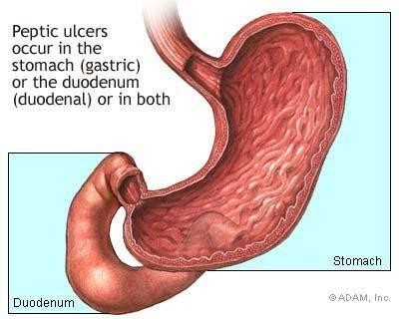

Slide 11
Risk Factors
🞇 Stress and Psychological Factors.
🞇 Smoking

Slide 12
Causes
🞇 H.pylori
🞇 NSAID’S
🞇 Genetic disorder
🞇 Others

Slide 13
Pathogenesis
🞇 H. pylori's penetrates the mucus layer of the stomach or duodenum so that it can attach itself to the lining.
🞇 The surfaces of the cells lining the stomach contain a protein, called decay-accelerating factor, which acts as a receptor for the bacterium.
🞇 H. pylori survives in the highly acidic environment by producing urease, an enzyme that generates ammonia to neutralize the acid.

Slide 14
🞇 Induce inflammation and stimulate the release of cytokines and other mediators of inflammation contributes to mucosal damage.
🞇 Infection, predominantly in the antrum of the stomach, leads to hypergastrinemia and an increased acid production.
🞇 Acid injury to the duodenum is thought to promote the
development of gastric metaplasia

Slide 15
🞇 Allowing the organism to colonize these areas and promote the development of duodenal ulcers
🞇 Only around 10 to 15% of people who are infected with H. pylori develop peptic ulcer disease

Slide 16
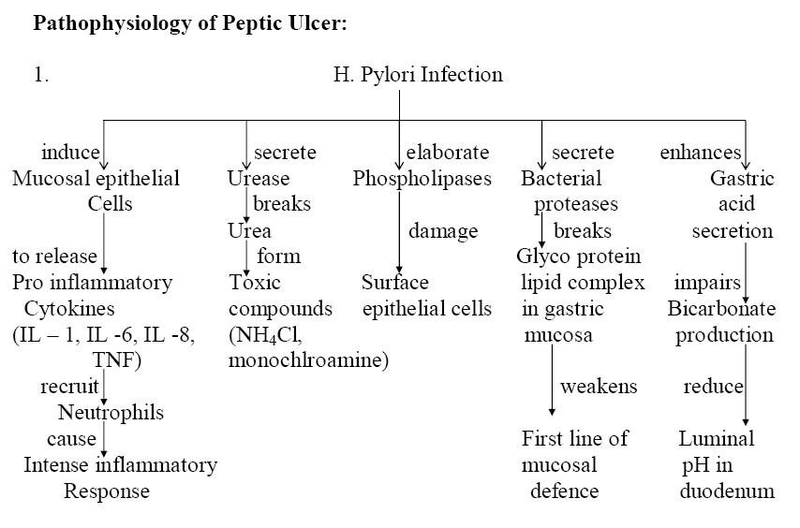

Slide 17
🞇 Genetic Factors
TRIGGERING FACTORS IN H.PYLORI
🞇 Immune Abnormalities
🞇 Lifestyle Factors: chronic stress, drinking coffee, and smoking.
🞇 Interruptions of sleep may weaken the immune system's ability to protect against harmful bacterial substances

Slide 18
Pathogenesis
NSAID-induced ulcers
🞇 The most common NSAIDs are aspirin, ibuprofen and naproxen although many others are available.
🞇 Aspirin appears to be the most ulcerogenic of the NSAIDs and is dose dependent
🞇 Involve mucosal injury and inhibition of prostaglandin synthesis.
🞇 Topical irritant effect of these drugs on the epithelium
🞇 Reduction of gastric mucosal blood flow and interference with the repair of superficial injury

Slide 19
(ZES)
🞇 Zollinger-Ellison Syndrome
🞇 (ZES) is the least common major cause of peptic ulcer disease.
🞇 In this condition, tumors in the pancreas and duodenum (called gastrinomas) produce excessive amounts of gastrin, a hormone that stimulates gastric acid secretion.
🞇 Multiple peptic ulceration in the stomach, duodenum, and even in jejunum
🞇 This is a rare genetic condition

Slide 20
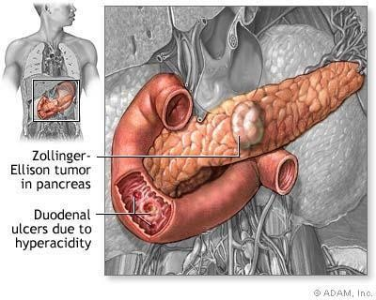

Slide 21
OTHERS
🞇 Smoking may augment the risk of peptic ulcer by impairing healing.
🞇 Alcohol use may cause increased acid Production
🞇 There is no convincing evidence that dietary factors play a
role in development of peptic ulcer.
🞇 Certain drugs other than NSAIDs may aggravate ulcers.
These include warfarin -- an anticoagulant that increases the risk of bleeding, oral corticosteroids, some chemotherapy drugs, spironolactone, Bevacizumab

Slide 22
Complications
Bleeding and hemorrhage
Stomach Cancer

Slide 23
Clinical presentation
Remitting, relapsing lesion
Epigastric burning or aching pain.
Dyspepsia.
Pain worse at night and 1 to 3 hours after meal.
Nausea, vomiting, bloating , belching and weight loss occur.

Slide 24
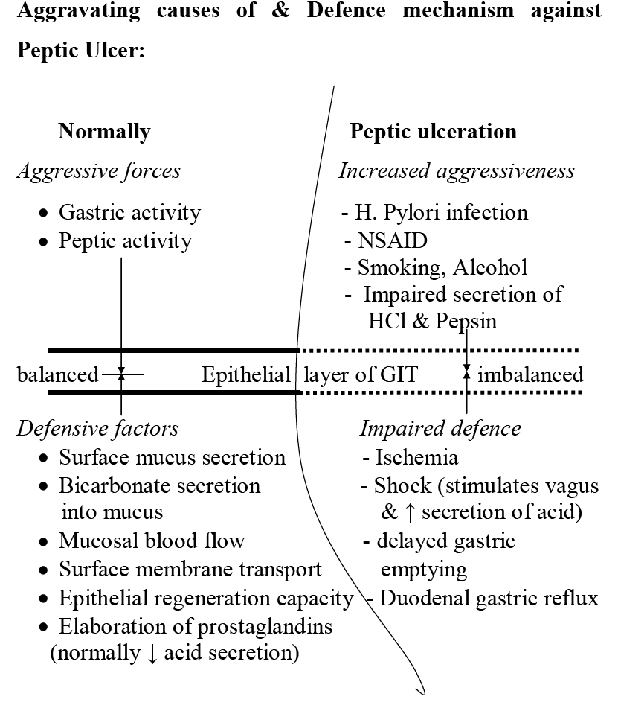

Slide 25
THANK YOU

