Slide 1
PHARMACOGNOSY AND PHYTOPHARMACUTICALS
Macro, powder and microscopic study of Podophyllum
17-09-2024
1

Slide 2
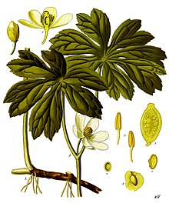
PODOPHYLLUM
Synonyms: Podophyllum radix, Indian podophyllum
Biological Source: It consists of dried pieces of rhizomes and roots of plants Podophyllum hexandrum Royle or Podophyllum emodi Wel.
Family: Berberidaceae
Geographical Source :- Podophyllum peltatum is indigenous to Eastern part of the United States and Canada. It grows wildly in Virginia, North Carolina, Kentucky, Indiana, and Tennessee.
17-09-2024
2

Slide 3
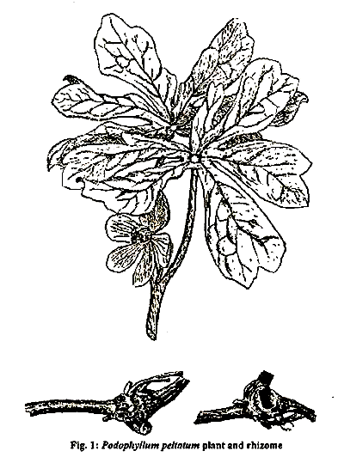
Hery , knotty , distance between two leaves very short – internodes
MACROSCOPICAL CHARACTERS:
General appearance: Drug contains either rhizomes or roots or both. Internodes of the rhizomes are very short and developed very little. So the rhizomes appear knotty and tortuous
Size – Length 3 to 8 cm; thickness 1 to 2 cm.
iii) Shape – Sub cylindrical, with irregular nodes, tortuous, dorsiventrally flattened.
(iv) Surface – On the upper surface of rhizome 3 to 4 circular depressed stem- scars, on lateral surface buds or bud scars and on the under surface numerous strong roots or root-scars are seen. Roots are 10 cm long, 3mm
(v) Thick, longitudinally wrinkled, nearly straight, curved or tortuous. Roots detach easily and are therefore found separate in the drug.
(vi) Colour – Earthy brown
Irregular shape
17-09-2024
3

Slide 4
(vii) Fracture – short, horny and starchy.
(viii) Fracture surface- Rhizomes contains 10 to 20 irregular vascular bundles separated by medullary rays with resin seen as numerous small glistering points.
(ix) Odour – slight, characteristics.
(x) Taste – Bitter, acrid.
17-09-2024
4

Slide 5
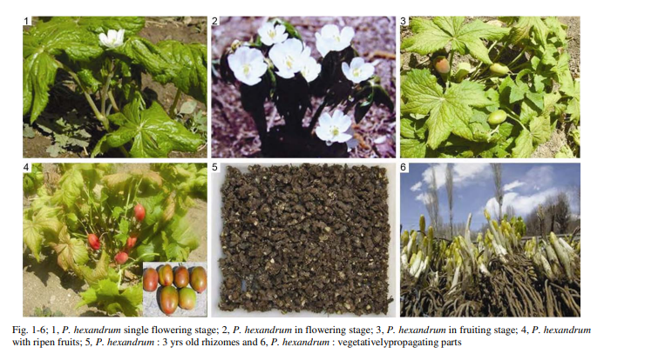
Initional fruit stage
17-09-2024
5

Slide 6
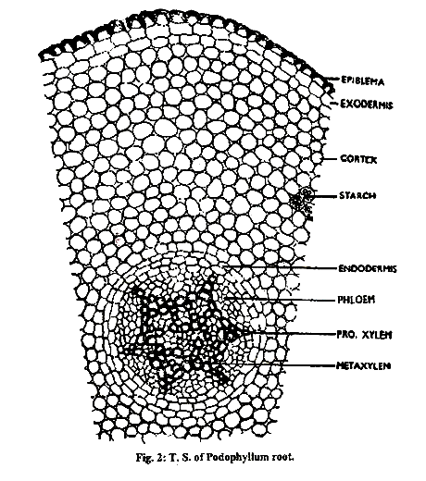
MICROSCOPY:
The transverse section of the rhizome of Podophyllum microscopically shows the following tissues from the periphery towards the centre:
A. Epidermis:
It is dead sometimes. It consists of elongated, rectangular, tabular, dark reddishbrown cells. A few cells are isodiametric.
B. Cork:
It is made up of about one to six layers of tabular, thin-walled, polygonal cell with brownish content.
C. Cortex:
It is abundant and forms the major bulk of the ground tissue. It consists of pitted, stout-walled cellulosic parenchyma with a small portion of collenchyma in the outer region. Most of these cells contain starch grains. These starch grains are usually simple but sometimes compound made up of two, four, eight or more (up to 15–20) components. Some cells of the ground tissue show presence of cluster crystals of the calcium oxalate. The size of the calcium oxalate crystals and starch grains can be a distinguishing feature between Indian podophyllum and American podophyllum. The cortex also shows a few scattered, lignified fibres.
17-09-2024
6

Slide 7
D. Vascular bundles:
Vascular bundles are small, conjoint, collateral and open with lignifi ed, pitted inner xylem vessels and outer phloem tissue. Above the phloem, lignified pericyclic fibres are present. Vascular tissues are separated by medullary rays. Medullary rays are seen as wide, prominent, multiseriate and made up of thick-walled parenchymatous cells.
E. Pith:
It is wide and made up of parenchymatous cells. Cells of pith show presence of cluster crystals of calcium oxalate and starch along with brownish content in few cells. A few sub-cylindrical, narrow stone cells occur in the pith along the inner side of some of the vascular bundles.
17-09-2024
7

Slide 8
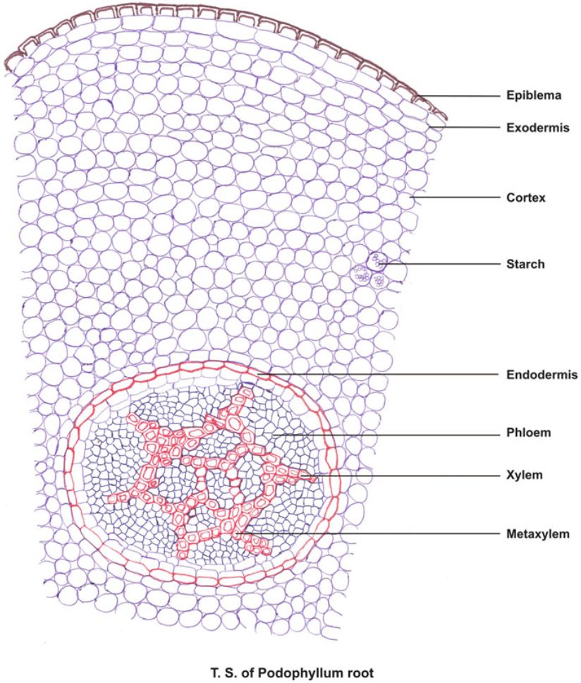
Not seen TS , seen TS of the rhizome
Single layered suberized cell it is not seen rhizome
Cellosic parenchyma , small portion of collenchyma
15 – 20 group single and it is having calcium oxalate crystals [ small ]
Single layered suberized cells , it is not seen in rhizome
Conduction of water minerals towards apical shoot , inner most part , it will transport water and food

Slide 9
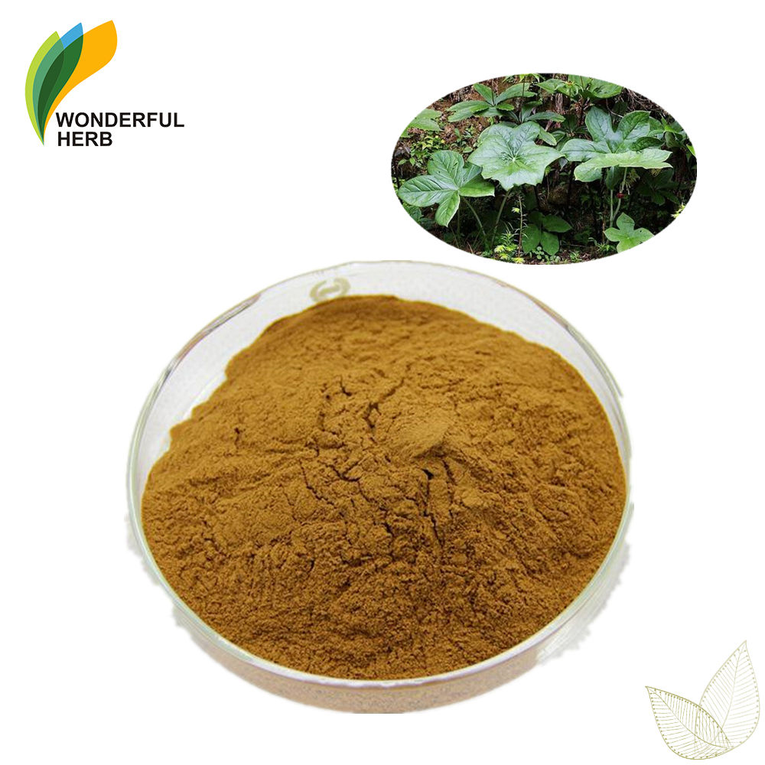
POWDER CHARACTER:
The powder of podophyllum is light brown in colour with a slight odour and bitter taste. It shows the following characters microscopically:
a. Sclereids:
These are abundant and occur in groups. Cells are elongated and rectangular in outline; walls are thickened and pitted. Cells are lignified and groups of sclereids are associated with thin-walled parenchyma of the pith.
b. Cork:
Fragments appear brownish and are composed of thin-walled, lignified, polygonal cells.
17-09-2024
9

Slide 10
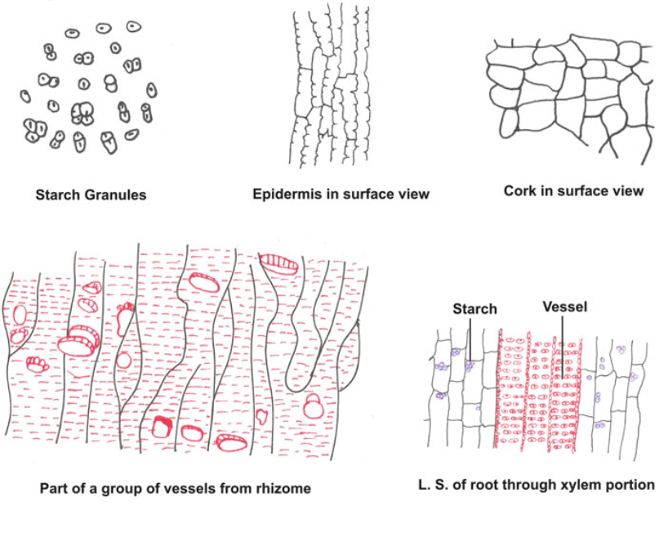
c. Vessels:
These vessels occur singly or in groups as associated with thin-walled xylem parenchyma. These are lignifi ed, reticulately thickened and irregular in shape. Sometimes vessels show slit-shaped pits and spiral or annular thickening.
d. Starch granules:
These are abundant, simple, small and spherical to ovoid in shape or mainly compound with two, three or up to eight or up to twenty components.
e. Calcium oxalate crystals:
Cluster crystals of calcium oxalate are seen. These are large, few in number and found scattered or within the thin-walled parenchyma of the cortex.
f. Epiblema and exodermis:
Fragments appear brown in colour; cells are elongated to rectangular in outline with thick walls and few pits. Epiblema cells or fragments are associated with exodermis, cells of which are similar in shape and size but with thin and wavy cell walls.
g. Parenchyma:
These cells are abundantly seen as fully loaded with starch granules. Sometimes cluster crystals of calcium oxalate are seen inside the cells. These cells are thin walled, elongated and rounded and occur in small groups. The parenchymatous cells of the pith have thickened and pitted walls.
17-09-2024
10

Slide 11

After cortex , small amount of the benith 15 – 20 of stRCH Granuls
Lots of trastion
Parenchyma rectangular cell
Xylem vessel lignified in nature and irregular shape
Spiral

Slide 12
Parenchyma
Calcium oxalate crystals
Pholem occur
17-09-2024
12

Slide 13
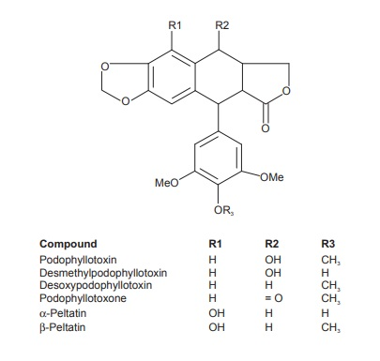
CHEMICAL CONSTITUENTS :-It contains Podophyllin resin is known as podophyllotoxin. α and β peltatins are present only in the American podophyllum.
It is also contains Quercetin, kaempferol, asiragalin, essential oil. Podophyllin is a lignin compound. Etoposide (4 -emethylepipodophyllotoxin ethylidene-glucoside) is semi- synthetically processed and used in testicular and lung cancer.
17-09-2024
13

Slide 14
Category
USES
Podophyllum resin or podophyllin shows cytotoxic activity.
It is used for the treatment of venereal and other warts. Podophyllotoxin is semisynthetically converted to a potent anticancer agent etoposide which is mainly used for the treatment of lung and testicular cancer.
Podophyllum resin is a strong gastrointestinal irritant. It acts as a drastic purgative in moderate doses but it has been mostly replaced by other purgative drugs.
Podophyllum has been used as a laxative. But it has been removed from the market due to safety concerns.
Podophyllum is applied directly to the skin for removal of warts, including plantar warts and genital warts. It is also used topically for white patches on the tongue in people with weakened immune systems (hairy leukoplakia) and for corns.
Podophyllum is a plant. The root and underground stem (rhizome) are used to make medicine.
Podophyllum is highly poisonous when taken by mouth. Nevertheless, some people take it orally for yellowed skin (jaundice), liver ailments, fever, syphilis, hearing loss, and cancer. Podophyllum is also used to empty the bowels, kill parasitic worms in the intestine, and counteract snakebite. Some women take it to cause an abortion
17-09-2024
14

