Slide 1
PHARMACOGNOSY AND PHYTOPHARMACEUTICALS
Macro, powder and microscopic study of Quassia
17-09-2024
1

Slide 2
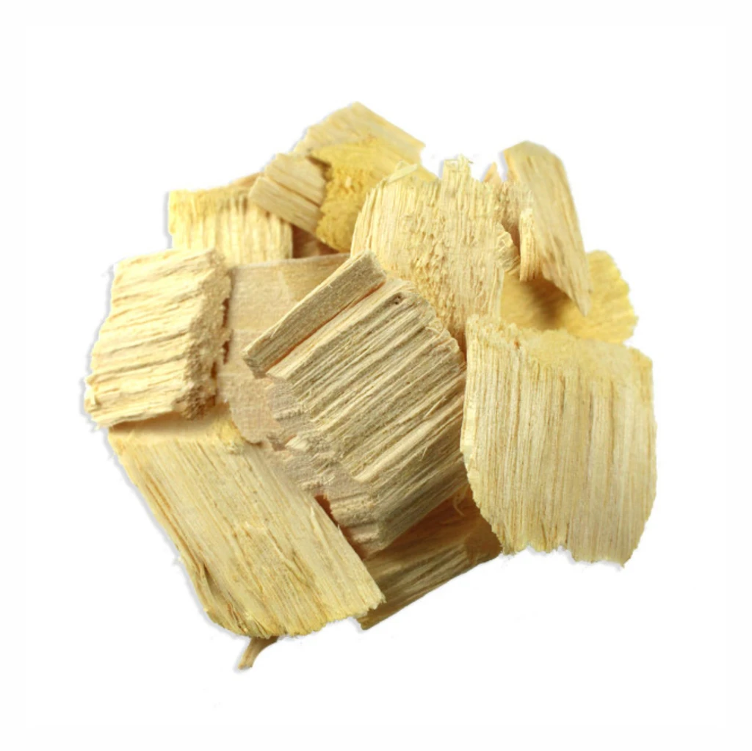
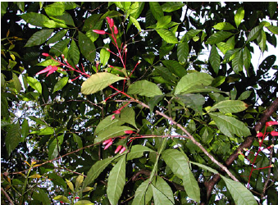
QUASSIA
Synonyms: Quassia wood, Bitter wood, Bharangi (Hin), Charangi (Sans.)
Biological source: Quassia consists of the dried stem wood of Picrasma excelsa (Sw.) Planch; Picrasma quassioides Benth; Picroena excelsa or Picrasma quassioides Benth which is known in commerce as Jamaica Quassia.
Family: Simarubaceae
Geographical location : The tree of Quassia which grows to a height upto 30 metres is native of Caribbean island mainly Jamaica Barbados and Martinique
Wood – it contain the all the cambium and
17-09-2024
2

Slide 3
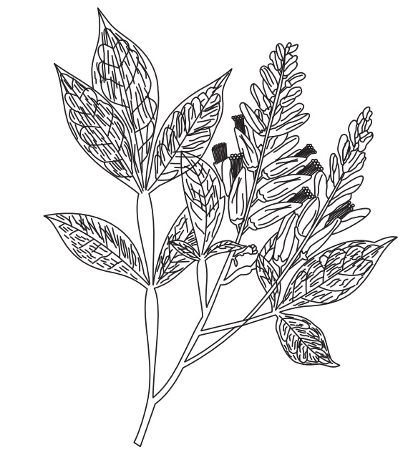
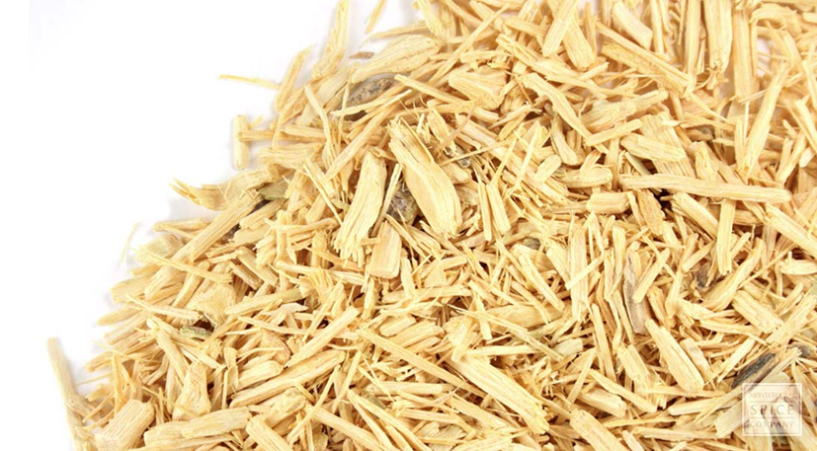
CHARACTERISTICS
It is in the form of chips or raspings, Chips are poanoconvex, has no smell but an intense bitter taste. They have false annual rings breaking easily longitudinally. Colour is white, but changes to yellow on contact with the air. Cork easily detaches from phloem. Bitter in taste.
17-09-2024
3

Slide 4
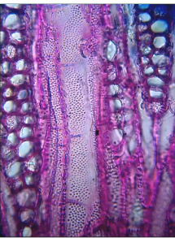
TRANSVERSE SECTION (TS):
1. Secondary xylem: It is composed of xylem vessels, xylem fi bres and xylem parenchyma
a. Vessels:
Big, occurring in large numbers, either single or in groups of few. At times the vessels occupy the entire region between two consecutive medullary rays. These are closely arranged and fill the entire region between the two consecutive medullary rays. These show minute bordered pits, with elliptical or hexagonal borders and slitlike pores. The length of an individual vessel is about one to five times more than that of breadth.
17-09-2024
4

Slide 5
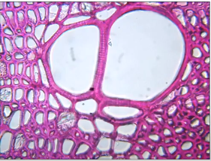
b. Xylem fibres:
These occupy the major portion of the wood. These are arranged in radial rows. In the TS, the fi bre mass appears to consist of alternate rows of smaller and larger elements. Fibres have narrow, oblique and slitlike pits.
c. Xylem parenchyma:
The cells of xylem parenchyma are small and square to polygonal or rectangular with uniformly and moderately thickened pitted walls. These cells are arranged in three- to seven-cell thick layers. Some cells of xylem parenchyma contain prisms of calcium oxalate. Each crystal is surrounded by a closely fitting lignified envelope. A few cells show presence of starch grains within them. These grains are simple, spherical or compound with two components.
17-09-2024
5

Slide 6
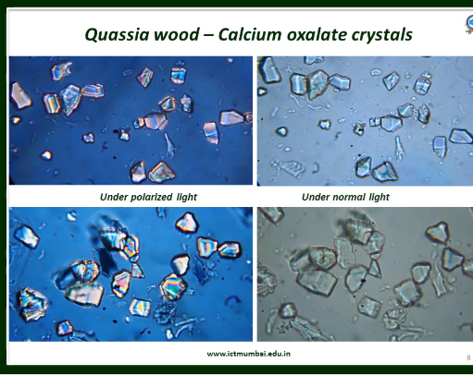
ii. Medullary rays:
These are prominent and homogenous. These are one to four cells wide and slightly elongated radially. These are heavily pitted with oblique septa. These occasionally contain prisms of calcium oxalate and starch granules
17-09-2024
6

Slide 7
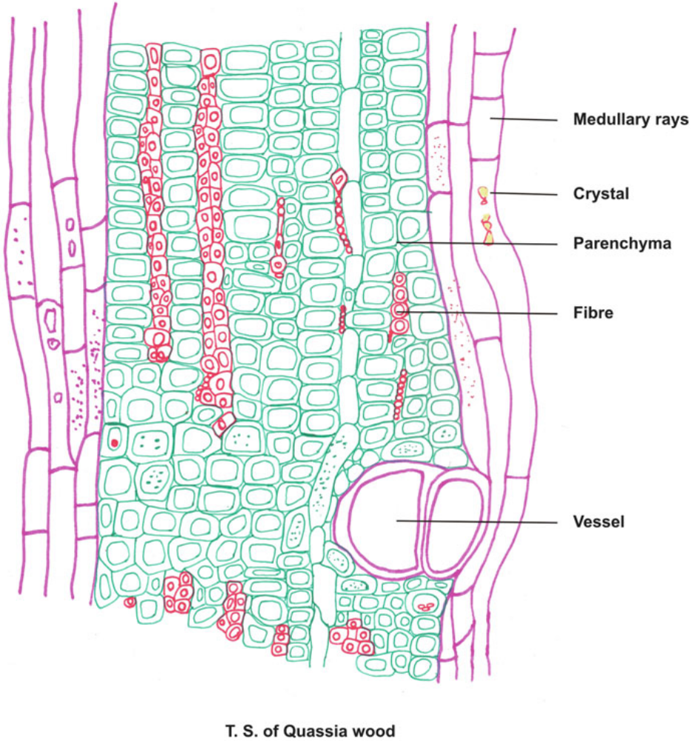
Prominent petted calcium oxalate crystal and starch granules
Narrow , slight lite tips
Single present group . And closely present in cells
17-09-2024
7

Slide 8
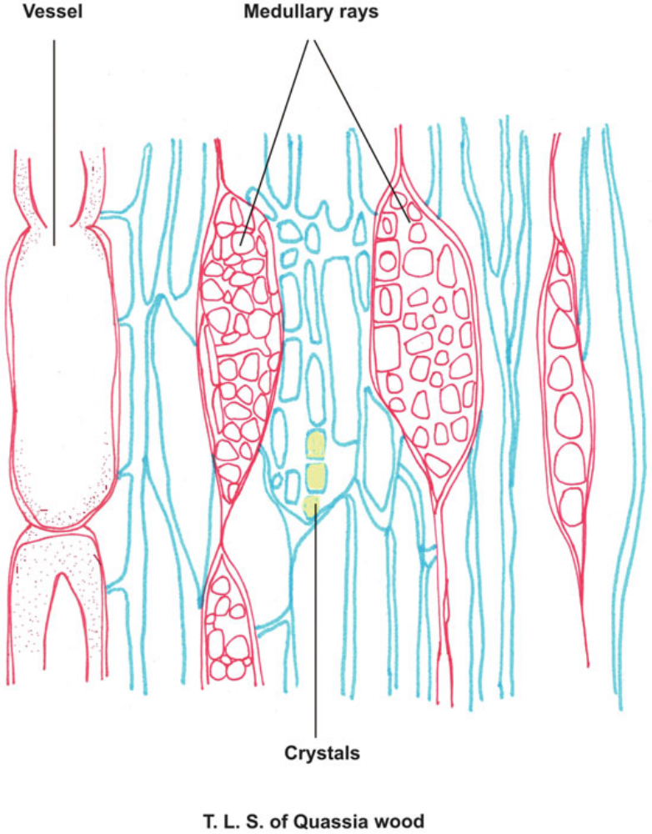
17-09-2024
8

Slide 9
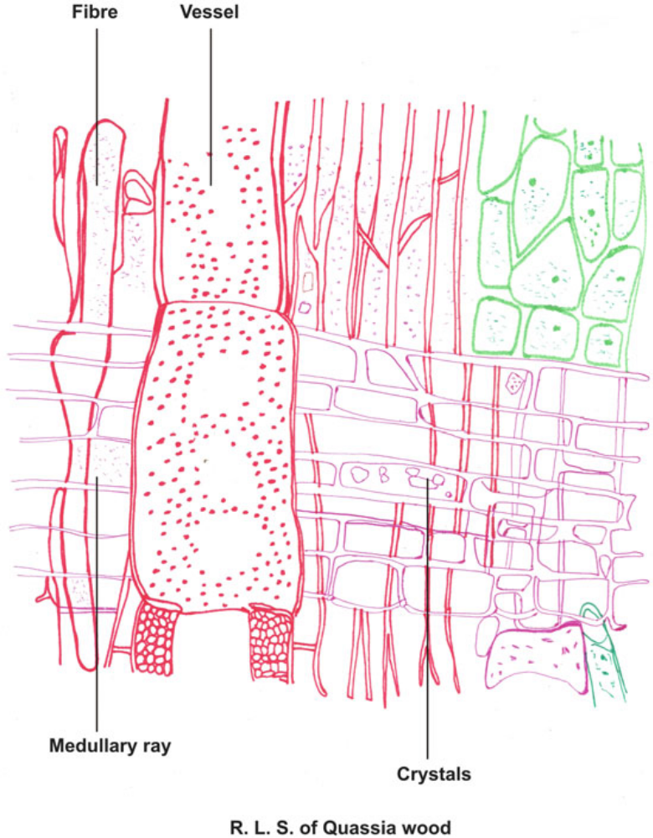
17-09-2024
9

Slide 10
POWDER CHARACTER:
The powder of quassia wood is pale yellowish buff in colour, odourless and intensely bitter in taste.
It shows the following characters microscopically:
a. Vessels:
These are found as fragmented or associated with other xylem tissues. These are numerous which occur singly or in small groups. These vessels are large, bordered and lignifi ed and show numerous minute and bordered pits.
b. Fibres:
These are seen abundantly, which occur in groups and usually found associated with other xylem tissues. These are lignified with moderately thick walls and few pits. These xylem fibres cross the medullary rays at right angles.
c. Medullary rays:
The cells appear polygonal to round in tangential sections with small, numerous pits in tangential walls. The cells are elongated with moderately thickened and lignified wall in radial view. Some cells of medullary rays contain fairly large prisms of calcium oxalate
17-09-2024
10

Slide 11
d. Calcium oxalate crystals:
A few prisms of calcium oxalate are found scattered as well as within the parenchymatous cells of the xylem and medullary rays. These are of various sizes. Sometimes twin prisms and conglomerate crystals also occur.
e. Starch granules:
These are few, mostly simple and spherical. Occasionally compound grains of two to three components are seen. Hilum is observed as rounded or slit shaped.
f. Xylem parenchyma:
It is generally found associated with xylem vessels and xylem fibres. Xylem parenchymatous cells are thick walled, lignifi ed and heavily pitted. Cells are longitudinally elongated and contain prisms of calcium oxalate
17-09-2024
11

Slide 12
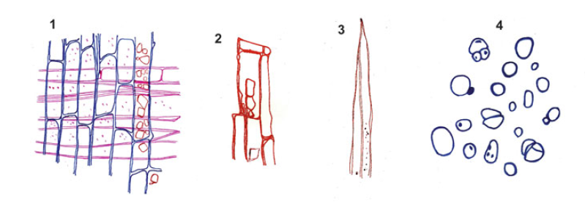
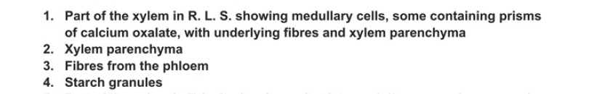
17-09-2024
12

Slide 13
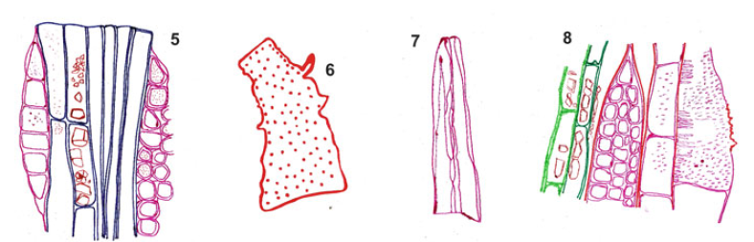
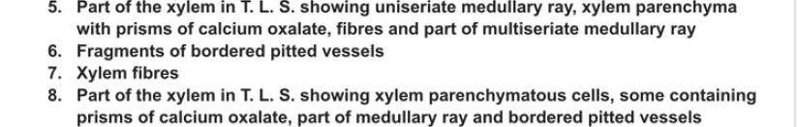
17-09-2024
13

Slide 14
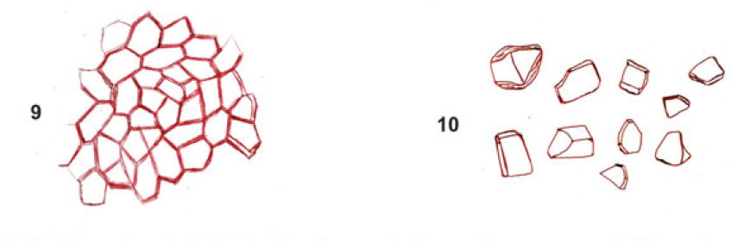
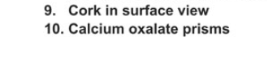
17-09-2024
14

Slide 15
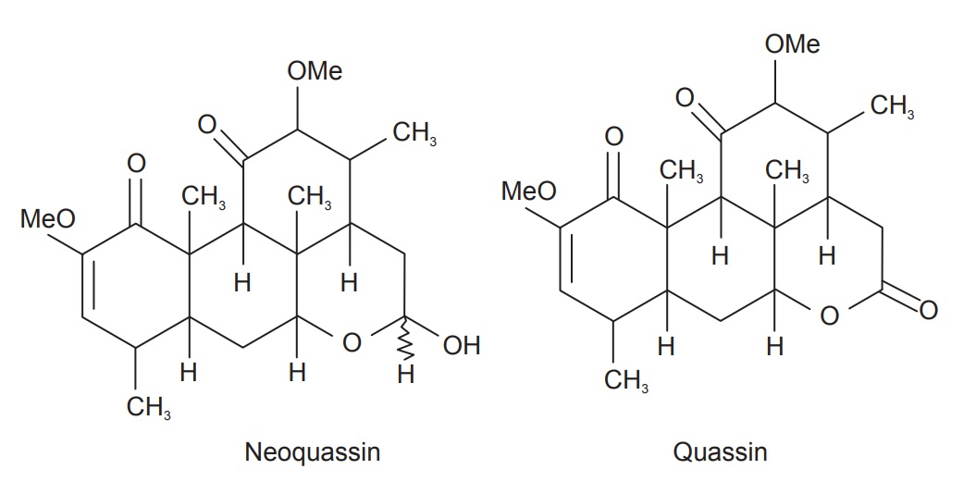
CHEMICAL CONSTITUENTS:
1. Bitter principle of terpenoids: Quassin, picrasmin or isoquassin; neoquassin.
2. It is also contains scopoletin (coumarin) and cathine-6-one (alkaloid)
17-09-2024
15

Slide 16
USES
Quassia wood is a pure bitter tonic and stomachic;
It is also a vermicide and slight narcotic;
It acts on flies and some of the higher animals as a narcotic poison.
It is a valuable remedy in convalescence, after acute disease and in debility and atonic dyspepsia; an antispasmodic in fever.
In small doses Quassia increases the appetite.
17-09-2024
16

