Slide 1
PHARMACOGNOSY & PHYTOPHARMACEUTICALS
Macro, powder and microscopic study of Rauwolfia.
17-09-2024
1

Slide 2
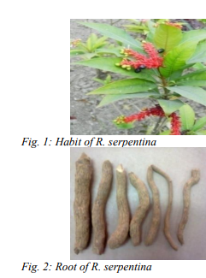
RAUWOLFIA
Synonyms and vernacular name:
Bengali – sarpagandha; Tamil – Chinanmdpodi; Sans Chhota-chand; Hindi – Chandrika; Bihar- Pagla ki dawa.
Biological source:
Rauwolfia consists of the dried roots and rhizomes of Rauwolfia serpentina Benth. It contains not less than 0.15% of reserpine.
Family: Apocynaceae
Geographical source: It is widely distributed in West land and in shady forests in Punjab eastward to Nepal, Sikkim, and Assam in India; Bhutan, Pakistan, Java and Thailand, etc
17-09-2024
2

Slide 3
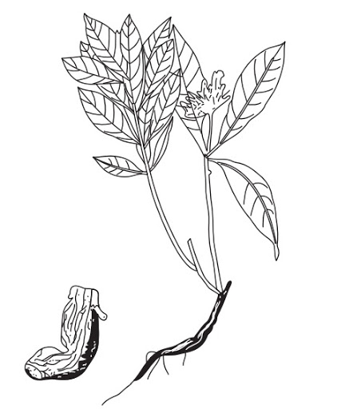
MACROSCOPICAL CHARACTERS:
(i) External features of roots and rhizomes are nearly similar but rhizomes can be made out by the presence of small central pith.
(ii) Drug consists of mostly small pieces, which are 2 to 15 cm long and 3 to 22 mm diameter.
(iii) Pieces are cylindrical, slightly tapering and tortuous.
(iv) Outer surface is greyish yellow, pale brown or brown.
(v) Fracture short.
(vi) Fracture surface show yellowish to brown bark and dense pale yellow radiating wood with 2 to 8 annular rings occupying nearly three fourth of the diameter.
(vii) Odour Odourless
(viii) Taste bitter
17-09-2024
3

Slide 4
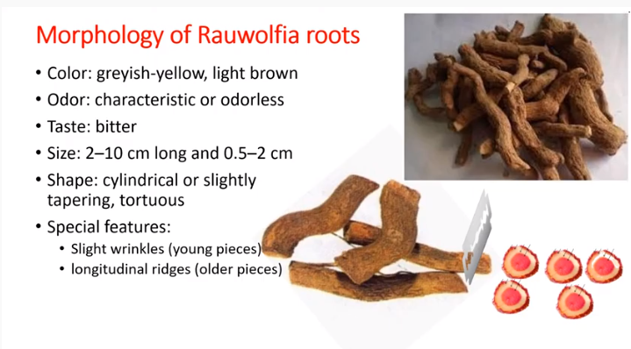
17-09-2024
4

Slide 5
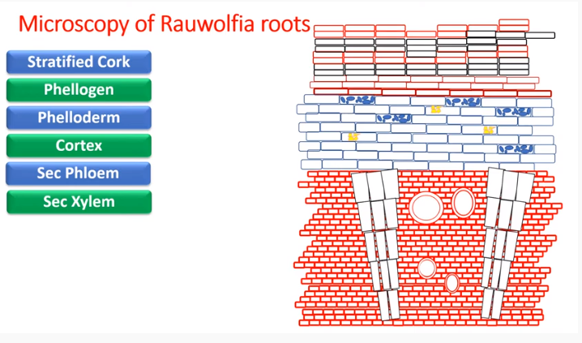
17-09-2024
5

Slide 6
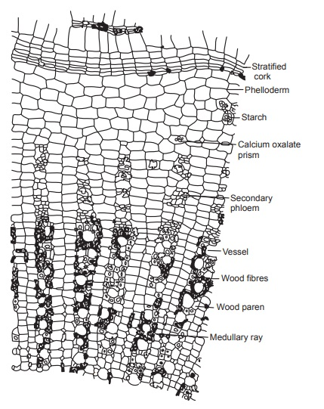
17-09-2024
6

Slide 7
Microscopical characters (T.S.):
T. S. of the root presents a circular outline with typical stratified cork and other secondary features. Following are the tissues seen from the periphery to the center.
1. Periderm:
a. Cork (Phellum):
Stratified, consists of alternating bands- of smaller, suberized and un-lignified cell up to 8 to 10 raw in radial depth- larger, suberized but lignified cell upto 5 to 7 raw in radial depth.
b. Phellogen:
Indistinct but is seen as a narrow layer of thin walled cells,
c. Phelloderm:
5 to 7 layers, immediately below the phloem, cell is arranged in the radial rows whereas away from phloem, cell is oval and has intercullar spaces. Phelloderm contains abundant starch grains (with triradiate hilum) and typical twin prisms of calcium oxalate
17-09-2024
7

Slide 8
2. Secondary phloem:
Is transverse by conspicuous medullary rays. Phloem consists of sieve tubes, companion cells and phloem parenchyma. Starch grains and calcium oxalate prism occurs throughout the phloem tissue.
3. Secondary xylem:
It is also transverse by well develop medullary rays. Xylem consists of vessels, wood fibres and lignified parenchyma. The vessels appear rounded, polygonal or at times radially elongated and occurs inner single or in pairs. Xylem fibres appear as rounded and polygonal structure with thick lignified walls. Typical oxalate prism and starch grains resembling those of the phelloderm and phloem occur freely in the wood parenchyma.
4. Medullary rays:
It runs radially from the center to the cortex through the phloem. Rays in the xylem region are lignified, pitted and are 1 to 5 cells wide although uniseriate rays are prominent. In the phloem region the ray cells are not lignified. Starch and typical oxalate prisms are in the medullary ray cells
17-09-2024
8

Slide 9
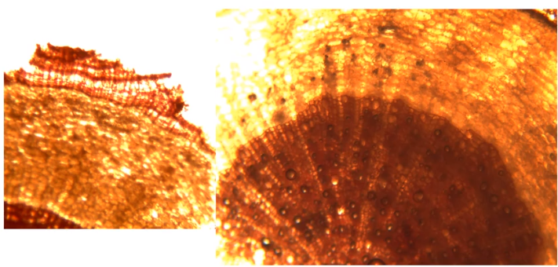
Sec phloem
Cortex
Stratified cork
17-09-2024
9

Slide 10
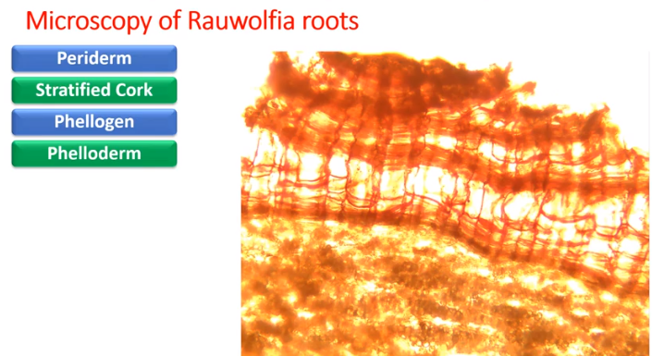
17-09-2024
10

Slide 11
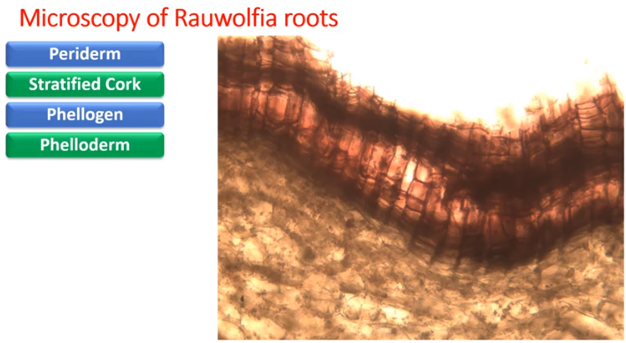
Red and colourless
17-09-2024
11

Slide 12
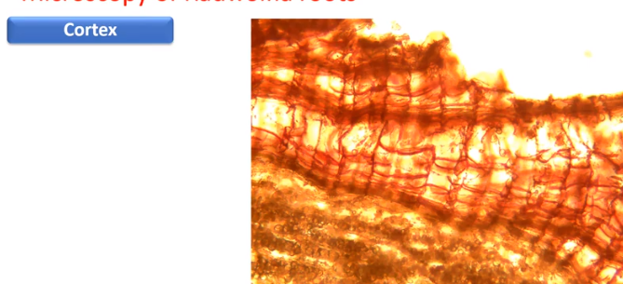
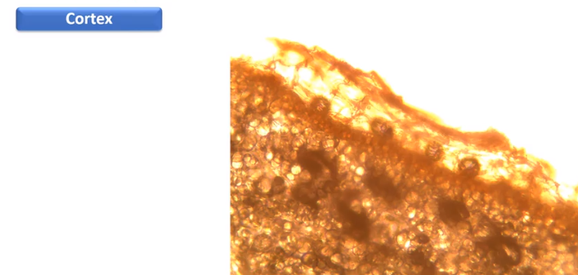
17-09-2024
12

Slide 13
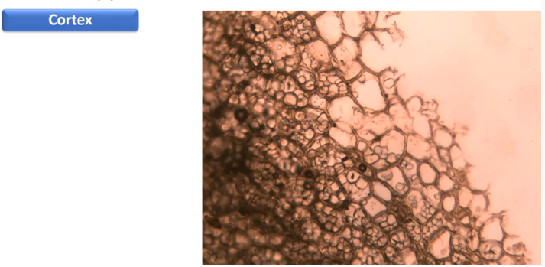
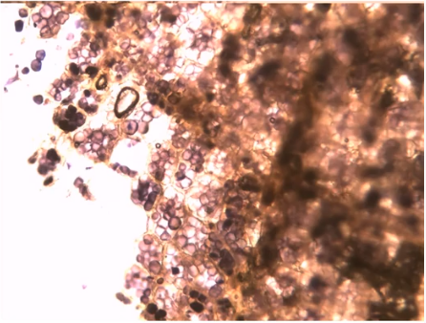
Starch grains
17-09-2024
13

Slide 14
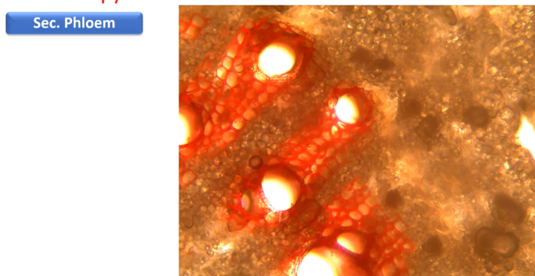
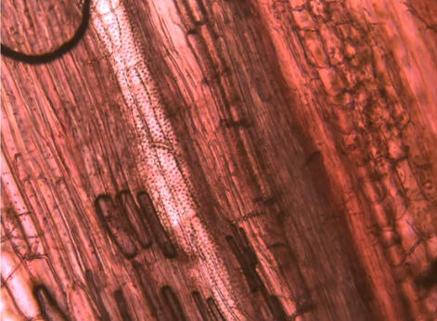
Medulary rays
Longitudinal sec phloem
17-09-2024
14

Slide 15
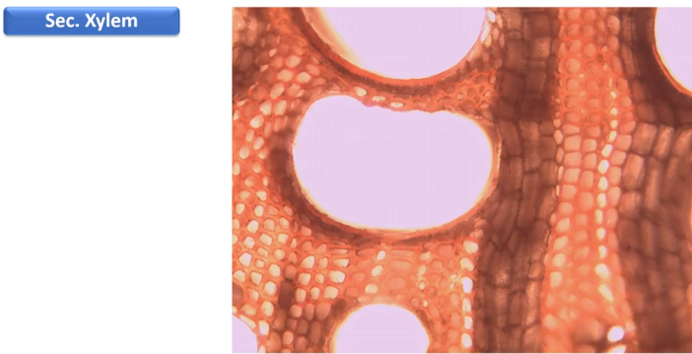
17-09-2024
15

Slide 16
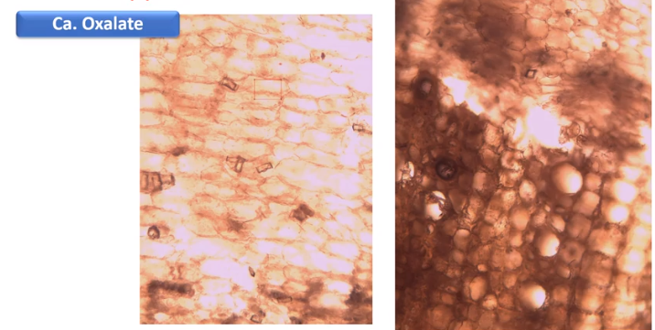
Presum in shape
17-09-2024
16

Slide 17
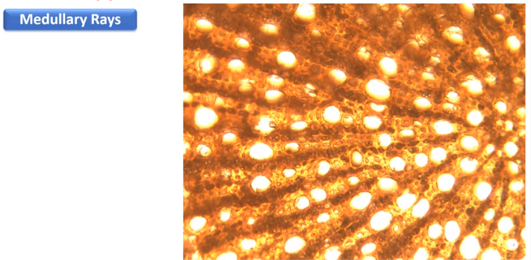
17-09-2024
17

Slide 18
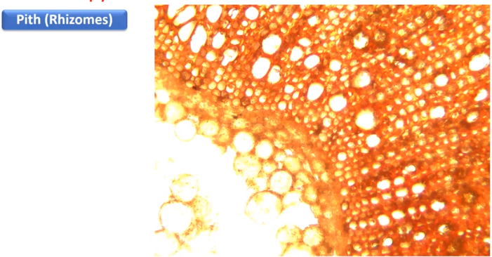
17-09-2024
18

Slide 19
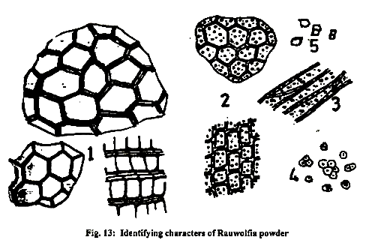
Powder analysis of Rauwolfia:
Cork: Stratified cork in several layers appearing like benzene rings
Parenchyma: Pitted and lignified parenchymatous cells of the xylem parenchyma and medullary ray cells.
Wood elements: Vessels few, long and with oblique end walls and perforations.
Starch granules: Largely simple but compound ones are also known to occur.
Granules are fairly large, possessing a distinct hilum in the form of a star or a split.
Calcium oxalate: Crystals in the form of prisms but not many in number.
Organoleptic characters:
Odour: Odourless.
Taste: Bitter.
17-09-2024
19

Slide 20
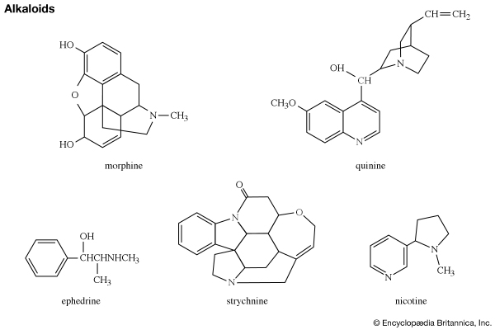
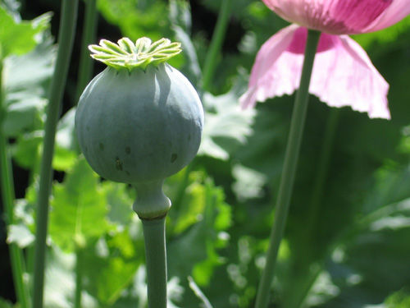
Alkaloids are a class of basic, naturally occurring organic compounds that contain at least one nitrogen atom. This group also includes some related compounds with neutral and even weakly acidic properties. Some synthetic compounds of similar structure may also be termed alkaloids.
17-09-2024
20

Slide 21
The proposed roles of alkaloids in plant metabolism, plant catabolism, or plant physiology are (1) end products of metabolism or waste products, (2) storage reservoirs of nitrogen, (3) protective agents for the plant against attack by predators, (4) growth regulators (since structures of some of them resemble structures of known growth regulators), or (5) substitutes for minerals in plants, such as potassium and calcium .
17-09-2024
21

Slide 22
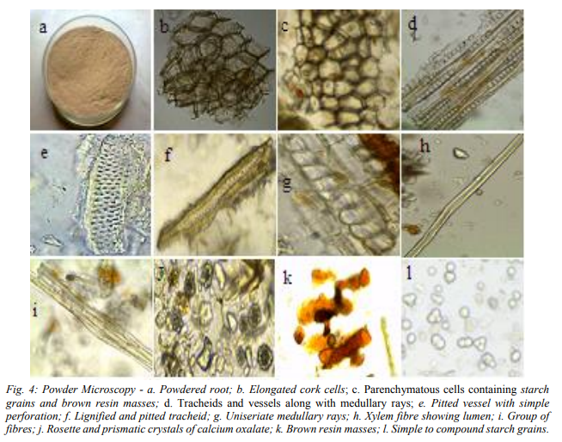
17-09-2024
22

