Slide 1
Clinical Pharmacy
Renal Function Tests
8/17/2023
1

Slide 2
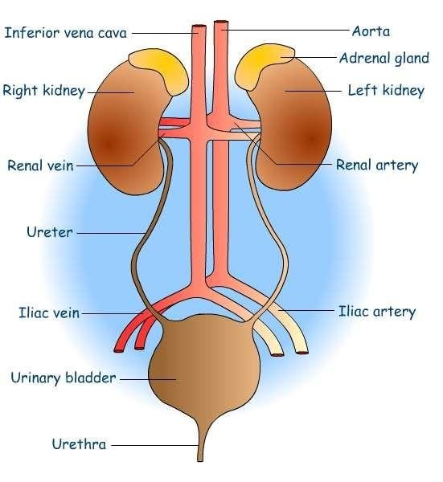
RENAL FUNCTION TESTS
2

Slide 3
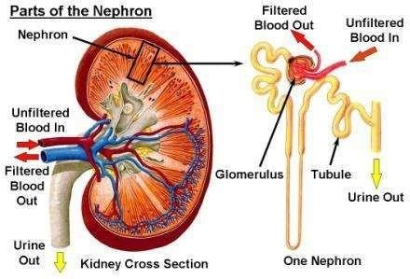
The functional unit of kidney - NEPHRON
3

Slide 4
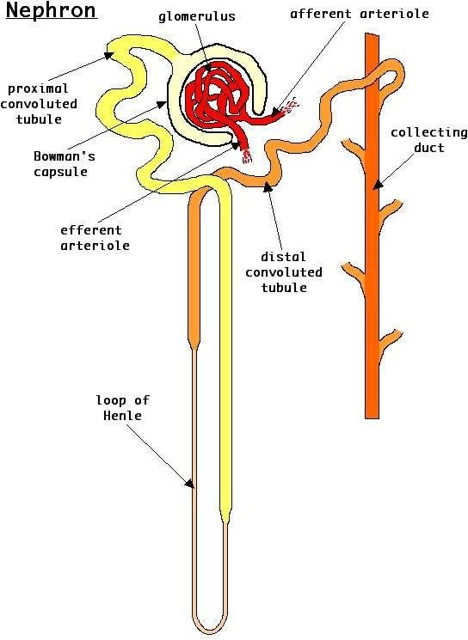
4

Slide 5
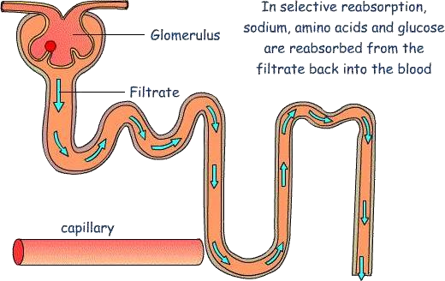
5

Slide 6
Functions of Kidney
Formation of Urine as the waste product
Excretion of NPN substances – Urea, Creatinine and Uric acid
Regulation of water, electrolytes & acid-base balance
Production of hormones – Erythropoitin, renin & calcitriol
6

Slide 7
Assessment of Renal Function
Assessment of the extent of renal damage
Monitoring the progression of renal disease
Monitoring & adjusting the dose of renal toxic drugs
RFT devised to give information regarding following parameters
Renal blood flow
Glomerular Filtration Rate
Urine output
Renal tubular function Renal Glomeruli Function
7

Slide 8
Renal Function Tests
a) those which measure GFR
b ) those which study tubular function
8

Slide 9
Renal function tests Classification
Urine analysis
  Physical examination
  Chemical examination
  Microscopic examination
Assessment of Glomerular function
  Renal Clearance tests
  Blood analaysis of Urea & Creatinine
  Proteinuria
  Hematuria
9

Slide 10
Renal function tests Classification
Tests to measure renal plasma flow
  Para amino hippurate test
Tests for assessment of tubular function
  Urine concentration test
  Urine dilution test
  Specific proteinuria or tubular proteinuria
  aminoaciduria
  Phenosulfonphthalein test (PSP)
Renal Biopsy
  to confirm the diagnosis & renal diseases
10

Slide 11
RFT - Tests for Glomerular Function Renal Clearance Tests
To assess the rate of glomerular filtration & renal blood flow.
“The renal clearance of a on substance is defined as the volume of plasma from which the substance is completely cleared by the kidneys per minute.”
This Depend On
plasma conc. Of the substance & it’s excretary rate
GFR
Renal plasma flow
11

Slide 12
Renal Clearance Tests
The GFR (Normal = 120 ml/minute )
Usually equal to clearance of that substance and is calculated by the following equation
C = U x V P
where,
C = clearance of the substance (ml/mt) U = Conc.of substance in urine (mg/L) P = Conc.of substance in plasma(mg/L) V = Vol.of the urine passed per sminute
12

Slide 13
Renal Clearance Tests
GFR – Normal 120 ml/minute
Lower than normal GFR indicate
  Acute tubular necrosis
  Glomerulonephritis
  Shock
  Acute Nephrotic syndrome
  Ac. & Ch. Renal failure
13

Slide 14
In order to determine the GFR, the sub.should be slected in such a way that which is
  freely filtered by glomerulus
  should not be reabsorbed or secreted
  should not be metabolized in the kidney
  should not be toxic
  should not be affected by dietary intake
14

Slide 15
The substances which are used for Clearance tests include :
Endogenous
Creatinine
Urea
Inulin
Exogenous
15

Slide 16
Creatinine Clearance Test
Based on the rate of excretion by the kidneys of metabolocally produced creatinine
Creatinine freely filtered in the glomerulus
Not reabsorbed by the tubules
(a small amount of creatinine is produced by the tubules)
16

Slide 17
Creatinine Clearance Test
Creatinine clearance is determined by
- collecting urine over 24hrs. Period
- a sample of blood is drawn during the urine collection period.
Creatinine Clearance =
U x V P
U = Urinary creatinine(mg/L) P = Plasma creatinine (mg/L)
V = Volume of urine per minute
17

Slide 18
Creatinine Clearance Test
Creatinine Clearance Normal range 90-120 ml/mt
↓ Creat. Clearance is very sensitive indicator of decreased GFR
↓ GFR may be caused by
Acute or Chronic damage to glomerulus or any of its components
↓ Blood flow to glomerulus may also produce decreased creat.clearance
8/17/2023
© R R INSTITUTIONS , BANGALORE
International Federation of Anti-Leprosy Associations (ILEP)
http://www.ilep.org.uk/en/

Slide 19
Urea Clearance Test
The sensitivity of urea clearance is much less than the creatinine clearance because—
-plasma conc. Of urea is affected by number of factors
e.g :
dietary protein fluid intake infection surgery, etc…
Approximately 40 % of filtered urea is normally reabsorbed by the tubules.
Normal value of Urea clearance : 75 ml/mt.

Slide 20
Inulin Clearance Test
Method of choice when accurate determination of GFR is required.
Inulin is polysacharide of
Fructose. freely filtered by glomerulus
not reabsorbed
not secreted or metabolically altered by the renal tubule.
Normal value : 120 ml/mt.
Disadvantages :
need for its IV adminstratio
technically difficulty of analysis

Slide 21
Blood analysis of Urea & Creatinine
Impairment of renal function results in elevation of
Blood Urea
Creatinine
Plasma urea is less reliable than creatinine because it is affected by dietary protein & liver function
So, Creatinine is more sensitive Renal Function Test.
( normal : 20 – 40 mg/dl )
( normal : 0.5 – 1.5 mg/dl )

Slide 22
Uremia :
Pre renal uremia :
Dehydration
diarrhea, severe vomiting
  Diabetic coma.
  severe burns
- Fever and severe infections
- intestinal obstruction ,

Slide 23
Renal uremia :
  Acute glomerulonephritis
  Nephrosis
  Malignant hypertension
  Chronic pyelonephritis
Post –renal uremia :
  Stones in urinary tract
  Enlarged prostate
  Tumors of bladder

Slide 24
Urine analysis
Physical examination
Chemical examination
Microscopic examination Physical examination
  Volume
  odor
  Appearance ( color)
  pH
  Sp.Gravity

Slide 25
Urine analysis
Volume : 800 – 2,500 ml ( average: 1500 ml /day)
Polyurea ( > 2500 ml/day )
  Diabetes Mnallitus
  Diabetes insipidus
later stages of Chronic glomerulonephritis
Oliguria : ( < 500 ml/ day )
  Fever, diarrhoea
  early stages of glomerulo nephritis
  cardiac failure

Slide 26
Urine analysis
Anuria : complete cessation of urine
Acute tubular necrosis
Bil. Renal stones
Surgical Schock.
Appearance & Color :
- Normal urine – transparent pale yellow or
amber color
- Turbity : indicate infection
Nephrotic syndrome .. fat particles
- Reddish coloration – hematuria
(Renal stones, cancer etc.)

Slide 27
Urine analysis
pH : normally- Acidic with pH 6.0 (range 5.5 – 7.5) Alkaline – found in UTI
Odour : Normal – aromatic
foul smell – indicates
bacterial infection.

Slide 28
Renal threshold
Renal threshold of a substance is the plasma level above which the compound is excreted in Urine.
Glucose Lactate Bicarbonate Calcium
180 mg/dl
60 mg/dl
28 mEq/L
10 mg/dl

Slide 29
Urine analysis
Chemical examination :
Glucose
Protein
Blood
glycosuria
proteinuria
—hematuria
Albuminuria
Benign proteinuria
300 mg/day
300-1000 mg/day
> 1000 mg/day
pathological proteinuria glomerular proteinuria
Micro-albuminuria : (30-300 mg/day ) Early indication of Nephropathy in pts. With Diabetes and hypertension.

Slide 30
Microscopic examination :
  cells ( RBC, WBC – Pus cells )
-Crystals ( calcium phosphate & ca.oxalates, amorphos
phosphates )
  Casts ( hyaline casts, granular casts & RBC casts)

Slide 31

Tests for tubular function
Specific gravity of urine – Normal 1.015-1.025
This is an indication of osmolality.
Incase of proteinuria S.G. elevated.
Earliest manifestation of renal disease may be difficulty in concentrating the urine.
↓ Sp.gr.— excessive water intake, ch.nephritis, Diabetes Insipidus
↑Sp.gr.— diabetes mellitus, nephrosis, Ch.Renal failure.
Fixed sp.gr. at 1.010 isosthenuria — earliest manifestation of renal dammage.

Slide 32
Concentration test :
Bladder is emptied in the morning specimen discarded.
Second specimen after one hour collected and specific gravity measured.
Sp.gr. >1.022 adequate renal function.

Slide 33
Dilution test :
Patients not allowed to drink after mid night.
Bladder emptied at 7 am
Water load 1200 ml over next 30 min.
Hourly urine sample collected for next 4 huors. Volume, Sp.gr. measured.
Normal person will excrete all the water load with in 4 hours.
Sp.gr. of at least on sample should fall to 1.003.

Slide 34

Thank you

