Slide 1
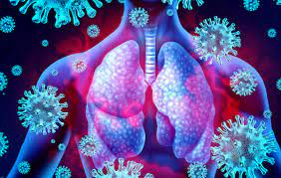
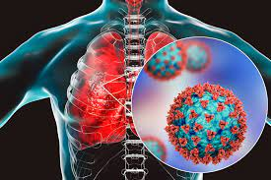
Respiratory Tract Infection
[ RTIs ]
Infection Disease
By Animesh Das

Slide 2
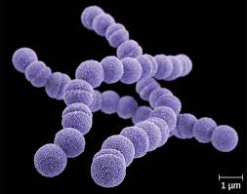
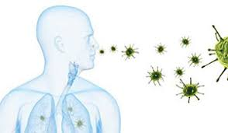
Definition
There are infection of the parts of the body involved in breathing , Sinuses , throat , airways or lungs .
There are two type of respiratory tract infection --
Upper Respiratory tract infection
Lower Respiratory infection
Causative agent – Viral / Bacterial

Slide 3
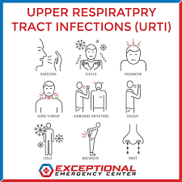
Type / Classification
Upper Respiratory tract infection --
Tonsillitis
pharyngitis
Laryngitis
Sinusitis
Otitis Media
certain influenza
Common clod
Lower Respiratory tract infection --
Pneumonia

Slide 4
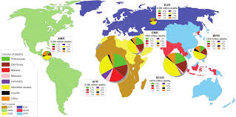
Epidemiology
Upper respiratory tract infection are the most common are the type of infection disease among adults , it estimated that adults experience .
Lower RTIs are the less common but the most common cause of death developing countries .
RTIs zone– India , UK , Europe , Africa , Pakistan .

Slide 5
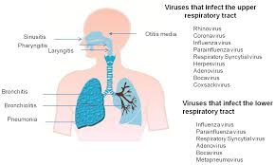
Sings and symptoms
A cough – you may bring up mucus (phlegm)
Sneezing.
A stuffy or runny nose.
A sore throat.
Headaches.
Muscle aches.
Breathlessness,
Tight chest or wheezing.
A high temperature

Slide 6
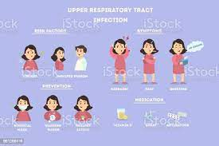
Risk factor
Smoking.
Poor Hygiene.
Crowded Populations.
Medical Conditions.
Age.
Disability.
Stress and Other Mental Health Factors.
References.

Slide 7
Mode of transmission
Incubation period – 2 to 14 days
Inhaling respiratory droplets from coughing or sneezing .

Slide 8
Pathogenesis
Upper Respiratory tract infection --
Bacteria Virus
Direct hand contest
Droplet infection
Enters the nose by inhaling
Immune Defences

Slide 9

Hair lining filters and trap some pathogens
Traps in upper respiratory tract which coats by mucous
Junction of the posterior nose to pharynx
Impinge on the back of the throat

Slide 10

Impinge on the back of the throat
Transport pathogens up to pharynx
Inflammation Respond to immune system
Increased Mucous secretion fever , swelling , runny nose etc .

Slide 11
Pathogenesis
Lower Respiratory tract infection --
Heath care system , smoking , microorganism etc
Inflammation
Bradykinins , Histamines , Prostaglandins
Increasing capillary permeability

Slide 12


Fluid / Cellular Exudation
Oedema of mucous membranes
Hypersecretion of mucous
Persistent cough

Slide 13
Management
Diagnosis
Treatment

Slide 14
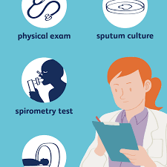
Diagnosis
Chest X ray
Blood culture
Physical examination
Sputum examination

Slide 15
Treatment
Category | Drug Name
Antibiotic | Amoxicillin , penicillin
antihistamines | Loratidine , Fexofenadine .
Stimulant | Doxapram
xanthine's | Theophylline
Bronchodilators | salmeterol , formoterol
Respiratory stimulant | Loratidine
Antivirals | Pentamidine

Slide 16
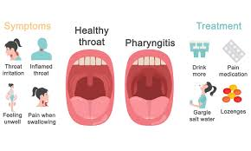
Complication
Acute otitis media
Asthma Exacerbation
Sinusitis
Lower respiratory tract disease
Epistaxis
Conjunctiva
Pharyngitis

Slide 17
Prevention
Cover your nose and mouth with a tissue when you cough or sneeze.
Wash your hands often with soap and water, especially after you cough or sneeze.
Avoid touching your eyes, nose or mouth.
Try to avoid close contact with sick people.
Stay home if you are sick.
Vaccines are recommended

Slide 18
Thank
you

